Slide 1
RDKit (new 3D) descriptors “a study case”
Guillaume GODIN
14th September 2018

Slide 2
Agenda
Firmenich D-Lab @ EPFL
DNN network architecture
“RDKit” 3D new descriptors
OCHEM “Dragon” & “RDkit” descriptors
Study 1: Multi learning task
Study 2: CNN vs DNN for Melting Point
What we need now ?

Slide 3
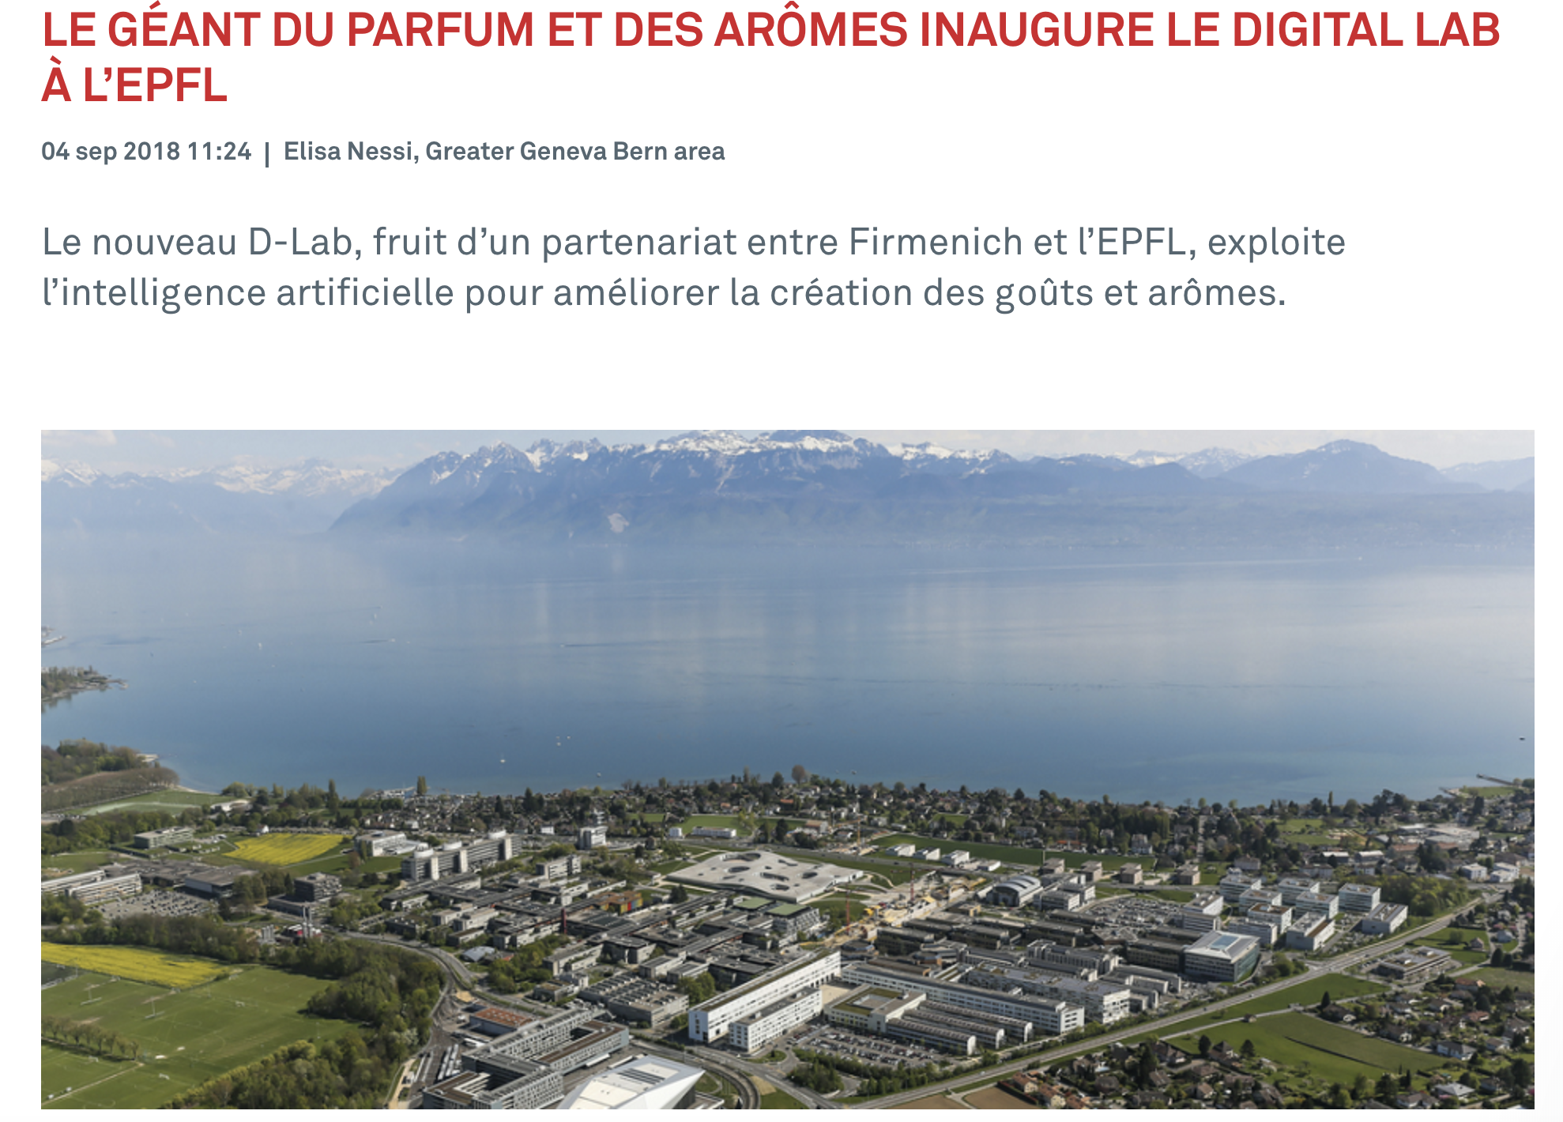
Firmenich D-Lab @ EPFL

Slide 4
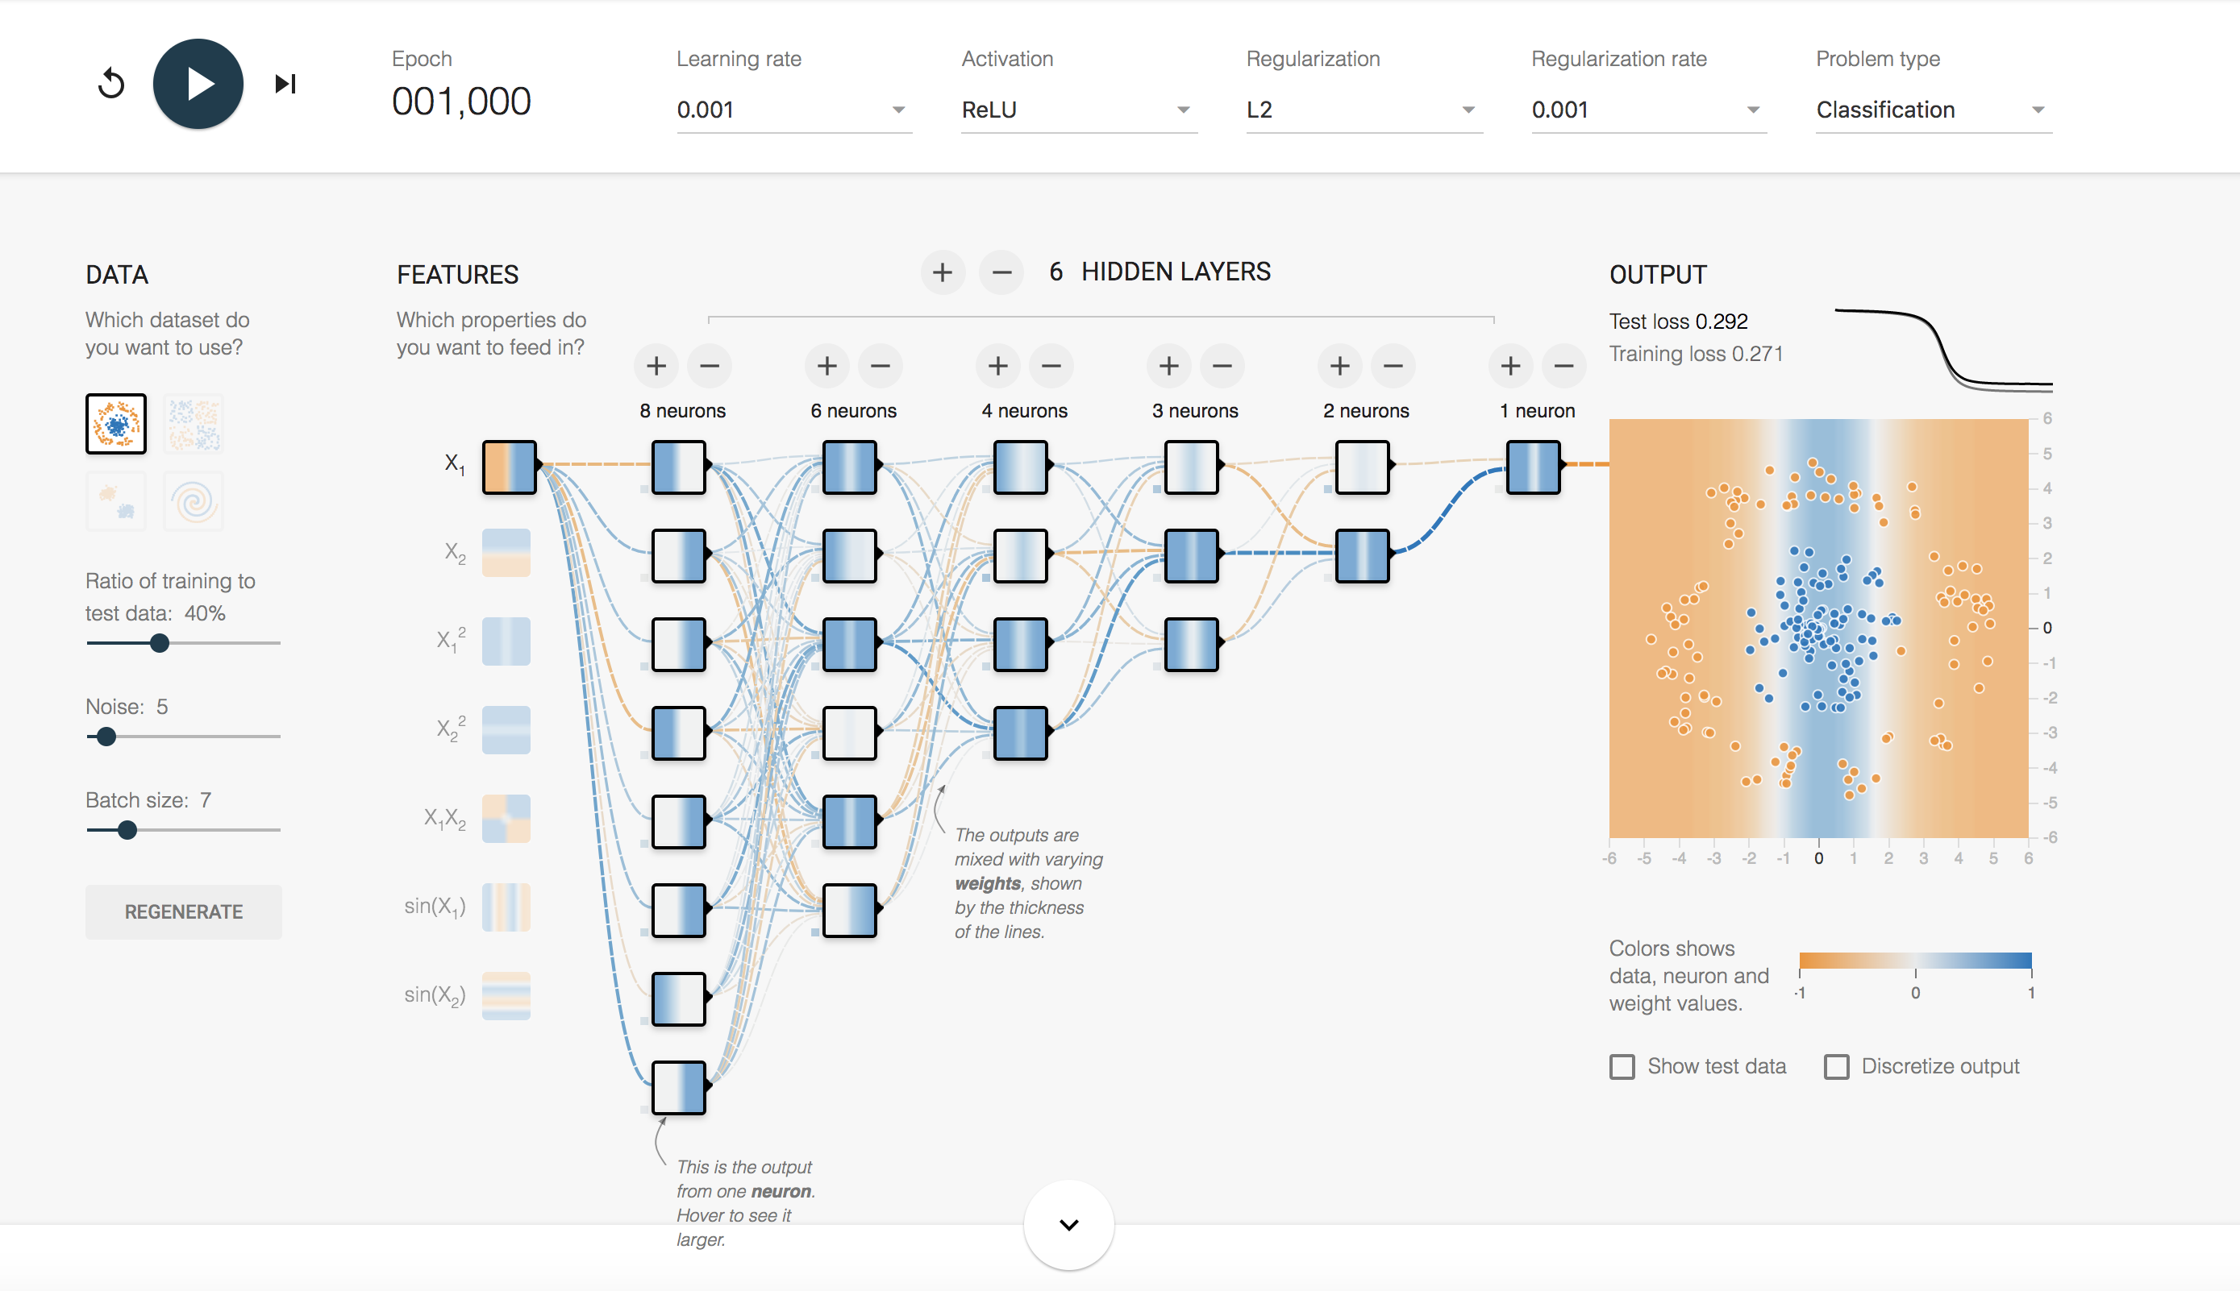

https://playground.tensorflow.org/

Slide 5
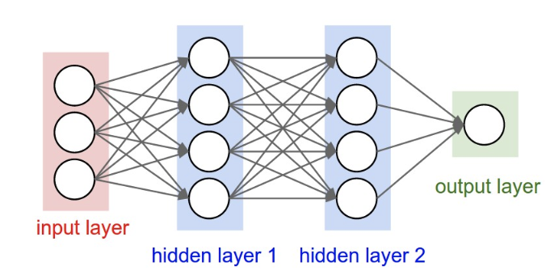
DNN network architecture
Input: dimension n
Hidden layer 1 : 512 neurons
Dropout 0.5
Relu
Hidden layer 2 : 256 neurons
Dropout 0.5
Relu
Hidden layer 3 : 128 neurons
Dropout 0.5
Relu
Hidden layer 4 : 64 neurons
Dropout 0.25
Relu
Hidden layer 5 : 32 neurons
Dropout 0.1
Relu
output : dimension 21

Slide 6
RDKit 3D descriptors since 2017.09
Autocorr3D | New in 2017.09 release. Todeschini and Consoni “Descriptors from Molecular Geometry” Handbook of Chemoinformaticshttp://dx.doi.org/10.1002/9783527618279.ch37 | C++
RDF | same | C++
MORSE | same | C++
WHIM | same | C++
GETAWAY | same | C++
Autocorr2D | same | C++
In Version 2018.09,
we add custom atomic properties descriptors

Slide 7
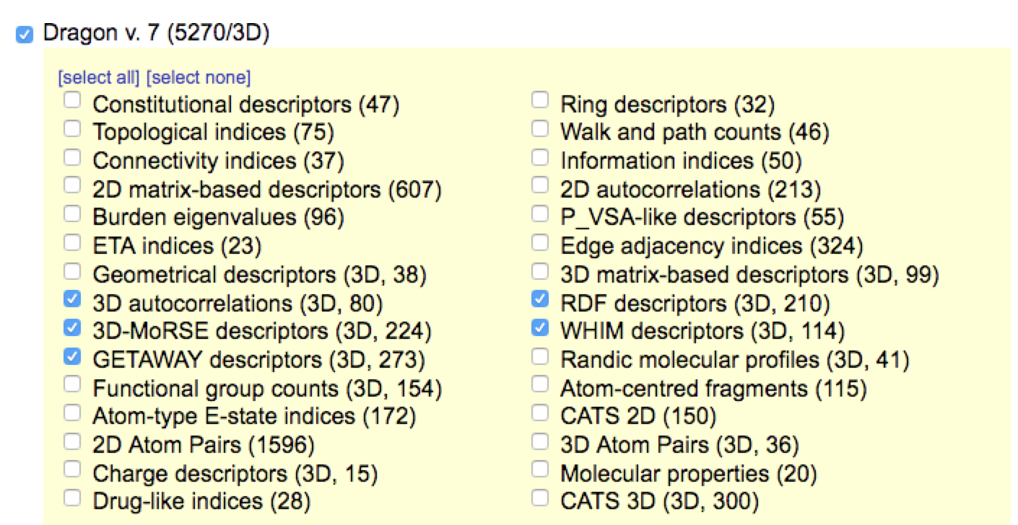
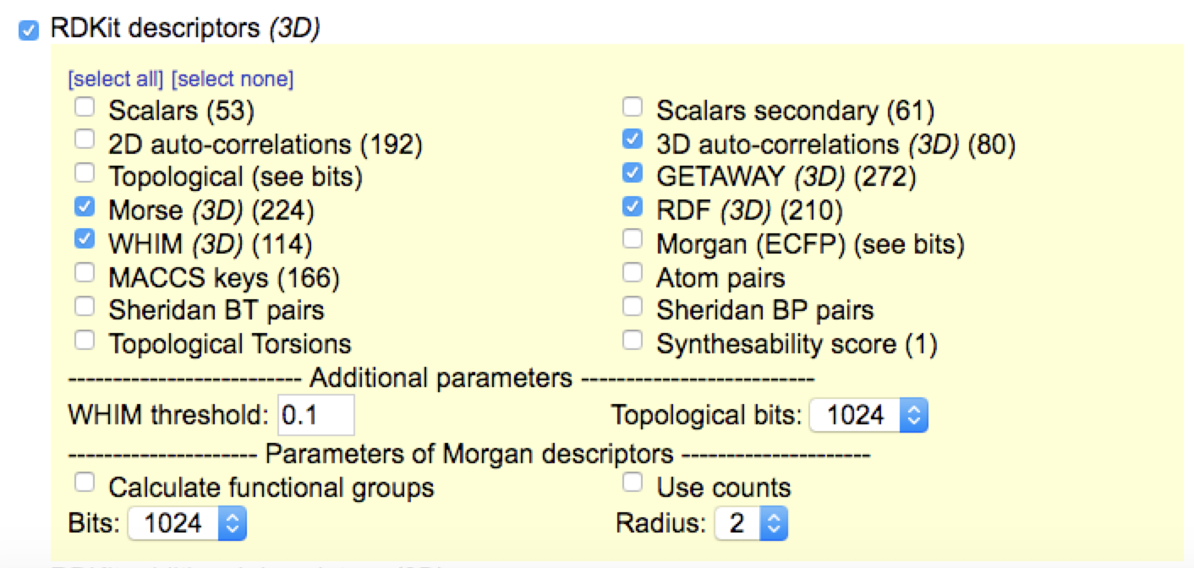
OCHEM* Dragon v7 & RDKit Descriptors
2 tests:
only 3D in common (see check blue boxes)
all 2D + 3D (exception RDKit not Sheridan & Topological Torsions)
*All computation made using OCHEM

Slide 8
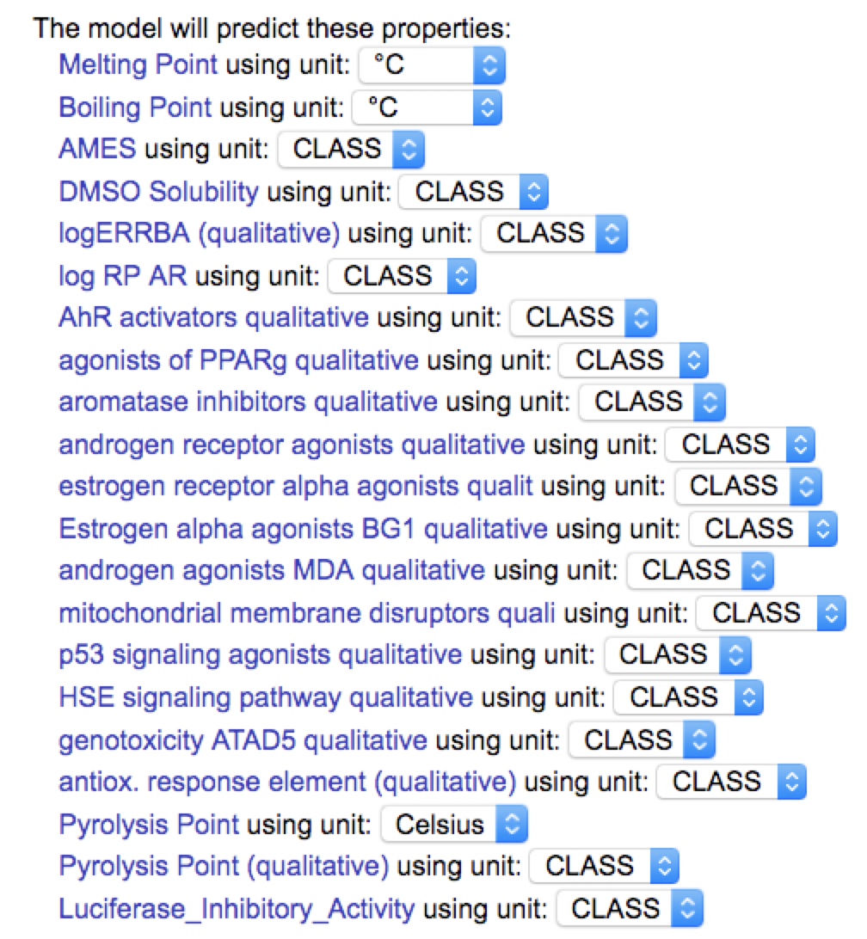
Study 1: Multi learning tasks
Dataset = 1’015’745 data points
List of target selects
Regression (MP/BP/Pyrolysis Point)
Classification 18 =>
We will train the same dense deep
network to learn all targets simultaneity (6 layers)
benefits
“one model”
“targets synergy”
Fast inference
We can learn targets with heterogenous chemical datasets
Public available datasets from OCHEM website grab from articles

Slide 9
Generation of descriptors
Speed:
RDKit “all”:
Dragon “all”:
Descriptor sizes after pre-filtration (“decorrelation”):
RDKit: 8143 (3x bigger)
Dragon: 2496 (v7) / 2429 (v6)
37 mins for RDKit
52 mins for Dragon

Slide 10
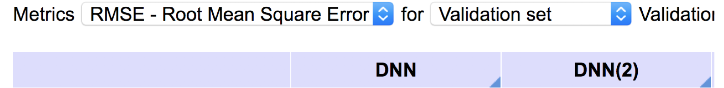
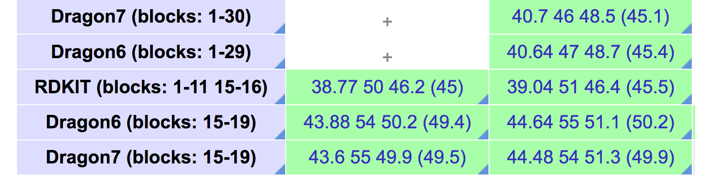
Results for regression targets (RMSE)
All descriptors
Only 3D
10000 epochs
2000 epochs

Slide 11
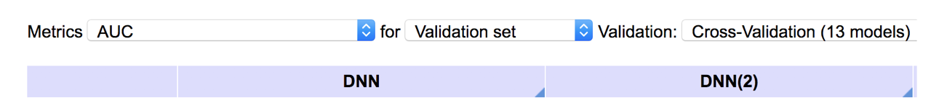
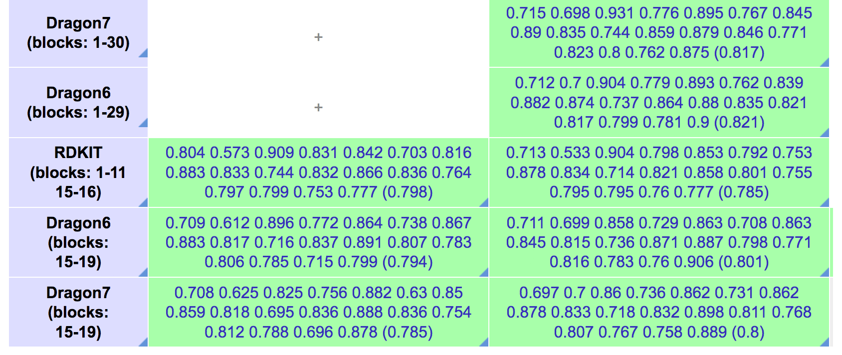
Results for classification targets (AUC)
All descriptors
Only 3D
10000 epochs
2000 epochs

Slide 12
Study 1: Conclusion
RDkit can be use to get very similar accuracy as Dragon v6 or v7
RDkit provide more flexibility to add personal descriptors (custom 3D available in RDKit 2018.09 version)
RDkit is faster (x6)

Slide 13
Study 2: CNN vs DNN for Melting Point
Compare Rdkit + major OCHEM features engineering descriptors DNN (like Study 1)
vs
CNN based on smile representation
We use a smaller Melting Point dataset (ie 19394 molecules)
We select a trivial Convolutional Neural Network architecture
We test augmentated smiles method

Slide 14
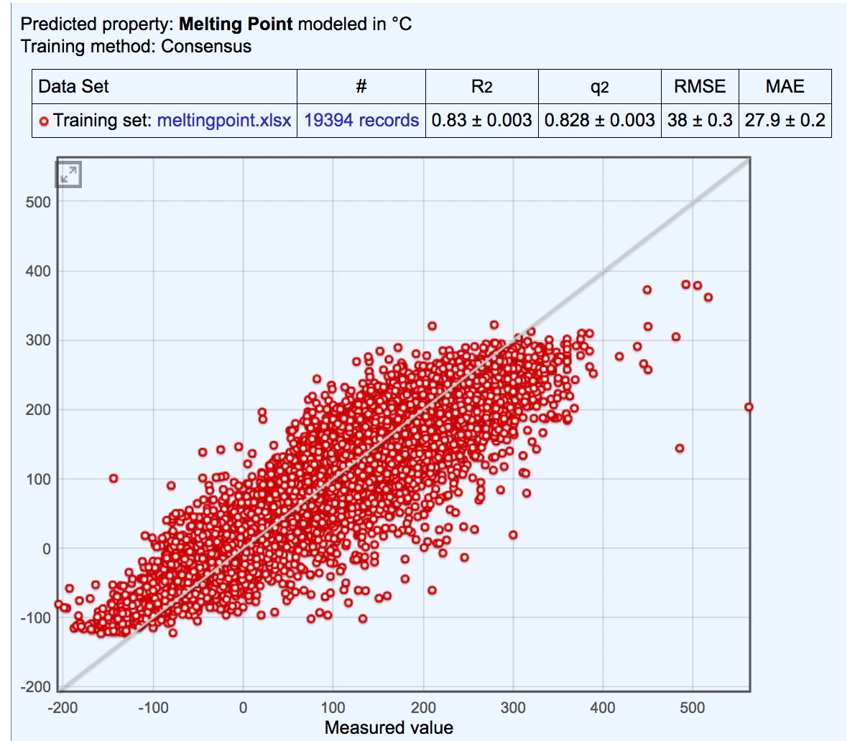
Features engineering DNN metamodel* only 2D (RDKit, Dragon, CDK, etc..)
*Metamodel is an average of Multiple individual models using one type of descriptors per model

Slide 15
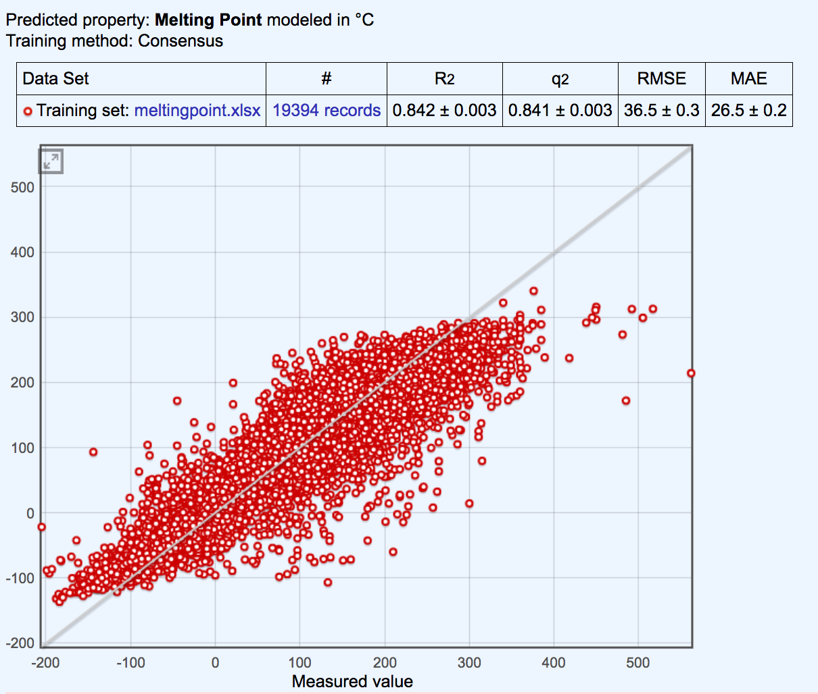
Features engineering DNN metamodel 2D + 3D (RDKit, Dragon, CDK, etc..)

Slide 16
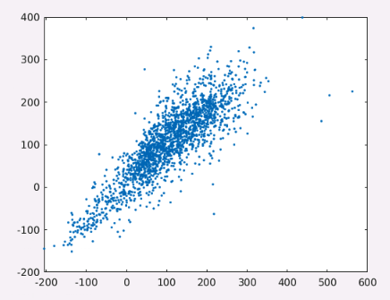

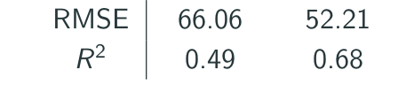
CNN method with smiles input
Input: multiple smiles
representation of the same molecule
=> augmentation by n
Keras / tensorflow: 3.8 mins
n = 10, RMSE= 48.6, R² = 0.73
Matlab DL : 5.4 mins
Celcius/Kelvin conversion error in publication &
experimental error (>500°C!)

Slide 17
Study 2: Conclusion
Features engineering descriptors (ie RDkit, Dragon, CDK, …) still perform better than smile augmented descriptors for the moment but we are half way
HOWEVER
We know that other chemical direct representation (images chemception, graph Conv weavenet) already reach close performance to advanced features engineering descriptors

Slide 18
What we need now ?
Faster way (not random) to enumerate all smiles from a molecule
Master Students @ EPFL (D-lab)
Data in physico-chemistry domains (any but enough)
PhD in chemoinformatic & Deep Learning @ EPFL or Geneva
1 Full position: senior Chemoinformatic scientist (with deep learning experience)
2 Full positions: senior Data scientists (with or without Chemical background)

Slide 19
Contributors
Igor Tetko => OCHEM (add RDkit + Firmenich Descriptors in OCHEM)
Gregory Landrum => RDKit (support on 3D descriptors)
Talia Kimber => CNN (Master thesis in progress)
Arvind Jayaraman => Mathworks (support on DL toolbox)
Firmenich IA Team:
Eric
Dario
Addis
Sven

Slide 20
Q&A
THANK YOU

Slide 21
Data sources “article”
Ghosh, D.; Koch, U.; Hadian, K.; Sattler, M.; Tetko, I.V. Luciferase advisor: High-accuracy model to flag false positive hits in luciferase hts assays. J. Chem. Inf. Model. 2018, 58, 933-942.
Tetko, I.V.; Novotarskyi, S.; Sushko, I.; Ivanov, V.; Petrenko, A.E.; Dieden, R.; Lebon, F.; Mathieu, B. Development of dimethyl sulfoxide solubility models using 163 000 molecules: Using a domain applicability metric to select more reliable predictions. J. Chem. Inf. Model. 2013, 53, 1990-2000.
Tetko, I.V.; Sushko, Y.; Novotarskyi, S.; Patiny, L.; Kondratov, I.; Petrenko, A.E.; Charochkina, L.; Asiri, A.M. How accurately can we predict the melting points of drug-like compounds? J. Chem. Inf. Model. 2014, 54, 3320-3329.
Tetko, I.V.; D, M.L.; Williams, A.J. The development of models to predict melting and pyrolysis point data associated with several hundred thousand compounds mined from patents. J. Cheminform. 2016, 8, 2.
Abdelaziz, A.; Spahn-Langguth, H.; Werner-Schramm, K.; Tetko, I.V. Consensus modeling for hts assays using in silico descriptors calculates the best balanced accuracy in tox21 challenge. Frontiers Environ. Sci. 2016, 4, 2.
Rybacka, A.; Ruden, C.; Tetko, I.V.; Andersson, P.L. Identifying potential endocrine disruptors among industrial chemicals and their metabolites - development and evaluation of in silico tools. Chemosphere 2015, 139, 372-378.
Brandmaier, S.; Sahlin, U.; Tetko, I.V.; Oberg, T. Pls-optimal: A stepwise d-optimal design based on latent variables. J. Chem. Inf. Model. 2012, 52, 975-983.
Sushko, I.; Novotarskyi, S.; Korner, R.; Pandey, A.K.; Cherkasov, A.; Li, J.; Gramatica, P.; Hansen, K.; Schroeter, T.; Muller, K.R., et al. Applicability domains for classification problems: Benchmarking of distance to models for ames mutagenicity set. J. Chem. Inf. Model. 2010, 50, 2094-2111.

