Slide 1
Computational Chemogenomics – is it more than Inductive Transfer?
J.B. Brown*, Y. Okuno*, G. Marcou#, A. Varnek# & D.Horvath#
dhorvath@unistra.fr
* Kyoto University Graduate School of Pharmaceutical Sciences, Department of Systems Bioscience
for Drug Discovery, 606-8501, Kyoto, Japan
# Laboratoire de Chemoinformatique, UMR 7140 Univ. Strasbourg – CNRS, 67000 Strasbourg, France

Slide 2
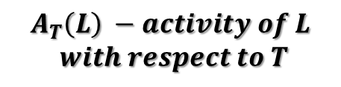
The Challenge of Polypharmacology..
‘Magic Bullet’ paradigm is wishful thinking: a drug will not interact only with the target is was ‘designed for’.
Polypharmacology (knowing all possible drug-biomolecule interactions) is necessary – unfortunately not sufficient – to understand the in vivo effects of a drug.
How does chemoinformatics live up to this challenge?
Ligands/Targets | T | t | …
L
l
…
$$A_{T}\left(L\right) −activity of L$$
$$with respect to T$$

Slide 3




Chemogenomics = QSAR of Protein-Ligand Complexes
ChemoGenomics
(CG) Model
Ligands/Targets | T | t | …
L
l
…
$$\hat{pK}\left(L@T\right)$$
$$\hat{pK}\left(L@t\right)$$
$$\hat{pK}\left(l@T\right)$$
$$\hat{pK}\left(l@t\right)$$

Slide 4
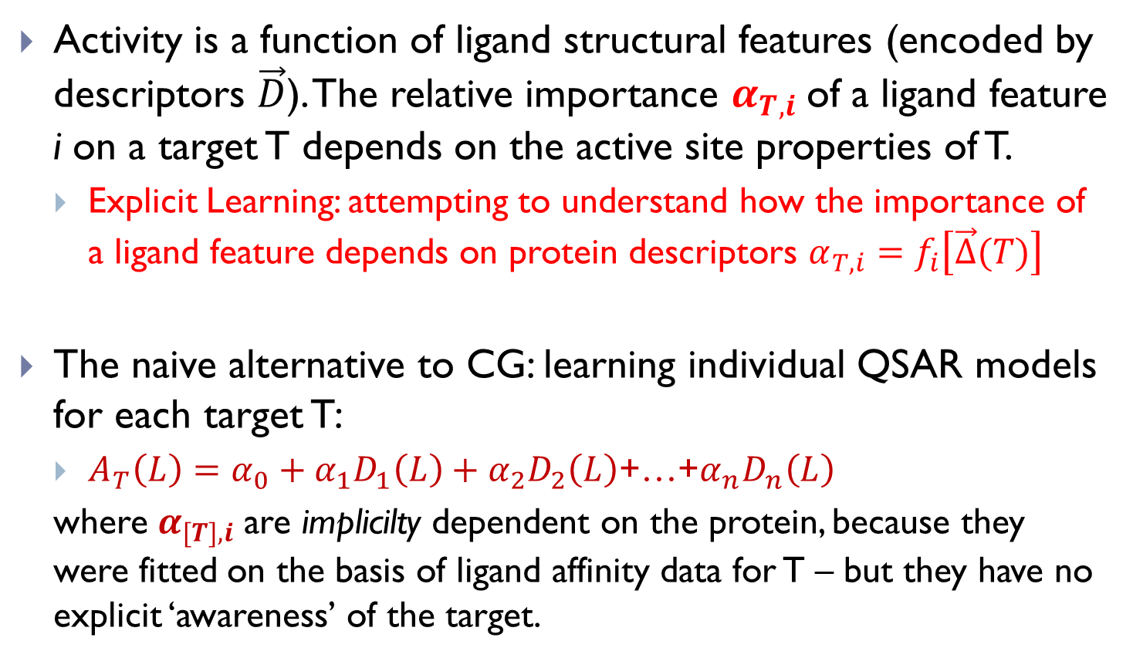
The Ideal of Chemogenomics: Explicit Learning (EL) powered by target information
Activity is a function of ligand structural features (encoded by descriptors $\vec{D}$). The relative importance $α_{T,i}$of a ligand feature i on a target T depends on the active site properties of T.
  Explicit Learning: attempting to understand how the importance of a ligand feature depends on protein descriptors $α_{T,i}=f_{i}\left[\vec{∆}(T)\right]$
The naive alternative to CG: learning individual QSAR models for each target T:
  $A_{T}\left(L\right)={α_{0}+α}_{1}D_{1}\left(L\right)+α_{2}D_{2}\left(L\right)$+…+$α_{n}D_{n}\left(L\right)$
  where $α_{[T],i}$are implicilty dependent on the protein, because they were fitted on the basis of ligand affinity data for T – but they have no explicit ‘awareness’ of the target.
Enables Model Building for Orphan Targets!
« Deorphanization »

Slide 5

Yet, inter-target Inductive Transfer (IT) of knowledge may also boost CG…
An alternative benefit in CG calculations may come from Inductive Transfer (IT) of knowledge between related targets:
  $A_{T}\left(L\right)=α_{1}D_{1}\left(L\right)+α_{2}D_{2}\left(L\right)$+…+$α_{n}D_{n}\left(L\right)$: n=10, 300 data points 
  $A_{t}\left(L\right)=β_{1}D_{1}\left(L\right)+α_{2}D_{2}\left(L\right)$+…+$α_{n}D_{n}\left(L\right)$: n=10, 7 data points ??
If enough data points exist to build a robust model for affinity of target T, supplementary data will be needed only to learn the difference between T and t:
  $A_{t}\left(L\right)=A_{T}\left(L\right)+\left(β_{1}−α_{1}\right)D_{1}\left(L\right)$: n=1, 7 data points 
Robustifies models for data-poor targets, but does not allow deorphanization!

Slide 6
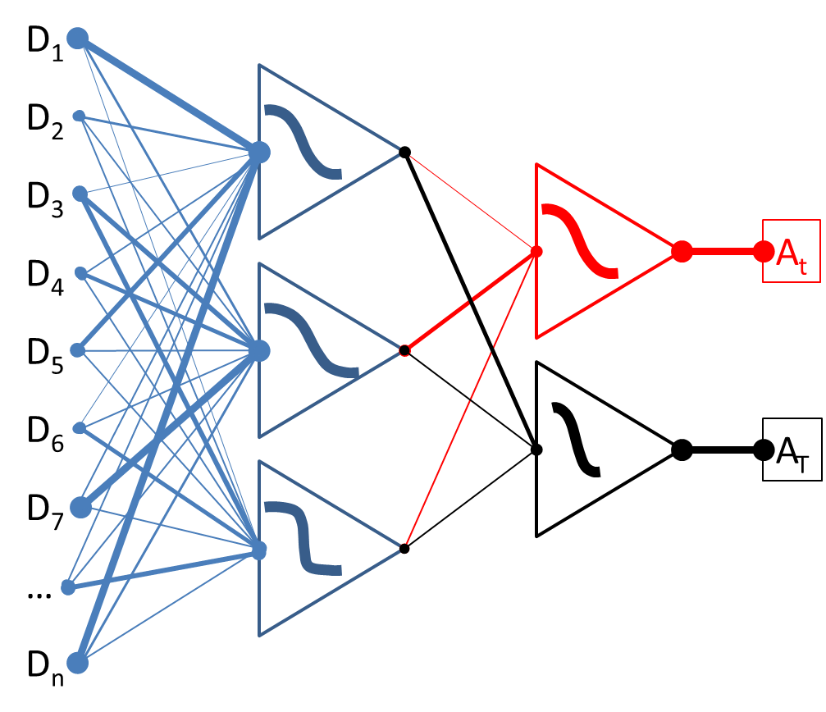
IT may also occur implicitly, with appropriate Machine Learning tools:
Multi-Task-Learning-enabled Neural Nets
Support Vector Machines, for example using the ‘Multi-Task’ Protein Kernel (J.P. Vert)

Slide 7
The Question: Which is the dominant ‘boost factor’ in CG: EL or IT?
You cannot know this by simply analyzing the machine learning algorithm:
  procedures allegedly operating in ‘EL’ mode, provided with protein descriptors, may also be used in IT mode, if target indicator variables are employed instead.
In absence of relevant protein descriptors, the best one may hope for is IT enhancement, but…
It is not clear whether, in presence of protein descriptors, these will be actually employed to build EL-models.
  What if protein descriptors act as nothing more but sophisticated indicator variables?

Slide 8
How do we address this Question?
By benchmarking of the relative performances of
  Classical single-endpoint QSAR
  Single-endpoint IT-enhanced QSAR
  IT-enhanced CG
  EL-enabled CG, with actual and ‘quasi-ideal’ protein descriptors
Data set: 31 GPCRs from ChEMBL, each associated to >50 ligands of known pK_{i} value (no arbitrary decoys).
Model building: Genetic-Algorithm-tuned Support Vector Regression (libsvm), optimizing operational parameters (kernel type, cost, gamma, etc.)
Benchmark includes two predictive challenges:
  Cross-validated prediction propensity
  Target deorphanization – the key test for genuine EL models!

Slide 9
Descriptors…
For ligands: ISIDA property-labeled sequence counts (aabPH02, seqPH37, treeSY03, treePH03) & fuzzy pharmacophore triplets (FPT1)
  Choice of the optimal descriptor space is part of the SVR algorithm tuning process, together with kernel, epsilon, gamma parameter choice.
  treePH03 turned out to be the consensus descriptor space.
For proteins:
  (IT-CG): Identity Fingerprints IDFP: bitstring of size N_{T} with one single bit set: the current target.
  (EL) Similarity Fingerprint SIMFP of size N_{T}, SIMFP_{T}(t) = covariance of pK_{i} values for t and T, over common ligands – quasi-ideal, because they capture actual functional relatedness!
  (EL) ProFeat terms & Aminoacid sequence snippet counts

Slide 10
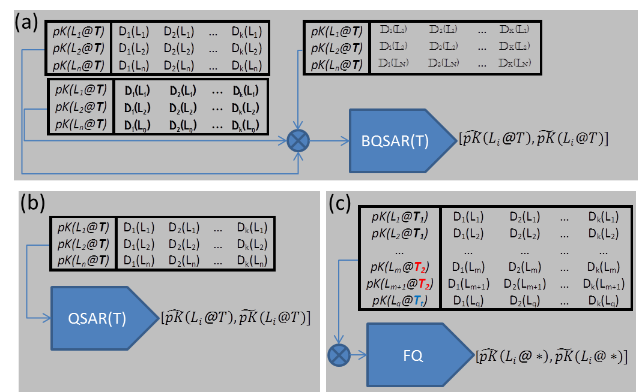
Benchmarking Baseline: ‘Classical’ QSAR
(a) BQSAR: Best QSAR, ⊗ stands for ligand descriptor selection; (b) QSAR in ‘consensus’ descriptor space treePH03; (c) FQ: Family QSAR, all ligands of all targets confounded, with no target information.
L – ligand, T – Target, D – ligand descriptors. Circumflex cap: predicted affinity, Tilda: cross-validated prediction for affinity

Slide 11
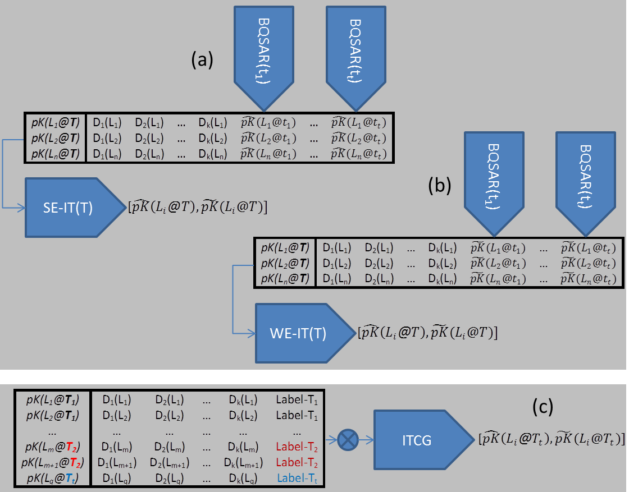
IT-Enhanced Strategies…
SE-IT (Strong Explicit Inductive Transfer) uses predicted BQSAR affinities of other targets as new descriptors.
WE-IT (Weak Explicit IT) uses cross-validated BQSAR affinities as new descriptors,

Slide 12
IT-Enhanced Chemogenomics
IT-CG learns from the entire profile, concatenating target label info (IDFP) to ligand descriptors

Slide 13
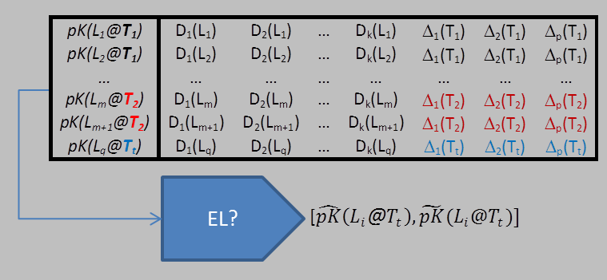
EL-Enabled strategies.
Three different models ELSim, ELP and ELSeq, using protein Δ=(SIMFP, ProFeat and sequence count descriptors), respectively, concatenated to the treePH03 ligand terms.

Slide 14
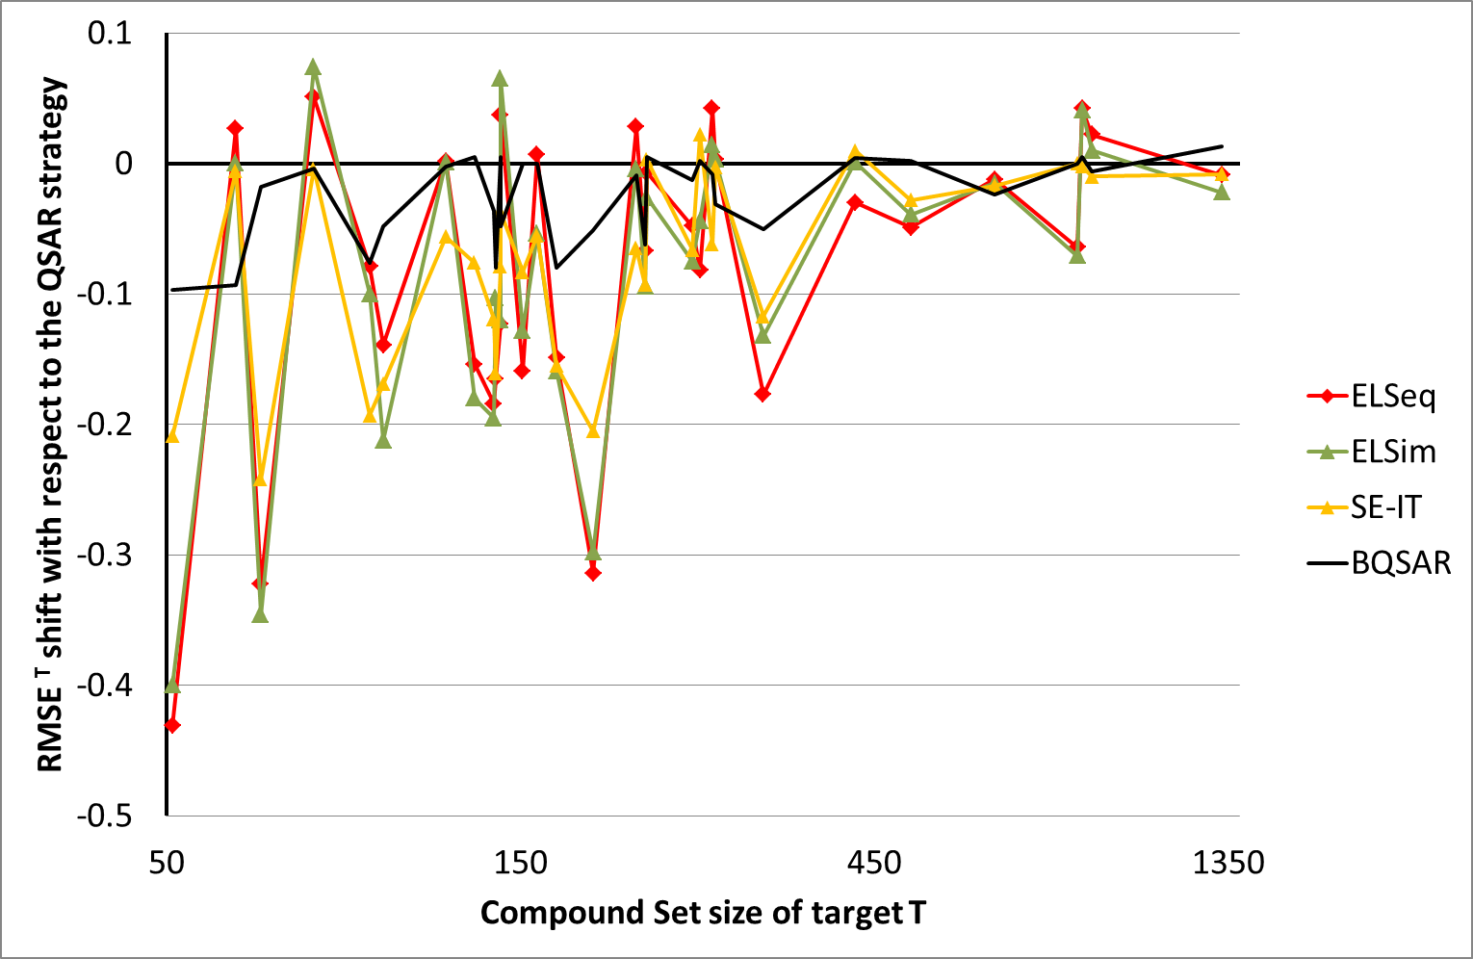
Yes, CG works: XV-RMS errors of many targets with smaller training sets decrease!
… yet, pure ID-driven enhancement is often nearly as strong as assumed EL benefit.

Slide 15
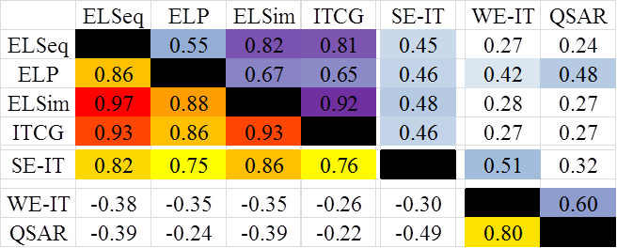
Cross-Validated Prediction Challenge: EL and IT similar in Strategy Space Map.
Correlation coefficients of prediction residuals at per-target and per-item levels, respectively

Slide 16
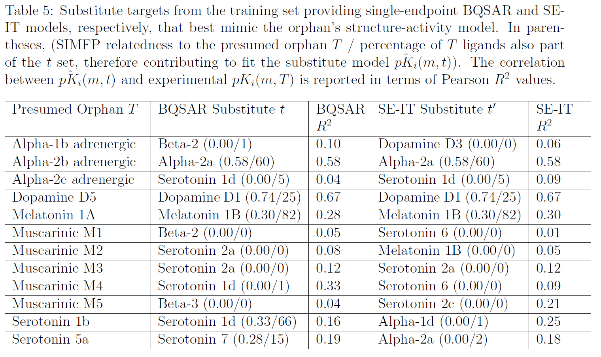
Deorphanization ‘by substitution’ – use a model of a training set target!

Slide 17
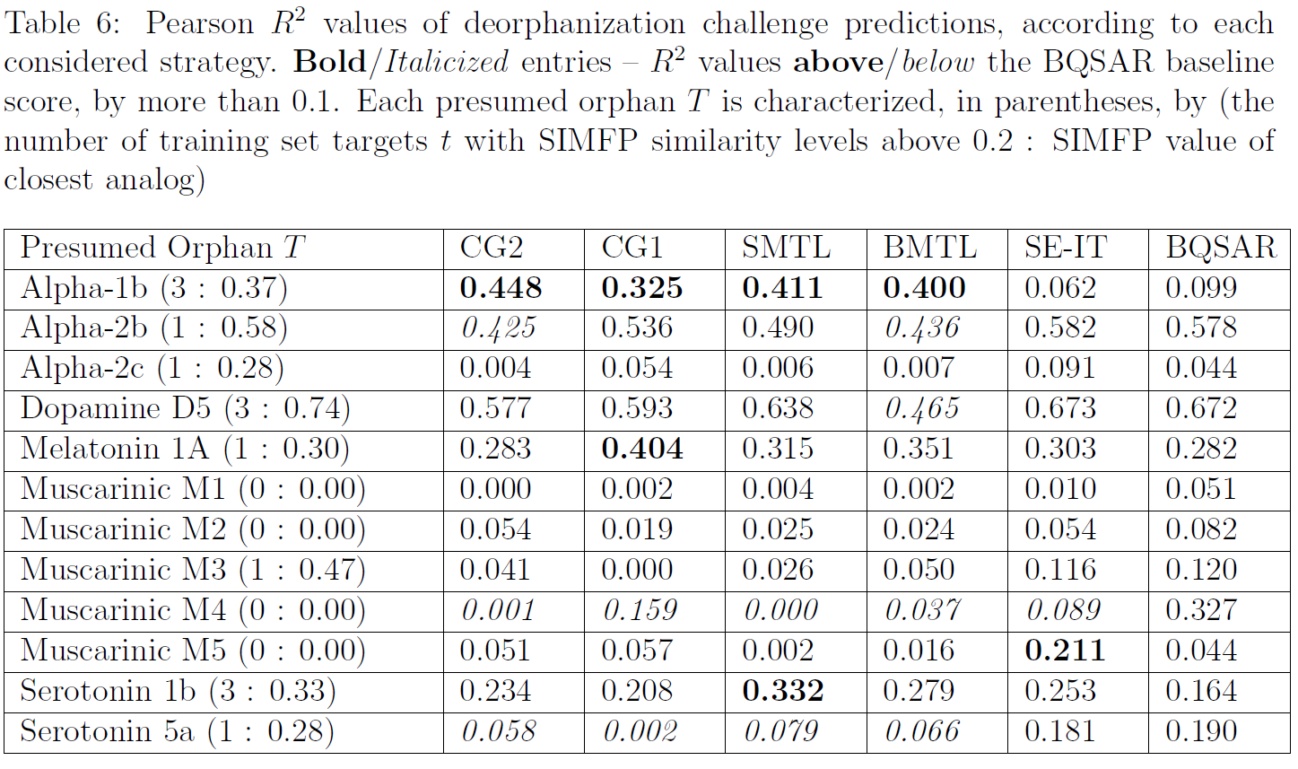
EL- and IT-CG only incidentally fare better than ‘substitution’ !

Slide 18
Conclusions…
Herein reported CG simulations are state-of-the-art results, comparing favorably to published work – at largely more challenging benchmarking conditions.
They confirm the advantage of CG over classical QSAR,
Yet, they show that this advantage is clearly due to IT effects, not due to EL…
Therefore, CG methods are not effective in target deorphanization – not more than mere substitution with a model of a related target.
Battle is not lost: perhaps better protein descriptors will trigger a clearly visible EL effect ?!
For more details, please check J. Comput.-Aided Mol. Des. 2014, 28 (6), 597-618

Slide 19
Acknowledgements
J.B. Brown and Y. Okuno wish to acknowledge support from the following sources:
(1) Financial support from Chugai Pharmaceutical Co., Ltd. and Mitsui Knowledge Co., Ltd.
(2) Japan Science and Technology Agency CREST program for big data and
(3) Japanese Society for the Promotion of Science Kakenhi(B) 25870336
All authors wish to thank the Japanese Society for the Promotion of Science for supporting this collaboration

