Slide 1
Optimal Option Portfolio Strategies
José Faias (CATÓLICA LISBON)
Pedro Santa-Clara (Nova, NBER, CEPR)
October 2011
Notes:
Good afternoon.
I will present this paper co-authored with Pedro Santa-Clara in which we form Optimal Option Portfolios Strategies. At our knowledge, this is the first paper that addresses this question.

Slide 2
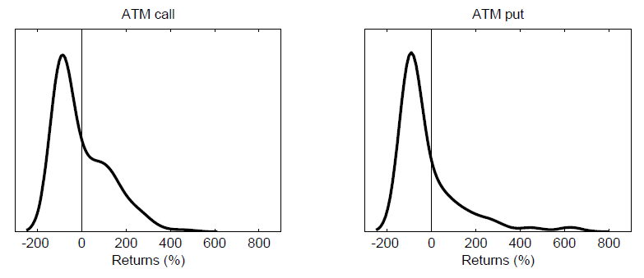
THE TRADITIONAL APPROACH
Mean-variance optimization (Markowitz) does not work
Investors care only about two moments: mean and variance (covariance)
Options have non-normal distributions
Needs an historical “large” sample to estimate joint distribution of returns
Does not work with only 15 years of data
We need a new tool!
Notes:
The traditional answer is to use the mean-variance optimization from Markowitz. This assumes that investors are quadratic utiliy optimizers and therefore their interest is in terms of only two moments: mean and variance. Of course, this is the case when returns follow a normal distribution. But notice if we need the mean and the variance, there is also the question of how to estimate them. For this we need a “large” sample. Usually historical. But we only have a short sample. This won’t work with only 10 years of data. Even if this would be possible, then the out-of-sample period would be really small. Truly, no ones uses portfolio optimization with options, they usually use them for hedging or speculative purposes. So we need a new tool.
The literature has evolved in several paths. One of which is to incorporate more moments. So by a Taylor’s expansion add skewness and kurtosis in the utility. But this does not solve the problem as well.

Slide 3
LITERATURE REVIEW
Simple option strategies offer high Sharpe ratios
Coval and Shumway (2001) show that shorting crash-protected, delta-neutral straddles present Sharpe ratios around 1
Saretto and Santa-Clara (2009) find similar values in an extended sample, although frictions severely limit profitability
Driessen and Maenhout (2006) confirm these results for short-term options on US and UK markets
Coval and Shumway (2001), Bondarenko (2003), Eraker (2007) also find that selling naked puts has high returns even taking into account their considerable risk.
We find that optimal option portfolios are significantly different from just exploiting these effects
For instance, there are extended periods in which the optimal portfolios are net long put options.
Notes:
We maximize an expected utility function (in our example we use a power utility function). On doing so we account for all moments of the distribution. In particular, we take into consideration skewness and kurtosis. Other choices of utility function can also be used (like dissapointment utility functions).
We deal with the small sample option data problem by using the underlying asset instead. First, this allows to find weights in the same month in which we have information about options. Second, historical extreme events take a role in option allocation. As a third step, we also take into consideration the current risk conditions prevalent at each month.
Notice that we only use current options prices and by using them we deal with the smile effect.
Finally, we add transaction costs ( in terms of bid-ask spread) to the optimization problem.
Coval and Shumway (2000)
The first component is a leverage effect. Because an option allows investors to assume much of the risk of
the option’s underlying asset with a relatively small investment, options have characteristics similar
to levered positions in the underlying asset. The Black-Scholes model implies that this implicit
leverage, which is reflected in option betas, should be priced. We show that this leverage should be
priced under much more general conditions than the Black-Scholes assumptions. In particular, call
options written on securities with expected returns above the risk-free rate should earn expected
returns which exceed those of the underlying security. Put options should earn expected returns
below that of the underlying security. We present strong empirical support for the pricing of the
leverage effect.
The second component of option risk is related to the curvature of option payoffs. Since
option values are nonlinear functions of underlying asset values, option returns are sensitive to
the higher moments of the underlying asset’s returns.

Slide 4
METHOD (1)
For each month t run the following algorithm:
1. Simulate underlying asset standardized returns
Historical bootstrap
Parametric simulation: Normal distribution and Generalized Extreme Value (GEV) distributions
2. Use standardized returns to construct underlying asset price based on its current level and volatility
This is what we call conditional OOPS. Unconditional OOPS is the same without scaling returns by realized volatility in steps 1 and 2.

Slide 5
METHOD (2)
3. Simulate payoff of options based on exercise prices and simulated underlying asset level:
and corresponding returns for each option based on simulated payoff and initial price
4. Construct the simulated portfolio return

Slide 6
METHOD (3)
5. Choose weights by maximizing expected utility
over simulated returns
Power utility
which penalizes negative skewness and high kurtosis
Output :

Slide 7
METHOD (4)
6. Check OOS performance by using
realized option returns
Determine realized payoff
and corresponding returns
Determine OOS portfolio return

Slide 8
DATA (1)
Bloomberg
S&P 500 index: Jan.1950-Oct.2010
1m US LIBOR: Jan.1996-Oct.2010
OptionMetrics
S&P 500 Index European options traded at CBOE (SPX): Jan. 1996-Oct.2010
Average daily volume in 2008 of 707,688 contracts (2nd largest: VIX 102,560)
Contracts expire in the Saturday following the third Friday of the expiration month
Bid and ask quotes, volume, open interest
Monthly frequency
Notes:
We use data from Bloomberg for the underlying asset, S&P 500, and 1m US Libor rate. Our frequency is monthly.
OptionMetrics is used for options data. The period covered goes from Jan 1996 to Oct. 2008.
We choose S&P 500 options which are European Options. This corresponds to the most liquid stock contract available.
This database provides bid price, ask price, volume, open interest and prices
For preventing errors in this database, we eliminate registers which bid quote is less than 1/8 of a dollar or whose bid is greater than the ask price; we also eliminate registers without volume and eliminate registers that do not fall in the standard bounds for European options
Before 2001 1/16. so 1/8 is conservative; <3$ for stock than .05 otherwise 0.10
No volume eliminates quotes even when there is no trade
RUT: Russell 2000 index

Slide 9
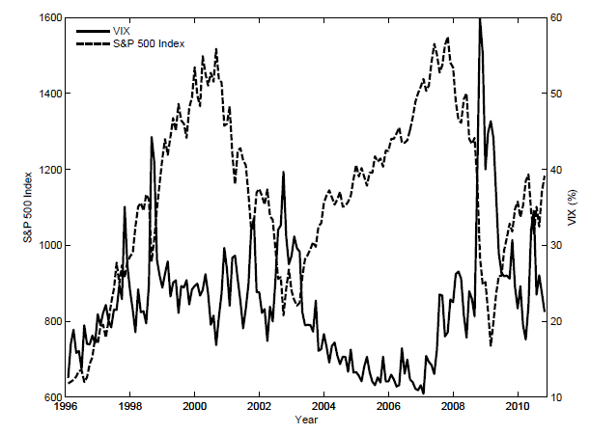
DATA (2)
Jan.1996-Oct.2010: a period that encompasses a variety of market conditions
Notes:
We use data from Bloomberg for the underlying asset, S&P 500, and 1m US Libor rate. Our frequency is monthly.
OptionMetrics is used for options data. The period covered goes from Jan 1996 to Oct. 2008.
We choose S&P 500 options which are European Options. This corresponds to the most liquid stock contract available.
This database provides bid price, ask price, volume, open interest and prices
For preventing errors in this database, we eliminate registers which bid quote is less than 1/8 of a dollar or whose bid is greater than the ask price; we also eliminate registers without volume and eliminate registers that do not fall in the standard bounds for European options
Before 2001 1/16. so 1/8 is conservative; <3$ for stock than .05 otherwise 0.10
No volume eliminates quotes even when there is no trade
RUT: Russell 2000 index

Slide 10
DATA (3)
Asset allocation using risk-free and 4 risky assets:
ATM Call Option (exposure to volatility)
ATM Put Option (exposure to volatility)
5% OTM Call Option (bet on the right tail)
5% OTM Put Option (bet on the left tail)
These options combine into flexible payoff functions
Left tail risk incorporated
Notes:
We use data from Bloomberg for the underlying asset, S&P 500, and 1m US Libor rate. Our frequency is monthly.
OptionMetrics is used for options data. The period covered goes from Jan 1996 to Oct. 2008.
We choose S&P 500 options which are European Options. This corresponds to the most liquid stock contract available.
This database provides bid price, ask price, volume, open interest and prices
For preventing errors in this database, we eliminate registers which bid quote is less than 1/8 of a dollar or whose bid is greater than the ask price; we also eliminate registers without volume and eliminate registers that do not fall in the standard bounds for European options
Before 2001 1/16. so 1/8 is conservative; <3$ for stock than .05 otherwise 0.10
No volume eliminates quotes even when there is no trade
RUT: Russell 2000 index

Slide 11
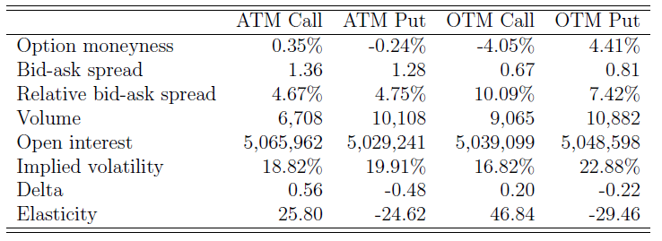
DATA (4)
Define buckets in terms of Moneyness (S/K‐1)
⇒ ATM bucket: 0% ± 1.5% ⇒ 5% OTM bucket: 5% ± 2%
Choose a contract in each bucket
Smallest relative Bid‐Ask Spread, and then largest Open Interest
Notes:
We use data from Bloomberg for the underlying asset, S&P 500, and 1m US Libor rate. Our frequency is monthly.
OptionMetrics is used for options data. The period covered goes from Jan 1996 to Oct. 2008.
We choose S&P 500 options which are European Options. This corresponds to the most liquid stock contract available.
This database provides bid price, ask price, volume, open interest and prices
For preventing errors in this database, we eliminate registers which bid quote is less than 1/8 of a dollar or whose bid is greater than the ask price; we also eliminate registers without volume and eliminate registers that do not fall in the standard bounds for European options
Before 2001 1/16. so 1/8 is conservative; <3$ for stock than .05 otherwise 0.10
No volume eliminates quotes even when there is no trade
RUT: Russell 2000 index

Slide 12
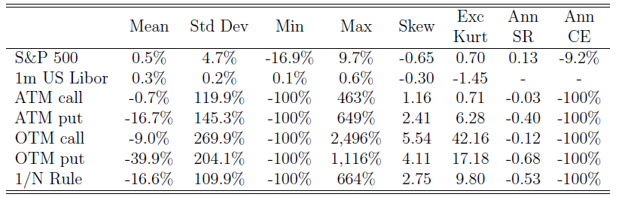
DATA (5)
Notes:
For this time period (between 1996 and 2008) the sharpe ratio of the market was only of 0.06. Strategies involving simple option strategies like shorting calls and puts seem quite rewarding during this period of time as already stated in previous literature. But this comes with a cost: negative skewness and substantial excess kurtosis. This is related to the riskness of these strategies. One way to prevent this, is by using the uniform rule, but this reduces substantially the Sharpe ratio.

Slide 13
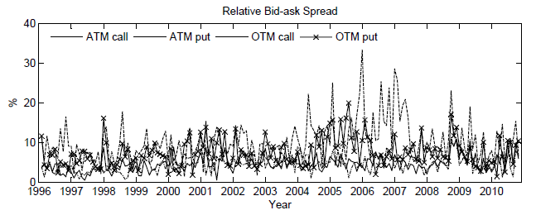
TRANSACTION COSTS
Options have substantial bid-ask spreads!

Slide 14
TRANSACTION COSTS
We decompose each option into two securities: a “bid option” and an “ask option” [Eraker (2007), Plyakha and Vilkov (2008)]
Long positions initiated at the ask quote
Short positions initiated at the bid quote
No short-sales allowed
“Bid securities” enter with a minus sign in the optimization problem
In each month only one bid or ask security is ever bought
The larger the bid-ask spread, the less likely will be an allocation to the security
Lower transaction costs from holding to expiration
Bid-ask spread at initiation only

Slide 15
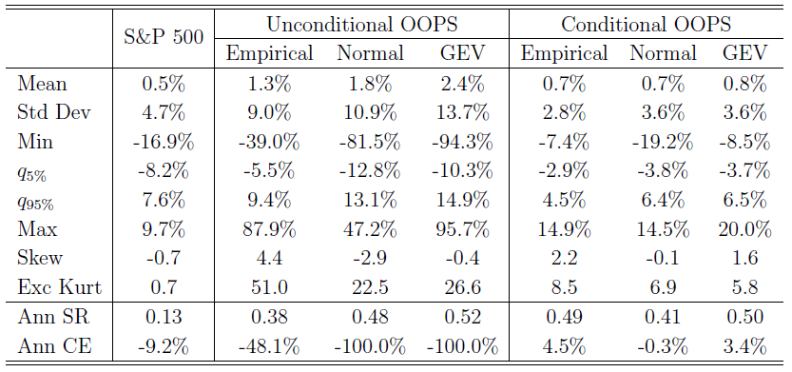
OOPS RETURNS
Out-of-sample returns

Slide 16
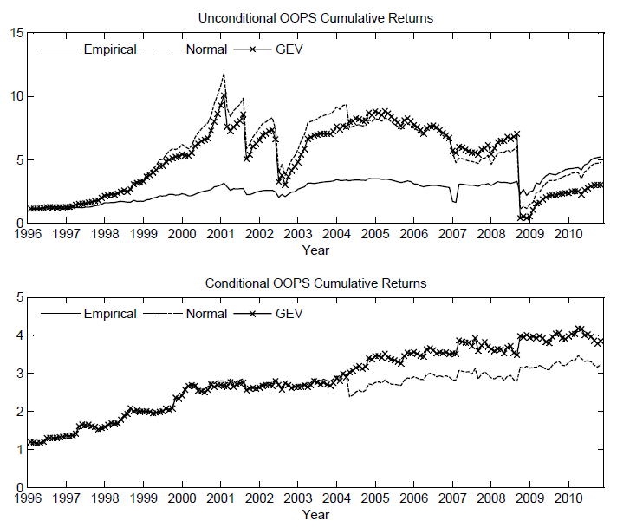
OOPS CUMULATIVE RETURNS

Slide 17
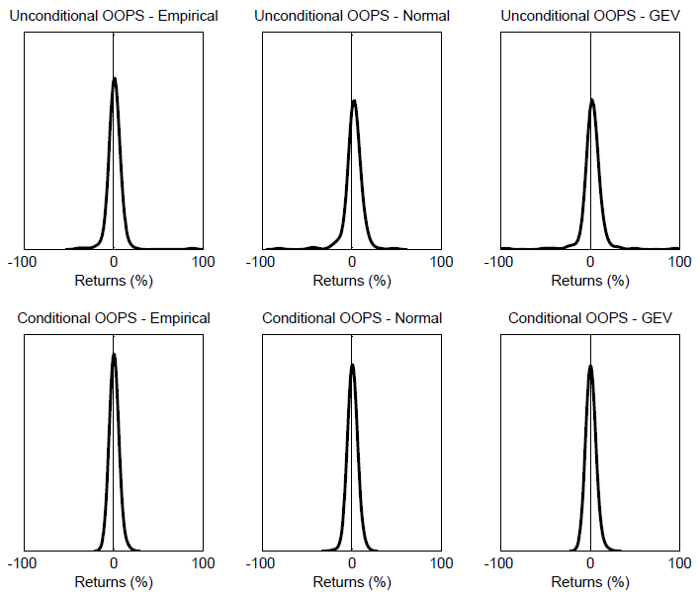
OOPS RETURN DISTRIBUTION

Slide 18
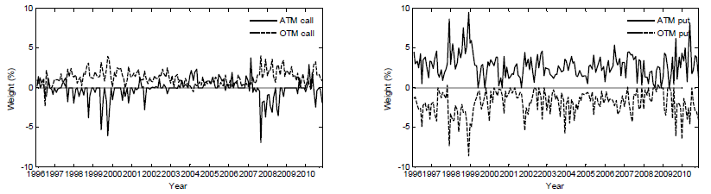
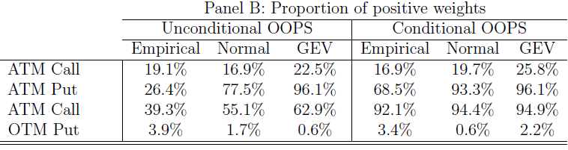
OOPS WEIGHTS
Proportion of positive weights

Slide 19
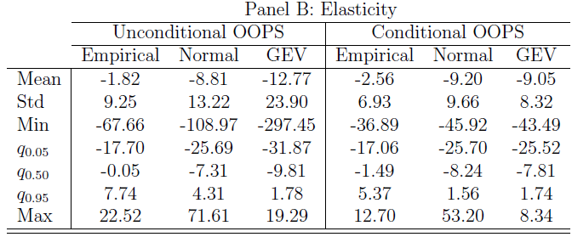
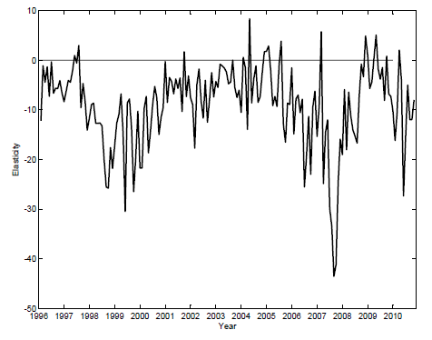
OOPS ELASTICITY

Slide 20
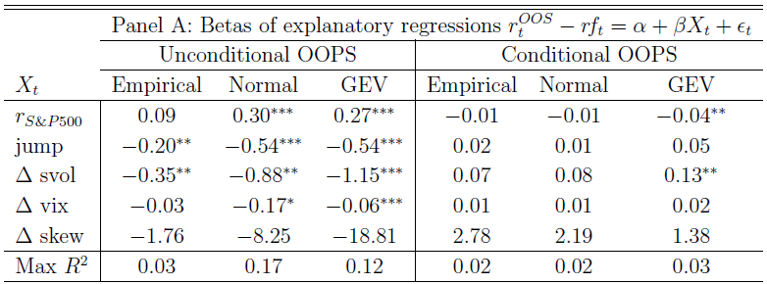
EXPLANATORY REGRESSIONS

Slide 21
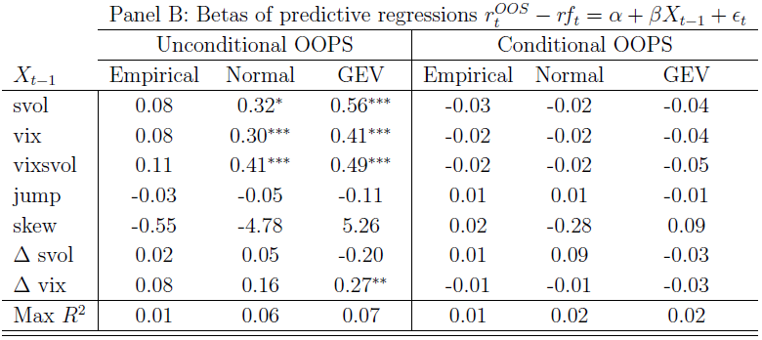
PREDICTIVE REGRESSIONS

Slide 22
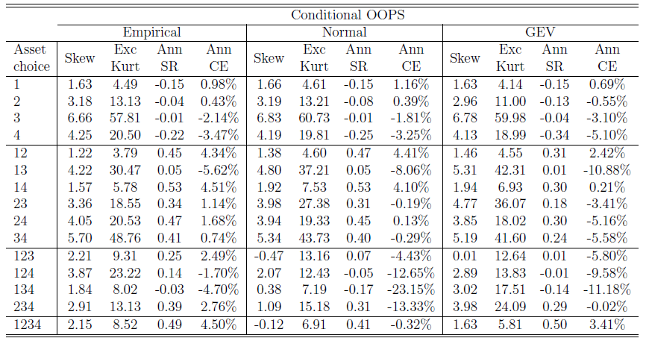
ROBUSTNESS CHECKS
Different security sets choice

Slide 23
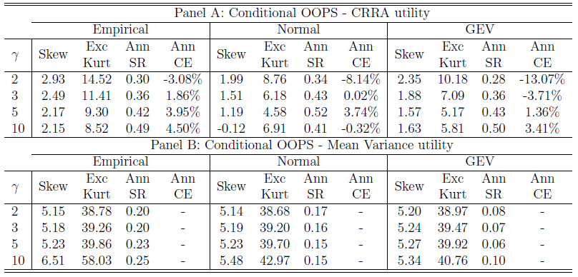
ROBUSTNESS CHECKS
Different preferences

Slide 24
CONCLUSIONS
We provide a new method to form optimal option portfolios
Easy and intuitive to implement
Very fast to run
Small-sample problem and current conditions of market are taken into account
Optimization for 1-month
Option characteristics
Volatility of the underlying
Transaction costs
Strategies provide:
Large Sharpe Ratio and Certainty Equivalent
Positive skewness
Small kurtosis

