Slide 1
Photocatalytic Deracemization
Zhijun Zhou (07.05.2026)
Supervisor: Prof. Jieping Zhu
Laboratory of Synthesis and Natural Products
(LSPN)

Slide 2
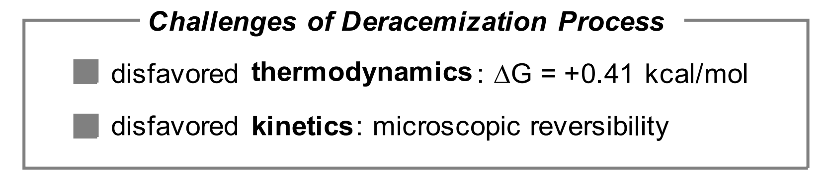

Photocatalytic Deracemization
Int 1
Int 2
Int 3
Int 4
R
R
R
R
R
R
R
S
R
S
R
S
entropy
Single Enantiomer
Racemic Substrate

Slide 3
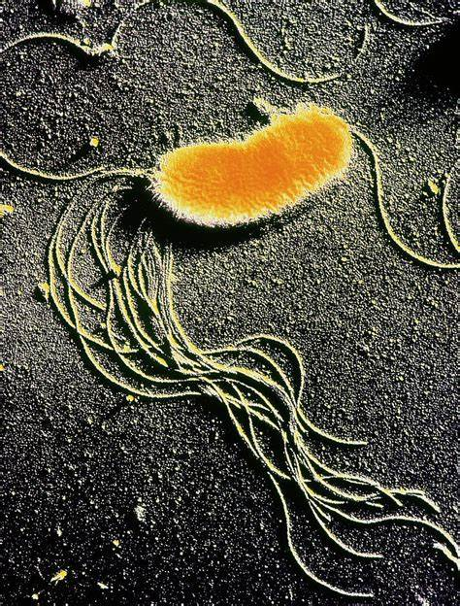
First Report
Pseudomonas fluorescens
References
Chibata, I.; Tosa, T.; Sano, R. Appl. Microbio. 1965, 13, 618−624.
3

Slide 4


Timeline
Living cell
Chemo-catalysis
Photocatalysis
1965
2005
2018
2026
4

Slide 5

1
Linear Deracemization
R
R
Int
Int
R
R
cat 1
cat 2
S
S
Int
Int
R
R
cat 1
cat 2
With or without catalyst
With chiral catalyst
5

Slide 6
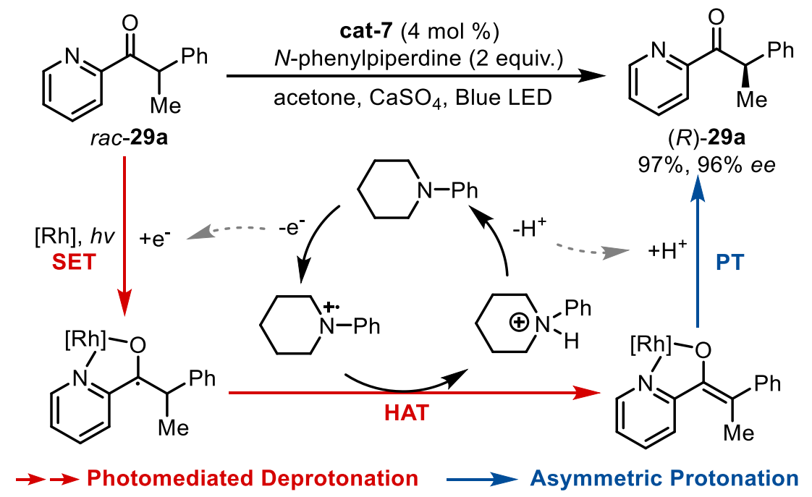

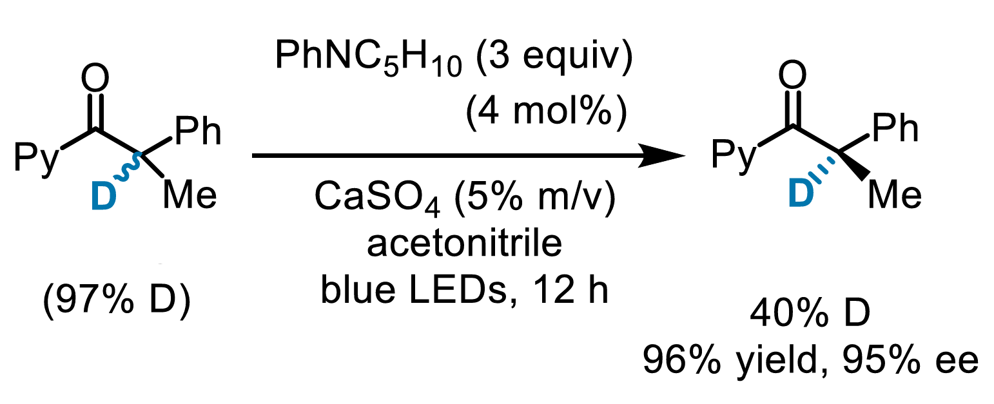
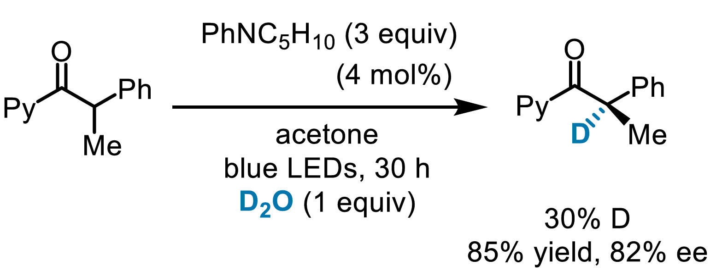
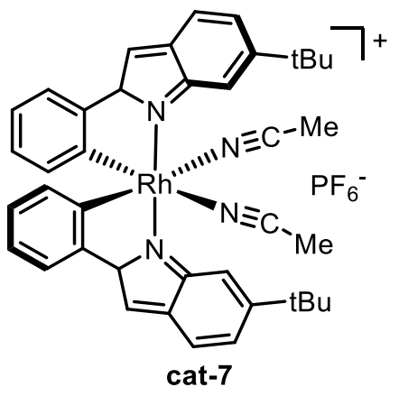
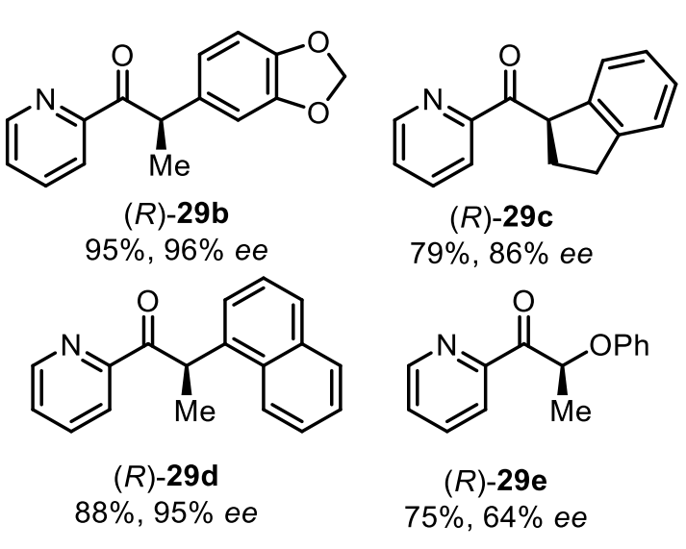
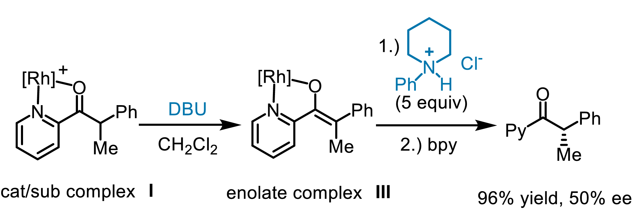
a) Retaining deuteration at chiral center
Pyridylketone
chirality induced
b) Introduction of deuterium at chiral center
Ketyl radical
Ref: Zhang, C.; Gao, A. Z.; Meggers, E. J. Am. Chem. Soc. 2021, 143, 13393−13400.
*Trace water can interfere
c) Deprotonation/asymmetric protonation sequence
*The enolate can indeed undergo stereocontrolled protonation
Chiral Bifunctional Photocatalyst
6

Slide 7
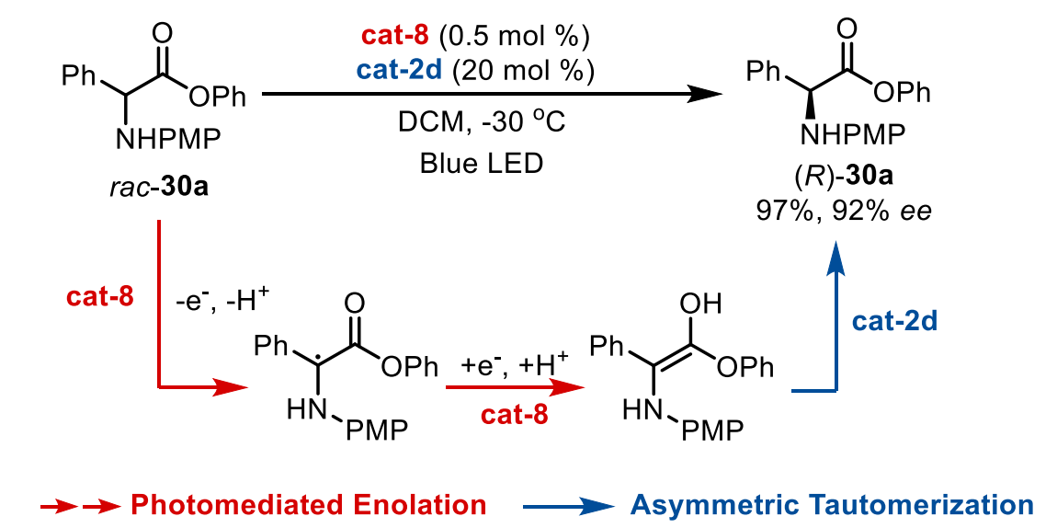
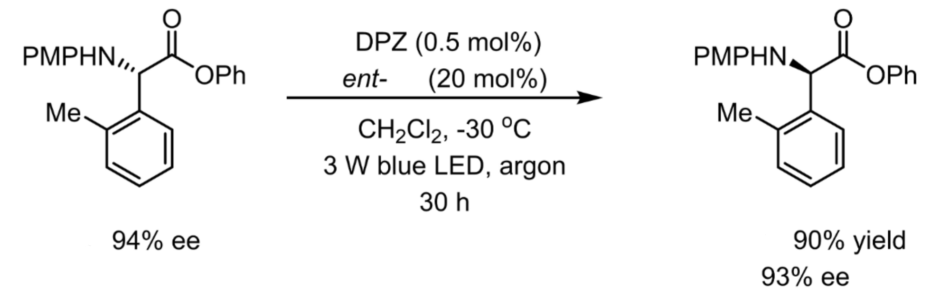

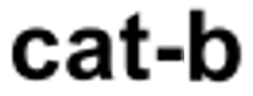
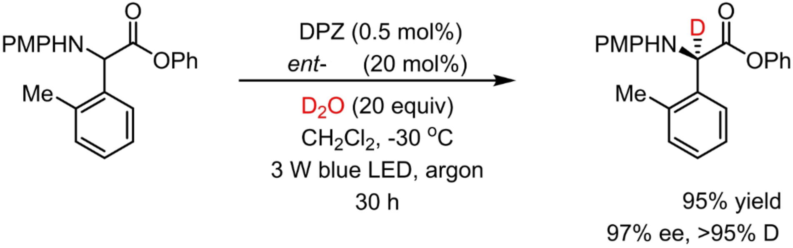
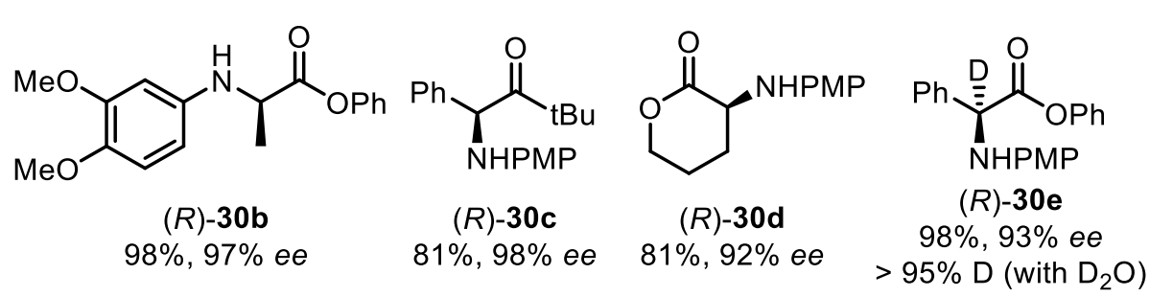
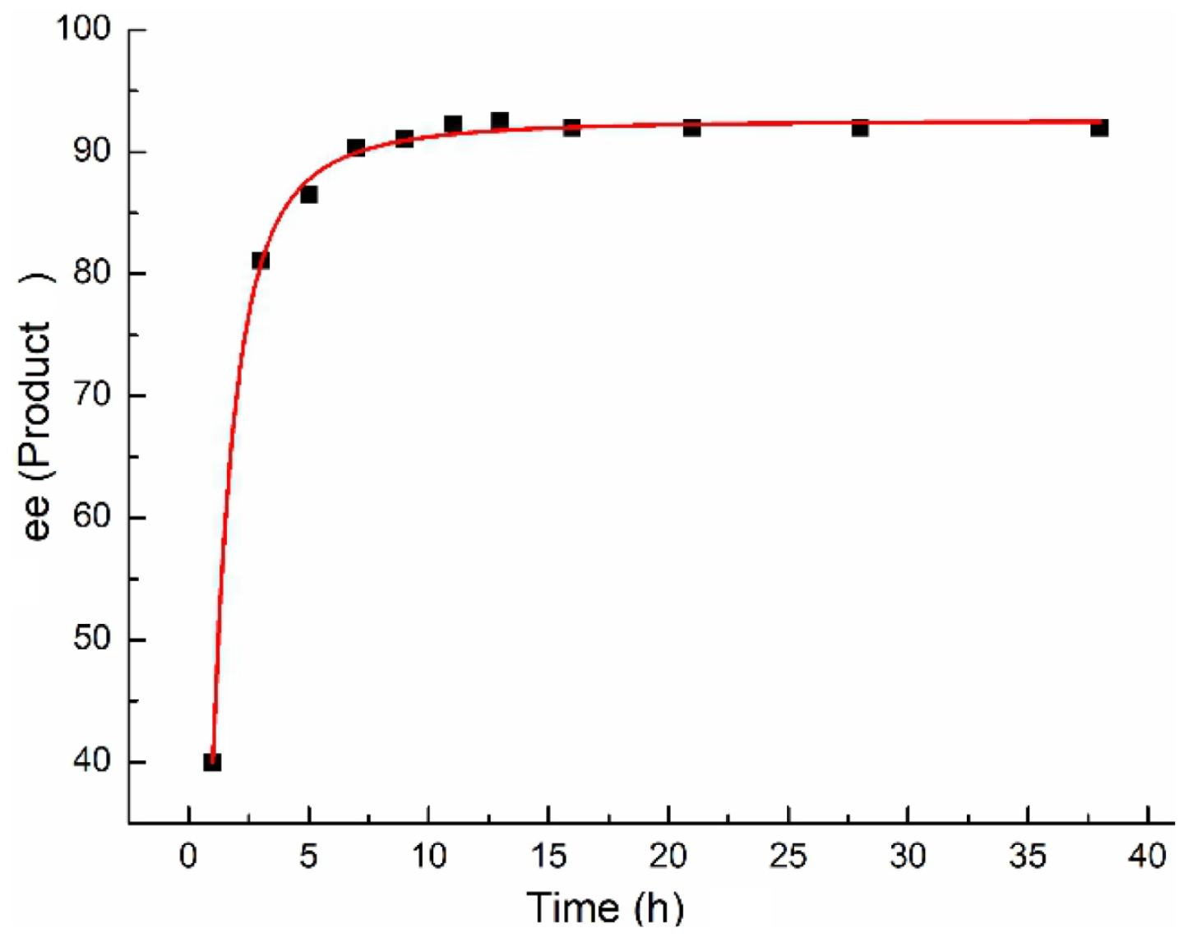
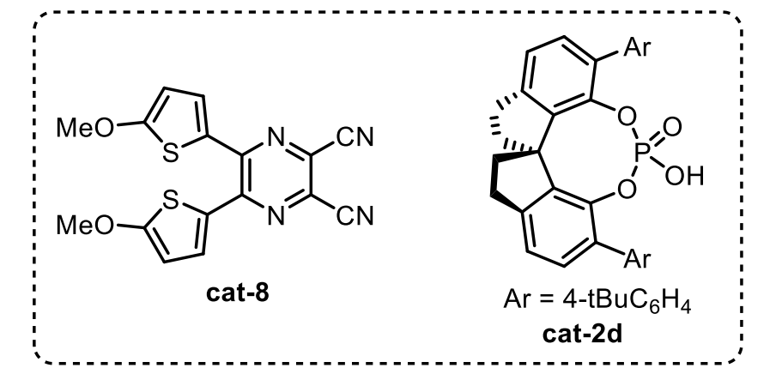
*Convert an S‑configured amino ester into the R‑enantiomer
amino ester
Ref: Gu, Z.; Zhang, L.; Li, H.; Ban, X.; Jiang, Z. Angew. Chem., Int. Ed. 2022, 61, e202211241.
Time-course studies for deracemization
*ee reached 81% within just 3 hours
*the best result was achieved after 13 hours
7

Slide 8
Ref: Wen, Lu.; Ding, J.; Duan, L.; Wang, H.; Zuo, Z. Science 2023, 382, 458-464.
Support the intermediacy of aldehydes and carbon‑centered radicals generated by β‑scission as the shared intermediate
Direct evidence for the LMCT process
8

Slide 9
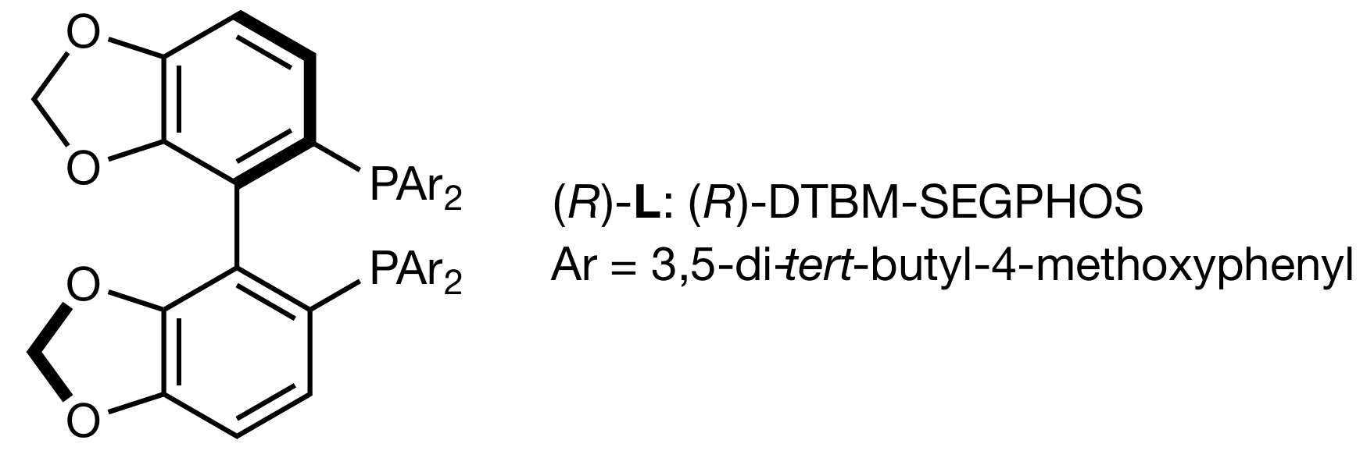
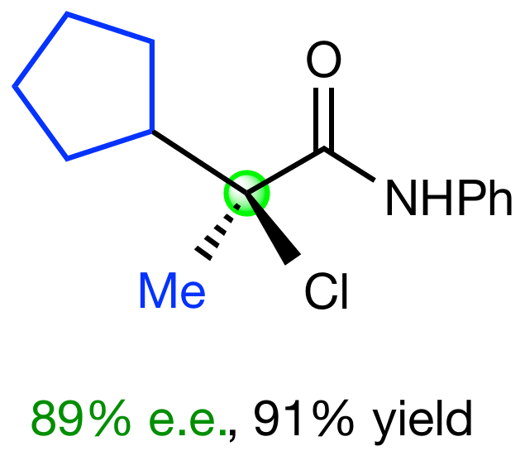

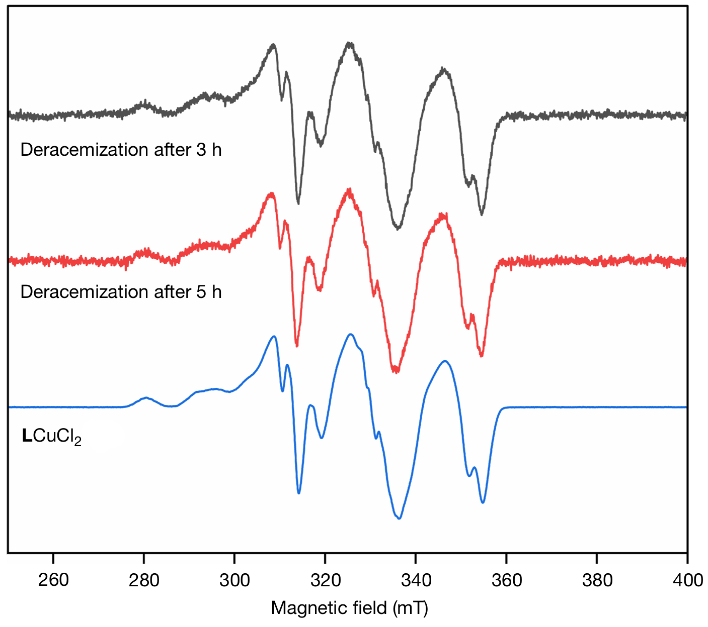
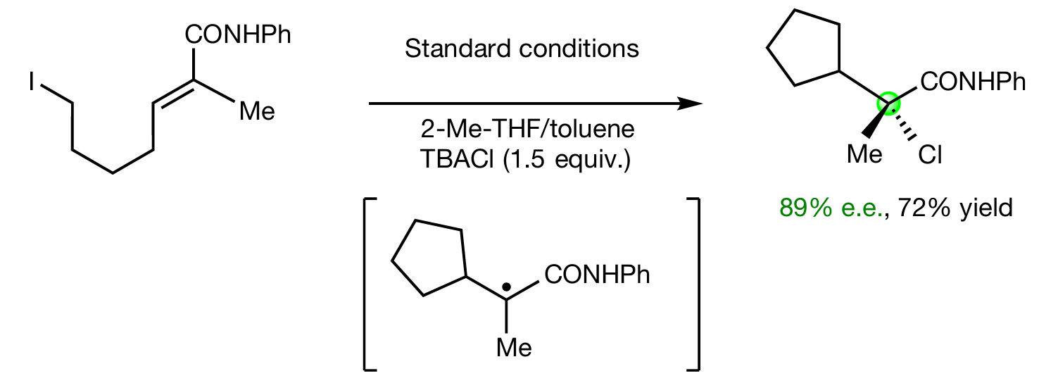
α‑haloamide
*** EPR spectroscopy: support for the presence of
LCuCl₂ during catalysed deracemization
halogen atom transfer
Ref: Zhong, F.; Fu, G C. Nature 2025 640, 107–113.
The reaction of an alkyl iodide in the presence of TBAC
9

Slide 10
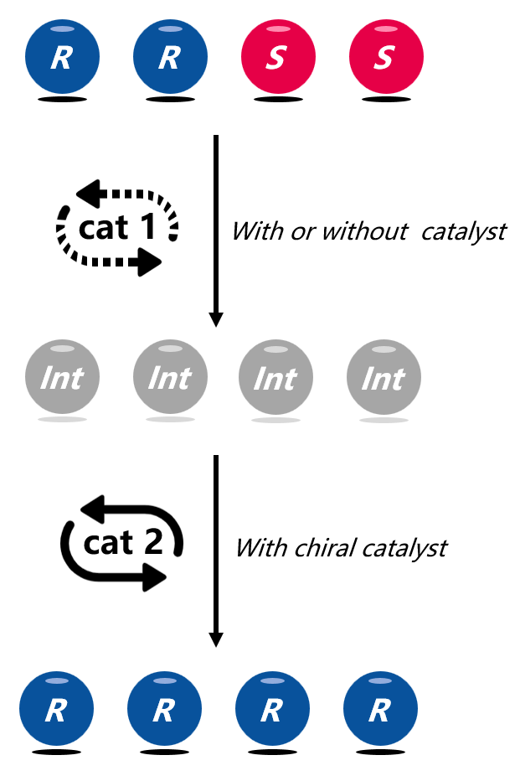
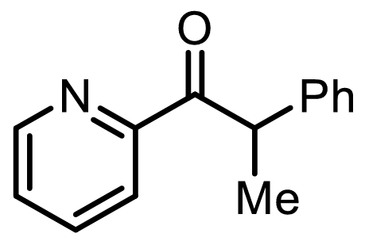
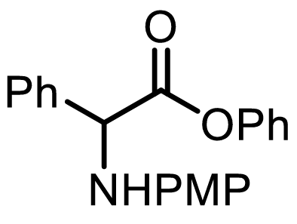
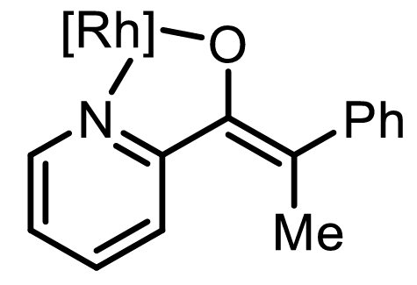
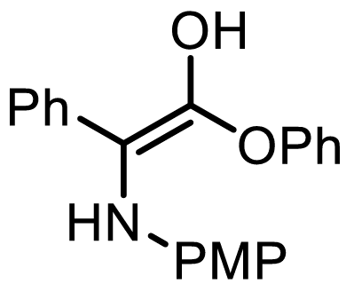
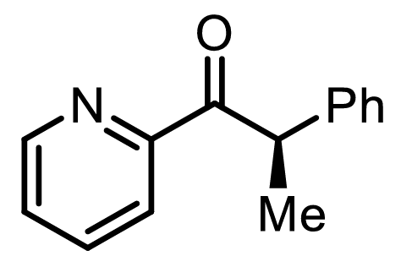
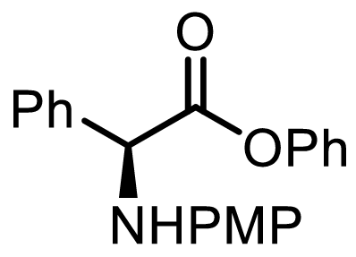
1
Linear Deracemization
10

Slide 11
2
Stereoinversion
R
R
R
R
S
S
cat 1
Int
Int
cat 1
R
R
cat 1
With chiral catalyst
11

Slide 12
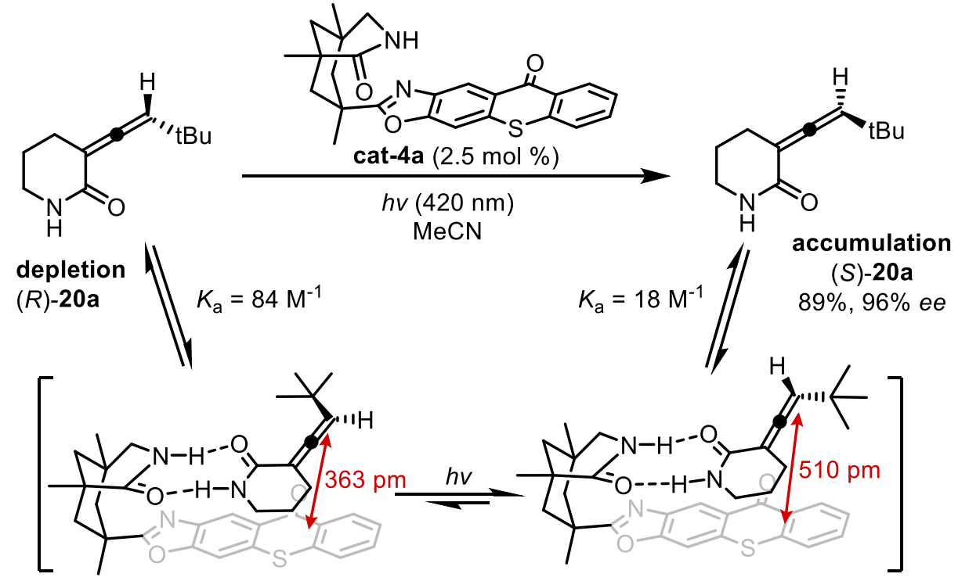
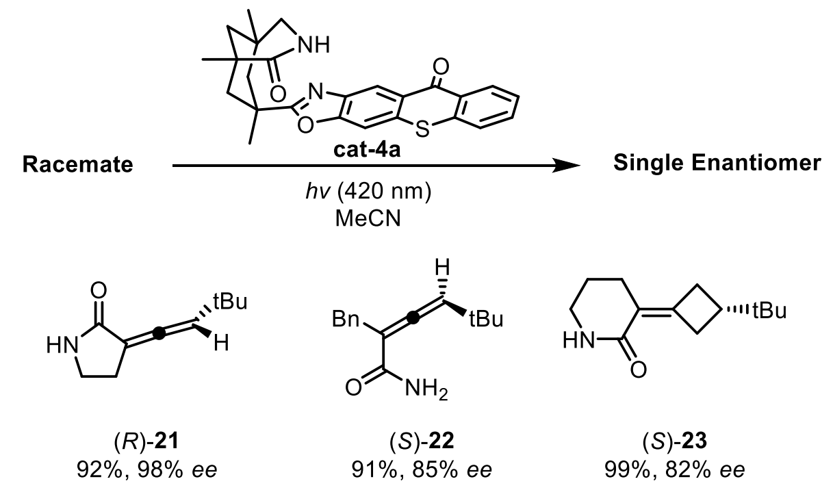

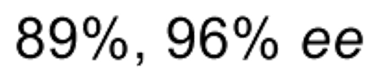
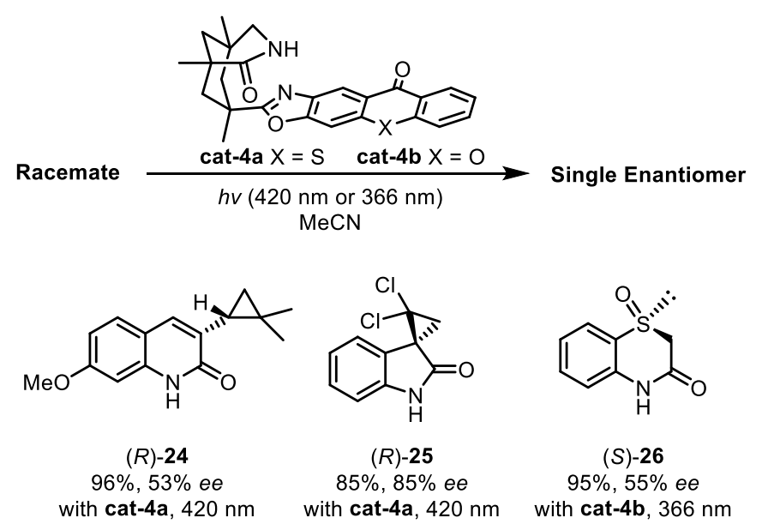
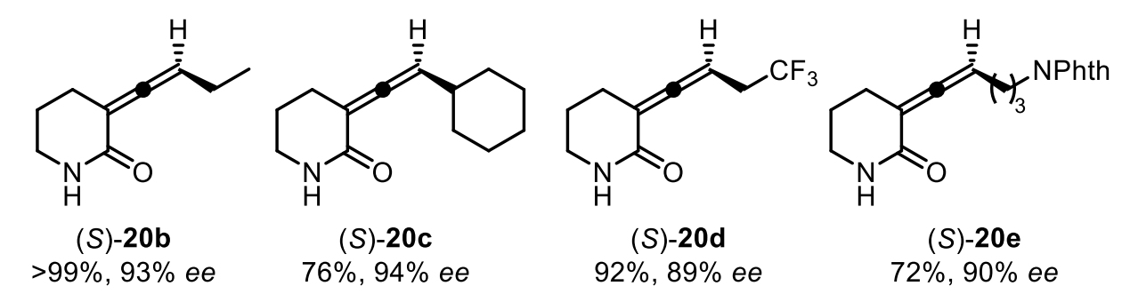
A designed bifunctional chiral photosensitizer
*amide group for chiral recognition
*thioxanthone unit as the light‑sensitive motif
Ref: Holzl-Hobmeier, A.; Bauer, A.; Bannwarth, C.; Bach, T. Nature 2018, 564, 240-243.
Ref: Plaza, M.; Jandl, C.; Bach, T. Angew. Chem., Int. Ed. 2020, 59, 12785-12788.
Plaza, M.; Groskopf, J.; Bach, T. J. Am. Chem. Soc. 2021, 143, 11209-11217.
Kratz, T.; Stratg , C.; Bach, T. J. Am. Chem. Soc. 2022, 144, 10133-10138.
Troster, A.; Bach, T. Angew. Chem., Int. Ed. 2019, 58, 3538-3541.
Wimberger, L.; Kratz, T.; Bach, T. Synthesis 2019, 51, 4417−4424.
Li, X.; R, Distiguish J.; Bach, T. Angew. Chem., Int. Ed. 2020, 59, 21640−21647.
12

Slide 13
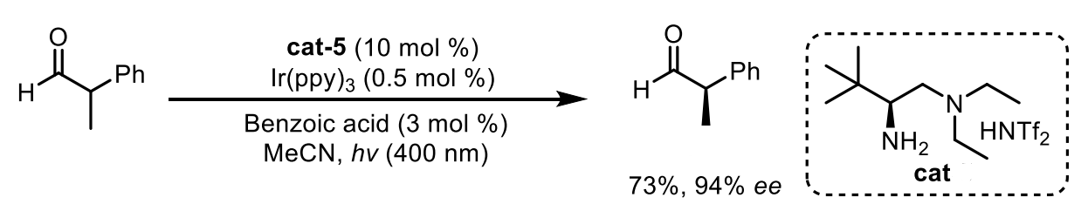

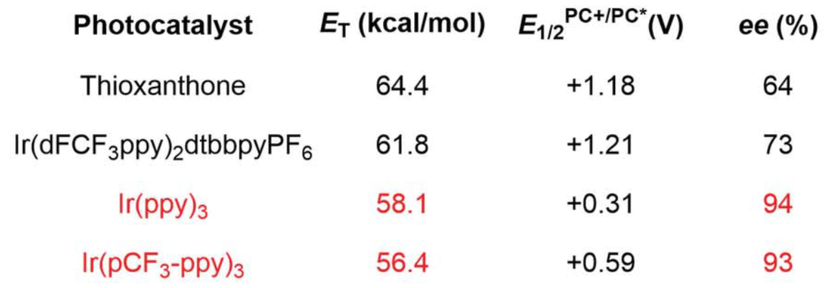
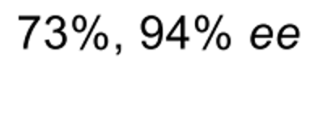
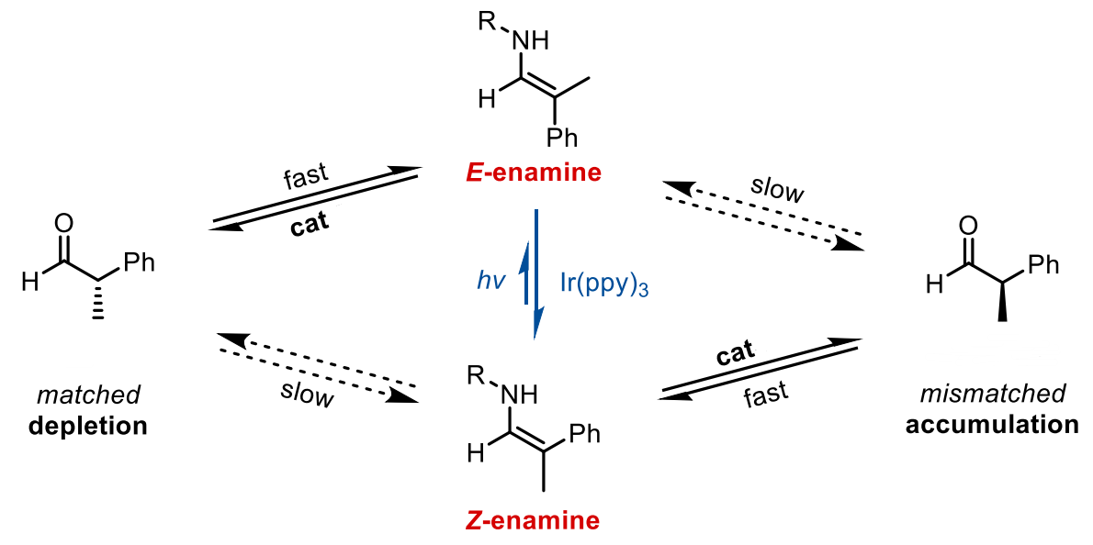
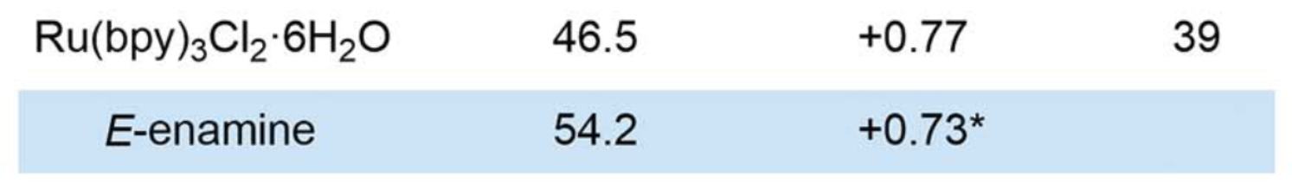
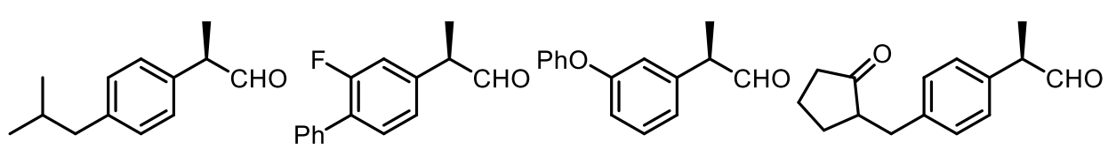

Comparision of various photocatalysts
α‑branched aldehyde
preferentially
key factor
preferentially
*DFT: E‑enamine can be excited to its triplet state much faster than the Z‑enamine
Ref: Huang, M.; Zhang, L.; Pan, T.; Luo, S. Science 2022, 375, 869−874.
Zhu, Y.; Zhang, L.; Luo, S. J. Am. Chem. Soc. 2016, 138, 3978−3981.
13

Slide 14
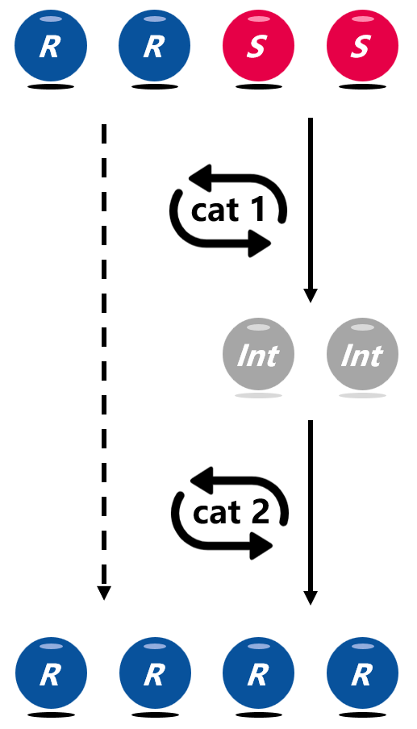
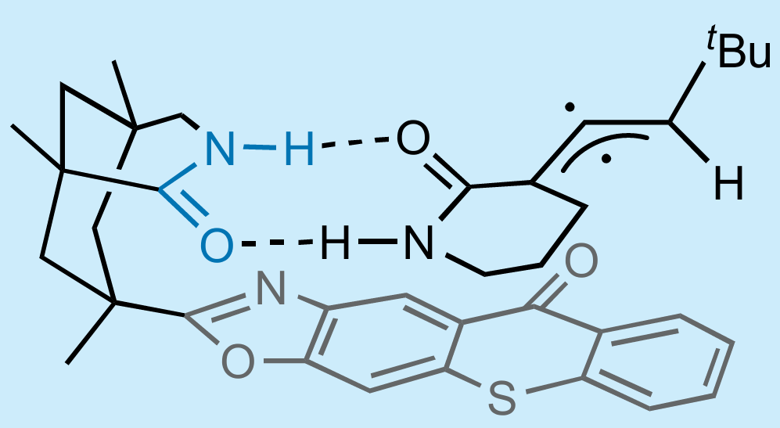
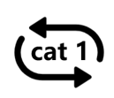
2
Stereoinversion
14

Slide 15
3
Cyclic Deracemization
R
R
R
R
S
S
cat 1
Int
Int
cat 2
S
R
cat 1
cat 2
With or without catalyst
With chiral catalyst
15

Slide 16
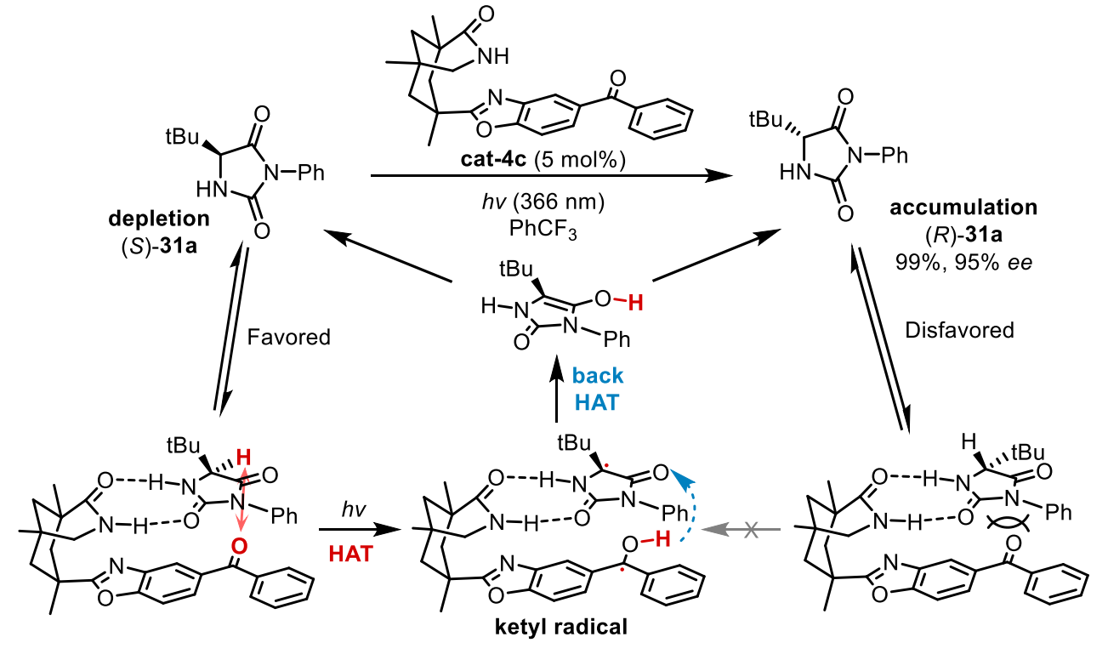
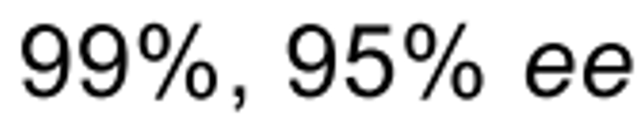
The enrichment model
a) H/D Crossover experiment - racemate
hydantoin derivative
Tautomerization
is unselective
About 25% H/D scrambling was observed
b) H/D Crossover experiment - enantiopure
Ref: Groskopf, J.; Storch, G.; Bach, T. J. Am. Chem. Soc. 2021, 143, 21241−21245.
Kutta, R. J.; Bach, T. J. Am. Chem. Soc. 2023, 145, 2354−2363.
No H/D scrambling occurred
16

Slide 17
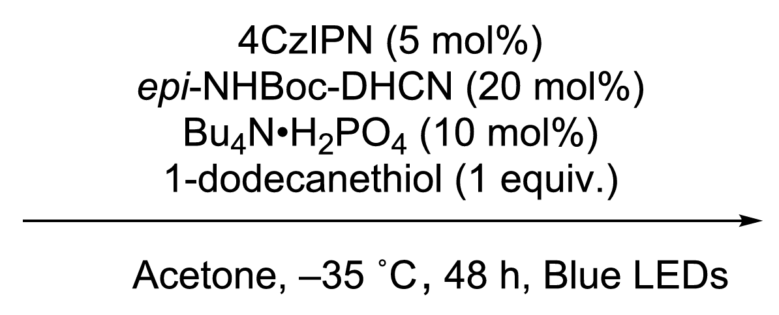
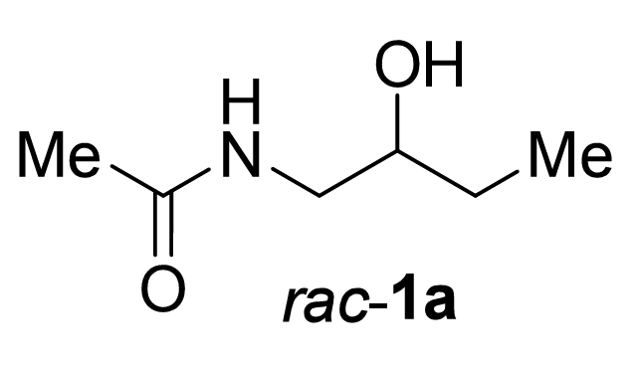
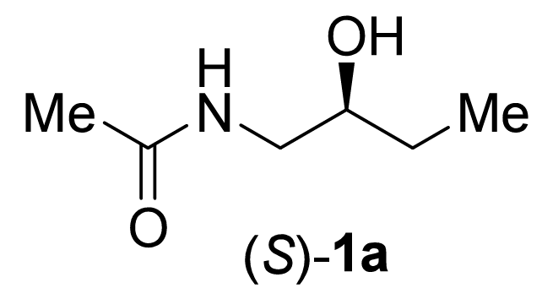
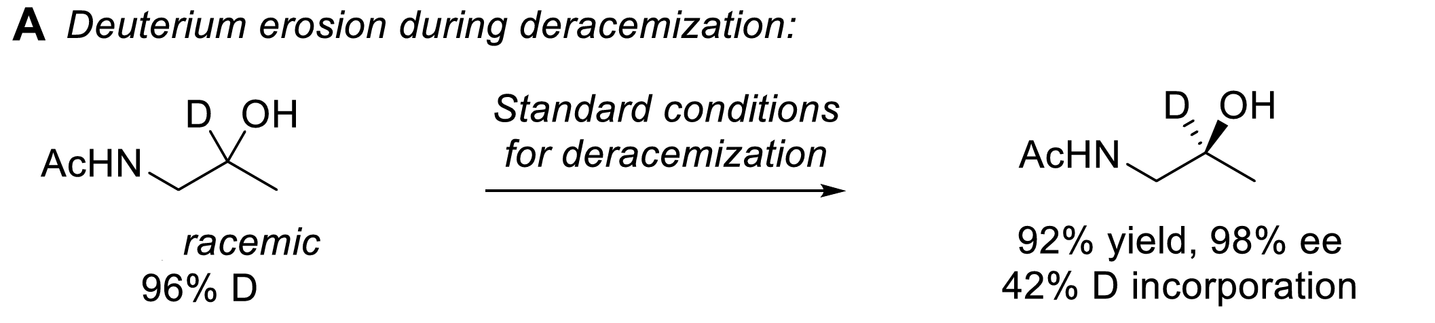
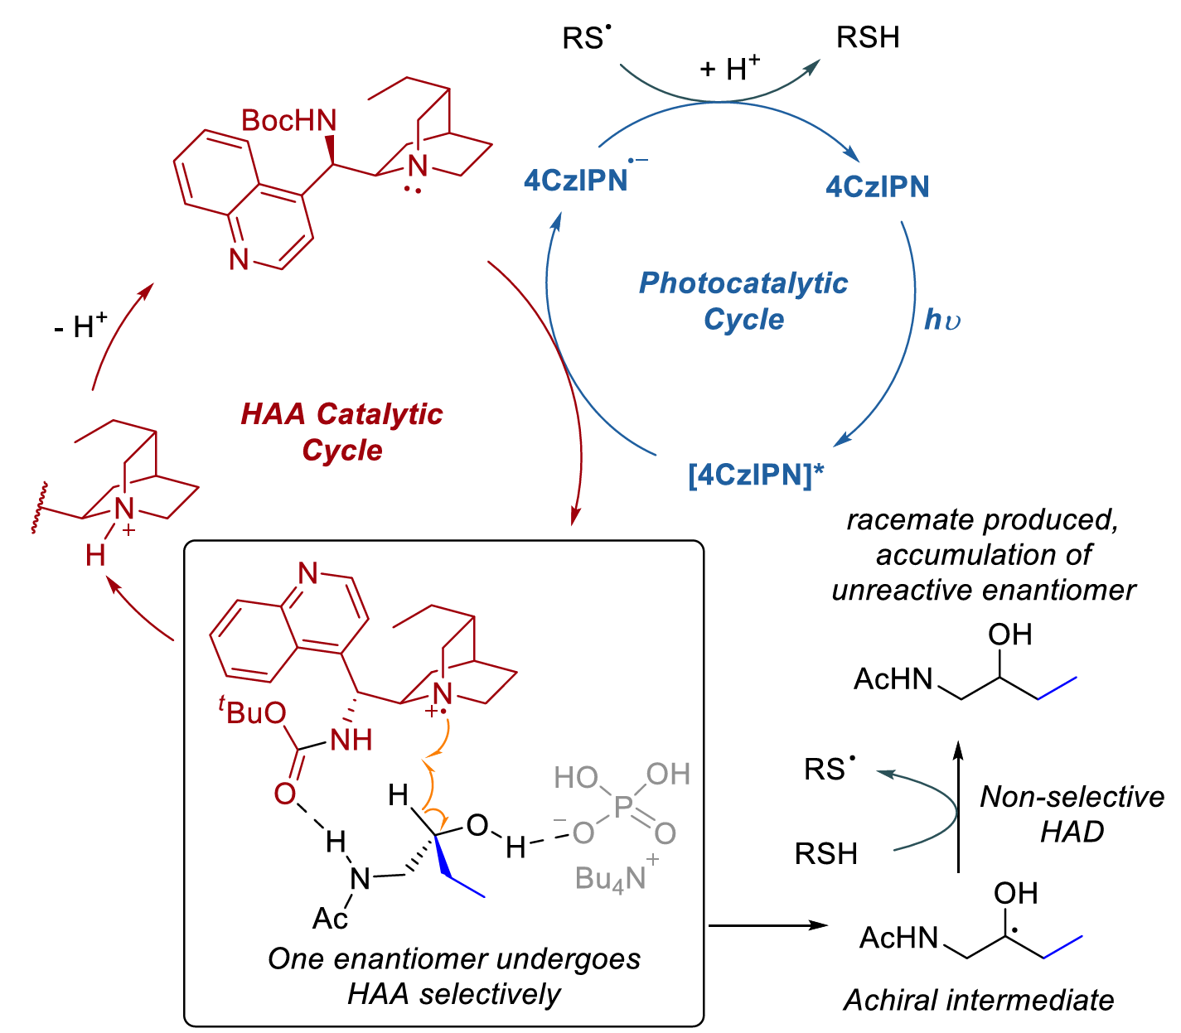
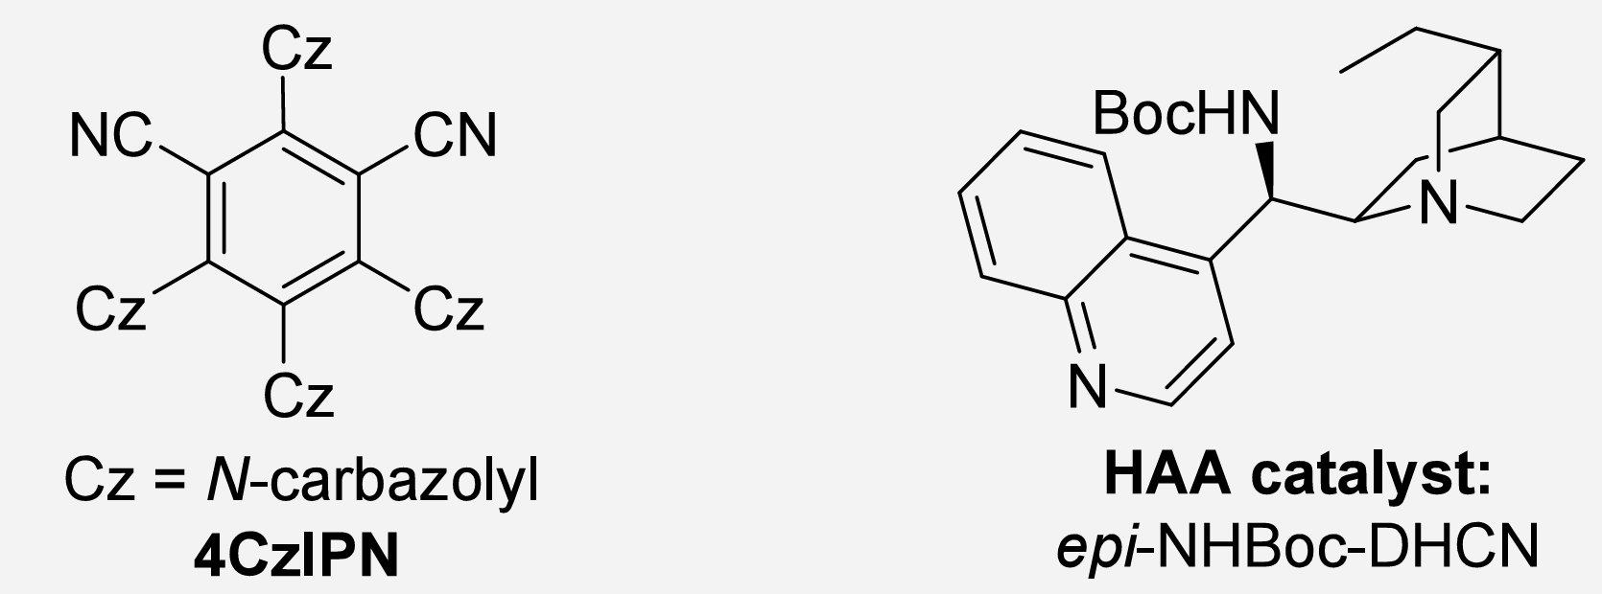
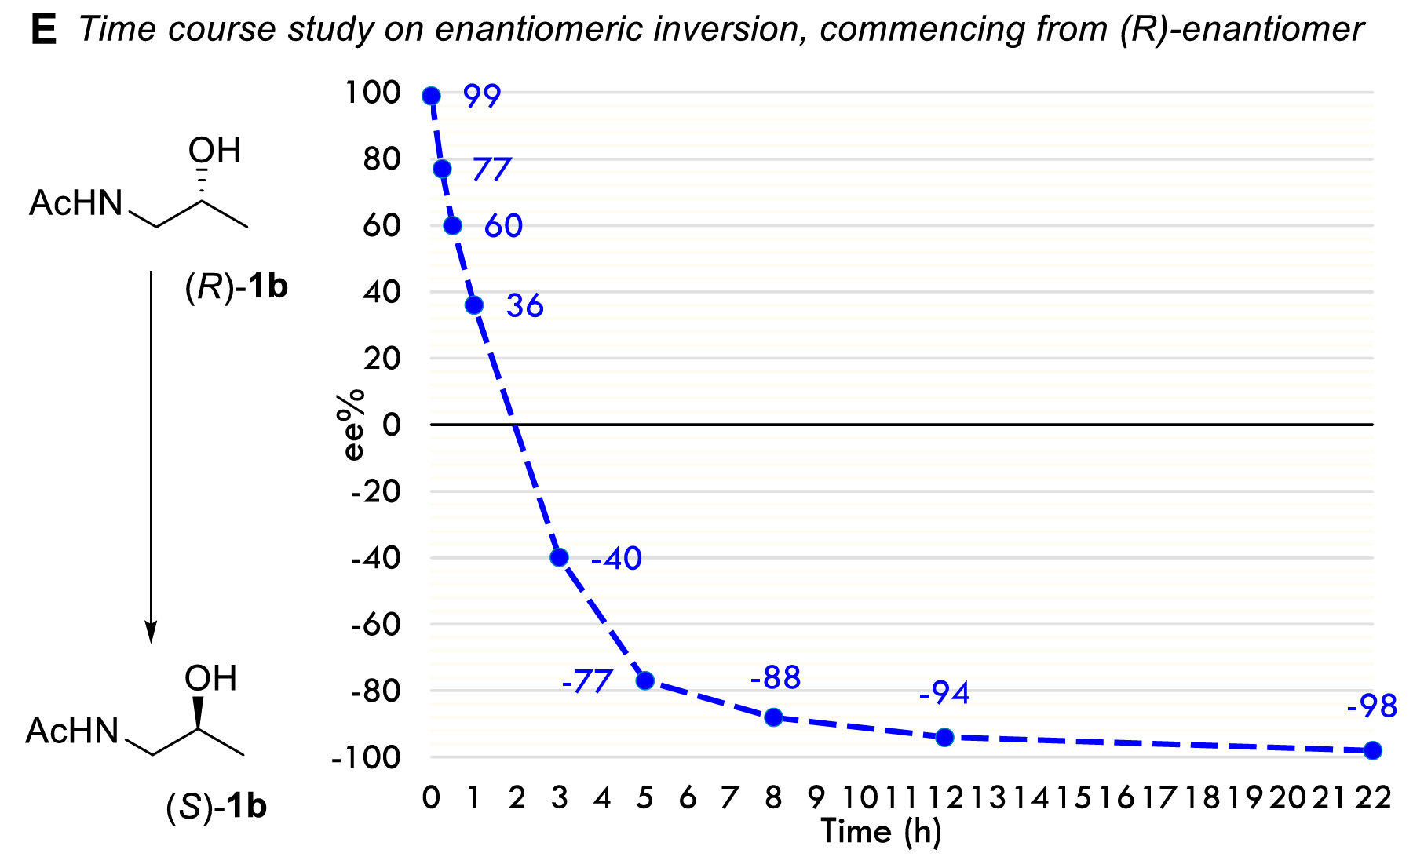

The enrichment model
1,2‑aminoalcohol
42% deuteration remained
**Hydrogen is introduced in the HAD step from the non‑deuterated thiol
** Racemic material is obtained after 2 hours, and after 10 hours
the S enantiomer was isolated in over 90% ee.
Ref: Davies, D.; Phipps, R. J. Am. Chem. Soc. 2026, 148, 141−147.
17

Slide 18
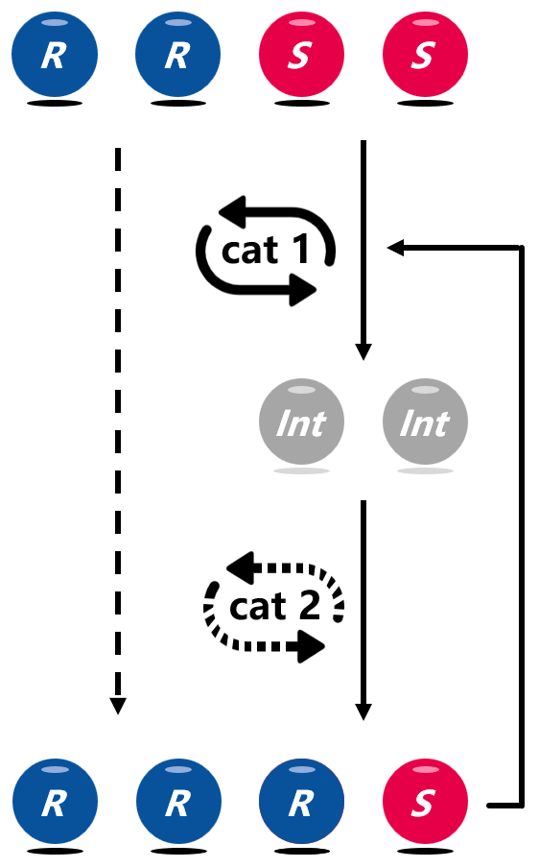


3
Cyclic Deracemization
18

Slide 19
Conclusion
Advantages
100% atom economy: Theoretical yield up to 100%, no waste.
Overcomes thermodynamic barriers: Uses photon energy to compensate entropy loss and bypass microscopic reversibility.
Mild conditions: Typically requires only visible light; avoids stoichiometric oxidants/reductants.
Diverse mechanisms: EnT, SET, HAT, and LMCT all enable stereodifferentiation.
Limitations
Dependence on specific "handles": Early strategies require substrates with amides (double H‑bonding) or electron-rich arenes (oxidizable) for efficient recognition.
Complex catalyst design: Many chiral photosensitizers require lengthy synthesis; some systems need multiple components (photosensitizer + chiral acid + chiral thiol + additives)
Energy/redox matching constraints: EnT requires matched triplet energies; SET needs suitable redox potentials; mismatches lead to inefficiency or racemization.
19

Slide 20
Thank you for your attention!
20

Slide 21
Q&A
21

