Slide 1

Dearomatization-Driven Construction of Bicyclo[3.2.1]octanes (BCOs) in Natural Product Synthesis
Jing Gong
Group Seminar @ LSPN
12.06.2025

Slide 2
Importance of Bicyclo[3.2.1]octanes(BCO)
BCOs are widely found in natural products and drugs.
Conquered by LSPN!

Slide 3
Introduction
First synthesis of bicyclo[3.2.1]-octanes
In 1903, Komppa and Hirn described the first preparation of bicyclo[3.2.1]-octan-7-one by intramolecular cyclization and subsequent decarboxylation of hexahydrohomoisophthalic acid.
The first comprehensive review on this particularly attractive nucleus appeared in Chemical Reviews (1999) by Jean Rodriguez.
Komppa, G.; Hirn, T. Chem. Ber. 1903, 36, 3610.
Rodriguez, J. et al, Chem. Rev. 1999, 99, 27-76.
Zhao, W. Chem. Rev. 2010, 110, 1706-1745
Menéndez, J. C. et al. Chem. Soc. Rev. 2011, 40, 3445-3454
Lippmaa, E. Pehk, T. Organic Magnetic Resonance, 1976, 8, 74-78.
Rodriguez, J. Coquerel, Y. et al, Chem. Rev. 2013, 113, 525−595.
Hong, R. et al. Tetrahedron Letters 2015, 56, 23–31

Slide 4
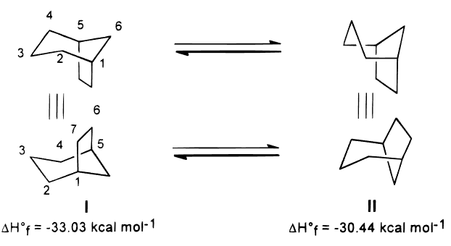
Introduction
General configuration of bicyclo[3.2.1]-octanes
chair-boat interconversion
Calculated heats of formation indicates that chair-like six-membered ring form I is normally the only formation.
Rudi, A. et al. Tetrahedron 1974, 30, 109
Walborsky, H. M. J. Am. Chem.Soc. 1959, 81, 4709

Slide 5
Outline
Three Ways to the Construction of BCOs in Natural Product Synthesis:
Oxidative Dearomatization-Induced [5 + 2] Cascade
Meta-Arene–Alkene Photocycloaddition (Meta Photocycloaddition)

Slide 6
Oxidative Dearomatization-Induced [5 + 2] Cascade
Oxidative Dearomatization-Induced [5 + 2] Cascade
Meta-Arene–Alkene Photocycloaddition (Meta Photocycloaddition)

Slide 7
Oxidative Dearomatization-Induced [5 + 2] Cascade
First report about oxidative dearomatization /[5 + 2] cycloaddition cascade (ODI-[5+2]) by Pettus
First report about oxidative dearomatization /[5 + 2] cycloaddition cascade of phenols.
Intramolecular stepwise [5 + 2] cycloaddition leading to the formation of 3 cycles in one operation.
The cascade was terminated by the incorporation of a separate nucleophile
Pettus, T.R.R. et al, J. Am. Chem. Soc. 2011, 133, 1603–1608

Slide 8
Oxidative Dearomatization-Induced [5 + 2] Cascade
Proposed mechanism for the ODI-[5+2] cascade
First report about oxidative dearomatization /[5 + 2] cycloaddition cascade of phenols.
Intramolecular stepwise [5 + 2] cycloaddition leading to the formation of 3 cycles in one operation.
The cascade was terminated by the incorporation of a separate nucleophile
Pettus, T.R.R. et al, J. Am. Chem. Soc. 2011, 133, 1603–1608

Slide 9
Oxidative Dearomatization-Induced [5 + 2] Cascade
Pettus’s ODI-[5+2] cascade process: scopes
Trisubstituted alkenes can afford higher yields.
Benzyl substituents play a crucial role.
Pettus, T.R.R. et al, J. Am. Chem. Soc. 2011, 133, 1603–1608

Slide 10
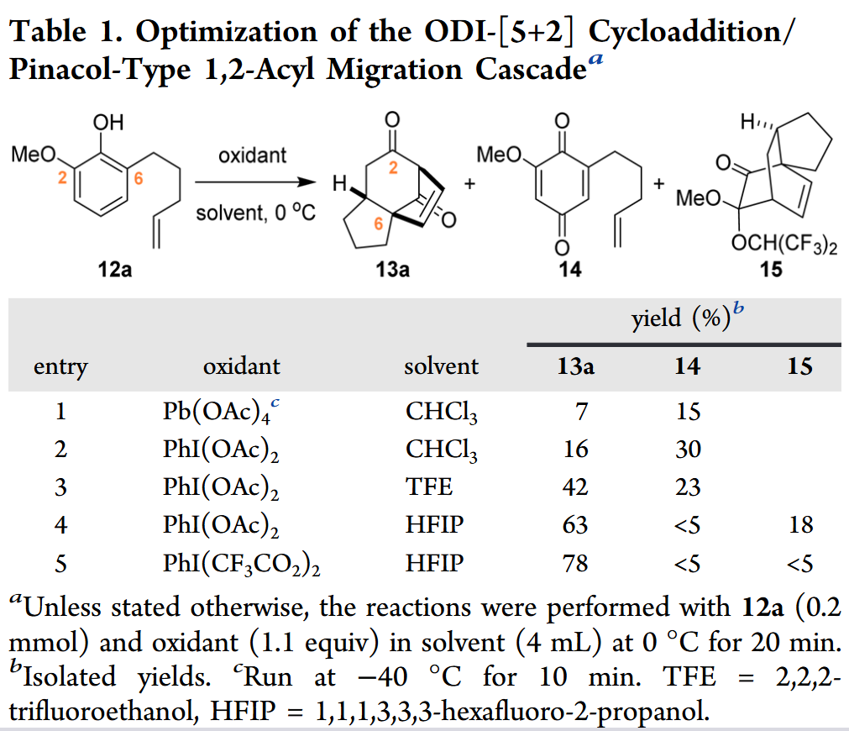
Oxidative Dearomatization-Induced [5 + 2] Cascade
Ding’s discovery: ODI-[5+2]/1.2-acyl migration cascade process
Conditions screening
Ding H. et al. J. Am. Chem. Soc. 2017, 139, 6098−6101
Pettus’s work: 1.1’-disubstituted oleﬁn derivative offered a poor yield

Slide 11
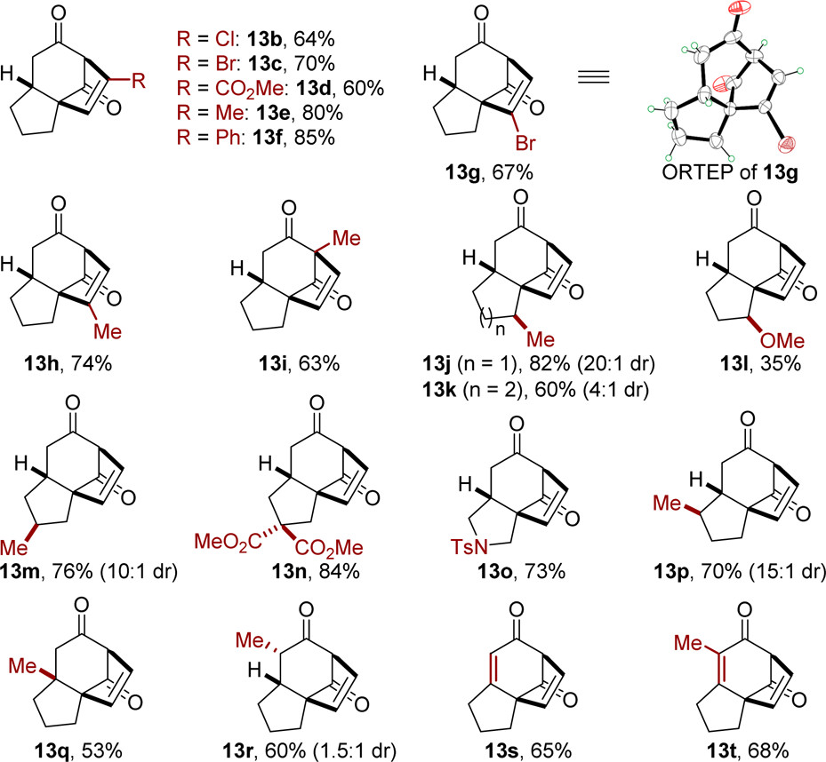
Oxidative Dearomatization-Induced [5 + 2] Cascade
ODI-[5+2]/1.2-acyl migration cascade process: scopes
3
3
5
4
4
5
Alkynes and monosubstituted alkenes work well in this ODI-[5+2] process
Ding H. et al. J. Am. Chem. Soc. 2017, 139, 6098−6101

Slide 12
Oxidative Dearomatization-Induced [5 + 2] Cascade
Ding H. et al. J. Am. Chem. Soc. 2017, 139, 6098−6101
Ding H. et al. Acc. Chem. Res. 2021, 54, 875−889
Ding H. et al. Angew. Chem. Int. Ed. 2021, 60, 14892-14896
Ding H. et al. J. Am. Chem. Soc. 2022, 144, 2495−2500
Ding H. et al. J. Am. Chem. Soc. 2023, 145, 8540−8549
Ding H. et al. J. Am. Chem. Soc. 2023, 145, 11927-11932

Slide 13
Oxidative Dearomatization-Induced [5 + 2] Cascade
ODI-[5+2]/1.2-acyl migration cascade process: Chemoselectivity of [5+2] and its application in total synthesis
Ding H. et al. J. Am. Chem. Soc. 2017, 139, 6098−6101

Slide 14
Oxidative Dearomatization-Induced [5 + 2] Cascade
Ding’s total synthesis of (–)-crinipellins
8 natural products were successfully synthesized asymmetrically in this work.
Ding H. et al. J. Am. Chem. Soc. 2022, 144, 2495−2500

Slide 15
Oxidative Dearomatization-Induced [5 + 2] Cascade
Ding’s total synthesis of (–)-crinipellins
Ding H. et al. J. Am. Chem. Soc. 2022, 144, 2495−2500

Slide 16
Construction of Bicyclo[3.2.1]octanes(BCO)
Oxidative Dearomatization-Induced [5 + 2] Cascade
Meta-Arene–Alkene Photocycloaddition (Meta Photocycloaddition)

Slide 17
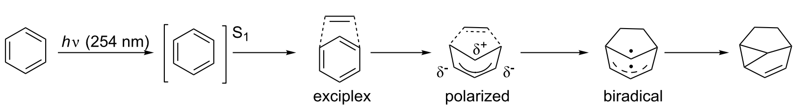
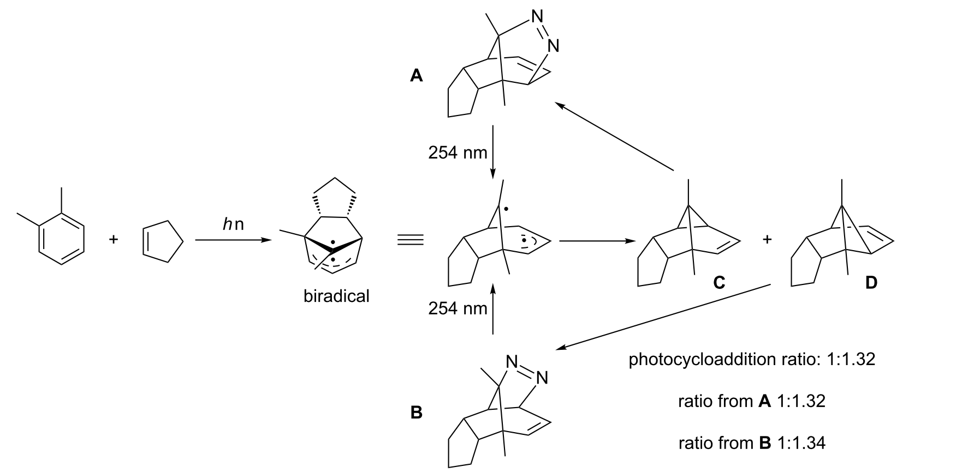
Meta-Arene–Alkene Photocycloaddition (Meta Photocycloaddition)
Reaction pathway
Evidence of biradiacal involved in meta photocycloaddition by Sheridan
Sheridan, R. S. J. Am. Chem. Soc. 1983, 105, 5140
Sheridan, R. S. et al, J. Am. Chem. Soc. 1985, 107,3360–3361

Slide 18
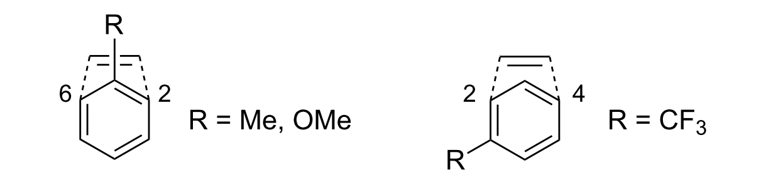
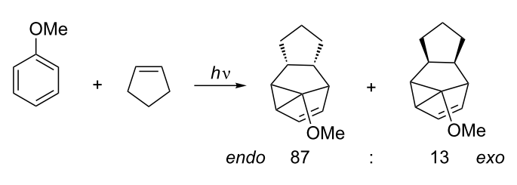
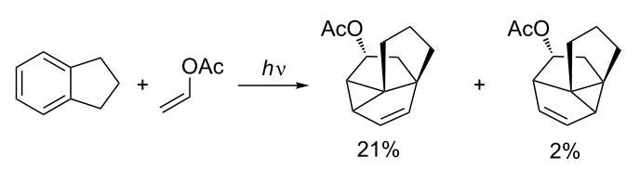
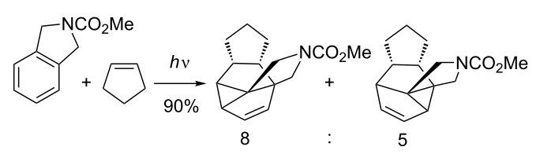
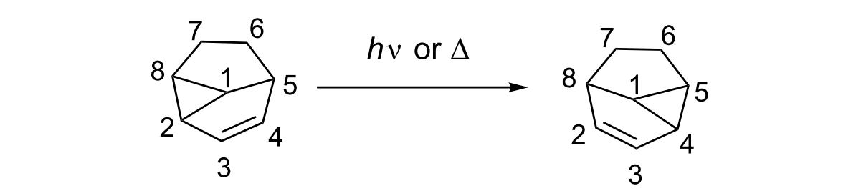
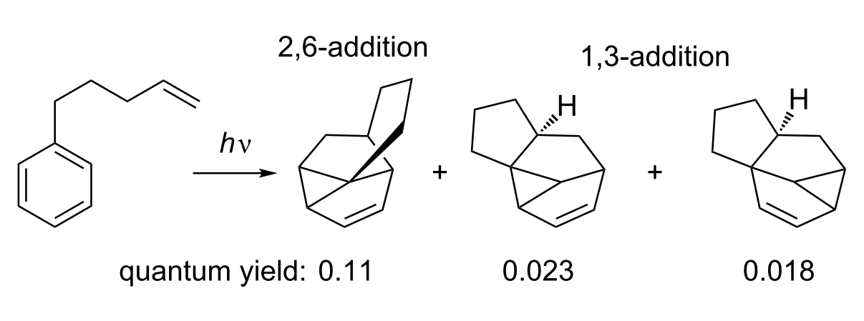
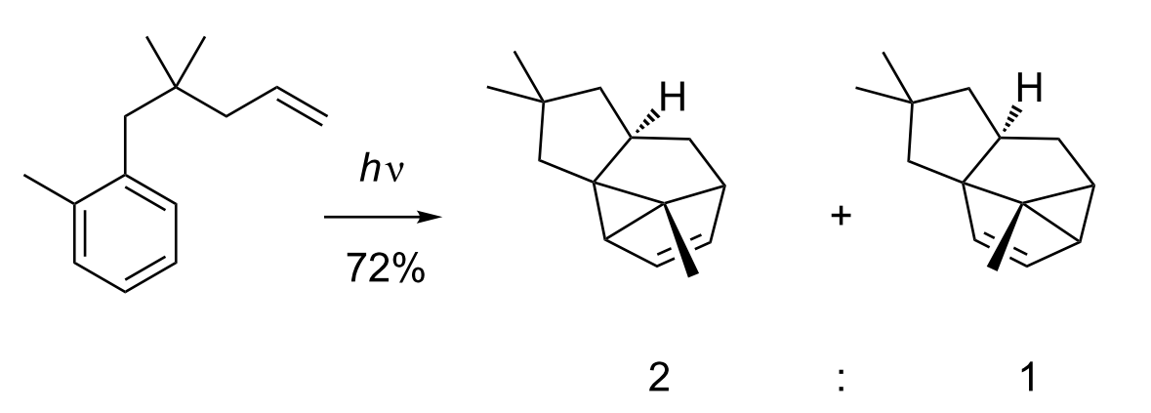
Meta-Arene–Alkene Photocycloaddition (Meta Photocycloaddition)
Chemoelectivity of Meta Photocycloaddition
Regioselectivity with electron withdrawing/donating substituents
Intermolecular photocycloaddition selectivity: endo versus exo
Regioselectivity of cyclopentene: depend on the energy of molecules
Vinylcyclopropane–cyclopentene rearrangement
Bochet, C.G. et al, Beilstein J. Org. Chem. 2011, 7, 525–542

Slide 19
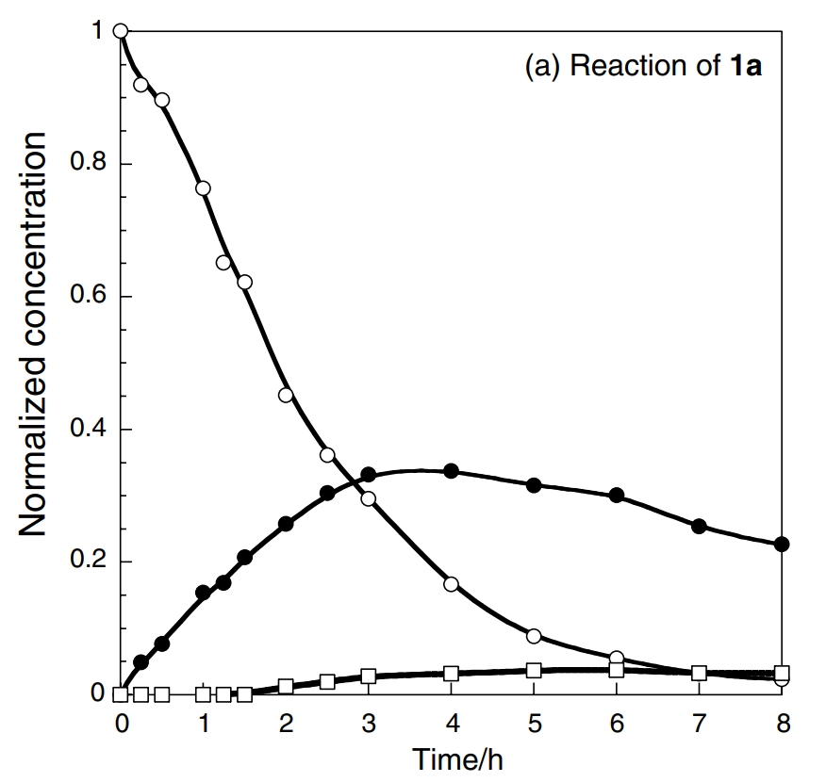
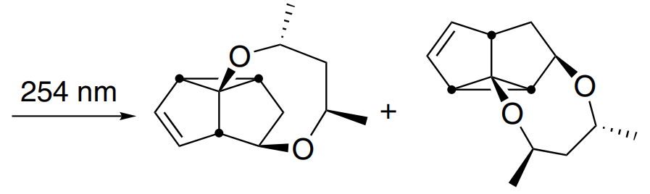
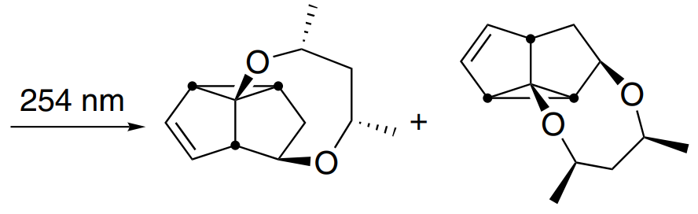
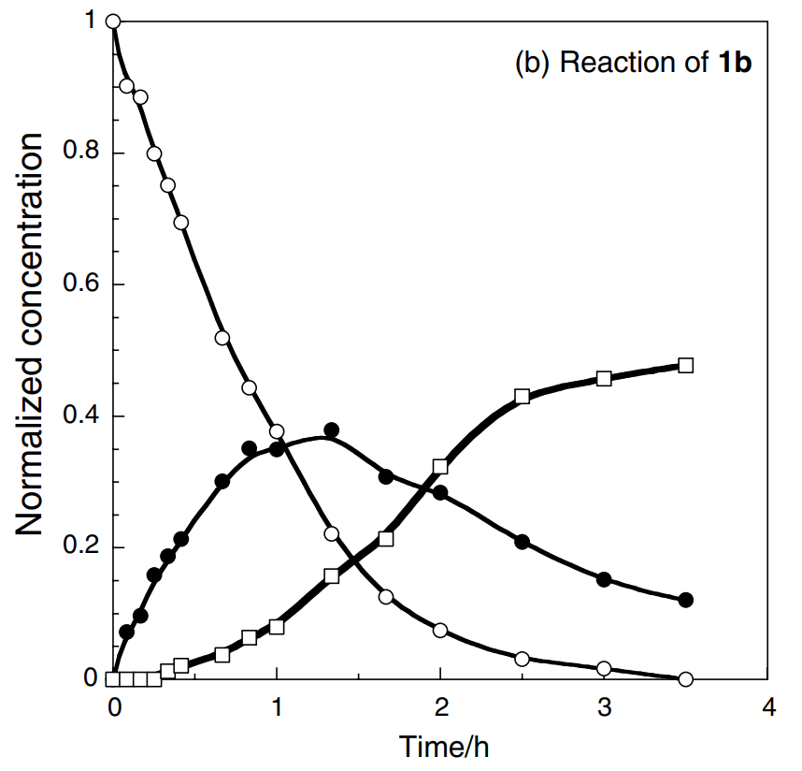
Meta-Arene–Alkene Photocycloaddition (Meta Photocycloaddition)
The isomerization rate of 3 to 4 is much different between the two substrates
R
R
1a
3a
3a 40%
4a 15%
4a
S
R
1b
4b
3b 2%
4b 70%
3b
3 is detected in the reactions of both 1a and 1b
4 is not the initial product from 1
Sugimura, T. et al. Tetrahedron: Asymmetry 2005, 16, 675–683
Sugimura, T. et al. Tetrahedron: Asymmetry 2004, 15, 1409–1417

Slide 20
Meta-Arene–Alkene Photocycloaddition (Meta Photocycloaddition)
Reisman’s total Synthesis of (–)-Talatisamine, (–)-Liljestrandisine and (-)-liljestrandinine
Reisman S. E. et al. ACS Cent. Sci. 2021, 7, 1311–1316,

Slide 21
Meta-Arene–Alkene Photocycloaddition (Meta Photocycloaddition)
Reisman’s total Synthesis of (–)-Talatisamine, (–)-Liljestrandisine and (-)-liljestrandinine
Reisman S. E. et al. ACS Cent. Sci. 2021, 7, 1311–1316,

Slide 22
Summary
1. Oxidative Dearomatization-Induced [5 + 2] Cascade
2. Meta-Arene–Alkene Photocycloaddition (Meta Photocycloaddition)

Slide 23
Thanks for your attention.

