Slide 1

Cooperative Catalysis
LSPN Group Seminar
Speaker: D Sathish
Supervisor: Prof. Jieping Zhu
Date: 08/02/2024
Venue/Time: BCH3118 at 17:30

Slide 2
LSPN
Outlook
Introduction
Different combinations of cooperative catalysis in organic transformations
Metal/Metal Cooperative Catalysis
Metal/Organo- Cooperative Catalysis
Metal/Photoredox Cooperative Catalysis
Organo-/Organo- Cooperative Catalysis
Conclusion

Slide 3
LSPN
Introduction
What is Cooperative Catalysis?
A single chemical transformation is achieved by activating both the nucleophile and the electrophile concurrently with two different catalysts or one catalyst with different sites.
Two Categories
Two catalysts and two catalytic cycles work in concert for a single transformation
One catalyst and one catalytic cycle but substrate activation across two sites of catalyst.
Traditional catalyst- One catalyst, one catalyst site, one catalytic cycle.
Synonyms
Synergistic catalysis (MacMillan)
Cooperative dual catalysis (Jacobsen)
Contemporaneous dual catalysis (Trost)
David W. C. MacMillan, Chem. Sci., 2012, 3, 633–658; Eric N. Jacobsen, J. Am. Chem. Soc., 2004,126, 9928-9929;
Barry M. Trost, J. Am. Chem. Soc. 2011, 133, 1706–1709.

Slide 4
LSPN
Introduction
1. Two catalysts and two catalytic cycles working in concert for a single transformation
2. One catalyst and one catalytic cycle but substrate activation across two sites
Traditional catalyst
Notes:
Note- One catalyst and one catalytic cycle but substrate activation across two sites-ex- asymmetric hydrogenation of polar compound (Nayori)

Slide 5
LSPN
Introduction
Why multicatalytic system?
Monocatalytic strategy
Some transformations are still challenging or nigh impossible.
Utilizes substoichiometric amounts of the catalyst to activate one of the reactants.
The second reactant often requires further activation.
Requires prior functional group manipulation.
Multicatalytic strategy
Maximize the chemical usefulness and efficiency of catalyst-driven reactions.
Minimizing waste -economic and environmental impact.
Challenges
Difficulty in ensuring redox compatibility between the transition metal catalysts.
Balanced kinetics between the two catalytic cycles.
Avoiding catalyst deactivation.
Notes:
Note- One catalyst and one catalytic cycle but substrate activation across two sites-ex- asymmetric hydrogenation of polar compound (Nayori)

Slide 6
LSPN
Introduction
Background
Other multi-catalyst reactions
Bifunctional catalysis
Cascade Catalysis
Double Activation Catalysis

Slide 7
LSPN
Introduction
Different combinations of cooperative catalysis in organic transformations
Metal/Metal Cooperative Catalysis
Metal/Organo- Cooperative Catalysis
Metal/Photoredox Cooperative Catalysis
Organo-/Organo- Cooperative Catalysis
Conclusion

Slide 8
LSPN
Metal/Metal Cooperative Catalysis
palladium- and vanadium-catalyzed a-allyl enone formation
Barry M. Trost, J. Am. Chem. Soc. 2011, 133, 1706–1709.
Notes:
DBPO = di-tertbutyl peroxyoxalate

Slide 9
LSPN
Metal/Metal Cooperative Catalysis
Synthesis of Substituted Butenolides and Isocoumarins Using Carbophilic Lewis Acid and Lewis Base.
Suzanne A. Blum, J. Am. Chem. Soc. 2009, 131, 18022–18023.

Slide 10
LSPN
Metal/Metal Cooperative Catalysis
Arylboration of Alkenes by Cooperative Palladium/Copper Catalysis
Kazuhiko Semba, J. Am. Chem. Soc. 2014, 136, 7567−7570.

Slide 11
LSPN
Metal/Metal Cooperative Catalysis
Direct difluoromethylation of aryl bromides and iodides
Qilong Shen, Nat Commun, 2014, 5, 5405-5411.
Notes:
Isolated-NHC_Ag-CH2F _Stable complex)- homolytic cleavage of Ag-CH2F- even at -50 oC.

Slide 12
LSPN
Metal/Metal Cooperative Catalysis
Cooperative Palladium/Copper Catalysis.
Kazuhiko Semba, Angew. Chem. Int. Ed. 2016, 128, 6383– 6387.

Slide 13
LSPN
Metal/Metal Cooperative Catalysis
Cooperative Bimetallic Catalysis via One-Metal/Two-Ligands
Xiaoming Wang, Angew. Chem. 2023, 135, e2023079.
Notes:
Polyfluoroarylation-Allylation –f diazocompound.

Slide 14
LSPN
Metal/Metal Cooperative Catalysis
Cooperative bimetallic catalysis via one-metal/two-Ligands
Xiaoming Wang, Angew. Chem. 2023, 135, e2023079.

Slide 15
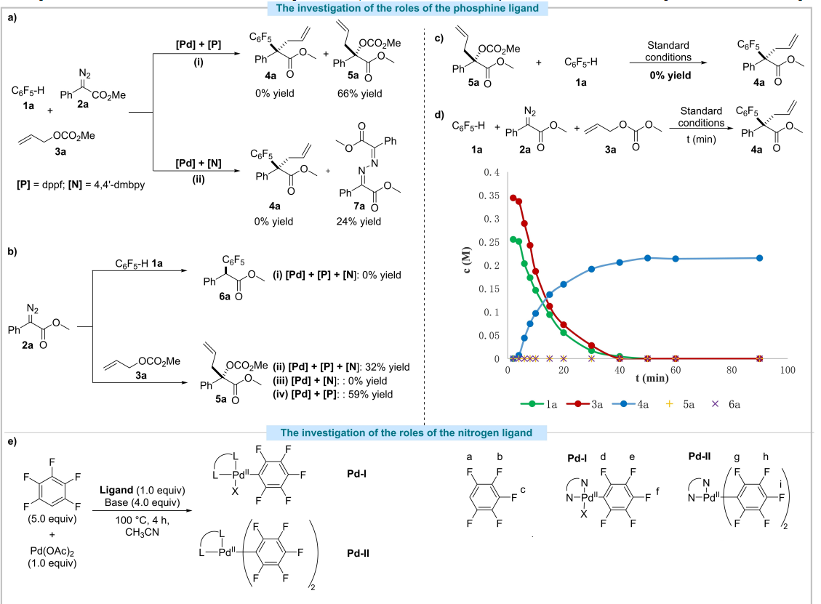
LSPN
Metal/Metal Cooperative Catalysis
Cooperative bimetallic catalysis via one-metal/two-Ligands
Xiaoming Wang, Angew. Chem. 2023, 135, e2023079.

Slide 16
LSPN
Introduction
Different combinations of cooperative catalysis in organic transformations
Metal/Metal Cooperative Catalysis
Metal/Organo- Cooperative Catalysis
Metal/Photoredox Cooperative Catalysis
Organo-/Organo- Cooperative Catalysis
Conclusion

Slide 17
LSPN
Metal/Organio- Cooperative Catalysis
Asymmetric α-allylation of α-branched aldehydes by Pd/enamine-catalysis
Benjamin List, Angew. Chem. Int. Ed. 2011, 50, 9471 –9474.

Slide 18
LSPN
Metal/Organio- Cooperative Catalysis
Asymmetric α-allylation of α-branched aldehydes by Pd/enamine-catalysis
Benjamin List, Angew. Chem. Int. Ed. 2011, 50, 9471 –9474.

Slide 19
LSPN
Metal/Organio- Cooperative Catalysis
Cooperative catalysis by norbornene and palladium complex
Jianrong Zhou, ACS Catal. 2016, 6, 1635−1639.
Notes:
Catellani 2004-ArI/P-sub-ArI, Phenyl acetylene, slow addition- otherwise bypdt.

Slide 20
LSPN
Metal/Organio- Cooperative Catalysis
cooperative N-heterocyclic carbene and Ir catalysis- Diastereodivergent synthesis
Frank Glorius , Nature Catalysis, 2020 , 3, 48–54.

Slide 21
LSPN
Metal/Organio- Cooperative Catalysis
cooperative N-heterocyclic carbene and Ir catalysis- Diastereodivergent synthesis
Frank Glorius, Nature Catalysis, 2020 , 3, 48–54.

Slide 22
LSPN
Metal/Organio- Cooperative Catalysis
Kinetic resolution of aziridine –NHC/Copper cooperative catalysis
Liu-Zhu Gong, Angew. Chem. Int. Ed. 2021 ,60, 3268–3276.

Slide 23
LSPN
Metal/Organio- Cooperative Catalysis
Kinetic resolution of aziridine –NHC/Copper cooperative catalysis
Liu-ZhuGong, Angew. Chem. Int. Ed. 2021 ,60, 3268–3276.
Notes:
Control exp-Cu+Phosphine ligand – recemise the enantiopure aziridide faster. 10% NHC completely supress the racemization.

Slide 24
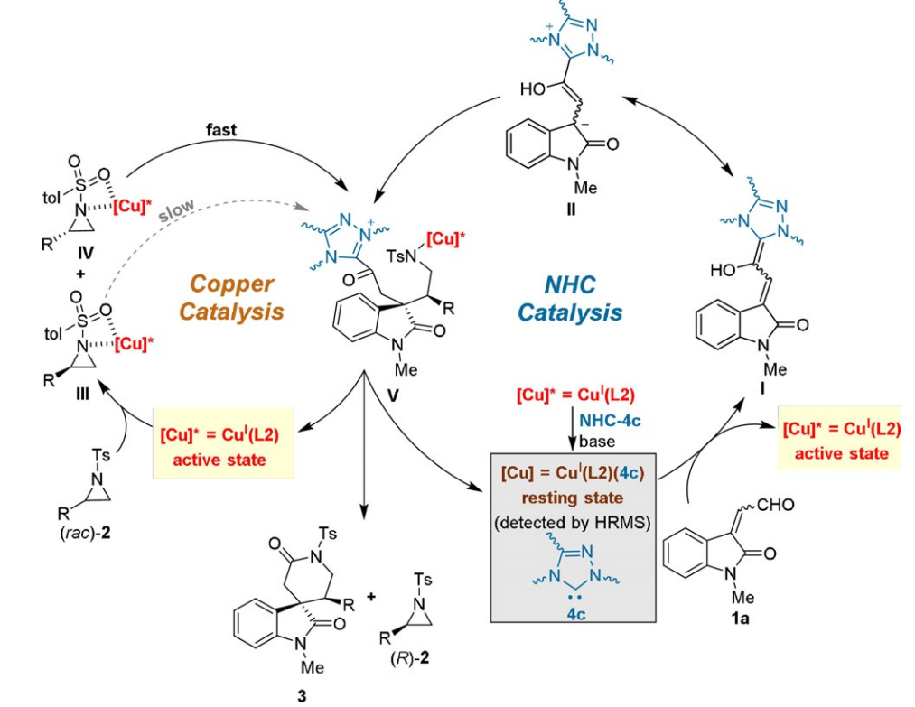
LSPN
Metal/Organio- Cooperative Catalysis
Kinetic resolution of aziridine –NHC/Copper cooperative catalysis
Liu-ZhuGong, Angew. Chem. Int. Ed. 2021 ,60, 3268–3276.
Notes:
Breslow intermediate I-

Slide 25
LSPN
Introduction
Different combinations of cooperative catalysis in organic transformations
Metal/Metal Cooperative Catalysis
Metal/Organo- Cooperative Catalysis
Metal/Photoredox Cooperative Catalysis
Organo-/Organo- Cooperative Catalysis
Conclusion

Slide 26
LSPN
Metal/Photoredox Cooperative Catalysis
Single-electron transmetalation in organoboron cross-coupling
Gary A. Molander, Science, 2014, 345, 433–436
Notes:
Suzukicoupling- lower the rate of oxidative addition and transmetallation for SP3 center- for sp3 center facile beta hydride elimination
Secondary benzylic Borane- works moderate %ee and yield

Slide 27
LSPN
Metal/Photoredox Cooperative Catalysis
Single-electron transmetalation inorganoboron cross-coupling
Gary A. Molander, Science, 2014, 345, 433–436
Notes:
Visible light source- 26w compact fluorecent light bulb

Slide 28
LSPN
Metal/Photoredox Cooperative Catalysis
Coupling of α-carboxyl sp³-carbons with aryl halides
David W. C. MacMillan, Abigail G. Doyle, Science, 2014, 345, 437–440.

Slide 29
LSPN
Metal/Photoredox Cooperative Catalysis
Coupling of α-carboxylsp³-carbons with aryl halides
David W. C. MacMillan, Abigail G. Doyle, Science, 2014, 345, 437–440.
Notes:
26w compact fluorecent light bulb- light source

Slide 30
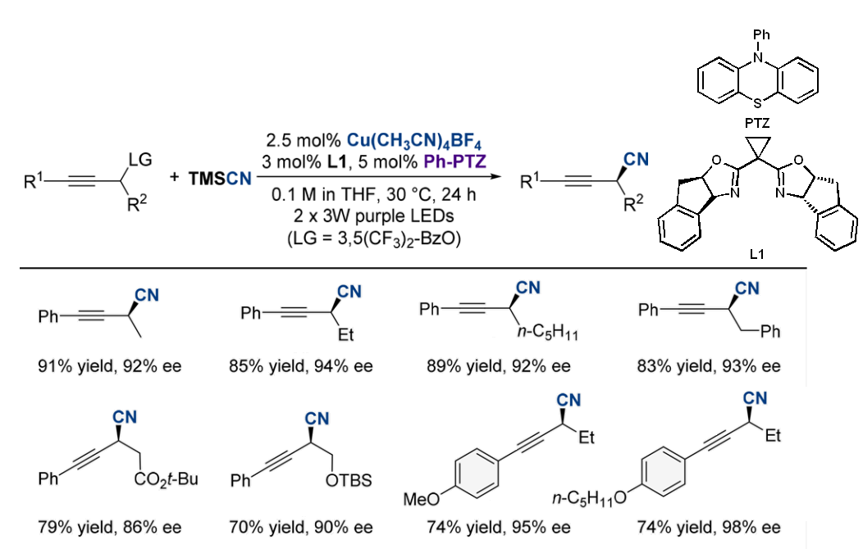
LSPN
Metal/Photoredox Cooperative Catalysis
Asymmetric Propargylic Radical Cyanation
Wen-Jing Xiao, J. Am. Chem. Soc., 2019, 141, 6167−6172.
Notes:
Nicholas reaction 1972-multistep- 1st asymmetric proporgyl radical cyanation
Ph-PTZ- phenothiazine
Visible light- 300- 400 nm ( 2* 3W purple LEDs 390nm

Slide 31
LSPN
Metal/Photoredox Cooperative Catalysis
Asymmetric Propargylic Radical Cyanation
Wen-Jing Xiao, J. Am. Chem. Soc., 2019, 141, 6167−6172.

Slide 32
LSPN
Introduction
Different combinations of cooperative catalysis in organic transformations
Metal/Metal Cooperative Catalysis
Metal/Organo- Cooperative Catalysis
Metal/Photoredox Cooperative Catalysis
Organo-/Organo- Cooperative Catalysis
Conclusion

Slide 33
LSPN
Organo-/Organo- Cooperative Catalysis
The Enantioselective Oxa-Michael–Mannich Reaction of Salicylic Aldehydes with Cyclohexenones.
Zhen-Yuan Xu, Chem. Eur. J. 2010, 16, 801–804.

Slide 34
LSPN
Organo-/Organo- Cooperative Catalysis
The Enantioselective Oxa-Michael–Mannich Reaction of Salicylic Aldehydes with Cyclohexenones.
Zhen-Yuan Xu, Chem. Eur. J. 2010, 16, 801–804.
Notes:
Dual activation – confirmed by mass- domino manner (box)

Slide 35
LSPN
Organo-/Organo- Cooperative Catalysis
Michael–aldol–dehydration reaction-combination of a chiral diamine and a chiral dicarboxylic acid
Hiyoshizo Kotsuki, Org. Lett., 2010, 12, 1616–1619.

Slide 36
LSPN
Organo-/Organo- Cooperative Catalysis
Pseudo three-component domino Michael–aldol reaction- stereoconvergent deracemization
Armando Cordova, Adv. Synth. Catal. 2012, 354, 2865–2872.

Slide 37
LSPN
Organo-/Organo- Cooperative Catalysis
Pseudo three-component domino Michael–aldol reaction- stereoconvergent deracemization
Armando Cordova, Adv. Synth. Catal. 2012, 354, 2865–2872.
Notes:
Deracemization-complete transformation racemate to single stereo isomeric product.

Slide 38
LSPN
Organo-/Organo- Cooperative Catalysis
Enantioselective vinylogous addition of butenolides to allenoates
Santanu Mukherjee, Chem. Commun., 2013, 49, 11203-11205.

Slide 39
LSPN
Organo-/Organo- Cooperative Catalysis
Isothiourea and Brønsted Acid Cooperative Catalysis
Jin Song, Chem. Org. Lett. 2020, 22, 2261–2265.

Slide 40
LSPN
Organo-/Organo- Cooperative Catalysis
Isothiourea and Brønsted Acid Cooperative Catalysis
Jin Song, Chem. Org. Lett. 2020, 22, 2261–2265.

Slide 41
LSPN
Conclusion
Applied in an increasing number of novel (or improving previously known) chemical transformations.
Yielding increased reactivity, selectivity, and efficiency.
Further information
David W. C. MacMillan., Chem. Sci., 2012, 3, 633–658.
Nitin T. Patil., Org. Biomol. Chem., 2015, 13, 8116-8162.
Sang-gi Lee., Chem. Rev., 2020, 120, 13382-13433.

Slide 42
LSPN
Thank you all for your attention !

Slide 43
LSPN

