Slide 1
Carbon radical philicity and its role in selective organic transformations
Ruijia Wang (March 30, 2023)
Laboratory of Synthesis and Natural Products
(LSPN)
Supervisor: Prof. Jieping Zhu

Slide 2
Introduction.
Carbon-centred alkyl radicals.
Alkyl radicals with α-heteroatoms.
Carbon-centred spn hybrid radicals.

Slide 3
Farney, E. P., Feng, S. S., Schäfers, F. & Reisman, S. E. Total synthesis of (+)-pleuromutilin. J. Am. Chem. Soc. 140, 1267–1270 (2018).

Slide 4
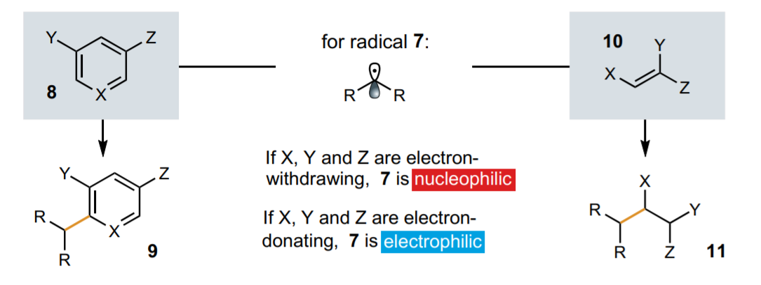

Slide 5
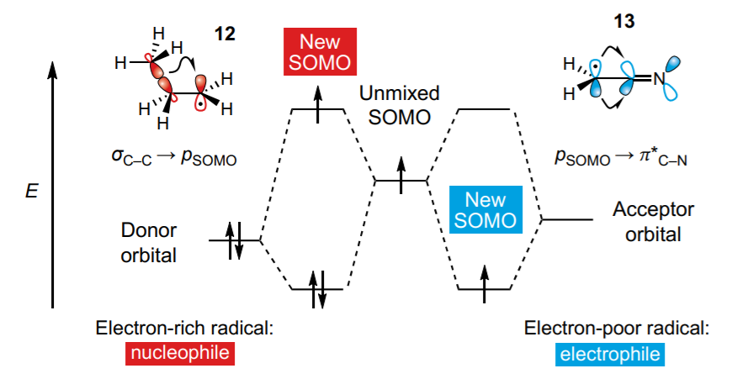
Carbon-centred alkyl radicals
SOMO: singly occupied molecular orbital

Slide 6
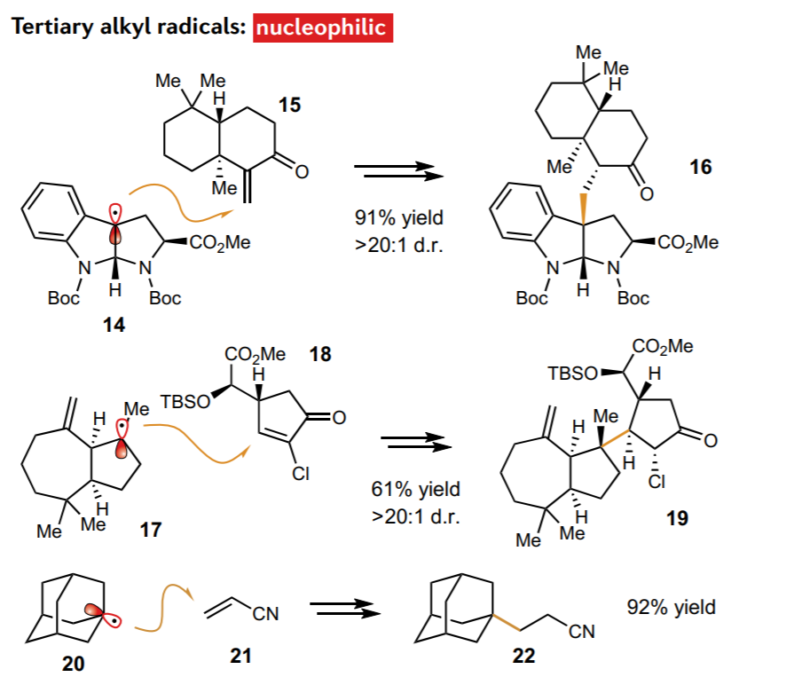
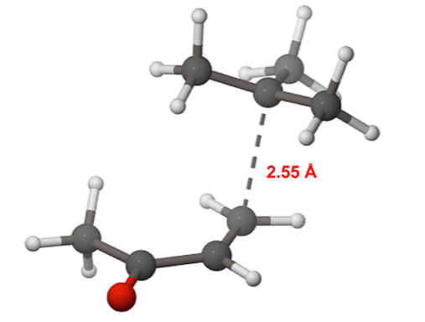
an early, starting-material-like transition state
Hammond, G. S. A correlation of reaction rates. J. Am. Chem. Soc. 77, 334–338 (1955).
Sun, Y., Li, R., Zhang, W. & Li, A. Total synthesis of indotertine A and drimentines A, F, and G. Angew. Chem. Int. Ed. 52, 9201–9204 (2013).
2. Schnermann, M. J. & Overman, L. E. A concise synthesis of (−)-aplyviolene facilitated by a strategic tertiary radical conjugate addition. Angew. Chem. Int. Ed. 51, 9576–9580 (2012).
3. Yang, H.-B., Feceu, A. & Martin, D. B. C. Catalystcontrolled C–H functionalization of adamantanes using selective H-atom transfer. ACS Catal. 9, 5708–5715 (2019).

Slide 7
Fors, B. P. & Hawker, C. J. Control of a living radical polymerization of methacrylates by light. Angew. Chem. Int. Ed. 51, 8850–8853 (2012).
Swift, E. C., Williams, T. M. & Stephenson, C. R. J. Intermolecular photocatalytic C–H functionalization of electron-rich heterocycles with tertiary alkyl halides.
Synlett 27, 754–758 (2016).

Slide 8
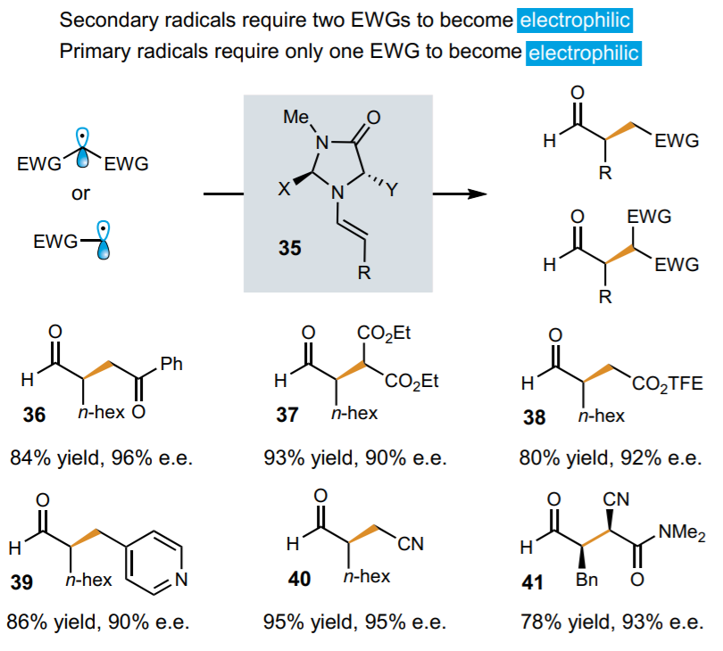
Laudadio, G. et al. C(sp3)–H functonalizationsf light hydrocarbons using decatungstate photocatalysis in flow. Science 369, 92–96 (2020).
Nicewicz, D. A. & MacMillan, D. W. C. Merging photoredox catalysis with organocatalysis: the direct asymmetric alkylation of aldehydes. Science 322, 77–80 (2008).
Shih, H.-W., Vander Wal, M. N., Grange, R. L. & MacMillan, D. W. C. Enantioselective α-benzylation of aldehydes via photoredox organocatalysis. J. Am. Chem. Soc. 132, 13600–13603 (2010).
Nacsa, E. A. & MacMillan, D. W. C. Spin-center shift-enabled direct enantioselective α-benzylation of aldehydes with alcohols. J. Am. Chem. Soc. 140, 3322–3330 (2018).
Welin, E. R., Warkentin, A. A., Conrad, J. C. & MacMillan, D. W. C. Enantioselective α-alkylation of aldehydes by photoredox organocatalysis: rapid access to pharmacophore fragments from β-cyanoaldehydes. Angew. Chem. Int. Ed. 54, 9668–9672 (2015).
Hu, A., Guo, J.-J., Pan, H. & Zuo, Z. Selective functionalization of methane, ethane, and higher alkanes by cerium photocatalysis. Science 361, 668–672 (2018).

Slide 9
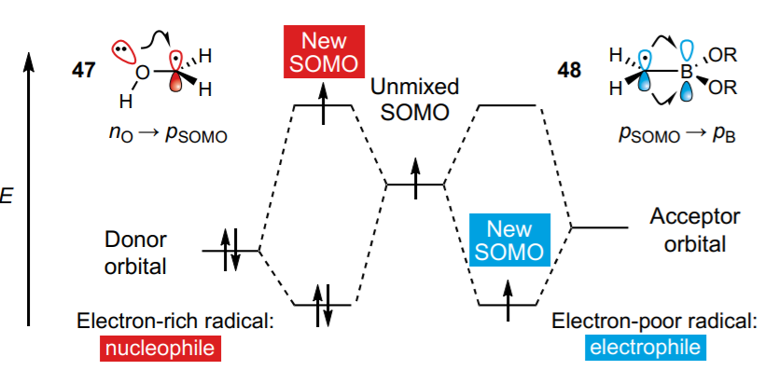
Alkyl radicals with α-heteroatoms
There are two factors that could affect the reactivity of the resulting α-heteroatom radical: the heteroatom’s electronegativity and its π-bonding capability.

Slide 10
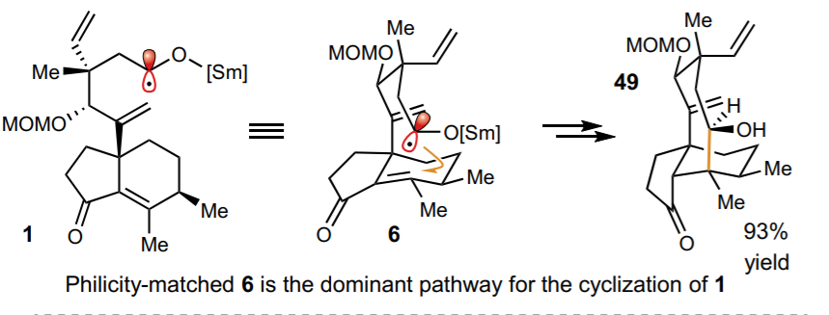
Wang, L., Lear, J., Rafferty, S. M., Fosu, S. C. & Nagib, D. A. Ketyl radical reactivity via atom transfer catalysis. Science 362, 225–229 (2018).

Slide 11
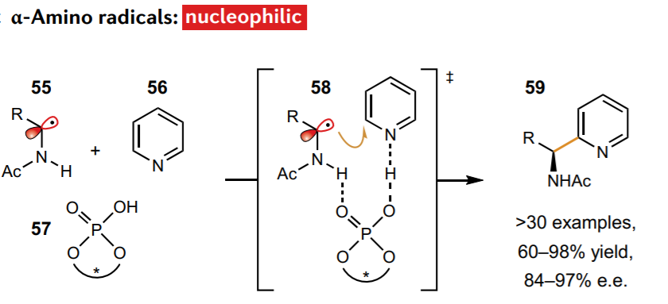
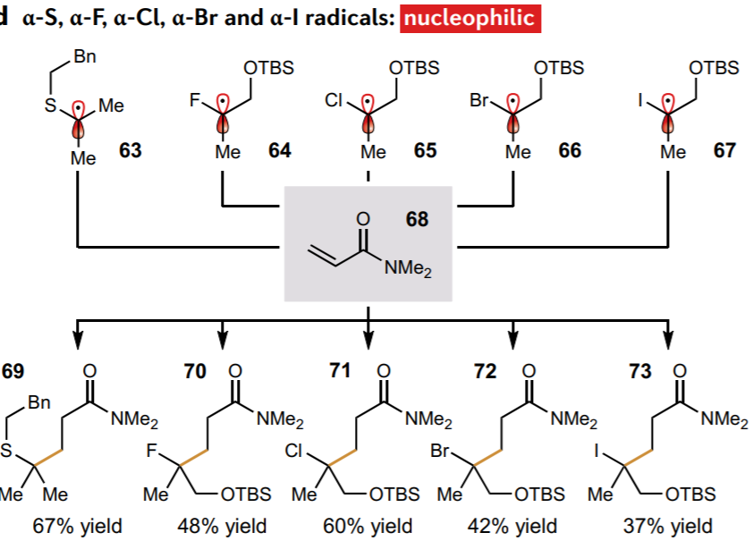
Proctor, R. S. J. & Phipps, R. J. Recent advances in Minisci-type reactions. Angew. Chem. Int. Ed. 58, 13666–13699 (2019).
Proctor, R. S. J., Davis, H. J. & Phipps, R. J. Catalytic enantioselective Minisci-type addition to heteroarenes. Science 360, 419–422 (2018)
Qi, L. & Chen, Y. Polarity-reversed allylations of aldehydes, ketones, and imines enabled by Hantzsch ester in photoredox catalysis. Angew. Chem. Int. Ed. 55, 13312–13315 (2016).
Lo, J. C. et al. Fe-catalyzed C–C bond construction from olefins via radicals. J. Am. Chem. Soc. 139, 2484–2503 (2017)

Slide 12
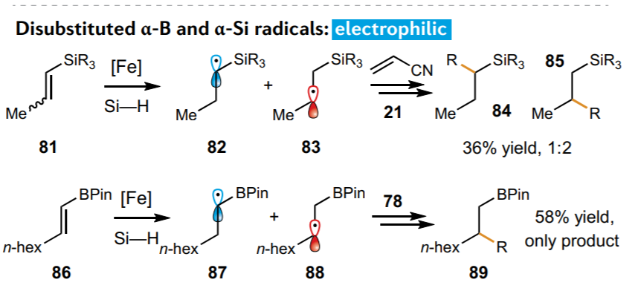

Slide 13
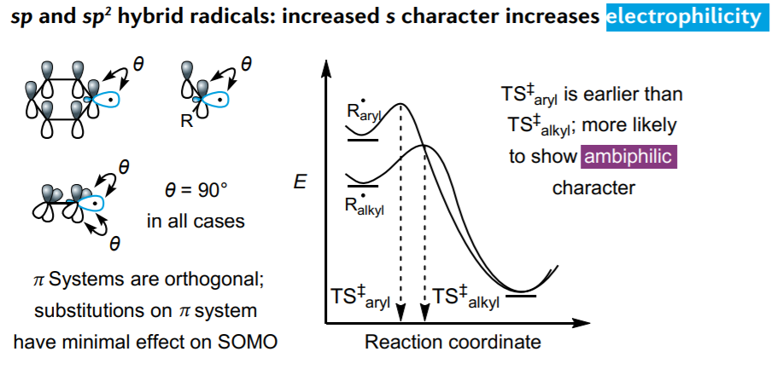
Carbon-centred spn hybrid radicals
More electrophilic
More starting-material-like transition states than those of p-orbital SOMOs, resulting in increased proclivity towards ambiphilicity. .

Slide 14
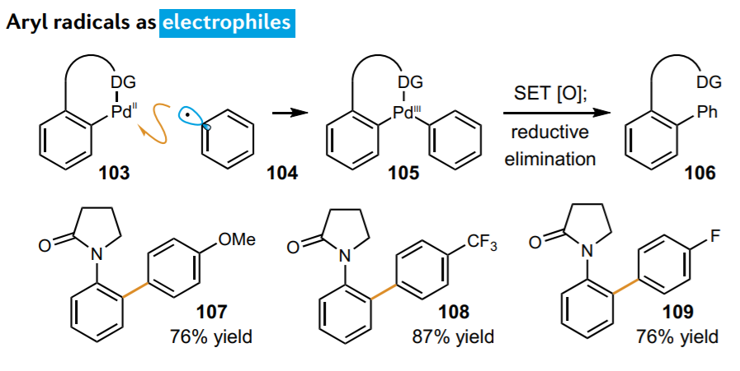
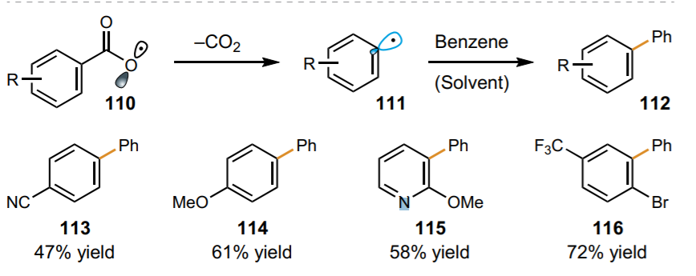
Kalyani, D., McMurtrey, K. B., Neufeldt, S. R. & Sanford, M. S. Room-temperature C–H arylation: merger of Pd-catalyzed C–H functionalization and visible-light photocatalysis. J. Am. Chem. Soc. 133, 18566–18569 (2011).
Candish, L., Freitag, M., Gensch, T. & Glorius, F. Mild, visible light-mediated decarboxylation of aryl carboxylic acids to access aryl radicals. Chem. Sci. 8, 3618–3622 (2017).

Slide 15
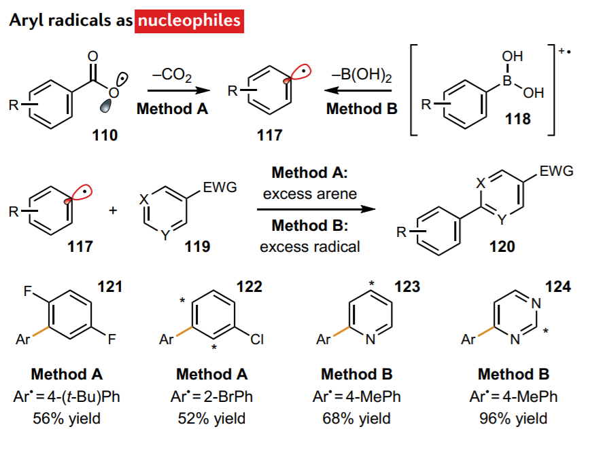
Seiple, I. B. et al. Direct C–H arylation of electron-deficient heterocycles with arylboronic acids. J. Am. Chem. Soc. 132, 13194–13196 (2010).

Slide 16
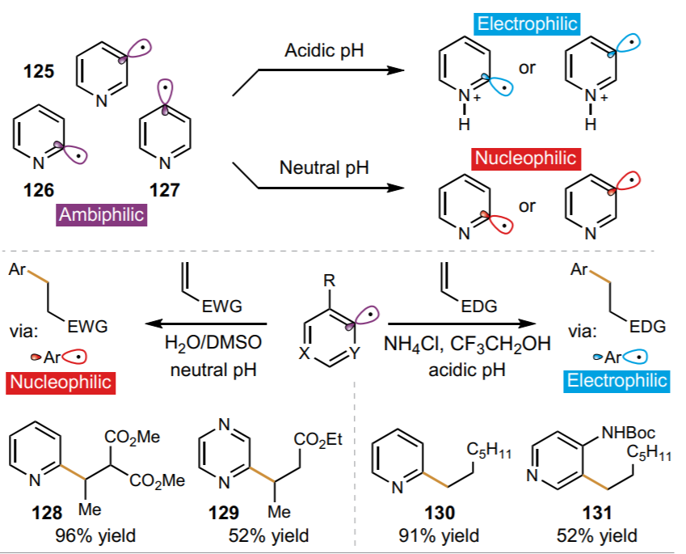
Aycock, R. A., Wang, H. & Jui, N. T. A mild catalytic system for radical conjugate addition of nitrogen heterocycles. Chem. Sci. 8, 3121–3125 (2017).
Boyington, A. J., Riu, M.-L. Y. & Jui, N. T. Anti-Markovnikov hydroarylation of unactivated olefins via pyridyl radical intermediates. J. Am. Chem. Soc. 139, 6582–6585 (2017).

Slide 17
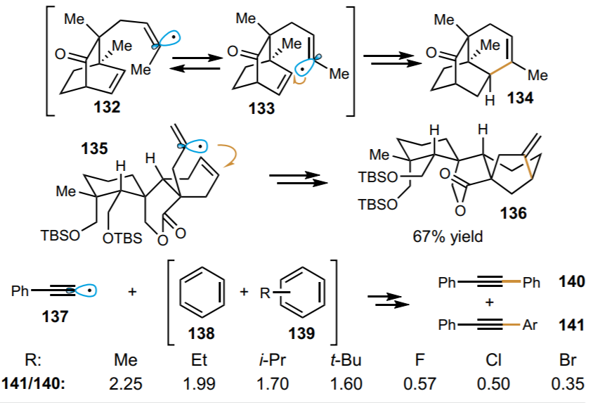

Slide 18
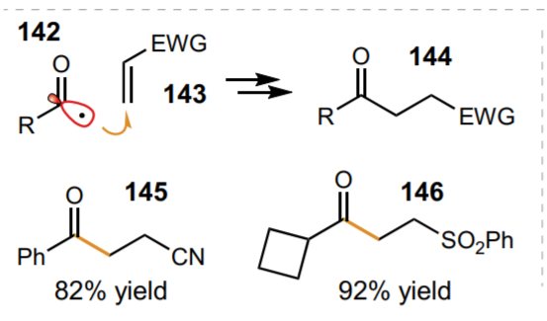
de Pedro Beato, E., Mazzarella, D., Balletti, M. & Melchiorre, P. Photochemical generation of acyl and carbamoyl radicals using a nucleophilic organic catalyst: applications and mechanism thereof. Chem. Sci. 11, 6312–6324 (2020).

Slide 19
Thank you for your listening

