Slide 1
Multicomponent Syntheses of: Fluorophores
Ángel Rentería Gómez

Slide 2
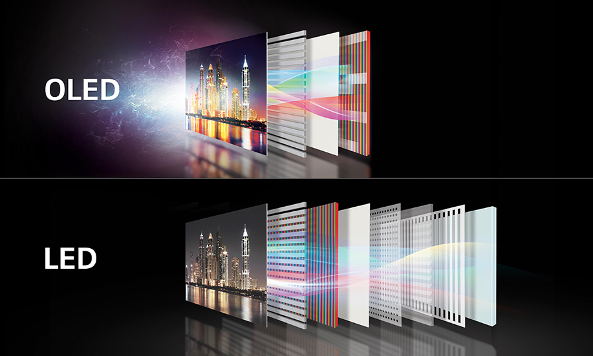
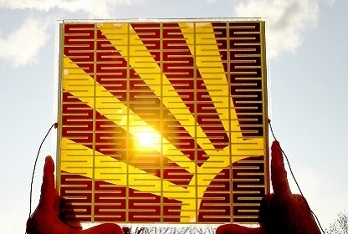
A group of atoms in a molecule that is responsible for the absorption of radiation is called a chromophore.
Applications in:
Organic light-emitting diodes (OLEDs)
Dye-sensitized solar cells (DSSCs)
Organic photovoltaics (OPVs)
Organic field effect transistors (OFETs)
Sensor arrays in bio- or environmental analytics
Chem. Soc. Rev., 2016, 45, 2825

Slide 3
Multicomponent process is a reaction of more than two starting materials leading to a product that contains most of the employed atoms.
Multi-component Reactions in Organic Synthesis, ed. J. Zhu,
Q. Wang and M.-X. Wang, Wiley-VHC, Weinheim, 2015.
T. J. J. Müller, et. al. Pure Appl. Chem. 2008, 80, 609

Slide 4
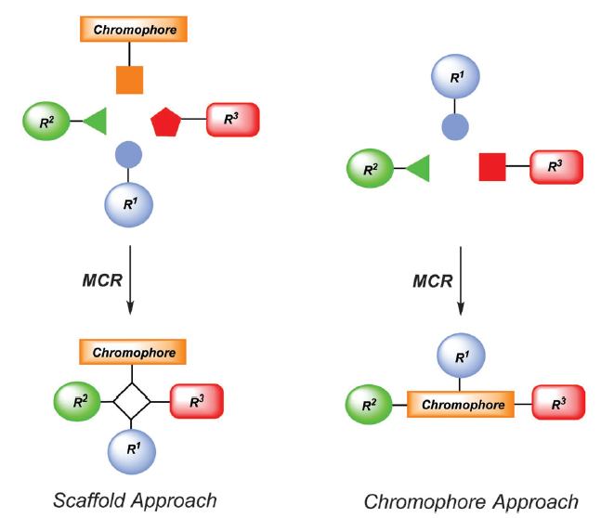

Slide 5
Fluorophores
Luminescent dyes exhibit intense light emission upon light excitation. The underlying chromophore is called the fluorophore.

Slide 6
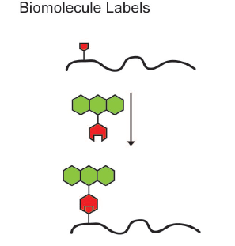
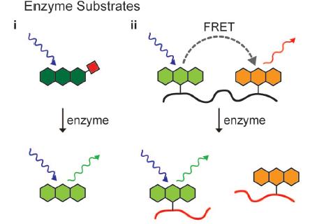
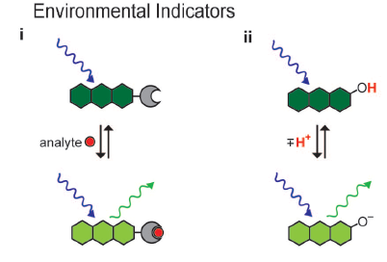
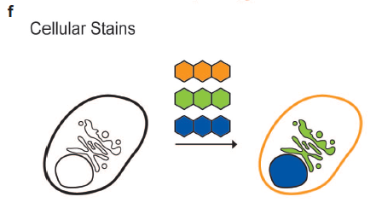
Ronald T. Raines, et. al. ACS Chemical Biology 2008, 3, 143

Slide 7
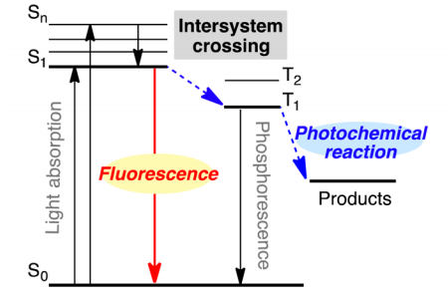
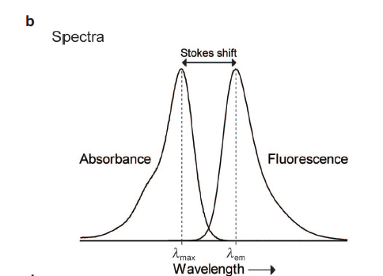
Fluorophores are highly interesting as functional π-electron systems. The emission range lies between UV and NIR with lifetimes varying from nanoseconds (fluorescence in a broader sense) to micro and milliseconds (generally referred to as phosphorescence).

Slide 8
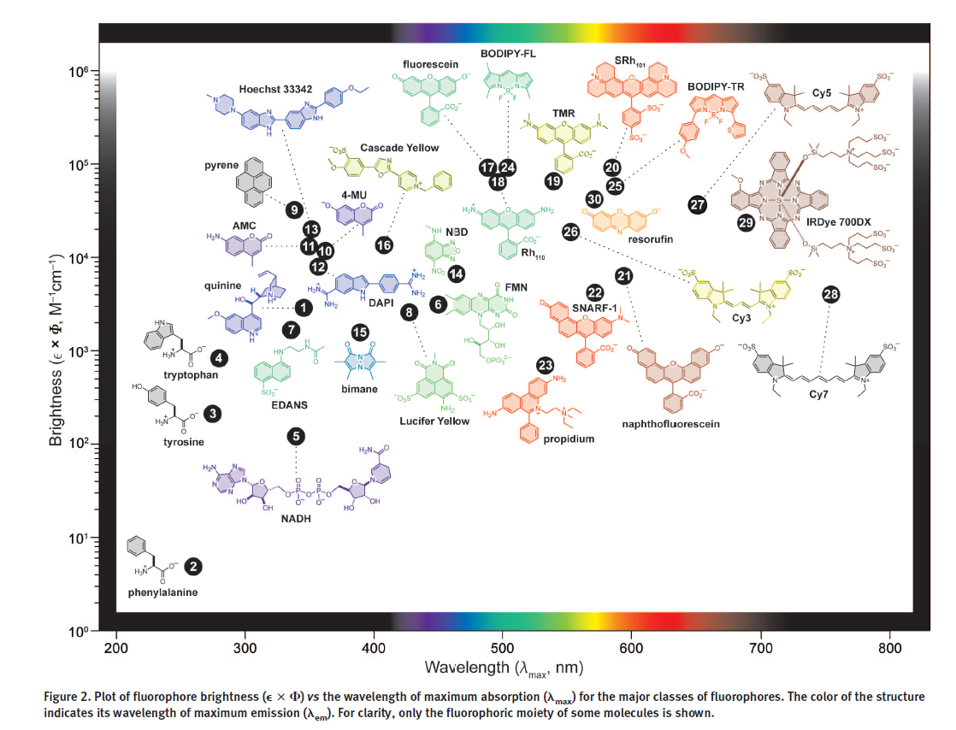

Slide 9
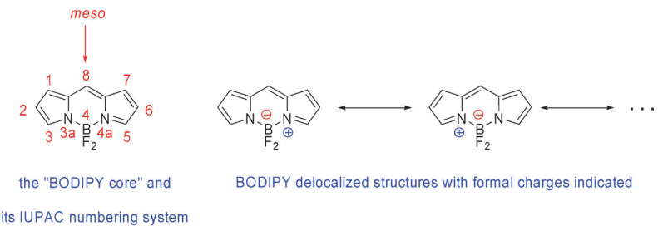
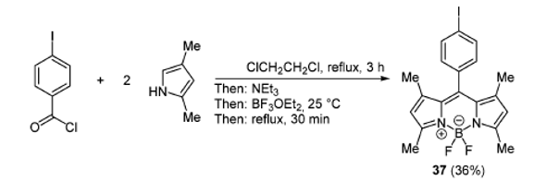
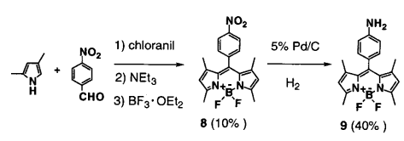
The 4,4-difluoro-4-bora-3a,4a-diaza-s-indacene (BODIPY) scaffold has played a pivotal role in fluorescent probe development, and it is one of the most exploited fluorophores due to its excellent photophysical properties
All the positions of the BODIPY core are possible sites for functionalization:
Synthesis of the BODIPY core
Chem. Soc. Rev., 2012, 41, 1130
One-pot methodology to prepare these organoboron complexes:
K. Burgess, et. al. Tetrahedron Lett., 2000, 41, 2303.
J. Am. Chem. Soc. 2001, 123, 100

Slide 10
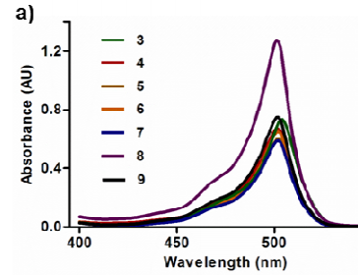
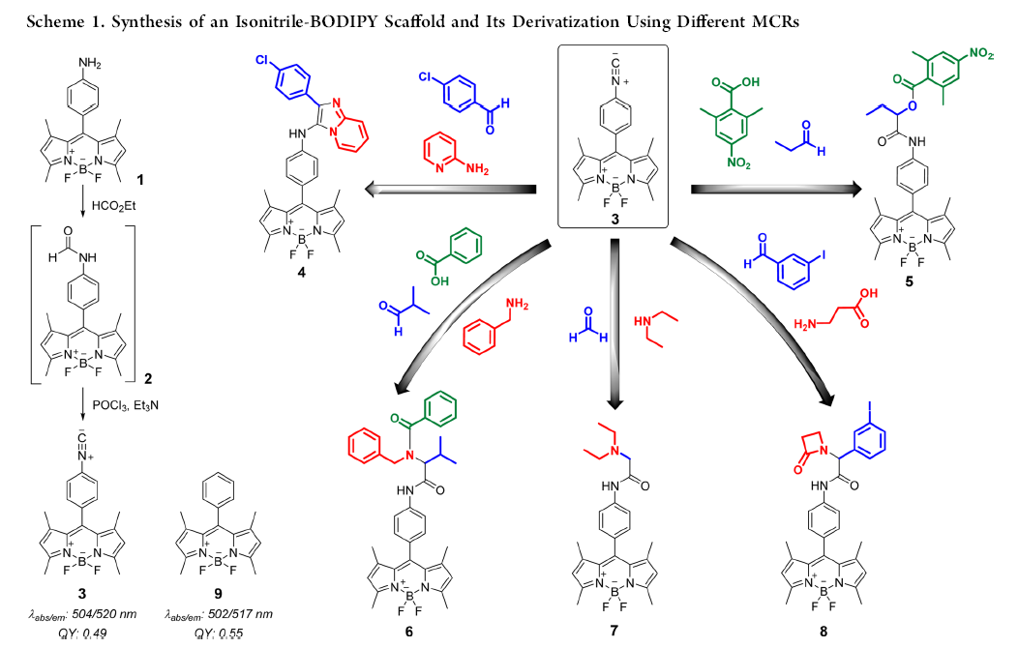
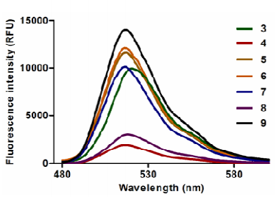
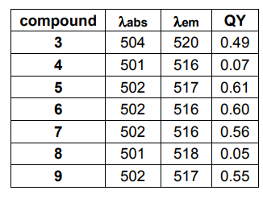
MCRs can increase the chemical diversity of BODIPY dyes with the formation of unusual C−C bonds and give BODIPY compounds with unexplored chemical connectivity and potentially new features as imaging probes
Fluorescence quantum yield (Φ_{F}) is an important optical property parameter of an organic fluorophore.
Rodolfo Lavilla, et. al. J. Am. Chem. Soc. 2013, 135, 16018

Slide 11
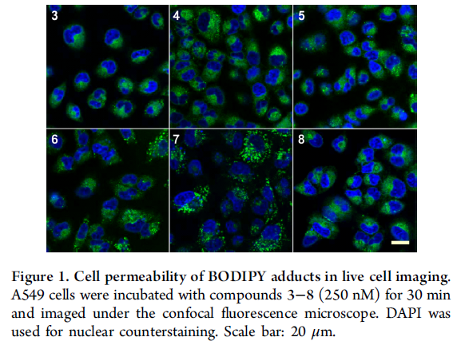
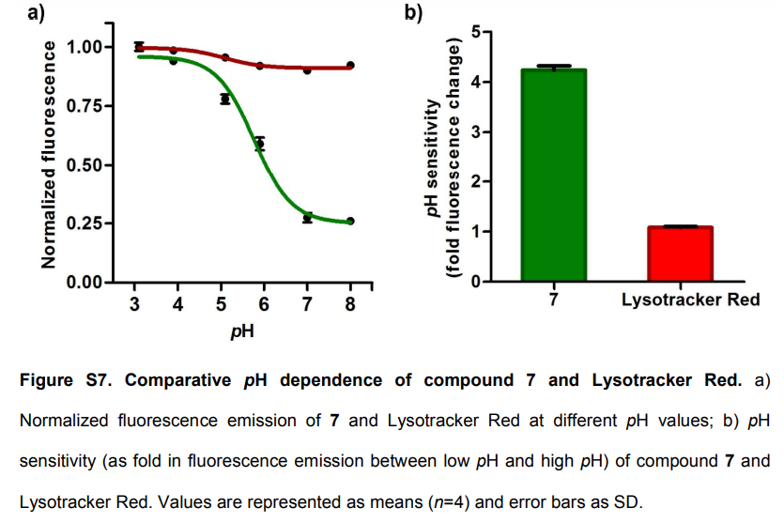
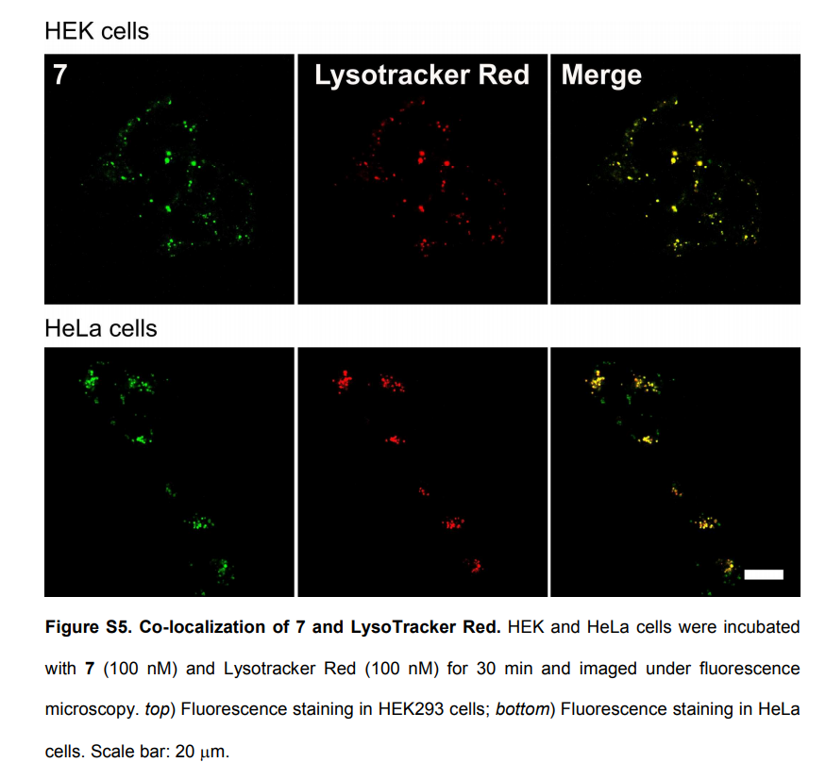
While most adducts stained the cytoplasm and some lysosomes, compound 7 exhibited a distinctive, vesicle-like staining pattern.
7 is an acidotropic fluorescent molecule with bright fluorescence emission in subcellular acidic environments
Remarkable properties of 7 as a cell permeable fluorescent probe for acidic microenvironments was applied to imaging phagosomal acidification in macrophages.

Slide 12
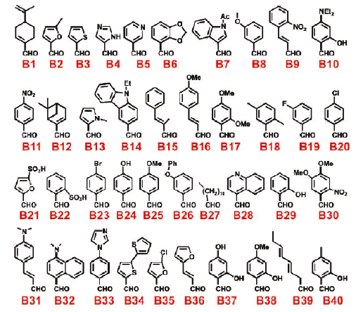
Imidazo[1,2-a]pyridines are naturally occurring synthetic compounds that are widely used in medicinal chemistry. Some of the imidazo[1,2-a]pyridines autofluoresced in UV and can be produced by the Groebke Blackburn–Bienaymé Multicomponent Reaction.
Bienaymé, H. et. al. Angew. Chem. Int. Ed. 1998, 37, 2234
N. Devi et al. Tetrahedron 2015 71 183. (a review)

Slide 13
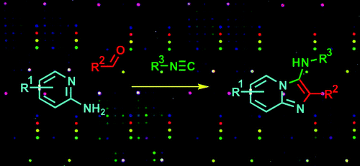
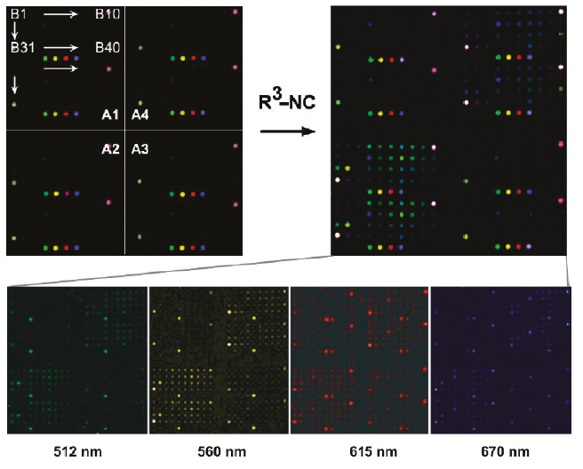
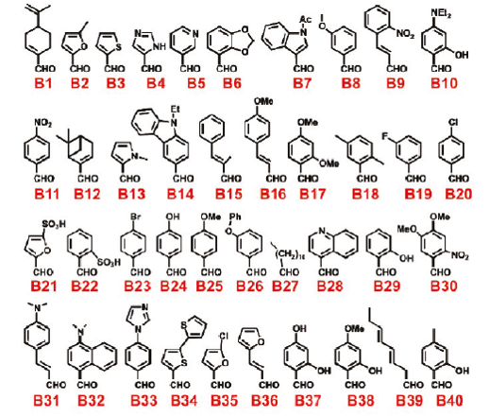
The repeated four-color spot motif is a set of control fluorophores: fluorescein, Cy3, TxR, and Cy5.
Maxim Y. Balakirev, et. al. J. Am. Chem. Soc. 2011, 133, 10058

Slide 14
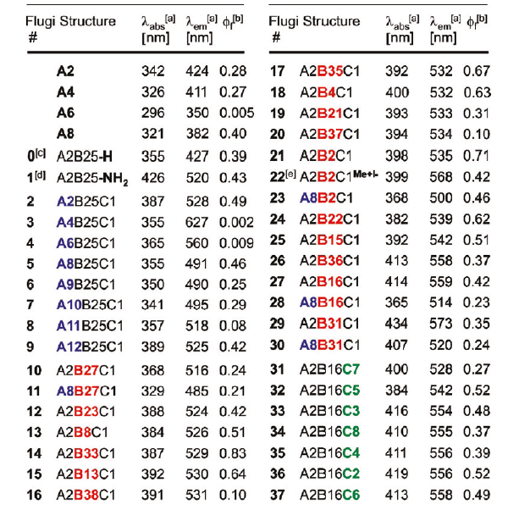
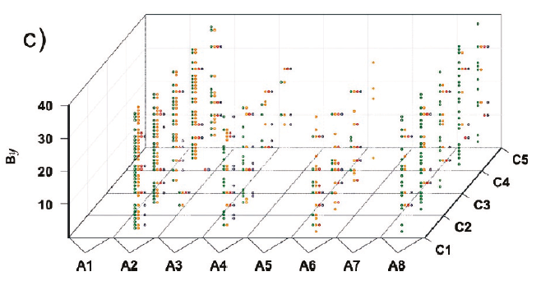
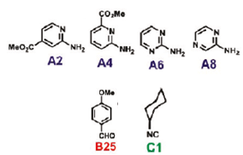
Cumulative microarray 3-CR profiling results for
eight amidines Ax, 40 aldehydes By, and five isocyanides Cz.
Hypsochromic shift
Excellent Stokes shift (272 nm) for Flugi 3 but low bright not useful as imaging probes
bathochromic effect
Good Stokes shift (142 nm) for Flugi 14 and excellent bright useful as imagin probes

Slide 15
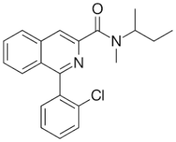
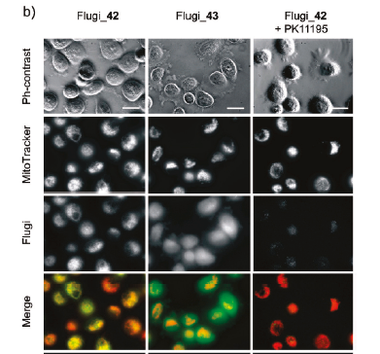
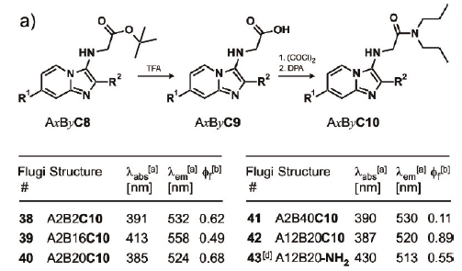
To determine whether these compounds could be used as imaging probes for the mitochondrial benzodiazepine receptor TSPO, we studied their localization in PC-3 prostate carcinoma cells. These cells show a high level of TSPO expression that is thought to be a hallmark of prostate cáncer.
PK11195
treatment of anxiety
Colocalization of Flugi_42 in mitochondria
Different
patterns of cell staining observed with Flugi_43. (cytoplasm and the plasma membrane)
Flugi_42 fluorescent staining was affected
with PK11195.
Notes:
It is one of the most commonly used PBR ligands: peripheral benzodiazepine receptor

Slide 16
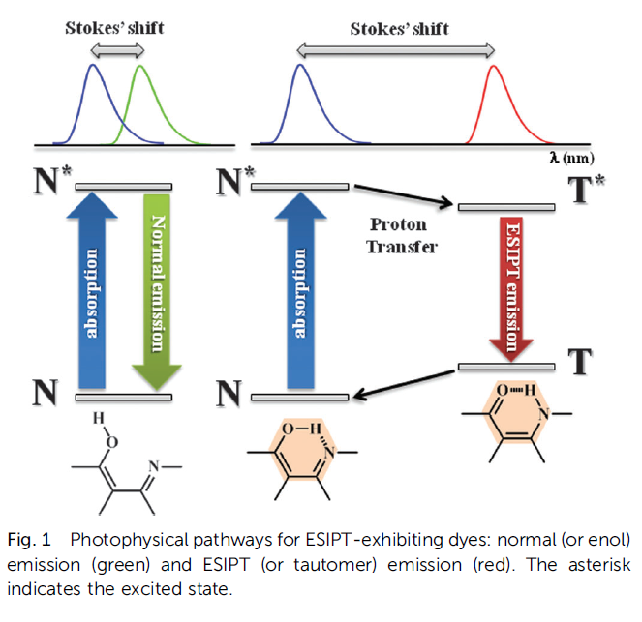
Excited state intramolecular proton transfer
New J. Chem., 2014, 38, 4607

Slide 17
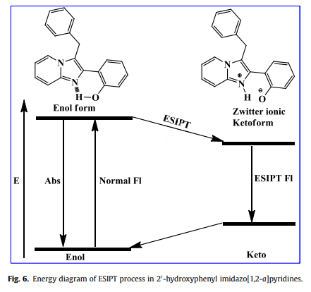
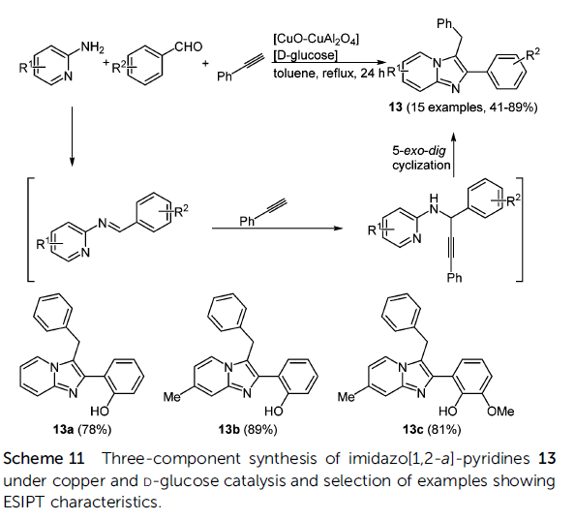
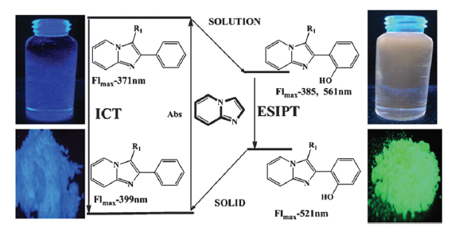
Imidazo[1,2-a]-pyridines 13 with a similar structure were prepared under copper and glucose catalysis, resulting in systems with excited state intramolecular proton transfer (ESIPT) characteristics.
J. Org. Chem. 2012, 77, 4438
A3-coupling
B. Umamahesh and K. I. Sathiyanarayanan, Dyes Pigm., 2015, 121, 88.
Notes:
tandem process using copper(II) oxide-copper(II) aluminate composite and D-glucose.
Group 11 metal (Cu, Ag, and Au) salts offer efficient catalysis for alkyne C−H activation in alkynylation with σ- activated imine and π-activation of triple bond toward cyclization
Cu(I) in situ generated by reduction of CuSO4 with reducing carbohydrates can be an efficient catalyst in A3 because classic methods suffer from the requirements of a stringent anaerobic procedure and harsh conditions.

Slide 18
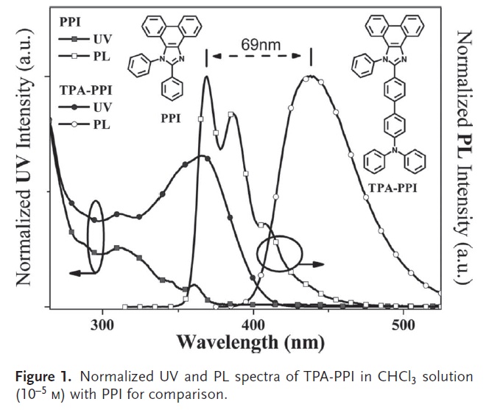
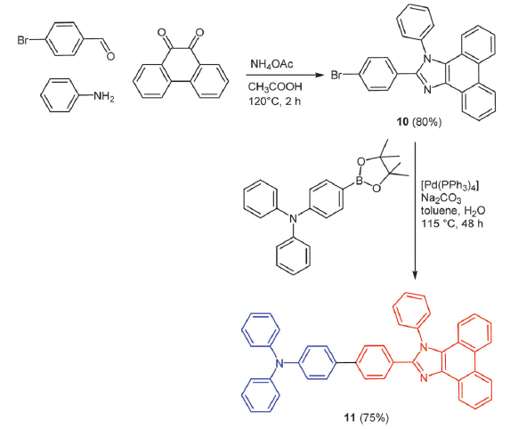
Blue-emitting emitters are indispensable in practical applications as indicated by the commercialization of inorganic light-emitting diodes. According to the standards of the full-color display industry, blue emitting materials should emit a saturated blue or deep-blue color to meet the demand of high quality displays. Unfortunately, deep-blue phosphorescent emitters are extremely rare.
J. Mater. Chem. C, 2015, 3, 913
1,2-diphenyl- 1H-phenanthro[9,10-d]imidazole (PPI)
A deep-blue electroluminescent chromophore 10 with a current efficiency of >5.0% was recently reported
369
438
9,10-Phenanthrenequinone
donor
acceptor
Ma, Y.; et. al. Adv. Funct. Mater., 2012, 22, 2797
Notes:
Despite the ease of getting blue Fluorescent emitters,
achieving a good trade-off among the necessary properties
required by the OLEDs field really represents a huge challenge
to researchers. According to the standards of the full-color
display industry, blue emitting materials should emit a saturated
blue or deep-blue color to meet the demand of highquality
displays. This indicates that the blue emitters should
possess a very wide band-gap (Eg), making it difficult to design
their molecular structure.

Slide 19
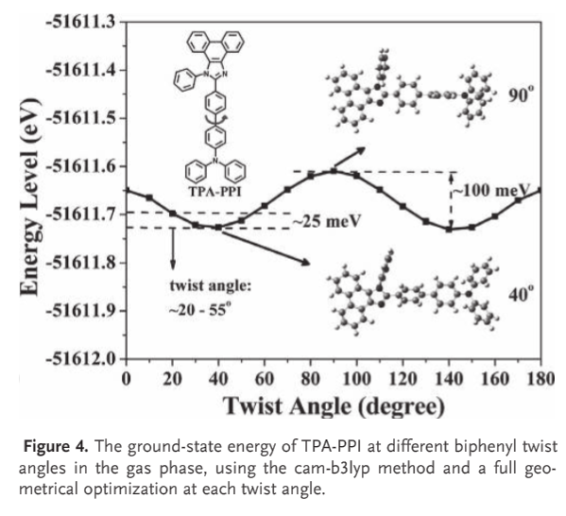
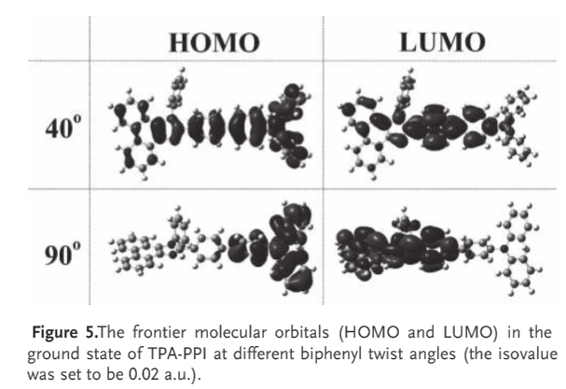
Time dependent density functional theory (TD-DFT) calculation

Slide 20
Tetrahydropyrimidines are another noteworthy class of biologically active compounds. Additionally some derivatives show interesting magnetic and photophysical properties.
H. Jiang, et. al. Org. Lett. 2007, 9, 4111
H. Jiang, et. al. Tetrahedron 2009, 65, 4604 .
Notes:
On the basis of this consideration, we assumed that the MCRs would proceed smoothly in the presence of a Brønsted acid as well

Slide 21
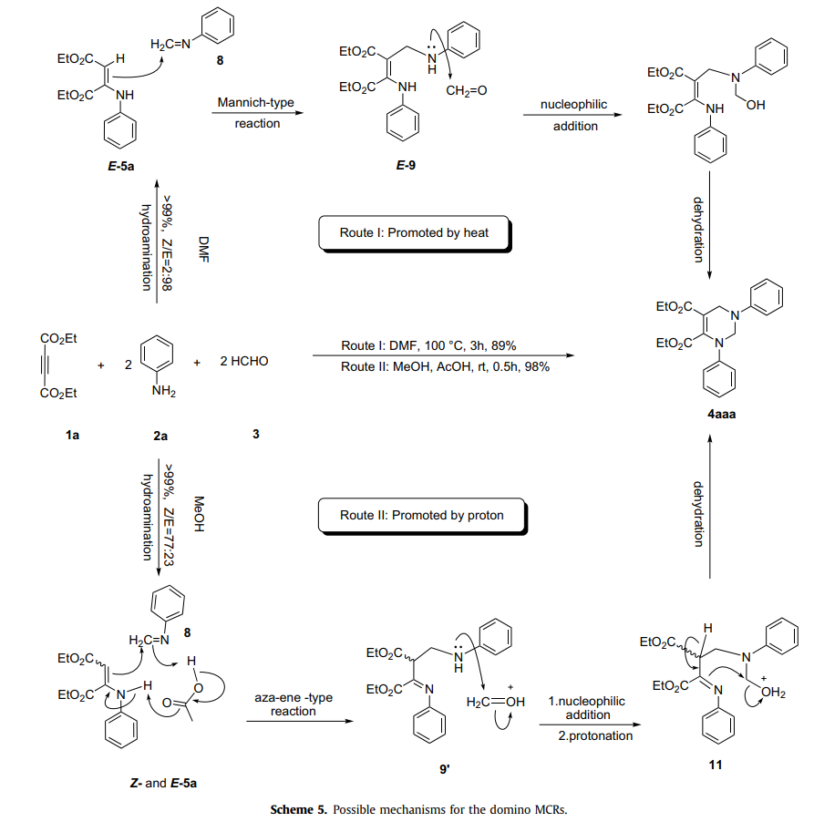
However, the substitution on the C-2/C-6 position of 4aaa remains a synthetic challenge owing to steric hindrance and regioselectivity.
Ethyl but-2-ynedioate
H. Jiang, et. al. Tetrahedron 2009, 65, 4604 .
Notes:
Following three domino sequences: (1) two-component hydroamination;
(2) three component Mannich-type reaction;
(3) two-component aminealdehyde dehydration-cyclization process

Slide 22
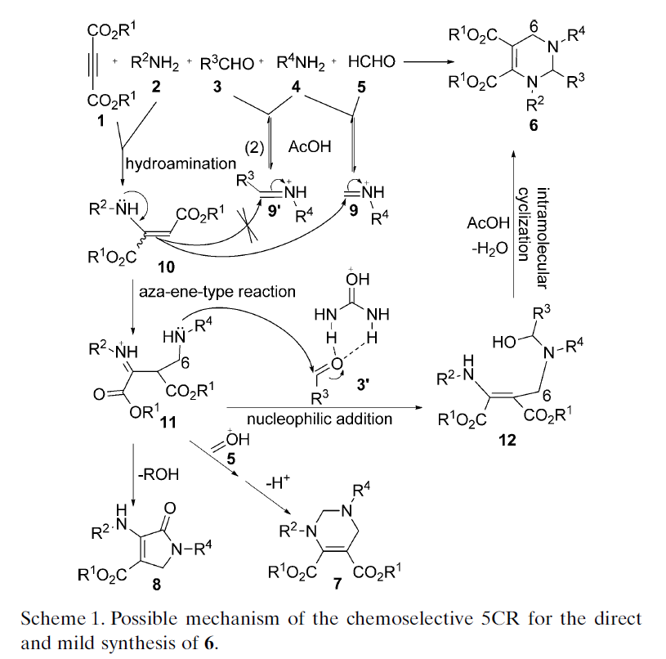
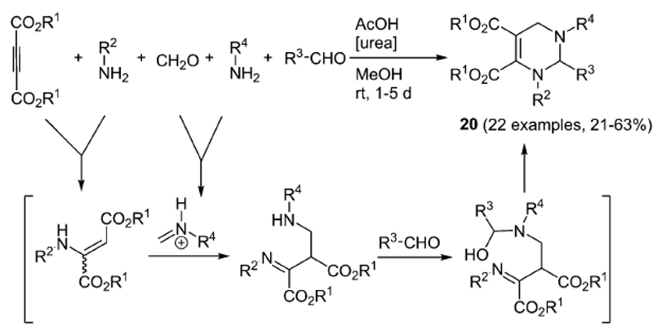
Five-component reaction (5CR) using urea as the organocatalyst could chemoselectively provide a direct and mild synthesis of C-6 unsubstituted tetrahydropyrimidines 20 (C-2 substituted)
Five-component synthesis of C-6 unsubstituted tetrahydropyrimidines
Compounds 20 show no fluorescence in solutions but emit strong blue or green fluorescence in aggregates.
S. Liu, et. al. Chem. – Eur. J., 2013, 19, 1268
Tetrahedron 2009, 65, 4604
J. Comb. Chem. 2009, 11, 685
Notes:
Because of electron-donating effect and steric hindrance of R2, the electrophilic
activity of the imine carbon in 9’ is lower than that in 9.
Reactant 3 is activated by AcOH and urea, through which 3 was converted to an active form 3’.
Reaction mixture A (1 mmol of 1 and 1 mmol of R²NH₂ in 0.5 mL of MeOH kept for 10–30 min), R³CHO (3.5 mmol)
and urea (0.2 mmol) were added into reaction mixture B (3.5 mmol of R⁴NH₂ , 1.4 mmol of 38% HCHO and 4 mmol of AcOH in 3 mL of MeOH kept for
10 min) in sequence, followed with stirring for desired time (monitored by TLC). The addition of CH2Cl2 (0.5 mL) in reaction mixture B was
needed to increase the intermediate solubility and the 5CR yield if the 5CR intermediate would precipitate.

Slide 23
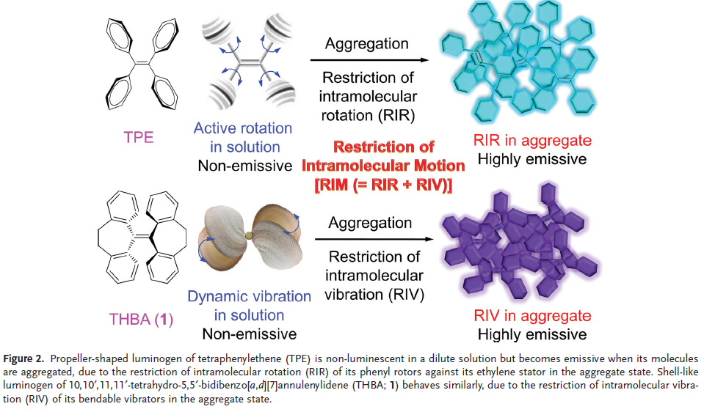
The QY values of conventional fluorophores often decrease at high concentration or in solid state due to the formation of detrimental excimeric species, which is called aggregation-caused quenching but products 20 show unusual characteristics of aggregation-induced emission enhancement (AIEE).
Adv. Mater. 2014, 26, 5429
Usually used as a solid form in practical applications, such as thin films in the fabrication of organic light-emitting diodes (OLEDs)
Nature 1999, 397, 121.

Slide 24
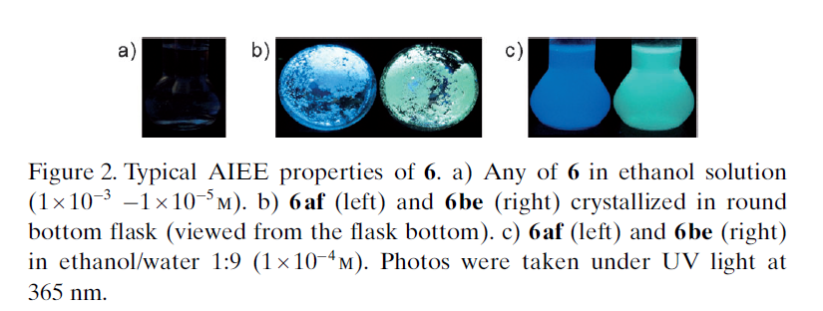
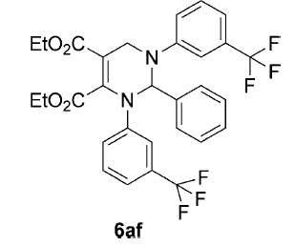
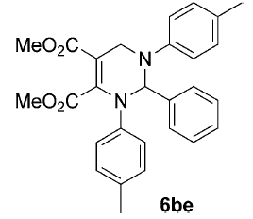

Slide 25
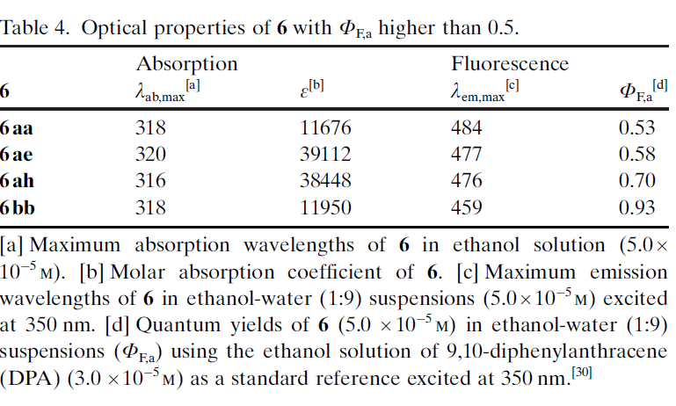
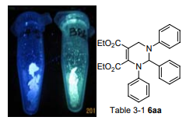
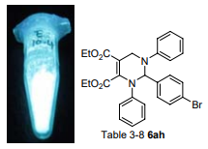
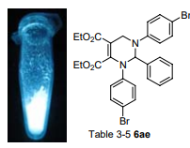
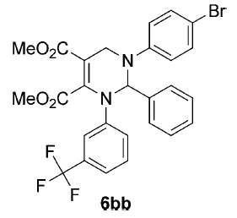
Same NMR, different melt point

Slide 26
Molecular stacking modes (MSM)
The analysis of single-crystal X-ray diffraction data indicates that the blue and green light-emitting properties of 6aa result from different MSMs: R/S-S/R mode for blue light emission (left) and R/R-S/S modes for green light emission (right).

Slide 27
Due to the steadily growing industrialization the detection of toxic heavy metal ions in the environment is an important Task Chemosensors with defined optical and mechanistic properties are the most elegant method for the recognition of metal ions.
Analyst, 2011, 136, 3289
Navneet Kaur et. al. RSC Adv., 2013, 3, 6160

Slide 28
The solvent polarity sensitivity of solvatochromic fluorophores has found wide application in studies on protein biochemistry.
Trends Biotechnol. 2010, 28, 73
Angew. Chem. Int. Ed. 2011, 50, 296
Four-component synthesis of fluorescent 3-ethynylquinoxalines through a glyoxylation− Stephens−Castro coupling
Thomas J. J. Müller, et. al. J. Org. Chem. 2014, 79, 3296
Notes:
it is noteworthy to mention that all four components are applied in strictly equimolar ratios

Slide 29
Already the computed ground-state structures indicate that HOMO−LUMO transitions should be accompanied with a dominant charge transfer character from the heteroaryl substituents in 2-position to the central quinoxaline core, this is in agreement with the observation of solvatochromic fluorescence in the compound.

Slide 30
ganciclovir
EC50 2.6±0.5 mM
hydroquinine 1,4-phthalazinediyl diether: (DHQ)2PHAL
Felix E. Held, et. al. Nature Communications 2017, 8, 1
Notes:
new metal-free 10-step sequence, with only a single work up procedure and starting from simple and readily available compounds

Slide 31
Notes:
aldehydes, nitroalkenes and malononitrile: The proposed unprecedented quinazolines, bearing amino (donor) and cyano (acceptor) groups at the same time, were expected to demonstrate desirable fluorescence properties.
Since direct aromatization of 4a was not successful using different oxidizing agents, we assumed that hydrolysis of CN groups to COOH might facilitate the subsequent aromatization step through CO2 release and might also prevent generation of toxic hydrogen cyanide (HCN). Applying acetic acid (AcOH).

Slide 32
Quinazoline compound 7h exhibits strong fluorescence between 370 and 600 nm, with a maximum at 439 nm. The fluorescence properties of potentially bioactive compounds, for example, antiviral, antimalarial and anticancer agents, might be very useful for an in vitro monitoring of compound-treated cultured cells by use of fluorescence microscopy.
Notes:
strong antiviral properties (EC50 down to 0.6±0.1 mM) against human cytomegalovirus (HCMV)

Slide 33
These results open up new perspectives for molecular imaging in the drug development process and mechanistic studies, avoiding the requirement of linkage of external fluorescent labels to potential drug molecules.
artesunic acid
Notes:
These results open up new perspectives for molecular imaging in the drug development process and mechanistic studies, avoiding the requirement of linkage of external fluorescent labels to potential drug molecules.
Artesunic acid on the other hand was selected because it proved to be a valuable building block in order to get highly bioactive compounds with just a few chemical transformations and also because of its promising pharmacological properties.
For all quinazoline compounds, cytotoxicity for primary human fibroblasts (HFFs; CC50) was undetectable at concentrations up to 100 mM

Slide 34
CONCLUSION
Multicomponent reactions as an ongoing task in organic synthetic chemistry have turned out to be a valuable tool in the preparation of functional fluorophores.
Fascinating results have been unraveled and molecules with photophysical properties can be designed, systematically studied and optimized by skillfully applying this powerful tool of diversity oriented synthesis.
Many synthetic pathways and structures are still unexplored in the world of multicomponent reactions. The unique combination of synthetic creativity, programmed reactivity, and systematic exploration of functional fluorophores will stimulate the development and rational design of functional materials by MCR.

Slide 35
For more examples

