Slide 1

Palladium-Catalyzed Arylhalogenation of Alkenes
Group Seminar
Jian Cao (Jieping Zhu’s Lab)
Laboratory of Synthesis and Natural Products (LSPN)
Ecole Polytechnique Fédérale de Lausanne (EPFL)

Slide 2
Outline
1. Introduction
2. Pd(II)/Pd(IV) Catalytic Cycle
3. Pd(0)/Pd(II) Catalytic Cycle
4. Summary and Outlook

Slide 3
Introduction

Slide 4
Introduction
Other types such as radical reactions are not included.

Slide 5
Outline
1. Introduction
2. Pd(II)/Pd(IV) Catalytic Cycle
3. Pd(0)/Pd(II) Catalytic Cycle
4. Summary and Outlook

Slide 6
Pd(II)/Pd(IV) Catalytic Cycle
First arylhalogenation:
Heck, R. F. J. Am. Chem. Soc. 1968, 90, 5538.

Slide 7
Pd(II)/Pd(IV) Catalytic Cycle
First arylhalogenation:
How was C-Cl bond formed?
Heck, R. F. J. Am. Chem. Soc. 1968, 90, 5538.

Slide 8
Pd(II)/Pd(IV) Catalytic Cycle
Stereochemical studies:
Backvall, J.-E.; Nordberg, R. E. J. Am. Chem. Soc. 1980, 102, 393.

Slide 9
Pd(II)/Pd(IV) Catalytic Cycle
Stereochemical studies:
Backvall, J.-E.; Nordberg, R. E. J. Am. Chem. Soc. 1980, 102, 393.

Slide 10
Pd(II)/Pd(IV) Catalytic Cycle
Sporadic reports between 1980-2008:

Slide 11
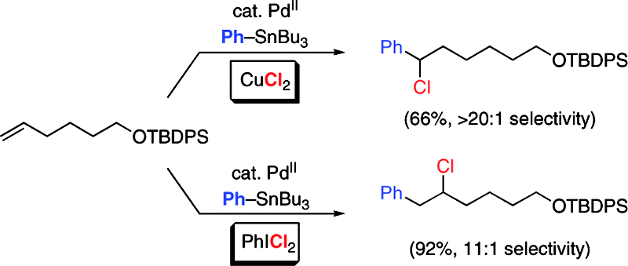
Pd(II)/Pd(IV) Catalytic Cycle
Comprehensive research:
Sanford, M. S. et. al. J. Am. Chem. Soc. 2008, 130, 2150; J. Am. Chem. Soc. 2010, 132, 8419.

Slide 12
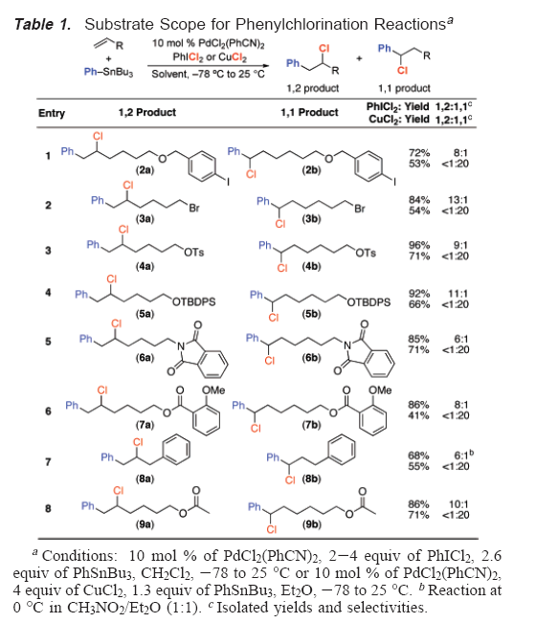
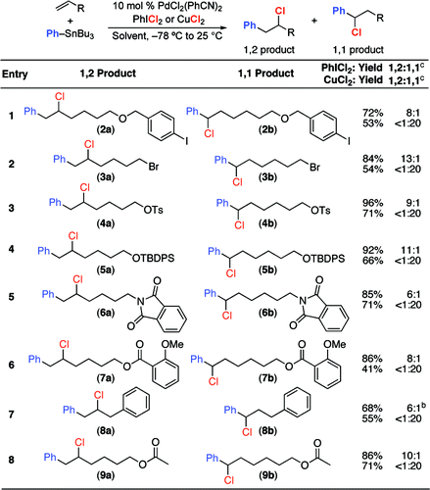
Pd(II)/Pd(IV) Catalytic Cycle
Sanford, M. S. et. al. J. Am. Chem. Soc. 2008, 130, 2150; J. Am. Chem. Soc. 2010, 132, 8419.

Slide 13
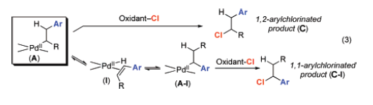
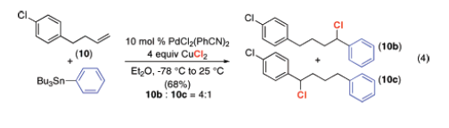
Pd(II)/Pd(IV) Catalytic Cycle
Explanation of regioselectivity:
Highly reactive PhICl2 leads to 1,2-product; less reactive CuCl2 leads to 1,1-product
Sanford, M. S. et. al. J. Am. Chem. Soc. 2008, 130, 2150; J. Am. Chem. Soc. 2010, 132, 8419.

Slide 14

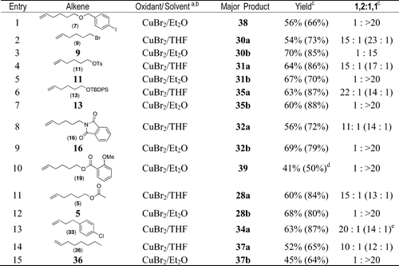
Pd(II)/Pd(IV) Catalytic Cycle
Arylbromination:
Sanford, M. S. et. al. J. Am. Chem. Soc. 2008, 130, 2150; J. Am. Chem. Soc. 2010, 132, 8419.

Slide 15
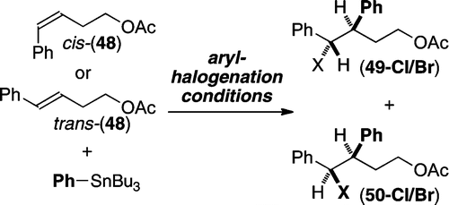
Pd(II)/Pd(IV) Catalytic Cycle
Stereochemistry:
Entry | Substrate | Oxidant | Solvent | Yield | Ratio 49:50
1 | cis-48 | PhICl₂ | CH₂Cl₂ | 40% | 12:1
2 | cis-48 | CuCl₂ | Et₂O | 51% | >30:1
3 | cis-48 | CuBr₂ | Et₂O | 41% | 5:1
4 | trans-48 | PhICl₂ | CH₂Cl₂ | 21% | 1:1.6
5 | trans-48 | CuCl₂ | Et₂O | 45% | 1:8
6 | trans-48 | CuBr₂ | Et₂O | 9% | 1:8
Sanford, M. S. et. al. J. Am. Chem. Soc. 2008, 130, 2150; J. Am. Chem. Soc. 2010, 132, 8419.

Slide 16
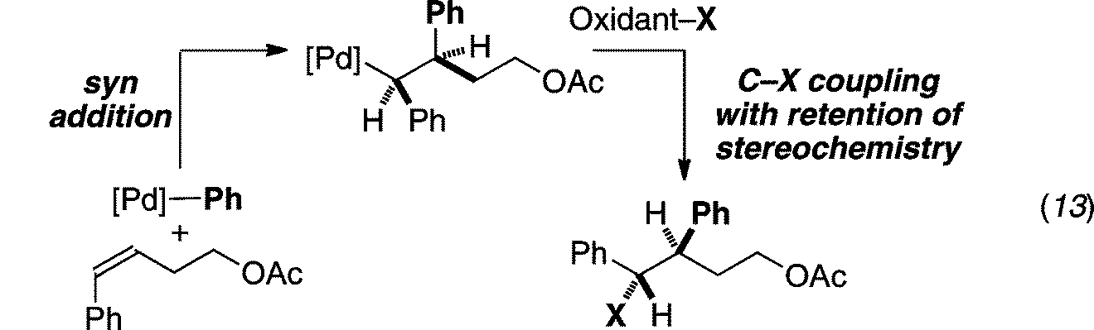
Pd(II)/Pd(IV) Catalytic Cycle
Stereochemistry:
Sanford, M. S. et. al. J. Am. Chem. Soc. 2008, 130, 2150; J. Am. Chem. Soc. 2010, 132, 8419.

Slide 17
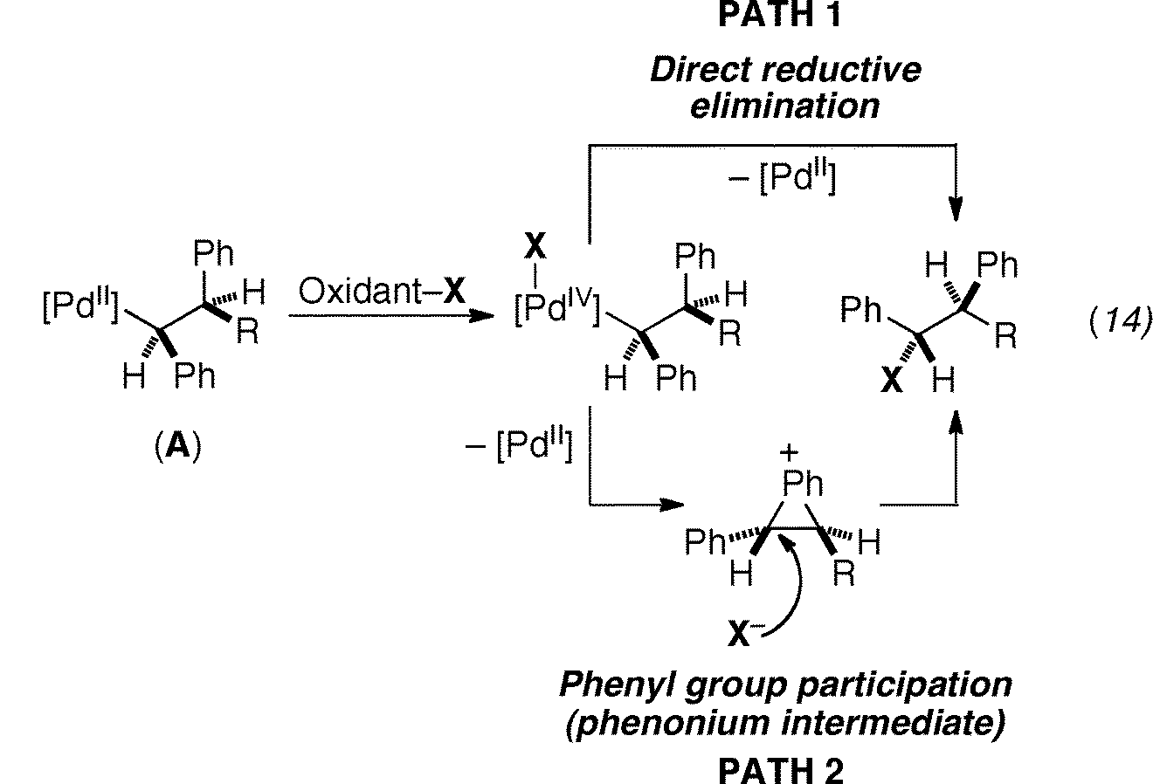
Pd(II)/Pd(IV) Catalytic Cycle
Explanation of stereochemistry:
Sanford, M. S. et. al. J. Am. Chem. Soc. 2008, 130, 2150; J. Am. Chem. Soc. 2010, 132, 8419.

Slide 18
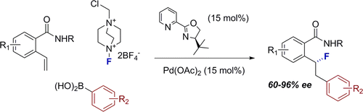
Pd(II)/Pd(IV) Catalytic Cycle
1,2-Arylfluorination:
Toste, F. D. et. al. J. Am. Chem. Soc. 2014, 136, 4101.

Slide 19
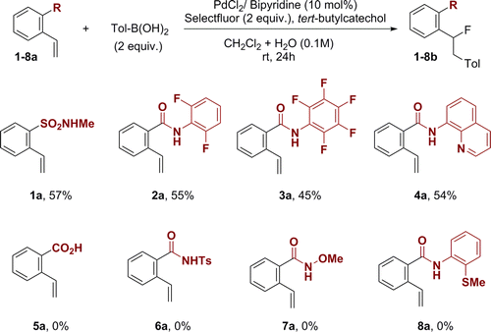
Pd(II)/Pd(IV) Catalytic Cycle
A directing group is necessary:
Toste, F. D. et. al. J. Am. Chem. Soc. 2014, 136, 4101.

Slide 20
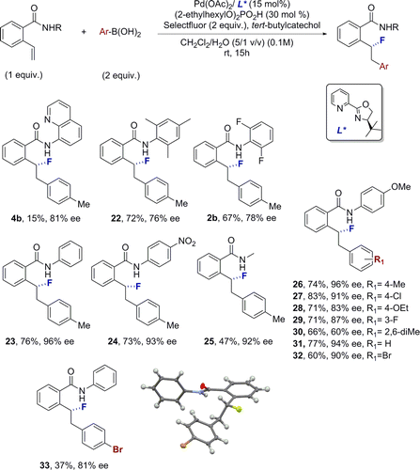
Pd(II)/Pd(IV) Catalytic Cycle
1,2-Arylfluorination:
Toste, F. D. et. al. J. Am. Chem. Soc. 2014, 136, 4101.

Slide 21
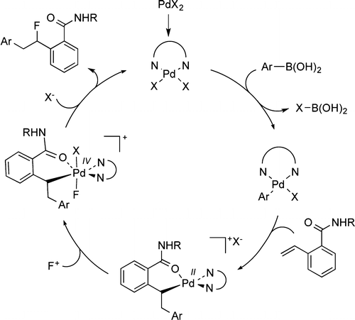
Pd(II)/Pd(IV) Catalytic Cycle
Arylfluorination:
Toste, F. D. et. al. J. Am. Chem. Soc. 2014, 136, 4101.

Slide 22
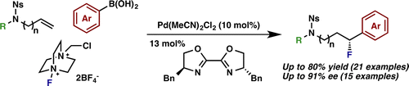
Pd(II)/Pd(IV) Catalytic Cycle
1,1-Arylfluorination:
Toste, F. D. et. al. J. Am. Chem. Soc. 2015, 137, 12207.

Slide 23

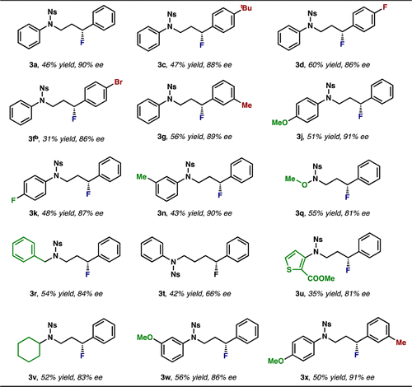
Pd(II)/Pd(IV) Catalytic Cycle
1,1-Arylfluorination:
Toste, F. D. et. al. J. Am. Chem. Soc. 2015, 137, 12207.

Slide 24
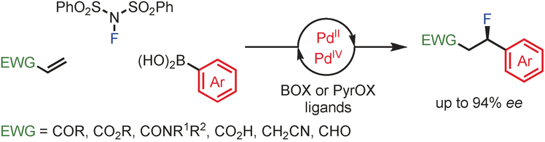
Pd(II)/Pd(IV) Catalytic Cycle
1,1-Arylfluorination:
Toste, F. D. et. al. Angew. Chem. Int. Ed. 2016, 55, 9045.

Slide 25
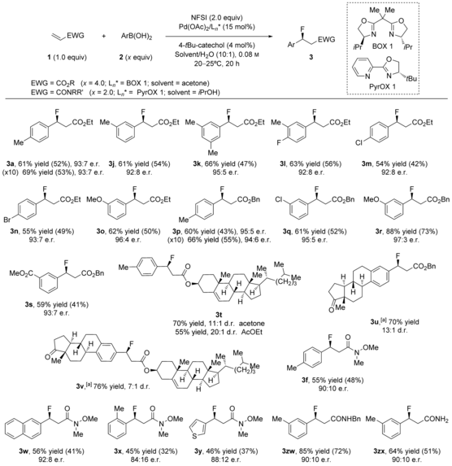
Pd(II)/Pd(IV) Catalytic Cycle
1,1-Arylfluorination:
Toste, F. D. et. al. Angew. Chem. Int. Ed. 2016, 55, 9045.

Slide 26
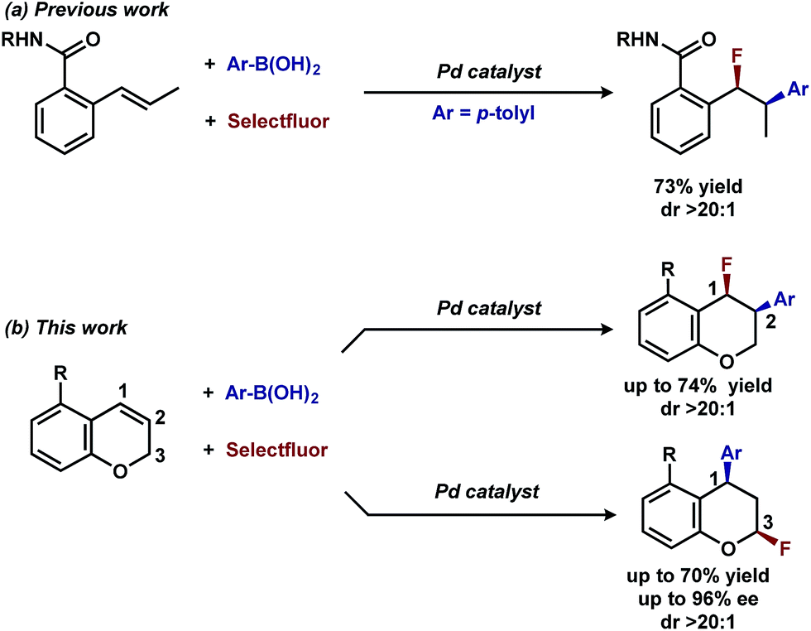
Pd(II)/Pd(IV) Catalytic Cycle
1,3-Arylfluorination:
Toste, F. D. et. al. Chem. Sci. 2017, 8, 2890.

Slide 27
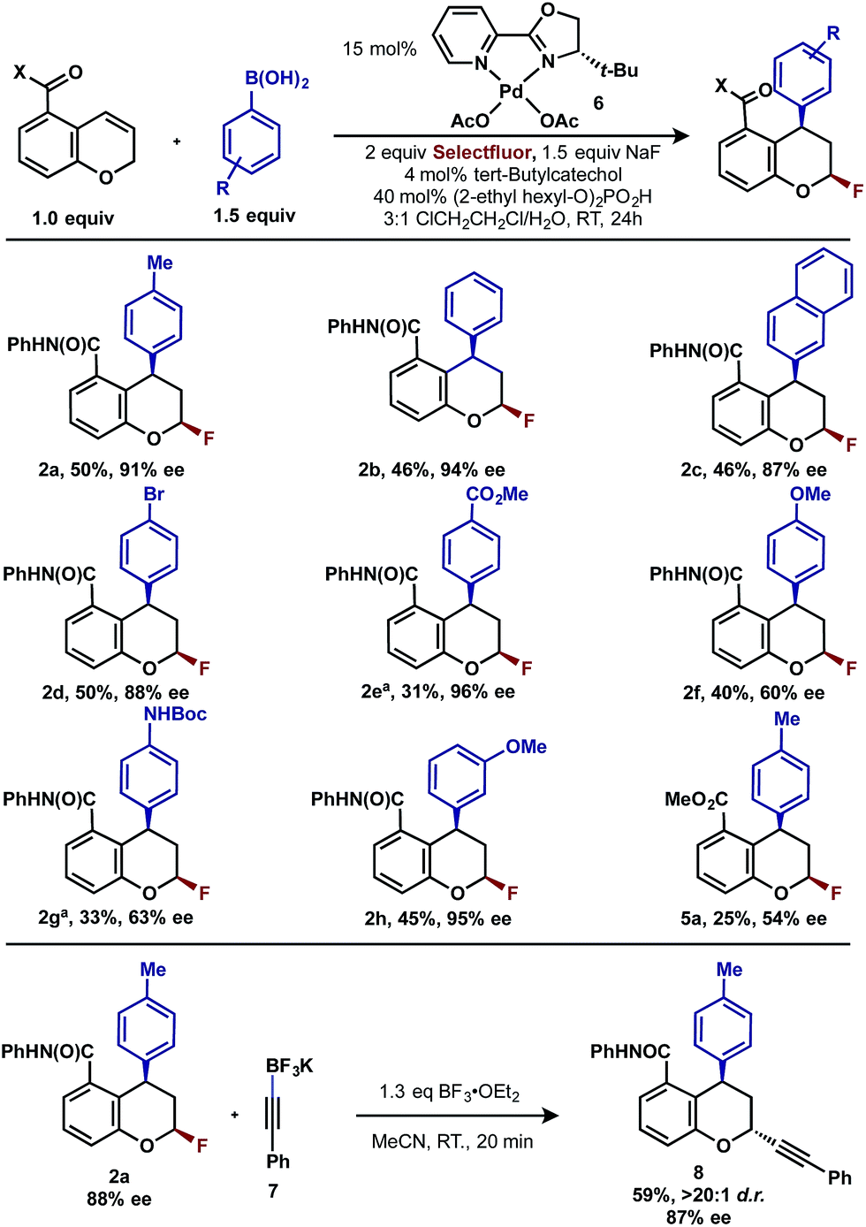
Pd(II)/Pd(IV) Catalytic Cycle
1,3-Arylfluorination:
Toste, F. D. et. al. Chem. Sci. 2017, 8, 2890.

Slide 28
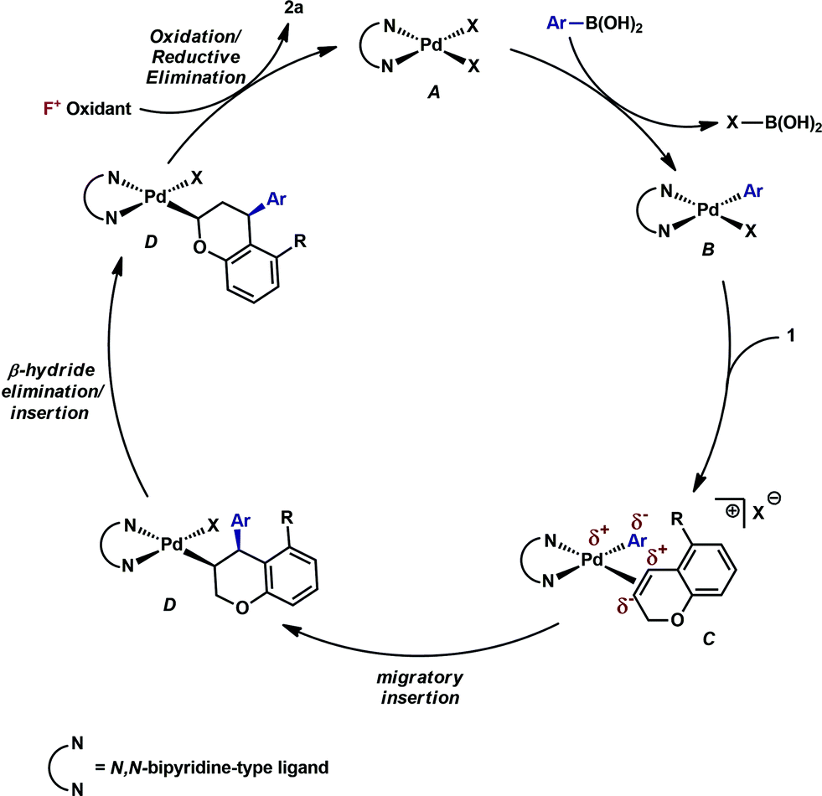
Pd(II)/Pd(IV) Catalytic Cycle
1,3-Arylfluorination:
Toste, F. D. et. al. Chem. Sci. 2017, 8, 2890.

Slide 29
Outline
1. Introduction
2. Pd(II)/Pd(IV) Catalytic Cycle
3. Pd(0)/Pd(II) Catalytic Cycle
4. Summary and Outlook

Slide 30

Pd(0)/Pd(II) Catalytic Cycle
Aryliodination:
Lautens, M. et. al. J. Am. Chem. Soc. 2011, 133, 1778.

Slide 31
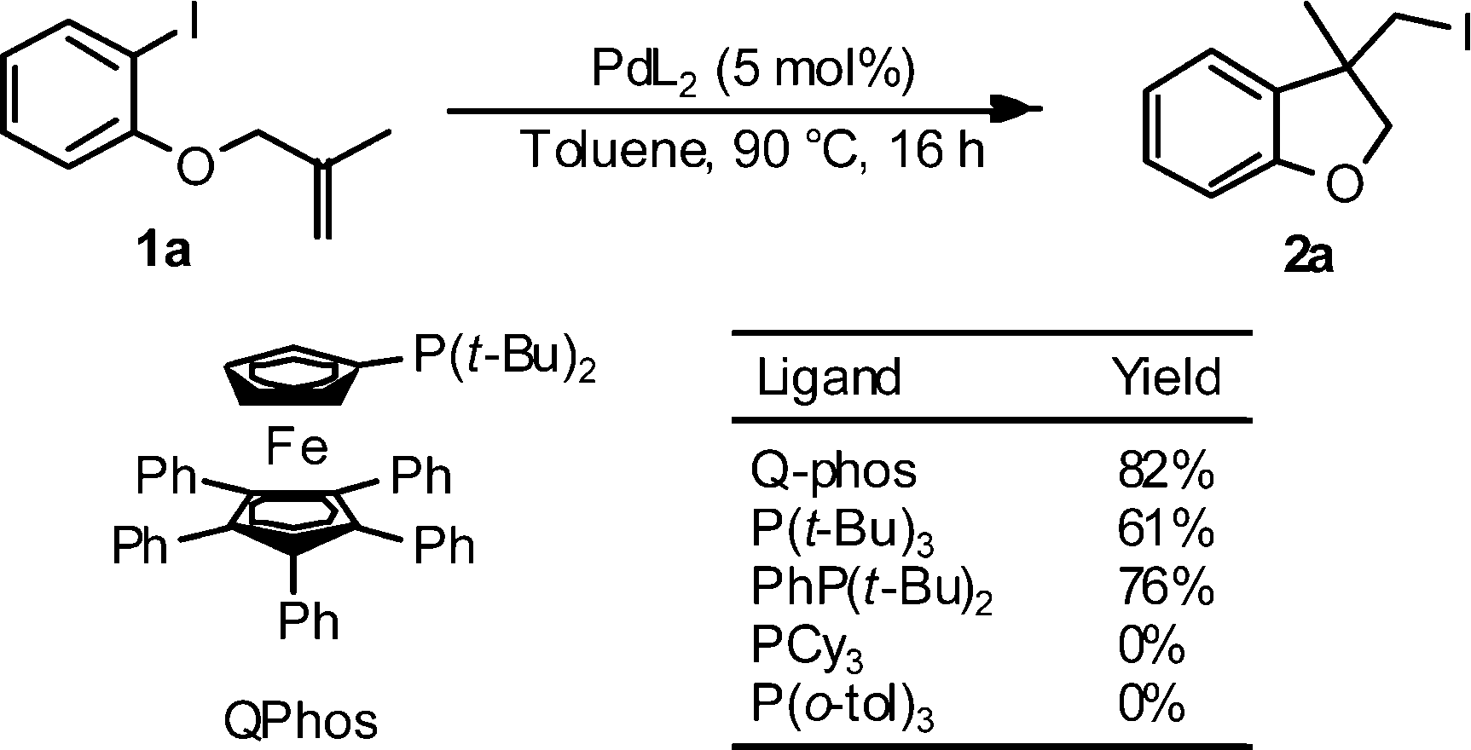
Pd(0)/Pd(II) Catalytic Cycle
Bulky phosphine ligands are crucial:
Lautens, M. et. al. J. Am. Chem. Soc. 2011, 133, 1778.

Slide 32
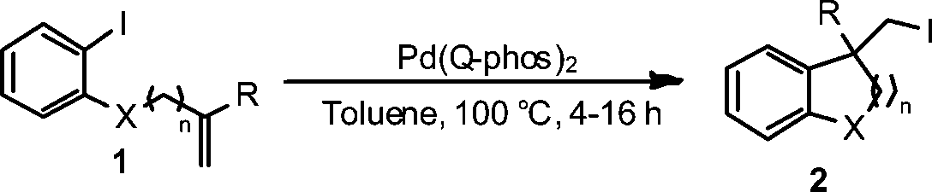
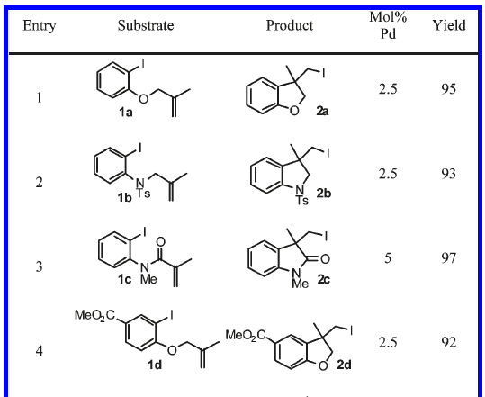
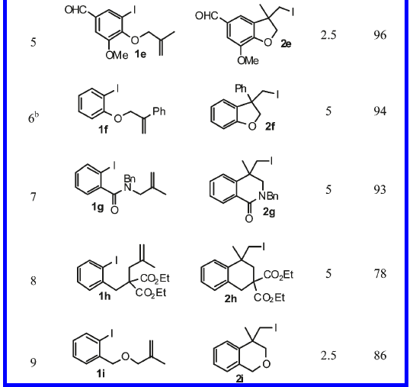
Pd(0)/Pd(II) Catalytic Cycle
Aryliodination:
R cannot be H
Lautens, M. et. al. J. Am. Chem. Soc. 2011, 133, 1778.

Slide 33
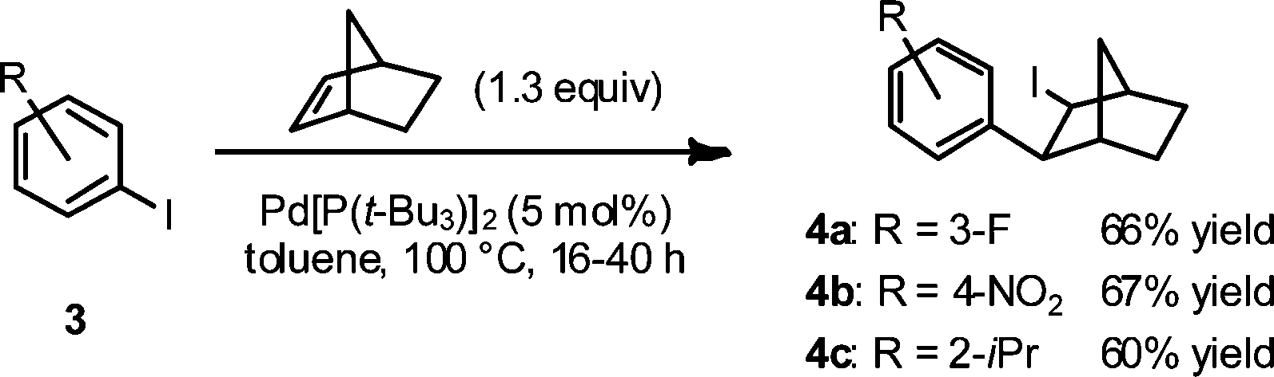
Pd(0)/Pd(II) Catalytic Cycle
Intermolecular aryliodination:
Lautens, M. et. al. J. Am. Chem. Soc. 2011, 133, 1778.

Slide 34
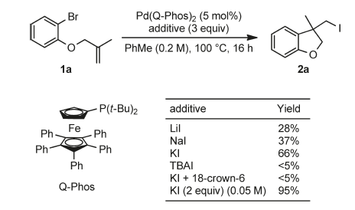
Pd(0)/Pd(II) Catalytic Cycle
Aryliodination using aryl bromides as substrates:
Arylbromination was unsuccessful.
Lautens, M. et. al. J. Am. Chem. Soc. 2011, 133, 14916.

Slide 35
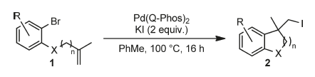
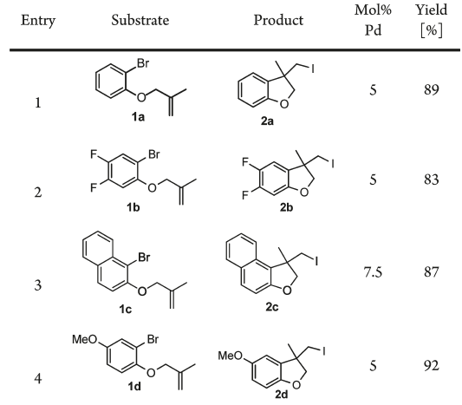
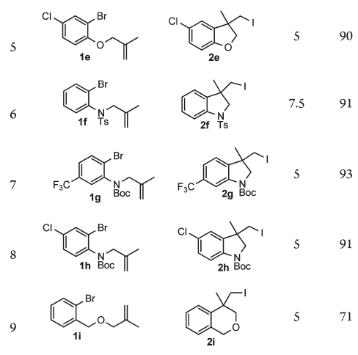
Pd(0)/Pd(II) Catalytic Cycle
Aryliodination using aryl bromides as substrates:
Lautens, M. et. al. J. Am. Chem. Soc. 2011, 133, 14916.

Slide 36
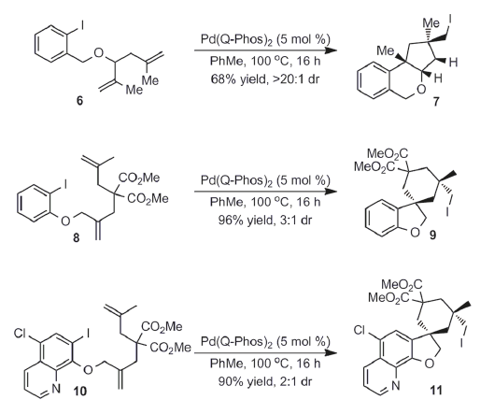
Pd(0)/Pd(II) Catalytic Cycle
Domino reactions:
Lautens, M. et. al. J. Am. Chem. Soc. 2011, 133, 14916.

Slide 37
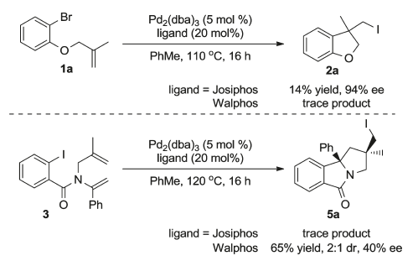
Pd(0)/Pd(II) Catalytic Cycle
Enantioselective variant:
Lautens, M. et. al. J. Am. Chem. Soc. 2011, 133, 14916.

Slide 38
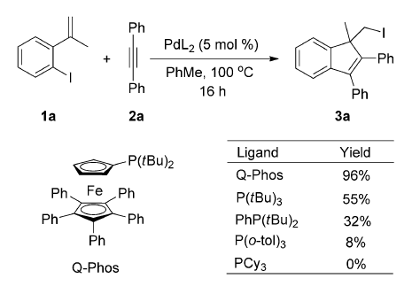
Pd(0)/Pd(II) Catalytic Cycle
Conjunctive carboniodination:
Lautens, M. et. al. Angew. Chem. Int. Ed. 2012, 51, 9870.

Slide 39
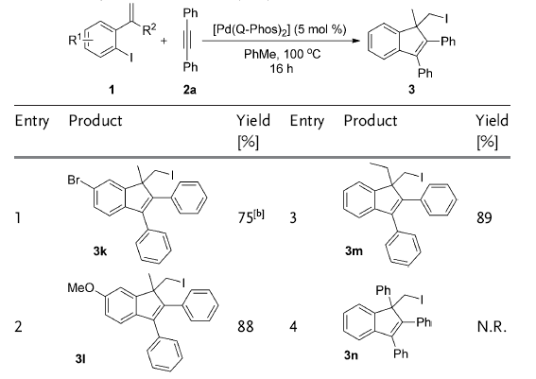
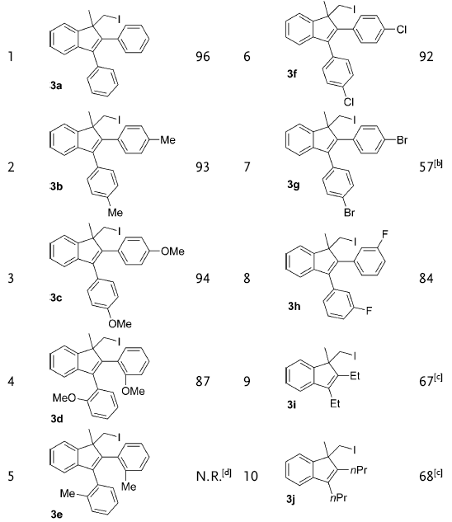
Pd(0)/Pd(II) Catalytic Cycle
Conjunctive carboniodination:
Lautens, M. et. al. Angew. Chem. Int. Ed. 2012, 51, 9870.

Slide 40
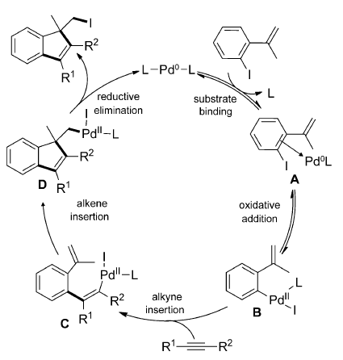
Pd(0)/Pd(II) Catalytic Cycle
Proposed mechanism:
Lautens, M. et. al. Angew. Chem. Int. Ed. 2012, 51, 9870.

Slide 41
Summary
End ?

Slide 42
Thanks for your attention !

