Slide 1
Transition metal catalyzed trifluoromethylation of unactivated alkene
Presented by Ala Bunescu
30/04/2013

Slide 2
Why CF3?
Important impact in pharmaceutic, agrochemistry and material science:
before 1957 no F-containing drug had been developed, our days 150 fluorinated drugs have come to market
~20% of all pharmaceuticals; ~30% for agrochemicals
~
Diederich- Science 2007, 317, 1881; J. T. Welch, Tetrahedron 1987, 43, 3123.

Slide 3
What is so special about CF3?
F enhance metabolic stability (mainly by lowering the susceptibility to cytochrome P450 enzymatic oxidation)
Enhance protein–ligand interactions
Increased lipophilicity
High elecrtonegativity (perturbation of pKa neighbor group, impact on bioavailability)
Small size (2.5 x Me)
Improve thermal, chemical stability of materials
Diederich, Science 2007, 317, 1881; Gouverneur, Chem. Soc. Rev. 2008, 37, 320; McClinton-Tetrahedron,1992, 6555

Slide 4
Methods to introduce CF3
Nucleophilic
Electrophilic
Radical

Slide 6
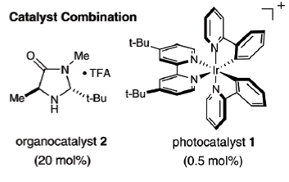
- McMillan α-Trifluoromethylation of Aldehydes via Photoredox Organocatalysis
McMillan-JACS, 2009, 10875

Slide 7
Trifluoromethylation of unactivated double bonds
Halotrifluoromehylation
Hydrotriflorometylation
Allylic CF3
Oxytrifluoromethylation

Slide 8
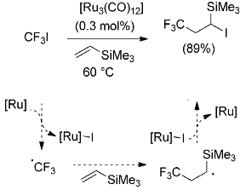
Iodotrifluoromethylation of double bond (ATRA)
ATRA: atom transfer radical addition
T. Fuchikami, I. Ojima, Tetrahedron Lett. 1984, 25, 303–306

Slide 9
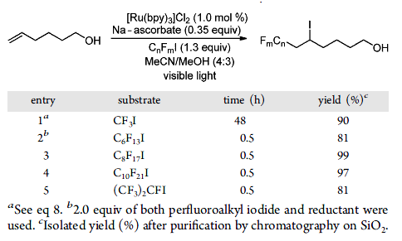
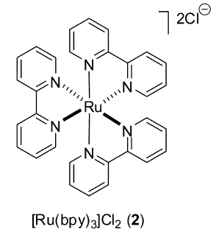
Iodotrifluoromethylation of double bond (ATRA)
Proposed Mechanism
Sthephenson-JACS, 2012, 8875

Slide 10
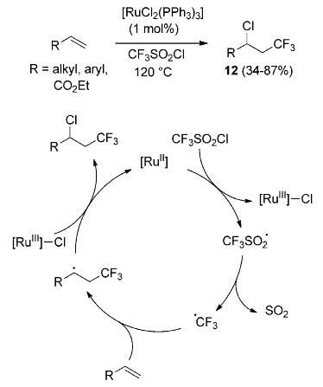
Chlorotrifluoromethylation (ATRA)
Yoshida- J. Chem. Soc. Perkin Trans. 1 1991, 627
Kamigata J. Chem. Soc. Chem. Commun. 1989, 1559

Slide 11
Hydrotrifluoromethylation of unactivated double bonds
Gouverneur-JACS, 2013, 2505
Qing-ACIE, 2013,2198

Slide 12
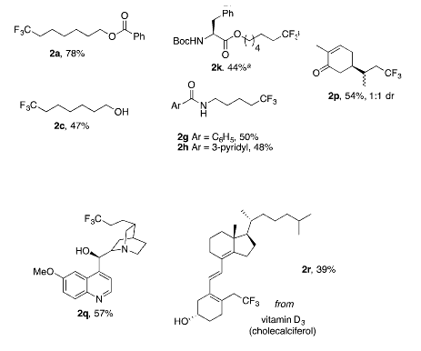
Hydrotrifluoromethylation double bonds: Ru
from carvone
from quinine
Gouverneur-JACS, 2013, 2505

Slide 13
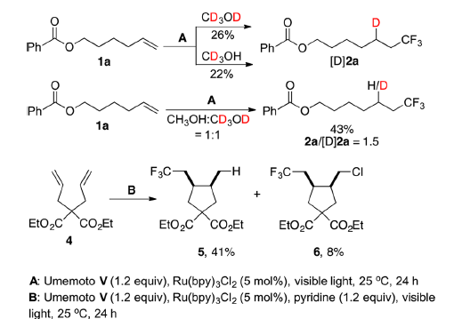
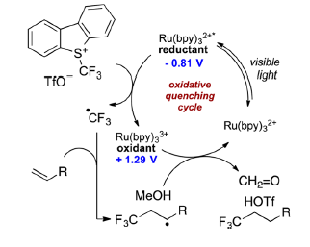
Hydrotrifluoromethylation of unactivated double bonds: Ru
Proposed Mechanism
Reduction potential
Umemeto reagent: -0.25V
Ru(bpy)3(II): 0.77V
MeOH: 1.5 V
Gouverneur-JACS, 2013, 2505

Slide 14
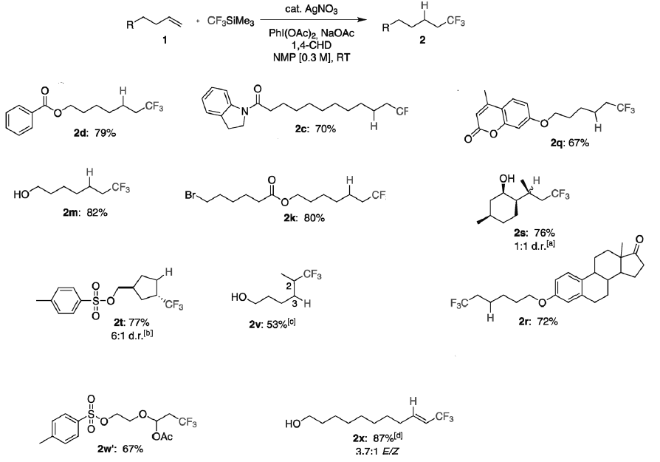
Hydrotrifluoromethylation of unactivated double bonds: Ag
from 4-methyl umbelliferone
from isopulegol
from estrone
from alkyne
Qing-ACIE, 2013,2198

Slide 15
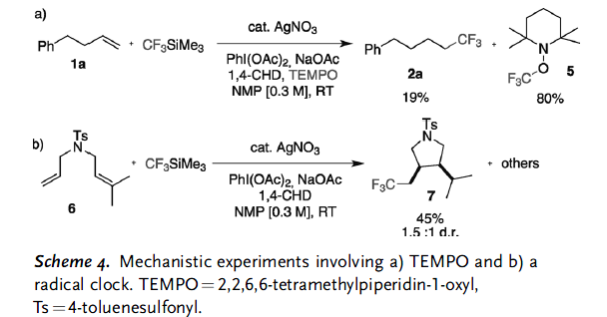
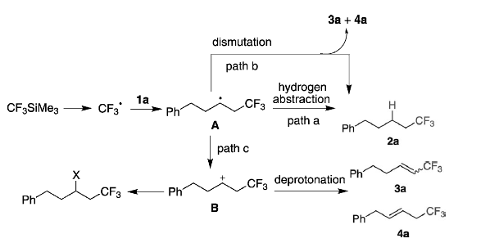
Hydrotrifluoromethylation of unactivated double bonds: Ag
Proposed Mechanism
Qing-ACIE, 2013,2198

Slide 16
Copper catalyzed allylic trifluoromethylation
Jianbo Wang-JACS, 2011,16410
15 examples
44%-97%
Buchwald –ACIE, 2011, 9120
,
Liu-JACS, 2011,15300
, DMAc

Slide 17
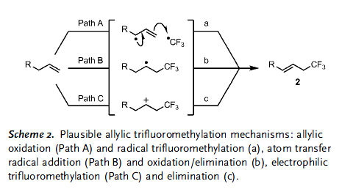
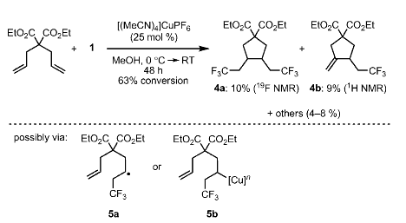
Copper catalyzed allylic trifluoromethylation
Buchwald
formation of an free allylic radical is unlikely to occur
high selectivity for the linear trifluoromethylation
(in contrast to Kharasch–Sosnovsky-type oxidative
alkene functionalizations)

Slide 18
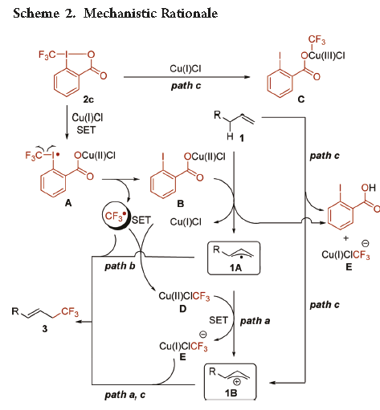
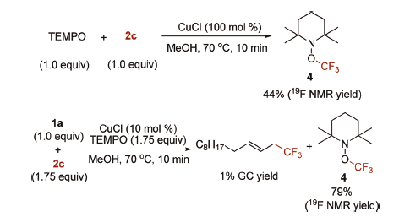
Copper catalyzed allylic trifluoromethylation
Wang
CF3 radical involved
allyl radical wasn’t trapped using TEMPO
no evidence of the involvement of either
allylmetal species or trifluoromethylmetal species in the mechanism.

Slide 19
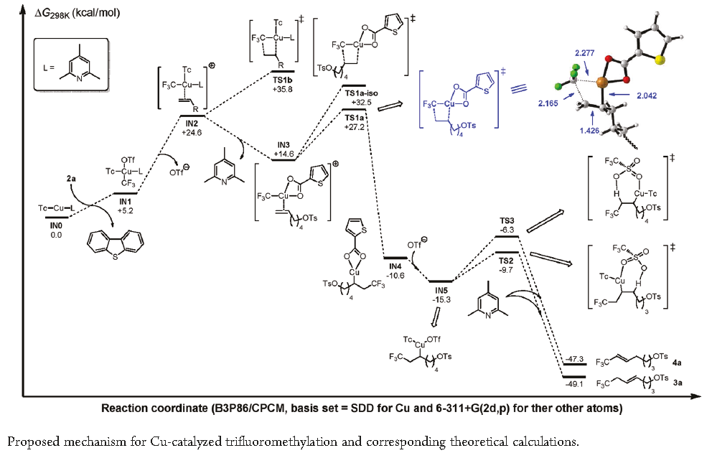
Copper catalyzed allylic trifluoromethylation
Liu
Cu(I)/ Cu(III)
Heck like four
memebered ring TS
regioselectivity
Direct protonation:

Slide 20
Oxytrifluoromethylation of unactivated double bonds
Sodeoka-TL, 2012, 5503
Szabo-OL, 2012, 2882
Buchwald- JACS, 2012, 12462
Akita- ACIE 2012,9567

Slide 21
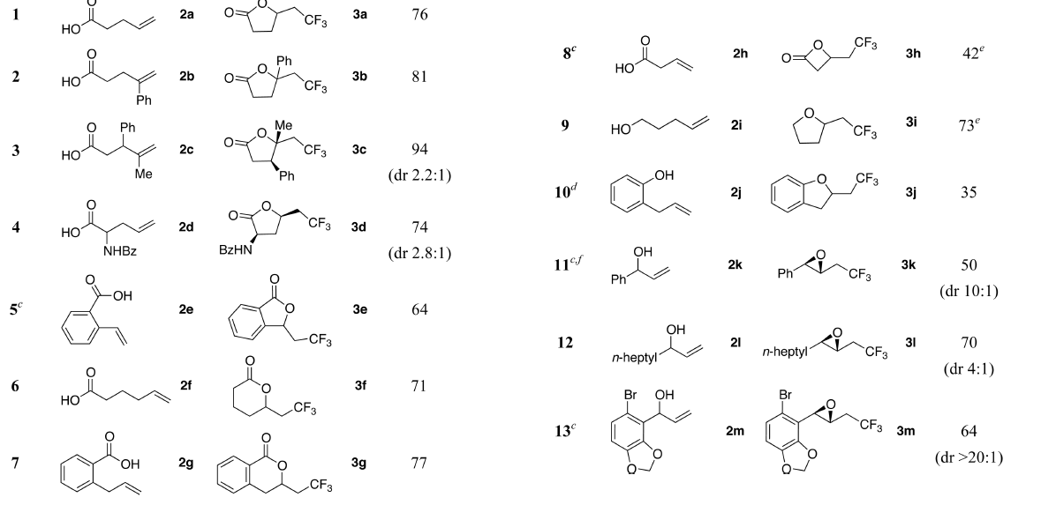
Three-component Oxytrifluoromethylation of Alkenes Mediated by Photoredox Catalysts
Buchwald- JACS, 2012, 12462

Slide 22
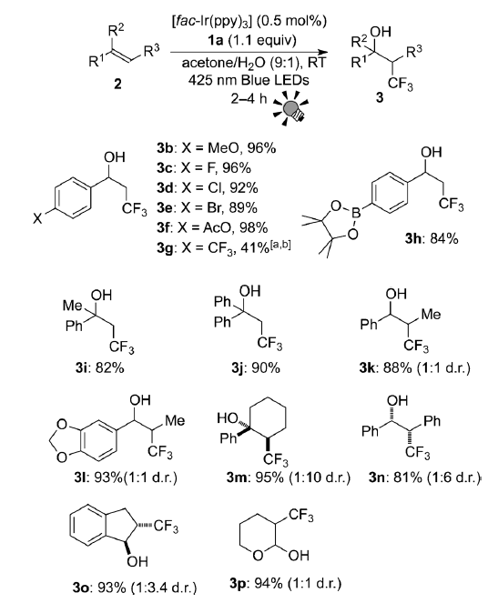
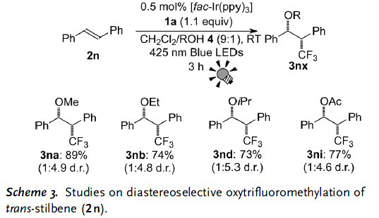
Three-component Oxytrifluoromethylation of Alkenes Mediated by Photoredox Catalysts
Linear alkene doesn’t react
Akita- ACIE 2012,9567

Slide 23
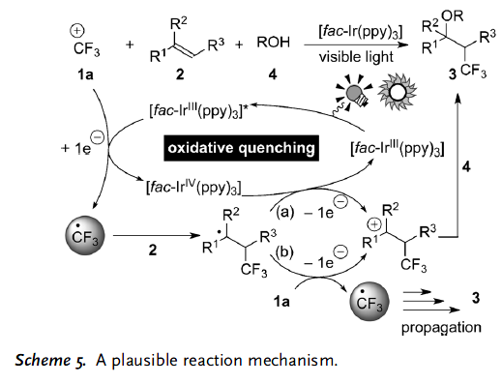
Oxytrifluoromethylation of unactivated double bonds
Akita- ACIE 2012,9567

Slide 24
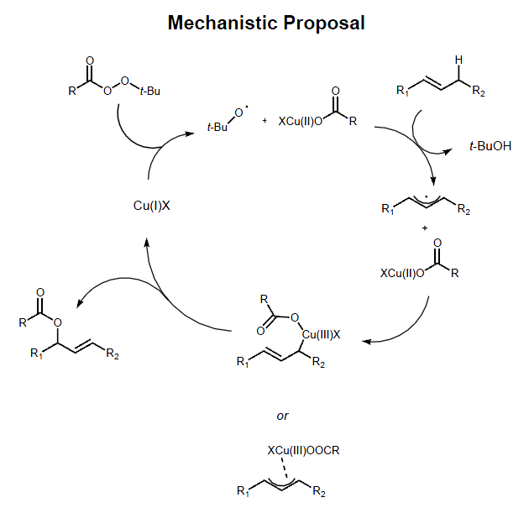
Kharasch–Sosnovsky

