Slide 1
Welwitindolinones
Tiffany Piou
Group meeting
04.30.12

Slide 2
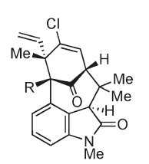
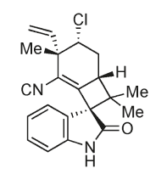
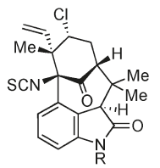
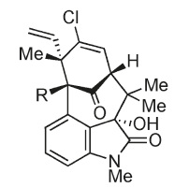
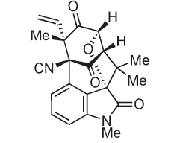
Welwitindolinone family
Welwitindolinone A isonitrile
Welwitindolinone B isothiocyanate (R = H, Me)
N-Methylwelwitindolinone C
(R = -NCS, -NC)
First isolated by Moore et al. in 1994
Isolated from Hapalosiphon welwitschii, Westiella intricata, Fischerella
Ten coumpounds have been identified to date
Wide variety of biological activities:
antifungialeffects, microtubule depolymerization…
3-hydroxy-N-methylwelwitindolinone C
(R = -NCS, -NC)
N-Welwitindolinone D
(R = -NCS, -NC)
Stratmann, K.; Moore, R. E.; Bonjouklian, R.; Deeter, J. B.; Patterson, G. M. L.; Shaffer, S.; Smith, C. D.; Smitka, T. A. J. Am. Chem. Soc. 1994, 116, 9935–9942.
Jimenez, J. I.; Huber, U.; Moore, R. E.; Patterson, G. M. L. J. Nat.Prod. 1999, 62, 569–572.

Slide 3
A unique class of compounds
N-Methylwelwitindolinone D
(R = -NCS, -NC)
N-Methylwelwitindolinone C
(R = -NCS, -NC)
3-hydroxy-N-methylwelwitindolinone C
(R = -NCS, -NC)
3,4-Disubstituted oxindole
Bicyclo[4.3.1]decane cores
- Highly functionalized cyclohexanone moiety
A bridgehead isocanate or isonitrile
More than 10 groups reported progress towards the synthesis of the bicyclic cores …
But successful synthesis published only very recently
Welwitindolinone B isothiocyanate (R = H, Me)

Slide 4
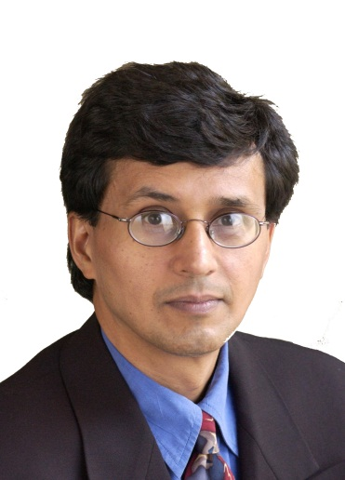
First total synthesis by Rawal’s group
PhD with Prof. Michael P. Cava University of Pennsylvania (1986)
Postdoctoral associate with Prof. Gilbert Stork at Columbia University
Professor at University of Chicago
Interest: Total synthesis

Slide 5
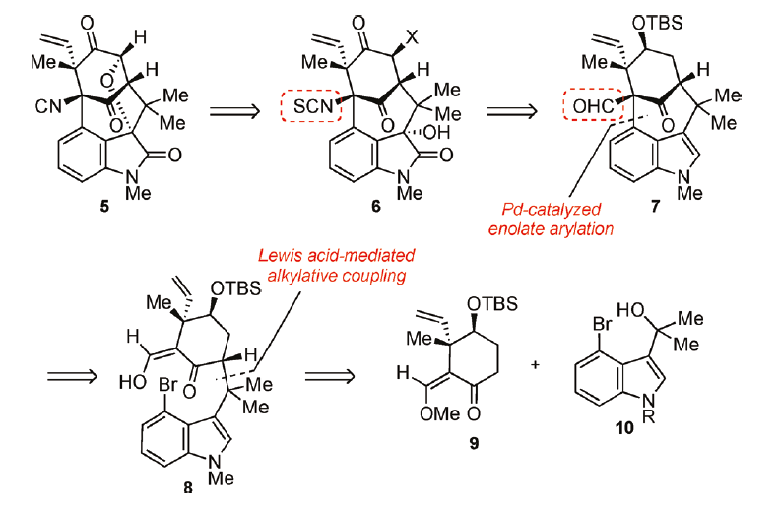
First total synthesis by Rawal’s group
N-Methylwelwitindolinone D
Rawal JACS 2011, 133, 5798

Slide 6
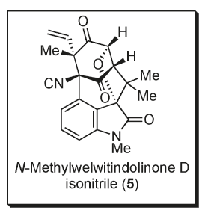
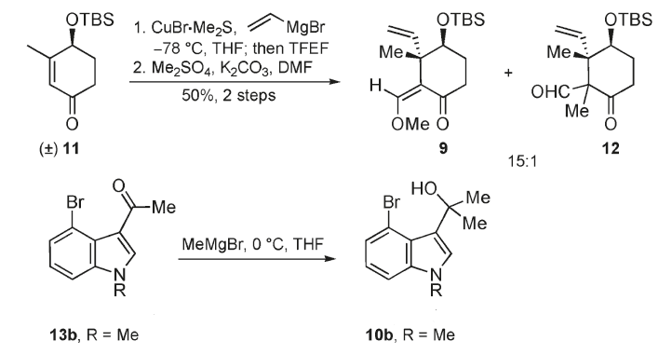
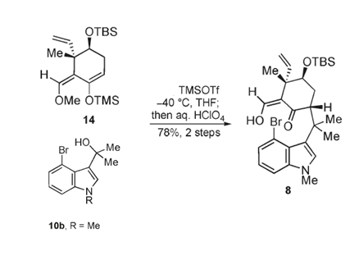
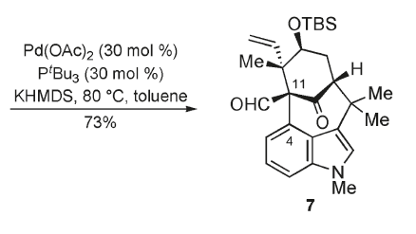
First total synthesis by Rawal’s group
Formation of the welwitindolinone core
7 steps
Rawal JACS 2011, 133, 5798

Slide 7
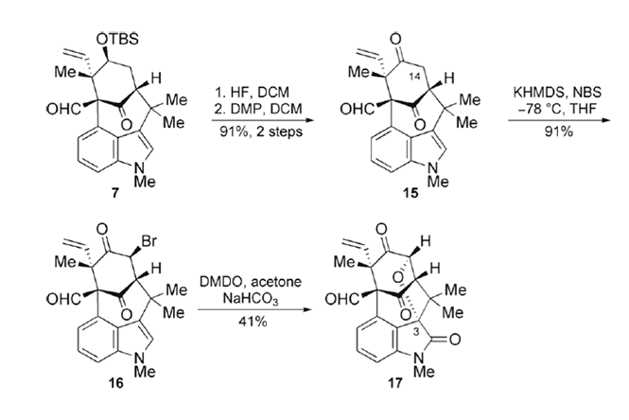
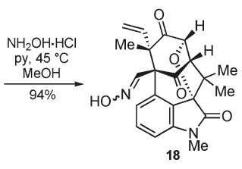
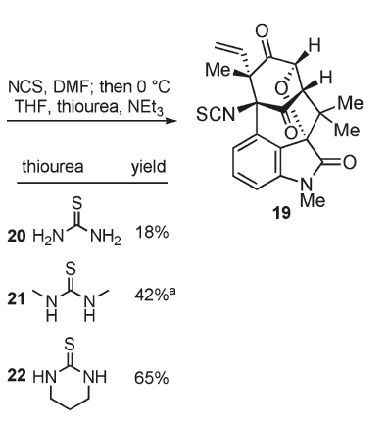
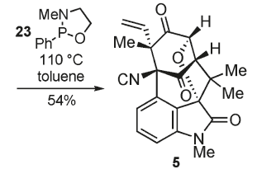
First total synthesis by Rawal’s group
Synthesis of N-methylwelwitindolinone D
Rawal JACS 2011, 133, 5798

Slide 8
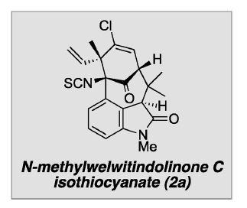
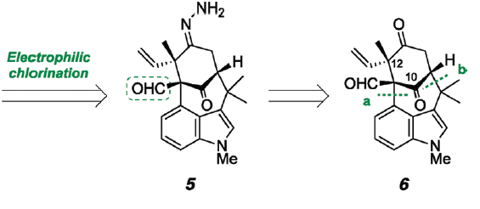
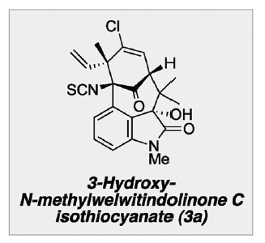
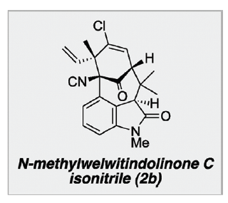
Rawal: Total synthesis of the N-methylwelwitindolinones C
Rawal 2012,134, 1392

Slide 9
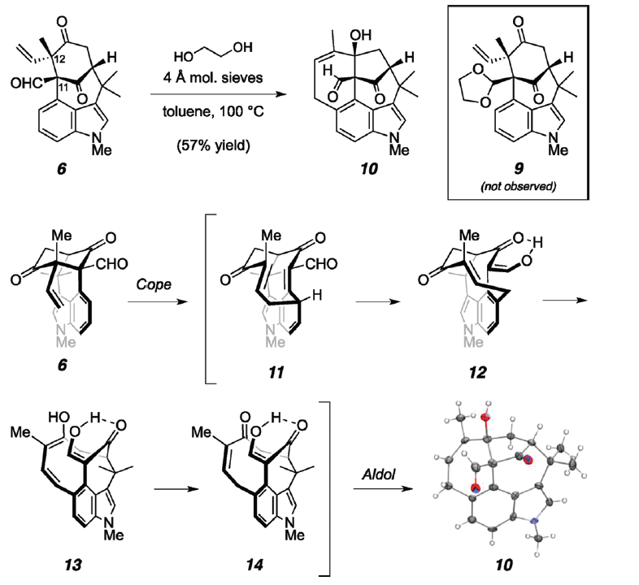
Rawal: Total synthesis of the N-methylwelwitindolinones C
Rawal 2012,134, 1392

Slide 10
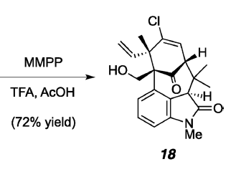
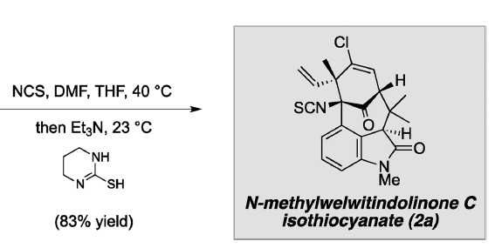
Rawal: Total synthesis of the N-methylwelwitindolinones C
Rawal 2012,134, 1392

Slide 11
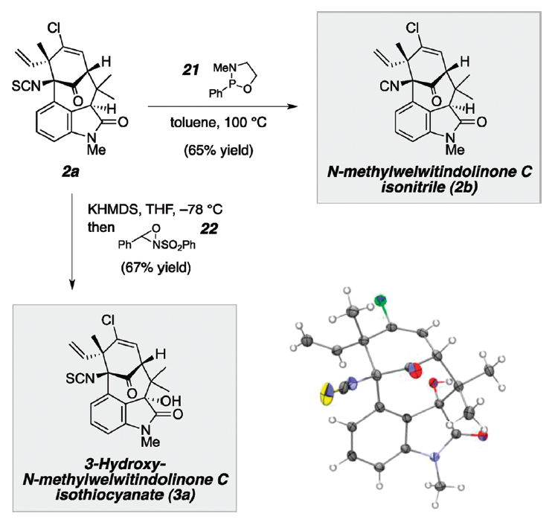
Rawal: Total synthesis of the N-methylwelwitindolinones C
Rawal 2012,134, 1392

Slide 12
Garg: Total synthesis of welwitindolinones
Ph.D. in 2005 from the California Institute of Technology with Professor Brian Stoltz
Post-doc University of California, Irvine Prof. Overman
Since 2007 Assistant professor at UCLA
Interest

Slide 13
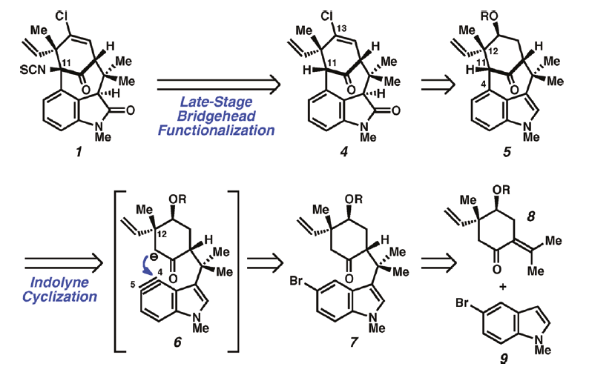
Synthesis of (-)N-Methylwelwitindolinone C isothiocyanate
Garg 2011, 133, 15797

Slide 14
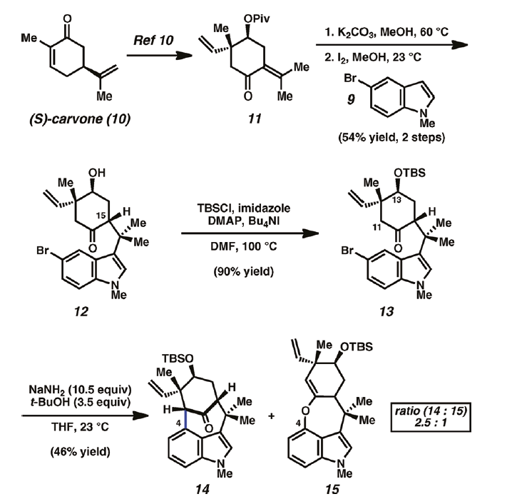
Synthesis of (-)N-Methylwelwitindolinone C isothiocyanate
Garg 2011, 133, 15797

Slide 15
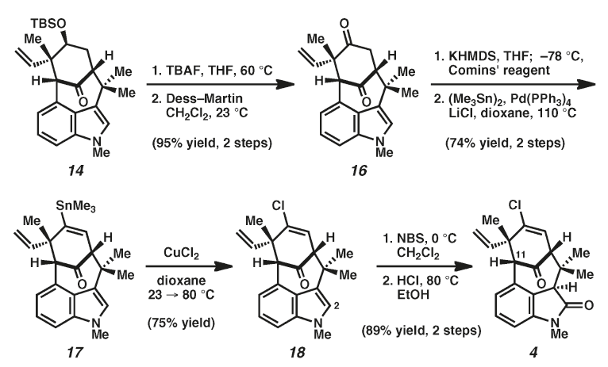
Synthesis of (-)N-Methylwelwitindolinone C isothiocyanate
Garg 2011, 133, 15797

Slide 16
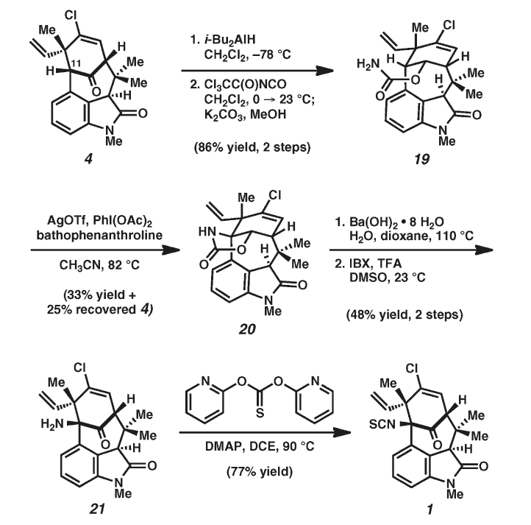
Synthesis of (-)N-Methylwelwitindolinone C isothiocyanate
Garg 2011, 133, 15797

Slide 17
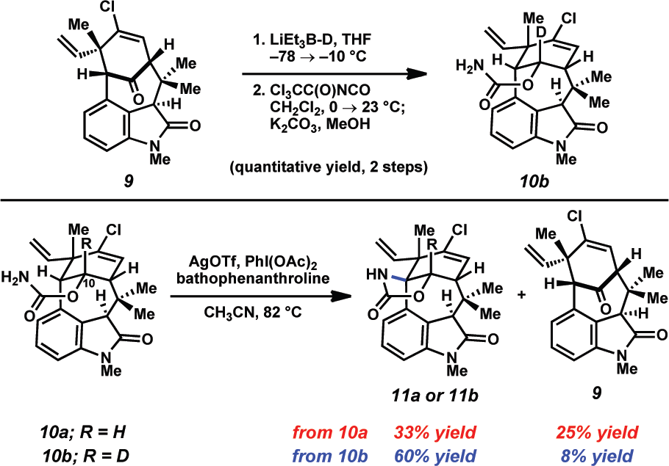
Synthesis of (-)N-Methylwelwitindolinone C isonitrile
Garg 2012, 134, 1396

Slide 18
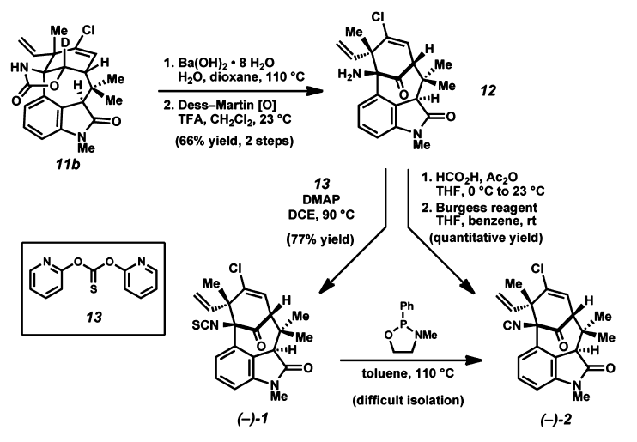
Synthesis of (-)N-Methylwelwitindolinone C isonitrile
Garg 2012, 134, 1396

Slide 19
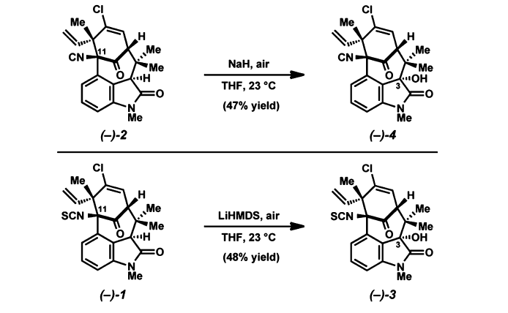
Synthesis of (-)N-Methylwelwitindolinone C isonitrile
Garg 2012, 134, 1396

