Slide 1
Recent Developments in Enantioselective Radical Reactions
Wangqing Kong
Zhu’s group meeting
23th, Feb, 2017

Slide 2
Outline
1. Introduction
2. Methods for Control of Asymmetry in Radical Chemistry
(1) Chiral Lewis Acid Chelation
(2) Organocatalysis
(3) Transition-Metal Catalysis
3. Conclusion

Slide 3
Introduction
Difficulties: Rare examples of stereoselective radical reactions
Species too reactive
Carbon radical is nearly planar
2. Advantages:
mild condition
good compatibility with several functional group
access to complex molecular architecture

Slide 4
1. Chiral Lewis Acid Chelation
1.1 Enantioselective Free Radical Addition Reactions
Stoichiometric amount of Lewis acid and chiral ligand are required!
Ned A. Porter et al. J. Am. Chem. Soc. 1995, 117, 11029.

Slide 5
1. Chiral Lewis Acid Chelation
1.1 Enantioselective Free Radical Addition Reactions
Mukund P. Sibi et al. Chem. Rev. 2003, 103, 3263.

Slide 6
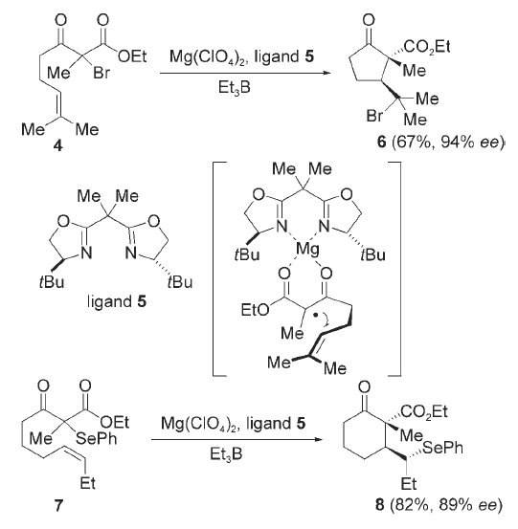
1. Chiral Lewis Acid Chelation
1.2 Tandem Atom Transfer Cyclizations
Dan Yang et al. J. Am. Chem. Soc. 2001, 123, 8612; Angew. Chem. Int. Ed. 2002, 41, 3014;
Angew. Chem. Int. Ed. 2006, 45, 255.

Slide 7
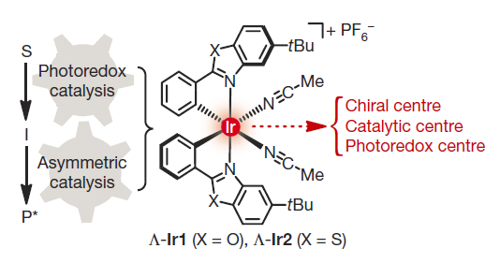
1. Chiral Lewis Acid Chelation
1.3 Combining Lewis Acid Catalysis and Photoredox catalysis
Eric Meggers et al. Nature 2014, 515, 100–103.
Notes:
Breakthrough design this chiral Ir catalyst, play two roles in reactions:

Slide 8
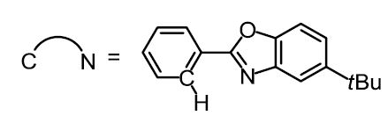
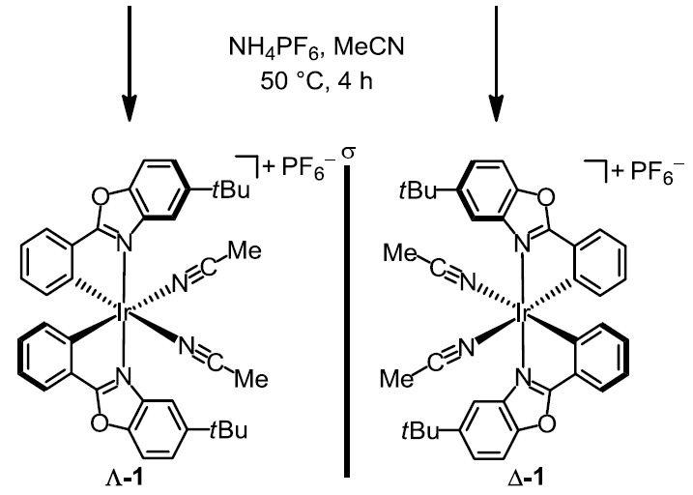
1. Chiral Lewis Acid Chelation
1.3 Combining Lewis Acid Catalysis and Photoredox catalysis
Synthesis of enantiopure Iridium catalysts:
Eric Meggers et al. Nature 2014, 515, 100–103.
Notes:
Breakthrough design this chiral Ir catalyst, play two roles in reactions:

Slide 9
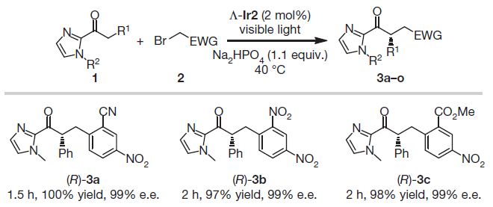
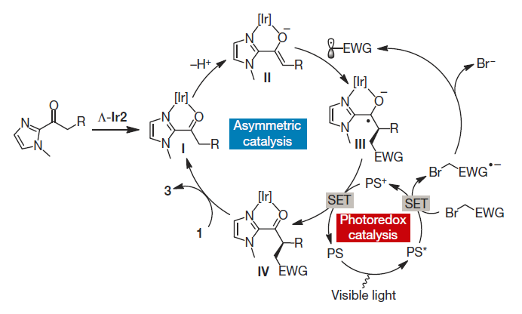
1. Chiral Lewis Acid Chelation
1.3 Combining Lewis Acid Catalysis and Photoredox catalysis
Plausible mechanism:
PS = iridium(III) enolate complex
Eric Meggers et al. Nature 2014, 515, 100–103.

Slide 10
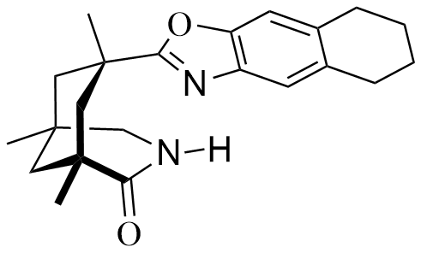
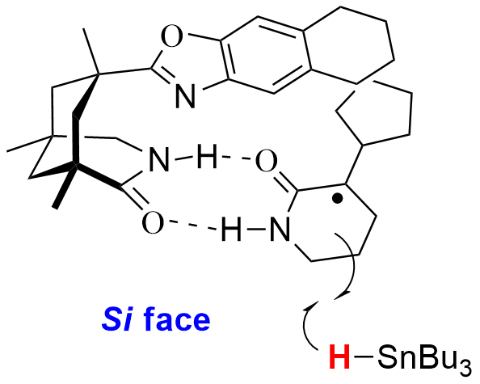
2. Organocatalysis
2.1 Hydrogen Bond Mediated Enantioselective Radical Cyclization
Inductive Model:
The reagent was completely (>90%) recovered (2.5 equiv. were used).
Thorsten Bach et al. Angew. Chem. Int. Ed. 2004, 43, 5849.

Slide 11
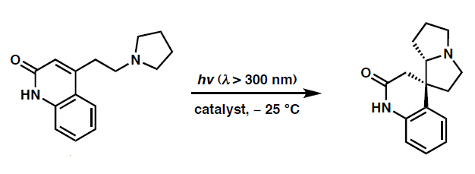
2. Organocatalysis
2.1 Hydrogen Bond Mediated Enantioselective Radical Cyclization
Single Electron Transfer Photosensitization
Patrick S. Mariano et al. J. Am. Chem. Soc. 1991, 113, 8847.

Slide 12
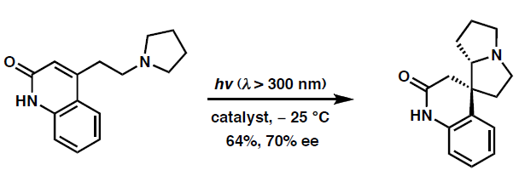
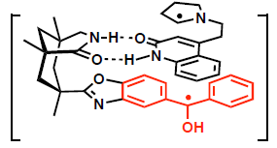
2. Organocatalysis
2.1 Hydrogen Bond Mediated Enantioselective Radical Cyclization
PET sensitized Catalyst:
Thorsten Bach et al. Nature 2005, 436, 1139

Slide 13
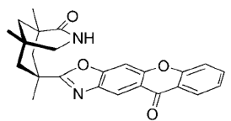
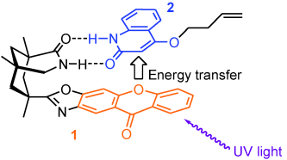
2. Organocatalysis
2.1 Hydrogen Bond Mediated Enantioselective Radical Cyclization
Thorsten Bach et al. Angew. Chem. Int. Ed. 2009, 48, 6640.

Slide 14
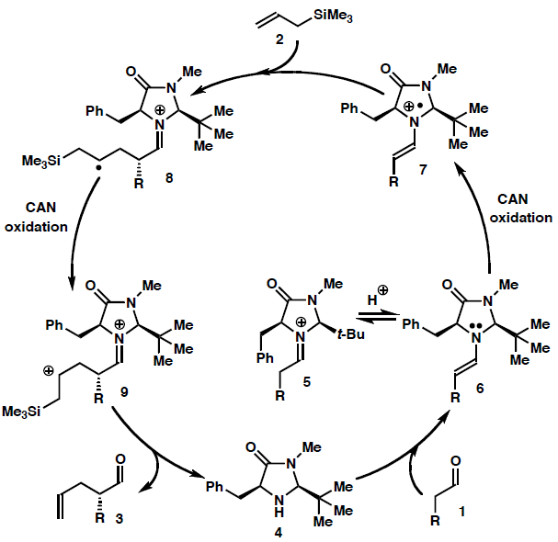
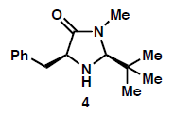
2. Organocatalysis
2.2 Singly Occupied Molecular Orbital (SOMO) Activation
SOMO catalysis
iminium catalysis
enamine catalysis
David W. C. MacMillan et al. Science 2007, 316, 582.

Slide 15
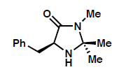
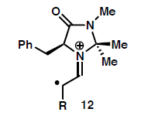
2. Organocatalysis
2.2 Singly Occupied Molecular Orbital (SOMO) Activation
Mukund P. Sibi et al. J. Am. Chem. Soc. 2007, 129, 395.
Notes:
Macmillan catalyst: Imidazolidinone salt

Slide 16
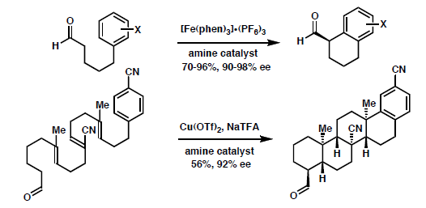
2. Organocatalysis
2.2 Singly Occupied Molecular Orbital (SOMO) Activation
J. Am. Chem.Soc. 2007, 129, 7004.
J. Am. Chem.Soc. 2008, 130, 398.
J. Am. Chem. Soc. 2009, 131, 11332.
Angew. Chem.Int. Ed. 2009, 48, 5121.
J. Am. Chem. Soc. 2009, 131, 11640.
J. Am. Chem. Soc., 2010, 132, 6001.
J. Am. Chem. Soc. 2010, 132, 5027.

Slide 17
2. Organocatalysis
2.3 Incorporating Photoredox Catalysis with Organocatalysis
David W. C. MacMillan et al. Science 2008, 322, 77.

Slide 18
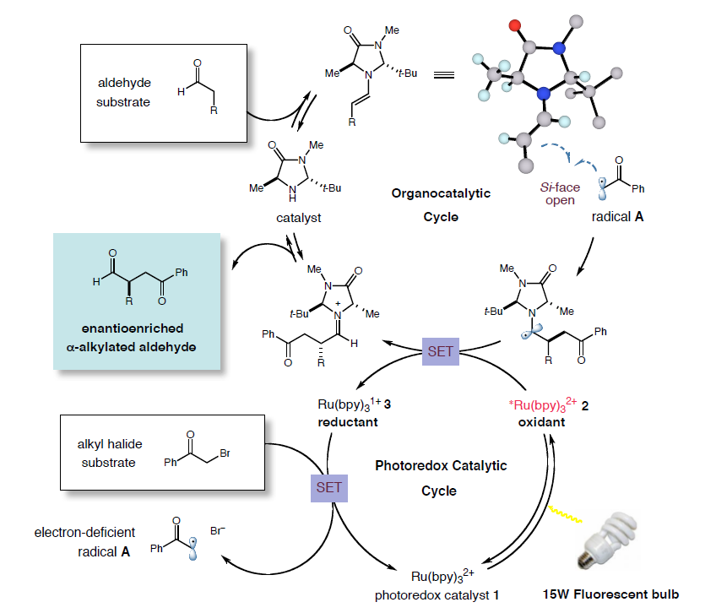
2. Organocatalysis
2.3 Incorporating Photoredox Catalysis with Organocatalysis
David W. C. MacMillan et al. Science 2008, 322, 77.
Notes:
Imidazolidinone salt

Slide 19
2. Organocatalysis
2.3 Incorporating Photoredox Catalysis with Organocatalysis
J. Am. Chem.Soc. 2009, 131, 10875.
90-99% ee
J. Am. Chem. Soc., 2010, 132, 13600.
87-97% ee

Slide 20
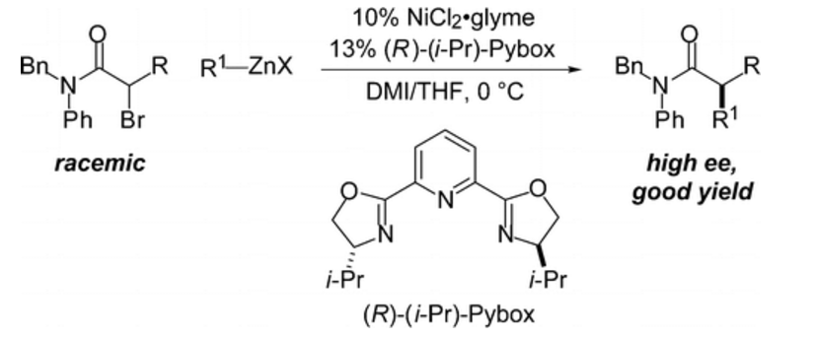
3. Transition Metal Catalysis
3.1 Asymmetric Ni-Catalyzed Negishi Cross-Couplings
α-Bromo Amides with Organozinc Reagents
Gregory C. Fu et al. J. Am. Chem. Soc., 2005, 127, 4594.

Slide 21
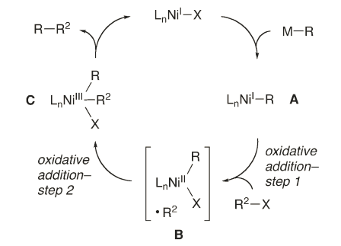
3. Transition Metal Catalysis
3.1 Asymmetric Ni-Catalyzed Negishi Cross-Couplings
Possible Reaction Pathway:
Gregory C. Fu et al. J. Am. Chem. Soc., 2005, 127, 4594; J. Am. Chem. Soc. 2011, 133, 15362;
J. Am. Chem. Soc. 2014, 136, 16588.

Slide 22
3. Transition Metal Catalysis
3.1 Asymmetric Ni-Catalyzed Negishi Cross-Couplings

Slide 23
3. Transition Metal Catalysis
3.1 Asymmetric Ni-Catalyzed Negishi Cross-Couplings

Slide 24
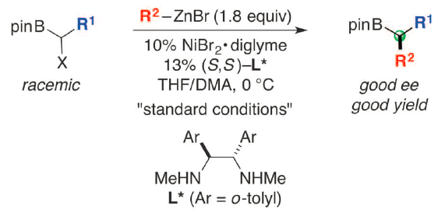
3. Transition Metal Catalysis
3.1 Asymmetric Nickel-Catalyzed Negishi Cross-Couplings
Alkylboronate esters:
Science 2016, 354, 1265.

Slide 25
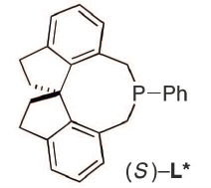
3. Transition Metal Catalysis
3.2 Asymmetric Cu-Catalyzed C-N Cross-Couplings Induced by Visible Light
Jonas C. Peters and Gregory C. Fu et al. Science 2016, 351, 681.

Slide 26
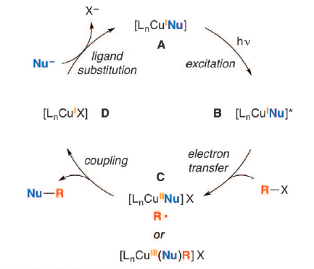
3. Transition Metal Catalysis
3.2 Asymmetric Cu-Catalyzed C-N Cross-Couplings Induced by Visible Light
Jonas C. Peters and Gregory C. Fu et al. Science 2016, 351, 681.

Slide 27
3. Transition Metal Catalysis
3.3 Copper-Catalyzed Asymmetric Oxytrifluoromethylation of Alkenes
Stephen L. Buchwald et al. Angew. Chem. Int. Ed. 2013, 52, 12655.

Slide 28
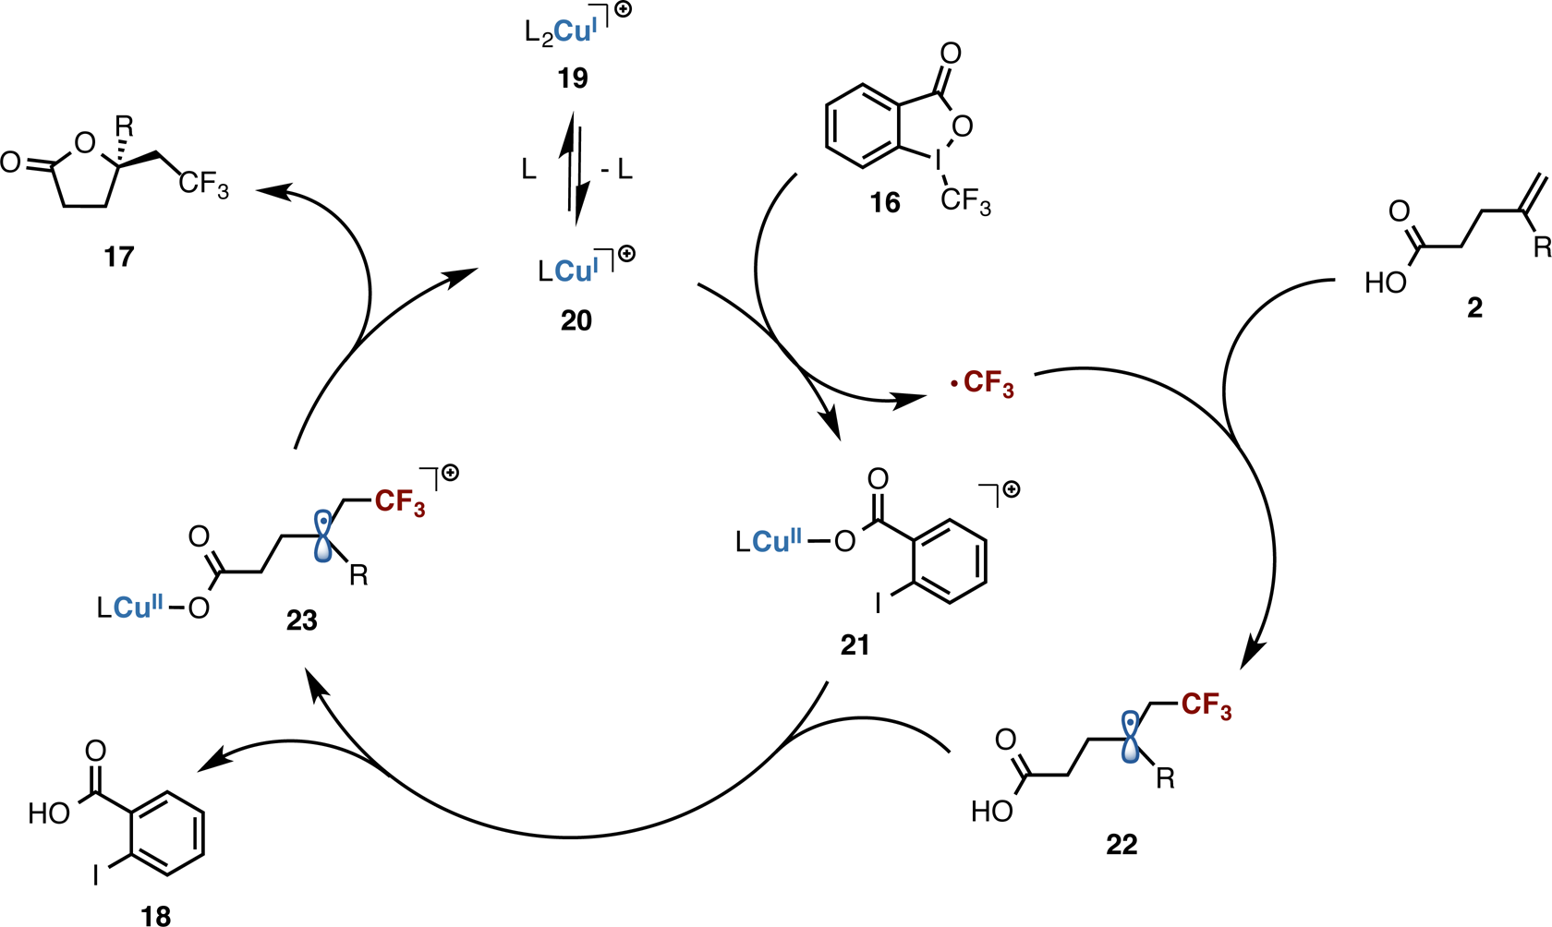
3. Transition Metal Catalysis
3.3 Copper-Catalyzed Asymmetric Oxytrifluoromethylation of Alkenes
Proposed mechanism:
Stephen L. Buchwald et al. Angew. Chem. Int. Ed. 2013, 52, 12655; J. Am. Chem. Soc. 2015, 137, 8069.

Slide 29
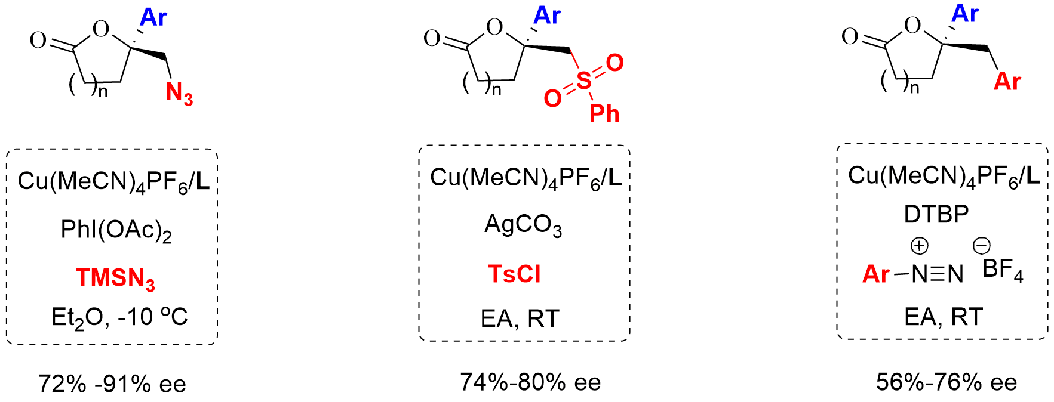
3. Transition Metal Catalysis
3.3 Copper-Catalyzed Asymmetric Oxyfunctionalization of Alkenes
Stephen L. Buchwald et al. J. Am. Chem. Soc. 2015, 137, 8069.

Slide 30
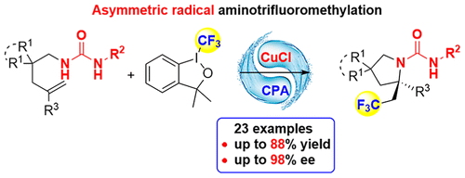
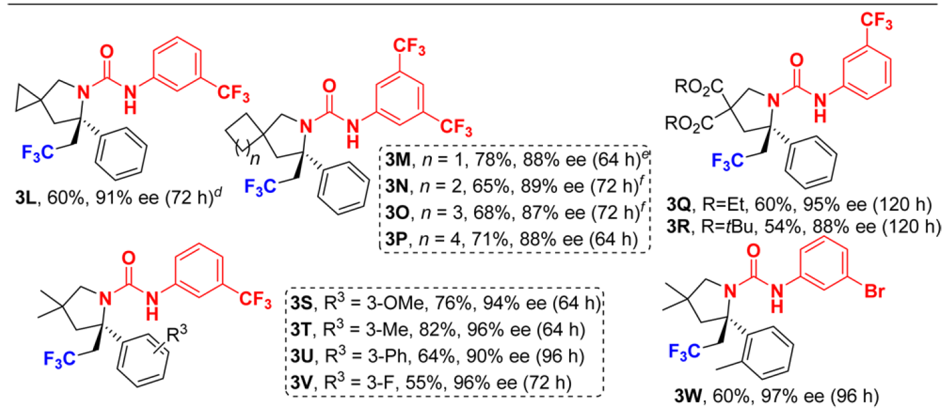
3. Transition Metal Catalysis
3.4 Enantioselective Cu/CPA-Catalyzed Aminotrifluoromethylation of Alkenes
Xin-Yuan Liu et al. J. Am. Chem. Soc. 2016, 138, 9357.

Slide 31
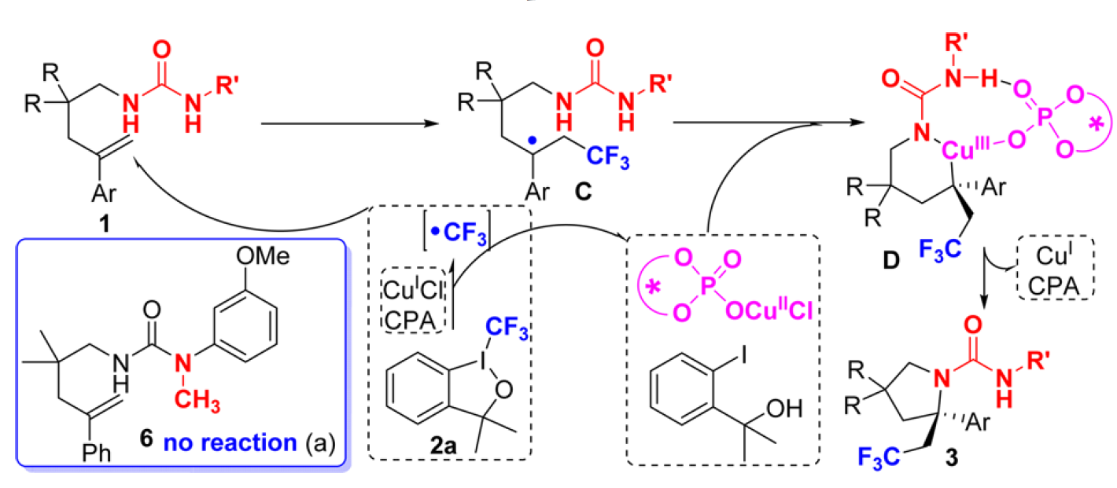
3. Transition Metal Catalysis
3.4 Enantioselective Cu/CPA-Catalyzed Aminotrifluoromethylation of Alkenes
Mechanistic Proposal:
Xin-Yuan Liu et al. J. Am. Chem. Soc. 2016, 138, 9357.

Slide 32
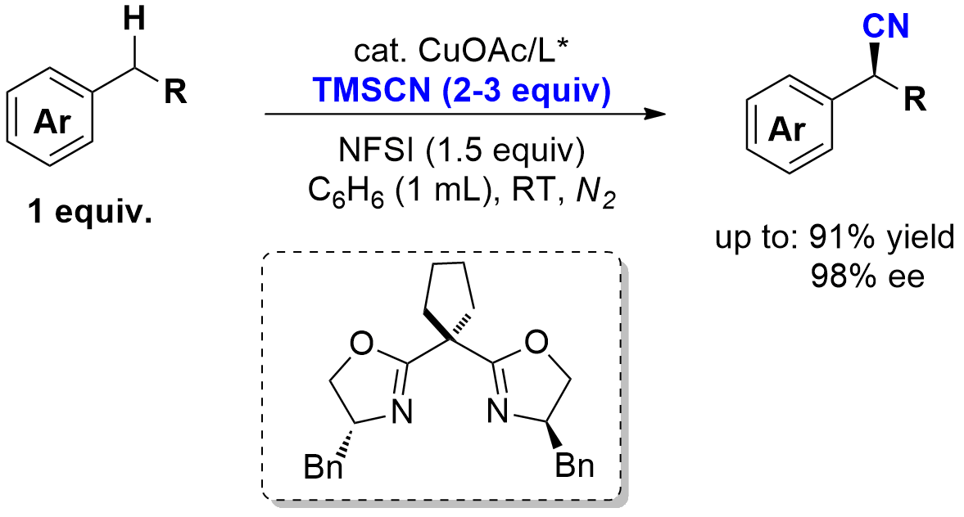
3. Transition Metal Catalysis
3.5 Enantioselective Copper-Catalyzed Cyanation of Benzylic Radicals
or
Guosheng Liu et al. Science 2016, 353, 1014.

Slide 33
3. Transition Metal Catalysis
3.5 Enantioselective Copper-Catalyzed Cyanation of Benzylic Radicals
1. Scope of alkyl naphthalenes:
2. Scope of heterocycle-containing alkyl arenes:

Slide 34
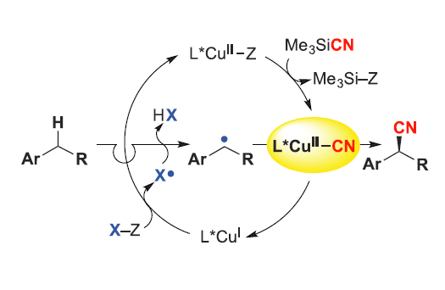
3. Transition Metal Catalysis
3.5 Enantioselective Copper-Catalyzed Cyanation of Benzylic Radicals
X = N(SO₂Ph)₂
Guosheng Liu et al. Science 2016, 353, 1014.
Notes:
N-Fluorobenzenesulfonimide

Slide 35
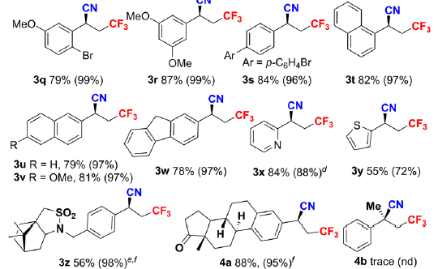
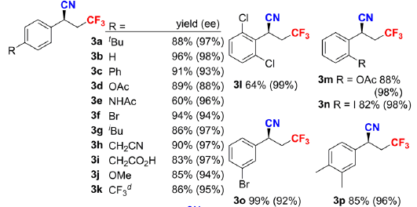
3. Transition Metal Catalysis
3.5 Enantioselective Copper-Catalyzed Cyanation of Benzylic Radicals
Guosheng Liu et al. J. Am. Chem. Soc., 2016, 138, 15547.

Slide 36
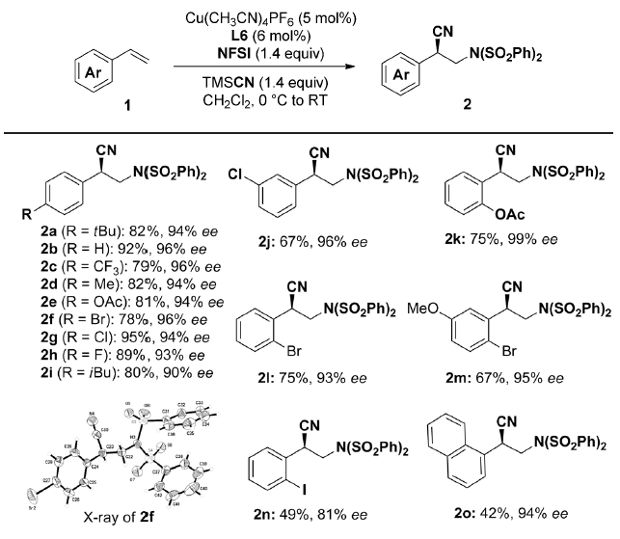
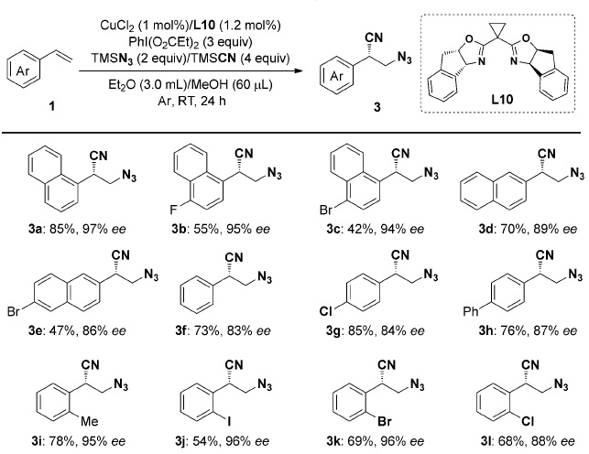
3. Transition Metal Catalysis
3.5 Enantioselective Copper-Catalyzed Cyanation of Benzylic Radicals
Guosheng Liu et al. Angew. Chem. Int. Ed. 2017, 56, 2054.

Slide 37
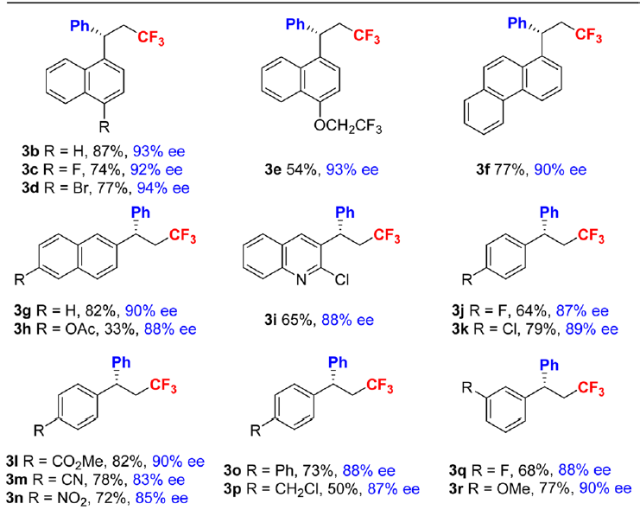
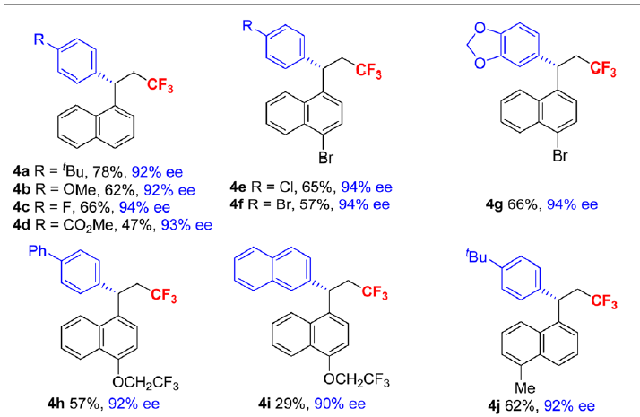
3. Transition Metal Catalysis
3.6 Enantioselective Copper-Catalyzed Arylation of Benzylic Radicals
Guosheng Liu et al. J. Am. Chem. Soc., 2017, DOI: 10.1021/jacs.6b13299

Slide 38
Conclusion
Much development concerning enantioselective radical reactions has occurred over the last ten years.
Formation of C-C and C-X bonds are possible
Asymmetric catalysis is now possible in many systems
Many areas left to explore

Slide 39
Thank You for Your Attention

