Slide 1
Metal-Catalyzed Late stage C-H functionalization
A powerful tool in total synthesis
3rd year seminar
Ioulia Gorokhovik 23.11.2011

Slide 2
New challenges in total synthesis
In the last decades, development of new techniques and methods has enabled chemists to synthesize structures of increasing complexity.

Slide 3
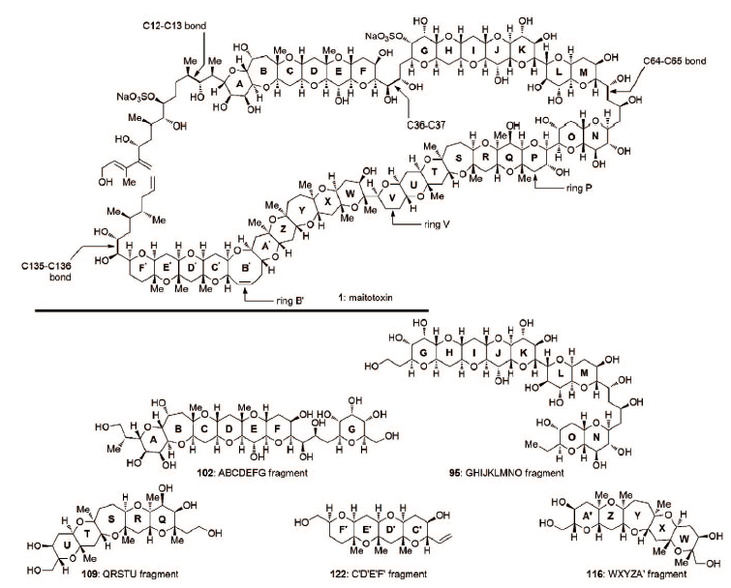
New challenges in total synthesis
Largest non polymeric
molecule found in nature
and most toxic non-peptide
Nicolaoou, K.C.; Aversa, R.J. Isr. J. Chem. 2011, 51, 359 – 377

Slide 4
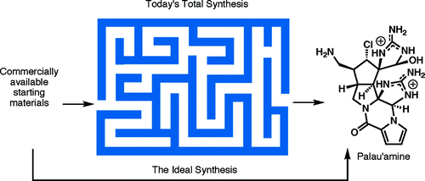
New challenges in total synthesis
In the last decades, development of new techniques and methods has enabled chemists to synthesize structures of increasing complexity.
New challenge : «Aiming for the ideal synthesis »
Which “...creates a complex molecule...in a sequence of only construction reactions involving no intermediary refunctionalizations, and leading directly to the target, not only its skeleton but also its correctly placed functionality.” (Hendrickson, 1975)
Hendrickson, J. B. J. Am. Chem. Soc. 1975, 97, 5784.
Gaich, T.; Baran, P.S. J. Org. Chem. 2010, 75, 4657–4673.

Slide 5
What is C-H activation ?
Principle : Functionalization of unactivated C-H bonds
Challenge :Find suitable catalysts and selectively functionalize one single C-H bond of a complex structure.
Prof Robert Bergman, Berkeley :
"If you asked people ten years ago whether anyone would ever come up with a catalytic method to do this, they would have said no. I don't think it is outrageous to say that in five or ten years there will be commercial applications.“ (Nature 2006, 440, 390-391).
Godula, K.; Sames, D. Science, 2006, 312, 67-72.

Slide 6
Why is it powerful for total synthesis ?
Complementary approach to classical transformations
Access to multiple structural analogs : in theory any C-H bond could be functionalized
Mild conditions : adapted for complex structure transformations
«Green chemistry» : atom economy and reduction of waste
Shorter routes to natural products, no need to functionalize the substrate and rapid complexity generation
Godula, K.; Sames, D. Science, 2006, 312, 67-72.
Davies, H.M.L.; Manning, J.R. Nature, 2008, 451, 417-424.

Slide 7
Outline
The beginnings of C-H activation
Coordination-directed metal insertion
Metal-catalysed carbene and nitrene insertion
Godula, K.; Sames, D. Science, 2006, 312, 67-72.

Slide 8
The beginings of c-h activation
Radical intramolecular chemistry

Slide 9
The principle
Chemistry started and developed in the 1800’s by Hoffmann : study of halogenoamines.
First total synthesis using C-H activation : nicotine in 1909 by Löffler.
Known as the Hoffmann-Löffler-Freytag reaction.
Godula, K.; Sames, D. Science, 2006, 312, 67-72.
Löffler, k.; Kober, S Berichte, 1909, 42, 3431.

Slide 10
The Hoffmann-Löffler-Freytag reaction
First total synthesis using C-H activation : nicotine in 1909 by Löffler.
Later used by E.J. Corey and recently by P. Baran.
Löffler, K.; Kober, S Berichte, 1909, 42, 3431.

Slide 11
C-h functionalization by directed metal inserton

Slide 12
The principle
Possible with sp² and sp³ C-H bonds.
Use of heteroatomic functional group to direct the metallation of the desired C-H bond
Godula, K.; Sames, D. Science, 2006, 312, 67-72.

Slide 13
Syntheses of alkaloids rhazinilam, rhazinal and rhazinicine
Isolated in 1970 and 1998-1999.
Promising starting point for the development of anti-cancer agents.
Syntheses : Sames in 2000 and 2002
Trauner in 2005 and 2009
Gaunt in 2008
Banerji, A.; Majumder, P. L.; Chatterjee, A. G. Phytochemistry 1970, 9, 1491– 1493.
Kam,T-S.; Tee, Y-M.; Subramaniam , G. Natural Product Letters, 1998, 12, 307-310.
Kam, T.S.; Subramaniam, G.; Chen, W. Phytochemistry 1999, 51, 159.

Slide 14
Total synthesis of (-)-rhazinilam
Sames, 2002 : by selective platinium-mediated sp³ C-H insertion/β-H elimination
Amino group close to the ethyl group : favorable scenario
Le Floc’h, D.; Gouault, N.; David, M.; van de Weghe, P. ARKIVOC 2010, 247-259.
Johnson, J.A.; Sames, D. J. Am. Chem. Soc. 2000,122, 6321-6322.

Slide 15
Total synthesis of (-)-rhazinilam
Sames, 2002 : by selective platinium-mediated sp³ C-H insertion/β-H elimination
Le Floc’h, D.; Gouault, N.; David, M.; van de Weghe, P. ARKIVOC 2010, 247-259.
Johnson, J.A.; Sames, D. J. Am. Chem. Soc. 2000,122, 6321-6322.

Slide 16
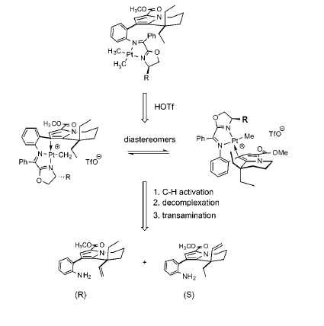
Total synthesis of (-)-rhazinilam
Sames, 2002 : by selective platinium-mediated sp³ C-H insertion/β-H elimination
Asymmetric : differentiation of the enantiotopic Et
Chiral auxiliary group containing an oxazoline and a Schiff base
Use of a stoechimoetric amount of cationic Pt
Bulkier R : better selectivity but lower conversion
Diastereoselectivity : from 3:1 to 20:1
Le Floc’h, D.; Gouault, N.; David, M.; van de Weghe, P. ARKIVOC 2010, 247-259.
Johnson, J.A.; Li, N.; Sames, D. J. Am. Chem. Soc. 2002,124, 6900-6903.

Slide 17
Total synthesis of rhazinilam
Trauner, 2005: by direct cross coupling reaction
Idea :
Le Floc’h, D.; Gouault, N.; David, M.; van de Weghe, P. ARKIVOC 2010, 247-259.
Bowie, A.L.; Hugues, C.C.; Trauner, D. Org. Lett. 2005, 7,5207-5209.

Slide 18
Total synthesis of rhazinilam
Trauner, 2005, rhazinilam: by direct cross coupling reaction
Le Floc’h, D.; Gouault, N.; David, M.; van de Weghe, P. ARKIVOC 2010, 247-259.
Bowie, A.L.; Hugues, C.C.; Trauner, D. Org. Lett. 2005, 7,5207-5209.

Slide 19
Total synthesis of rhazinal
Trauner, 2009, rhazinal: by direct cross coupling reaction
Bowie, A.L.; Hugues, C.C.; Trauner, D. Org. Lett. 2005, 7,5207-5209.
Bowie, A.L.; Trauner, D. J. Org. Chem. 2009, 74, 1581-1586.
Le Floc’h, D.; Gouault, N.; David, M.; van de Weghe, P. ARKIVOC 2010, 247-259.

Slide 20
Total synthesis of rhazinicine
Gaunt, 2008 : by C-H borylation/Suzuki coupling and oxidative cyclization
Le Floc’h, D.; Gouault, N.; David, M.; van de Weghe, P. ARKIVOC 2010, 247-259.
Beck, E.M.; Hatley, R.; Gaunt, M.J. Angew. Chem. Int. Ed. 2008, 47, 3004-3007.

Slide 21
Total synthesis of rhazinicine
Gaunt, 2008 : by C-H borylation/Suzuki coupling and oxidative cyclization
Le Floc’h, D.; Gouault, N.; David, M.; van de Weghe, P. ARKIVOC 2010, 247-259.
Beck, E.M.; Hatley, R.; Gaunt, M.J. Angew. Chem. Int. Ed. 2008, 47, 3004-3007.
Also in 2011 : Liao, X.; Stanley, L.M.; Hartwig, J.F. J. Am. Chem. Soc. 2011, 133, 2088-2091.

Slide 22
Synthesis of (+)-lithospermic acid
Isolated in 1975. Active component of traditional herbs.
Potent and nontoxic anti-HIV activity.
Synthetic challenge : appropriate protecting group strategy required.
First synthesis : by Ellman and Bergman in 2005
by Yu in 2011
O’Malley, S.J.; Tan, K.L.; Watzke, T.; Bergman, R.G.; Ellman, J.. J. Am. Chem. Soc. 2005, 127, 13496-13497..

Slide 23
Synthesis of (+)-lithospermic acid
Ellman and Bergman, 2005 : by C-H activation/hydroarylation
O’Malley, S.J.; Tan, K.L.; Watzke, T.; Bergman, R.G.; Ellman, J.. J. Am. Chem. Soc. 2005, 127, 13496-13497..

Slide 24
Synthesis of (+)-lithospermic acid
Ellman and Bergman, 2005 : by C-H activation/hydroarylation
O’Malley, S.J.; Tan, K.L.; Watzke, T.; Bergman, R.G.; Ellman, J.. J. Am. Chem. Soc. 2005, 127, 13496-13497..

Slide 25
Synthesis of (+)-lithospermic acid
Ellman and Bergman, 2005 : by C-H activation/hydroarylation
O’Malley, S.J.; Tan, K.L.; Watzke, T.; Bergman, R.G.; Ellman, J.. J. Am. Chem. Soc. 2005, 127, 13496-13497..

Slide 26
Synthesis of (+)-lithospermic acid
Yu, 2011: by C-H olefination/C-H carbene insertion
Wang, D.-H.; Yu, J.-Q. J. Am. Chem. Soc. 2011, 133, 5767-5769..

Slide 27
Synthesis of (+)-lithospermic acid
Yu, 2011: by C-H olefination/C-H carbene insertion
Wang, D.-H.; Yu, J.-Q. J. Am. Chem. Soc. 2011, 133, 5767-5769..

Slide 28
Synthesis of (+)-lithospermic acid
Yu, 2011: by C-H olefination/C-H carbene insertion
Wang, D.-H.; Yu, J.-Q. J. Am. Chem. Soc. 2011, 133, 5767-5769..

Slide 29
C-h Functionalization through metal carbenoid/nitrenoid
C-C and C-N bonds formation

Slide 30
The principle
Advantages :
Often the conditions are very mild
Catalyst very selective for diazo site : extremely tolerant of other functional groups
Catalyst very active : low loadings of catalyst (1 mol%)
Davies, H.M.L.; Manning, J.R. Nature, 2008, 451, 417-424.
Davies, H.M.L.; Dick, A.R. Top. Curr. Chem. 2010, 292, 303-345.
Davies H.M.L. Angew. Chem. Int. Ed. 2006, 45, 6422-6425.

Slide 31
The catalyst and the carbenoid
More selective carbenoid
More reactive carbenoid
Davies, H.M.L.; Manning, J.R. Nature, 2008, 451, 417-424.
Davies, H.M.L.; Dick, A.R. Top. Curr. Chem. 2010, 292, 303-345.
Davies H.M.L. Angew. Chem. Int. Ed. 2006, 45, 6422-6425.
Davies H:M:L:, Beckwith, R.E.J. Chem. Rev. 2003, 103, 2861-2903.

Slide 32
Which C-H bond ?
Electronic, steric and conformational effects
Electronic effects :
C-H activation prefered on sites where a partial positive charge is stabilized.
5-membered rings favored over other size rings, if no EDG or conformational effects.
Equatorial C-H bonds favored
Davies, H.M.L.; Manning, J.R. Nature, 2008, 451, 417-424. Davies, H.M.L.; Dick, A.R. Top. Curr. Chem. 2010, 292, 303-345.
Davies H.M.L. Angew. Chem. Int. Ed. 2006, 45, 6422-6425. Davies H:M:L:, Beckwith, R.E.J. Chem. Rev. 2003, 103, 2861-2903.

Slide 33
Intramolecular C-H activation : the begining
Used since the early 80’s
Cane, D.E.; Thomas, P.J. J. Am. Chem. Soc. 1984, 106, 5295-5303.
D. F. Taber, J. L. Schuchardt, J. Am. Chem. Soc. 1985, 107, 5289.
Notes:
Known for some time now

Slide 34
Intramolecular C-H activation
Recently :
Srikrishna, A.; Sheth, Vishal M.; Nagaraju, G Synlett, 2011, 16, 2343-2346.
Notes:
Isolated ch3 functiunalization

Slide 35
Intramolecular vs intermolecular C-H activation
Doyle, M.P.; Hu, W.; Valenzuela, M.V.; J. Org. Chem. 2002, 67, 2954.
Davies, H.M.L.; Jin, Q. Tetrahedron Asymmetry , 2003, 14, 941.
Davies, H.M.L.; Dick, A.R. Top. Curr. Chem. 2010, 292, 303-345.

Slide 36
Intermolecular C-H activation
Davies, H.M.L.; Manning, J.R. Nature, 2008, 451, 417-424.
Davies, H.M.L.; Hansen, T.; Hopper, D.W.; Panaro, S.A. J. Am. Chem. Soc, 1999, 121, 6509-6510.
Thai, D.L.T; Sapko, M.T.; Reiter, C.T.; Bierer, D.E.; Perel, J.M. J. Med. Chem. 1998, 41, 591-601.
Prashad, M.; Kim, H.Y.; Lu, Y.; Liu, Y.; Har, D.; Repic, O.; Blacklock, TJ.; Giannousis, P. J. Org. Chem., 1999, 64, 1750-1753.
Y. Matsumura, Org. Lett., 1999, 1, 175-178
Notes:
Intermolecular c-h activation made possible by acceptor/donor carbenoid chemistry

Slide 37
Intermolecular C-H activation
Vinyl diazoacetates :
Davies, H.M.L.; Manning, J.R. Nature, 2008, 451, 417-424.
Davies, H.M.L.; Stafford, D.G.; Hansen, T. Org. Lett. 1999, 1, 233-236.

Slide 38
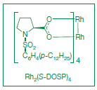
Total synthesis of (-)-colombiasin A, (-)-elisapterosin B and (+)-erogorgiaene
Davies, H.M.L.; Walji, A.M. Angew. Chem. Int. Ed. 2005, 44, 1733-1735.
Davies, H.M.L.; Dai, X.; Long, M.S. J. Am. Chem. Soc. 2006, 128, 2485-2490.
Davies, H.M.L.; Manning, J.R. Nature, 2008, 451, 417-424.

Slide 39
Existing strategies
Davies, H.M.L.; Dai, X.; Long, M.S. J. Am. Chem. Soc. 2006, 128, 2485-2490.

Slide 40
C-H activation/Cope rearrangement
Davies, H.M.L.; Dai, X.; Long, M.S. J. Am. Chem. Soc. 2006, 128, 2485-2490.
Notes:
2,2-DMB : 2,2 dimethylbutane

Slide 41
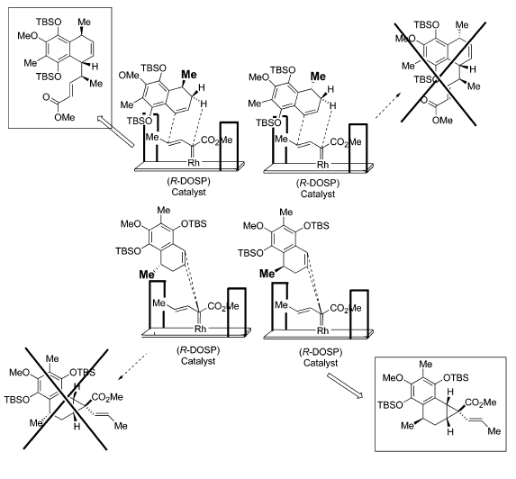
C-H activation/Cope rearrangement : Models
Davies, H.M.L.; Dai, X.; Long, M.S. J. Am. Chem. Soc. 2006, 128, 2485-2490.
Notes:
«blocking groups»

Slide 42
C-H activation/Cope rearrangement
Davies, H.M.L.; Dai, X.; Long, M.S. J. Am. Chem. Soc. 2006, 128, 2485-2490.
Notes:
Rajouter les rendements

Slide 43
Total synthesis of (-)-tetrodotoxin
(-)-tetrodotoxin extracted from japanese fugu fish.
Poison : very potent as a selective blocker of voltage-gated sodium ion channels.
Structure elucidated in 1964 by Woodward.
First racemic total synthesis by Kishi in 1972 : about 30 steps
Second total synthesis in 2003 by Isobe : more than 60 steps
25 protecting group manipulations
A shorter version published in 2004.
Total synthesis by Du Bois : 32 steps
2 C-H functionalisations, 5 protecting group manipulations
Hinman, A.; Du Bois, J. J. Am. Chem. Soc. 2003, 125, 11510-11511.

Slide 44
Total synthesis of (-)-tetrodotoxin
Hinman, A.; Du Bois, J. J. Am. Chem. Soc. 2003, 125, 11510-11511.

Slide 45
Total synthesis of (-)-tetrodotoxin
Hinman, A.; Du Bois, J. J. Am. Chem. Soc. 2003, 125, 11510-11511.

Slide 46
Rh-nitrene insertion
Used for C-N bond formation at an alkyl site.
Pioneered by Breslow, and further developed by Du Bois.
Detailed mechanism still unclear.
No second substituent to give flexibility, compared to carbenes.
Hinman, A.; Du Bois, J. J. Am. Chem. Soc. 2003, 125, 11510-11511.
Espino, C.G.; Du Bois, J. Angew. Chem. Int. Ed. 2001, 40, 598-600.
Godula, K.; Sames, D. Science, 2006, 312, 67-72.

Slide 47
Conclusion

Slide 48
C-H functionalization : a powerful tool in total synthesis
Rapidly evolving field : many groups working on the development of new methods/conditions/catalysts.
Work to be done : improve regioselectivity and selectivity, reactivity…
Many total syntheses already published, and more are appearing in the literature every year.
C-H functionalization :
mild conditions => compatible with complex structures
rapid generation of complexity => interesting for complex molecules
no prefunctionalization needed => shorter syntheses
complementary approach => different strategies
green chemistry => appreciated nowadays
Soon C-H bonds will be seen as ubiquituous functional groups

Slide 49
Thanks for your attention
Questions

