Slide 1
LSPN Group seminar
Recent Development in Isocyanide-Based
Catalytic Enantioselective Reactions
Shuo Tong
19-10-2017

Slide 2
Outline
Introduction
Enantioselective Passerini Reaction
Enantioselective Ugi Reaction
Summary and outlook

Slide 3
Introduction
Asymmetric MCRs

Slide 4
Development of Asymmetric MCRs
1850
Strecker
1882
Hantzsch
1891
Biginelli
1912
Mannich
1921
Passerini
1959
Ugi
1993
er
1996
er
1999
er
2003
er
2009
er
2016
er
*
*
*
*
Isocyanides have unique reactive natures and can react with both nucleophiles and electrophiles at the same atom to form α-adducts.
*
*

Slide 5
P-3CR
U-4CR

Slide 6
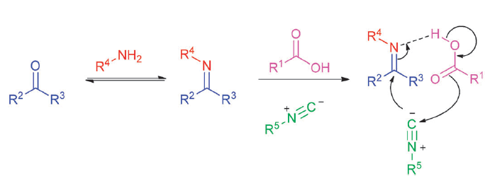
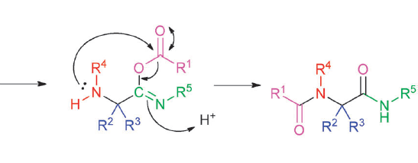
Key stereodifferntiating step
P-3CR
Stereodifferentiating step
U-4CR
Stereodifferentiating step

Slide 7
then Why so difficult?
RCOOH, not only a reagent, but also a catalyst
Stereocontrol in α-addition step
Catalyst turnover
chelate with catalyst

Slide 8
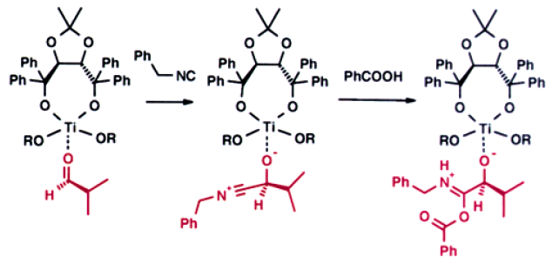
First enantioselective P-3CR
6 examples, 32-42% ee
Oxophilic Lewis acids, to interact with aldehydes, carboxylic acids, and isocyanides
Alexander Domling et al. Org. Lett. 2003, 5, 4021.

Slide 9
Low ee
Limited scope
6 examples, 32-42% ee
Aldehydes | Aromatic | No example
 | Aliphatic | 12-46% y | 23-42% ee
Isocyanides | tertiary | No example
 | secondary | No example
 | primary | OK
 | aromatic | No example
Carboxylic acids | Aromatic | OK
 | Aliphatic | No example
Strong backgroud reaction occured

Slide 10
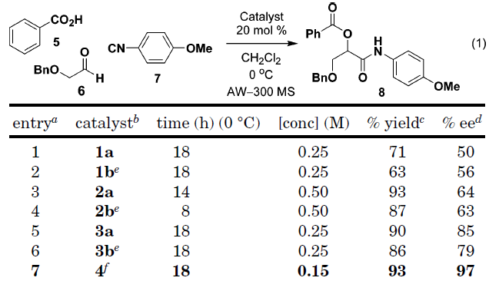
Cu-pybox
Stuart L. Schreiber et al. Org. Lett. 2004, 6, 4231.

Slide 11
Anhydrous conditions were necessary for high enantioselectivity
H₂O enhanced the rate of backgroud reation
Michael C. Pirrung et al. J. Am. Chem. Soc. 2004, 126, 444.
Aldehydes | Limitation: only bidentate coordinating aldehydes
Isocyanides | tertiary | OK
 | secondary | No example
 | primary | OK
 | aromatic | OK
Carboxylic acids | Aromatic | OK
 | Aliphatic | Decreased ee

Slide 12
Simplify the problem
RCOOH, not only a reagent, but also a catalyst
Stereocontrol in α-addition step
Catalyst turnover

Slide 13
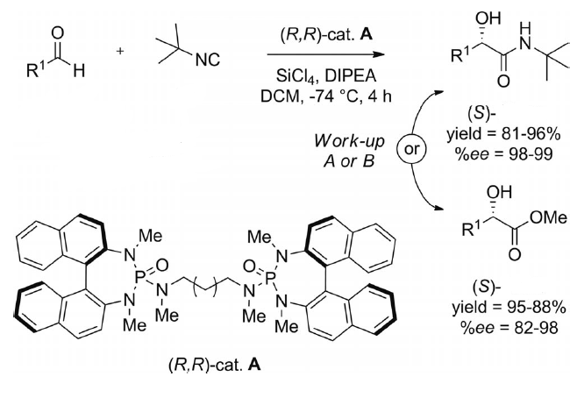
A
B
3
Scott E. Denmark et al. J. Am. Chem. Soc. 2003, 125, 7825; J. Org. Chem. 2005, 70, 9667.

Slide 14
Enantioselective Passerini-Type Reaction
Scott E. Denmark et al. J. Am. Chem. Soc. 2003, 125, 7825; J. Org. Chem. 2005, 70, 9667.

Slide 15
Only suitable for chelating aldehyde
Non chelating aldehyde
By using the catalyst with only one single coordination site
Mei-Xiang Wang & Jieping Zhu et al, Eur. J. Org. Chem. 2007, 4076; Org. Lett. 2007, 3615; J. Org. Chem. 2009, 74, 8396.

Slide 16
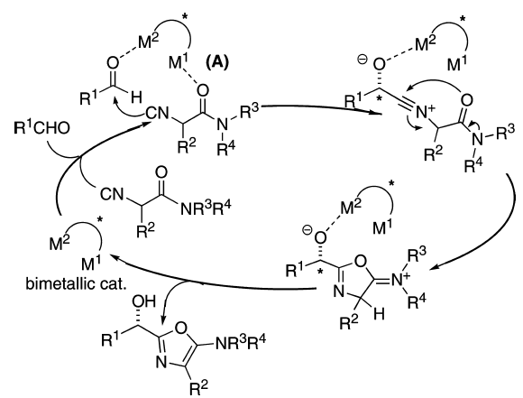
Heterobimetallic Schiff Base Complex
Shigeki Matsunage & Masakatsu Shibasaki et al. J. Am. Chem. Soc. 2009, 131, 8384.

Slide 17
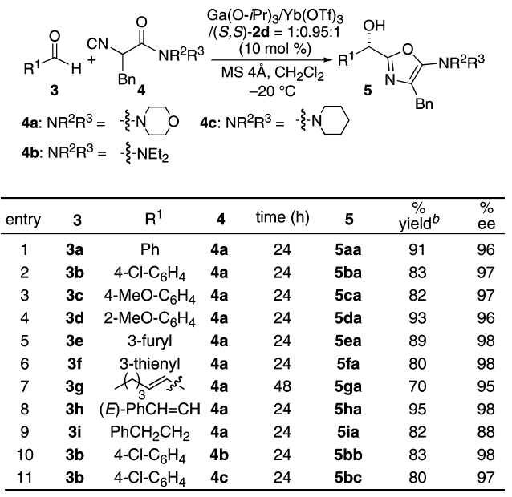
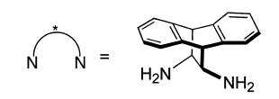

Slide 18
Catalytic Enantioselective P-3CR
Aliphatic aldehydes
Good ee
Mei-Xiang Wang & Jieping Zhu et al. Angew. Chem. Int. Ed. 2008, 47, 388-391.

Slide 19
80% ee
83% ee
Mei-Xiang Wang & Jieping Zhu et al. Angew. Chem. Int. Ed. 2008, 47, 9454.

Slide 20
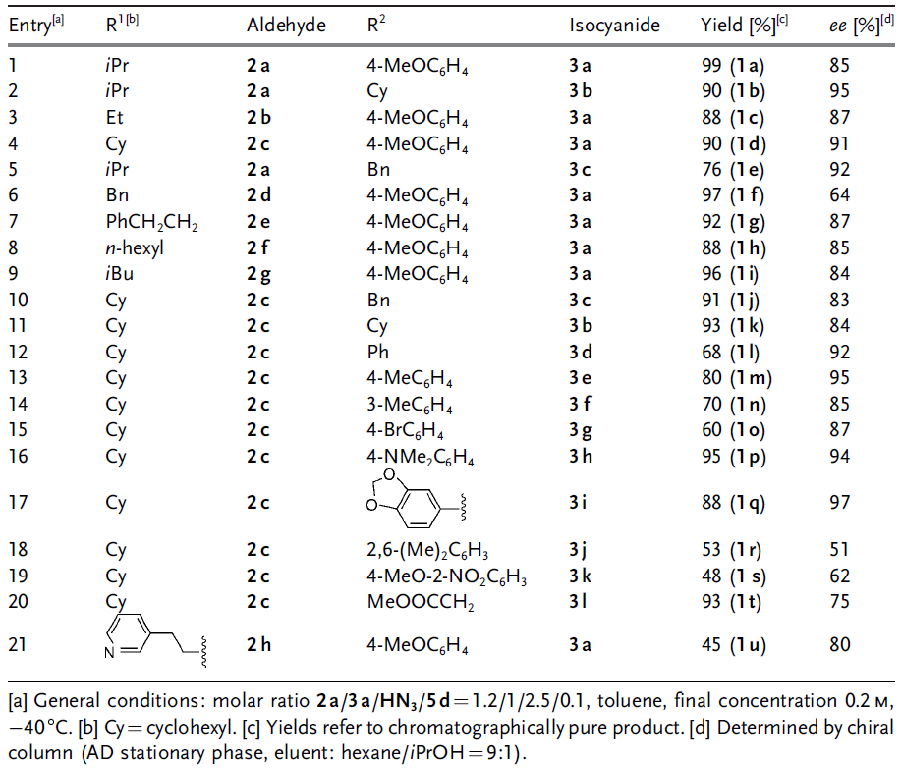

Slide 21
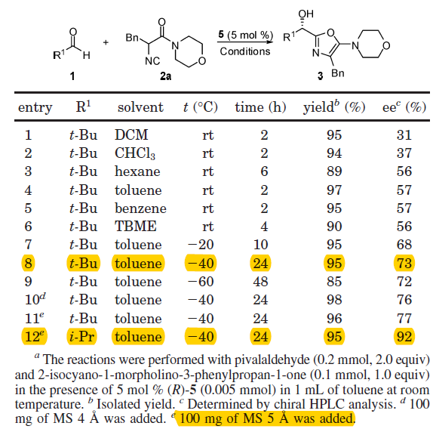
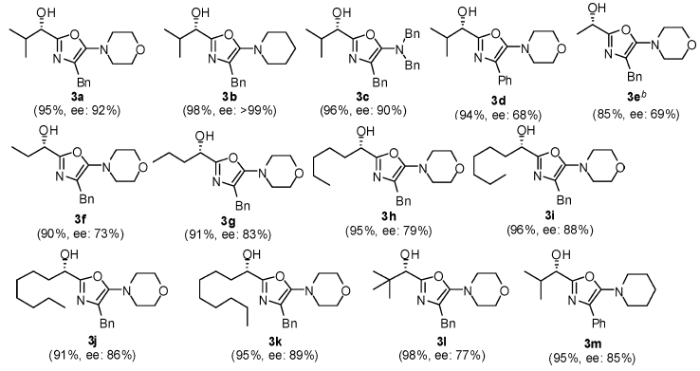
CPA
Guofu Zhong et al. Org. Lett. 2010, 12, 2414.

Slide 22
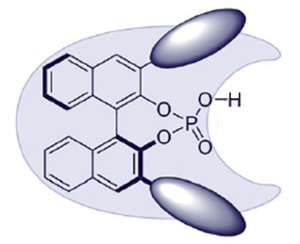
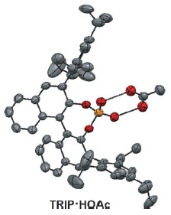
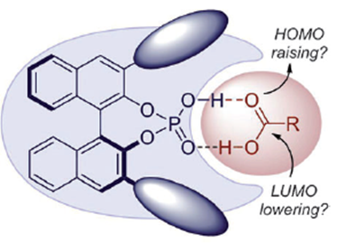
Activation of carboxylic acid by heterodimerization with CPA
X
X
This self-assembly increases both the acidity of the phosphoric acid catalyst and the reactivity of the carboxylic acid
Benjamin List et al. Angew. Chem. Int. Ed. 2014, 53, 7063.

Slide 23
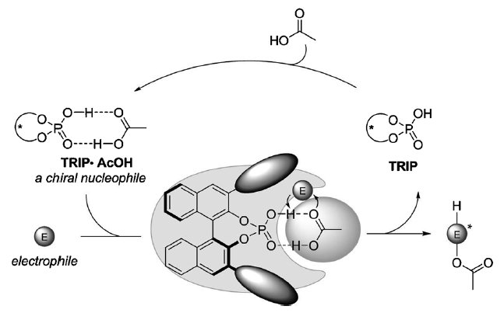
Benjamin List et al. Angew. Chem. Int. Ed. 2014, 53, 7063.
Xin-Yuan Liu & Bin Tan et al. J. Am. Chem. Soc. 2015, 137, 14039.

Slide 24
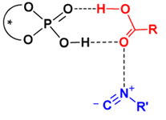
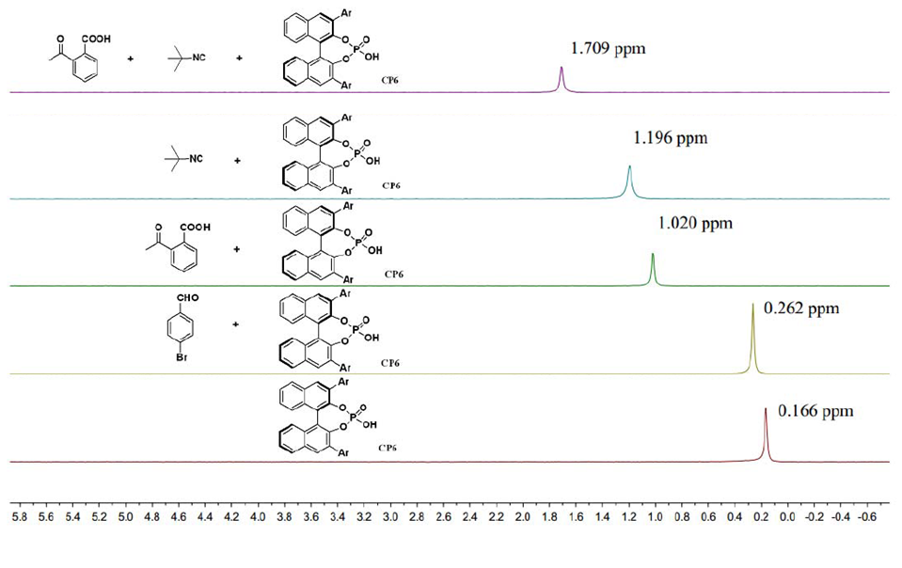
³¹P NMR

Slide 25
Advantage and limitation of Tan’s work
Aldehydes | Aromatic | 65-83% y (EWG) 41-55% y (EDG) | 93-98% ee 89-90% ee
 | Aliphatic | 78-99% y | 85-93% ee
Isocyanides | tertiary | OK
 | secondary | Yield decreased, ee mained
 | primary | No example
 | aromatic | No example
Carboxylic acids
Xin-Yuan Liu & Bin Tan et al. J. Am. Chem. Soc. 2015, 137, 14039.

Slide 26
Introduction
Enantioselective Passerini Reaction
Enantioselective Ugi Reaction
Summary and outlook

Slide 27
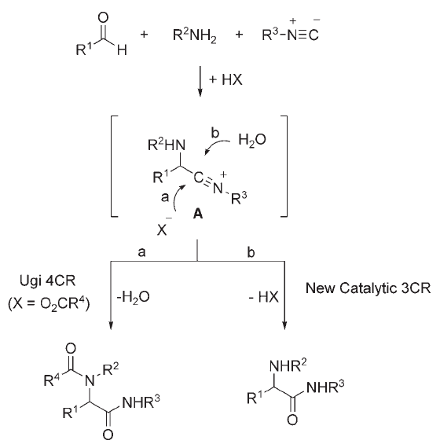
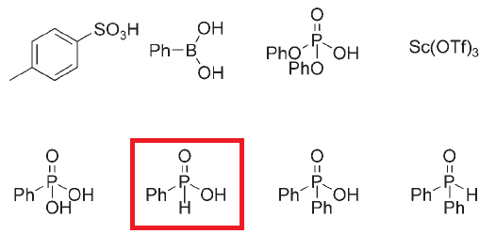
Catalytic Three-Component Ugi Reaction
HX =
Phenyl phosphinic acid
Water acts as the internal nucleophile
Benjamin List et al. Angew. Chem. Int. Ed. 2008, 47, 3622.

Slide 28
Catalytic Enantioselective Attempt

Slide 29
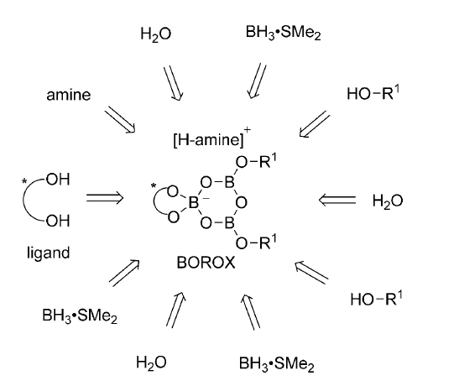
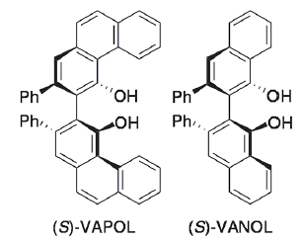
13 Ligands
12 amines
47 alcohols
cat* 8-5-47
William D. Wulff et al. Angew. Chem. Int. Ed. 2014, 53, 3436.

Slide 30
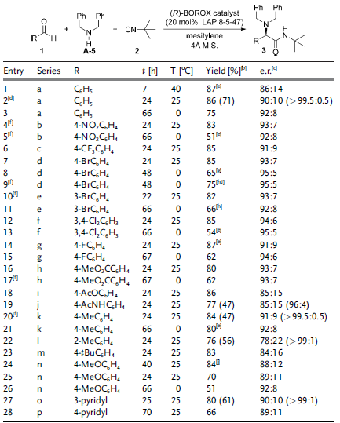
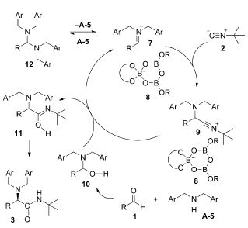

Slide 31
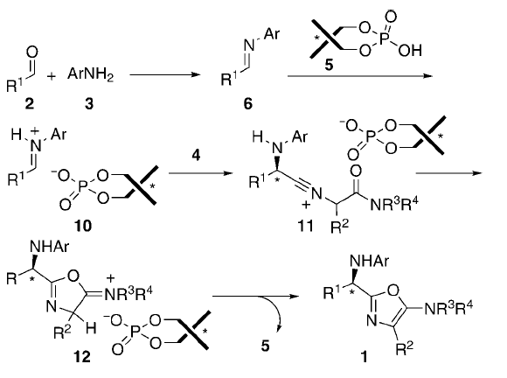
Enantioselective Ugi-type Reaction
Scope: Aliphatic aldehyde, aniline
Mei-Xiang Wang & Jieping Zhu et al. Angew. Chem. Int. Ed. 2009, 48, 6717.

Slide 32
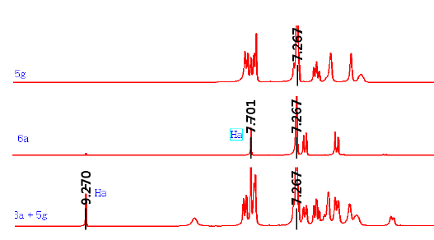
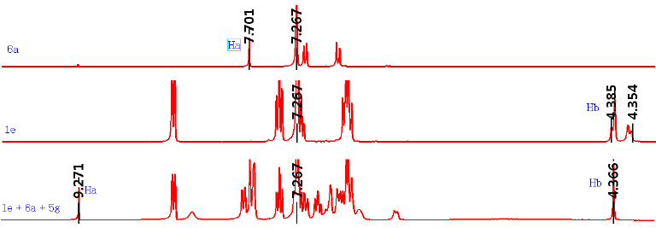

Slide 33
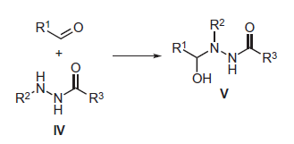
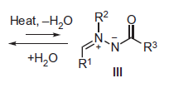
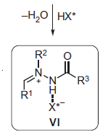
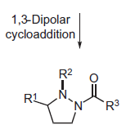
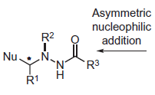
Azomethine imines
Keiji Maruoka et al. Angew. Chem. Int. Ed. 2012, 51, 7279.

Slide 34
Keiji Maruoka et al. Angew. Chem. Int. Ed. 2012, 51, 7279.

Slide 35
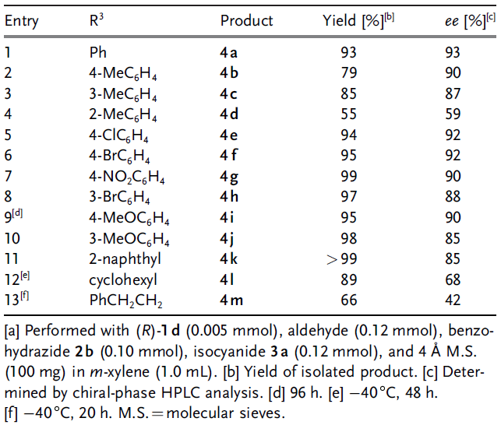

Slide 36
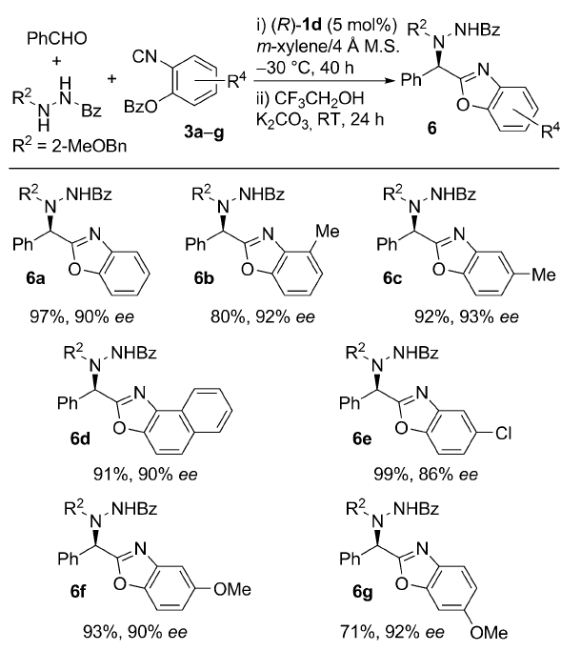

Slide 37
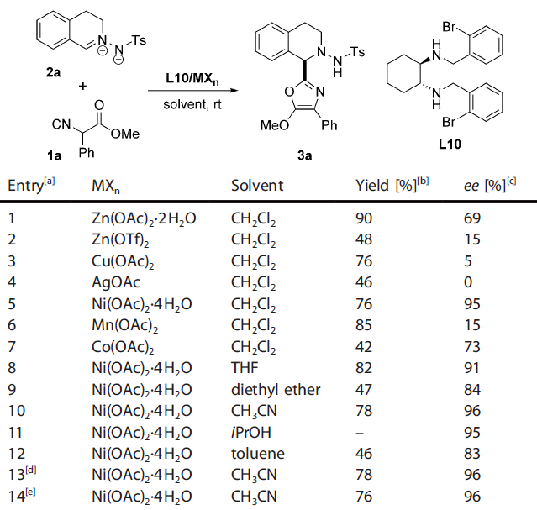
Rui Wang et al. Chem. Eur. J. 2017, 23, 6974.

Slide 38
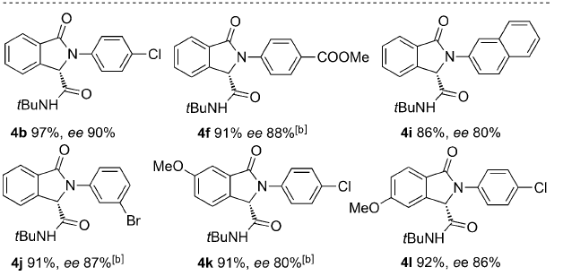
Ugi 4-Center 3-Component Reaction
De-Xian Wang, Mei-Xiang Wang & Jieping Zhu Angew. Chem. Int. Ed. 2016, 55, 5282.

Slide 39
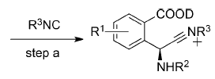
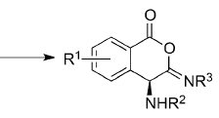
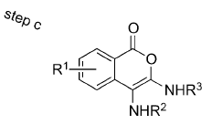
DKR

Slide 41
Summary and Outlook
P-3CR
U-4CR

Slide 42
Thanks for your attention
Questions?

Slide 44
