Slide 1

Enantioselective Rh-catalyzed Aldehyde C-H Activation
Group Seminar
Hua Wu (Jieping Zhu’s Lab)
Laboratory of Synthesis and Natural Products (LSPN)
Ecole Polytechnique Fédérale de Lausanne (EPFL)

Slide 2
Outline
1. Introduction
2. Enantioselective Alkenes Hydroacylation
3. Enantioselective Alkynes and Allene Hydroacylation
4. Enantioselective Carbonyl Hydroacylation
5. Summary and Outlook

Slide 3
Introduction
Atom economic
b. Green (no waste product generated)
Sakai Fu G. C. Dong, V. M Stanley, L. M. Willis Brookhart, Maurice
Jun, Chul-Ho Krische, Michael J Lenges, Christian
Glorius, Frank
Wills, M. C. Chem. Rev. 2010, 110, 725-748.

Slide 4
Introduction
No opportunity for the enantioselective catalysis
Wills, M. C. Chem. Rev. 2010, 110, 725-748.

Slide 5
Introduction
General Mechanism:
Reversible steps: oxidative addition, olefin coordination and insertion

Slide 6
Introduction
First intramolecular report:
The reaction was discovered by K. Sakai in 1972 as part in a synthetic route to certain prostanoids
Sakai, K. et al. Tetrahedron Lett. 1972, 13, 1287.
First intermolecular example:
Miller, R. G. J. Organomet. Chem. 1980, 192, 257.

Slide 7
Outline
1. Introduction
2. Enantioselective Alkenes Hydroacylation
3. Enantioselective Alkynes and Allene Hydroacylation
4. Enantioselective Carbonyl Hydroacylation
5. Summary and Outlook

Slide 8
Enantioselective Alkenes hydroacylation
First enantioselective example:
Young, C. G. et al. J. Chem. Soc., Chem. Commun. 1983, 1215.
Sakai, K. Tetrahedron Lett. 1989, 30, 6349.

Slide 9
Enantioselective Alkenes hydroacylation
Sakai, K. et al. Tetrahedron Lett. 1993, 34, 5927.
Morehead, A. T., Jr. et al. J. Am. Chem. Soc. 2005, 127, 16042.

Slide 10
Enantioselective Alkenes hydroacylation
Synthesis of indole derivatives
L. M. Stanley. et al. Chem. Commun. 2014, 50, 2765.
L. M. Stanley. et al. Org. Lett. 2017. Doi: 10.1021/acs.orglett.7b02230.

Slide 11
Enantioselective Alkenes hydroacylation
Intramolecular Olefin Hydroacylation
a. X was very crucial for this reaction.
b. X was replaced by CH2, no hydroacylation product
Vy M. Dong. J. Am. Chem. Soc. 2009, 131, 6932-6933.

Slide 12
Enantioselective Alkenes hydroacylation
Intermolecular Alkenes Hydroacylation

Slide 13
Enantioselective Alkenes hydroacylation
Substrate-Directed Intermolecular Hydroacylation
Vy M. Dong; J. Am. Chem. Soc. 2010, 132, 16330-16333.

Slide 14
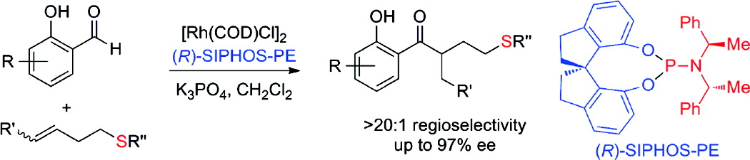
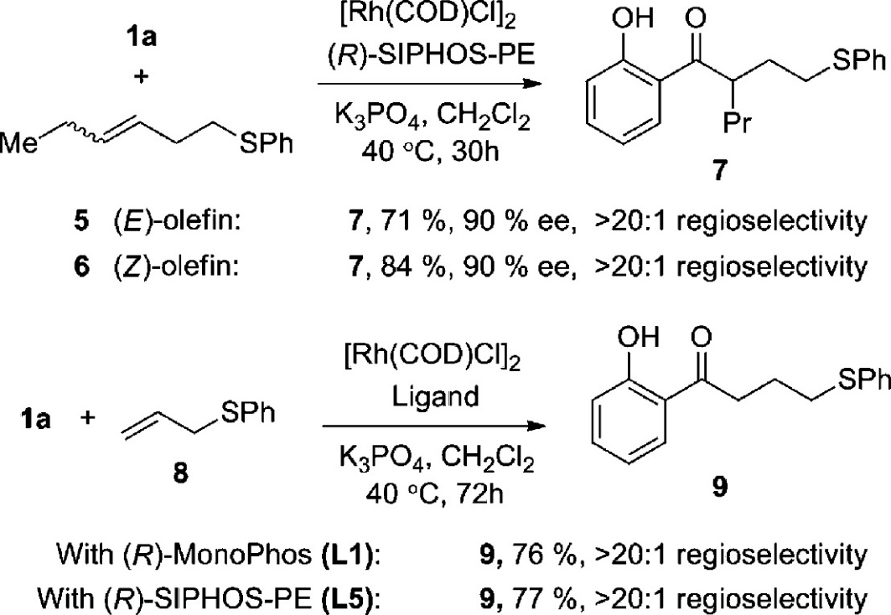
Enantioselective Alkenes hydroacylation
Enantioselective Intermolecular Hydroacylation
Effects of Olefin Structure on Regioselectivitya
Vy M. Dong; J. Am. Chem. Soc. 2010, 132, 16330-16333.

Slide 15
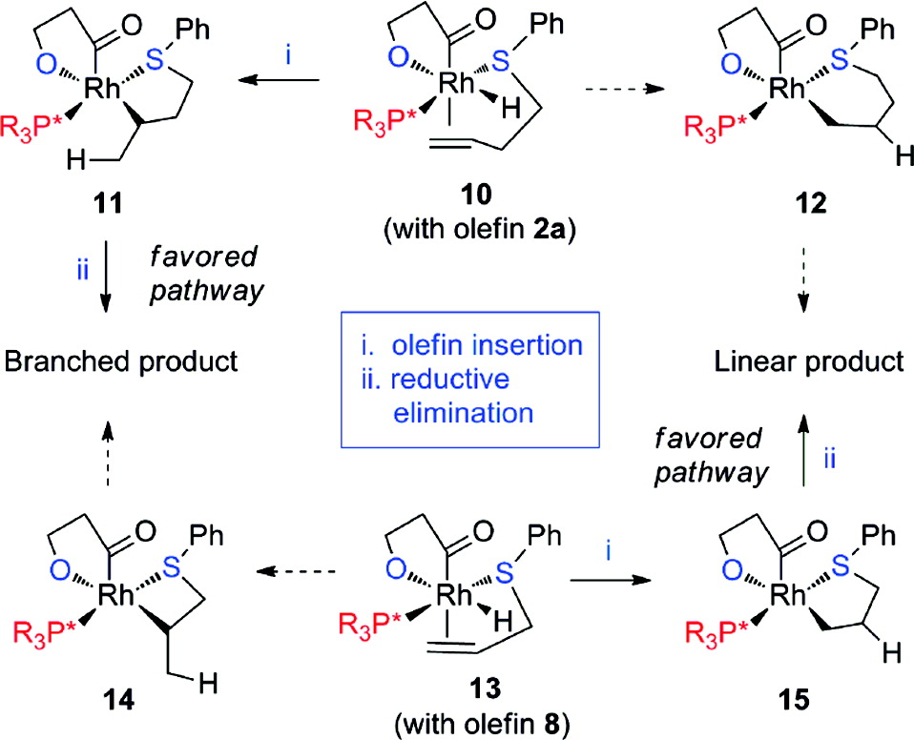
Enantioselective Alkenes hydroacylation
Rationale for Observed Regioselectivitiesa
Vy M. Dong; J. Am. Chem. Soc. 2010, 132, 16330-16333.

Slide 16
Enantioselective Alkenes hydroacylation
Enantioselective Desymmetrization of Cyclopropenes
V. M. Dong. et al. J. Am. Chem. Soc. 2010, 132, 16354-16355.

Slide 17
Enantioselective Alkenes hydroacylation
Desymmetrization of bis(allyl) aldehyde
Proceeded via isomerization and hydroacylation
V. M. Dong. et al. Chem. Sci. 2015, 6, 4479.

Slide 18
Enantioselective Alkenes hydroacylation
Desymmetrization of Quaternary Centers
V. M. Dong. et al. Chem. Sci. 2015, 6, 4479.

Slide 19
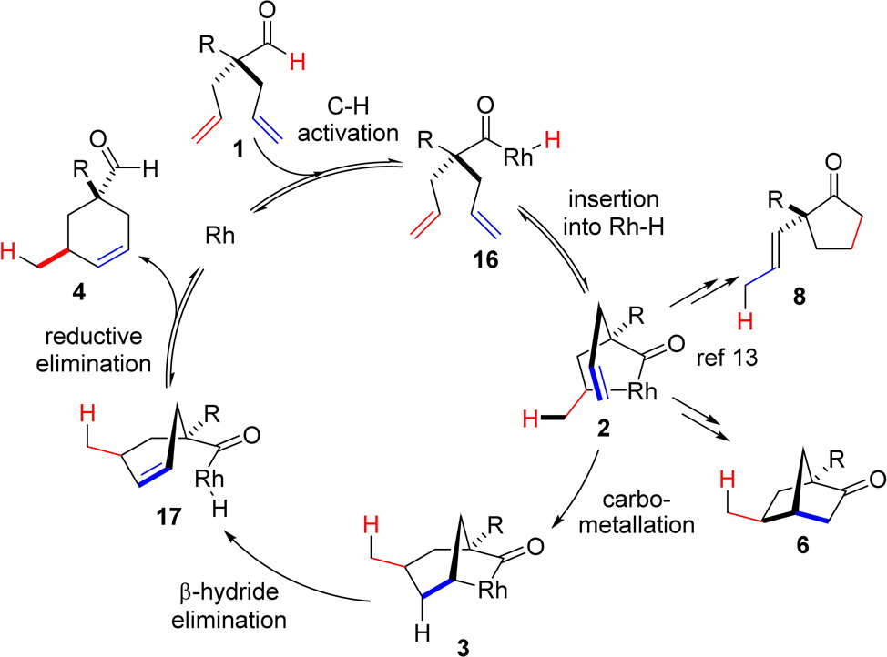
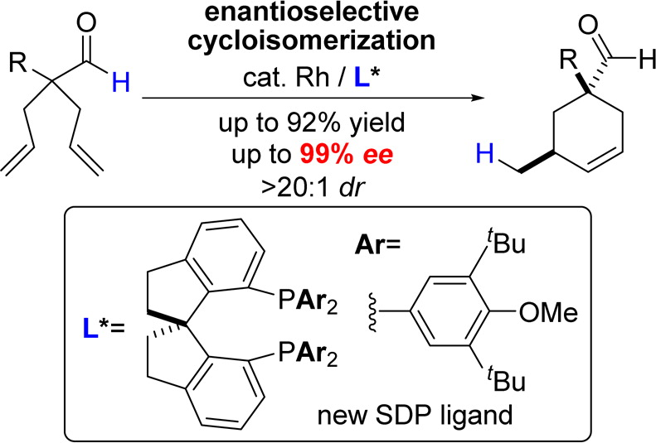
Enantioselective Alkenes hydroacylation
Enantioselective Cycloisomerization to Cyclohexenes
V. M. Dong. et al. J. Am. Chem. Soc. 2016, 138, 3310-3313.

Slide 20
Outline
1. Introduction
2. Enantioselective Alkenes Hydroacylation
3. Enantioselective Alkynes and Allene Hydroacylation
4. Enantioselective Carbonyl Hydroacylation
5. Summary and Outlook

Slide 21
Intramolecular Alkyne Hydroacylation
Due to the desire to generate organic molecules containing stereogenic centers, the study of alkynes in hydroacylation reactions has received significantly less attention than the alkene-based process.
Choice of catalyst and solvent was crucial
Tanaka, K.; Fu, G. C. J. Am. Chem. Soc. 2001, 123, 11492.

Slide 22
Enantioselective Alkynes Hydroacylation
Enantioselective kinetic resolution
Enantioselective desymmetrization
Fu, G. C. et al. J. Am. Chem. Soc. 2002, 124, 10296.

Slide 23
Enantioselective Alkynes Hydroacylation
Tanaka, K.; Fu, G. C. J. Am. Chem. Soc. 2003, 125, 8078.

Slide 24
Enantioselective Allene Hydroacylation
Only one example of allene hydroacylation
Willis, M. C. J. Am. Chem. Soc. 2008, 130, 17232.

Slide 25
Outline
1. Introduction
2. Enantioselective Alkenes Hydroacylation
3. Enantioselective Alkynes and Allene Hydroacylation
4. Enantioselective Carbonyl Hydroacylation
5. Summary and Outlook

Slide 26
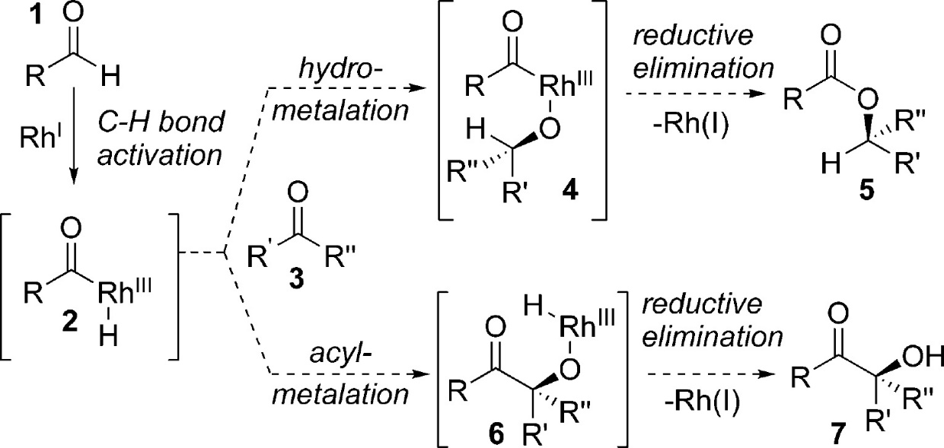
Enantioselective Carbonyl Hydroacylation
Ester compound
Decarbonylation
Benzoin compound

Slide 27
Enantioselective Carbonyl Hydroacylation
Rh(I)-Catalyzed intramolecular ketone Hydroacylation
V. M. Dong. J. Am. Chem. Soc., 2008, 130, 2916
V. M. Dong. et al. Chem. Sci. 2011, 2, 407-410.

Slide 28
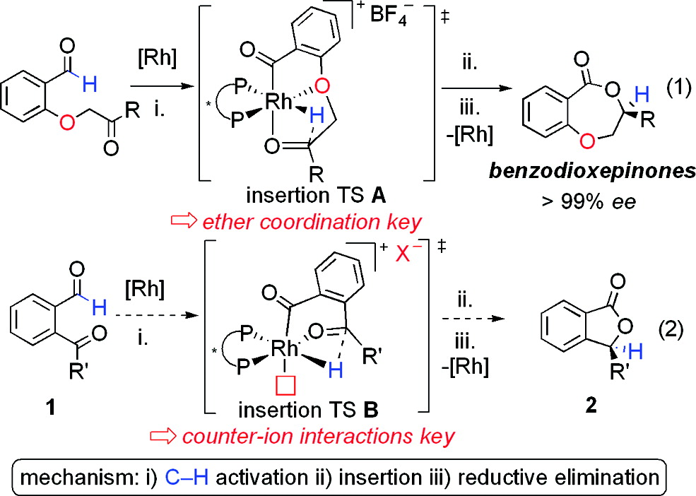
Enantioselective Carbonyl Hydroacylation
Enantioenriched phthalide synthesis
phthalide
V. M. Dong. et al. J. Am. Chem. Soc. 2009, 131, 15608-15609.

Slide 29
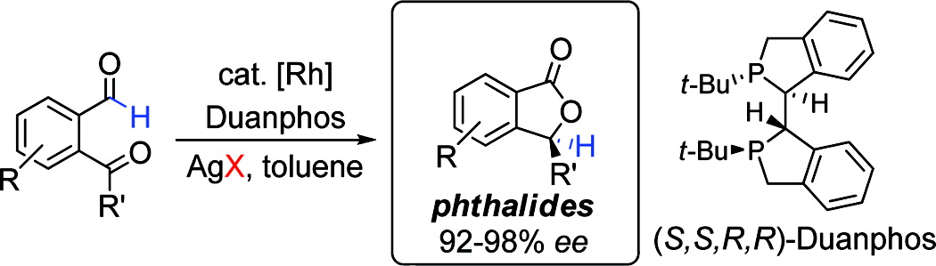
Enantioselective Carbonyl Hydroacylation
Effect on counterion
V. M. Dong. et al. J. Am. Chem. Soc. 2009, 131, 15608-15609.

Slide 30
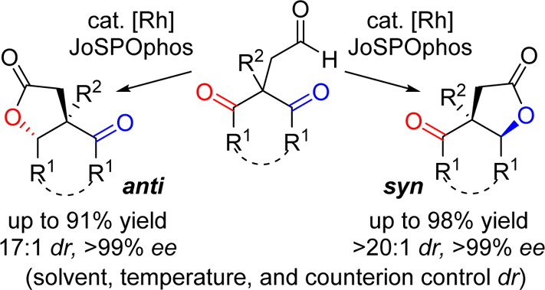
Enantioselective Carbonyl Hydroacylation
Enantioselective Desymmetric Ketone Hydroacylation
Both syn and anti bicyclic lactiones can be acessed !
V. M. Dong. et al. J. Am. Chem. Soc. 2016, 138, 12013-12016

Slide 31
Enantioselective Carbonyl Hydroacylation
Enantioselective Desymmetric Ketone Hydroacylation
Difference: Counterion, solvent and temperature
V. M. Dong. et al. J. Am. Chem. Soc. 2016, 138, 12013-12016

Slide 32
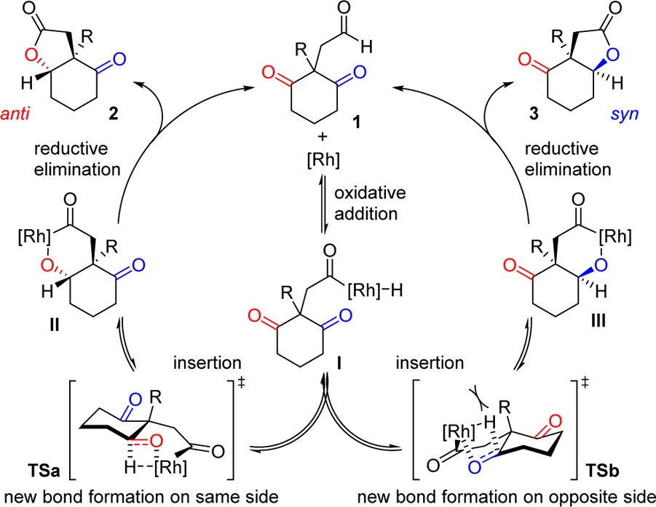
Enantioselective Carbonyl Hydroacylation
Reductive elimination governs diastereoselectivity.
V. M. Dong. et al. J. Am. Chem. Soc. 2016, 138, 12013-12016

Slide 33
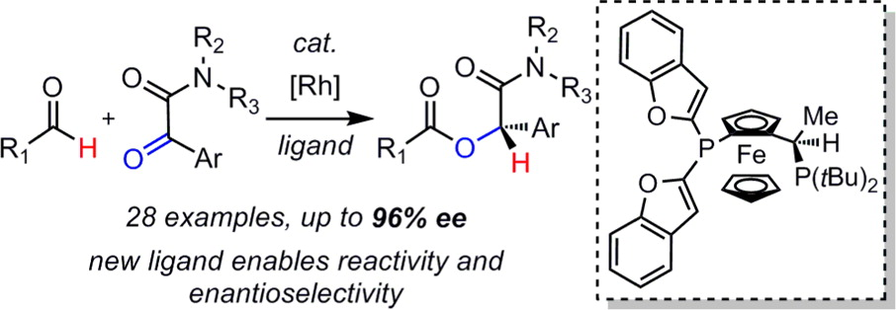
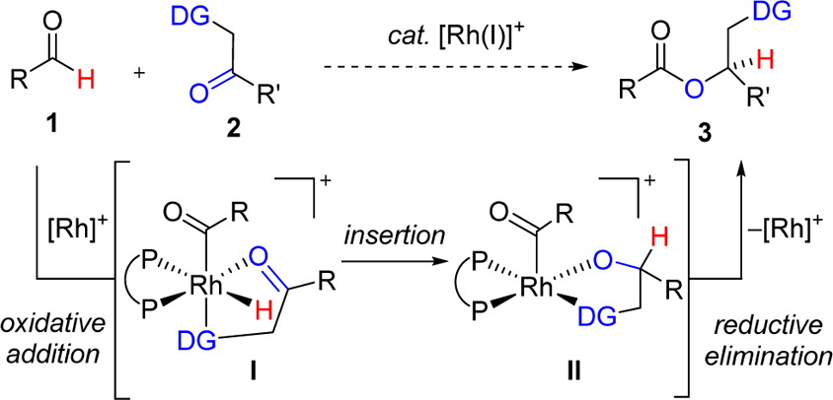
Enantioselective Carbonyl Hydroacylation
Intermolecular Hydroacylation
R1 = aliphatic group
Proposed mechanism
V. M. Dong. et al. J. Am. Chem. Soc. 2014, 136, 9471-9476

Slide 34
Summary
a. Key points for the chemo-, regio- and enantioselectivity
Ligand effect
Counterion effect
Substrate effect (directing group)
b. Limited to alkenes, alkynes, allene, ketones
End ?

Slide 35
Thanks for your attention !

