Slide 1
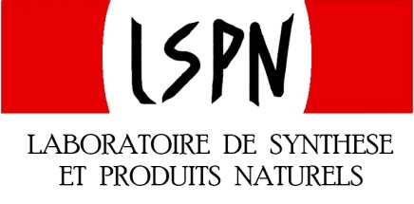
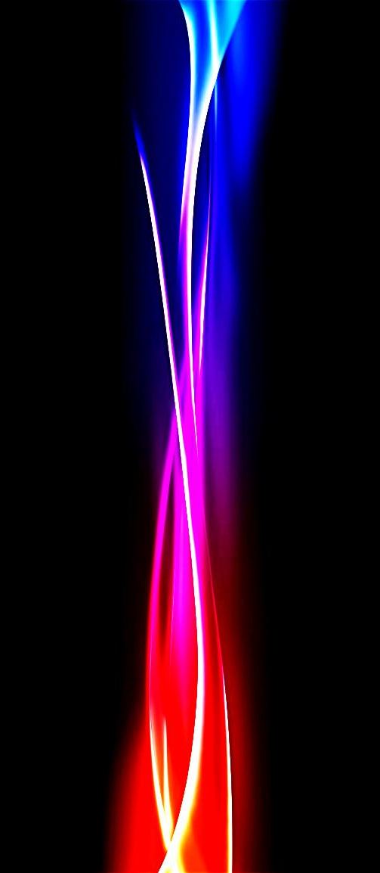
Enlightenment, Radical Pathway towards Complex Structures
Jean-Baptiste Gualtierotti
Frontiers in Chemical Synthesis:
Towards Sustainable Chemistry
Session III: Organocatalysts and Radicals

Slide 2
Layout
Historical Background
Methods for the formation of complex structures through total synthesis
Photo-cycloadditions
Photo-rearrangements
Norrish 1 and 2
Photo-extrusion
Photo-oxidation
Photo-protecting groups
- Summary and questions

Slide 3
primary Radicals
Gomberg (U. of Michigan 1900): first who recognized he had stumbled the evidence of a free radical
1911 enough evidence for the community to accept their existence
Giacomo Ciamician, by some called the father of photochemistry, proposed the concept of solar energy as green source to replace societies dependency on coal (1912)
1929: Paneth and Hofeditz produced the methyl free radical, CH₃
In 1933, Morris Kharasch and his student, Frank Mayo, invoked a free-radical mechanism and discovered
"the peroxide effect”
Evolved towards plastic, understanding of many processes (ie oxidative stress) and so on
1970’s and onwards: truly used in synthesis i.e Barton reaction in steroid synthesis
On the arid lands there will spring up industrial colonies without smoke and without smokestacks;
forests of glass tubes will extend over the plains and glass buildings will rise everywhere;
inside of these will take place the photochemical processes that hitherto have been the guarded secret of the plants,
but that will have been mastered by human industry which will know how to make them bear even more abundant fruit than nature,
for nature is not in a hurry and mankind is.
Giacomo Ciamician science 36, 385, 1912

Slide 4
A singular entity
Advantageous over ionic counterparts
In addition light based chemistry
Atom economy = $\frac{Mw product}{\sum{Mw} reactants }$
Mw light << Standard reagents
More FG tolerant
Lesser pH dependence
Potential cascade reactions
Can acess congested «areas»
E factor = $\frac{m overall waste}{m product}$
Light waste?
Photochemical reactions lead to a reversal of terminal
symmetry relation-ships and reversal of stereospeciﬁcity
Woodward-Hoffmann rules
Thermal [1.3] antarafacial
sigmatropic shift
Photo [1.3] superafacial
sigmatropic shift

Slide 5
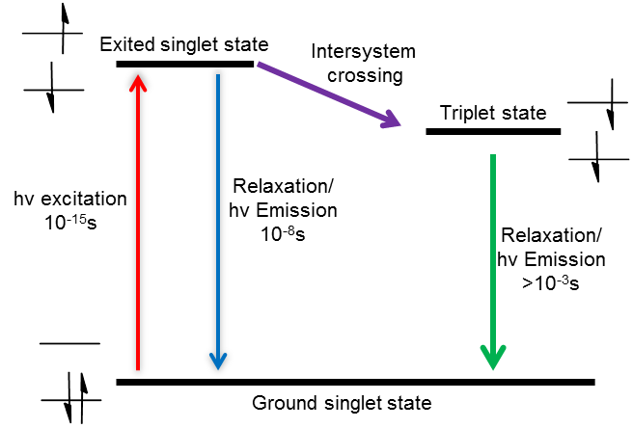
Photo-excitation pathways
Simplified Jablonski diagram:
Quantum yield:
Φ$=\frac{Nbre events}{Nbre of photons absorbed}$
Sensitization by energy transfer
Dexter or FRET mechanism

Slide 6
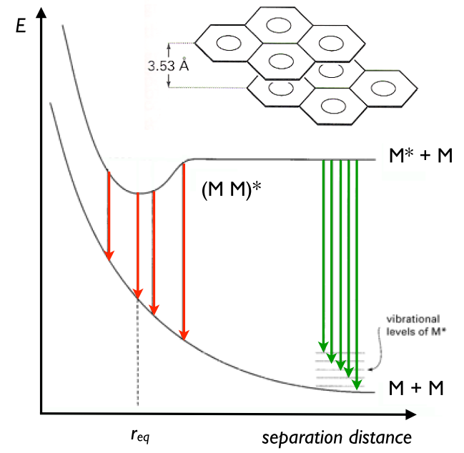
Exiplex
Complex formed by the stabilizing interactions between
ground state molecule and exited state molecule
M + M*: eximer
M + N*: exiplex

Slide 7
Towards complex structures through radicals
Questions
How to control the formation of an intermediate singlet or triplet state?
What reaction media are available for the following reactions?

Slide 8
2+2 cycloadditions
Most common photochemical reaction, based on excitation to the reactive long lived ππ* triplet (biradical) state
Photosensitivisation oft needed for ISC
Buu Hue, B. T.; Dijkink, J.; Kuiper, S.; van Schaik, S.; van Maarseveen, J. H.; Hiemstra, H Eur. J. Org. Chem. 2006, 127-137.
Crimmins, Michael T.; Pace, Jennifer M.; Nantermet, Philippe G.; Kim-Meade, Agnes S.; Thomas, James B.; Watterson, Scott H.; Wagman, Allan S.. J. Am. Chem. Soc. 2000, 122, 8453-8463

Slide 9
2+2 cycloadditions
Additives to enhance diaselectivity
Tsutsumi, K.; Nakano, H.; Furutani, A.; Endou, K.; Merpuge, A.; Shintani, T.; Morimoto, T.; Kakiuchi, K., J. Org .Chem 2004, 69 (3), 785-789.

Slide 10
2+2 cycloadditions
De Mayo varient
Enol followed by retro-aldol
David E. Minter and, Christopher D. Winslow J.Org.Chem 2004 69 (5), 1603-1606

Slide 11
2+2 cycloadditions
Paternó-Büchi varient
Hetero 2+2 cycloadditon, passing through triplet nπ* or ππ* carbonyl biradical
Nehrings, A.; Scharf, H.-D.; Runsink, J., Angew Chem 1985, 97 (10), 882-883.
Boxall, Richard J.; Ferris, Leigh; Grainger, Richard S. Synlett 2004 2379-2381

Slide 12
2+2 cycloadditions
Paternó-Büchi varient
Efforts to reach stero-control have been made
Guo, H.; Herdtweck, E.; Bach, T., Angew. Chem. Int. Ed. 2010, 49 (42), 7782-7785.

Slide 13
4+2 cycloadditions
Rarer: photoexcitation dealigns orbitals
Some examples exist: based on photoswitching rather than photoactivation
Davies, H. M. L.; Loe, Ø.; Stafford, D. G., Org Let 2005, 7 (25), 5561-5563.

Slide 14
Photocycloadditions
Additions on aromatic cores leading to the loss of aromaticity
ortho
para
meta
Intra/inter selectivity:
Regioselective issues: Controllable by tethering and substituant optimisation
Steroselective issues: endo prefered
Facial selectivity: Structure dependent

Slide 15
Photocycloadditions
Meta-photocycloaddition
Endo selectivity
Α-cedrene 1
Howbert J.J. Wender P.A., J. Am. Chem. Soc, 1981 103, 688-690
Deicated review: Chappell, D.; Russell, A. T., Organic & Biomolecular Chemistry 2006, 4 (24), 4409-4430.

Slide 16
5+2 Photocycloadditions
Unusual intramolecular reaction, protecting group free
Lainchbury, M. D.; Medley, M. I.; Taylor, P. M.; Hirst, P.; Dohle, W.; Booker-Milburn, K. I.,
J. Org. Chem. 2008, 73 (17), 6497-6505.

Slide 17
6+2 Photocycloadditions
6 + 2 also exists, although rare in synthesis
Feldman, K. S.; Wu, M. J.; Rotella, D. P., J.Am.Chem.Soc 1990, 112 (23), 8490-8496.

Slide 18
Photo-rearangements
X = CH2 Di-π-methane rearangement
X = O Oxa-Di-π-methane rearangement
Singh, V.; Sahu, P. K.; Mobin, S. M., Tetrahedron 2004, 60 (44), 9925-9930

Slide 19
Photo-rearangements
Barton Nitrite ester reaction
5 hydrogen abstraction
Hakimelahi G.H., Li P., Moosavi-Movahedi A., Chamani J., Khodarahmi G. A., Ly T. W., Valiyev F.,
Leong M. K., Hakimelahi S., Shia K. Chao I. Org. Biomol. Chem., 2003, 1, 2461-2467
Similar to the Hofmann-Löffler-Freytag Reaction, amine instead of alcohol

Slide 20
Photo-fries rearangement
Strong lewis acid
Mild alternative
Through homolitical cleavage
of the ester bond
Regioselectivity dependant
on substituded positions
«standard» reaction did not work
Okada K., Suzuki R., Yokota T. Biosci. Biotechnol, Biochem. 1999, 63, 257-260
Standard Fries in general requires unencumbered arenes
Magauer, T.; Martin, H. J.; Mulzer, J., Angew Chem. Int. Ed. 2009, 48 (33), 6032-6036.

Slide 21
Norrish-Yang reaction
Norrish 2
Yang
Kraus, G. A.; Chen, L., J. Am. Chem. Soc 1990, 112 (9), 3464-3466.
Wessig, P; Teubner, J Synlett 2006, 1543-1546

Slide 22
Norrish cleavage
C.-H Lin, Y.-L. Su, H.-M. Tai, Heterocycles 2006, 68, 771-777
Molander, G. A.; St. Jean, D. J.; Haas, J., J. Am. Chem. Soc 2004, 126 (6), 1642-1643.

Slide 23
Photoextrusion
Cyclic ketone double
alpha cleavage
Veerman, M.; Resendiz, M. J. E.; Garcia-Garibay, M. A., Org Lett 2006, 8 (12), 2615-2617.
Tetrazo-option also known

Slide 24
Photooxydation
Singlet oxygen is far more reactive than ground state triplet oxygen
Easy oxidation, sunlight is sufficient.
Vassilikogiannakis, G.; Margaros, I.; Montagnon, T.; Stratakis, M., Chem.–Eur. J. 2005, 11 (20), 5899-5907.
Photo-oxydation of furans gave several natural products
Miyaoka, H.; Yamanishi, M.; Kajiwara, Y.; Yamada, Y.,
J Org Chem 2003, 68 (9), 3476-3479.
Mace, L. H.; Shanmugham, M. S.; White, J. D.; Drew, M. G. B., Org. Biomol. Chem. 2006, 4 (6), 1020-1031.

Slide 25
Protecting groups
Cleavage by light avoids reagents and is rapid and clean
via
Snider, B. B.; Busuyek, M. V., Tetrahedron 2001, 57 (16), 3301-3307.

Slide 26
Photochemical MCR
Light as an auxillary for radical chemistry
Ryu, I.; Kreimerman, S.; Araki, F.; Nishitani, S.; Oderaotoshi, Y.; Minakata, S.; Komatsu, M., J. Am. Chem. Soc 2002, 124 (15), 3812-3813.
Recent similar work by Corey R. J. Stephenson on light photoredox catalysis

Slide 27
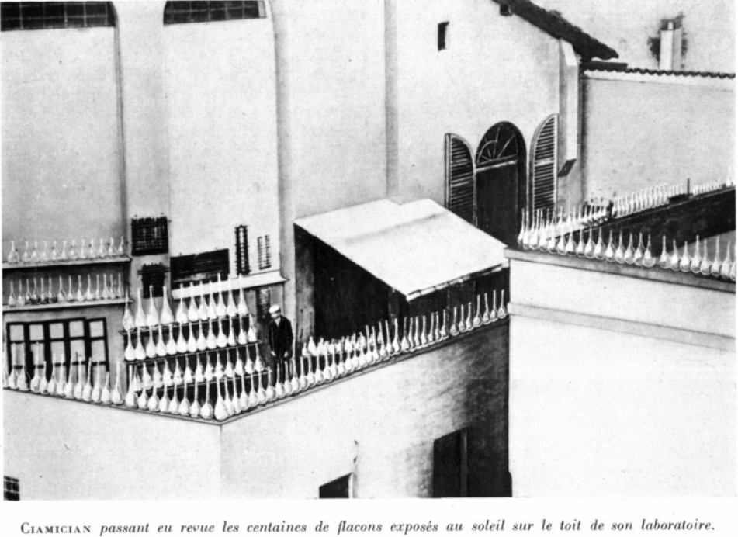
Summary
Many structures are accessible through photo-induced radical reactions
Oft in greener conditions, even at times in crystal phase
Sensitizers, additives and carefully chosen substituents can induce selectivity on several levels
Questions?

