Slide 1
Major developments in Rh-catalyzed asymmetric 1,4-addition of boron species to enone
Group Seminar
By Raphaël Beltran

Slide 2
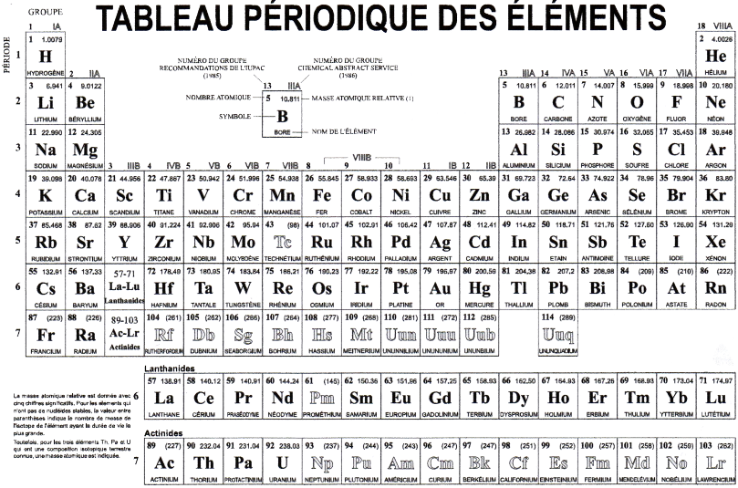
Conjugated Addition Reactions extensively studied using transition metals

Slide 3
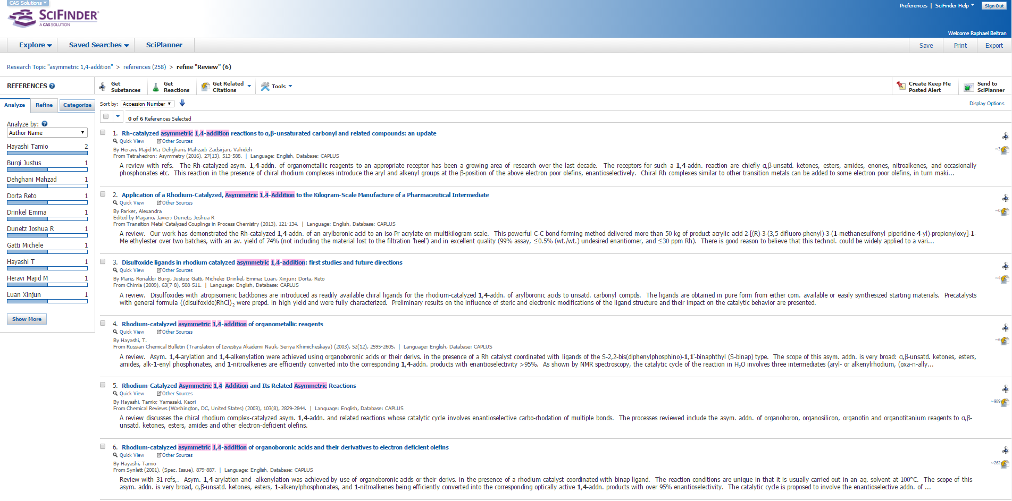

Slide 4
Table of contents
Introduction
First non-asymmetric & asymmetric 1,4 addition
Mechanistic studies
Evolution of chiral ligands
Application in total synthesis
Conclusion

Slide 5
Origins of conjugated addition
First example of carbon nucleophile adding to an electron-deficient double bond
Michael systematically investigated the reaction of stabilized anions with α,β-unsaturated systems

Slide 6
Origins of conjugated addition
First conjugated addition to enone
Beginning of a vast number of studies with organometallic reagents.

Slide 7
First enantioselective 1,4-addition using Rh
α-cyano carboxylate with vinyl ketone or acrolein
TRAP ligand designed by the same group. Both planar chiralities & stereogenic centers.

Slide 8
First 1,4 addition of boronic acid
1,4-addition of aryl-boronic acids to α,β- unsaturated ketones using a phosphine-rhodium complex as a catalyst system. Sakai, M.; Hayashi, H.; Miyaura, N. Organometallics 1997, 16, 4229.

Slide 9
First 1,4 addition of boronic acid
1,4-addition of aryl-boronic acids to α,β- unsaturated ketones using a phosphine-rhodium complex as a catalyst system. Sakai, M.; Hayashi, H.; Miyaura, N. Organometallics 1997, 16, 4229.
Suggesting that the reaction is accelerated upon the increase of the P-Rh-P angles: dppb>dppp>dppe

Slide 10
First 1,4 addition of boronic acid
1,4-addition of aryl-boronic acids to α,β- unsaturated ketones using a phosphine-rhodium complex as a catalyst system. Sakai, M.; Hayashi, H.; Miyaura, N. Organometallics 1997, 16, 4229.
Suggesting that the reaction is accelerated upon the increase of the P-Rh-P angles: dppb>dppp>dppe
Electron-withdrawing & -donating groups: No difference.

Slide 11
First asymmetric 1,4-addition of boronic acid
What about the catalytic species?

Slide 12
First asymmetric 1,4-addition of boronic acid
Generation of Rh(acac)[(S)-binap]
High reaction temperature (100 °C). Less than 60 °C < 3% yield.
Mixture of dioxane and water in a ratio of 10 to 1.
Takaya, Y.; Ogasawara, M.; Hayashi, T.; Sakai, M.; Miyaura, N. J. Am. Chem. Soc. 1998, 120, 5579.

Slide 13
First asymmetric 1,4-addition of boronic acid
Generation of Rh(acac)[(S)-binap]
High reaction temperature (100 °C). Less than 60 °C < 3% yield.
Mixture of dioxane and water in a ratio of 10 to 1.
Takaya, Y.; Ogasawara, M.; Hayashi, T.; Sakai, M.; Miyaura, N. J. Am. Chem. Soc. 1998, 120, 5579.

Slide 14
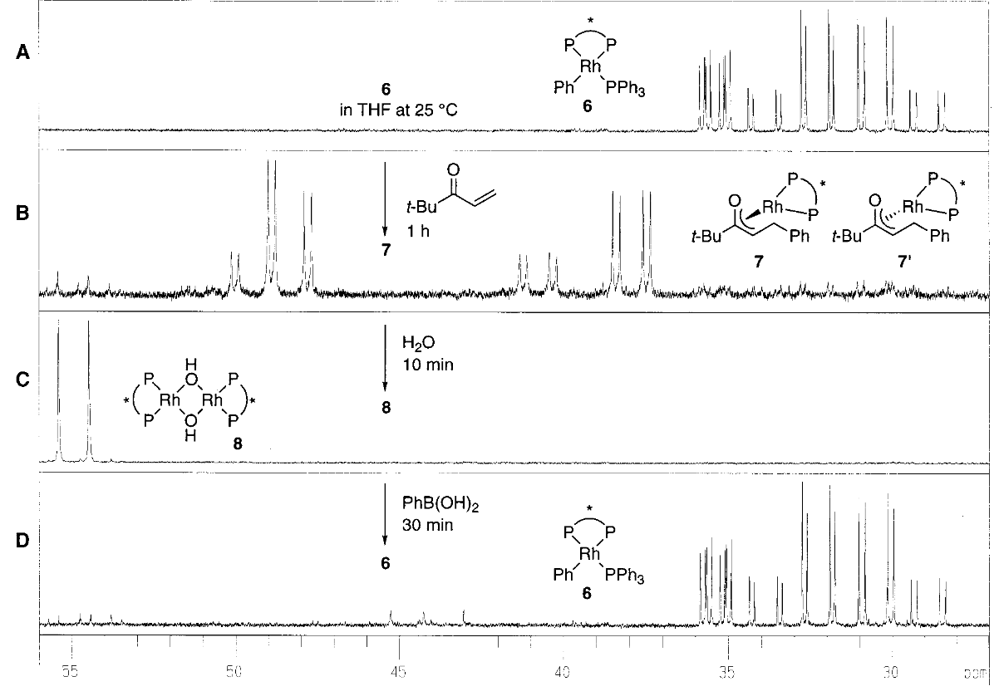
Mechanistic studies
T. Hayashi, J. Am. Chem. Soc., 2002, 124, 5052
Three ddd, characteristic of square-planar Rh complex with 3 unequivalent phosphorus atoms
Two new species in a ratio 2/1. One singlet at -4.5 ppm assignable to PPh3.
This isomers assigned to two diastereomeric oxa-π-allylrhodium complexes
Immediate generation of a new rhodium species assigned to be hydroxorhodium. Nb, the singlet for free PPh3 stay at the same high field
Transmetalation of a phenyl group from boron to rhodium species 8. Quite fast at 25 °C
PPh₃ which was free in step B & C came back to the rhodium at the transmetalation

Slide 15
Mechanistic studies
T. Hayashi, J. Am. Chem. Soc., 2002, 124, 5052
Three ddd, characteristic of square-planar Rh complex with 3 unequivalent phosphorus atoms
Two new species diastereomeric oxa-π-allylrhodium complexes
Immediate generation of a new rhodium species: hydroxorhodium.
Transmetalation of a phenyl group to rhodium specie.
Done at 25 °C

Slide 16
Mechanistic studies
T. Hayashi, J. Am. Chem. Soc., 2002, 124, 5052

Slide 17
Mechanistic studies
T. Hayashi, J. Am. Chem. Soc., 2002, 124, 5052

Slide 18
Mechanistic studies
M. Lautens, Chem. Rev., 2003, 103, 169

Slide 19
Evolution of Chiral Ligands

Slide 20
Bisphosphine ligands
Based on chiral BINOL, play with atropisomeric (such as BINAP) to get high ee in 1,4-addition reactions

Slide 21
Bisphosphine ligands

Slide 22
Bisphosphine ligands

Slide 23
Monodentate ligands
New class of ligands? Why?

Slide 24
Chiral diene ligands
Importance of dienes as ligands.

Slide 25
Chiral diene ligands
Second major class of metal complex for asymmetric conjugated addition.

Slide 26
Chiral diene ligands
Range of chiral diene ligands

Slide 27
Table of contents
Introduction
First non-asymmetric & asymmetric 1,4 addition
Mechanistic studies
Evolution of chiral ligands
Application in total synthesis
Conclusion

Slide 28
Application in total synthesis
Enantioselective approach

Slide 29
Application in total synthesis
Enantioselective approach of (R)-Tolterodine

Slide 30
Application in total synthesis
Enantioselective approach for important intermediate in alkaloids

Slide 31
Conclusion
Developments
Racemic, first asymmetric, pre-catalyst/active species, mechanism, evolution of ligands.
Many advantages to create a new carbon-carbon bond with this reaction
Very high enantioselectivity
Very good yield
Carried out in aqueous solvent
Variety of sp² carbon group (aryl and alkenyl group) can be introduced
Various type of olefins ( ketone, esters, amide etc.)

Slide 32
Thank you!

Slide 33
Questions?

Slide 34
Model with phosphine ligands
Diene: steric difference, space discrimination around the central metal.
Phosphine: Conformation differentiation.

Slide 35
Chiral diene ligands
Chirality is controlled by the size of the substituents attached to the double bond.
T. Hayashi, J. Am. Chem. Soc., 2003, 125, 11508

Slide 36
Boron

Slide 37
Chiral diene

Slide 38
Phosphoramidites

Slide 39
Application in total synthesis
Enantioselective approach for the synthesis of (-)-indatraline

Slide 40
Application in domino process
Enantioselective approach for synthesis of dihydroquinolinones

Slide 41
Application in total synthesis
Enantioselective approach for the synthesis of (-)-ecklonialactone A

Slide 42
Application in total synthesis
Diastereoselective approach with the 1st total synthesis of (−)-Isoschizogamine

