Slide 1
Micro-topic: Frustrated Lewis Pairs
Group Meeting LSPN 26.06.2012
Jean-Baptiste Gualtierotti

Slide 2
Concept
Steric hindrance stops formation of adduct:
Result: Strong unquenched, «frustrated» Lewis acid
and strong unquenched Lewis base coexist
Opening for novel reactivity

Slide 3
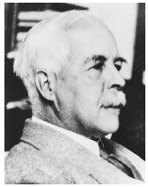
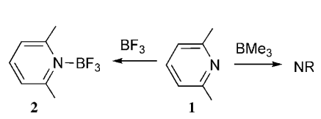
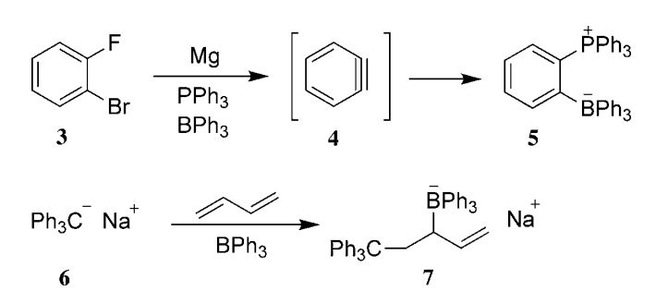
Discovery Timeline
1923
Definition of Lewis acids and bases in by Gilbert Lewis
Propagation of use in organic chemistry
Based on the acid/base reaction for the formation of adducts
1942
Effect of steric hindrance within adduct noticed by Brown
1959
Wittig, Benz and then Tochtemann noticed similar anomalies
1966
G.N. Lewis, Valence and the Structure of Atoms and Molecules 1923 142.
G. Wittig, E. Benz, Chem. Ber. 1959, 92, 1999 – 2013.
H. C. Brown, H. I. Schlesinger, S. Z. Cardon, J. Am. Chem. Soc. 1942, 64, 325 – 329.
W. Tochtermann, Angew Chem. Int. Ed. Engl. 1966, 5, 351 – 371.

Slide 4
Discovery Timeline
1978 -1990
Gutmann published his analysis of the interaction of Lewis acids and bases
2000
Scott Denmark capitalizes on the principle of Gutmann
2006
Stephan Douglas encounters same phenomena as Brown
2008
Stephan formalizes the concept
From then on has drawn interest by certain groups as a potential novel catalyst system
2012
T. Wynn, S. E. Denmark J. Am. Chem. Soc. 2001, 123, 6199 – 6200
Gutmann, V. The Donor-Acceptor Approach to Molecular Interac-tions; Plenum Press: New York, 1978.
L. Cabrera, G. C. Welch, J. D. Masuda, P. Wei and D. W. Stephan, Inorg. Chim. Acta, 2006, 359, 3066.
D. W. Stephan Org. Biomol. Chem., 2008, 6, 1535–1539

Slide 5
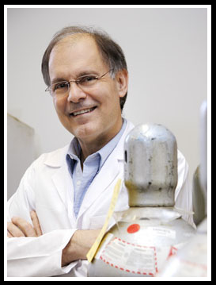
Major players in the field
Prof Douglas W. Stephan
-Ph.D 1980 (University of Western Ontario)
-Postdoc 1980-1982 (Harvard, R.H. Holm)
-Professor 2008-present (University of Toronto ) -Assistant Professor 1982-1985 (University of Windsor) -Promoted upto University Professor 2002-2007
Current research: · The reactivity of "frustrated Lewis pairs" · B-based hydrogenation catalysis · Main group CO₂ chemistry · P-based Lewis acids · Transition metal mediated CO₂ reduction · New ligands derived from FLP chemistry

Slide 6
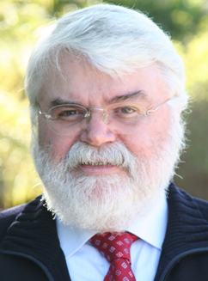
Major players in the field
Prof Gerhard Erker
-PhD: 1973 (Univ. Bochum, W. R. Roth)
-Postdoc (1974-75, Princeton University, M. Jones, Jr.
-Professor 1985-90 (Univ. Würzburg)
-Professor Univ. Münster 1990
Current research
Development of novel catalyst systems
Metal catalyzed polymerization reactions
Frustrated Lewis Pairs: metal-free dihydrogen activation/ activation of carbon dioxide and more
Carbon-carbon bond activation
Surface chemistry and heterogeneous catalysis
Unusual organic compounds
Bio-organometallic chemistry
Both professors often collaborated together on the subject

Slide 7
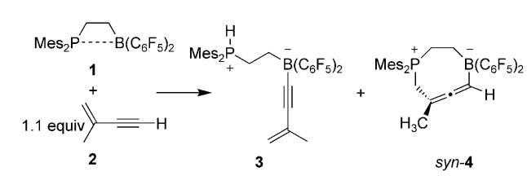
Concept
FLP will interact with unsubtituted systemps to form stable adducts that readily crystalise
Many studies on such systems have been made
Addition to conjugated enynes
Addition to ynones
Addition to aldehydes/ketones
With terminal alkynes slight variation of reaction conditions may yield addition or deprotonation adducts
B-H Xu, R. A. A. Yanez, H. Nakatsuka, M. Kitamura, R. Frohlich, G Kehr, G. Erker Chem. Asian J. 2012, 7, 1347 – 1356
C. M. Momming, G. Kehr, B. Wibbeling, R. Frohlich, B. Schirmer, S. Grimme, G. Erker Angew. Chem. Int. Ed. 2010 49 2414-2417
D. W. Stephan, G. Erker Angew. Chem. Int. Ed. 2010, 49, 46 – 76
T. Voss, T. Mahdi, E. Otten, R. Frolich, G. Kehr, D. W. Stephan, G. Erker organometallics, 2012, 31, 2367-2378

Slide 8
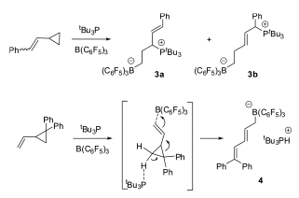
Concept
Ring opening reactions
Regio-specific, B-C bond will form at the unsaturated methylene carbon
and resulting attack by phosphine at carbocation polarized site
J. G. M. Morton, M. A. Dureen, D. W. Stephan Chem. Commun., 2010, 46 , 8947–8949

Slide 9
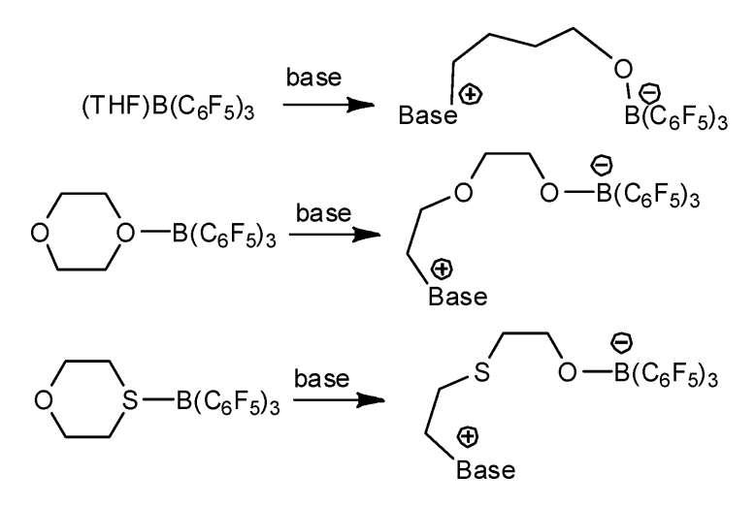
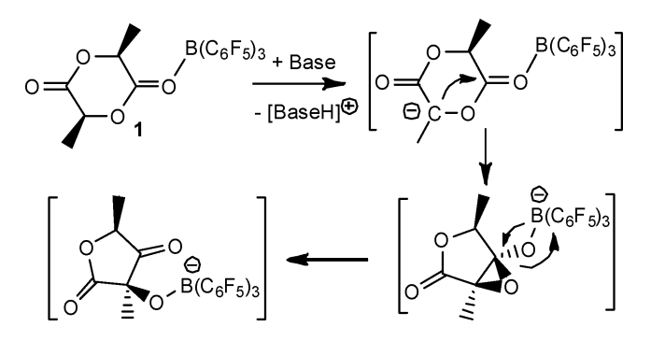
Concept
Ring opening reactions
Base can be phosphines or tertiary amines
Exception lactides over hindrance prevents attack of the Lewis base and favors deprotonation for ring contraction
C. Kreitner, S. J. Geier, L. J. E. Stanlake, C. B. Caputo, D. W. Stephan Dalton Trans. 2011, 6771-6777 and references cited therein

Slide 10
Concept
Activation of small molecules
CO₂ Trapping
NO trapping
2 equiv
Clean reactions
A. J. P. Cardenas, B. J. Culotta, T. H. Warren, S. Grimme, A. Stute, R. Frhlich, G. Kehr, G. Erker Angew. Chem. Int. Ed. 2011, 123, 7709 –7713
C. M. Mmming, E. Otten, G. Kehr, R. Frhlich, S. Grimme, D. W. Stephan, G. Erker Angew. Chem. Int. Ed. 2009, 48, 6643 –6646

Slide 11
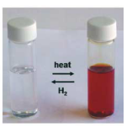
Applications
Activation of hydrogen
Main application of FLP: With H2 form an adduct holding poth protic and hydric centers
H₂ release at 110 °C
H₂ adsobtion at 25 °C
HD scrambling between P and B positions observed at 100° probably via
For H₂ release:
ΔH≠= 90 kJ/mol
ΔS≠ = -96j/mol K
1st order kinetics for H₂ release
G. C. Welch, R. R. San Juan, J. D. Masuda, D. W. Stephan Science, 2006, 314, 1124-1126

Slide 12
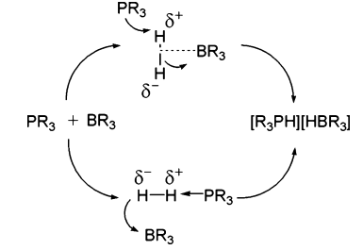
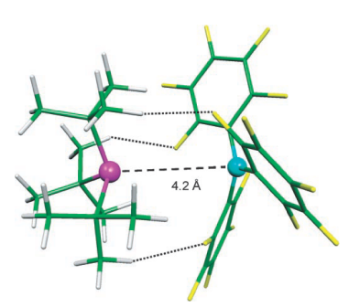
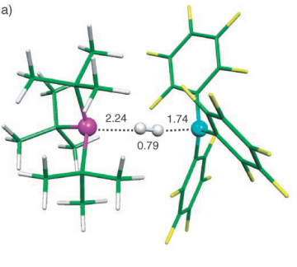
Applications
A second system
Tethered variant
Computational studies
Doted lines H-F hydrogen bonds
ΔE≠= -11.5 kcal/mol vs free state
(1/2 compared to standard adduct)
Optimal distance for bifunctional cooperativity vs H₂
Push pull electron transfer
ΔE≠= -26.3 kcal/mol vs free states
T. A. Rokob, A. Hamza, A. Stirling, T. Soos, I. Papai Angew. Chem. Int. Ed. 2008, 47, 2435 –2438

Slide 13
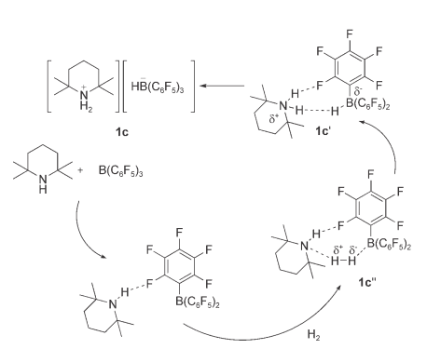
Applications
Amine base varient
NHC varient
V. Sumerin, F. Schulz, M. Nieger, M. Leskela, T. Repo, B. Rieger Angew. Chem. Int. Ed., 2008, 47, 6001-6003
P. A. Chase, A. L. Gille, T. M. Gilbert, D. W. Stephan Dalton Trans, 2009, 7179-7188

Slide 14
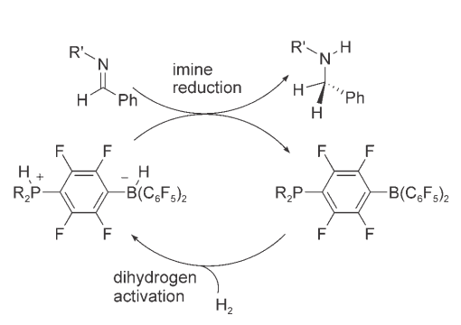
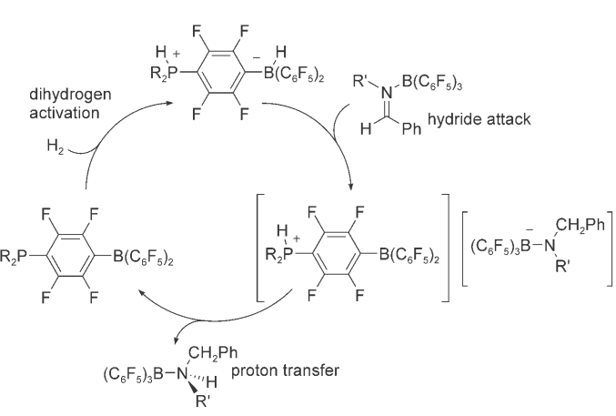
Applications
Reduction of imines
Works catalytically with
- Sterically encumbered imines
- Less encumbered imine/B(C₆F₅)₃ adducts
- Nitriles/aziridines can also be reduced
Decent yields 60 -98%
Issues: release of catalyst
Mechanism
Studies show two pathways
From imine
From adduct
Protonation
P. A. Chase, G. C. Welch, T. Jurca, D. W. Stephan Angew. Chem. Int. Ed. 2007, 46, 8050-8053

Slide 15
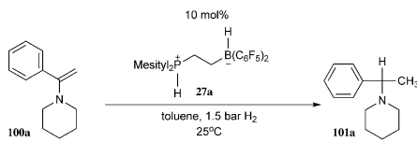
Applications
Catalytic reduction of enamines
5 examples
70-90% yields
Self reduction
Handful of examples
Decent yields 50% with 5% catalyst
S. Schwendemann, R. Frohlich, G. Kehr, G. Erker Chem. Sci., 2011, 2, 1842–1849
P. A. Chase, G. C. Welch, T. Jurca, D. W. Stephan, Angew. Chem. Int. Ed. 2007, 46, 8050-8053.

Slide 16
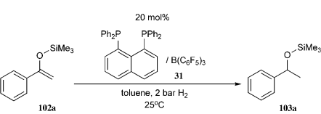
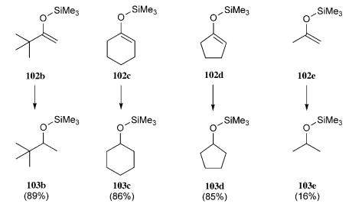
Applications
Reduction of silyl enolates
Catalyst
Scope
H. Wang, R. Frohlich, G. Kehr, G. Erker Chem. Commun., 2008, 5966–5968

Slide 17
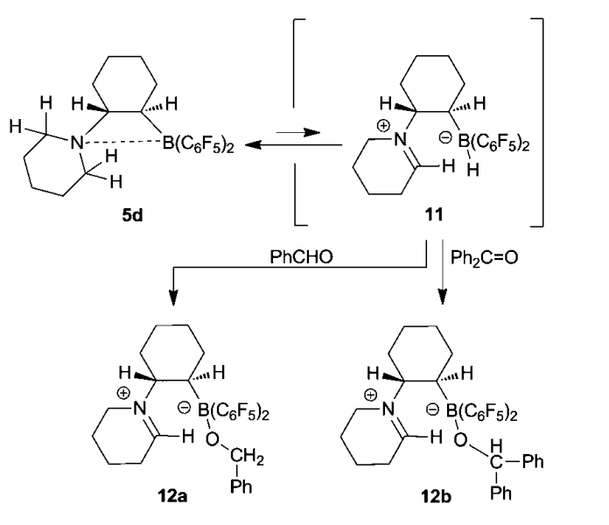
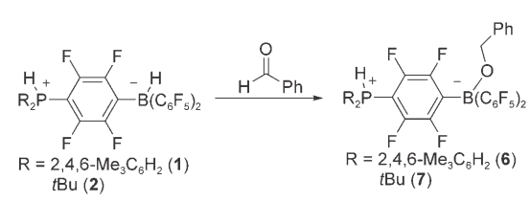
Applications
Mentioned aldehyde/ketone reduction attempts
Trapping of catalyst is main issue
S. Schwendemann, R. Frohlich, G. Kehr, G. Erker Chem. Sci., 2011, 2, 1842–1849
P. A. Chase, G. C. Welch, T. Jurca, D. W. Stephan Angew. Chem. Int. Ed. 2007, 46, 8050-8053

Slide 18
Conclusion
- Original reactivity due to coexistence of free Lewis acids and bases
- Activation of small molecules has led to some basic reactions
- Synthetic use under developed: Substitution of activated positions to form new structures?
- Potential uses: crystallization auxiliaries?

