Slide 1
Last Group Metting of the Year
LSPN 04.12.2012
Jean-Baptiste Gualtierotti
Micro-topic:
Desymmetrization
(Part 1?)

Slide 2
Concept
Structure A
Topicity?
enantio
homo
diastereo
achiral
meso
Chiral C₂
Pseuo chiral C₂
Enantiopic
differientiation
monofunctionalisation
Diastereotopic
differientiation
Structure B
A Lower state of chirality
Desymmetrization
B Higher state of chirality
Note: facial differentiation could be considered desymmetrization
Magnuson, Tettrahedron 1995, 2167.

Slide 3
Concept
Superior to kinetic resolution
Desymmetrisation
In theory may have 100% yield
Kinetic resolution
In theory may have 50% yield
May be higher if starting compound
can racemise during the process

Slide 4
Scope
What?
Anhydrides
Epoxides
Aziridine
Enes
Ethers
Dienes
Diols
Ketones
With what?
Willis J. Chem. Soc., Perkin Trans 1, 1999, 1765
hydrolysis
Ring openings
transesterifications
methathesis
alkylation
reductions
oxydations
Asymetic deprotonation
New frontiers in Asymmetric catalysis, Wiley, 2007, edited Leutens chapter 10 by Rovis (on server)

Slide 5
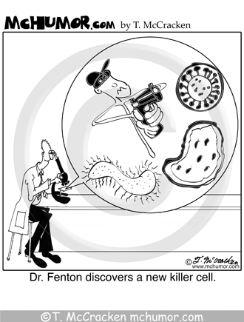
Enzymes
Traditionally «feared» by chemists despite being often highly selective
- Sensitive to contamination
- Work in water
- Require bio-knowledge to handle
- Optimized by controlled mutagenis
- Requires specific equipment
Modern advances made them «chemist-friendly»
Gotor, Chem. Rev. 2005, 105, 313

Slide 6
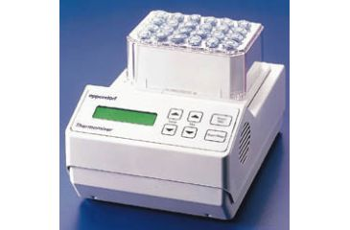
Enzymes
Commercial sources for broader substrate scope
Most enzymes from review are availible from sigma-aldritch
Gotor, Chem. Rev. 2005, 105, 313
Basic prediciton rules through models and empiricla rules
3D models availibe rcsb.PDB; following simple substituant size analysis
Weissfloch, A. N. E.; Rappaport, A. T.; Cuccia, L. A. J. Org. Chem 1991, 56, 2656-2665.
Classical optimisation possibilities
Organic media methods
Immobilized enzymes
Carrea, G.; Riva, S. Angew. Chem. Int Ed. 2000, 39, 2226-2254
Cao, L.; Langen, L. v.; Sheldon, R. A. Curr. Opin. Biotechnol. 2003, 14, 387-394
Small, convenient reactors
Ionic liquids/additives
Baudequin, C.; Baudoux, J.; Levillain, J.; Cahard, D.; Gaumont, A.-C.; Plaquevent, J.-C. Tetrahedron: Asymmetry 2003, 14, 3081-3093.

Slide 7
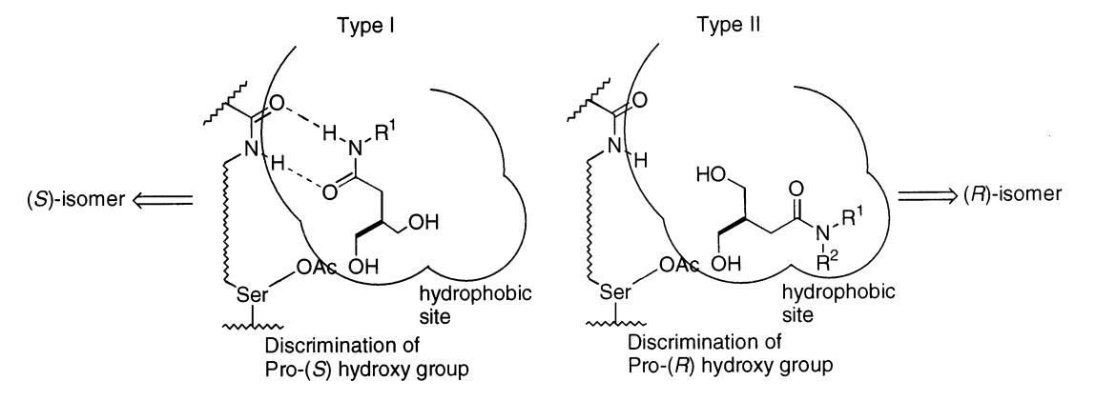
Enzymes: desymmetrization of diols
Many diols can de desymetrized
Few general enzymes: try and see method
Sacrificial group R³ controls ratio
Yields 77%, ee >95%
Takabe Tetrahedron: Asymmetry 2000, 11, 4825

Slide 8
Enzymes: desymmetrization of diols
Synthesis of Rifamycin S fragment
Chênevert, J. Org. Chem 2000, 1707
Original synthesis: 9 steps
from start to final intermediate
With 4.5:1 desym ratios
Oku, J. Org. Chem 1992, 1637.
Large range of diols can be desymmetrized in relatively mild conditions

Slide 9
Enzymes Carboxilic acid derivates
Pig liver esterase main family
Intermediate for several analogues
Ohrlein, Adv. Synth. Catal., 2003, 713
Zaks, Adv. Synth. Catal., 2001, 343

Slide 10
Enzymes Carboxilic acid derivates
Work best on R = H-bond donor or acceptor,
Weak vs aromatic
Gotor, Tetrahedron asymmetry, 2003, 603
R = aromatic, aliphatic,
higly dependant on solvent and R,
Strong vs H-bond donor/acceptors
weak vs aromatic
Oda, Tetrahedron Letters, 1988, 1717

Slide 11
Enzymes Carboxilic Baeyer-Villiger oxidations
Develloped yet require more equipment
Mihovilovic, Bioorg. Med. Chem., 2003, 1479
Some recent examples function in ionic liquids with commercial enzymes
Arends, Green Chem, 2011, 2154

Slide 12
Ring opening Desymmetrizations: Epoxides
Early examples
Yamashita, Bull. Chem. Soc. Jpn, 1988, 1213
First high ee’s examples
Jacobsen
Nitriles: org lett, 2000, 1001
Azides: J. Am. Chem. Soc., 1995, 5897
Thiols: J. Org. Chem., 1998, 5252
Acids: Tettrahedron Letters, 1997, 773

Slide 13
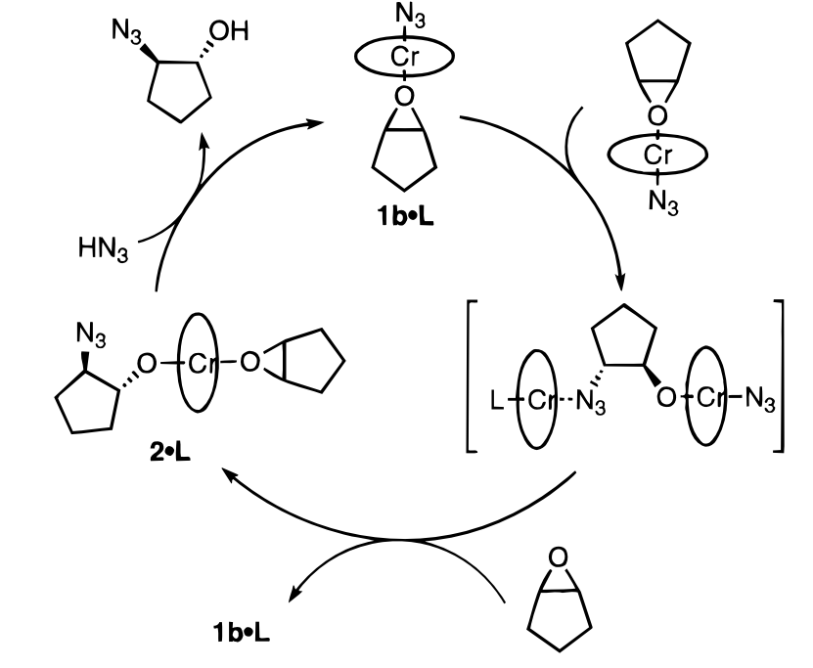
Ring opening Desymmetrizations: Epoxides
L = THF or ether
Jacobsen, J. Am. Chem. Soc. 1996, 10924

Slide 14
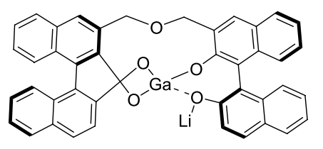
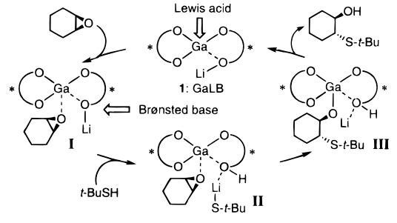
Ring opening Desymmetrizations: Epoxides
R = Phenols
>67%, >66% ee
Cat.
Shibasaki, J. Am. Chem. Soc., 2000, 2252
Kureshy, chirality 2011, 76.

Slide 15
Ring opening Desymmetrizations: Epoxides
>88%, >90% ee
> 94%, > 87%
Denmark, J. Org. Chem., 1998, 2428
Fu, J. Am. Chrm. Soc., 2001, 353
>95%, >90% ee
Nakajima, Tetrahedron Letters, 2002, 8827
Mechanistic studies

Slide 16
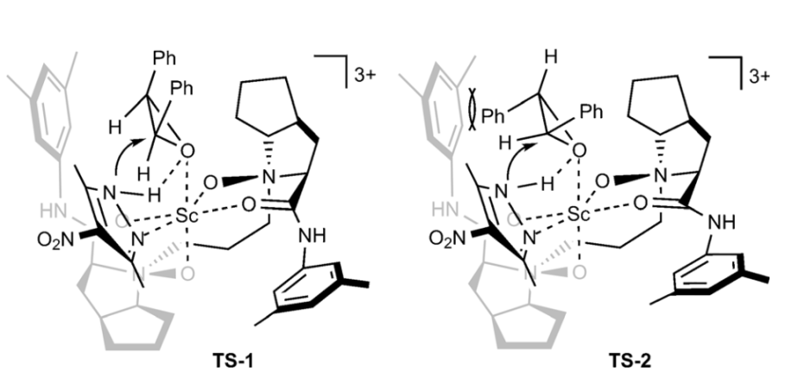
Ring opening Desymmetrizations: Aziridines
Feng, Chem. Eur. J. 2012, 3473

Slide 17
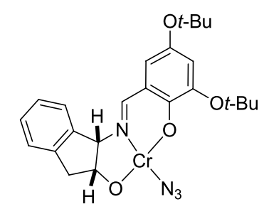
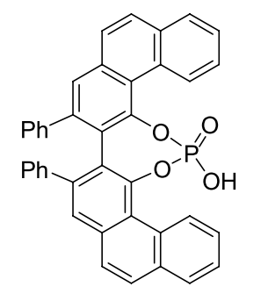
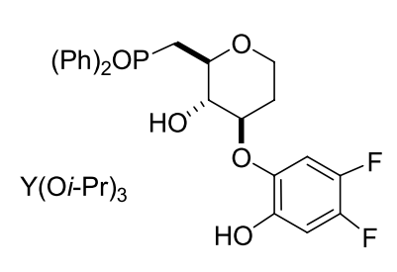
Ring opening Desymmetrizations: Aziridines
Salen complexes are too big, lowering of catalitic acitvity due to substituent on nitrogen
R = alkyl
R₃ = TMSN₃
75-95%, 83-94% ee
49-97%, 70-95% ee
94-99%, 87-96% ee
Jacobsen, Org. Lett., 1999, 1611
Antilla, J. Am. Chem. Soc., 2007, 12084.
Shibasaki, J. Am. Chem. Soc., 2006, 6312

Slide 18
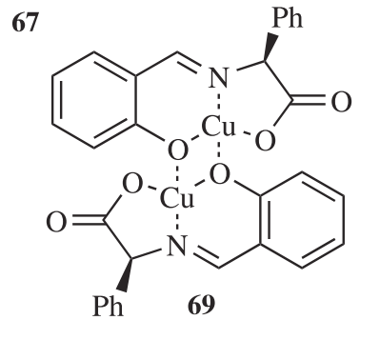
Ring opening Desymmetrizations: Aziridines
With RMgBr
89% yield 55% ee
R = Me, Pent, ^{i}pr, ph,
2,4,6-trimethyl-ph
Muller, Helvetica Chimica Acta, 2001, 662
With TMSCl
R = Cl
>80%, 95% ee
Ooi, J. Am. Chem. Soc., 2012, 8794

Slide 19
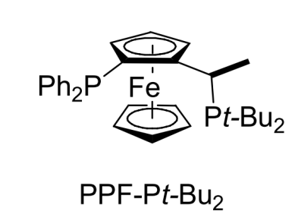
Ring opening Desymmetrizations: Bridged compounds
Nu = alcohol/poor amines Cat = Rh(COD)Cl₂ 53-96%, 93-99% ee
Lautens, J. Am. Chem. Soc., 2000, 5650
Nu = phenol, 60-41%, 91-99% ee
Lautens, Org. Lett., 2000, 1677.
Nu = thiols, 52-92%, 90-98% ee
Lautens, J. Org. Chem., 2004, 2194.
Nu = rich amines Cat = Rh(COD)l₂ 71-97%, 88-98%
Indol (C-3 position reactive)
Lautens, J. Am. Chem. Soc, 2001, 7170.
Lautens, Org. Lett, 2002, 3465.
>80%, >89% ee

Slide 20
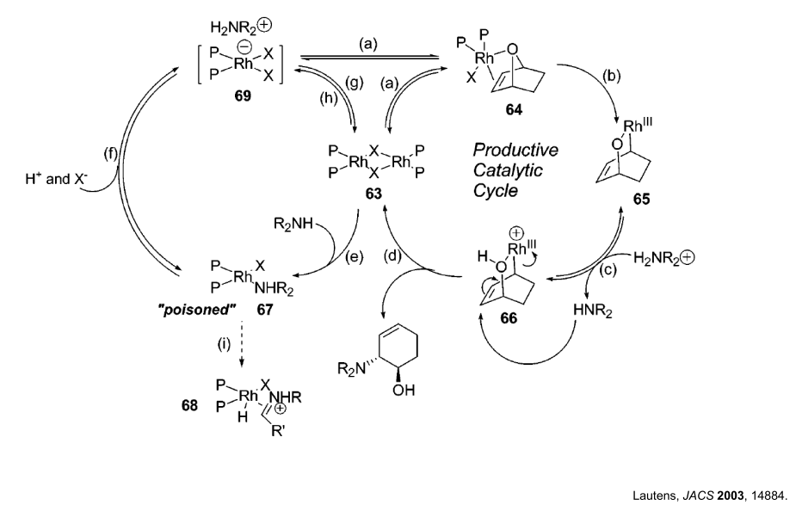
Ring opening Desymmetrizations: Bridged compounds

Slide 21
Ring opening Desymmetrizations: Bridged compounds
90%, 89% ee
Lautens, J. Am. Chem. Soc., 2000, 1804
i-Pr-POX: (4S)-2-(2-(diphenylphosphino)-
phenyl)-4-isopropyl-1,3-oxazoline
Lautens, J. Am. Chem. Soc., 2004, 1437
Fesulphos-Palladium(II) Complexes with secondary amines as nucleophiles:
Carretero J. Am. Chem. Soc. 2005, 17938

Slide 22
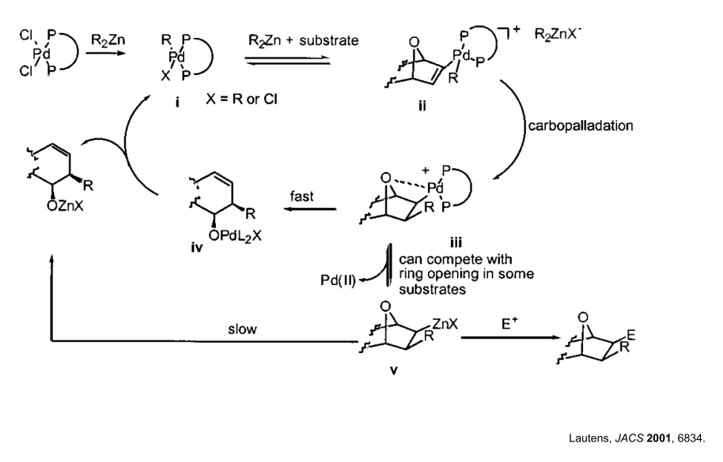
Ring opening Desymmetrizations: Bridged compounds

Slide 23
Ring opening Desymmetrizations: Bridged compounds
Yang, J. Org. Chem. 2012, 9756
With AgOTf, TBAI, TMEDA 80°C
Nu = Phenols >92%, 93%ee
Mechanistically hypothesized that Ir functions as Rh

Slide 24
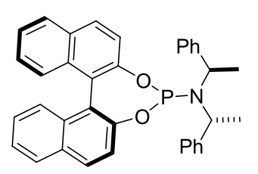
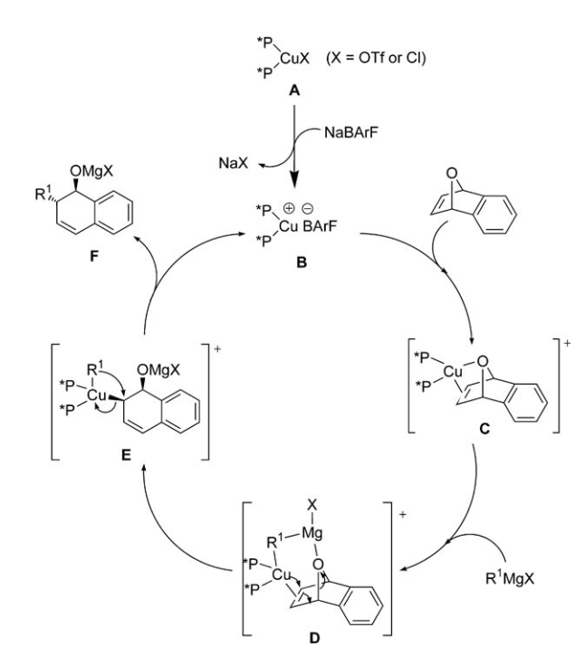
Ring opening Desymmetrizations: Bridged compounds
Zhou J. Org. Chem, 2005, 3734
Zhou, Chem. Asian J. 2008, 2105

Slide 25
Ring opening Desymmetrizations: Anyhdrides
First report
Seebach, J. Org. Chem., 1998, 1190
Most popular method
See Diaz de Villegas, Chem. Soc. Rev. 2011, 5564
Chinchona alkaloid catalysts

Slide 26
Ring opening Desymmetrizations: Anyhdrides
Deng 2000
List 2010
Mode of action
Song 2009

Slide 27
Ring opening Desymmetrizations: Anyhdrides
Ni(COD)₂, i-Pr-POX Et₂Zn 85%, 79% ee
Rovis, J. Am. Chem. Soc, 2002, 174.
Pd(OAc)₂ (5 mol%), JOSIPHOS, Ph₂Zn 61-83%, 89-97% ee
Rovis, J. Am. Chem. Soc, 2004, 10248.
Rh(COD)₂Cl₂ (4 mol%), Taddol-PNMe₂, Li-Aryl, Zn(OTf)₂ 56-88%%, 76-88% ee
Rovis, Angew. Chem. Int. Ed, 2007, 4514.
Rh(COD)₂Cl₂ (5 mol%), t-Bu-POX, (Alkyl)₂Zn 62-87%%, 88-95% ee
Rovis, J. Am. Chem. Soc, 2007, 9302.

Slide 28
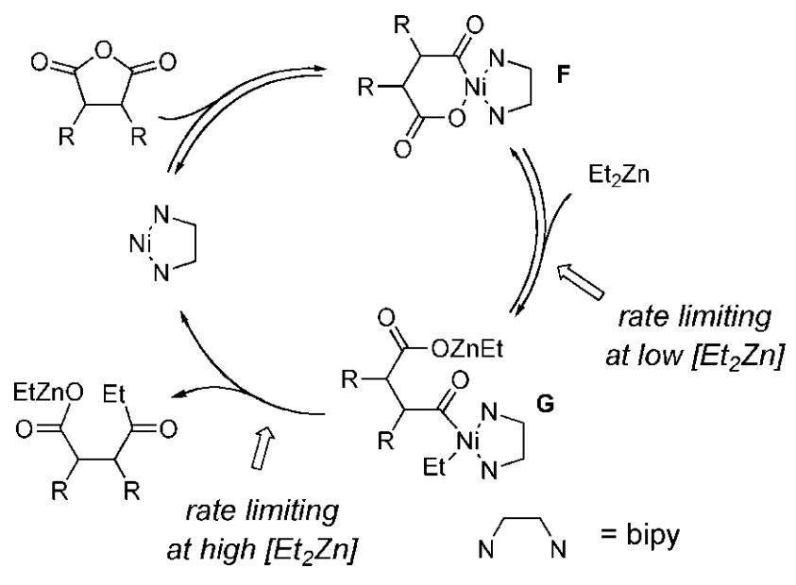
Ring opening Desymmetrizations: Anyhdrides
Summerized: Rovis, Acc. Chem. res., 2008, 327

Slide 29
The end?

