Slide 1
Copper Catalyzed C-N Bond Formation Using O-Acyl Hydroxylamine
Xu Bao
17. 11. 2016

Slide 2
Introduction
Amination of Organometallic Reagents
Amination of Electron-Deficient Arenes
Amination Approach to α-Amino Derivatives
Aminoboration of Alkenes
Hydroamination of Alkenes
Diamination, Oxyamination of Alkenes
Outlook

Slide 3
Introduction

Slide 4
Introduction
Amination of Organometallic, Organoboron Reagents
Amination of Electron-Deficient Arenes
Amination Approach to α-Amino Derivatives
Aminoboration of Alkenes
Hydroamination of Alkenes
Diamination, Oxyamination of Alkenes
Outlook

Slide 5
Amination of Organometallic Reagents (1)

Slide 6
Amination of Organometallic Reagents (2)

Slide 7
Amination of Organometallic Reagents (3)

Slide 8
Amination of Organometallic Reagents (4)
Yan, X.; Chen, C.; Zhou, Y.; Xi, C. Org. Lett. 2012, 14, 4750.

Slide 9
Amination of Organometallic Reagents (5)
Rucker, R. P.; Whittaker, A. M.; Dang, H.; Lalic, G. Angew. Chem. Int. Ed. 2012, 51, 3953
Rucker, R. P.; Whittaker, A. M.; Dang, H.; Lalic, G. J. Am. Chem. Soc. 2012, 134, 6571.

Slide 10
Introduction
Amination of Organometallic Reagents
Amination of Electron-Deficient Arenes
Amination Approach to α-Amino Derivatives
Aminoboration of Alkenes
Hydroamination of Alkenes
Diamination, Oxyamination of Alkenes
Outlook

Slide 11
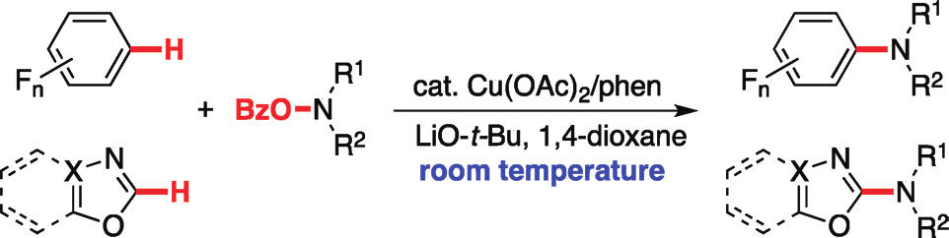
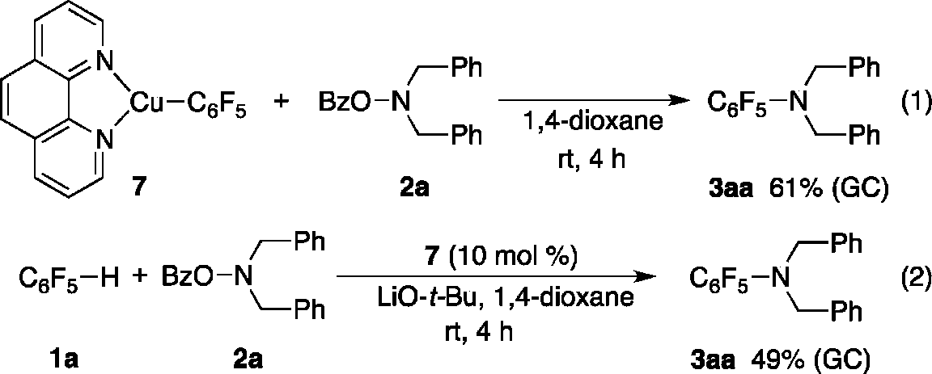
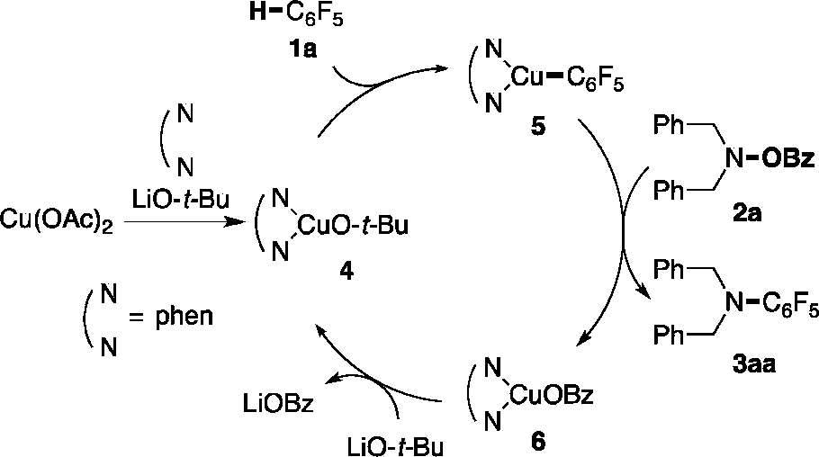
Amination of Electron-Deficient Arenes (1)
Matsuda, N.; Hirano, K.; Satoh, T.; Miura, M. Org. Lett. 2011, 13, 2860.

Slide 12
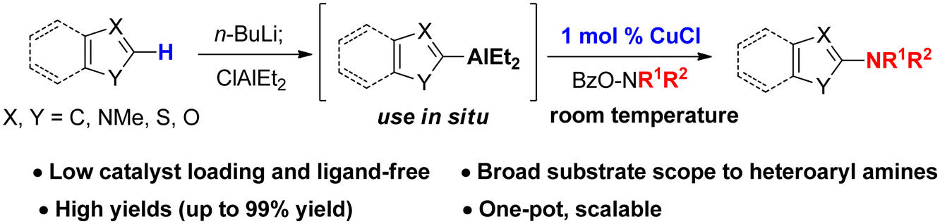
Amination of Electron-Deficient Arenes (2)
McDonald, S. L.; Hendrick, C. E.; Wang, Q. Angew. Chem. Int.Ed. 2014, 53, 4667.
Yoon, H.; Lee, Y. J. Org. Chem. 2015, 80, 10244.

Slide 13
Introduction
Amination of Organometallic Reagents
Amination of Electron-Deficient Arenes
Amination Approach to α-Amino Derivatives
Aminoboration of Alkenes
Hydroamination of Alkenes
Diamination, Oxyamination of Alkenes
Outlook

Slide 14
Amination Approach to α-Amino Derivatives (1)
Mechanism investigations
Matsuda, N.; Hirano, K.; Satoh, T.; Miura, M. Angew. Chem. Int. Ed. 2012, 51, 11827

Slide 15
Amination Approach to α-Amino Derivatives (2)
McDonald, S. L.; Wang, Q. Angew. Chem. Int. Ed. 2014, 53, 1867.
McDonald, S. L.; Wang, Q. Chem. Commun. 2014, 50, 2535.

Slide 16
Introduction
Amination of Organometallic Reagents
Amination of Electron-Deficient Arenes
Amination Approach to α-Amino Derivatives
Aminoboration of Alkenes
Hydroamination of Alkenes
Diamination, Oxyamination of Alkenes
Outlook

Slide 17
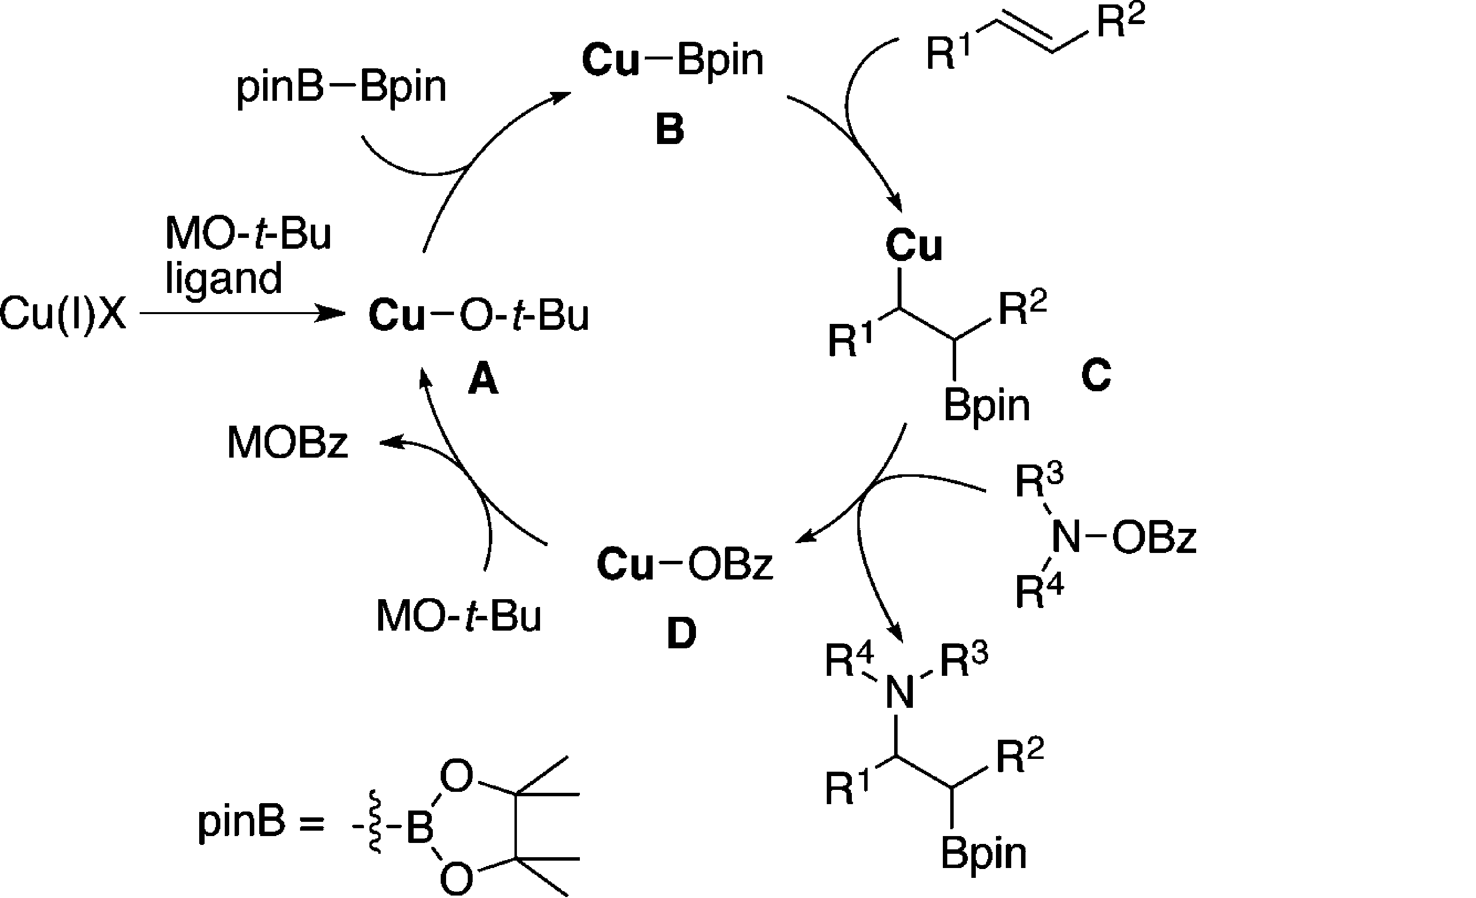
Aminoboration of Alkenes (1)
Matsuda, N.; Hirano, K.; Satoh, T.; Miura, M. J. Am. Chem. Soc.2013, 135, 4934.

Slide 18
Aminoboration of Alkenes (2)
Sakae, R.; Hirano, K.; Miura, M. J. Am. Chem. Soc. 2015, 137, 6460.

Slide 19
Aminoboration of Alkenes (3)
Sakae, R.; Hirano, K.; Satoh, T.; Miura, M. Angew. Chem. Int.Ed. 2015, 54, 613.

Slide 20
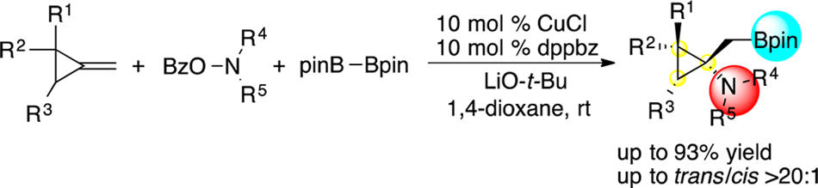
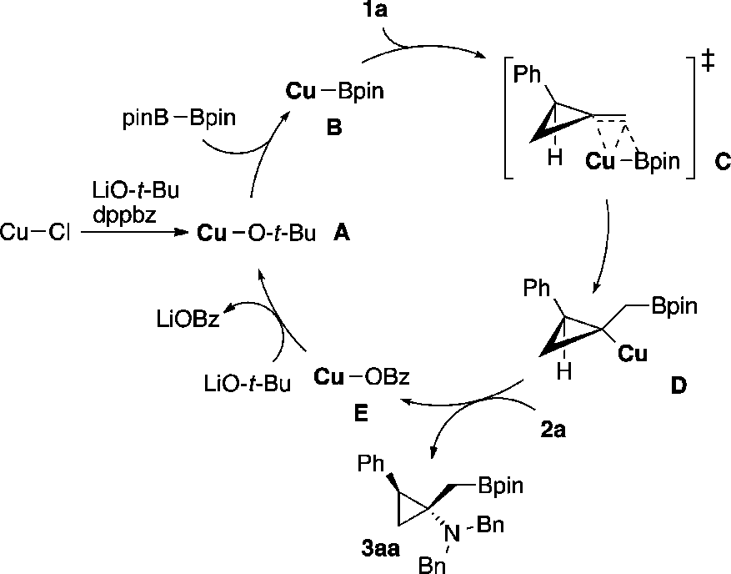
Aminoboration of Alkenes (4)
Sakae, R.; Matsuda, N.; Hirano, K.; Satoh, T.; Miura, M. Org. Lett. 2014, 16, 1228.

Slide 21
Introduction
Amination of Organometallic Reagents
Amination of Electron-Deficient Arenes
Amination Approach to α-Amino Derivatives
Aminoboration of Alkenes
Hydroamination of Alkenes
Diamination, Oxyamination of Alkenes
Outlook

Slide 22
Hydroamination of Alkenes (1)
Miki, Y.; Hirano, K.; Satoh, T.; Miura, M. Angew.Chem. Int. Ed.2013, 52, 10830.

Slide 23
Hydroamination of Alkenes (2)
Zhu, S.; Niljianskul, N.; Buchwald, S. L. J. Am. Chem. Soc. 2013, 135, 15746.

Slide 24
Hydroamination of Alkenes (3)
Miki, Y.; Hirano, K.; Satoh, T.; Miura, M. Org. Lett. 2014, 16, 1498.

Slide 25
Hydroamination of Alkenes (4)
Nishikawa, D.; Hirano, K.; Miura, M. J. Am. Chem. Soc.2015, 137, 15620

Slide 26
Hydroamination of Alkenes (5)
Zhu, S.; Buchwald, S. L. J. Am. Chem. Soc. 2014, 136, 15913.

Slide 27
Hydroamination of Alkenes (6)
Yang, Y.; Shi, S.-L.; Niu, D.; Liu, P.; Buchwald, S. L. Science 2015, 349, 62

Slide 28
Introduction
Amination of Organometallic Reagents
Amination of Electron-Deficient Arenes
Amination Approach to α-Amino Derivatives
Aminoboration of Alkenes
Hydroamination of Alkenes
Diamination, Oxyamination of Alkenes
Outlook

Slide 29
Diamination, Oxyamination of Alkenes (1)
Shen, K.; Wang, Q. Chem. Sci. 2015, 6, 4279.

Slide 30
Diamination, Oxyamination of Alkenes (1)
Hemric, B. N.; Wang, Q.; Beilstein J. Org. Chem. 2016, 12, 22

Slide 31
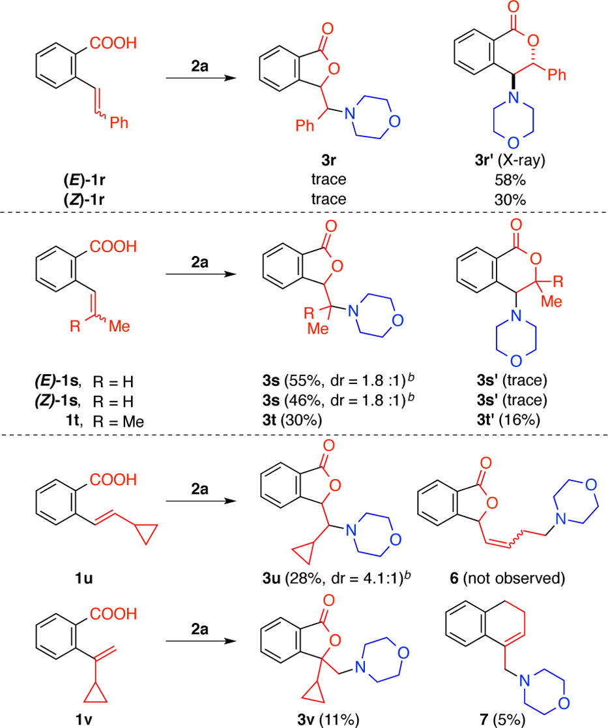
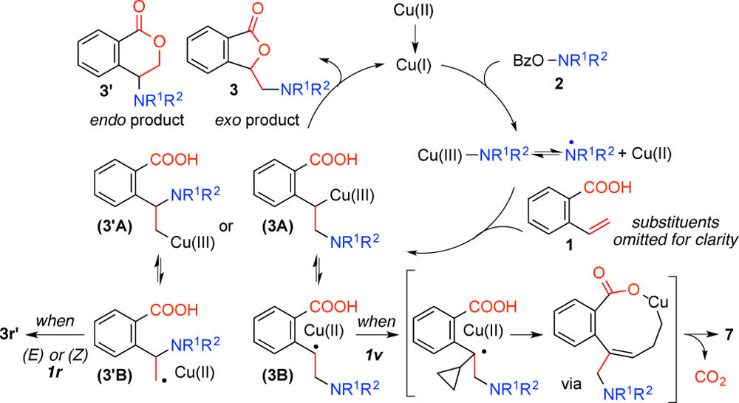
Diamination, Oxyamination of Alkenes (1)
Hemric, B. N.; Shen, K.; Wang, Q. J. Am. Chem.Soc.2016, 138, 5813.

Slide 32
Introduction
Amination of Organometallic Reagents
Amination of Electron-Deficient Arenes
Amination Approach to α-Amino Derivatives
Aminoboration of Alkenes
Hydroamination of Alkenes
Diamination, Oxyamination of Alkenes
Outlook

Slide 33
Outlook
New approach toward C-N formation
2. High to excellent enantioselectivity
3. No intramolecular examples
4. Aza-quaternary carbons
Less variety of substrates
Enantioselectivity
Mechanism for C-N formation not clean

Slide 34
Thanks For Your attention

