Slide 1
Cinchona Alkaloids : Efficient Tunable Organocatalyts in Asymmetric Synthesis
Antonin Clemenceau
04.06.15

Slide 2
Plan :
I- Organocatalysis: Concepts and Principle
II- Cinchona Alkaloids
A- Presentation
B- History
C- Other Potential Examples
III- Conclusion
3

Slide 3
Introduction
Organocatalysis
Concept borns in the late 1990s
Before only enzymes and metal-catalyst were used for asymmetric catalysis
Another powerful tool for the Modern Organic Chemistry
Explosion of this field during this century
4

Slide 4
Organocatalysis: Concepts and principle
Definition : The use of small organic molecules to catalyse asymmetric transformation
First example of asymmetric organic synthesis was reported with proline catalyst in 1971 by two industrial research groups
Advantage:
- Non-toxic, environmentally friendly
- Low cost
- Robust
- Metal-free reaction
Principle
Creation of a new C-C or C-heteroatom bond controlled by the organocatalyst
===> Induction of chirality
5

Slide 5
Organocalysts
6

Slide 6
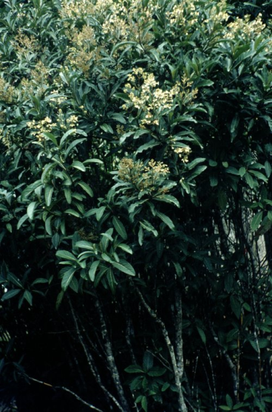
Cinchona Alkaloids
Quinine isolated by Pelletier in 1820
Quinine and derivatives were recognized as antimalarial agent
First Total Synthesis in 1944 by Woodward and Doering
A dimer derivative ((DHQD)₂-PHAL) is used as chiral ligand in the Sharpless asymmetric dihydroxylation.
Quinquina Tree
Nomenclature
Considered as pseudo-enantiomers because
The stereogenic centers (C8, C9) have the opposite absolute configuration
The centers in the quinuclidine fragment (C3, C4) are identical
Ref:
R. B. Woodward and W. E. Doering J. Am. Chem. Soc., 1944, 66, 849 - 849
T. Marcelli, J. H. van Maarseveen, H. Hiemstra Angew. Chem. Int. Ed. 2006, 45, 7496 – 7504
B. Sharpless et al. J. Org. Chem. 1992, 57, 2771-2773
7

Slide 7
Cinchona Alkaloids
Bifunctional Catalyst
Easily tunable moiety
Ref: A. G. Doyle, E. N. Jacobsen Chem. Rev. 2007, 107, 5713 – 5743
J. Alemán, A. Parra, H. Jiang, K. A. Jørgensen Chem. Eur. J. 2011, 17, 6890 – 6899
J. -W. Xie, W. Chem, R. Li, M. Zeng, W. Du, L. Yue, Y. -C. Chen, Y. Wu, J. Zhu, J. -G. Deng Angew. Chem. Int. Ed. 2007, 46, 389 –392
8

Slide 8
1981: Quinine
Enantioselective conjugate addition of aromatic thiols to conjugated cycloalkenones
First example of Cinchona Alkaloid as Organocatalyst
9
Ref: H. Hiemstra, H. Wynberg J. Am. Chem. Soc. 1981, 103, 417.

Slide 9
1981: Suggested Mechanism
10
Ref: H. Hiemstra, H. Wynberg J. Am. Chem. Soc. 1981, 103, 417.

Slide 10
1999 : β-Isocupreine
Asymmetric Baylis−Hillman Reaction
β-Isocupreine
Cagelike structure
Conformationally rigid
No pseudoenantiomer of the β-isocupreine easily accessible
11
Ref: Y. Iwabuchi, M. Nakatani, N. Yokoyama, S. Hatakeyama J. Am. Chem. Soc. 1999, 121, 10219-10220

Slide 11
1999 : Proposed Reaction Mechanism
Syn diastereomers are produced from the aldol reaction
Steric constraints of C unfavoured the β elimination
12
Ref: Y. Iwabuchi, M. Nakatani, N. Yokoyama, S. Hatakeyama J. Am. Chem. Soc. 1999, 121, 10219-10220
See also: G. Masson, J. Zhu, C. Housseman Angew. Chem. Int. Ed. 2007, 46, 4614 – 4628

Slide 12
2004 : Cupreine and cupreidine
Enantioselective Conjugate Addition of Malonate and β-Ketoester to Nitroalkane
13
Ref: H. Li, Y. Wang, L. Tang, L. Deng J. Am. Chem. Soc. 2004, 126, 9906-9907

Slide 13
2005 : Thiourea Cinchona Alkaloids
Simultaneous donation of two hydrogens
Electrophile activation as enzymes system
Strong and directional H-bonds formation
Ref: J. Ye, D. J. Dixon, P. S. Hynes Chem. Commun. 2005,4481
S. H. McCooey, S. J. Connon Angew. Chem. Int. Ed. 2005, 44, 6367
B. Vakulya, S. Varga, A. Csámpai, T. Soós Org. Lett., 2005, 7, 1967-1969
M. S. Taylor, E. N. Jacobsen Angew. Chem. Int. Ed. 2006, 45, 1520 – 1543
14

Slide 14
2005 : Thiourea Cinchona Alkaloids
Enantioselective Conjugate Addition
15
Ref: J. Ye, D. J. Dixon, P. S. Hynes Chem. Commun. 2005, 4481-4483
S. H. McCooey, S. J. Connon Angew. Chem. Int. Ed. 2005, 44, 6367
B. Vakulya, S. Varga, A. Csámpai, T. Soós Org. Lett., 2005, 7, 1967-1969

Slide 15
2006 : C6’-Thiourea Cinchona Alkaloids
Asymmetric Henry reaction
Switch of the H-bond donor C9 to C6’
16
Ref: T. Marcelli, R. N. S. van der Haas, J. H. van Maarseveen, H. Hiemstra Angew. Chem. Int. Ed. 2006, 45, 929 –931

Slide 16
2007 : Amino Cinchona Alkaloids
Activation mode
Ref: P. Melchiorre Angew. Chem. Int. Ed. 2012, 51, 9748 – 9770
L. Jiang, Y. -C. Chen Catal. Sci. Technol. 2011,1, 354-365
S. Bertelsen, K. A. Jørgensen Chem. Soc. Rev., 2009, 38, 2178–2189
17

Slide 17
2007 : Amino Cinchona Alkaloids
Activation mode: Secondary amine vs Primary amine
Ref: P. Melchiorre Angew. Chem. Int. Ed. 2012, 51, 9748 – 9770
L. Jiang, Y. -C. Chen Catal. Sci. Technol. 2011,1, 354-365
S. Bertelsen, K. A. Jørgensen Chem. Soc. Rev., 2009, 38, 2178–2189
18

Slide 18
2007 : Amino Cinchona Alkaloids
Ref: J.-W. Xie, W. Chen, R. Li, M. Zeng, W. Du, L. Yue, Y. –C. Chen, Y. Wu, J. Zhu, J. –G. Deng Angew. Chem. Int. Ed. 2007, 46, 389 –392
W. Chen, W. Du, Y. –Z. Duan, Y. Wu, S.-Y. Yang, Y.- C. Chen Angew. Chem. Int. Ed. 2007, 46, 7667 –7670
The same year, 2 other groups published organocatalytic reaction with Amino Cinchona Alkaloids:
S. H. McCooey, S. J. Connon Org. Lett. 2007, 9, 599 – 602.
G. Bartoli, M. Bosco, A. Carlone, F. Pesciaioli, L. Sambri, P. Melchiorre Org. Lett. 2007, 9, 1403 – 1405.
19

Slide 19
2008 : Squaramide Cinchona Alkaloids
Difference with thiourea:
Asymmetric conjugate addition of dicarbonyle to nitroalkene
20
Ref: J. P. Malerich, K. Hagihara, V. H. Rawal, J. Am. Chem. Soc. 2008, 130, 14416.
J. Alemán, A. Parra, H. Jiang, K. A. Jørgensen Chem. Eur. J. 2011, 17, 6890 – 6899.

Slide 20
2011 : Cinchona-Derived Amino Phosphine precatalyst
Aldol (or Mannich) reaction
Ref:
F. Sladojevich, A. Trabocchi, A. Guarna, D. J. Dixon J. Am. Chem. Soc. 2011, 133,1710 –1713.
P. Shao, J. Liao, Y. A. Ho, Y. Zhao Angew.Chem. Int. Ed. 2014, 53,5435 –5439.
I. Ortín, D. J. Dixon Angew.Chem. Int. Ed. 2014, 53 ,3462 –3465.
R. De la Campa, I. Ortín, D. J. Dixon Angew.Chem. Int.Ed. 2015, 54,4895 –4898.
21

Slide 21
Other potential application
Over the years simple asymmetric reactions were performs
with Cinchona Alkaloids
How has been used this organocatalyst scaffold in
challenging transformations?
22

Slide 22
Other Potential Application
Asymmetric Diels−Alder Reactions
23
Ref.: Y. Wang, H. Li, Y. -Q. Wang, Y. Lui, B. M. Foxman, L. Deng J. Am. Chem. Soc. 2007, 129, 6364-6365

Slide 23
Other Potential Application
Asymmetric Diels−Alder Reactions
24
Ref.: Y. Wang, H. Li, Y. -Q. Wang, Y. Lui, B. M. Foxman, L. Deng J. Am. Chem. Soc. 2007, 129, 6364-6365

Slide 24
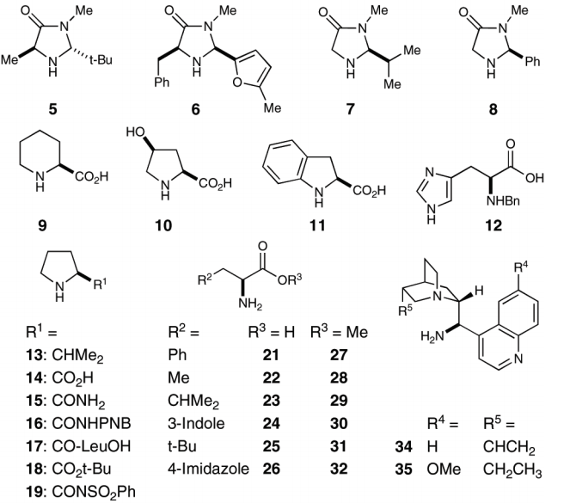
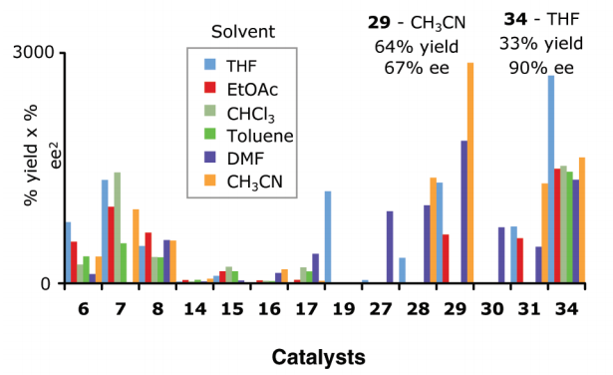
Other Potential Application
Enantioselective α-Fluorination
First highly enantioselective fluoration using
Organocatalysis
Cinchona Alkaloids give the best result
Enamine activation mode
25
Ref: P. Kwiatkowski, T. D. Beeson, J. C. Conrad, D. W. C. MacMillan J. Am. Chem. Soc. 2011, 133, 1738–1741

Slide 25
Other Potential Application
Asymmetric Tamura cycloadditions
26
Ref: F. Manoni, S. J. Connon Angew. Chem. Int. Ed. 2014, 53, 2628 –2632

Slide 26
Other Potential Application
Asymmetric [5+3] formal cycloadditions
27
Ref: X. Yin, Y. Zheng, X. Feng, K. Jiang, X. -Z. Wei, N. Gao, Y. –C. Chen Angew. Chem. Int. Ed. 2014, 53, 6245-6248

Slide 27
Other Potential Application …Toward Total Synthesis
Ref:
P. Jakubec, D. M. Cockfield, D. J. Dixon J. Am. Chem. Soc. 2009, 131, 16632 – 16633
P. Chen, X. Bao, L.-F. Zhang, M. Ding, X.-J. Han, J. Li, G.-B. Zhang, Y.-Q. Tu, C.-A. Fan Angew. Chem. Int. Ed. 2011, 50, 8161-8166
28

Slide 28
Other Potential Application …Toward Total Synthesis
29
Ref: T. Buyck, Q. Wang, J. Zhu Angew. Chem. Int. Ed. 2013, 52, 12714 – 12718

Slide 29
Conclusion
Easily avalaible & tunable
Various way of substrate activation
Enantioselective control
Catalytic process
Environmentally friendly
Widely used in organocatalysis
… Still lot of thing can be done
Dual and cooporatives catalysis
can be an issue

Slide 30
Thanks for your attention

Slide 31
Suggested Mechanism
Asymmetric Tamura cycloadditions
Ref: F. Manoni, S. J. Connon Angew. Chem. Int. Ed. 2014, 53, 2628 –2632

Slide 32
Suggested Mechanism
Asymmetric [5+3] formal cycloadditions
Ref: X. Yin, Y. Zheng, X. Feng, K. Jiang, X. -Z. Wei, N. Gao, Y. –C. Chen Angew. Chem. Int. Ed. 2014, 53, 6245-6248

