Slide 1
Recent Progress in sp³ C-H Activation Catalyzed by Palladium
Bo Yao

Slide 2
Concepts related with C-H activation
C-H activation
In general definition, C-H activation should refer to any chemical process that increases the reactivity of C-H bond.
In organometallic definition, C-H activation refers to the formation of a complex wherein the C-H bond interacts directly with the metal catalyst or reagent. The complexes often afford a C-M intermediate in the absence of free radical or ionic intermediates.
“C–H bond activation” is frequently used as an organometallic term to describe certain metal-mediated processes.
C-H transformation: C-H bonds are transformed into C-C, C-X bond
C-H oxidation: The oxidation valence of carbon is increased.
C-H functionalization: New functional groups are connected to the carbon.
Oxidative functionalization: Oxidant is needed for the functionalization.
C-H arylation/halogenation/oxygenation/metallation

Slide 3
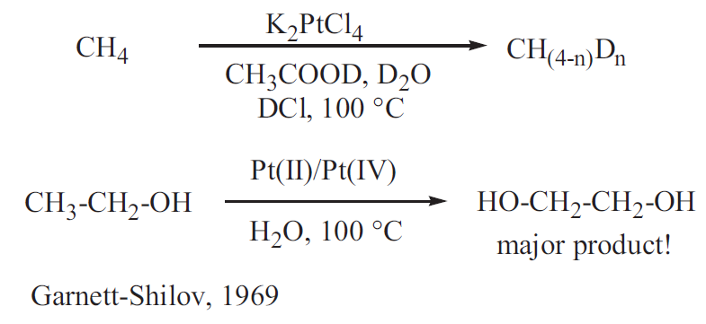
A few decades later in 1968, Halpern formulated the need for new approaches to the activation of C–H bonds with a particular focus on saturated hydrocarbons. C–H bond activation, equated with “dissociation of carbon–hydrogen bonds by metal complexes”, was identified as one of the most important challenges in catalysis
Clearly, a new reactivity mode, other than radical or ionic substitution, had been discovered and the term “activation of saturated hydrocarbons” was used.

Slide 4
Challenge in sp³ C-H activation
High bond dissociation energy
Lack of $π$-group to interact with transition metals
Difficulty in controlling selectivity

Slide 5
Strategies for sp³ C-H activation
1. Oxidation of sp³ C-H bond ajacent nitrogen and oxygen
Shun-Ichi Murahuashi, J. Am. Chem. Soc. 2003, 125, 15312-15313
Chao-Jun Li , J. Am. Chem. Soc. 2005, 127, 6968-6969

Slide 6
Strategies for sp³ C-H activation
2. sp³ C-H activation triggered by oxidative addition intramolecularly
Gerald Dyker, Angew. Chem. Int. Ed. Engl. 1992, 31, 1023-1025

Slide 7
Strategies for sp³ C-H activation
3. sp³ C-H activation by directing groups promoted C-H cleavage
Dalibor Sames, J. Am. Chem. Soc. 2002, 124, 11856-11857

Slide 8
Recent progress for sp³ C-H activation catalyzed by palladium
Triggered by oxidative addition
Cascade reaction
Pd(II)-Pd(IV)
Gerald Dyker,
J. Org. Chem. 1993, 58, 6426-6428
Angew. Chem. Int. Ed. Engl. 1994, 33, 103-105
Olivier Baudoin,
J. Am. Chem. Soc. 2008, 130, 15157-15166; Angew. Chem. Int. Ed. 2009, 48, 179-182
Angew. Chem. Int. Ed. 2003, 42, 5736-5740; Chem. Eur. J. 2007, 13, 792-799
Adv. Synth. Catal. 2007, 349, 2054-2060
Keith Fagnou,
J. Am. Chem. Soc. 2007, 129, 14570-14571
Nobutaka Fujii and Hiroaki Ohno,
Org. Lett. 2008, 10, 1759-1762

Slide 9
Recent progress for sp³ C-H activation catalyzed by palladium
Triggered by oxidative addition
More work in this field
Qiao-Sheng Hu,
Angew. Chem. Int. Ed. 2006, 45, 2289-2292
Tetrahedron 2008, 64, 2537-2552
Paul Knochel,
Angew. Chem. Int. Ed. 2006, 45, 3462-3465
Chem. Asian J. 2007, 2, 416-433
Stephen L. Buchwald,
J. Am. Chem. Soc. 2005, 127, 4685-4696
Marta Catellani,
Chem. Commun. 2000, 2003-2004
Helena C. Malinakova,
Org. Lett. 2002, 4, 3679-3681
Organometallics 2003, 22, 2961-2971

Slide 10
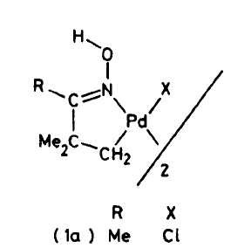
Recent progress for sp³ C-H activation catalyzed by palladium
Directing group promoted C-H cleavage
β-C-H activation
O-methyl oxime
Walter S. McDonald and Bernard L. Shaw,
J. Chem. Soc., Dalton Trans. 1980, 1992
Melanie S. Sanford,
J. Am. Chem. Soc. 2004, 126, 14570-14571

Slide 11
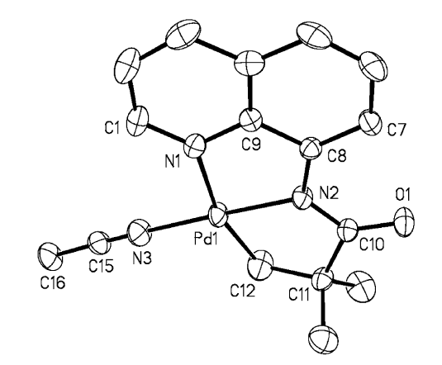
Recent progress for sp³ C-H activation catalyzed by palladium
Directing group promoted C-H cleavage
β-C-H activation
8-aminoquinoline amide
Olafs Daugulis,
J. Am. Chem. Soc. 2005, 127, 13154-13155
J. Am. Chem. Soc. 2010, 132, 3965-3972
Org. Lett. 2005, 7, 3657-3659
E. J. Corey,
Org. Lett. 2006,8, 3391-3394
Jin-Quan Yu,
J. Am. Chem. Soc. 2006, 128, 12634-12635

Slide 12
Recent progress for sp³ C-H activation catalyzed by palladium
Directing group promoted C-H cleavage
β-C-H activation
Carboxylate amide and acid
Jin-Quan Yu,
J. Am. Chem. Soc. 2007, 129, 3510-3511
J. Am. Chem. Soc. 2008, 130, 7190-7191
J. Am. Chem. Soc. 2009, 131, 9886-9887
J. Am. Chem. Soc. 2010, 132, 3680-3681
J. Am. Chem. Soc. 2010, 132, 17378-17381

Slide 13
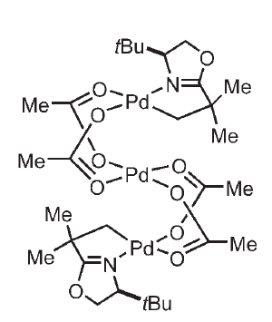
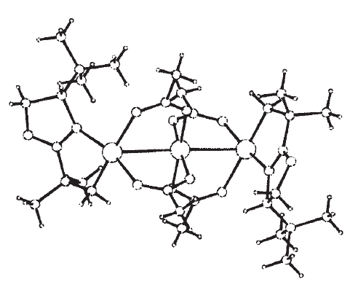
Recent progress for sp³ C-H activation catalyzed by palladium
Directing group promoted C-H cleavage
β-C-H activation
Diaselective oxidation
trinuclear alkyl-Pd complex
Jin-Quan Yu,
Angew. Chem. Int. Ed. 2005, 44, 2112-2115
Angew. Chem. Int. Ed. 2005, 44, 7420-7424
Org. Lett. 2006, 8, 5685-5688

Slide 14
Recent progress for sp³ C-H activation catalyzed by palladium
α-C-H activation
Keith Fagnou,
J. Am. Chem. Soc. 2008, 130, 3266-3267
André B. Charrette,
Org. Lett. 2008, 10, 1641-1643
Melanie S. Sanford,
J. Am. Chem. Soc. 2005, 127, 7330-7331
Jin-Quan Yu,
Org. Lett. 2006, 8, 3387-3390
γ-C-H activation
Other metals
Fe, Ni, Cu, Ru, Rh, Pt, Ir…
Olafs Daugulis,
J. Am. Chem. Soc. 2005, 127, 13154-13155

Slide 15
Challenges
Find directing groups which are easy to attach to and deattach from substrates.
Develop the methods with milder condition and broader scope.
Site-selective C-H activation.
Mechanism is far from clear.

