Slide 1
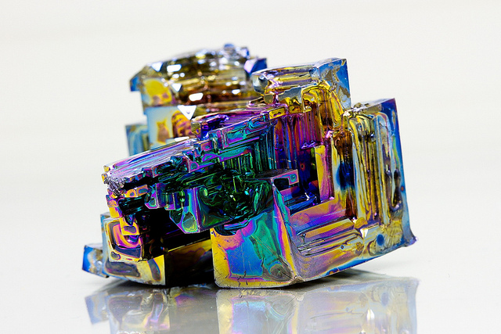
Bismuth in Organic Synthesis
LSPN Group Seminar
by Balàzs Budai

Slide 2
Overview
Properties
  History
  Oxidation states
  Synthesis
  Structure
  Metallochirality
Bismuth (V)
  Oxidation
  Alkylation, Alkenylation
  C, N, O, S - Arylation
  Application
Bismuth (III)
  Cross-coupling
  Lewis acidity and catalysis
    Aldolization
    Alkylation
    Allylation
    Amination
    Arylation
    Cationic cyclization
    Cycloaddition
    Cycloisomerization
    Epoxide Opening
    Etherification
    Hydroamination
    Hydroalkoxylation
    Hydroalkylation
    Hydroarylation
    Oxidation
    Oxycarbonylation
  Application in synthesis
Summary and Outlook
Notes:
Ullmann, Chan-Lam, Buchwald-Hartwig

Slide 3
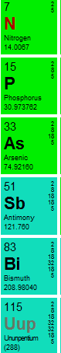
History and General Properties
pre-16th century – Incas used its alloys, tools found in Machu Picchu
1753 – Claude Francois Geoffroy (fr): Bismuth is distinct from tin and lead.
1860 – Papaffy Miklos (London Metal Exchange) Bi → Al + Ag, disappeared with 40K GBP (~5M CHF today)
Cosmetics, medical applications (radio-opaque, antiseptic nature)
Peptobismol (Bi-subsalicylate) – over-the-counter drug for stomach problems
Environmentally friendly substituent for lead (fishing, hunting and shooting) (d = 9.78 g/cm³)
Many Bi-salts are less toxic than table salt
Industrial chem. (Bi-Mo, Bi-Pt), nanochem. (BiVO₄, BOI), photochem. (Bi₂O₃, BiVO₄, BOI)
Expands on solidification → alloys
Diamagnetic → Maglev trains
64th most abundant (~Cd, Ag) and heaviest stable element 0.3 CHF/g
Rutledge, J. W. Science 1984, 223 (4636)
Wikipedia
Mohan, R. Nat. Chem. 2010, 2 (4), 336–336.
Oxidation potential:
Mostly Bi(V)/Bi(III) redox is employed
Nucleofugality: triphenylbismuthonio group is twice as good leaving group as TfO ⁻
σ – donor : weak ligand in metal complexes
σ and π – acceptor : acceptor with dative-, anionic-, alkyl-, aryl- or even metal ligands
(back donation from d-orbital into Bi-C σ*)
Notes:
Inca GORDON, R. B.; Rutledge, J. W. Science (80-. ). 1984, 223 (4636).
Wittig, G.; Clauß, K. Justus Liebigs Ann. Chem. 1952, 578 (1), 136–146.
Triphenylbismuth is almost the hardest to oxidize
Nucleofugality Matano, Y. Organometallics 2000, 19 (12), 2258–2263.
Bi-M complexes: Braunschweig, H.; Cogswell, P.; Schwab, K. Coord. Chem. Rev. 2011, 255 (1–2), 101–117.
Benjamin, S. L.; Reid, G. Coord. Chem. Rev. 2015, 297–298, 168–180.

Slide 4
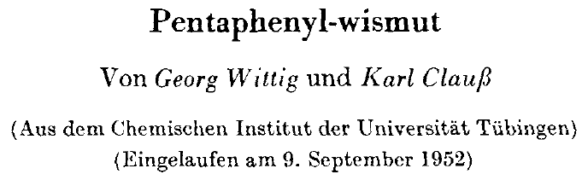
Properties
Oxidation States, Structure and Nomenclature
Wittig, G. Justus Liebigs Ann. Chem.
1952, 578 (1), 136–146.
Notes:
Bond angles in Ph3Bi are explained by low level of hybridization of p orbitals
Wittig, G.; Clauß, K. Justus Liebigs Ann. Chem. 1952, 578 (1), 136–146.

Slide 5
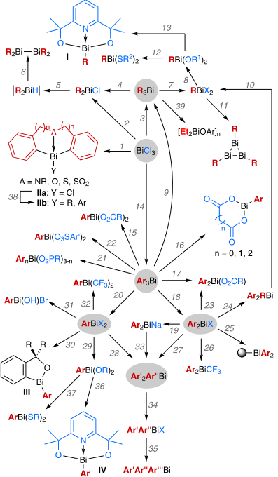
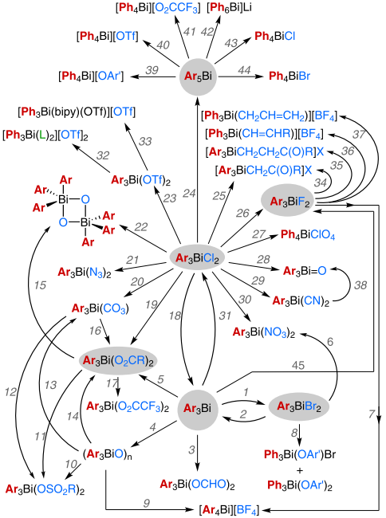
Properties
Synthesis
Routes to Bi(III) compounds
Routes to Bi(V) compounds
Gagnon, A. Synthesis (Stuttg). 2017, 49 (8), 1707–1745.
Notes:
Well-established methods to prepare derivatives.
In less than 4 steps any kind of bismuth compounds are accessible.
Scheme 1 Available routes for the synthesis of trivalent organobismuth re- agents: (1) a) Li–Ar(CH2)nA(CH2)nAr–Li or b) XMg–Ar(CH2)nA(CH2)nAr–MgX; (2) RLi (2 equiv); (3) a) RMgCl (3 equiv) or b) RLi (3 equiv) or c) R2Zn (1.5 equiv) or d) AlR3 (2 equiv) or e) LiAlR4 (2 equiv) or f) R2Cd (1.6 equiv) with BiBr3 instead of BiCl3 or g) RNa (3 equiv; R = Cp); (4) Cl2 gas; (5) LiAlH4, –80 °C; (6) Decomposition of R2BiH at r.t.; (7) BiI3; (8) NaOR1 (2 equiv); (9) RLi (3.0 equiv); (10) a) HCl gas (2 equiv) or b) HBr (2 equiv); (11) LiAlH4, –70 °C; (12) HSR2 (2 equiv); (13) 2,6-C5H3N(CR2- OH)2; (14) a) ArMgBr (3 equiv) or b) ArLi (3 equiv) or c) NaBAr4 or d) ArI, ball mill, Bi(0), CuI, Cu(0), CaCO3 or e) ArBr, CoBr2, CH2=CHCH2Cl, Zn(0); (15) RCO2H (2 equiv); (16) HO2C(CH2)nCO2H; (17) RCO2H (1 equiv); (18) a) BiCl3 (0.5 equiv) or b) BiBr3 or c) IBr (1 equiv) or d) TMSOTf (1 equiv); (19) NaC10H8 (3 equiv) (X = OTf); (20) BiCl3 (2.0 equiv); (21) RPO2H; (22) ArSO3H (2 equiv); (23) RCO2Na (1 equiv); (24) a) RLi (1 equiv) or b) RMgX (1 equiv); (25) Resin–CH2OAr–MgX; (26) Cd(CF3)2 (1.1 equiv); (27) a) Ar′′MgX (Ar′ = Ar) or b) Ar′′Li (Ar′ = Ar); (28) Ar′′MgX (2 equiv, Ar′ = Ar); (29) NaOR (2 equiv); (30) Li– Ar(CR2)OLi; (31) NaOH; (32) Cd(CF3)2 (2.2 equiv); (33) a) Ar′′I (Ar′ = Ar) or b) Ar′′N2BF4 (Ar′ = Ar); (34) a) HBr or b) I2 or c) BF3·OEt2; (35) a) Ar′′′MgBr or b) Ar′′′Li; (36) 2,6-C5H3N(CR2-OH)2; (37) HSR (2 equiv); (38) RLi or ArLi; (39) ArOH.
Scheme 3 Available routes for the synthesis of pentavalent organobis- muth reagents: (1) Br2; (2) a) H2S or b) Na2S2O4 or c) (NH4)2S; (3) O3; (4) PhIO; (5) a) BzOOBz, BF3·OEt2 or b) RCO2H, H2O2 or c) RCO2H, t-BuOOH or d) PhI(OAc)2 or e) AcOOH or f) NaBO3, AcOH or g) RCO2H, i-PrOH; (6) AgNO3; (7) a) BF3·OEt2 then ArB(OH)2 or b) BF3·OEt2, TMSCN, then n-Bu3SnAr; (8) NaOAr′ (Ar′ = C6F5, C6Cl5); (9) BF3·OEt2; (10) TsOH; (11) a) TsOH or b) MsOH; (12) TsOH (2 equiv); (13) air (CO2); (14) Bz2O; (15) KOt-Bu, H2O; (16) RCO2H; (17) CF3CO2H; (18) Na2S2O4; (19) a) RCO2Ag or b) RCO2Na or c) AcOH, Pb(OAc)2; (20) K2CO3; (21) NaN3; (22) KOt-Bu, H2O; (23) AgOTf; (24) ArLi (2 equiv); (25) Me2CO, AgX (R = Me, X = ClO4 or BF4); (26) a) NaF or b) AgF; (27) AgClO4 (Ar = Ph); (28) Ag2O; (29) a) KCN or b) AgCN; (30) AgNO3; (31) a) Cl2 or b) SO2Cl2 or c) PhICl2; (32) 2L (L = Ph3P=O or DMAP); (33) bipy; (34) R(TMSO)C=CH2, BF3.OEt2; (35) siloxycyclopropane with a) TMSOTf (X = OTf) or b) BF3·OEt2 (X = BF4); (36) RCH=CHB(OH)2, BF3·OEt2; (37) CH2=CHCH2TMS, BF3·OEt2; (38) HgO; (39) Ar′OH (Ar′ = C6F5, C6Cl5); (40) CF3SO3H; (41) CF3CO2H; (42) PhLi; (43) HCl; (44) Br2; (45) XeF2.
3.2
Gagnon, A.; Dansereau, J.; Le Roch, A. Synthesis (Stuttg). 2017.

Slide 6
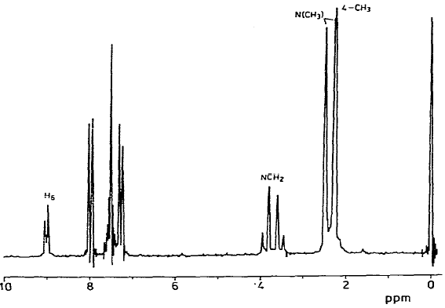
Properties
Hypervalency and Chirality
Hypervalency
electrons around
bismuth
ligands around
bismuth
Gagnon, A. Synthesis (Stuttg). 2017, 49 (8), 1707–1745.
Chirality
first chiral tetraarylbismuthonium (1999)
never resolved
Wolters, J. J. Organomet. Chem. 1981, 212, C7–C9.
Suzuki, H.; Chem. Commun.
1992, No. 16, 1143.
Matano, Organometallics
1999, 18 (26), 5668–5681.
Inversion barrier: 34 - 69 kcal/mol
(Phospine: 24 kcal/mol Ammonia: 7 kcal/mol)
Gagnon, A. Synthesis (Stuttg). 2017, 49 (8), 1707–1745.
Notes:
Gagnon, A.; Dansereau, J.; Le Roch, A. Synthesis (Stuttg). 2017.
FIRST Bras, P.; Herwijer, H.; Wolters, J. J. Organomet. Chem. 1981, 212, C7–C9.
FIRST RESOLVED Suzuki, H.; J. Chem. Soc. Chem. Commun. 1992, No. 16, 1143.
FIRST –ONIUM salt Matano, Organometallics 1999, 18 (26), 5668–5681.

Slide 7
Bismuth (V)
Oxidation
General Mechanism
Bi(V)/Bi(III) redox
Nucleofugality
Evolution of Methodologies
Challenger and Richards
1934
Ph₃Bi(OH)₂
Oxidation of simple alcohols to aldehydes
Barton and Dodonov
1978-1985
polyphenol bismuth (V) compounds:
Ph₃BiCO₃, (Ph₃BiCl)₂O, etc.
Harsh conditions
are needed
Matano
2001 and 2002
allylic-1°
allylic-2°
benzylic-1°
benzylic-2°
aliphatic-1°
aliphatic-2°
Matano, Y. J. Org. Chem. 2004, 69 (25), 8676–8680.
Matano, Y.; Angew. Chemie - Int. Ed.
2002, 41 (16), 3028–3031.
Notes:
DBU: (1) Matano, Y.; Nomura, H. Angew. Chemie - Int. Ed. 2002, 41 (16), 3028–3031.
KOtBu: (1) Matano, Y.; Nomura, H. 2001, 2 (15), 6443–6444.
CF3: (1) Matano, Y.; Hisanaga, T.; Yamada, H.; Kusakabe, S.; Nomura, H.; Imahori, H. J. Org. Chem. 2004, 69 (25), 8676–8680.

Slide 8
Bismuth (V)
Oxidation
Selectivity and reactivity
Matano Y. Bull Chem Soc Jpn 2008, 81, 1621
Matano, Y.; Angew. Chemie - Int. Ed. 2002, 41 (16), 3028–3031.
Order of selectivity:
allylic, benzylic > primary > secondary

Slide 9
Bismuth (V)
C-Alkylation, C-Alkenylation
Alkylation
S_{N}2-type alkylation
Bi(V)/Bi(III) redox
Nucleofugality
Bismuth-ylides
No “real” ketone
No Wittig possible
Vinet, L.; Zhedanov, A. Bismuth-Mediated Organic Reactions; Ollevier, T., Ed.; Topics in Current Chemistry; Springer Berlin Heidelberg: Berlin, Heidelberg, 2012; Vol. 311.
Notes:
Ref: Book 45(aldeh(1) Matano, Y. J. Chem. Soc. Perkin Trans. 1 1994, 1 (19), 2703.
65(aziri) 67 68 69 70

Slide 10
Bismuth (V)
C-Alkylation, C-Alkenylation
Ylide → Carbenoid
Alkenylation
Mechanism | Observation
SN1 | Retention of E/Z ratio
SN2 | Retention of E/Z ratio
Addition-Elimination | No beta-EWG → no stabilization
Carbene / C-H insertion | Parallel pathway
Ligand-exchange, then ligand-coupling | Explains stereochemical outcome and substituent effects
Mukaiyama, T.; Chem. Lett. 2006, 35 (10), 1140–1141.
Selectivity of alkenyl vs aryl transfer with regard to alkenyl’s β-substituents:
β-alkyl > β-phenyl > β-methyl > β,β-dimethyl
preference of alkenyl migration
Notes:
Mukaiyama, T.; Chem. Lett. 2006, 35 (10), 1140–1141. Trials with mixed E/Z alkenyl bismuthonium salts

Slide 11
Bismuth (V)
C- and O-Arylation
Barton 1980-1981
Barton, D. H. R.; J. Chem. Soc., Chem. Commun. 1980, 8 (5), 246–247.
Barton, D. H. R.; J. Chem. Soc. Chem. Commun. 1981, No. 10, 503.
Notes:
More than 70 papaers discussing Bi arylation
quinine, naphtalene Barton, D. H. R.; J. Chem. Soc., Chem. Commun. 1980, 8 (5), 246–247.
Dearomat Barton, D. H. R.; J. Chem. Soc. Chem. Commun. 1981, No. 10, 503.

Slide 12
Bismuth (V)
C- and O-Arylation
O- vs C- selectivity
Chemoselectivity depends on:
  Counter anion of Bi-salt
  Electronics of substrate
  pH of reaction mixture
Barton Tetrahedron Lett. 1982, 23, 3365.
Relative migratory aptitude of aryl groups depends on:
  Electronics of aromatic ligands
  The lower the electron density, the higher aptitude it have
Notes:
O vs C
pH Barton Tetrahedron Lett. 1982, 23, 3365.

Slide 13
Bismuth (V)
O-Arylation
Phenol
Matano Y. Bull Chem Soc Jpn, 2008, 81:1621
Aliphatic alcohol
Advantages
  Selective for axial alcohol
  High yields are obtained
Drawbacks
  Only diols work
  No tertiary alcohol
  Not selective for 1° / 2° alcohol
  Not selective for relative configuration
Gagnon, A. Synthesis (Stuttg). 2017, 49 (8), 1707–1745.

Slide 14
Bismuth (V)
O-Arylation
Attempt on desymmetrization
Mukaiyama
“Mukaiyama-modified Barton etherification”
Chem. Lett. 2006, 35 (10), 1140–1141.
Nicolaou
Angew. Chemie Int. Ed. 2009, 48 (37), 6870–6874.
Baran
Attempt on Maeocrystal V
Matano-Barton condition, still, oxidation is not possible!
Org. Lett. 2009, 11 (21), 4774–4776.
Notes:
Nicolaou, K. C.; Sarlah, D.; Wu, T. R.; Zhan, W. Angew. Chemie Int. Ed. 2009, 48 (37), 6870–6874.
Mukaiyama, T.; Sakurai, N.; Ikegai, K. Chem. Lett. 2006, 35 (10), 1140–1141.
(1) Krawczuk, P. J.; Schöne, N.; Baran, P. S. Org. Lett. 2009, 11 (21), 4774–4776.

Slide 15
Bismuth (III)
Lewis acidity and catalysis
Base or acid?
Take home this:
99% of the cases Bi(OTf)₃ or BiCl₃ is the catalyst.
Bismuth(III) activates alcohol and unsaturated C-C bonds.
Typical transformations to consider screening Bi(III) compounds:
  Sakurai allylation
  Silyl-enol ether activation
  Tsuji-Trost-type allylic / propargylic substitution
  Friedel-Crafts (mild)
  Diels-Alder reaction
Notes:
TfOH (1) Tschan, M. J. L.; Thomas, C. M.; Strub, H.; Carpentier, J. F. Adv. Synth. Catal. 2009, 351 (14–15), 2496–2504.
Wabnitz, T. C.; Yu, J. Q.; Spencer, J. B. Chem. - A Eur. J. 2004, 10 (2), 484–493.
First OH activation (1) Labrouillère, M.; Le Roux, C.; Gaspard-Iloughmane, H.; Dubac, J. Synlett 1994, 1994 (9), 723–724.

Slide 16
Bismuth (III)
Alkylation
Friedel-Crafts benzylation
Rueping, M.; Adv. Synth. Catal. 2006, 348 (9), 1033–1037.
Deoxygenative allylation
Gibbs, R. A. Tetrahedron Lett. 2005, 46 (48), 8345–8350.
Propargylic substitution
Zhan, Z.; Chem. Commun. 2006, 1 (31), 3352.
Direct allylic / propargylic substitution
Shibasaki, M. Angew. Chemie - Int. Ed. 2007, 46 (3), 409–413.
Notes:
Labrouillère, M.; Le Roux, C.; Gaspard-Iloughmane, H.; Dubac, J. Synlett 1994, 1994 (9), 723–724.
BiOTF Rueping, M.; Adv. Synth. Catal. 2006, 348 (9), 1033–1037.
(1) BiCL De, S. K.; Gibbs, R. A. Tetrahedron Lett. 2005, 46 (48), 8345–8350.
propargZhan, Z.; Chem. Commun. 2006, 1 (31), 3352.
Proparg allyl(1) Shibasaki, M. Angew. Chemie - Int. Ed. 2007, 46 (3), 409–413.
Drierite is a desiccant

Slide 17
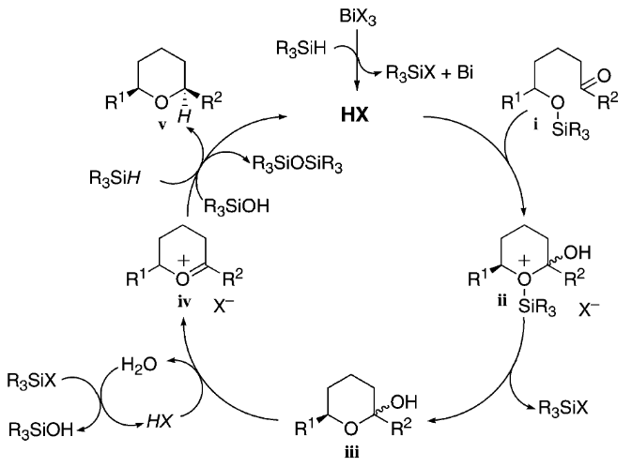
Bismuth (III)
Etherification – P. A. Evans
Tandem Etherification
Evans, P. A.; J. Am. Chem. Soc. 2003, 125 (38), 11456–11457.
Catalytic cycle
Evans, P. A.; J. Am. Chem. Soc. 2003, 125 (38), 11456–11457.
Notes:
Evans, P. A.; J. Am. Chem. Soc. 2003, 125 (38), 11456–11457.
(1)
) Centro(1) Evans, P. A.; Cui, J.; Gharpure, S. J. Org. Lett. 2003, 5 (21), 3883–3885.
(1) Mucocin (1 Evans, P. A.; Cui, J.; Gharpure, S. J.; Polosukhin, A.; Zhang, H.-R. J. Am. Chem. Soc. 2003, 125 (48), 14702–14703.
Bajwa thought TMSBr is responsible for catalytic cycle
Hydride attack avoids allylic strain

Slide 18
Bismuth (III)
Etherification – P. A. Evans
Catalytic cycle
Evans, P. A.; J. Am. Chem. Soc. 2003, 125 (38), 11456–11457.
Total Syntheses
Evans, P. A.; J. Org. Lett. 2003, 5 (21), 3883–3885.
Evans, P. A.; J. Am. Chem. Soc. 2003, 125 (48), 14702–14703
Notes:
Evans, P. A.; Cui, J.; Gharpure, S. J.; Hinkle, R. J. J. Am. Chem. Soc. 2003, 125 (38), 11456–11457.
(1)
) Centro(1) Evans, P. A.; Cui, J.; Gharpure, S. J. Org. Lett. 2003, 5 (21), 3883–3885.
(1) Mucocin (1 Evans, P. A.; J. Am. Chem. Soc. 2003, 125 (48), 14702–14703.

Slide 19
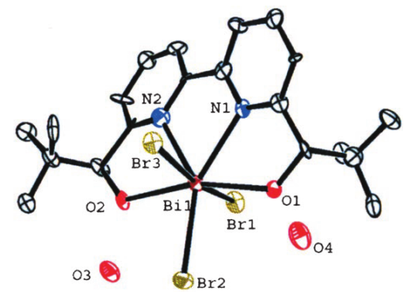
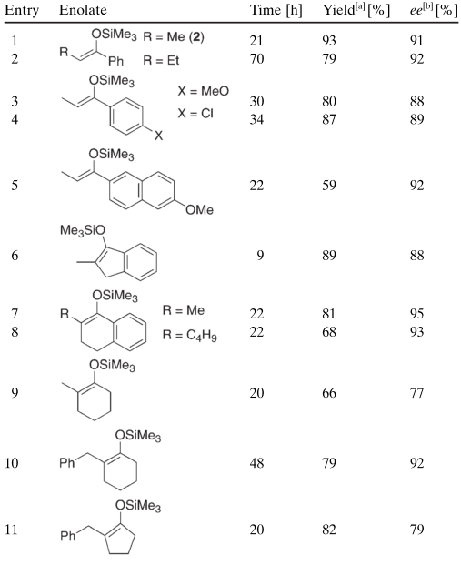
Bismuth (III)
Reaction in Aqueous Media
Mukaiyama aldol in aq. media
Kobayashi, S.; Chem. - A Eur. J. 2006, 12 (23), 5954–5960.
Most chiral catalysts are unstable in water
Lewis acids are typically non-stable in aqueous media
Bi(OTf)₃ is known to hydrolyze is water
Notes:
Bipy forms weaker complex than chiralbipy. Its role is to not let any free BiOTf in solution because it would readily hydrolyze.

Slide 20
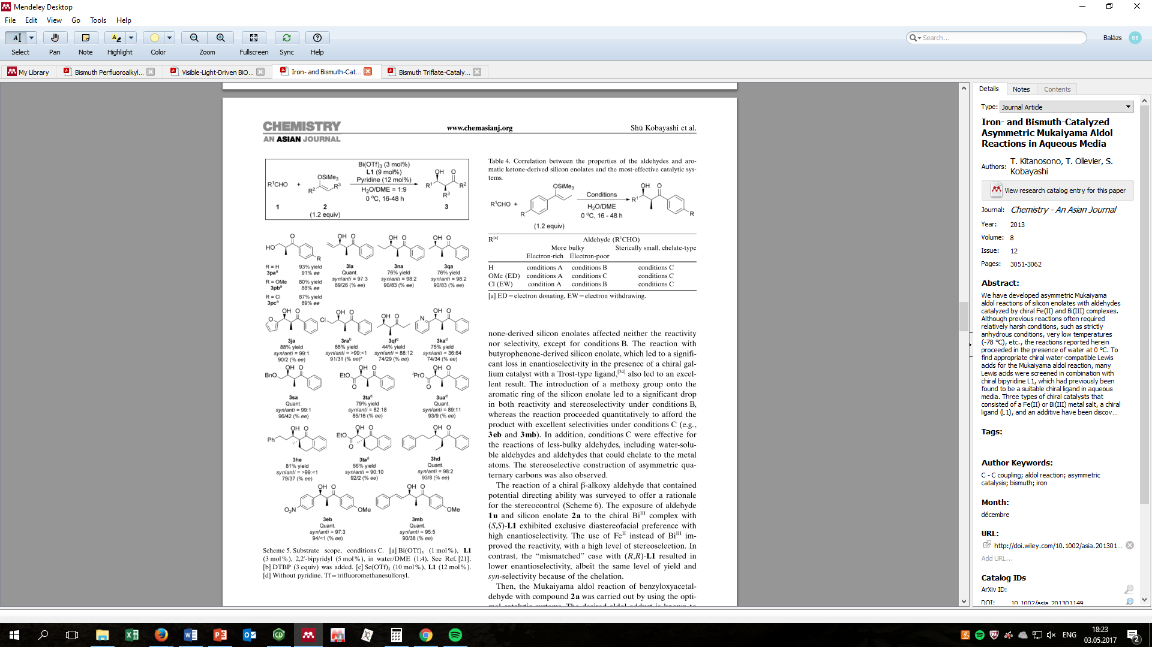
Bismuth (III)
Reaction in Aqueous Media
State of the Art
Kitanosono, T.; Ollevier, T.; Kobayashi, S. Chem. - An Asian J. 2013, 8 (12), 3051–3062.
Notes:
Bipy forms weaker complex than chiralbipy. Its role is to not let any free BiOTf in solution because it would readily hydrolyze.

Slide 21
Bismuth (III)
Carbon-dioxide fixation
The very first report
Reversibility demonstrated
Breunig, H. J.Dalt. Trans. 2008, 9226 (14), 1831.
Application
“…intramolecular coordination of the sulfur atom to the bismuth atom is expected to be very flexible, as observed for the dibenzoazabismocine framework,17 and can adjust the Lewis acidity of the bismuth atom and facilitate the exchange of the product and the reactant.”
Shimada, S. Angew. Chemie Int. Ed. 2008, 47 (35), 6590–6593.
Yin, S.-F.; Shimada, S. Chem. Commun. 2009, No. 9, 1136.
Review: Yin, S. RSC Adv. 2014, 4 (23), 11907.

Slide 22
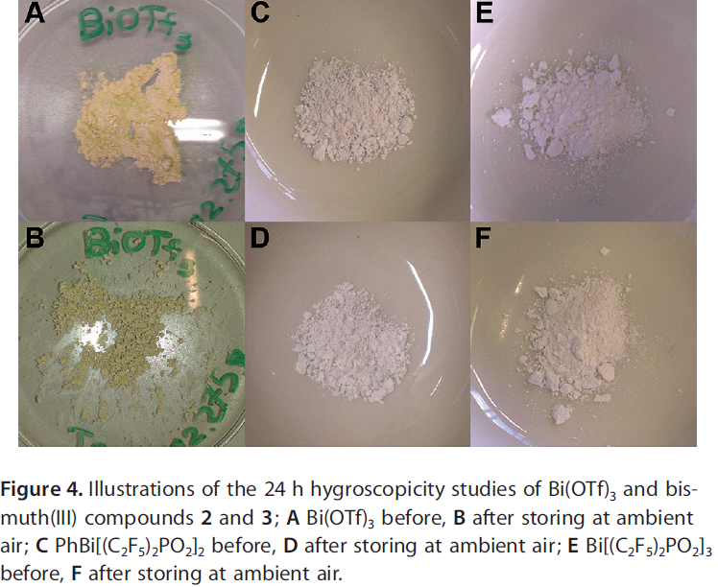
Bismuth (III)
State of the Art Complexes
Synthesis and structure
Demonstration of activity and stability
Friedel-Crafts
Diels-Alder
Hoge, B. Chem. - A Eur. J. 2017, 23 (7), 1568–1575.

Slide 23
Overview and Outlook
Bismuth is great, because:
  Mild, non-toxic and inexpensive reagent
  Easy and established methods to prepare its derivatives
  B(V):
    As oxidant: More stable and selective, than DMP
    C, O arylation and C-alkenylation without prefunctionalization
    Darzens/Corey-Chaykovsky and ring expansion with Bi-ylides
  Bi(III):
    Activation of allylsilanes and silyl-enolethers
    Mild Friedel-Crafts and Diels-Alder catalyst
    Benzylic-, allylic-, propargylic-substitution
    CO₂ activation
Why bismuth never made it to mainstream chemistry?
  Few enantioselective transformations
  Easy inversion of chirality
  Bi(III)/Bi(V) oxidation potential → catalytic regeneration?
  Low AE
  We do not completely understand its properties and reactivity

Slide 24
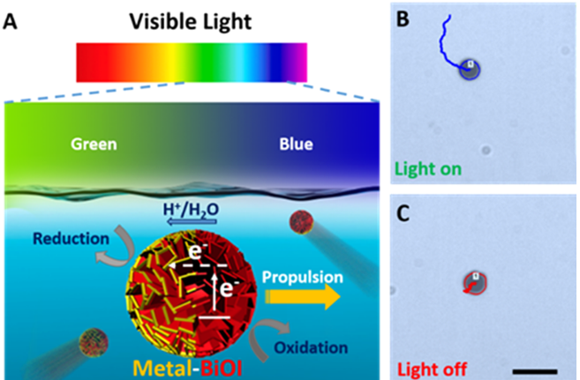
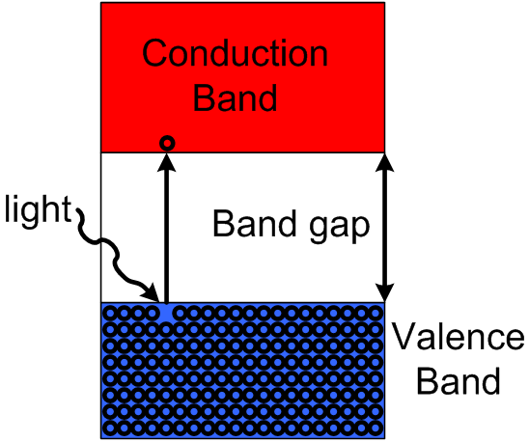
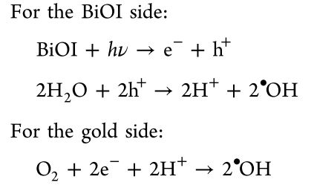
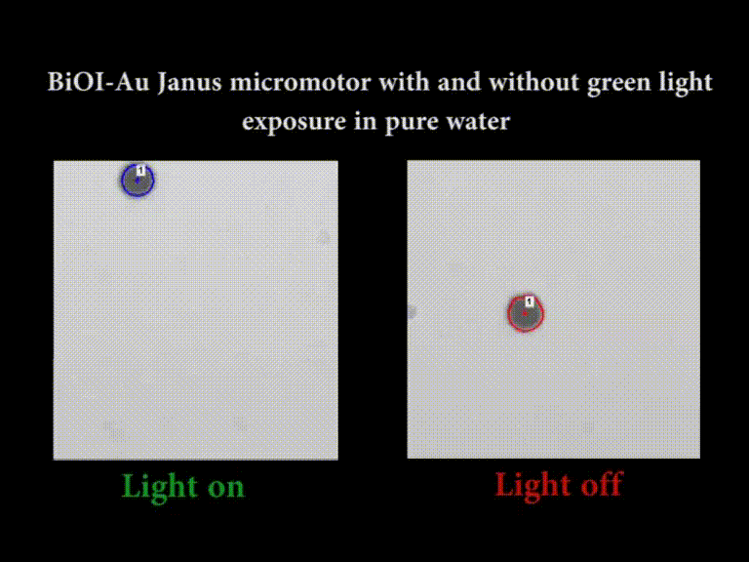
BONUS SLIDE
Works from green to the blue end of the spectrum
Not complicated preparation
1.62 μm/s 43 kilolux of green light (~strong headlamp, weaker end of spectrum)
0.6 μm/s = Brownian movement
Imagine controlling objects/instrument in the space!
Dong, R.; Hu, Y.; Wu, Y.; Gao, W.; Ren, B.; Wang, Q.; Cai, Y. J. Am. Chem. Soc. 2017, 139 (5), 1722–1725.

Slide 25
Thank you for your attention!
Please feel free to ask your questions.

