Slide 1
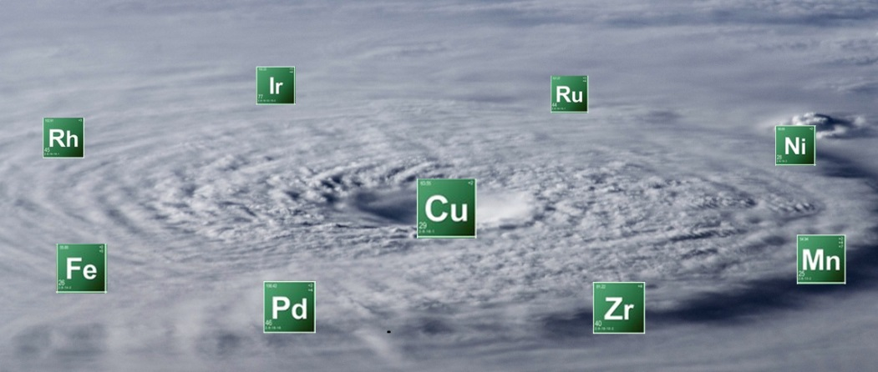
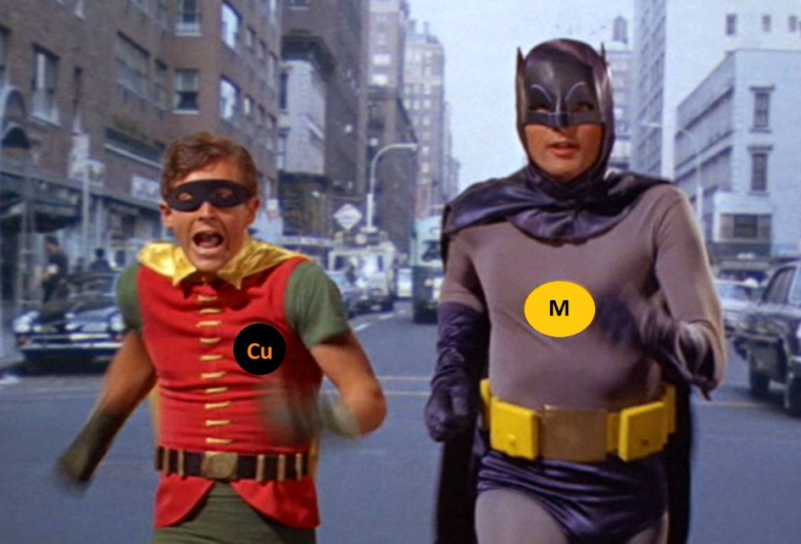
Copper with other Metal in Bimetallic Catalysis
Antonin Clemenceau
Date: 20.10.16

Slide 2
Plan
Introduction
Copper and Palladium as bimetallic system
Copper and other metal as bimetallic system
Conclusion

Slide 3
Intro:

Slide 4
Intro:

Slide 5
Intro:

Slide 6
Everything started with:
The lighthouse of the bimetallic catalysis field

Slide 7
Cu/Pd: Wacker reaction
Copper used as Oxidant due to the low redox potential of Cu^{II}/Cu^{I} (E⁰ = 0.153 V)

Slide 8
Cu/Pd: Sonogashira reaction

Slide 9
Cu/Pd: Sonogashira reaction
Easy insertion of the copper in the alkyne C-H bond

Slide 10
Cu/Pd: C-H_{alkynyl} functionalisation
Ynone formation:

Slide 11
Cu/Pd: C-H_{alkynyl} functionalisation
Triazole synthesis

Slide 12
Cu/Pd: C-H_{Heterocycle} activation
C₂ vs C₅

Slide 13
Cu/Pd: C-H_{Heterocycle} activation
C₂ vs C₅

Slide 14
Cu/Pd: C-H_{Heterocycle} activation
C₂ vs C₅

Slide 15
Cu/Pd: C-H_{Heterocycle} activation
C₂ vs C₃

Slide 16
Cu/Pd: Decarboxylative Arylation

Slide 17
Cu/Pd: dimer formation

Slide 18
Cu/Pd: α-allylation

Slide 19
Cu/Pd: Allene formation

Slide 20
Other bimetallic sytem Cu/M
Cu/M:
- Various possibility with extremely different reactivity
- Only some pertinent example will be cover in this part
- Cu/Mn, Cu/Fe, Cu/Zr, Cu/Ni, Cu/Ru, Cu/Ir

Slide 21
Other bimetallic sytem Cu/M
Cu/Mn: Radical cyclisation from oxidation of acidic C-H bond (developped by B. Snider)
Application for total synthesis:

Slide 22
Other bimetallic sytem Cu/M
Cu/Fe:

Slide 23
Other bimetallic sytem Cu/M
Cu/Zr: Dynamic kinetic AAA

Slide 24
Other bimetallic sytem Cu/M
Cu/Ni: Sylation of Csp² and Csp³

Slide 25
Other bimetallic sytem Cu/M
Cu/Ru: Photoredox - difluroacetylation

Slide 26
Other bimetallic sytem Cu/M
Cu/Ru: Photoredox

Slide 27
Other bimetallic sytem Cu/M
Cu/Ir: Photoredox

Slide 28
Other bimetallic sytem Cu/M
Cu/Ir: Photoredox

Slide 29
Conclusion
Cu/M:
- Explosion of the bimetallic catalysis during the last decades
- Copper Cheap metal which offer various possibilities
- Photoredox chemistry or asymmetric catalysis can be performed
- Be creative with this tool, plenty of other transformation are still unexplored

Slide 30
Thanks for you attention!
Questions ?

