Slide 1

Intramolecular Asymmetric Heck Reaction and Application in Natural Products Synthesis
Wangqing Kong
Zhu’s group meeting
13th, Aug, 2015

Slide 2
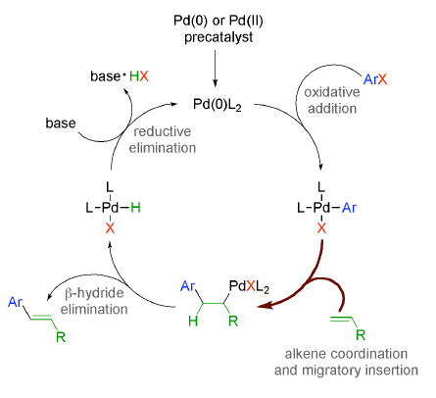
Mizoroki-Heck Reaction
Mizoroki (1971)
Heck (1972) 2010 Nobel Prize
Notes:
Heck acknowledged the Mizoroki publication and detailed independently discovered work.

Slide 3
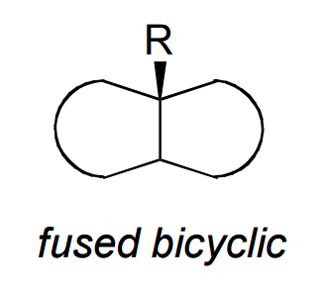
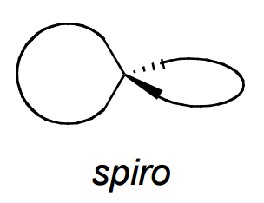
Construction of quaternary stereocenters by the intramolecular asymmetric Heck reaction
Skeletal Motif
Notes:
As you can see ,there are some nature products. I think you can also find all of them have the common point: the quaternary stereocenters
We can easy classify the quaternary stereocenters
Think about that, how to construct this kind of stereocenters. As I know there are not too many choice, especially the last three.
But all of them can be achieved by heck.

Slide 4
Content ： Different Reaction Modes in Asymmetric Heck
1.
2.
π-allylic-Pd formation
3.
Intramolecular Reductive Heck Reactions
4. X = B(OH)₂
Oxidative boron Heck-type Reaction
5. X = H
Fujiwara-Moritani Reaction

Slide 5
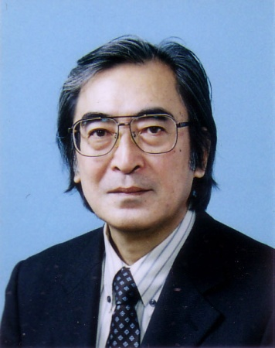
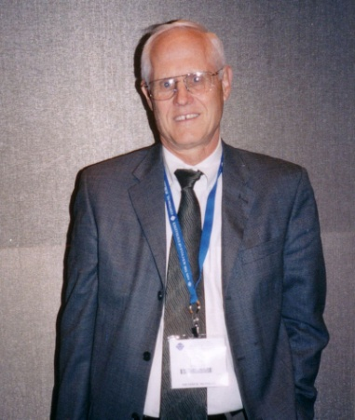
The Pioneers in Intramolecular Asymmetric Heck Reaction
Masakatsu Shibasaki
Larry E. Overman
Notes:
The asymmetric intramolecular Heck reaction was reported initially in 1989 by Overman and Shibasaki independently.
As is the case in many asymmetric catalytic systems only moderate stereoinduction was initially obtained.

Slide 6

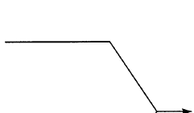

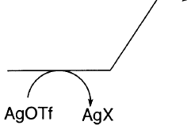

Asymmetric Heck Reaction Mechanism
1. Cationic Pathway:
The cationic pathway was first proposed independently by Cabri and Hayashi to describe the Heck reactions of aryl triflates in the presence of palladium-diphosphine catalyst.
triflate dissociation
High ee
halide abstraction by Ag(I)
Chiral bidentate ligand always chelated to the palladium center throughout the alkene coordination and migratory insertion steps!!!
Cabri, W.; Candiani, I.; DeBernardis, S.; Francalanci, F.; Penco, S. J. Org. Chem. 1991, 56, 5796;
Ozawa, F.; Kubo, A.; Hayashi, T. J. Am. Chem. Soc. 1991, 113, 1417.

Slide 7
M. Shibasaki. J. Am. Chem. Soc., 1994, 116, 11737.
M. Shibasaki, Tetrahedron Lett. 1992, 33, 2593; Tetrahedron: Asymmetry 1995, 6, 757.

Slide 8
Lentiginosine
M. Shibasaki. Tetrahedron Letters, 1993, 34, 4965; J. Org. Chem. 1995, 60, 398.
Notes:
Indolizine [ɪndə'laɪzɪn] zeolite ['zi:əlaɪt] Lentiginosine [len'tɪdʒənəʊs]

Slide 9
(-)-Eptazocine
M. Shibasaki. J. Am. Chem. Soc. 1993, 115, 8477.
Notes:
Eptazocine 依他佐辛
[ˈkrəʊmiəm]

Slide 10
Halenaquinone and Halenaquinol
M.Shibasaki. J. Org. Chem. 1996, 61, 4876.

Slide 11
(+)-Xestoquinone
Brian A. Keay. J. Am. Chem. Soc. 1996, 118, 10766.

Slide 12
This was the first example of an enantioselective intramolecular Heck reaction with a bidentate phosphinamine ligand that proved to be superior to BINAP.
A. Hallberg. J. Org. Chem. 1997, 62, 595.

Slide 13
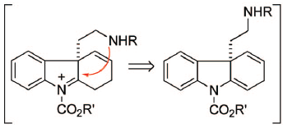
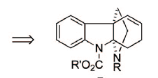
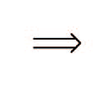
(+)-Minfiensine
Minfiensine
A
B
C
Retro-synthesis
L. E. Overman. J. Am. Chem. Soc., 2008, 130, 5368; J. Am. Chem. Soc., 2005, 127, 10186.

Slide 14
L. E. Overman. J. Am. Chem. Soc., 2008, 130, 5368; J. Am. Chem. Soc., 2005, 127, 10186.

Slide 15
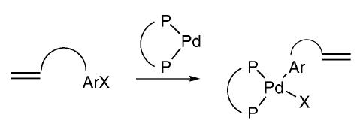



Asymmetric Heck Reaction Mechanism
2. Neutral Pathway :
dissociation of one arm of the bidentate ligand
low ee
(without Ag(I) salts)

Slide 16
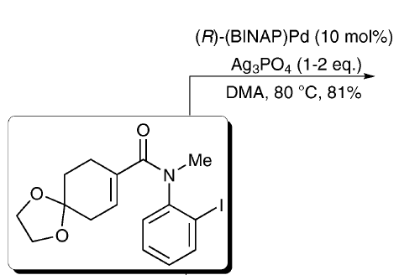
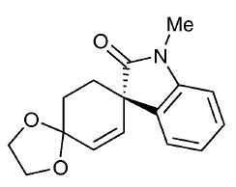
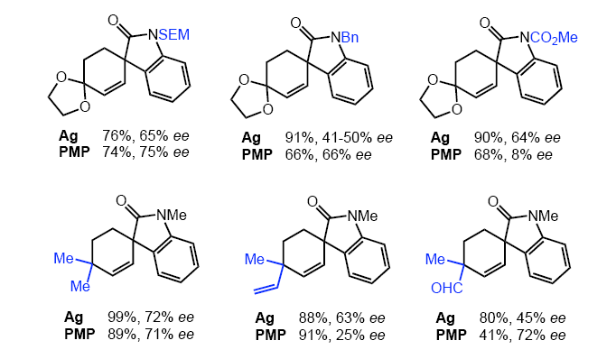
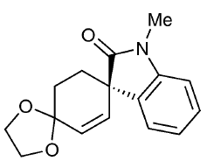
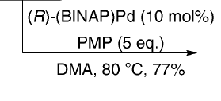
The same enantiomer of chiral ligand gave opposite enantiomers.
(S, 81% yield, 71% ee)
(R, 77% yield, 66% ee)
This was the first example of a Heck reaction proceeding with good asymmetric induction using aryl iodide in the absence of a silver salt.
L. E. Overman. J. Org. Chem. 1992, 57,4571; J. Am. Chem. Soc. 1998, 120, 6477
Notes:
Surprisingly, the products obtained under both sets of reaction conditions were enantiomeric, even though the same enantiomer of chiral ligand was used.

Slide 17
Bidentate or Monodentate Phosphine Ligands?
Ashimori, A.; Bachand, B.; Overman, L. E.; Poon, D. J. J. Am. Chem.Soc. 1998, 120, 6488; Angew. Chem., Int. Ed. 1997, 36, 518.

Slide 18
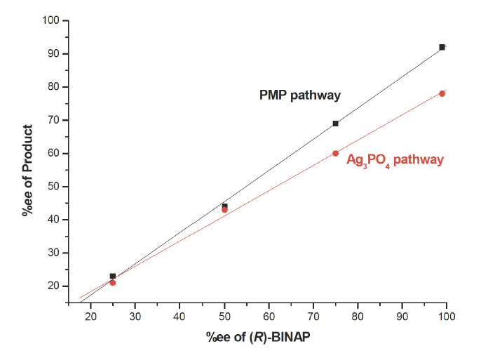
Chiral Amplification Study
Catalyst is monomeric Pd-BINAP.
Both Phosphanes of BINAP are coordinated to Pd in the enantioselective step
Ashimori, A.; Bachand, B.; Overman, L. E.; Poon, D. J. J. Am. Chem.Soc. 1998, 120, 6488; Angew. Chem., Int. Ed. 1997, 36, 518.
Notes:
The presence of multiple chiral components in a reaction transition state often results in a nonlinear relationship between the enantiopurity of catalyst and product . Such nonlinear effects thus offer a convenient tool for studying new catalyst formulations.

Slide 19
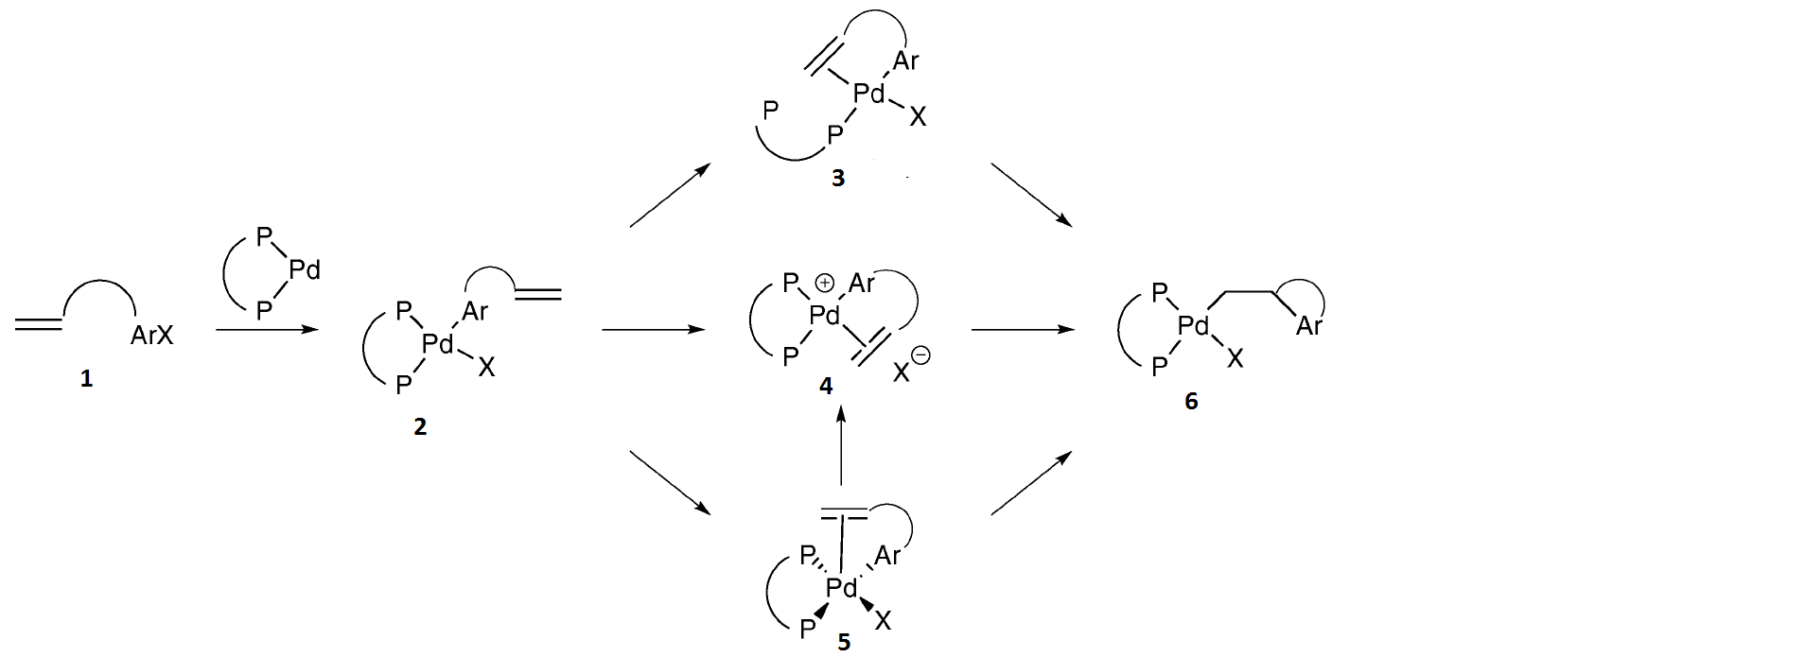
Mechanistic Neutral Pathway ：
X
X
X
Conclusion: 1 2 5 4 6
Reference for pentacoordinate Pd intermediate: V. G. Albano, G. Natile and A. Panunzi, Coord. Chem. Rev., 1994, 133, 67.
The migratory insertion directly from this pentavalent intermediate is less favourable than from a tetra-coordinate Pd complex! References see: Thorn, D. L.; Hoffmann, R. J. Am. Chem. Soc. 1978, 100, 2079; Samsel, E. G.; Norton, J. R. J. Am. Chem. Soc. 1984, 106, 5505.

Slide 20
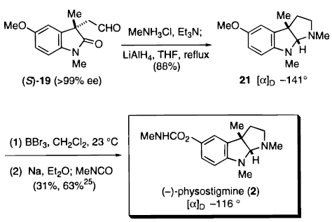
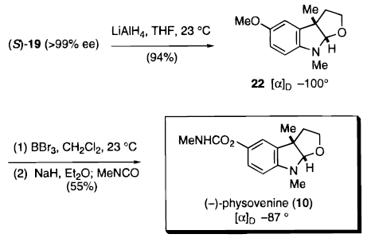
Physostigmine and Physovenine
L. E. Overman. J. Am. Chem. Soc.,1998, 120, 6500; J. Am. Chem. Soc. 1998, 120, 6488; J. Org. Chem. 1993, 58, 6949.
Notes:
Physostigmine [faɪsəʊ'stɪgmi:n] Physovenine [faɪsəʊv'naɪn]

Slide 21
Only one substrate in this paper
This is the only reported example to date of a monodentate ligand which has induced good enantioselectivities in the intramolecular asymmetric Heck cyclisation of the cyclohexadienone.
The ligand to Pd ratio in the catalytically active species is as yet unknown but the authors speculate that two ligands are bound to the metal centre.
B. L. Feringa. J. Am. Chem. Soc., 2002, 124, 184.

Slide 22
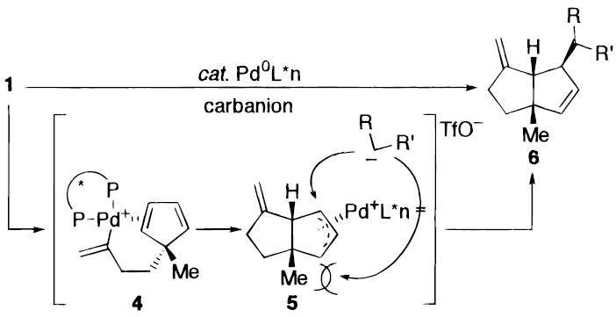
2. Asymmetric Heck cyclization, π-allylic-Pd formation and nucleophile trapping
M. Shibasaki. J. Org. Chem. 1991, 56, 4093; J. Am. Chem. Soc. 1996, 118, 7108.

Slide 23
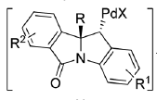
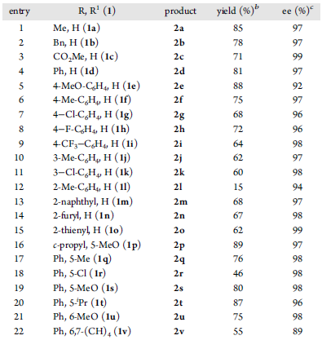
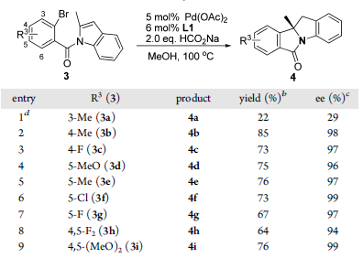
3. Intramolecular Reductive Heck Reactions
Yi-Xia Jia. J. Am. Chem. Soc., 2015, 137, 4936.

Slide 24
4. Oxidative Boron Heck-type Reaction
The first and only example for the intramolecular oxidative boron Heck-type reactions!
K. Akiyama and K. Mikami, Heterocycles, 2007, 74, 827.

Slide 25
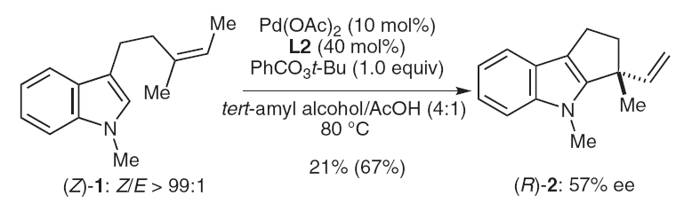
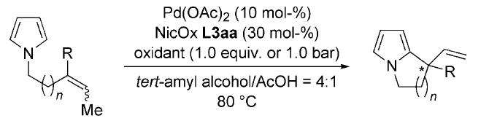
5. Fujiwara-Moritani Reaction
R = Me, n = 1, 70% yield, 70% ee
R = Ph, n = 1, 16% yield, 68% ee
J. A. Schiffner, A. B. Machotta and M. Oestreich, Synlett, 2008, 2271;
H. Zhang, E. M. Ferreira and B. M. Stoltz, Angew. Chem., Int. Ed., 2004, 43, 6144;
J. A. Schiffner, T. H. Woeste and M. Oestreich, Eur. J. Org. Chem., 2010, 174.

Slide 26
Summary and outlook
------- ??????

Slide 27
Thank You for Your Attention

