Slide 1
Laboratory of Synthesis and Natural Products (LSPN)
The Enantioselective
Pictet-Spengler Reaction
Group Seminar
Cyril Piemontesi – 23.03.2017
Notes:
ketone

Slide 2
Content
Introduction
Stoichiometric use of Lewis acid
Seminal works of Jacobsen and List
Indole as nucleophile
Phenyl as nucleophile
Pyrrole as nucleophile
Conclusion, questions and answers
The Asymmetric Pictet-Spengler Reaction

Slide 3
Content - Precisions
Only enantioselective transformations (no diastereoselective induction)
Only “chemical” reactions (no biocatalyzed reactions)
Only «aza» PS (no oxygen or other heteroatom-based PS)
Not all the literature present, mainly based on seminal works (methodology)
No application in total synthesis of natural products or drugs
Classified regarding the nature of the nucleophile and of the substituent of the amine
http://www.openwetware.org/wiki/Todd:Catalytic,_Asymmetric_Pictet-Spengler_Reaction (last visit: 19.03.2017)
The Asymmetric Pictet-Spengler Reaction

Slide 4
Introduction
The Asymmetric Pictet-Spengler Reaction

Slide 5
Pictet-Spengler reaction - Discovery
Discovered in 1911 by Pictet (Swiss chemist!) and Spengler in Geneva¹
Initially with phenylethylamine and an aldehyde (or an acetal)
Only 17 years later: PS with tryptamine (Tatsui)²
52’000 results in Google (391’000 for Wittig reaction) but as important
Pictet and Spengler - 1911
Tatsui - 1928
In nature: Pictet-Spenglersases (see slide “importance”)
Pictet, A.; Spengler, T. Ber. dtsch. Chem. Ges. 1911, 44, 2030.
Tatsui, G. J. Pharm. Soc. Jpn. 1928, 48, 92.
The Asymmetric Pictet-Spengler Reaction

Slide 6
Pictet-Spengler reaction - Mechanism
2 different mechanisms commonly accepted
Very hard to discriminate between the two (fast rearomatization)
Imine not very reactive
Wagner-Meervein
Electron-rich aromatics react faster (good for the yield, bad for the ee)
The Asymmetric Pictet-Spengler Reaction

Slide 7
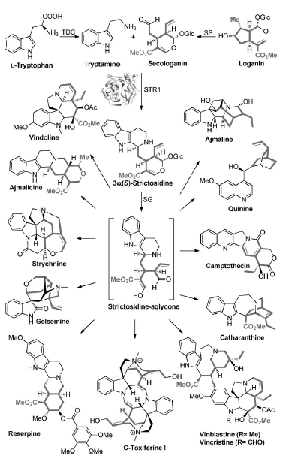
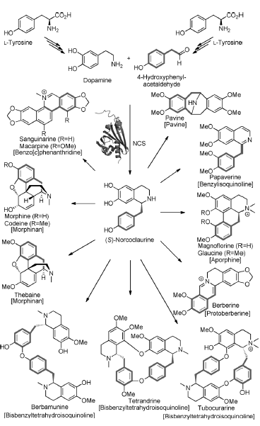
Pictet-Spengler reaction - Importance
Use for the synthesis of 1,2,3,4-tetrahydro-β-carboline and 1,2,3,4-tetrahydroisoquinoline
Review of PS in nature: Stöckigt, J.; Antonchick, A. P.; Wu, F.; Waldmann, H. Angew. Chem. Int. Ed. 2011, 50, 8538.
The Asymmetric Pictet-Spengler Reaction

Slide 8
Stoichiometric Lewis Acid
The Asymmetric Pictet-Spengler Reaction

Slide 9
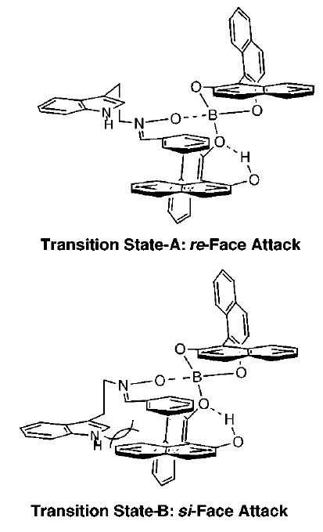
Indole – C3 linker – Stoichiometric LA
First example of reagent controlled PS: using (Ipc)₂BCl (1.9 equiv)¹ and nitrones
Working with aromatic (neutral or rich) R, generally 70-90% ee
Aliphatic aldehyde give poor ee (35%), electron poor aryl give no ee
Second generation using BINOL ligand (2 equiv boron) ²
Can now give better ee with electron poor aromatic aldehyde (75%)
Catalytic gave good yield but very poor ee
Kawate, T.; Yamada, H.; Soe, T.; Nakagawa, M. Tetra. Asym. 1996, 7, 1249.
Yamada, H.; Kawate, T.; Matsumizu, M.; Nishida, A.; Yamaguchi, K.; Nakagawa, M. J. Org. Chem. 1998, 63, 6348.
The Asymmetric Pictet-Spengler Reaction

Slide 10
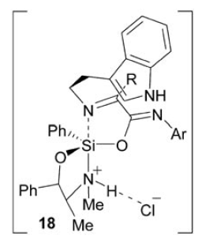
Indole – C3/C4/N1 linker – Stoichiometric LA
2nd example of reagent controlled PS (1.3 to 2 equiv silane)^{1,2}
Aromatic on the amide crucial for the yield (C₆H₆=0% vs 65%)
Also work with aliphatic ketone and can form the imine in situ
In general 80-95% ee
Iso-PS also possible with C4 and N1 linker
82-98% ee
R: Aryl and alkyl
DS = Dean-Stark
86-96% ee
R: Aryl and alkyl
Bou-Hamdan, F. R.; Leighton, J. L. Angew. Chem. Int. Ed. 2009, 48, 2403.
Schönherr, H.; Leighton, J. L. Org. Lett. 2012, 14, 2610.
The Asymmetric Pictet-Spengler Reaction

Slide 11
Seminal works on catalytic enantioselective PS
The Asymmetric Pictet-Spengler Reaction

Slide 12
Indole – C3 linker – Catalytic BA
1st example of catalytic enantioselective PS¹
N-acyl iminium very reactive compare to iminium
Thiourea catalyst gave 85-93% ee
Only aliphatic aldehydes + acetylated (AcCl crucial) tryptamine
Catalyst got S-acetylated at the required temperature for aromatic aldehyde (>-30 °C)
Taylor, M. S.; Jacobsen, E. N. J. Am. Chem. Soc. 2004, 126, 10558.
The Asymmetric Pictet-Spengler Reaction

Slide 13
Indole – C3 linker – Catalytic BA
1st example of catalytic enantioselective PS catalyzed by BPA¹
BPA catalyst gave 62-96% ee
Only aliphatic and electron-poor aromatic aldehydes (vs Jacobsen)
gem-disubstituted tryptamine required
Why is the gem-disubstitution required and
what would be the reaction outcome without it (with propanal)?
Seayad, J.; Seayad, A. M.; List, B. J. Am. Chem. Soc. 2006, 128, 1086.
The Asymmetric Pictet-Spengler Reaction

Slide 14
Indole as nucleophile
The Asymmetric Pictet-Spengler Reaction

Slide 15
Indole – C3 linker – N-S
BPA in low catalyst loading (5 mol%)¹
Sulphenyl stabilized the iminium (favor PS vs enamine formation)
BHT as radical scavenger to avoid product decomposition (homolytic cleavage)
Aliphatic and aromatic aldehyde tolerated
72-87% ee except acetaldehyde (30%)
Wanner, M. J.; van der Haas, R. N. S.; de Cuba, K. R.; van Maarseveen, J. H.; Hiemstra, H. Angew. Chem. Int. Ed. 2007, 46, 7485.
The Asymmetric Pictet-Spengler Reaction

Slide 16
Indole – C3 linker – Nalkyl
BPA in low catalyst loading¹
Aliphatic and aromatic aldehyde tolerated in 61-87% ee
SPA in low catalyst loading (1st example with SPA). Much better than BPA (yield + ee)²
Various aryl group tolerated
Aliphatic and aromatic aldehyde tolerated with 90-98% ee
NH of the indole crucial for the ee
Sewgobind, N. V.; Wanner, M. J.; Ingemann, S.; de Gelder, R.; van Maarseveen, J. H.; Hiemstra, H. J. Org. Chem. 2008, 73, 6405.
Huang, D.; Xu, F.; Lin, X.; Wang, Y. Chem. Eur. J. 2012, 18, 3148.
The Asymmetric Pictet-Spengler Reaction

Slide 17
Indole – C3 linker – NAcyl
From hydroxylactame with thiourea catalysis
TMSCl for the formation of the iminium
R = alkyl or aryl / n = 1 or 2 with 81-99% ee
S_{N}1 + Asymmetric Counteranion Directed Catalysis mechanism
ee depends on the size of the counter anion (Cl: 97, Br: 68 and I: <5% ee)
Raheem, I. T.; Thiara, P. S.; Peterson, E. A.; Jacobsen, E. N. J. Am. Chem. Soc. 2007, 129, 13404.
The Asymmetric Pictet-Spengler Reaction

Slide 18
Indole – C3 linker – NAcyl
R¹ = alkyl or aryl / R² = H or EWG / n = 1 or 2 with 72-99% ee¹
Compatible with the enol lactone-forming gold(I)-catalyzed cycloisomerization of
alkynoic acids
Can go down to 1 mol% catalyst loading
One single diastereoisomer (cis)
matched
Can be isolated
Can be isolated
missmatched
Muratore, M. E.; Holloway, C. A.; Pilling, A. W.; Storer, R. I.; Trevitt, G.; Dixon D. J. J. Am. Chem. Soc. 2009, 131, 10796.
The Asymmetric Pictet-Spengler Reaction

Slide 19
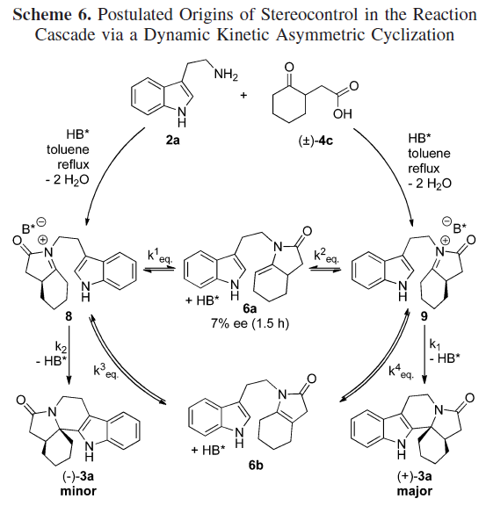
Indole – C3 linker – NAcyl
From the open form of the lactone before¹
R¹ = alkyl or aryl / R² = alkyl or EWG / n = 1 or 2 with 68-98% ee
One single diastereoisomer (cis)
Dynamic kinetic asymmetric cyclization
k¹_{eq}, k²_{eq}, k³_{eq}, k⁴_{eq} >> k₁ > k₂
Can be isolated
Can be isolated
missmatched
matched
Holloway, C. A.; Muratore, M. E.; Storer, R. I; Dixon, D. J. Org. Lett. 2010, 12, 4720.
The Asymmetric Pictet-Spengler Reaction

Slide 20
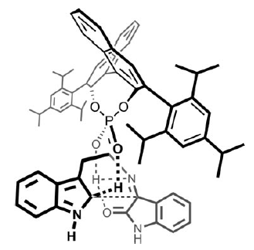
Indole – C3 linker – NH₂
With isatine (reactive ketone)
R¹ = H and R²= H, alkyl, aryl
Very sensitive to the substituent on
the tryptamine
0-94% ee¹
Sn and Sc Box and Pybox gave poor ee
With isatine (reactive ketone)
R¹ = H, Me (!!) and R²= H, alkyl
Not sensitive at all to water (pocket)
DMF as solvent
71-95% ee²
Badillo, J. J.; Silva-García, A.; Shupe, B. H.; Fettinger, J. C.; Franz, A. K. Tetrahedron Lett. 2011, 52, 5550.
Duce, S.; Pesciaioli, F.; Gramigna, L.; Bernardi, L.; Mazzanti, A.; Ricci, A.; Bartoli, G.; Bencivennia, G. Adv. Synth. Catal. 2011, 353, 860.
The Asymmetric Pictet-Spengler Reaction

Slide 21
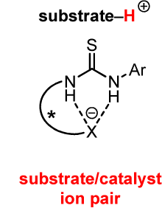
Indole – C3 linker – NH₂
With thiourea:
R = alkyl and aryl with 86-99% ee¹
Acid not required for aliphatic aldehyde if tryptamine rich enough (slower but higher ee)
Very slow if not electron rich tryptamine
With thiourea-acid catalyst:
R = aryl only with 32-92% ee² and much faster than Jacobsen
In situ Boc protection of the product to avoid product inhibition (otherwise add malonic acid)
Klausen, R. S.; Jacobsen, E. N. Org. Lett. 2009, 11, 887.
Mittal, N.; Sun, D. X.; Seidel, D. Adv. Org. Lett. 2014, 16, 1012.
The Asymmetric Pictet-Spengler Reaction

Slide 22
Indole – C2, C4, N1 linker
Synthesis of tetrahydro-γ-carboline (drug discovery)¹
Work with aliphatic and aromatic aldehyde with 79-95% ee
1 example with ketone
Direct in situ Boc protection + trituration afforded all examples in >99% ee without column
Lee, Y.; Klausen, R. S.; Jacobsen, E. N. Org. Lett. 2011, 13, 5564.
The Asymmetric Pictet-Spengler Reaction

Slide 23
Indole – C2, C4, N1 linker
1st example of 7-membered ring formation via PS¹
Work with electron poor and rich aromatic imine in 84-91% ee
For the same example imine vs aldehyde: 90 vs 83% ee
NH of the indole required for the ee (not for the yield)
1 example with 7-aza-indole but work only with aldehyde (0% vs 77% yield, 90% ee)
Why is there a difference in ee between ketone and PMP imine and
what would be the TS to explain it?
Cheng, D.-J.; Wu, H.-B.; Tian, S.-K. Org. Lett. 2011, 13, 5636.
The Asymmetric Pictet-Spengler Reaction

Slide 24
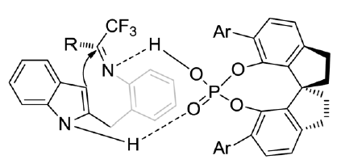
Indole – C2, C4, N1 linker
Synthesis of 7-membered ring with quaternary stereocenters bearing a CF₃ moiety¹
Work with electron poor and rich aromatic ketone with 87-99% ee
NH of the indole required for the ee
Li, X.; Chen, D.; Gu, H.; Lin, X. Chem. Commun. 2014, 50, 7538.
The Asymmetric Pictet-Spengler Reaction

Slide 25
Phenyl as nucleophile
The Asymmetric Pictet-Spengler Reaction

Slide 26
Phenyl
BPA in combination with BINOL ligand for the synthesis of tetrahydroisoquinolines
Nps give a good para/ortho ratio compare to H, Me, Bn + 24-86% ee
Work with electron poor and rich aromatic aldehyde + aliphatic one
One hydroxyl group on the aryl is not enough
Why is enantioselective reaction harder to develop
with phenylethylamine compared to tryptamine?
Mons, E.; Wanner, M. J.; Ingemann, S.; van Maarseveen, J. H.; Hiemstra, H. J. Org. Chem. 2014, 79, 7380.
The Asymmetric Pictet-Spengler Reaction

Slide 27
Pyrrole as nucleophile
The Asymmetric Pictet-Spengler Reaction

Slide 28
Pyrrole
C2 or C4 attack depending on the substitution of the pyrrole and on the LA used¹
For C4 attack: 70-97% ee.
Use TIPS as steric bulk to prevent C2 attack
Catalyst influence the regioselectivity too. 3:1 vs >50:1 C4/C2 with catalyst
For C2 attack: 52-93% ee
For both R = aliphatic, aromatic or H
Raheem, I. T.; Thiara, P. S.; Jacobsen, E. N. Org. Lett. 2008, 10, 1577.
The Asymmetric Pictet-Spengler Reaction

Slide 29
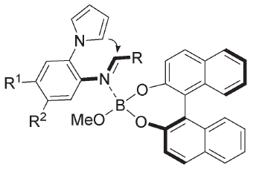
Pyrrole
Synthesis of 1,2,3,4-Tetrahydropyrrolo[1,2-a]pyrazines¹
Branched aliphatic and aromatic aldehyde tolerated in 65-94% ee
BPA also influence the regioselectivity (10:1 C2/C5 without catalyst)
Boron-BINOL complex better than BPA²
Aliphatic and aromatic aldehyde in 72-95% ee
He, Y.; Lin, M.; Li, Z.; Liang, X.; Li, G.; Antilla, J. C. Org. Lett. 2011, 13, 4490.
Li, Y.; Su, Y.-H.; Dong, D.-J.; Wua, Z.; Tian, S.-K. RSC Adv. 2013, 3, 18275.
The Asymmetric Pictet-Spengler Reaction

Slide 30
Tandem reaction ending by PS
The Asymmetric Pictet-Spengler Reaction

Slide 31
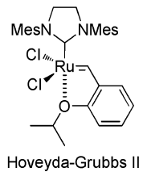
Tandem reaction
Tandem RCM/Isomerization/PS¹
Aliphatic and aromatic R tolerated in 68-99% ee
Evidence for the particiation of only BPA in the isomerization + asymmetric steps
Tandem Isomerization/isomerization/PS²
Aliphatic and aromatic R tolerated in 37-87% ee
Enol ether additive if R is not H
(otherwise no isomerization)
Cai, Q.; Liang, X.-W.; Wang, S.-G.; Zhang, J.-W.; Zhang, X.; You, S.-L. Org. Lett. 2012, 14, 5022.
Cai, Q.; Liang, X.-W.; Wang, S.-G.; You, S.-L. Org. Biomol. Chem. 2013, 11, 1602.
The Asymmetric Pictet-Spengler Reaction

Slide 32
Tandem reaction
Tandem Michael addition/condensation/PS¹
Aliphatic enone only
Aryl and alkyl R tolerated in 60-96% ee
Selective for the fused ring system
Aillaud, I.; Barber, D. M.; Thompson, A. L.; Dixon, D. J. Org. Lett. 2013, 15, 2946.
The Asymmetric Pictet-Spengler Reaction

Slide 33
Conclusion
The Asymmetric Pictet-Spengler Reaction

Slide 34
Conclusion
PS very useful reaction and tolerant to many variations
Missing method for the use of NH₂-tryptamine and for phenylethylamine
Ketone not well tolerated in the scope for the electrophiles except when “cheating”
Be able to lower the catalyst loading as well as the time of the reaction
The Asymmetric Pictet-Spengler Reaction

Slide 35
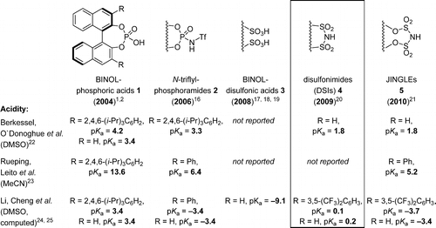
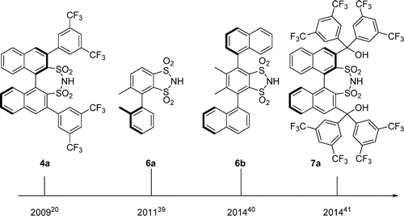
Outlook
Use of catalytic Lewis acid or of stronger chiral acid
Use of Bis-thiourea
James, T.; van Gemmeren, M.; List, B. Chem. Rev. 2015, 115, 9388.
Kennedy, C. R.; Lehnherr, D.; Rajapaksa, N. S.; Ford, D. D.; Park, Y.; Jacobsen, E. N. J. Am. Chem. Soc. 2016, 138, 13525.
The Asymmetric Pictet-Spengler Reaction

Slide 36
END
But nevertheless a useful method… :)
Piemontesi, C.; Wang, Q.; Zhu, J. J. Am. Chem. Soc. 2016, 138, 11148.
The Asymmetric Pictet-Spengler Reaction

Slide 37
Conclusion and outlook
The Asymmetric Pictet-Spengler Reaction

Slide 38
Answers
The Asymmetric Pictet-Spengler Reaction

Slide 39
Answers
Why is the gem-disubstitution required and
what would be the reaction outcome without it?
gem-disubstituted tryptamine required for the Thorpe-Ingold effect + for steric reason
Side-reaction
The Asymmetric Pictet-Spengler Reaction

Slide 40
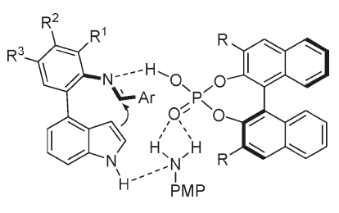
Indole – C2, C4, N1 linker
Why is there a difference in ee between ketone and PMP imine and
what would be the TS to explain it?
For the same example imine vs aldehyde: 90 vs 83% ee
NH of the indole required for the ee (not for the yield)
Cheng, D.-J.; Wu, H.-B.; Tian, S.-K. Org. Lett. 2011, 13, 5636.
The Asymmetric Pictet-Spengler Reaction

Slide 41
Answers
Why is enantioselective reaction harder to develop
with phenylethylamine compared to tryptamine?
No “binding point” compare to tryptamine
The Asymmetric Pictet-Spengler Reaction

