Slide 1
Arynes in Pericyclic and Nucleophilic Reactions
LSPN Group Seminar
Rubén Omar Torres Ochoa
April 14th, 2016

Slide 2
Table of Contents
Introduction
Aryne Generation
Arynes in Pericyclic Reactions
Arynes in Nucleophilic Reactions
Summary and Outlook

Slide 3
INTRODUCTION
W. E. Bachmann, et al., J. Am. Chem. Soc. 1927, 49, 2089–98.
G. Wittig, Naturwissenschaften 1942, 30, 696-703.
J. D. Roberts, et al., J. Am. Chem. Soc. 1953, 75, 3290-91.

Slide 4
First experimental observations that supported benzyne existence:
J. D. Roberts, et al., J. Am. Chem. Soc. 1953, 75, 3290-91.

Slide 5
¹⁴C labelling experiment to demonstrate the existence of benzyne.
42%
Practically 1:1 ratio
J. D. Roberts, et al., J. Am. Chem. Soc. 1953, 75, 3290-1.
“These facts as well as the orientation data for various substituents can be accommodated by an elimination-addition mechanism involving at least transitory existence of an electrically neutral “benzyne” intermediate”
Further experimental evidence of its existence
IR J. G. Radziszewski, et al., J. Am. Chem. Soc. 1992, 114, 52–57.
Photoelectron W. C. Lineberger, et al., J. Am. Chem. Soc. 1998, 120, 5279–5290.
NMR R. Warmuth, Chem. Commun. 1998, 59–60.

Slide 6
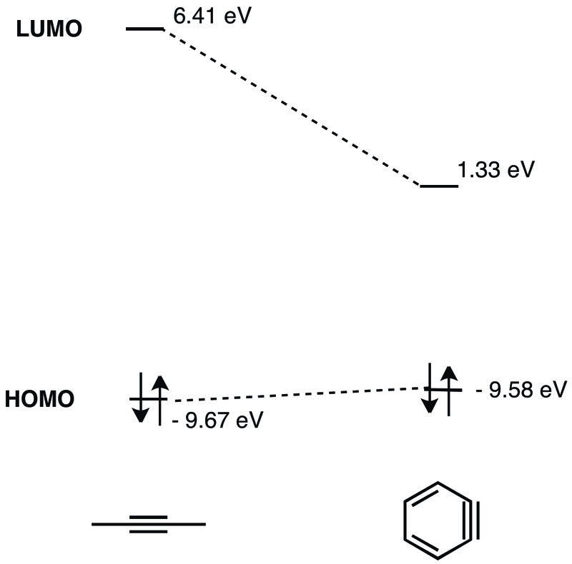
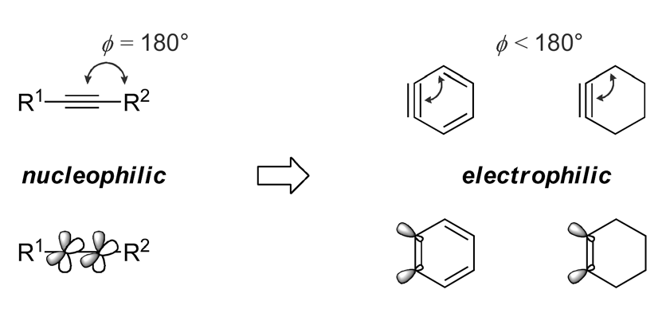
Why are arynes too reactive?
N. G. Rondan, et al., Tetrahedron Lett. 1979, 20, 3237 – 3240.
Nucleophilic
addition
reactions
Pericyclic
reactions
Reactivity
Transition metal-catalyzed reactions

Slide 7
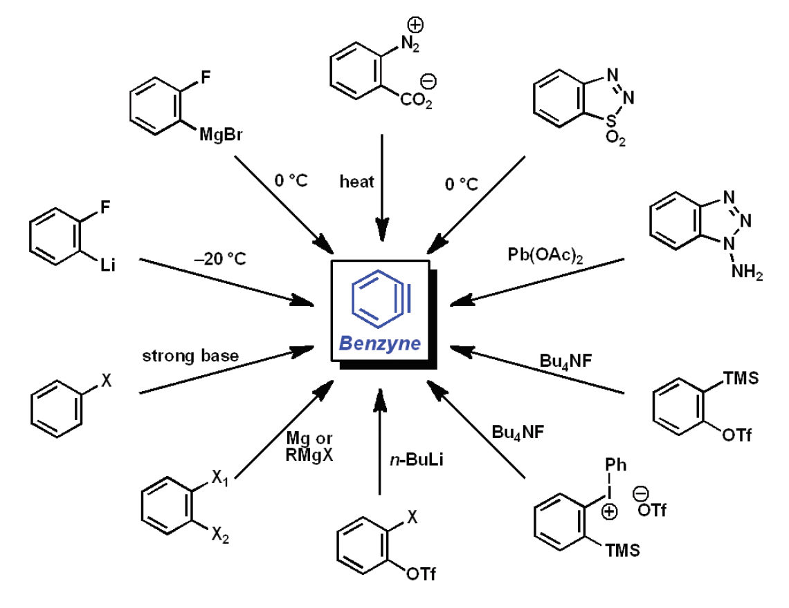
ARYNE GENERATION
Elimination reactions
Cost:
5g → 99 CHF
(TCI provider)
T. Kitamura, et al., J. Chem. Soc., Chem. Commun. 1995, 983. C. D. Campbell, et al., J. Chem. Soc., C 1969, 742. T. Matsumoto, et al., Tetrahedron Lett. 1991, 32, 6735. L. Friedman, et al., J. Am. Chem. Soc. 1963, 85, 1792. L. Friedman, et al., Org. Synth. 1968, 48, 12. G. Wittig et al., Org. Synth. 1967, 47, 4. R. W. Hoffmann, Dehydrobenzene and Cycloalkynes; Academic Press: New York, 1967. T. Kitamura, Aust. J. Chem. 2010, 63, 987. A. M. Dyke, et al., Synthesis 2006, 4093. H. Kobayashi, et al., Chem. Lett. 1983, 1211.

Slide 8
Preparation of the most used aryne precursors
Original method
Y. Himeshima, et al.,
Chem. Lett., 1983, 8, 1211-4.
Optimized method
N. K. Garg, et al., J. Org. Chem., 2009, 74, 8842-3.
Method for preparing
different aryne precursors
D. Peña, et al., Synthesis, 2002, 1454-8.

Slide 9
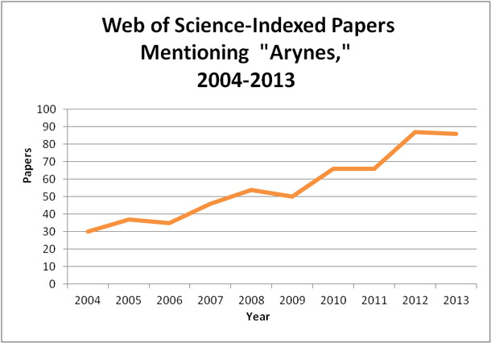
(Title, abstract, or keywords)
http://sciencewatch.com/articles/chemists-adding-arynes-hunt-cures

Slide 10
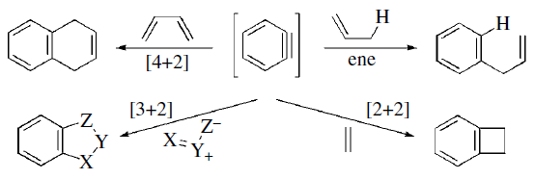
ARYNES IN PERICYCLIC REACTIONS

Slide 11
DIELS-ALDER CYCLOADDITIONS
The most studied pericyclic reaction with arynes.
This result also confirmed benzyne existence
First report
Quantitative
(3 steps)
S. Sorgel, et al., Eur. J. Org. Chem., 2006, 4405-18.

Slide 12
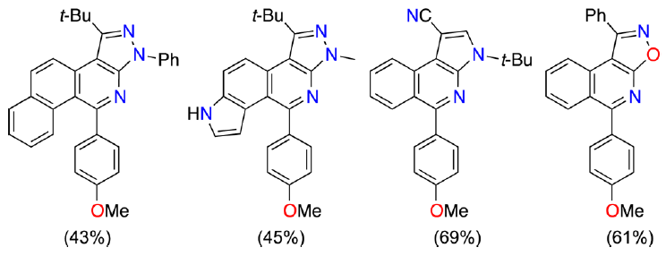
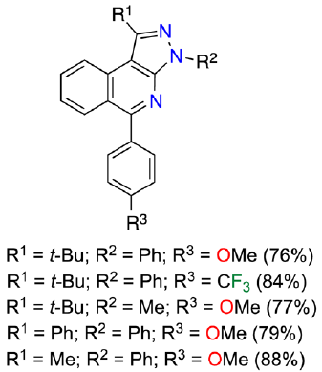
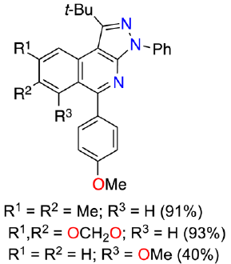
Y. Coquerel, et al., Org. Lett. 2015, 17, 3374−77.

Slide 13
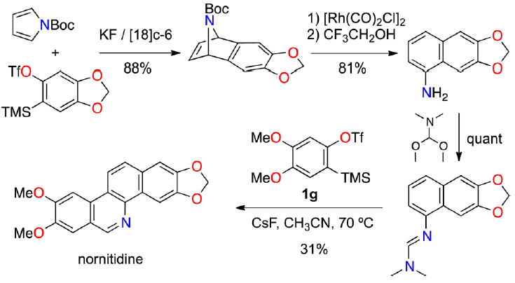
Two aryne Diels-Alder were involved!
Y. Coquerel, et al., Org. Lett. 2015, 17, 3374−77.

Slide 14
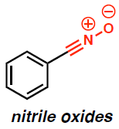
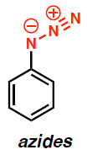
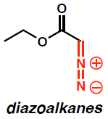
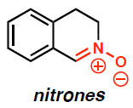
[3 + 2] CYCLOADDITIONS
Regiocontrol is the principal issue to be solved in this kind of reactions.
Arynes produced by the milder methods are chosen for this transformations.
No synthesis of any natural product using [3 + 2] cycloadditions has been reported to date.

Slide 15
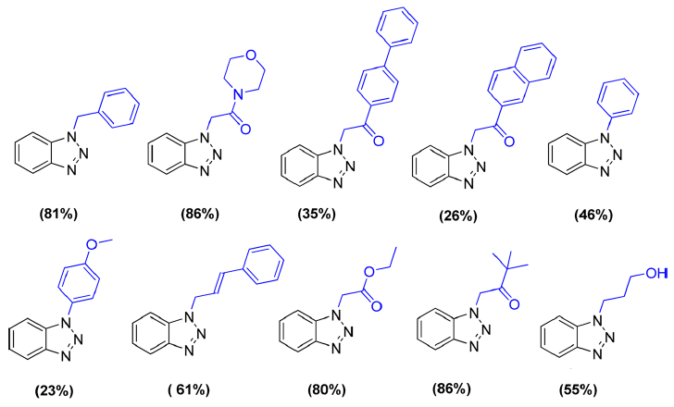
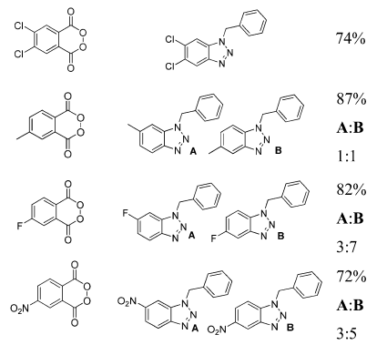
[3 + 2] CYCLOADDITIONS
L. Shi, et al., J. Org. Chem. 2015, 80, 5928-33.

Slide 16
[2 + 2] CYCLOADDITIONS WITH ALKENES
Easy access to benzocyclobutene
This kind of reaction works best using olefins bearing electrodonating substituents.
Byphenylene is a common detected side-product.

Slide 17
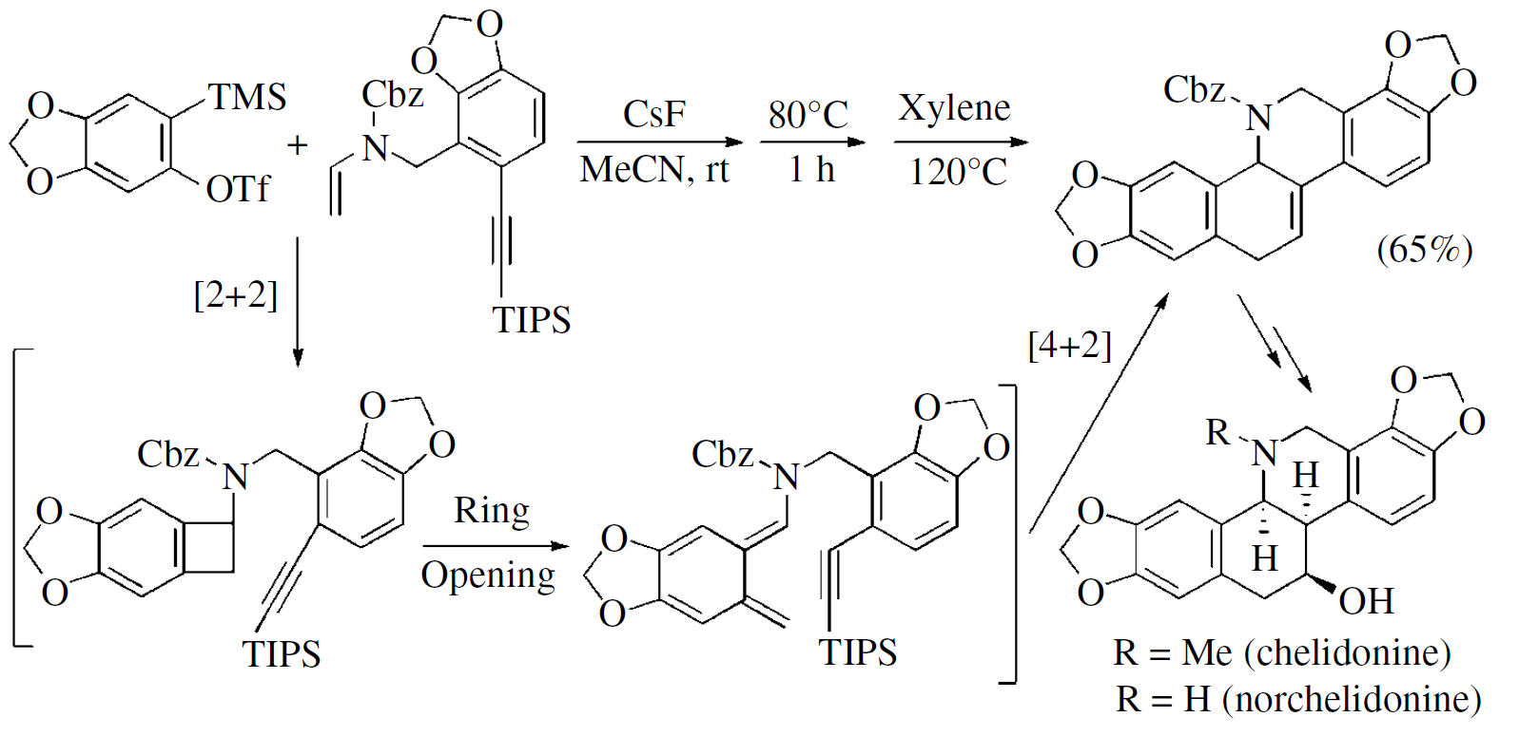
Stable products
R. P. Hsung, et al., Org. Lett., 2009, 11, 3666-69.
R. P. Hsung, et al., Org. Lett., 2012, 14, 2742–2745.

Slide 18
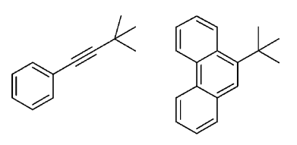
ENE REACTIONS
Few useful synthetic procedures have been published in this area.
Reports with alkenes, alkynes; intra- e intermolecular versions.
Interesting side-products
Propargyl chlorides and bromides can be used.
Internal alkynes are also good substrates.
The reaction also works with substituted aryne precursors.
C. H. Cheng, et al., J. Am. Chem. Soc., 2006, 128, 2232–33.

Slide 19
Good procedure for C2-arylation of anilines
C4-arylation product was not detected
Hetero-ene reaction
M. F. Greaney, et al., Angew. Chem. Int. Ed., 2012, 51, 1006–1009.

Slide 20
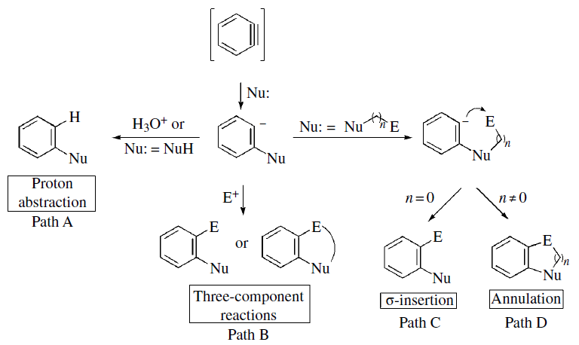
NUCLEOPHILIC ADDITION REACTIONS TO ARYNES

Slide 21
PROTON ABSTRACTION
Metal-free method to prepare byphenyls, anilines, phenylethers, phenylthioethers, etc.
This strategy could be used as alternative to Buchwald-Hartwig and Sonogashira reactions.

Slide 22
M. Beller, J. Org. Chem. 2001, 66, 1403-12.
O. Daugulis, Org. Lett. 2011, 13, 4172-75.

Slide 23
O. Daugulis, et al., Org. Lett. 2011, 13, 4172-75.
R. C. Larock, et al., J. Org. Chem., 2006, 71, 3198–3209.

Slide 24
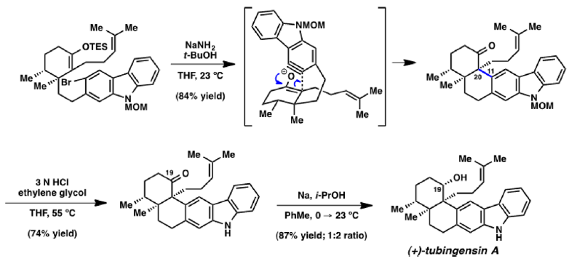
Antiviral, anticancer, and
insecticidal activity.
N. K. Garg, et al., J. Am. Chem. Soc. 2014, 136, 3036−39.

Slide 25
THREE COMPONENT REACTIONS
Useful procedure for obtaining o-disubstituted arene derivatives.
Several electrophiles and nucleophiles can be used.

Slide 26
A. G. M. Barrett, et al., J. Am. Chem. Soc. 2006, 128, 14042.
Tokuyama, et al., Org. Lett., 2013, 15, 1946-49.

Slide 27
Only sterically hindered isocyanide could be used.
All tested substituted aryne precursors gave low yields.
Kunai, et al., Angew. Chem. Int. Ed., 2004, 43, 3935-38.

Slide 28
σ - INSERTION
Nucleophile and electrophile are attached directly.
Aryne is inserted between Nu and E.
β-Ketoesters, 1,3-dinitriles, 1,3-diesters, ureas, trifluoroacetamides, etc. are usually used.
Carbon-carbon σ-insertion
S. J. Danishefsky, et al., J. Am. Chem. Soc., 1996, 118, 9509-25.

Slide 29
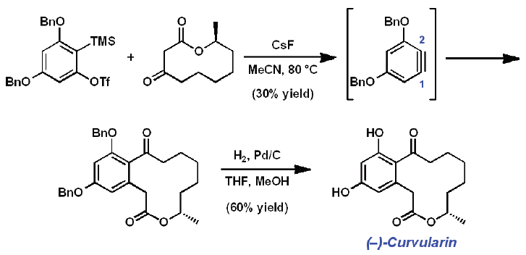
B. M. Stoltz, et al., J. Am. Chem. Soc. 2006, 128, 11752.
B. M. Stoltz, et al., Org. Lett. 2010, 12, 1612.

Slide 30
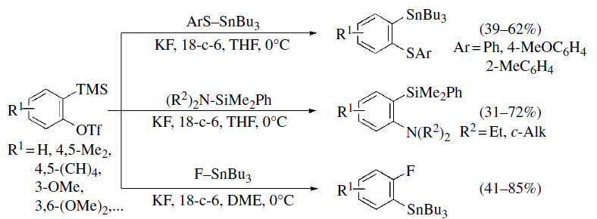
Heteroatom-heteroatom σ-insertion
A. Kunai, et al., Chem. Commun., 2004, 1980-81.
A. Kunai, et al., Chem. Commun., 2005, 3454-56.
K. Takaki, et al., Angew. Chem. Int. Ed., 2013, 52, 8629-32.
Heteroatom-carbon σ-insertion
CF₃ crucial for the reaction
Limited to secondary substrates
R. C. Larock, et al., J. Am. Chem. Soc. 2006, 125, 13112-13113.

Slide 31
ANNULATION
Useful for building 4-, 5- or 6-membered ring systems.
Reaction condition optimization is crucial for the success of these transformations.
[2 + 2] Annulation reactions
P. Caubere, et al., J. Org. Chem. 1991, 56, 4078–4081.

Slide 32
[3 + 2] Annulation reactions
Moderate yields.
Low scope.
It works only with malonates or acetoacetates.
R. C. Larock, et al., J. Org. Chem., 2012, 77, 2743–2755.
Regiospecific method for preparing 2,3-disusbstituted indoles in high yields.
Acidic conditions were needed to promote dehydration.
J. Zhu, et al., Chem. Commun. 2013, 10284-86.

Slide 33
[3 + 2] Annulation reactions
N. P. Argade, et al., Org. Lett. 2013, 15, 4006-9.

Slide 34
[3 + 2] Annulation reactions
[4 + 2] Annulation reactions
Broad scope
High yields
Conditions: 1 eq SM, 2 eq aryne precursor, TBAT, THF, rt
Only 4 examples
Moderate yields
B. M. Stoltz, et al., J. Am. Chem. Soc., 2008, 130, 1558-59.

Slide 35
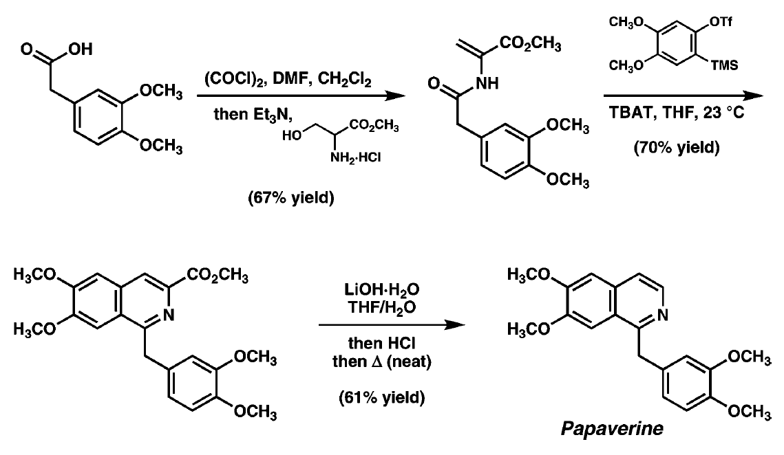
B. M. Stoltz, et al., J. Am. Chem. Soc., 2008, 130, 1558-59.

Slide 36
SUMMARY AND OUTLOOK
Dienophiles
Reactivity
Electrophiles
Harsh reaction
conditions
Mild reaction
conditions
Generation
New synthetic procedures
Growing field
Total synthesis

Slide 37
CONCLUSIONS
Recent renaissance in their chemistry.
New mild generation methods has increased the aryne-based methodologies.
TMS-aryl-triflates is the most preferred method for preparing arynes in situ.
Arynes react as electrophiles and also in pericyclic reactions because their low-lying LUMO.
Their utility in total synthesis has been proved (to date, more than 80 natural products).
In spite of benzynes are intrinsically unstable and highly reactive, organic synthesis exploits these qualities.

