Slide 1
Palladium Catalyzed C-H Amination
Presented by Ala Bunescu: 1st year PhD student, LSPN, EPFL
PhD supervisor : Prof. Jieping Zhu

Slide 2
Questions:
What is the mechanism of C-H amination?
What are the limits of C-H amination?

Slide 3
Plan
Introduction
Pd-Catalyzed direct C-H amination: Mechanistic overview
Examples found in literature:
Mechanistical pathway
Type of oxidant: internal/external
Type of C-H bond: sp³, allylic, aromatic( Inter/Intra Molecular)

Slide 4
Pd-Catalyzed direct C-H amination
Advantages:
Desavantages:
Atom economy /low energy starting material
Direct route to complex product
An alternative approach for Buchwald-Hartwig Amination
Inert nature of most C-H carbon bonds: harsh conditions
Requirement of site selectivity: directory group
Absence of generality

Slide 5
Pd-Catalyzed direct C-H amination: Mechanistical Overview
Reductive functionalization pathway
Electrophilic functionalization pathway

Slide 6
Reductive Functionalization Pathway
Pd ^{II/0} Catalytic Cycle
Pd ⁰ Oxidation
C-H activation
I
a
II
b
c
Reductive Elimination
Ligand Exchange
III

Slide 7
Electrophilic Functionalization Pathway
Direct electrophilic Functionalization of Paladacycle:
One or Two electron Oxidation of Palladacycle:
C-H activation
Direct Electrophilic cleavage
I
II
b
b
C-H activation
I
a
c
Reductive Elimination
III
II
Pd(II) oxidation :
Two / one electron oxidant
Internal oxidant /external oxidant

Slide 8
Examples: Type of Mechanism
Pd(0)/Pd(II): 2 examples
Pd(II)/Pd(IV): 2 examples
Nitrene insertion: 1 example

Slide 9
C-H Amination to carbazole: Pd(0)/Pd(II)
1 2
3 4 5 6
R: OMe (92%)
F (94%)
CF₃ (88%)
R: OMe (81%)
F (78%)
CF₃ (95%)
R: Me (82%)
OMe (41%)
CF₃ (86%)
CO₂Me (99%)
R: OMe (97%)
F (87%)
CF₃ (94%)
SMe (82%)^{b}
NO₂ (72%)^{b}
Buchwald, S.L. J. Am. Chem.Soc., 2005, 127, 14560-14561
Buchwald, S.L. J. Org. Chem., 2008, 73,7603-7610

Slide 10
Propese Mechanism
a
I
II
III
b
Electrophylic C-H activation excluded:
OMe group in position 3 give just 41% yield
At lower temperature just 2’-acetamino- 4-metoxybiphenyl (metoxy group in 2) cyclizide in73% (inductive effect of MeO)

Slide 11
C-H amination to oxindole: Pd(0)/Pd(II)
1 2
3 4 5 6
84%
82%
R : OMe (30%)
Cl (63%)
R : OMe (61%)
Cl (65%)
Non-substituted substrates failed: Thorpe- Ingold effect
MeO in 4 retarded the process : no S_{E}Ar for C-H activation
Proposed mechanism: via six membered palladacycle in Pd(0)/Pd(II)
7 8
97%
39%
Murakami, M. Chemistry Lett., 2009, 38, 328-329

Slide 12
Oxidative Pd(II) C-H Bond Amination to Carbazole : Pd(II)/Pd(IV)
1 2
Scope of reaction
3 4 5 6
Rª: Bn (96%)
i-Pr (96%)
Allyl (79%)
Me (80%)
R¹: OMe (85%)^{b}
Me (86%)^{b,a}
F (79%)
CO₂Me(95%)ª
R²: OMe (81%)
CO₂Me(94%)
R³: Me (56%)*
OMe(75%)
ª Use of 1eq of AcOH
^{b} Mixture C10/C4 carbazole isomer
Gaunt,M. J.Am.Chem.Soc, 2008, 130, 16184–16186

Slide 13
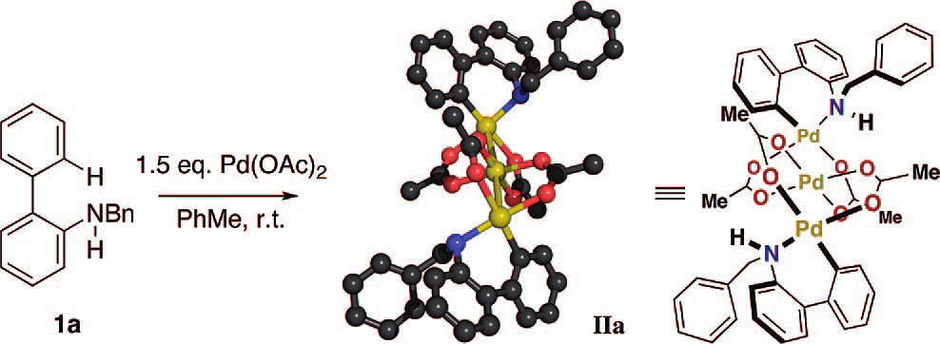
Proposed Mechanism: Pd(II)/Pd(IV)
Experimental observation:
Electron rich substrate react faster: -electrophilic mechanism
-stronger interaction of C-H with the metal
X ray of IIa : trinuclear complex
IIa can be transformed to the carbazole: PhI(OAc)₂, PhMe, rt
No oxidation in DMSO or in presence of coordinating additive (Py) : monomeric paladacycle

Slide 14
Pd(II) C-H Activation to β, γ, δ-lactame
γ, δ-lactame :
1 2
3 4 5 6 7
R¹: OMe(94%)
OBn(95%)
R: OMe(90%)
Cl (88%)
F(86%)
R¹: Ph (58%)
Et (60%)
iPr (62%)
78%
91%
8 9 10 11
88%
72%
Sp² CH 72%
Sp³ CH 68%
Yu, J.-Q. J.Am.Chem. Soc. 2008, 130, 14058–14059

Slide 15
Pd(II) C-H Activation to β, γ, δ-lactame
β-lactame
1 2 3
68%
One-pot procedure
Reductive elimination of R-Cl from five membered palladacycle
Strained transition state

Slide 16
Proposed Mechanism: Pd(II)/Pd(IV)
1 2 3
Experimental observation/ hypothesis
Using PhI(OAc)₂ give 10% of desired oxindole
CuCl₂ source of Cl^{+ :} 1ē or 2ē ?
PdCl₂ ligand exchange with AgOAc
Sequential chlorination –amination excluded:
4 5 6
40%
Not observed

Slide 17
C-H activation via nitrene insertion
1 2
Sp3 C-H amination
Probe to nitrene intermediacy:
Proposed mechanism: cyclopalladation then nitrene insertion into Pd-C bond or Pd(II) nitrene. Pd(II)/Pd(IV) is not excluded
3 4 5
88%
89%
93%
Oxidation to form nitrene
Curtius Rearrangement to isocyanate
Pd-catalyzed o-methoxylation
6 7 8
Chi-Ming Che J.Am. Chem. Soc, 2006, 128, 9048-9049

Slide 18
Examples: Type of oxidant
External Oxidant:
bystanding oxidant: definition
F⁺ :baystanding oxidant
Example1: Indoline synthesis via Pd(II)/Pd(IV)
Internal Oxidant:
Example1: N-Nosyl carbamate
Example2: Oxime esters

Slide 19
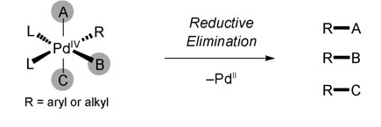
External Oxidant Pd(II)/Pd(IV)
Octahedral Pd IV: lack of selectivity
Bystanding oxidant : “A reagent that participates in electron transfer to increase the oxidation state of a transition metal species but is not incorporated into the final product during subsequent reductive elimination”
Why F⁺ bystanding oxidant?
Yu J.-Q. Angew. Chem. Int. Ed. 2011, 50, 1478 – 1491

Slide 20
F+: Bystanding Oxidants in Pd(II)/Pd(IV) Catalysis
Cl₂, CuCl₂, NCS, NBS, NIS, IOAc, and PhICl₂ source of X ⁺ : halogenating agent C-H activation reactions
F⁺ more problematic:
F⁺ reagent : strong sigma donor ligand hamper the C-H activation
Highly electronegative, low polarizability : attenuate the reductive elimination

Slide 21
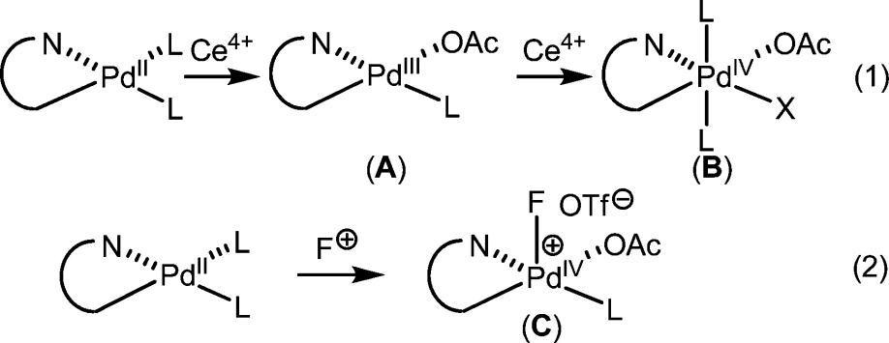
C-H amination using F⁺ and Ce⁴⁺as oxidant: Indoline synthesis
Oxidant:
1 2
3 4
Using classical oxidation agent (CuCl₂, NCS, NBS, NIS, IOAc) give halogenation/ acetoxylation side product
22 examples, yield 53-91% when F⁺ (two electron oxidant ) is used: large number of functionalities are tolerated (Br,Cl, F, CN, NO₂…), quinoline low yield
9 examples, yield 40-80% when Ce(SO₄)₂
Yu J., Q. J. Am. Chem. Soc., 2009, 131, 10806–10807

Slide 22
External-oxidant free oxidative amination:
1 2 3
Internal oxidant
4 5 6
R¹: t-Bu (84%)
Me (52%)
Ph (57%)
R²: Troc (87%)
Bn (70%)
R: OMe (45%)
F (66%)
Br(68%)
7 8 9 10
85%
72%
68%
72%
Yu, J. M., J. Am. Chem. Soc., 2010, 132, 12862–12864

Slide 23
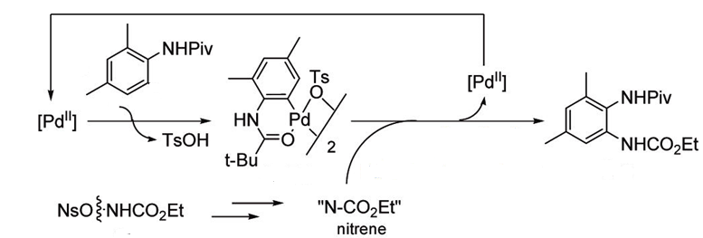
Proposed mechanism: Pd(II)/Pd(IV) or nitrene:
a
a-Pd
ab
Nitrene insertion or
Pd(III)/Pd(IV) intermediate
b
Experimental observation:
Isotope effect (k_{H}/k_{D}) =3.7
Stoichiometric amidation of cyclopaladated intermediate afford 45% of ab
Anilide stabilized reactive intermediary species
Treating a-Pd, a with b in presence of K₂CO₃(generate nitrene) give 74% desired compound

Slide 24
External-oxidant free oxidative amination: Indole synthesis
1 2
Internal oxidant
3 4 5
R¹: Me (65%)
F (61%)
Cl (63%)
Br(60%)
OMe(40%)
R¹: Me (65%)
Et (51%)
n=1(41%)
n=2 (51%)
Hartwig J., F. J. Am. Chem. Soc., 2010, 132, 3676–3677

Slide 25
Proposed mechanism Pd(0)/Pd(II)
C-N bond reductive elimination
N-O bond oxidative addition
b
a
IV
I
Tautomerization
C-H activation
II
Experimental observation:
Complex V was isolated (X-Ray structure)
Complex (1%) catalyzed the reaction with a in 58%
By heating V indole b is obtained in 31%
V

Slide 26
Type of C-H bond
C(sp³)-H
Allylic
Aromatic
Note : Pd(II) catlyzed addition of nitrogen nucleophiles to the alkene is not included in this talk

Slide 27
Sp3-CH Amination : from aniline to indoline
1 2
C(sp³)-H vs C(sp²)-H
C(sp³)-H vs benzylic C-H
3 4 5 6 7
48:52
39 :0%
R²: H(73%)
Me(80%)
Et (59%)
iPr(24%)
Large variety of groups is tolerated: Cl, OMe, CHO, ketone…
Glorius, F. Angew. Chem. Int. Ed., 2009, 48, 6892 –6895

Slide 28
Allylic intramolecular C-H amination: syn-1,3 and 1,2-Aminoalcohols
1 2
R: iPr (76%,7/1*)
tBu (8%, 18/1)
nPr (59%, 1.6/1)
3
*dr (anti:syn)
4 5
6 7 8 9
76%, 3.4/1
67%, 4.5/1
76%, 3.4/1
R: iPr (80%, 6/1)
tBu (84%, 6.3/1)
Et (87%, 4.3/1)
White,C. J.Am.Chem.Soc., 2007, 129, 7274-7276; White,C. J.Am.Chem.Soc., 2009, 131, 11707-11711
Stoichiometric allylic amination: Hegedus,L.S. J. Am. Chem. SOC. 1981, 103, 3037 ; Trost, B.M. Tetrahedron, 1977, 33, 2615

Slide 29
Possible mechanism:
Allylic C-H amination / isomerization of double bond followed by aminopalladation
Alkene 4 give very poor yield (9% for Z, 20% for E)
Proposed mechanism:
1 2 3
4
Catalyst and endogenous base regeneration
Electrophilic
C-H cleavage
I
a
IV
Nucleophilic functionalization
II
Acid/Base exchange
b
III

Slide 30
Allylic intermolecular C-H amination
Heterobimetallic catalysis :
Lewis Acid catalysis Cr bind to BQ –π-Allyl complex increasing his electrophilicity
Bronsted base activation :
Exogenous base will increase the concentration of deprotonated nucleophile nitrogen
1 2 3
4 5
pKa~3.5
White, C. J.Am.Chem.Soc., 2008, 130, 3316-3318
White, C. J.Am. Chem. Soc., 2009, 131, 11701–11706

Slide 31
Aromatic intramolecular amination with amine
1 2 3
4 5 6 7
R: OMe (79%)
Br (56%)
Cl (60%)
Me(82%)
73%
80%
75%
8 9
97%
78%
No external oxidant is required
Reaction work as well with amine in presence of benzoyl peroxide
CsF as base, cycloppaladation, Pd(II)/Pd(IV) or electrophilic amination
Pd(dba)₂ catalyzed as the reaction: N-O bond oxidative addition
Jin-Quan Yu, JACS, 2011

Slide 32
Thank you for your attention!

