Slide 1
Isocyanoacetate Reactivity :
Stereocontroled Formation of Oxazoline
03 july 2012

Slide 2
Introduction
Structure and reactivity

Slide 3
Introduction
Structure and reactivity

Slide 4
Base catalyzed
Schöllkopf: Reaction through action of base
Tet. Lett 1968, 59, 6231
ACIE 1970, 9, 300

Slide 5
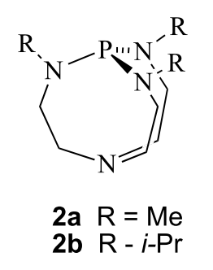
Organocatalyzed
Verkade: use of non ionic base
Tet. Lett. 2001, 42, 6263
In 2009 Gong described the first organocatalyzed oxazoline formation
Synlett 2009, 2191

Slide 6
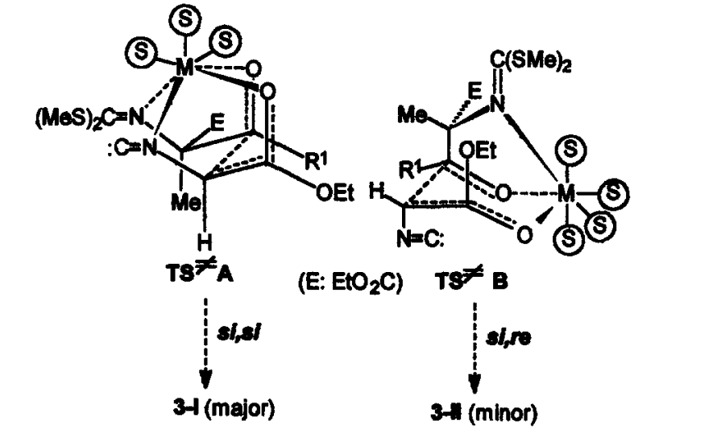
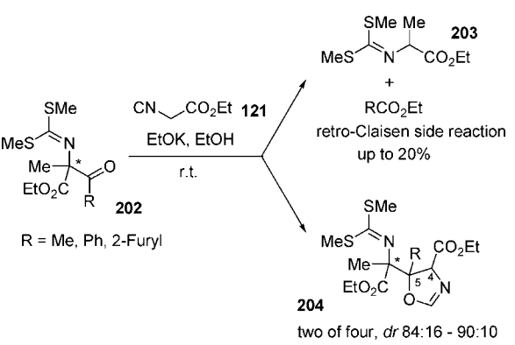
From chiral substrate
Diastereoselective reaction from non-enolizable chiral ketone
Diastereoselectivity increase with the coordinative ability of conter anion (K⁺>Na⁺>>Li⁺ 84/16, 80/20, 66/34)
Diastereoselectivity decrease with the solvent size (MeOH < EtOH < tBuOH 84/16, 84/16, 59/41)
Alvarez-Ibarra Tetrahedron 1999, 55, 3041

Slide 7
Main aspect
Thermodynamic control = Trans oxazoline as major product
Highly selective to the trans with aldehyde
Linear ketone needs heating to achieve good yields
Problem of reactivity with enolizable ketone (deprotonation)
Non enolyzable 1-3 diketone suffers of retro-Claisen

Slide 8
First report
Saegusa and Ito: use of catalytic Cu₂O
JOC 1971, 36, 3316
Kirschner: Highly efficient diastereoselective formation of oxazoline
Tet Lett 2006, 47, 8641

Slide 9
Mecanism
Mecanism
Metal coordination increase acidity of α-proton

Slide 10
Enantioselective
Ito and Hayashi: Use of ferrocenylphosphine Gold(I) complex
JACS 1986, 108, 6405
Central and planar chirality : Need to be oposite
(R)-(S) ligand

Slide 11
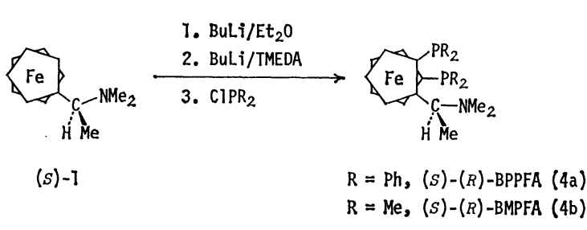
Catalyst synthesis
Kumada, Bull. Chem. Soc. Jpn. 1980, 53, 1138

Slide 12
Silver catalyzed
Silver = huge decrease of selectivity !
Hayashi and Ito, Tet Lett 1991, 32, 2799

Slide 13
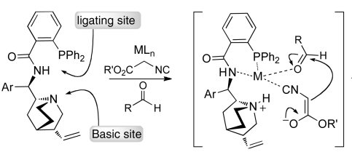
Silver catalyzed
Dixon : Cinchona devived amino phosphine precatalyst
Idea :
Postulated activation mode
JACS 2011, 133, 1710

Slide 14
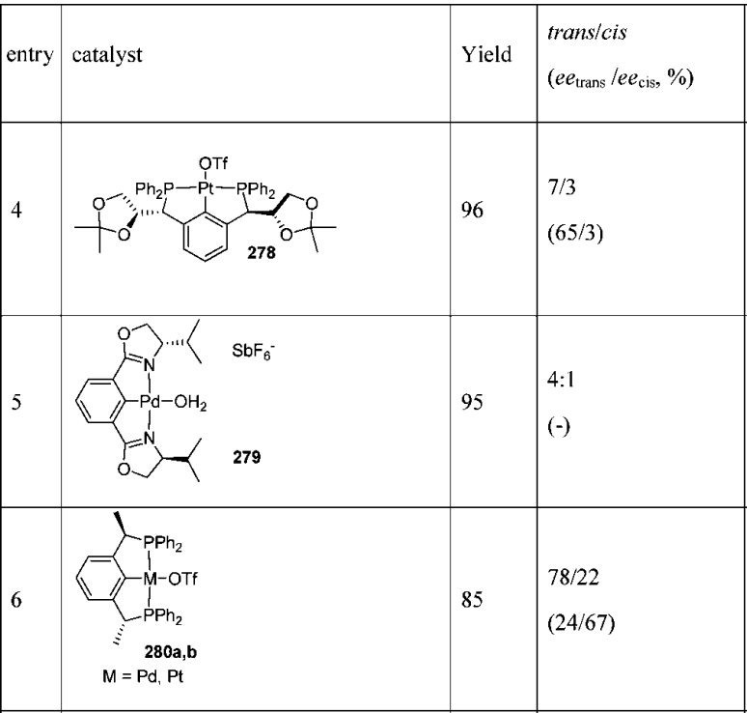
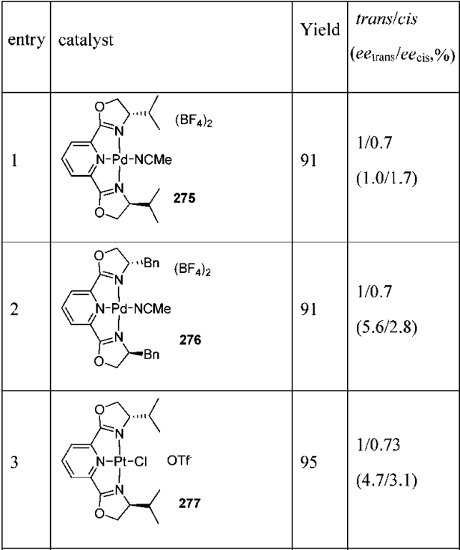
Palladium / Platinium
Pd or Pt pincer complex
First reported in 1993 by Pregosin
Very low ee (< 15%)
Pregosin, Helv. Chim. Acta 1993, 76, 2239

Slide 15
Palladium / Platinium
Pd or Pt pincer complex
Explanation : why the ee is so low
NMR studies shows that isocyanide displace the ligand
Pregosin, J. Organomet. Chem. 1996, 507, 85

Slide 16
Cooperative catalysis
Kyungsoo Oh described a cooperative catalysis approch in 2011
JOC 2011, 13, 1306

Slide 17
Others Metals
This reaction works with many transitions metal as Zn, Ru, Rh, Ni
Use of oxazoline :
Ligand
Hydrolysis to serine derivatives

Slide 18
Conclusion
Metal catalyzed
First with Cu₂O
Nowdays, many transition metal (Au, Ag, Cu, Pd, Pt, Zn, Ni, Rh, Ru, Co)
Kinetic control
Enantiomeric applications with Au and Ag
Base catalyzed
First with BuLi or NaCN
Nowdays, non ionic base
Thermodynamic control (trans selectivity)
Enantiomeric application cinchona

