Slide 1
A Special Tribute To a Very Special Person

Slide 2
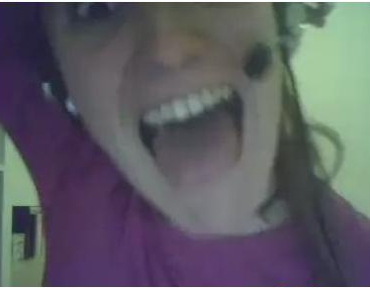

Slide 3
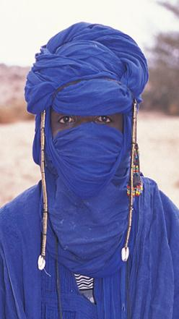
Cristina’s through the years…
1995
2012
2031 ?

Slide 4
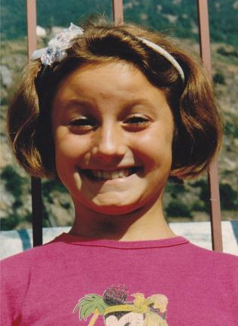
Cristina’s yearbook…
Cristina Boero
TORINO
11

Slide 5
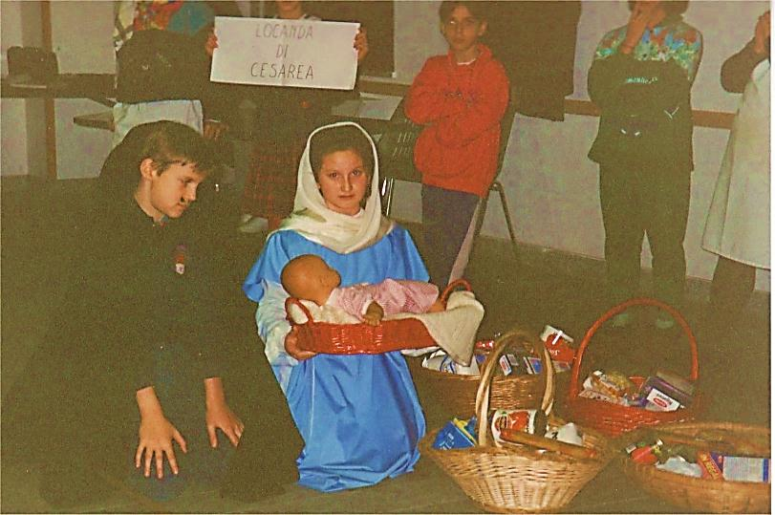
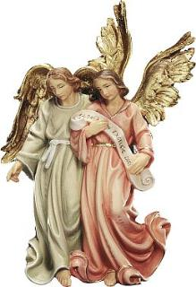
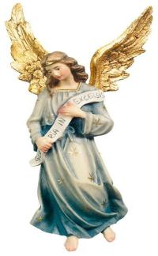
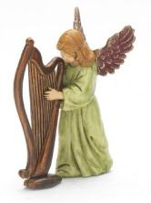
Prayerful

Slide 6
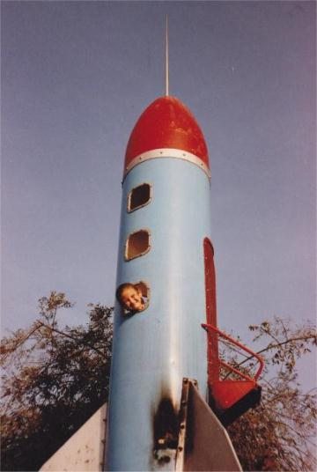
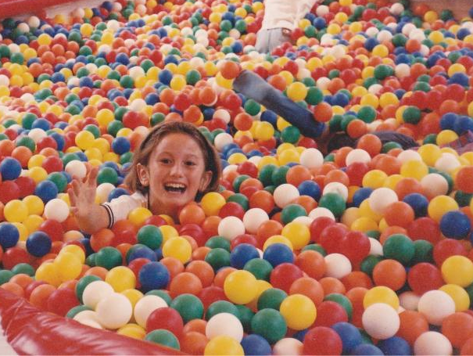
Active
& Curious

Slide 7
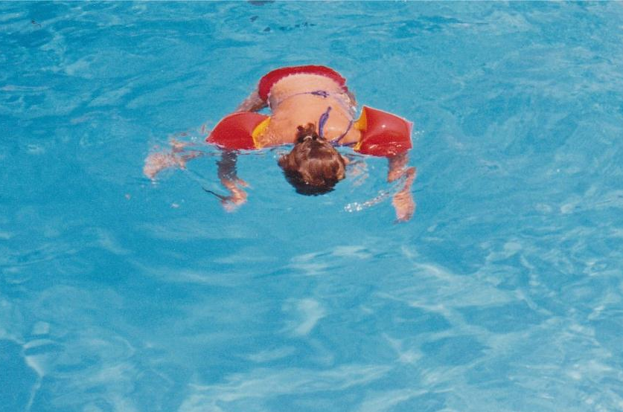
Athletic
Enjoy the Silence!!!

Slide 8
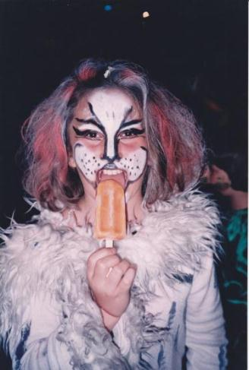
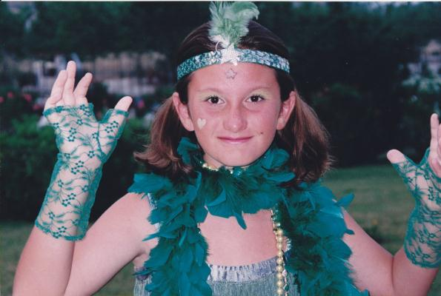
Eccentric

Slide 9
… And then the Ph.D came…

Slide 10
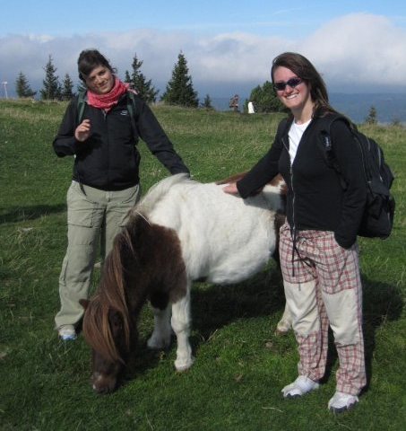
… With a little bit of biology…

Slide 11
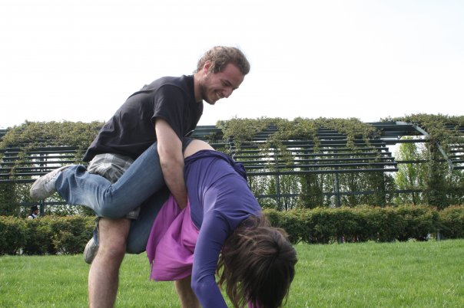
… A little bit of physics…

Slide 12
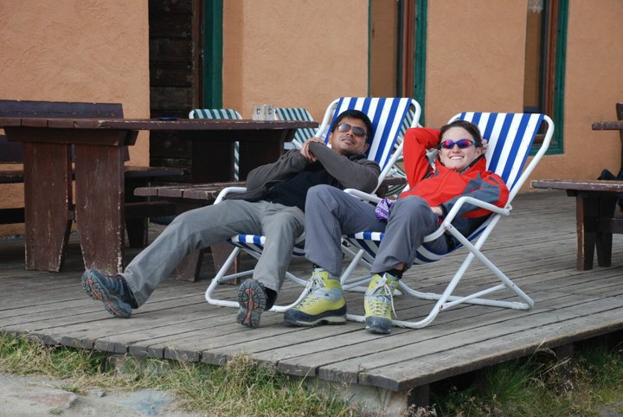
… A little bit of interaction with peers…

Slide 13
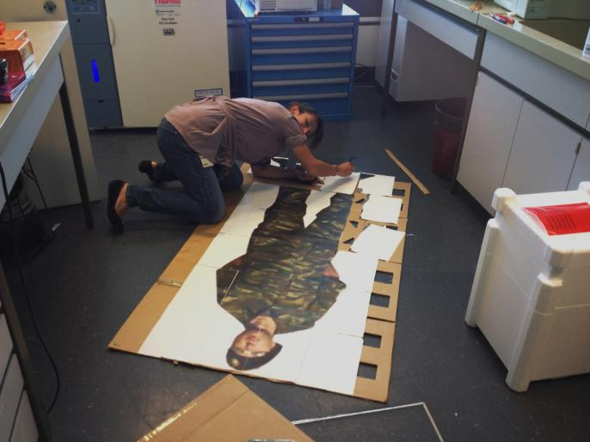
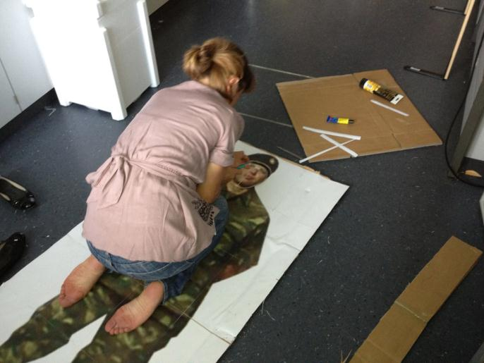
… And a lot of hard work in the lab…

Slide 14
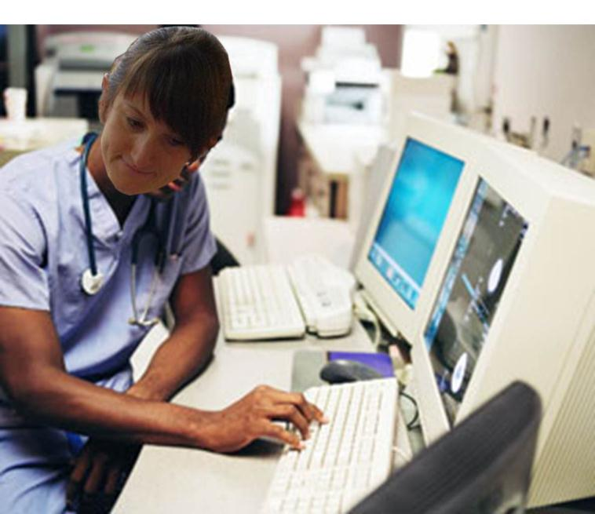
Notes:
Scusate, ma non siamo riusciti a trovare una foto di lei che lavora sul serio, e quindi siamo dovuti ricorrere ad un fotomontaggio…

Slide 15
The nightmare of her colleagues
Time estimated to display everything: 2 months

Slide 16
So… What’s next?

Slide 17
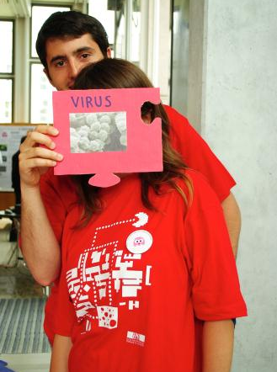
… She is no longer considered as a constructive member of her team…
… So new careers are needed!
Notes:
Dire che nei canoni classici la sua voce non trova collocazione

Slide 18
Singer?
Cristina
Soprano
Mezzo-soprano
Contralto
Tenor
Baritone
Bass
Notes:
Dire che nei canoni classici la sua voce non trova collocazione

Slide 19
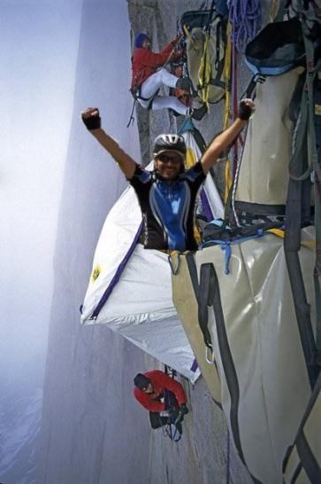
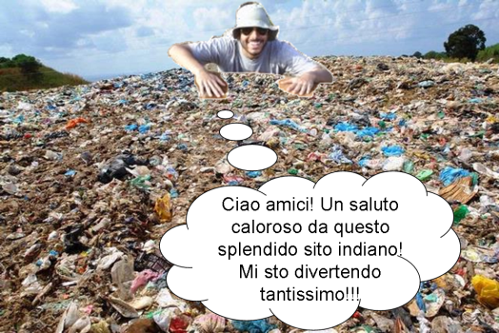
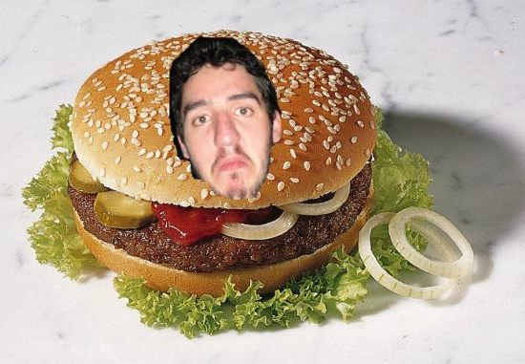
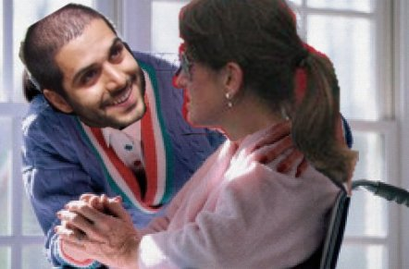
Cartoonist?
Notes:
Dire che nei canoni classici la sua voce non trova collocazione

Slide 20
(De)motivational Speaker?
Andrea, there will probably be a day in which you say something meaningful, but I'm not sure about it (6/8/2009)
Ivan, your sweater looks like it has been taken out of a trash bin (23/9/2012)
Jack, nanotubes are not a problem, but your lazyness is one (4/1/2010)
Guys: f**k!
(everyday)
Notes:
Dire che nei canoni classici la sua voce non trova collocazione

Slide 21
… Maybe teaching?

Slide 22
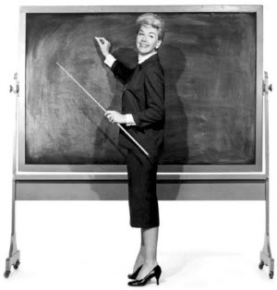
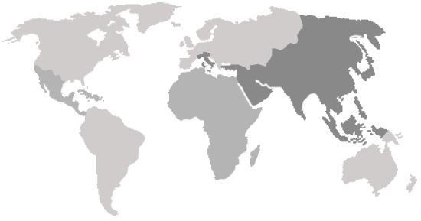
Geography 101

Slide 23
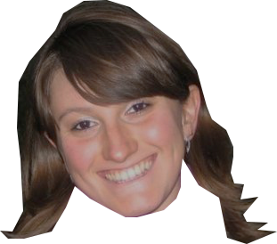
This map is wrong.
There are some parts I have never heard of
Notes:
This map

Slide 24
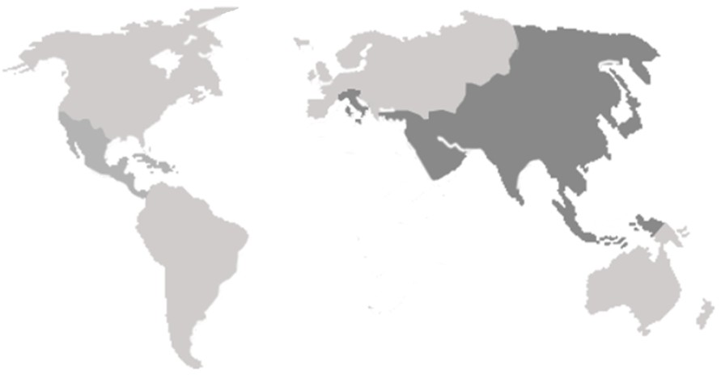
Now it’s ok!!!
Notes:
This map

Slide 25
The fantastic world of Cri
Are you ready?

Slide 26
TORINO
Torino

Slide 27
TORINO
Cuba
CUBA

Slide 28
TORINO
CHEZ
XU
CUBA
Chez Xu

Slide 29
TORINO
CHEZ
XU
CALCUTTA
CUBA
Calcutta

Slide 30
SPEAKER’S
CORNER
TORINO
CHEZ
XU
CALCUTTA
Speaker’s
Corner
CUBA

Slide 31
SPEAKER’S
CORNER
TORINO
CHEZ
XU
CALCUTTA
CALCUTTA
CUBA
Calcutta

Slide 32
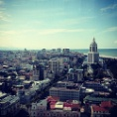
TORINO
SPEAKER’S
CORNER
BATUMI
CHEZ
XU
CALCUTTA
Batumi
CALCUTTA
CUBA

Slide 33
CALCUTTA
TORINO
SPEAKER’S
CORNER
BATUMI
CHEZ
XU
CALCUTTA
CALCUTTA
CUBA
Calcutta

Slide 34
CALCUTTA
TORINO
SPEAKER’S
CORNER
BATUMI
CHEZ
XU
AFRICA
CALCUTTA
CALCUTTA
CUBA
Africa

Slide 35
CALCUTTA
TORINO
SPEAKER’S
CORNER
BATUMI
CHEZ
XU
AFRICA
CALCUTTA
CALCUTTA
CALCUTTA
CUBA
Calcutta

Slide 36
CALCUTTA
TORINO
SPEAKER’S
CORNER
BATUMI
CHEZ
XU
AFRICA
CALCUTTA
CALCUTTA
CALCUTTA
CUBA
Surfers
SURFERS

Slide 37
CALCUTTA
CALCUTTA
TORINO
SPEAKER’S
CORNER
BATUMI
CHEZ
XU
AFRICA
CALCUTTA
CALCUTTA
CALCUTTA
CUBA
Calcutta
SURFERS

Slide 38
CALCUTTA
CALCUTTA
TORINO
SPEAKER’S
CORNER
BATUMI
CHEZ
XU
AFRICA
CALCUTTA
CALCUTTA
CALCUTTA
CUBA
Calcutta
SURFERS
CALCUTTA

Slide 39
CALCUTTA
CALCUTTA
TORINO
SPEAKER’S
CORNER
BATUMI
CHEZ
XU
AFRICA
CALCUTTA
CALCUTTA
CALCUTTA
CUBA
Calcutta
SURFERS
CALCUTTA
CALCUTTA

Slide 40
CALCUTTA
CALCUTTA
CALCUTTA
TORINO
SPEAKER’S
CORNER
BATUMI
CHEZ
XU
AFRICA
CALCUTTA
CALCUTTA
CALCUTTA
CUBA
Calcutta
SURFERS
CALCUTTA
CALCUTTA

Slide 41
CALCUTTA
CALCUTTA
CALCUTTA
CALCUTTA
CALCUTTA
CALCUTTA
TORINO
SPEAKER’S
CORNER
BATUMI
CALCUTTA
CALCUTTA
CHEZ
XU
CALCUTTA
CALCUTTA
CALCUTTA
CALCUTTA
CALCUTTA
CALCUTTA
AFRICA
CALCUTTA
CALCUTTA
CALCUTTA
CALCUTTA
CALCUTTA
CALCUTTA
CUBA
Calcutta
CALCUTTA
CALCUTTA
CALCUTTA
SURFERS
CALCUTTA
CALCUTTA
CALCUTTA
CALCUTTA
CALCUTTA
CALCUTTA

Slide 42
No.
Nothing is better than staying here one more year and keep on saving science!!!

Slide 43
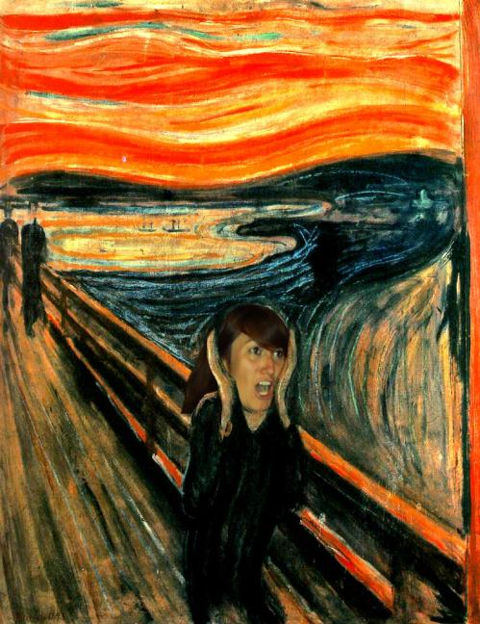
Congratulations, Dr. Boero!

