Slide 1
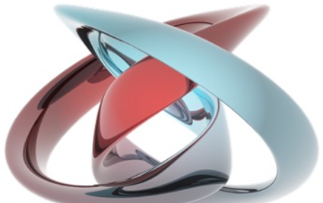
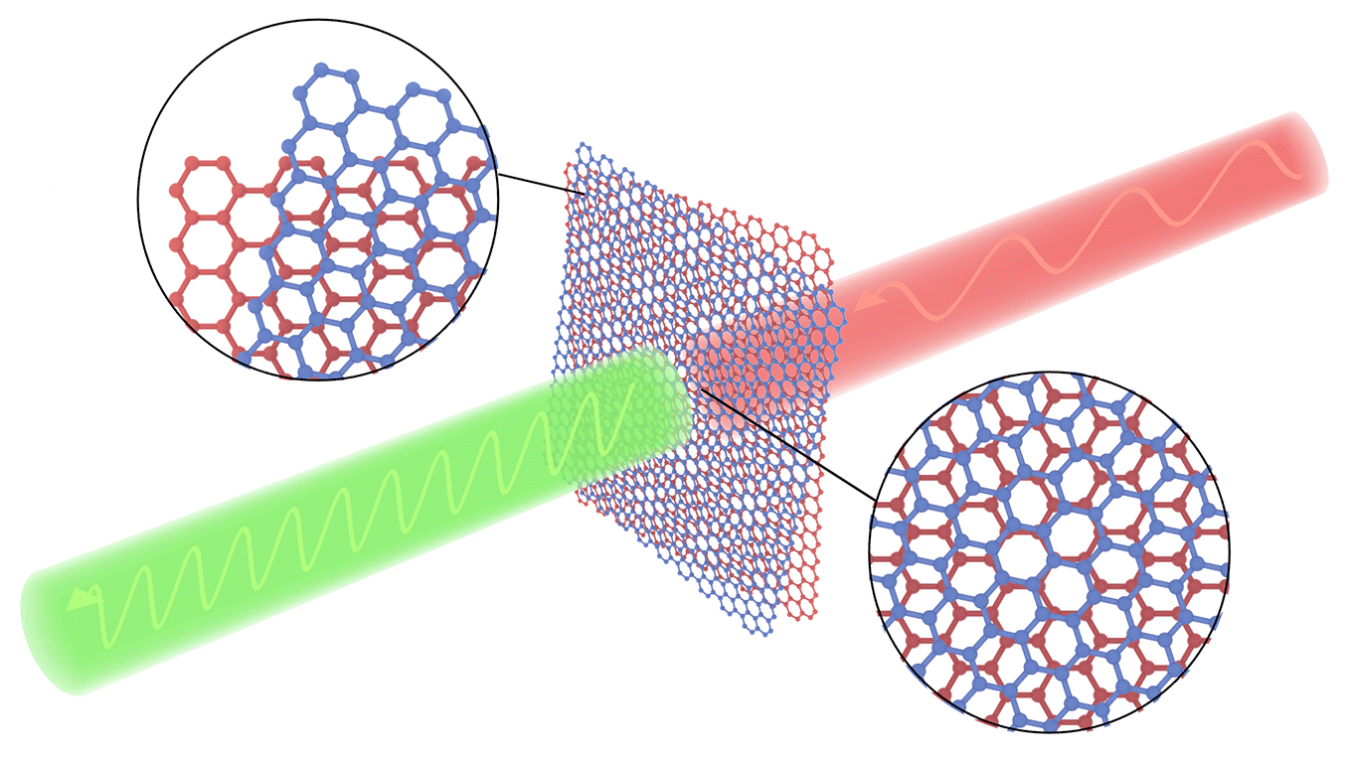
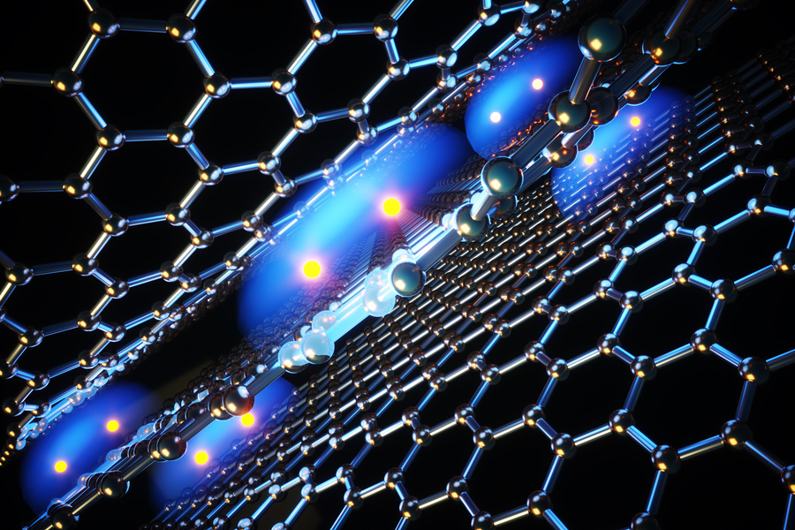
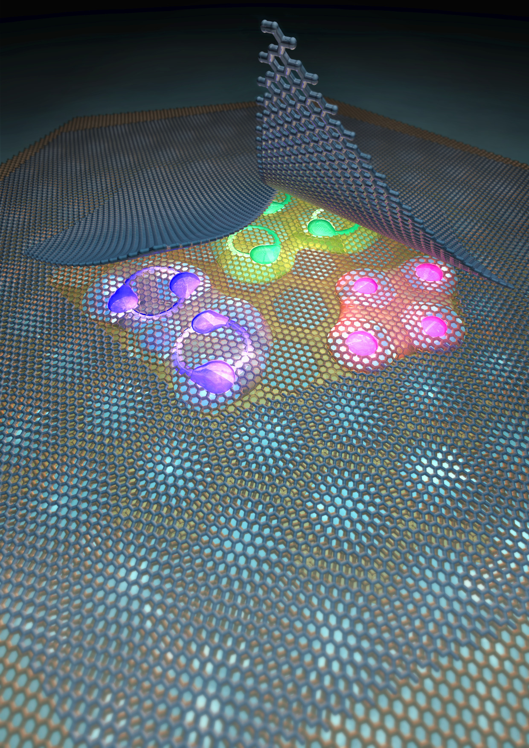
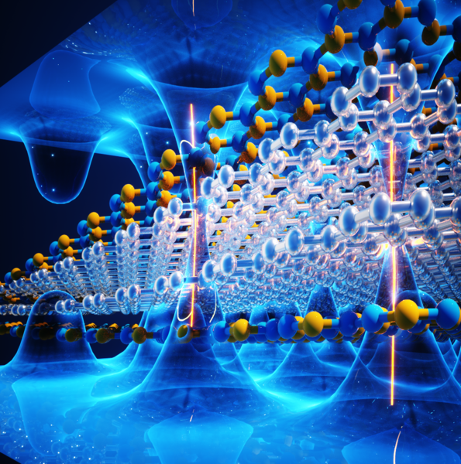
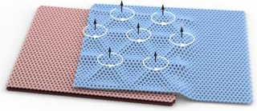
Laboratory of Quantum Physics: Topology and Correlations
Twist in the tale !!!
Matter 3, 1361, (2020)
Mitali Banerjee

Slide 2
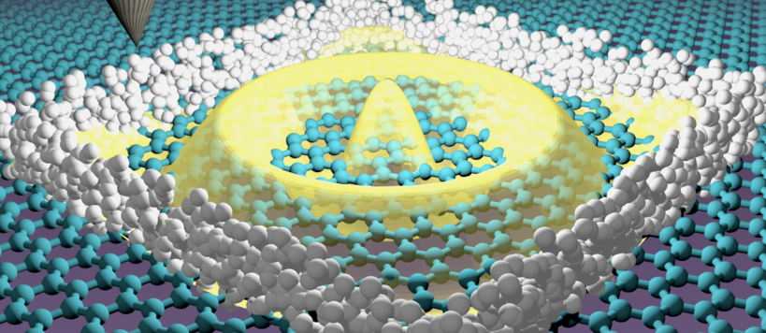
Correlated Quantum materials
Courtesy Jose Lado (Aalto University)

Slide 3
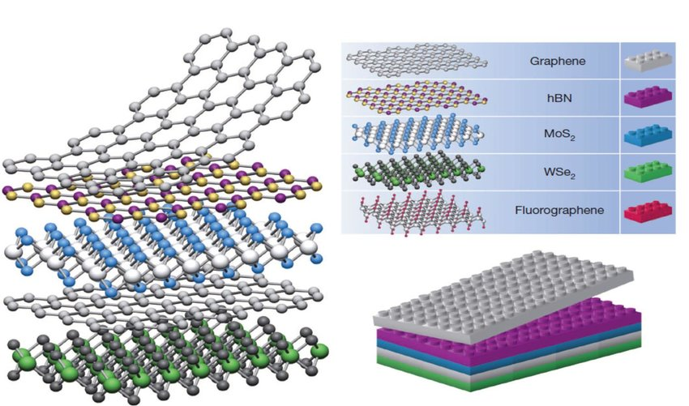
van der Waals materials
Nature 499, 419 (2013)

Slide 4
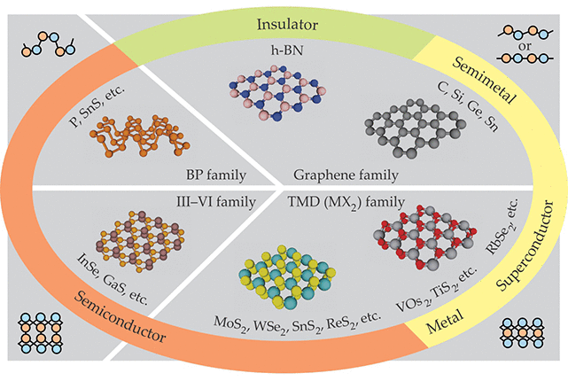
van der Waals materials
Physics Today 69, 38 (2016)

Slide 5
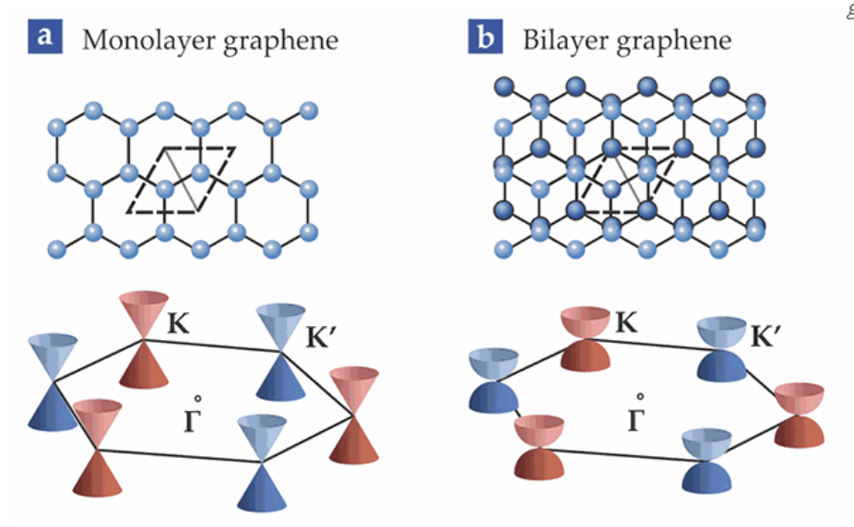
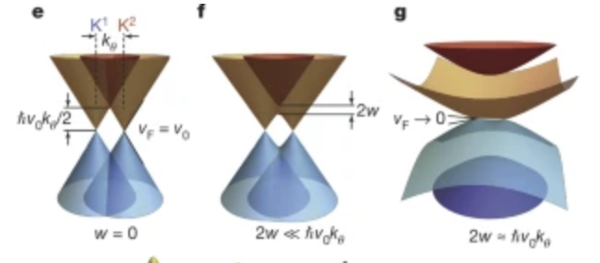
Graphene

Slide 6
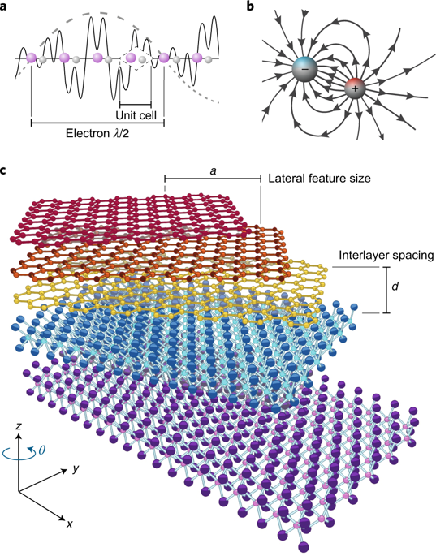
Other materials
Nature Nanotechnology 13, 986(2016)

Slide 7
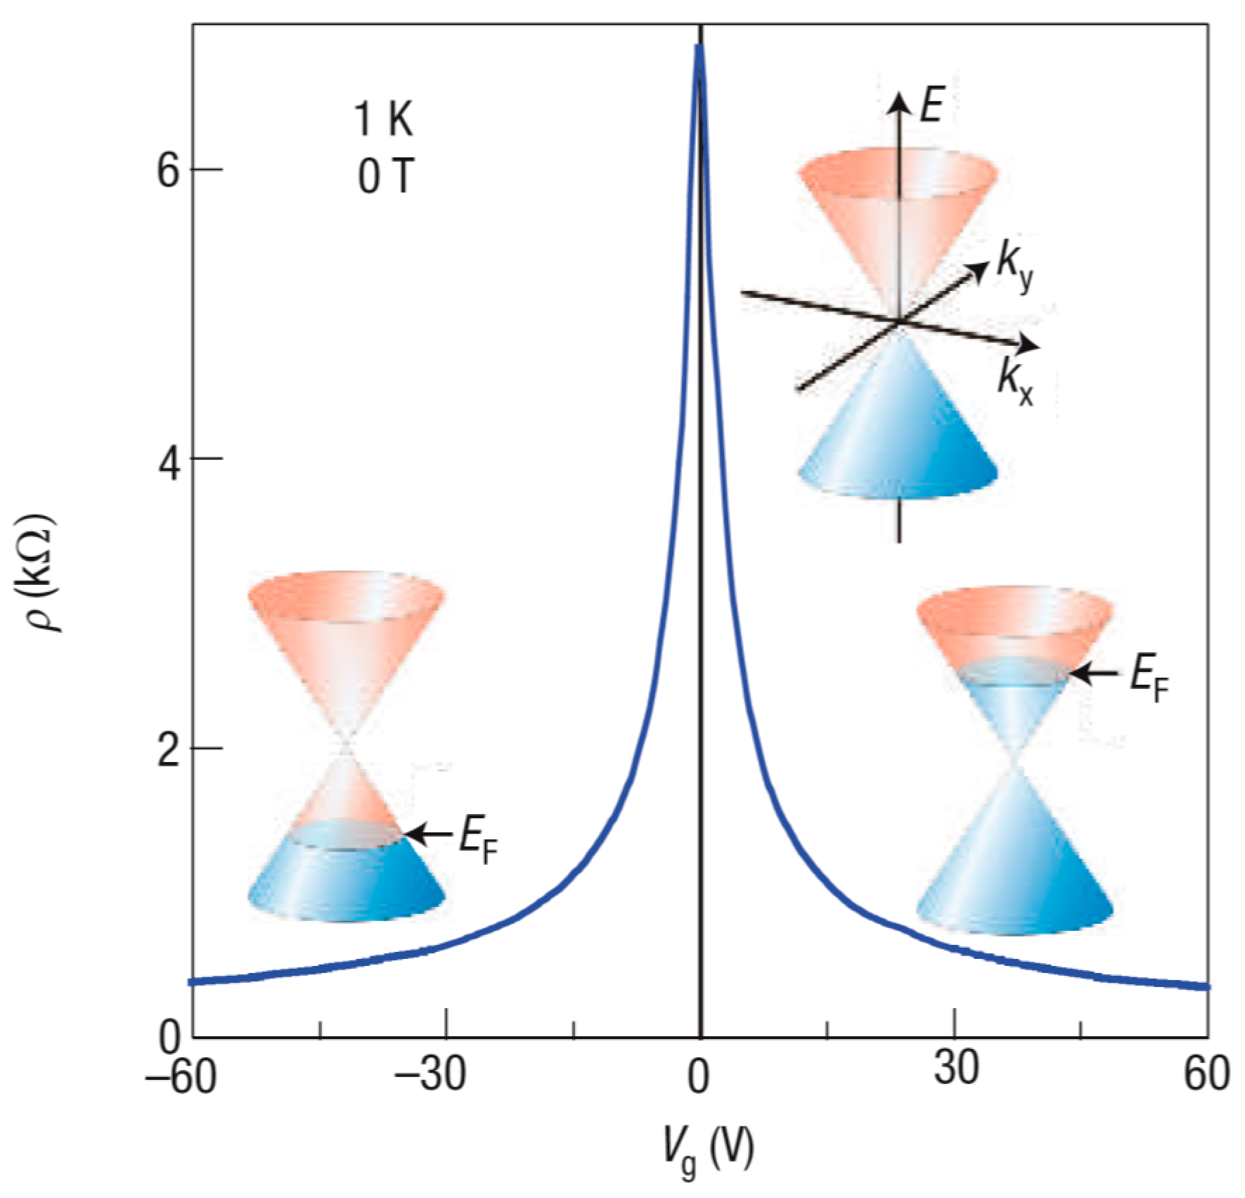
Single Layer graphene

Slide 8
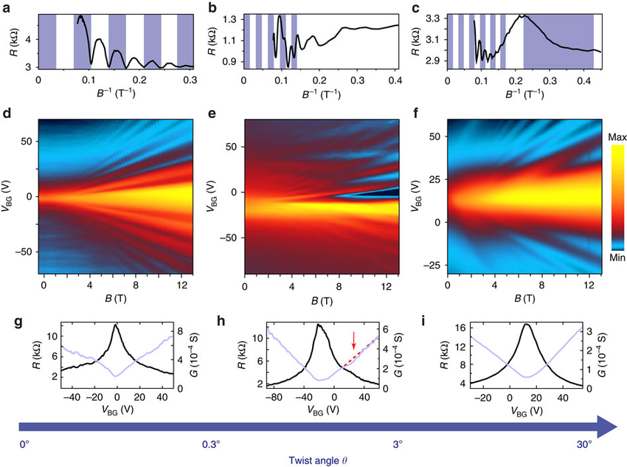
Bi-layer graphene
Nature Communications 5, 5742 (2014)

Slide 9
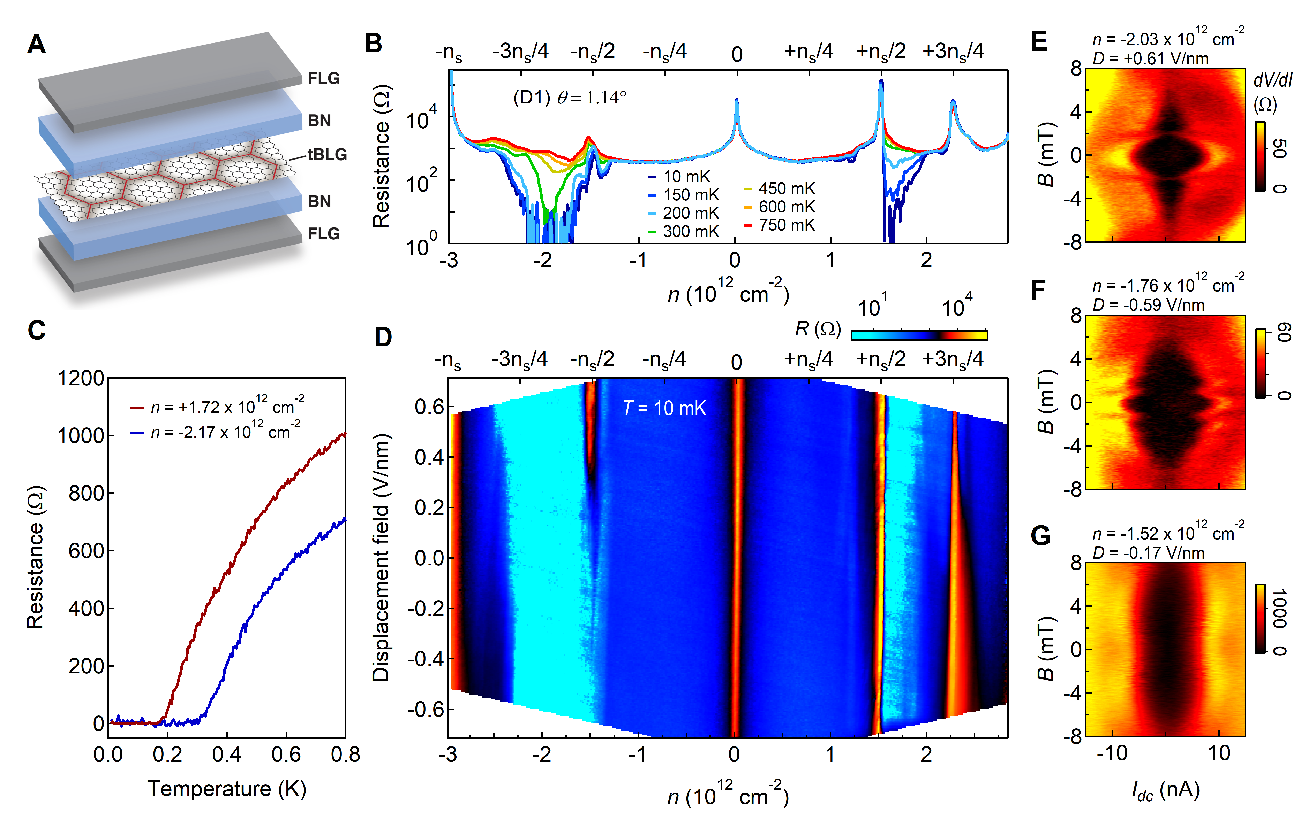
Twisted bi-layer graphene
Science 363, 1059 (2019)

Slide 10
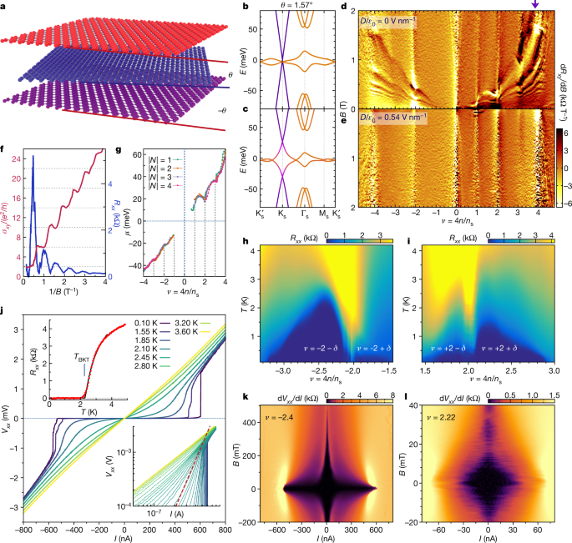
Twisted tri-layer graphene
Nature 590, 249 (2021)

Slide 11
