Slide 1
Emergency procedure
Immediately activate the building fire alarm system or call 115 ou au 021 693 3000
Assist any person in immediate danger to safety.
Close all doors and windows
Use a nearby fire extinguisher to control and extinguish the fire.
Don ’t use elevators
Report: remaining persons in the building and any particular danger.

Slide 2
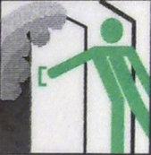
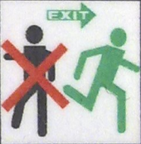
EVACUATION
On evacuation alarm
Close all doors and windows
Follow the emergency exit signs.
Don’t go back
Don’t use elevators
Join the meeting zone

