Slide 1
Lecture 6
Microscopy

Slide 2
Imaging System
z₁
z₂
Illumination
θ
Image
Object
Diffraction limited resolution
Δx = λ/(2 NA) where NA = n sinθ

Slide 3
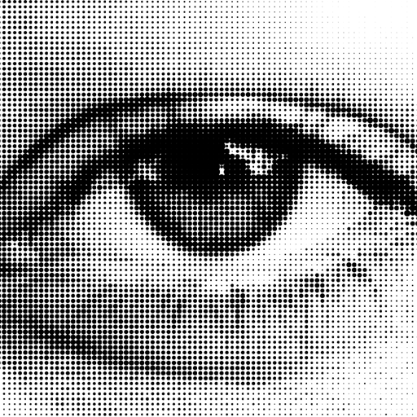
Let’s try to simulate an imaging system with a halftone image input!

Slide 4
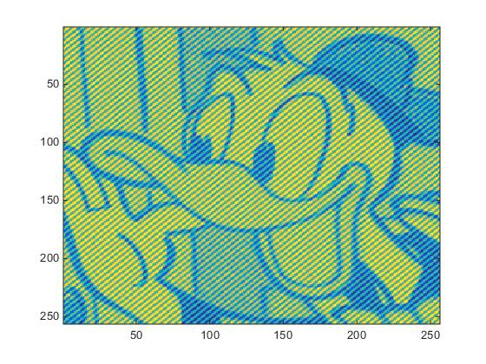
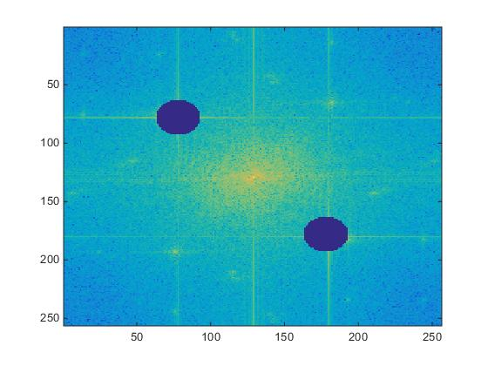
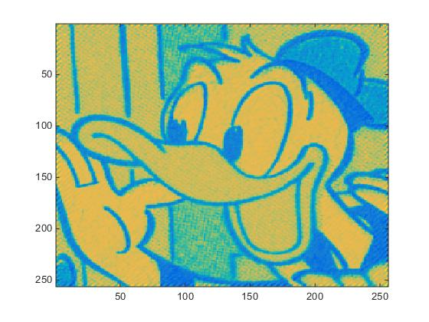
Sampled image
Fourier filter

Slide 5
Today
Microscopy
Phase contrast (bright field, dark field)
Differential Interferometric Contrast (DIC)
Confocal microscopy
Superresolution (STED)
Ptychography

Slide 6
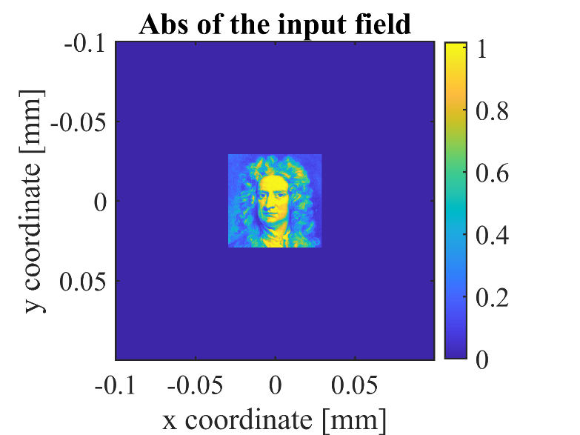
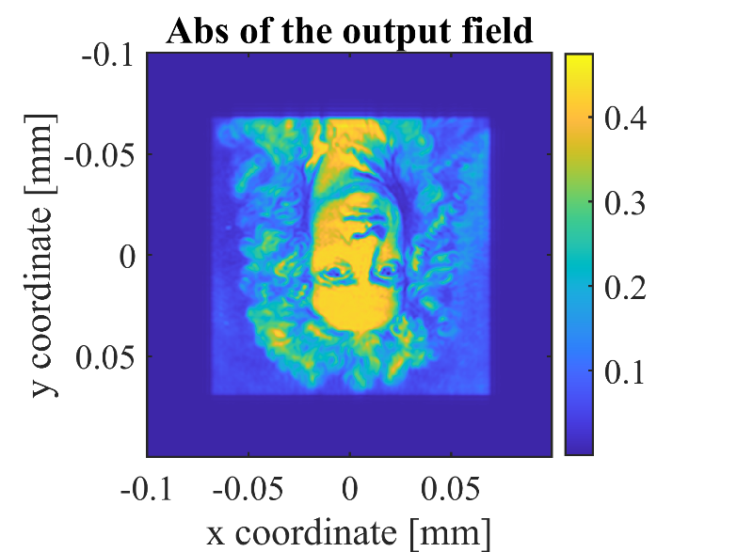
Bright Field Microscope for an amplitude object
F1
F2

Slide 7
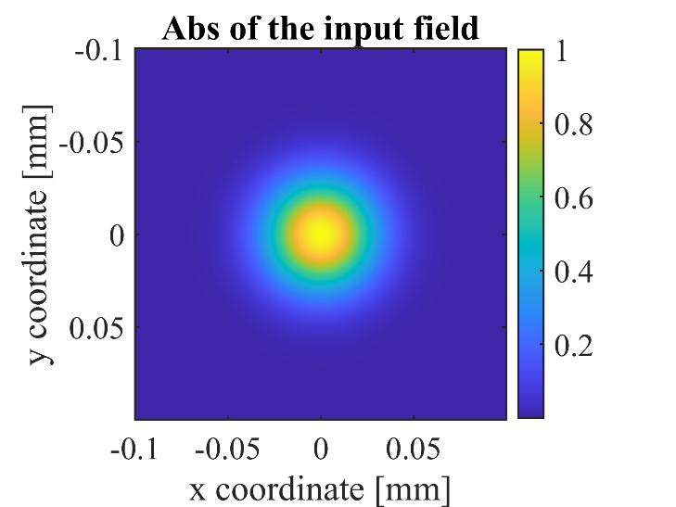
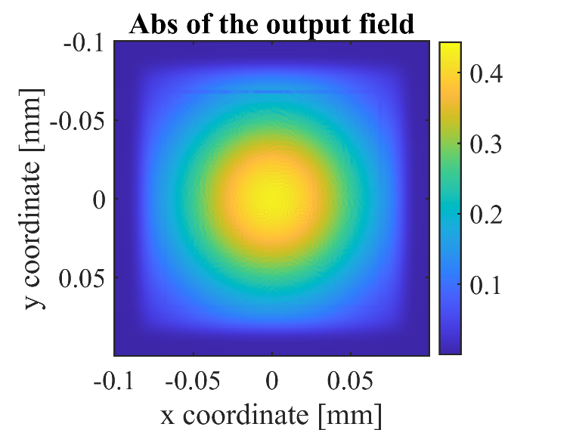

Bright Field Microscope image for a phase object
F1
F2

Slide 8
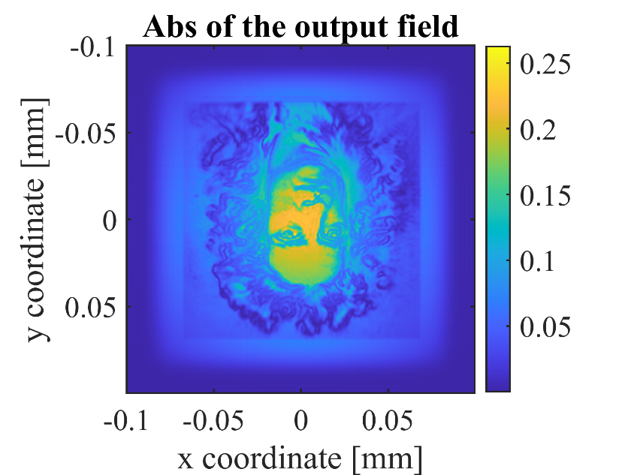
Dark Field Microscope
F1
F2
Circular
Block

Slide 9
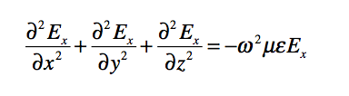

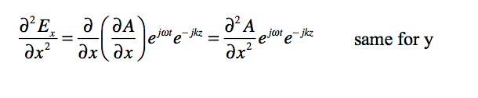
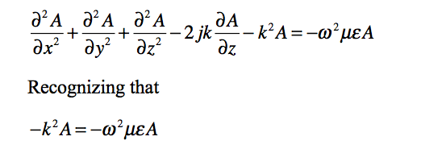

~0

Slide 10
BPM in inhomegeneous media

Slide 11
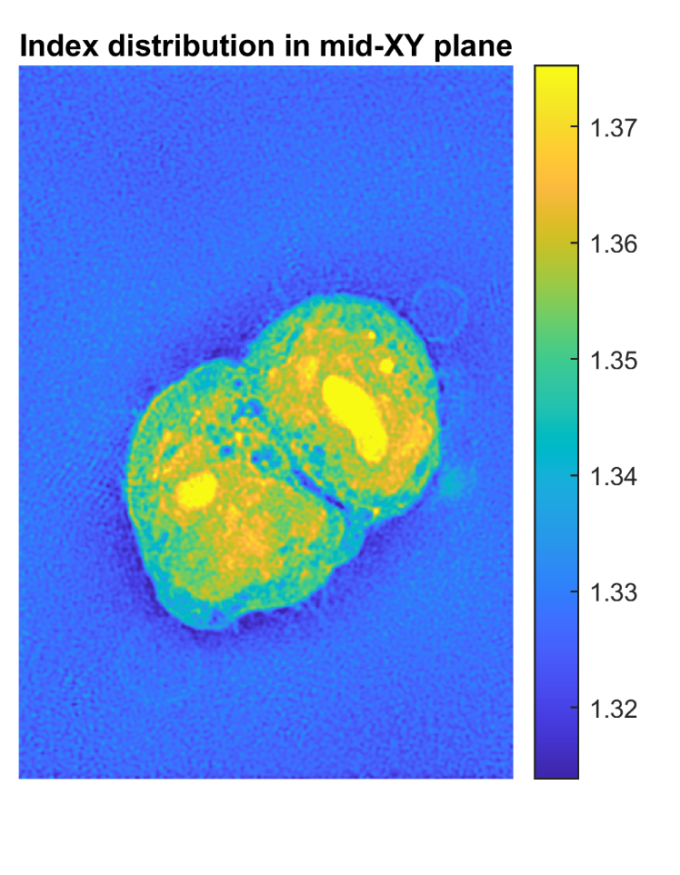
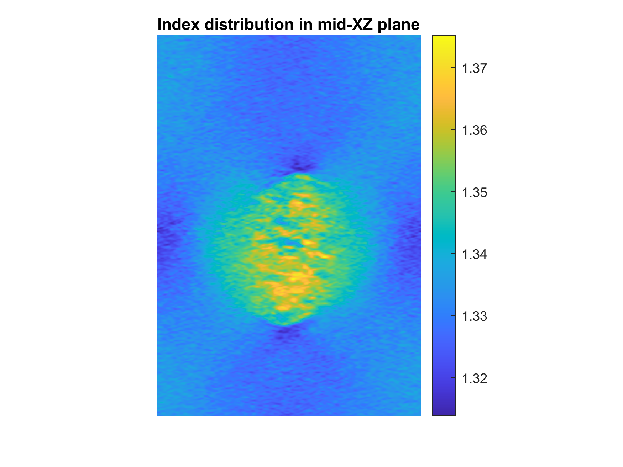
BPM through a cell
5 µm
5 µm
HCT-116 Cancer colon cell

Slide 12
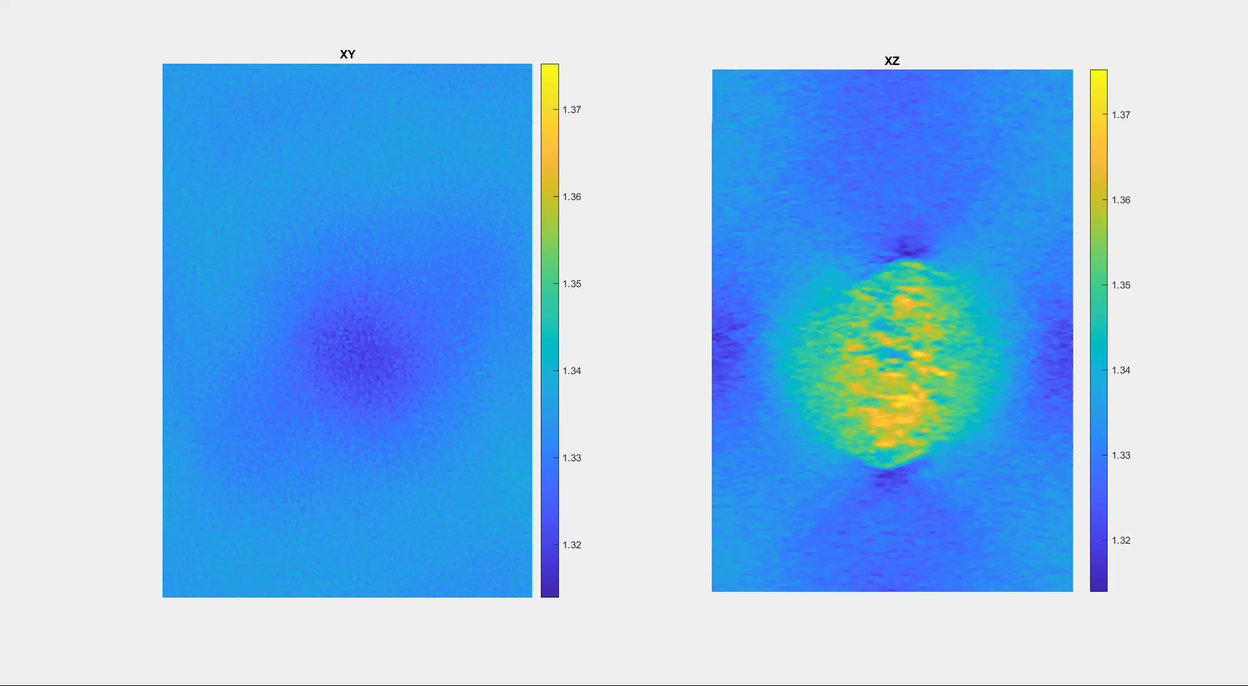
Z-stack of colon cancer cell

Slide 13
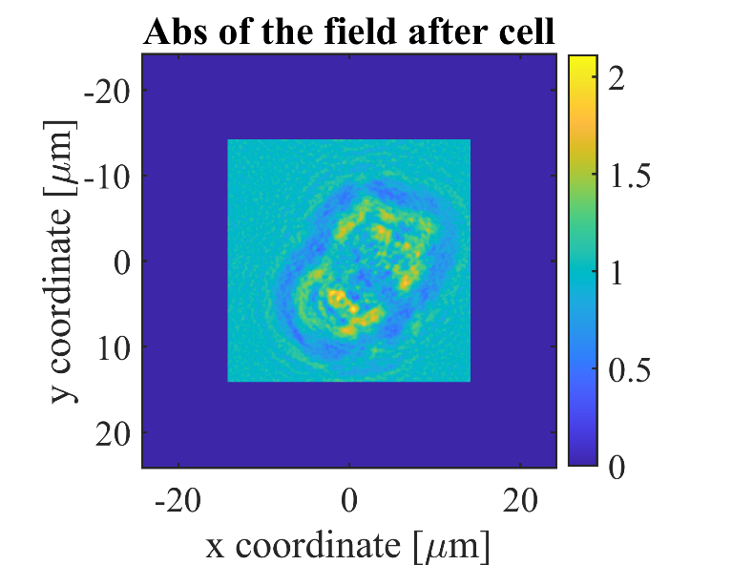
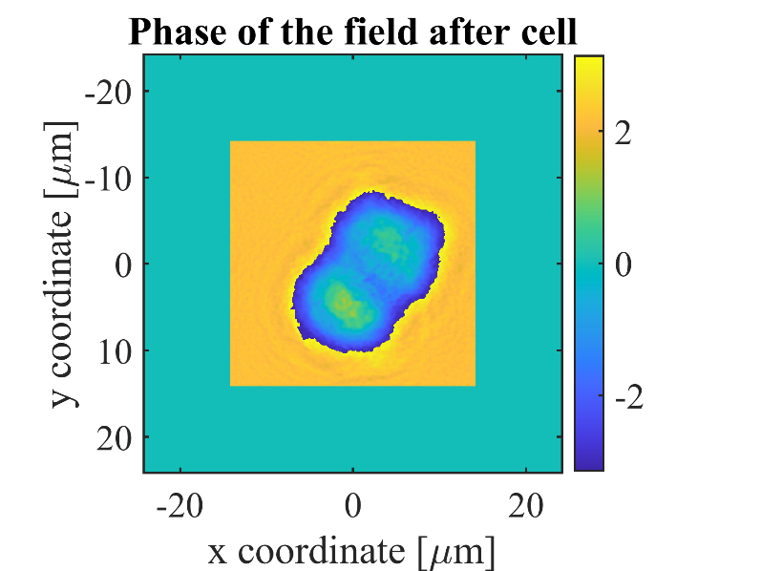
BPM through a cell

Slide 14
Phase Contrast Microscope for a cell
Field after
cell
F
F
F
F
Circular
Phase Plate exp(jπ/2)
Back
propagate
Goes
to BPM
We want to focus to this plane

Slide 15
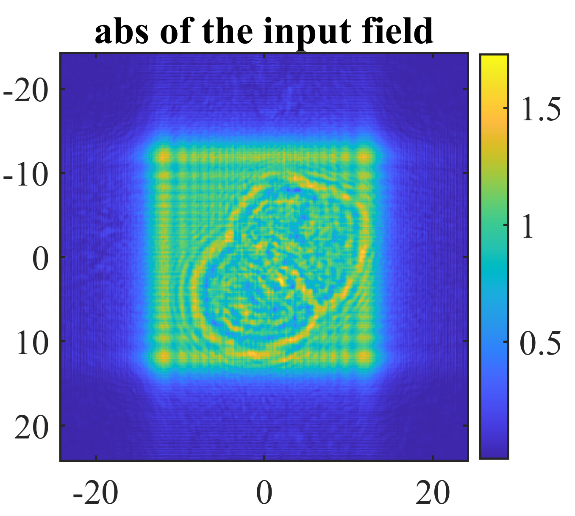
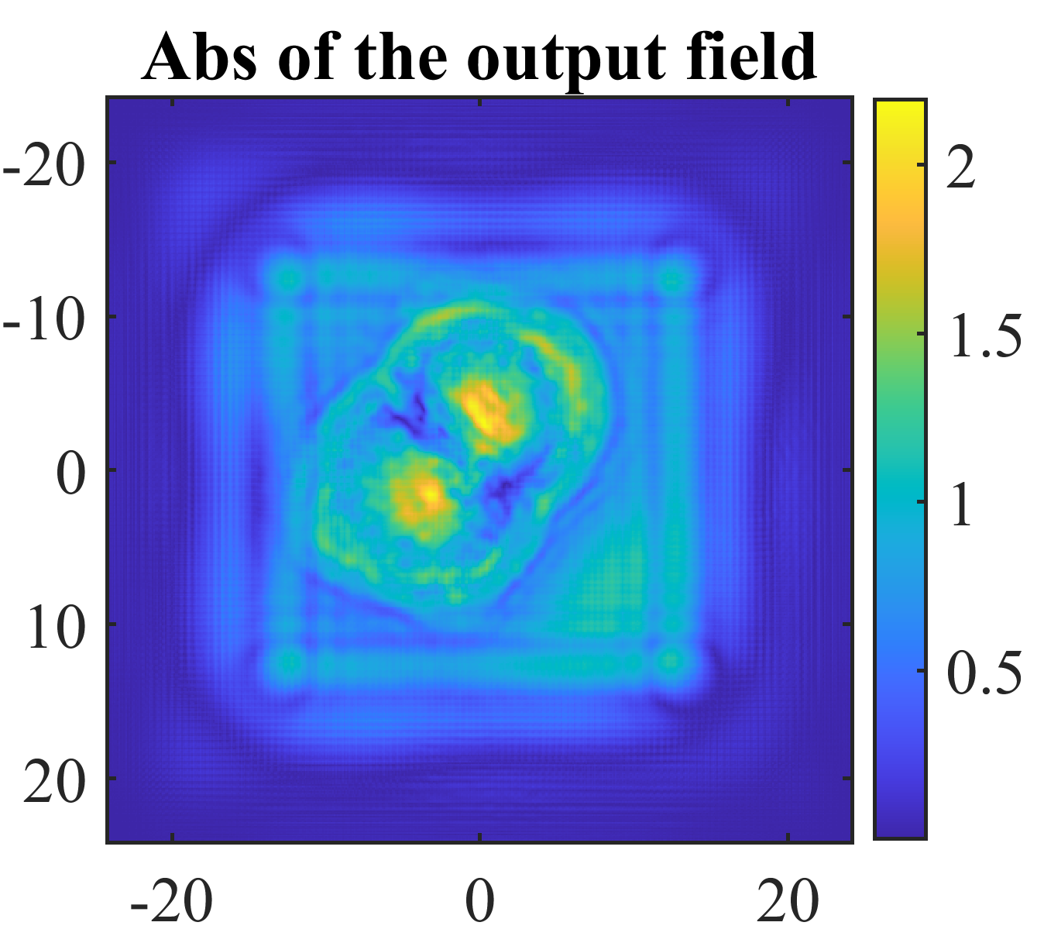
Phase Contrast Microscope for a cell
F
F
F
F
Back
propagate

Slide 16
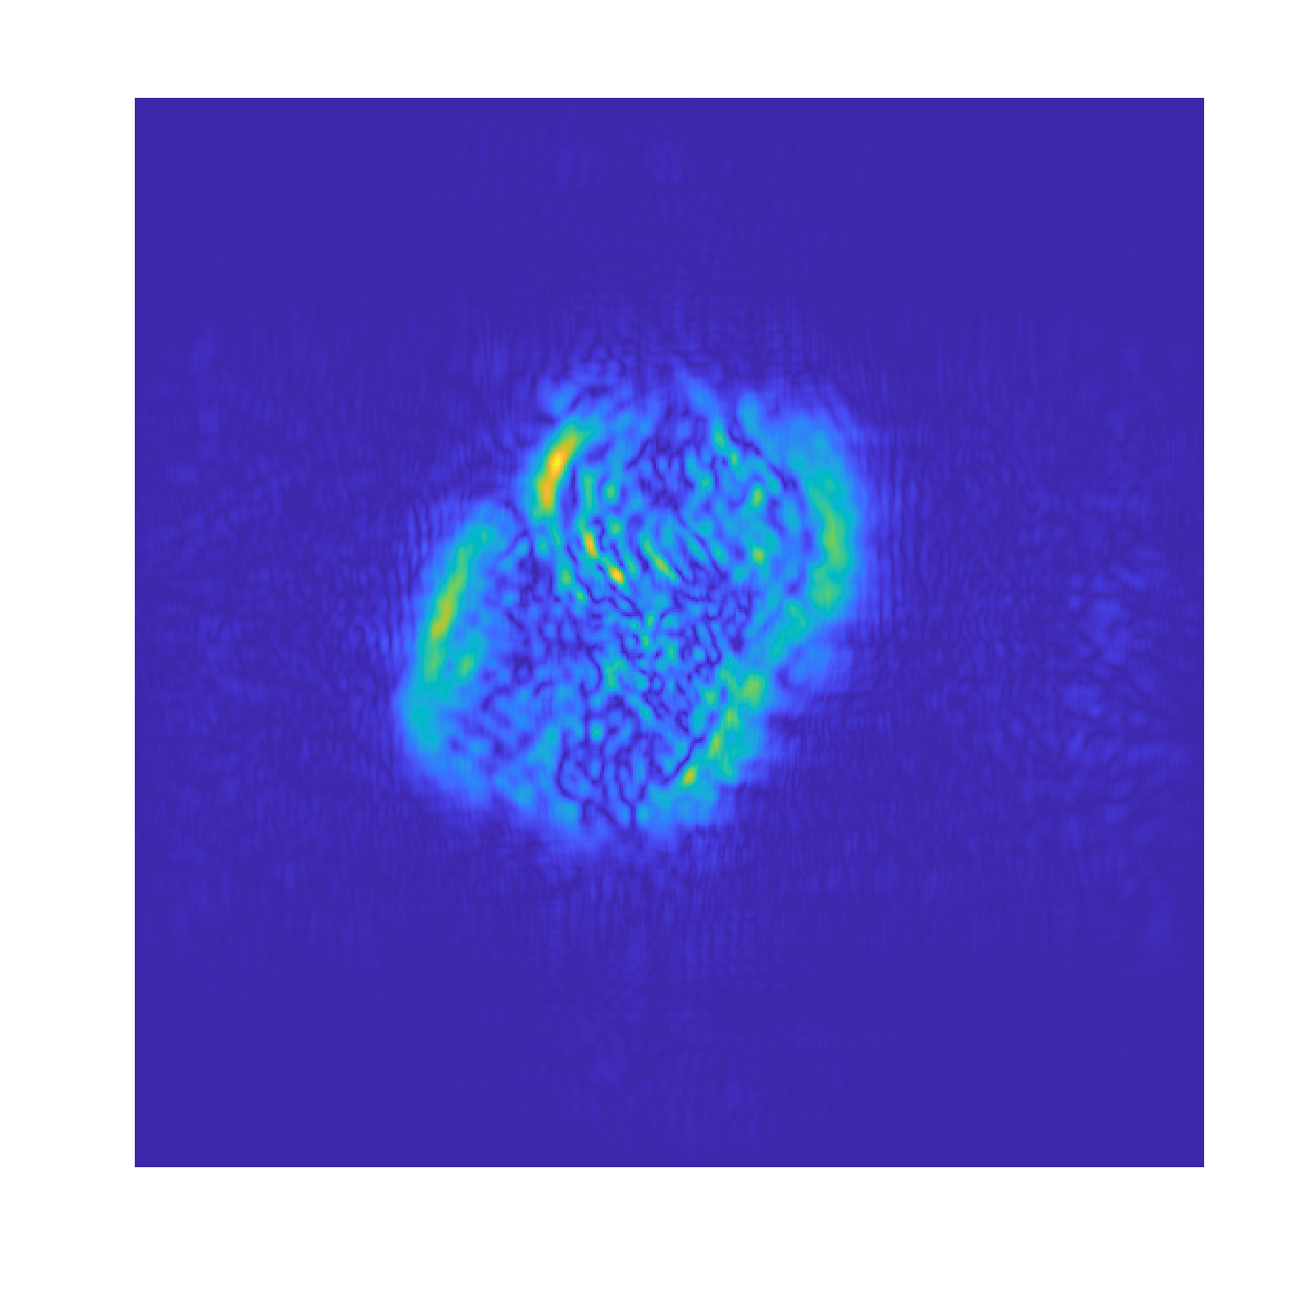
Differential Interferometric Contrast (DIC)

Slide 17
4F Imaging System
F₂
F₂
F₁
F₁
PSF
MTF
Fourier
Transform
Fourier
Transform
M=-F₂/F₁

Slide 18
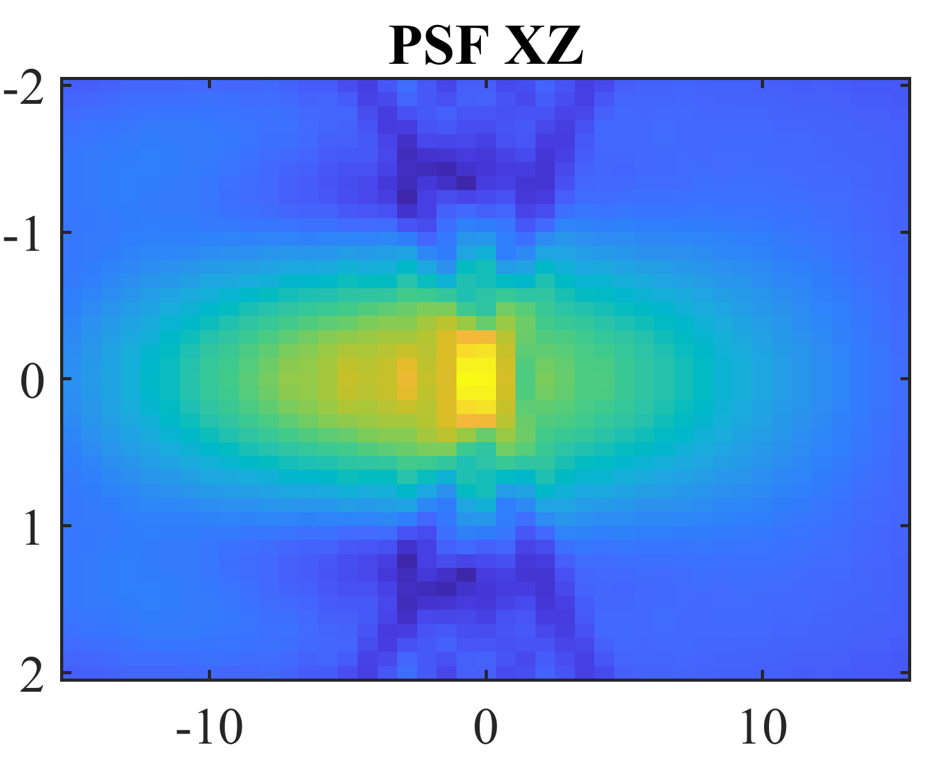
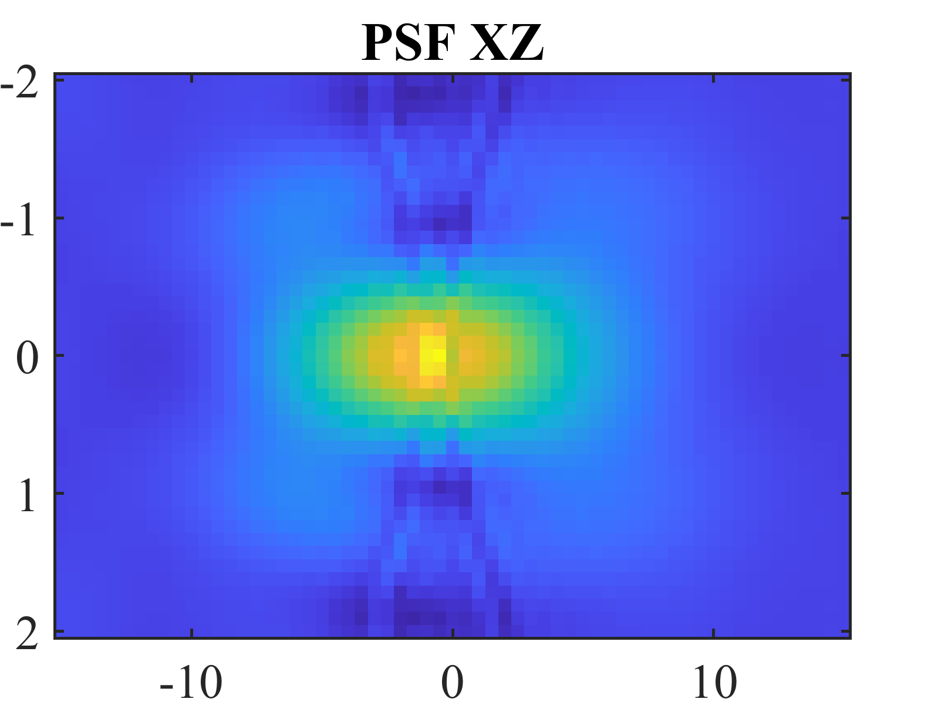
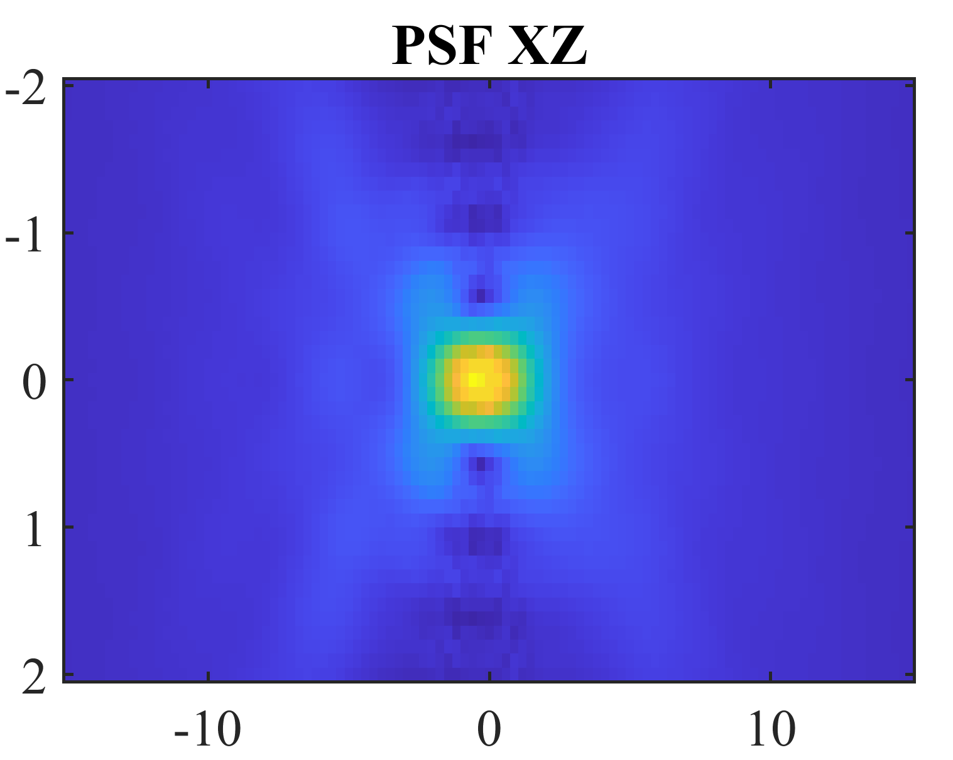
Axial resolution
Z

Slide 19
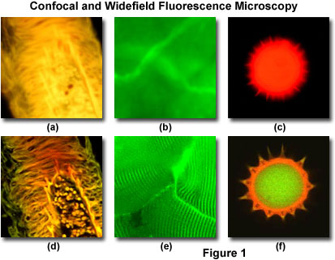
Confocal vs Wide field images

Slide 20
Confocal
F1
F2
x
z
y

Slide 21
Confocal
F1
F2
x
z
y
Scanning
the sample in XYZ

Slide 22
STED superresolution microscopy

Slide 23
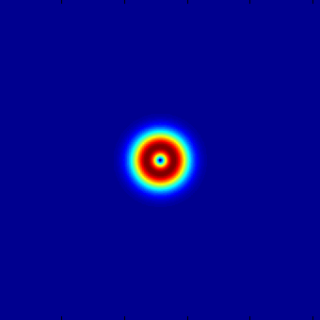
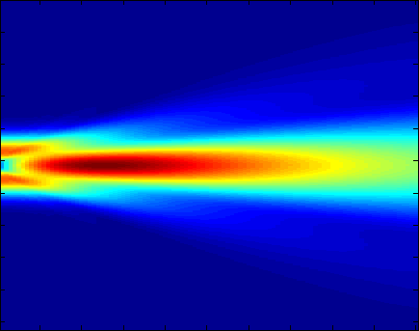
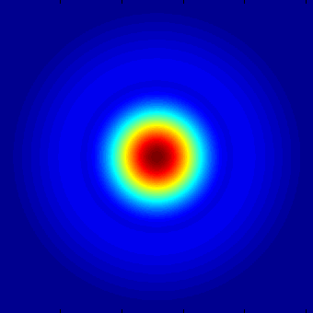

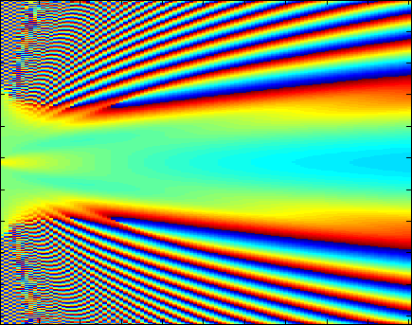
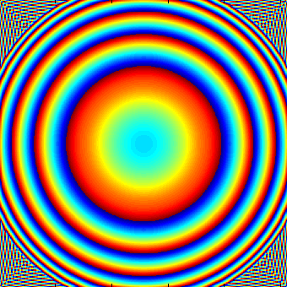
Donut beam with plane phase
λ = 800nm
Input
Propagation profile
Output
Amplitude
Phase

Slide 24

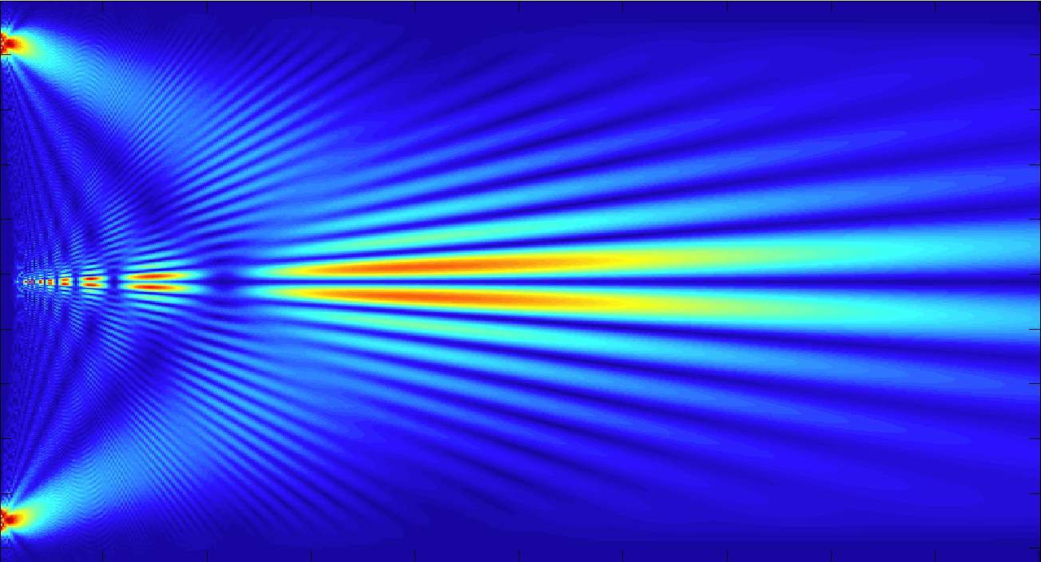
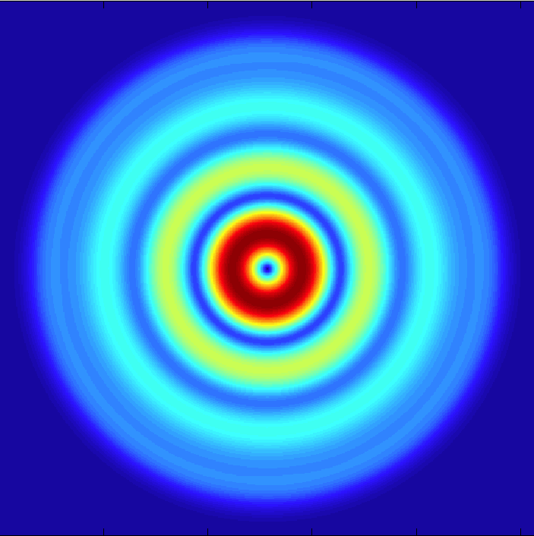

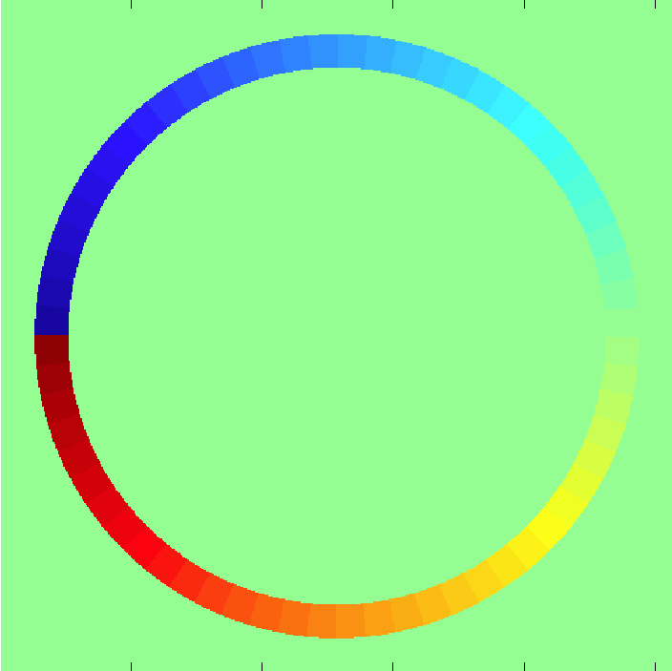
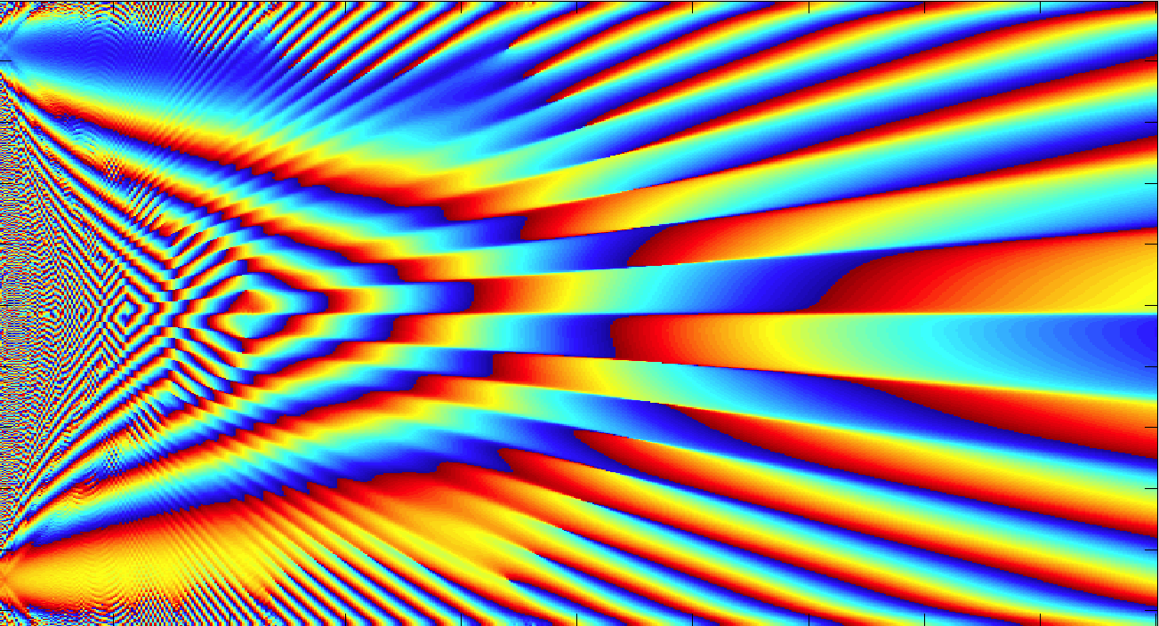
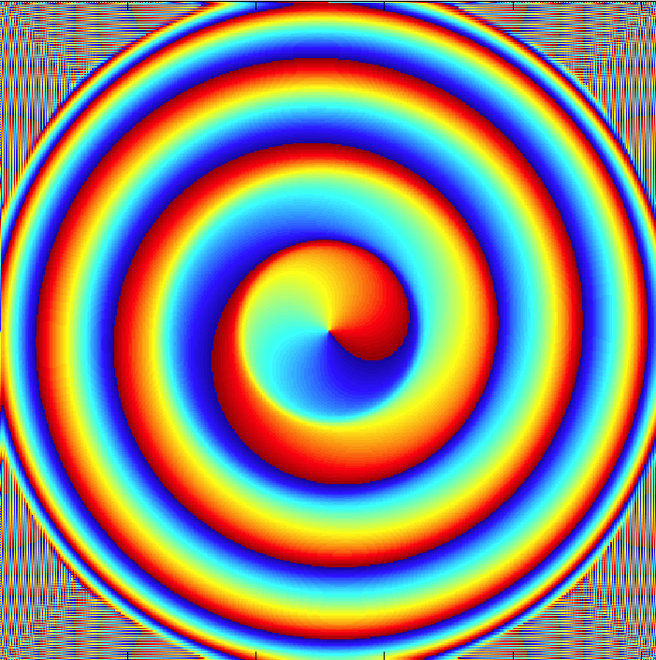
Ring with a “particular” phase
Input
Propagation profile
Output
Amplitude
Phase

Slide 25
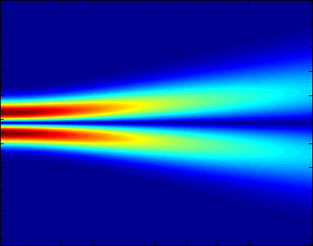
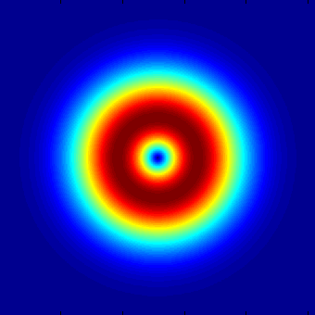
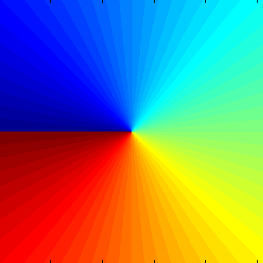
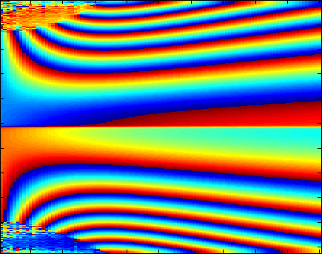
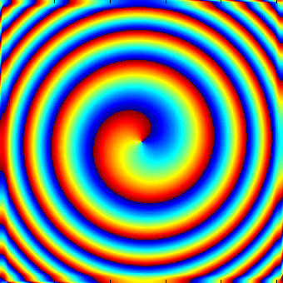
Vortex
λ = 800nm
Input
Propagation profile
Output
Amplitude
100μm
20mm
Phase

Slide 26
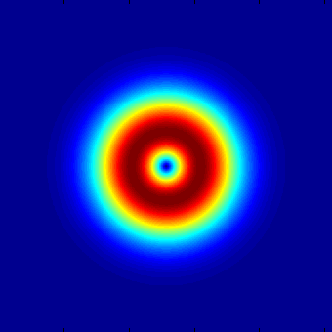
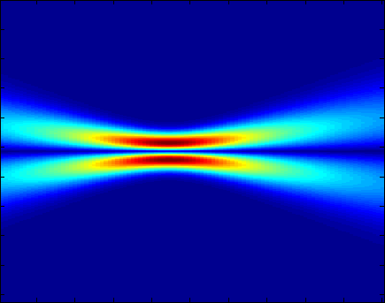
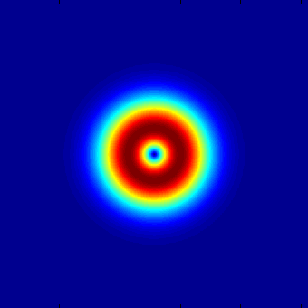
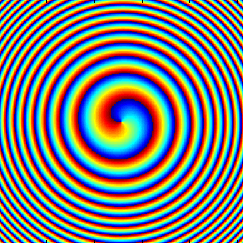
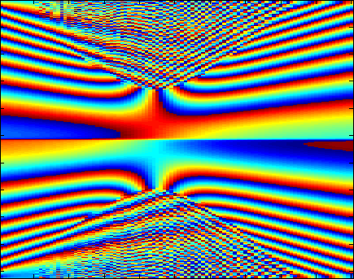
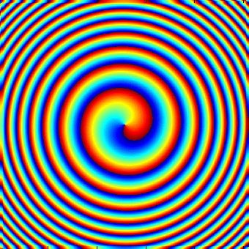
Converging vortex, cannot fill the center
λ = 800nm
Input
Propagation profile
Output
Amplitude
100μm
20mm
Phase
D. Psaltis, Optical Waves Propagation – EPFL, Fall semester 2013

Slide 27
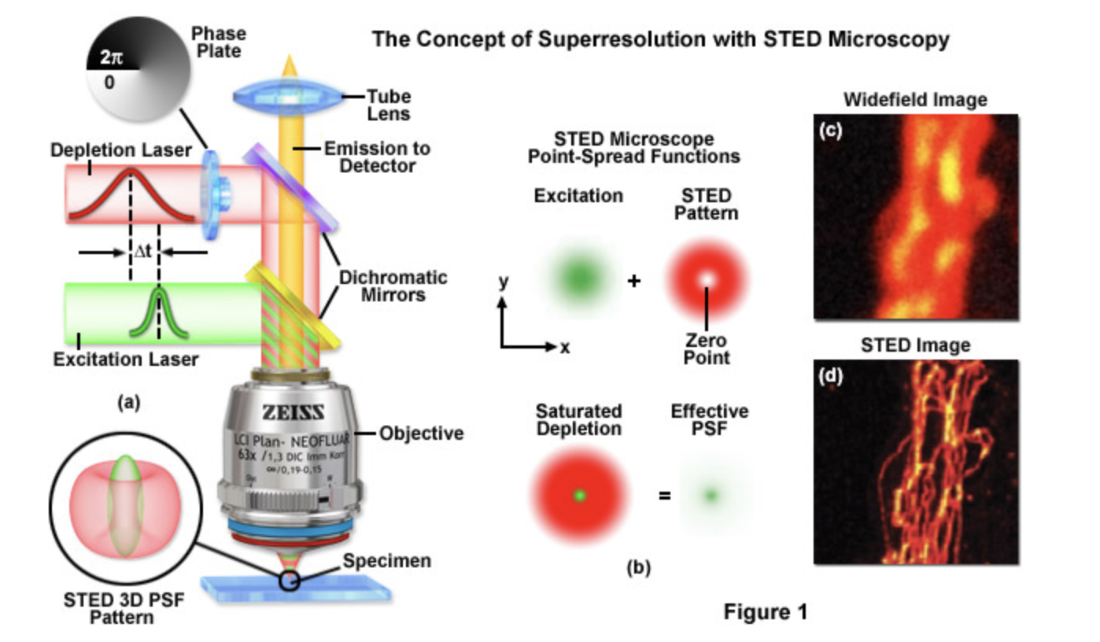

Slide 28

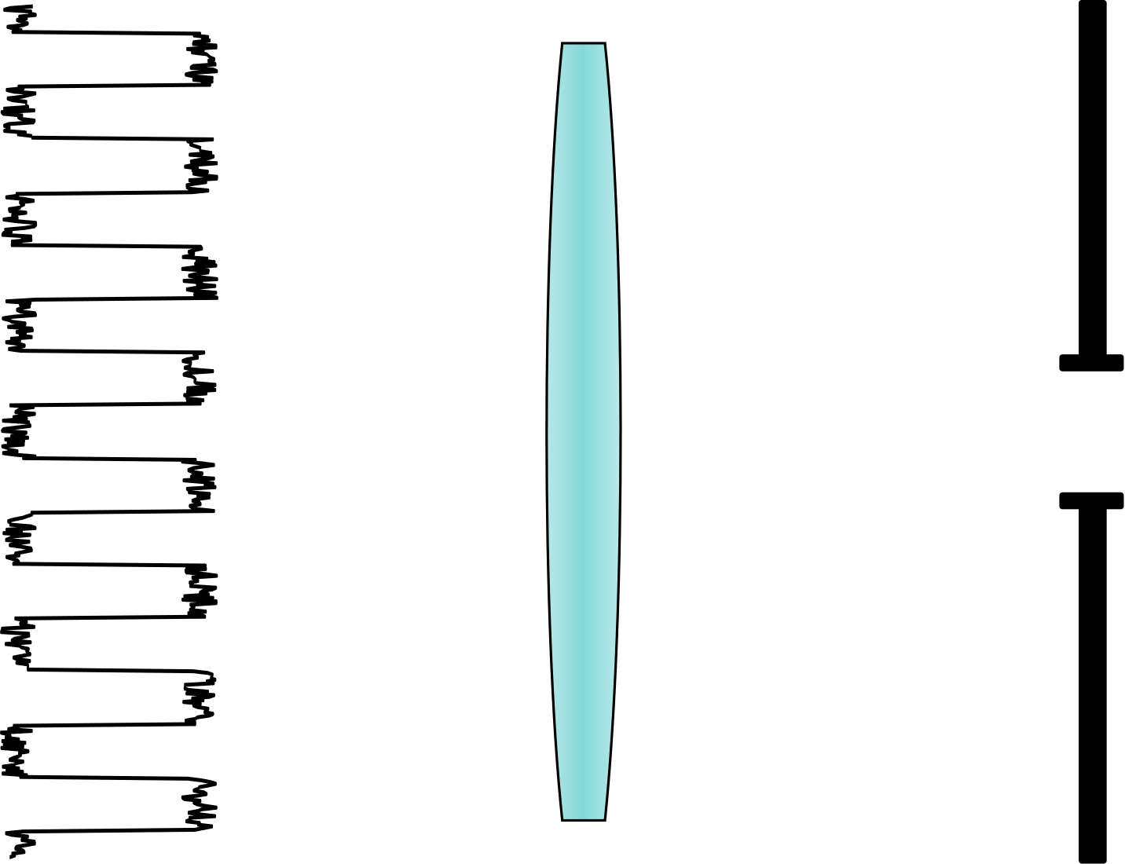
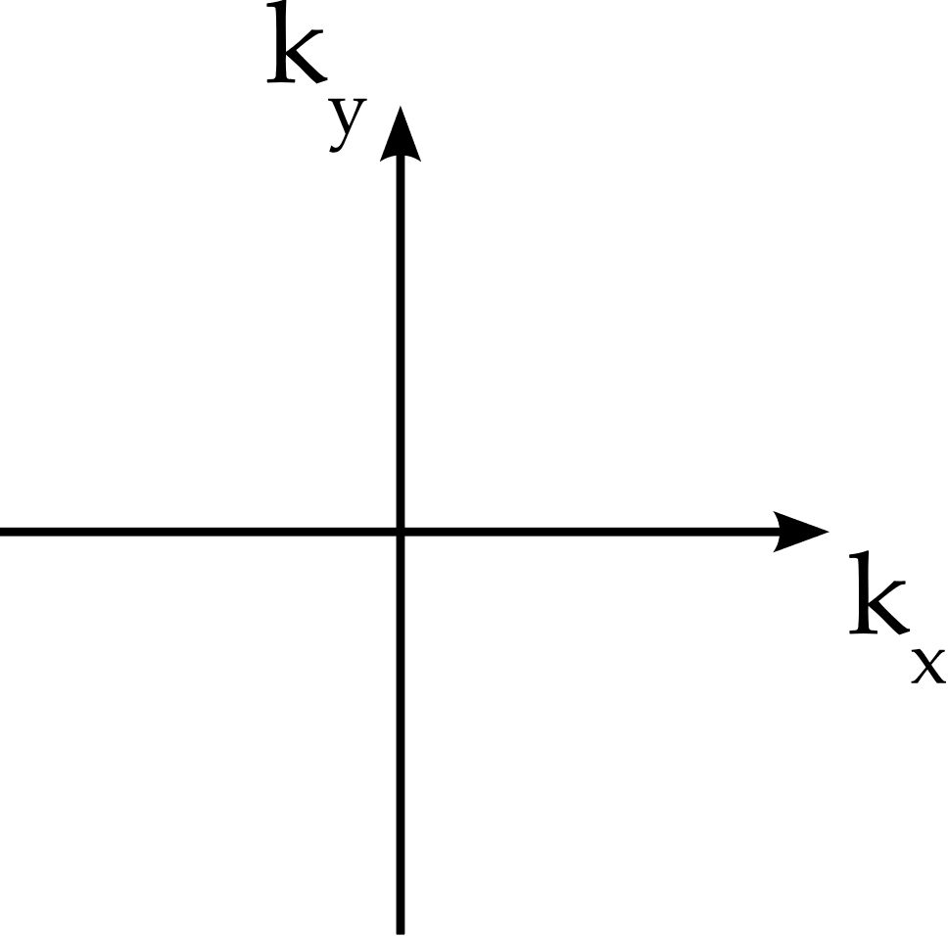











Ptychography

Slide 29
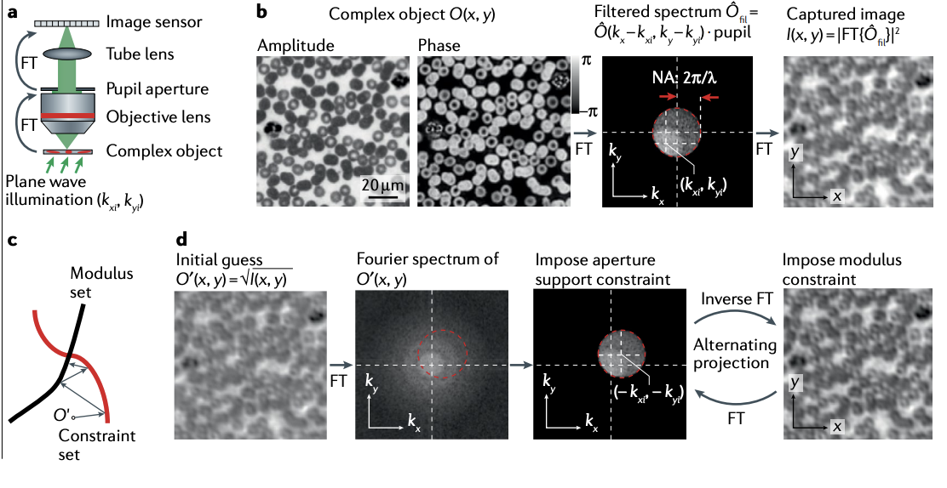
Ptychography

Slide 30
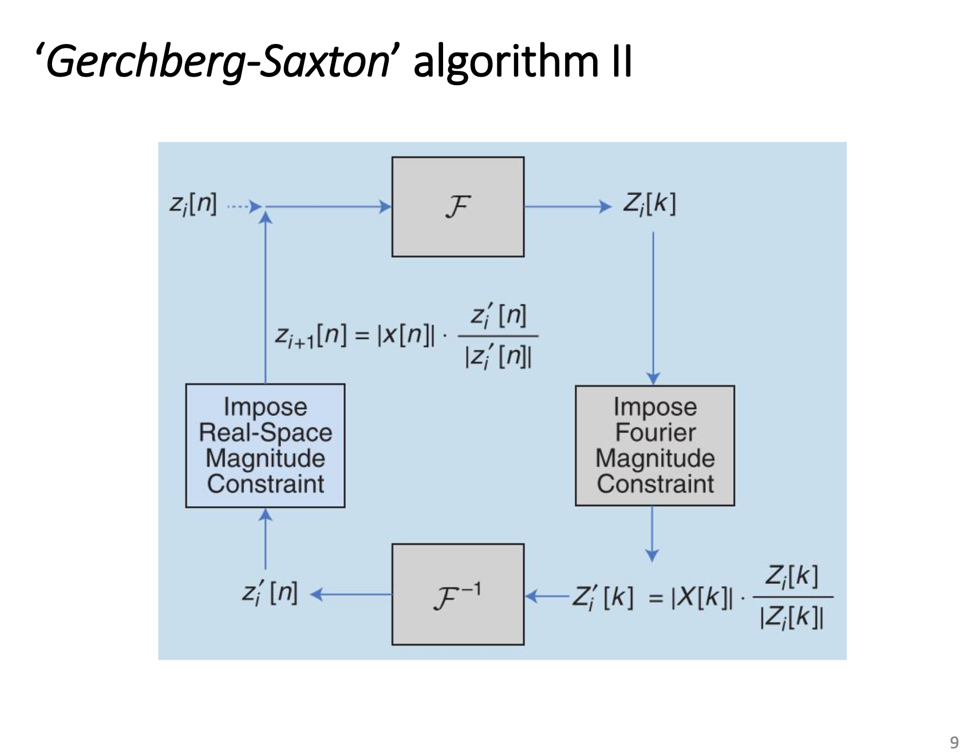

Slide 31

Ptychography

