Slide 1
Geometrical Optics & Ray Tracing
MICRO-421 Imaging Optics
Lecture #6

Slide 2
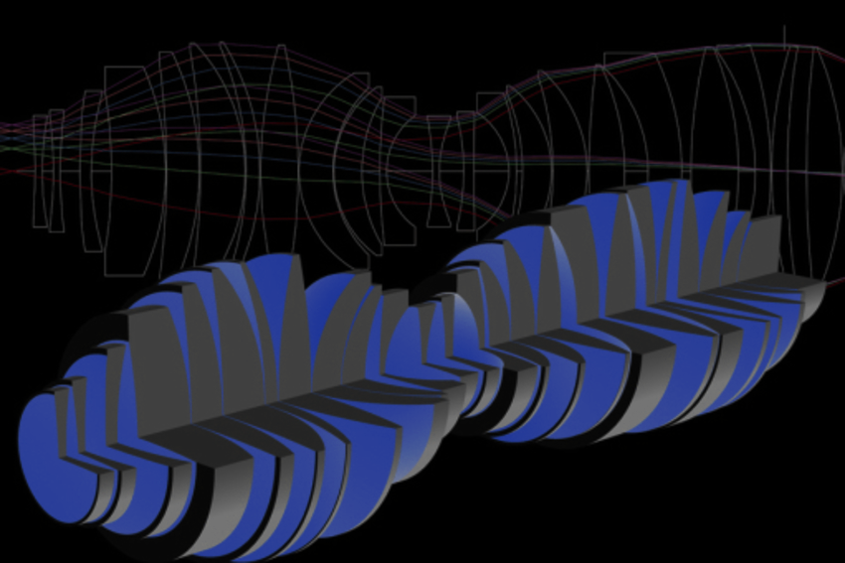
Overview
Introduction to geometrical optics
Imaging aberrations
Ray tracing and optical design software
From ray tracing to PSF
Numerical aberration correction
Example: Aspheric lens imaging

Slide 3
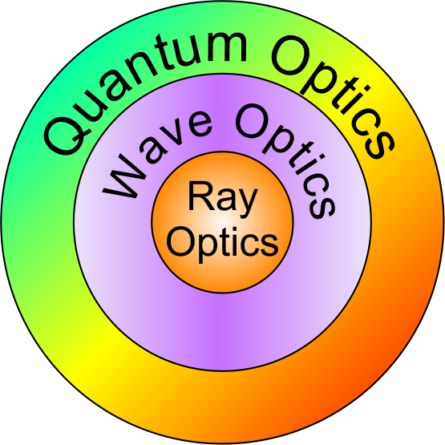
What is Geometrical (Ray) Optics?
Geometrical (ray) optics
macroscopic-scale phenomena
light travels in straight lines (rays)
wavelength λ → 0, frequency ν → ∞
explains reflection and refraction
useful for designing imaging systems
Wave optics
microscopic-scale phenomena
light (electromagnetic radiation) is a wave
action of light described by Maxwell's equations
explains reflection, refraction, dispersion, interference, polarization, diffraction
Quantum optics
atomic-scale phenomena
light is photons
has both wave-like and particle-like characteristics
used to analyze light-matter interactions
explains photoelectric effect, lasers

Slide 4
Rays vs Wave Fronts
Wave front: a surface over which an optical disturbance has a constant phase
Rays: lines normal to the wave front at every point of intersection
Phase

Slide 5
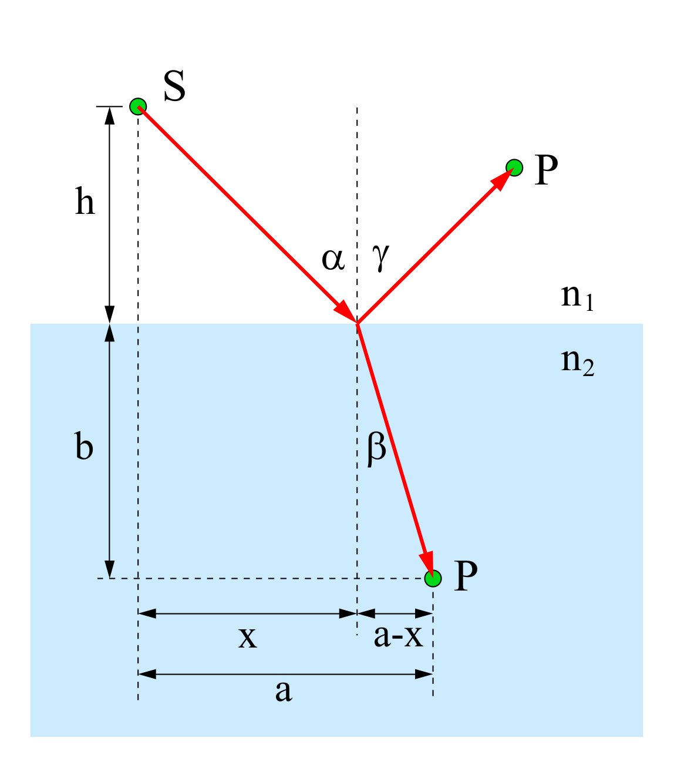
Fermat Principle and Snell’s Law
The path taken by a ray between two given points is the path that can be traversed in the shortest optical path (OPL).
Snell’s Law

Slide 6
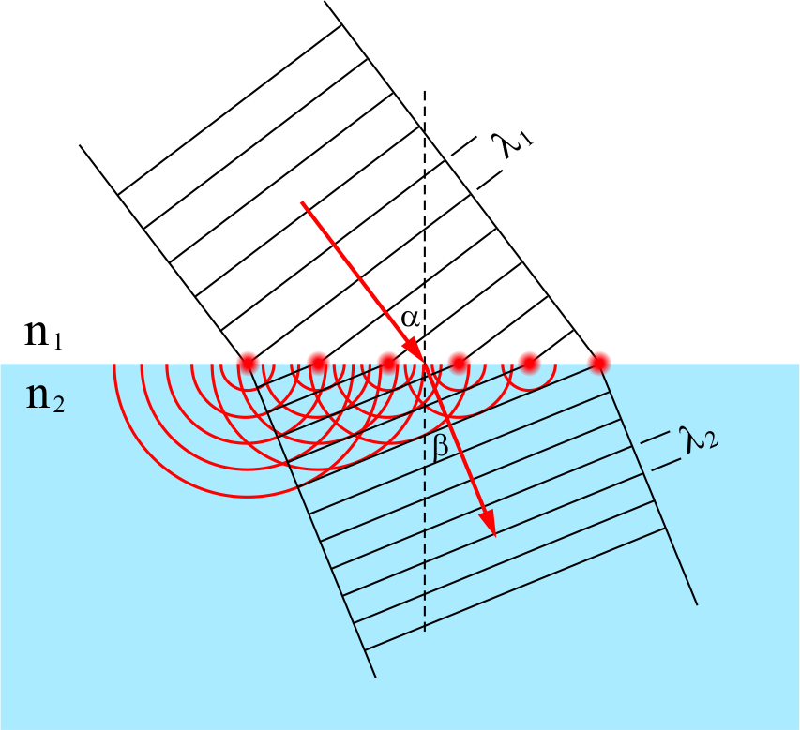
Huygens Principle and Snell’s Law
Every point on a wave front is a source of secondary spherical wavelets, and the secondary wavelets superimpose to form the next wave front.
Snell’s Law

Slide 7
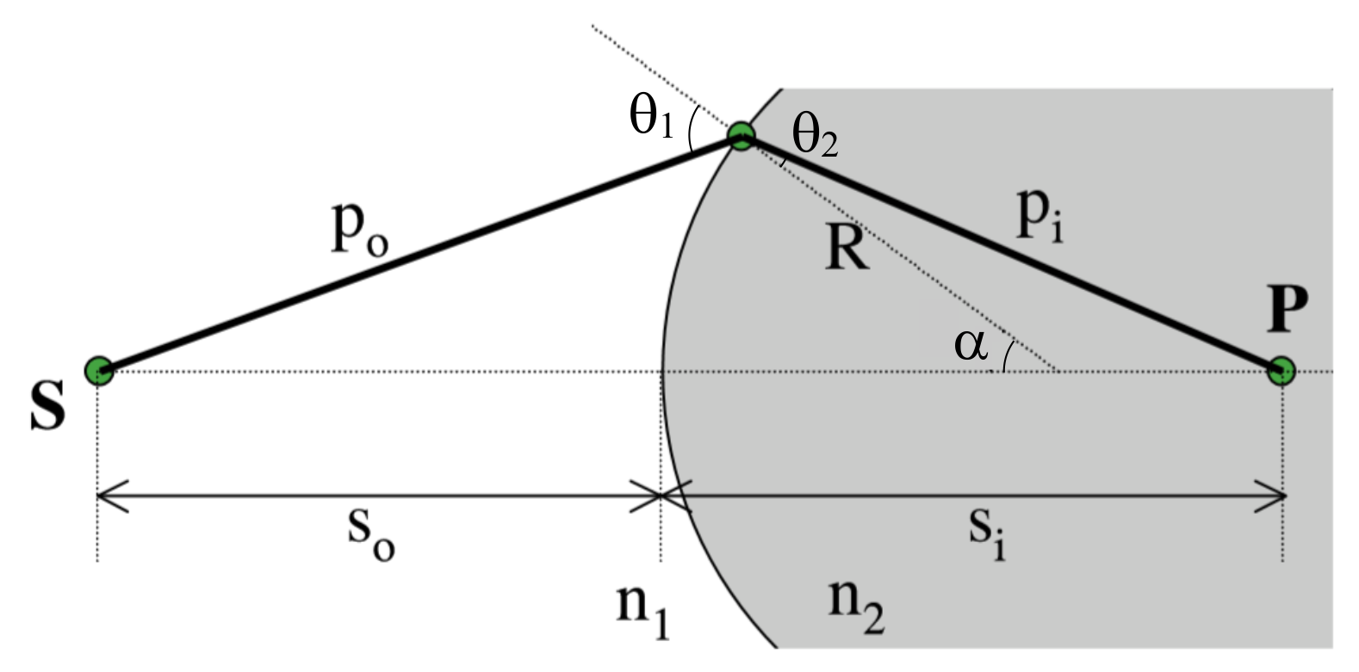
First-order (Paraxial) Optics
Snell’s law
For small θ
Lens Maker’s Formula
Under paraxial approximation, the emerging rays intersect at the same point P, forming a perfect image

Slide 8
Third-order Optics
Paraxial approximation becomes increasingly unsatisfactory when larger angled peripheral rays are considered

Slide 9
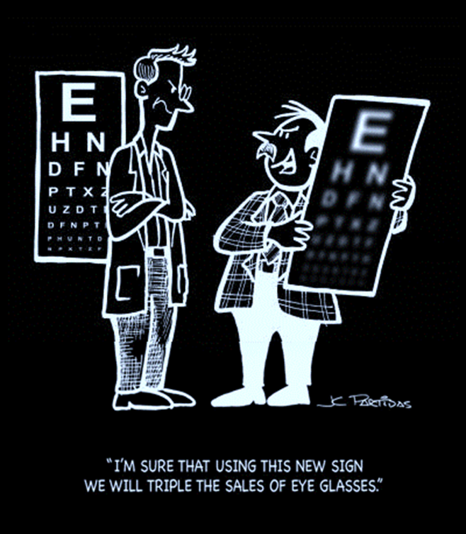
Types of Imaging Aberrations
Monochromatic (Seidel) aberrations
Spherical aberration
Astigmatism
Coma
Distortion
Field curvature
Chromatic aberrations
Axial chromatic aberration
Lateral chromatic aberration

Slide 10
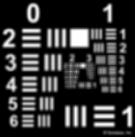
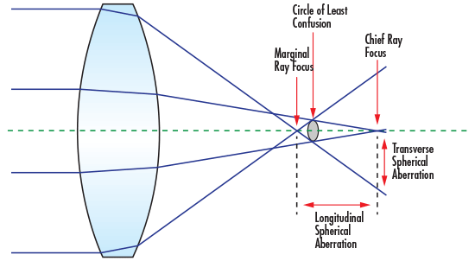
Spherical Aberration

Slide 11
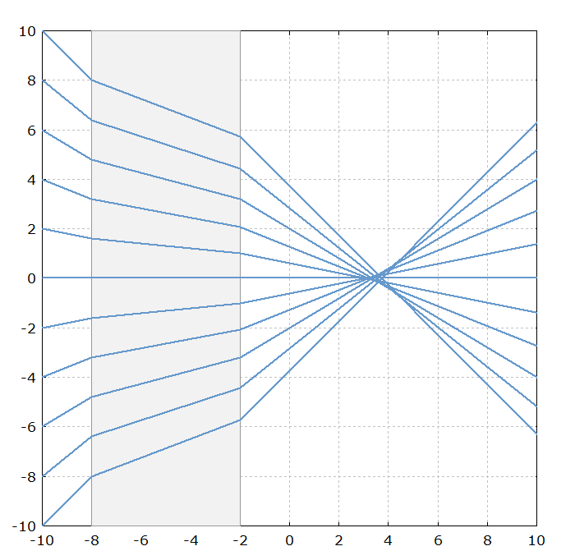
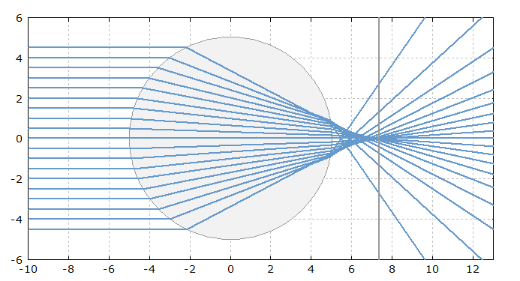
Spherical Aberration in Simple Optics

Slide 12
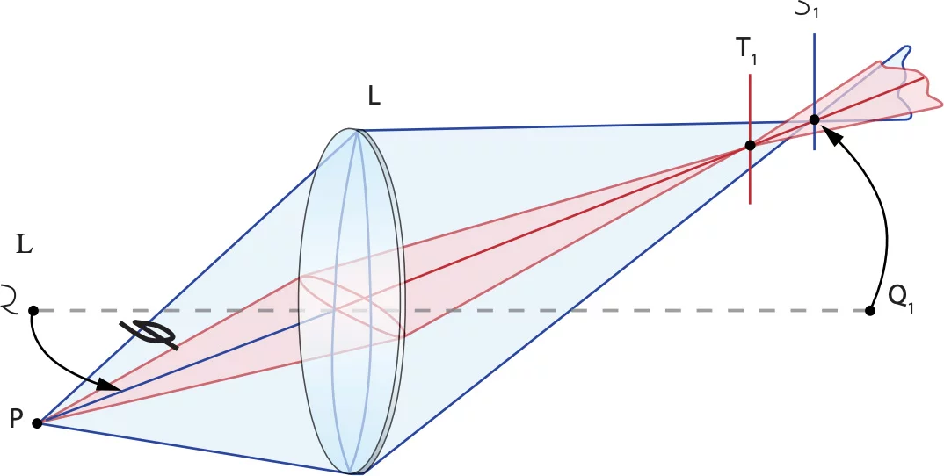
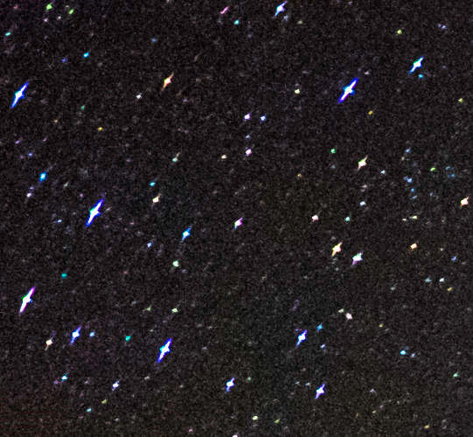
Astigmatism

Slide 13
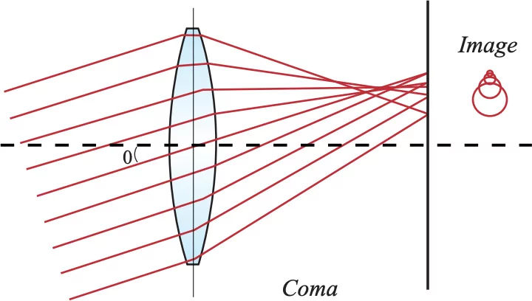
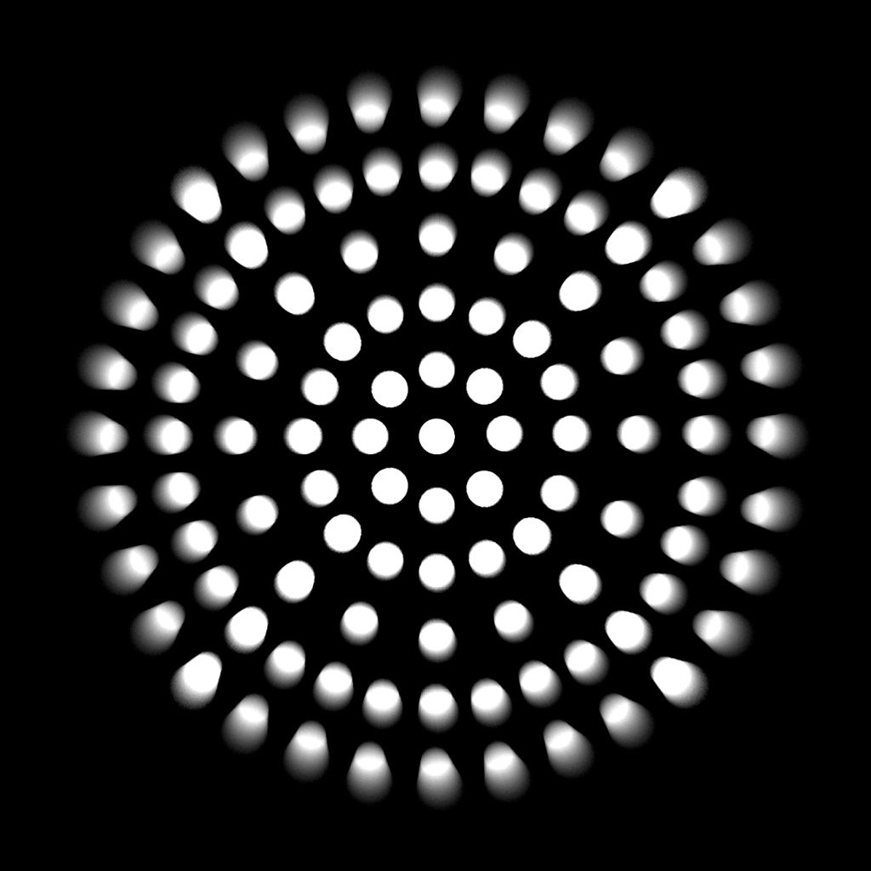
Coma

Slide 14
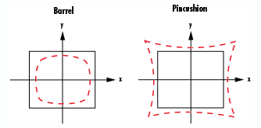

Distortion

Slide 15
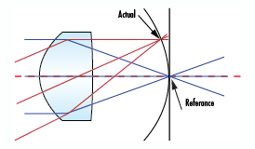

Field Curvature

Slide 16
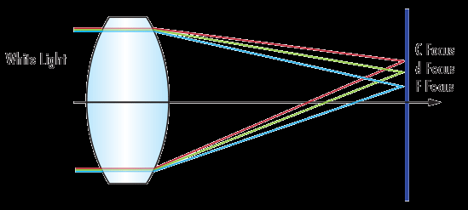
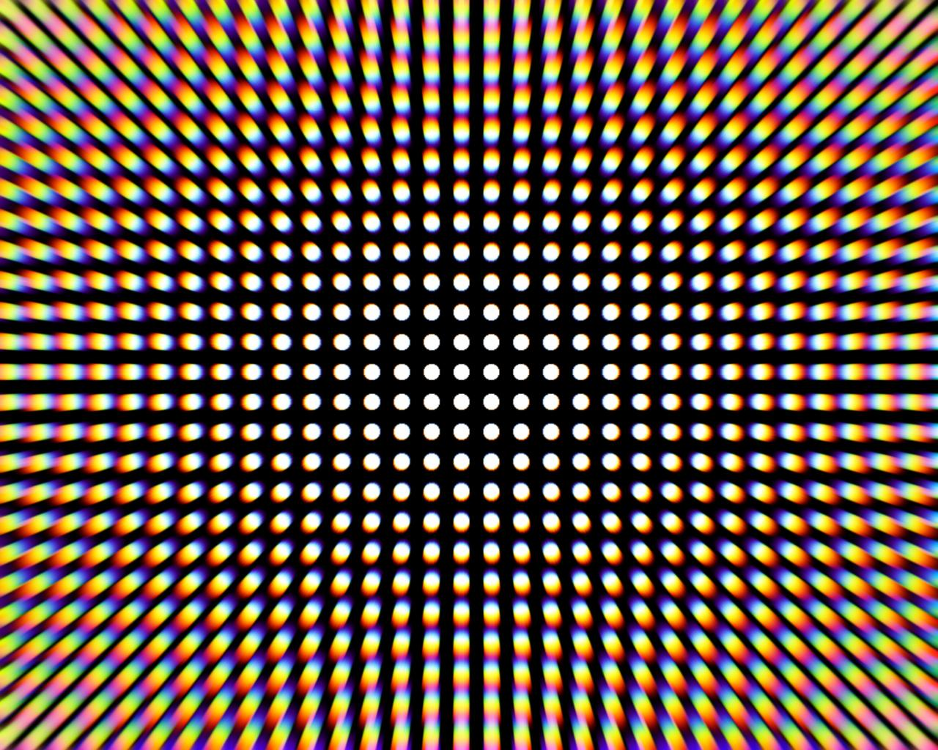
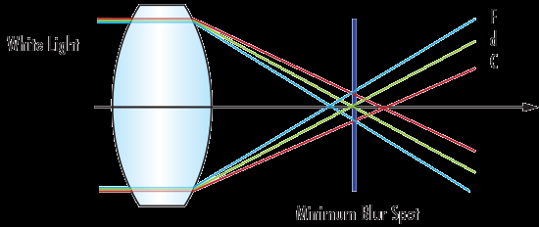
Chromatic Aberration

Slide 17
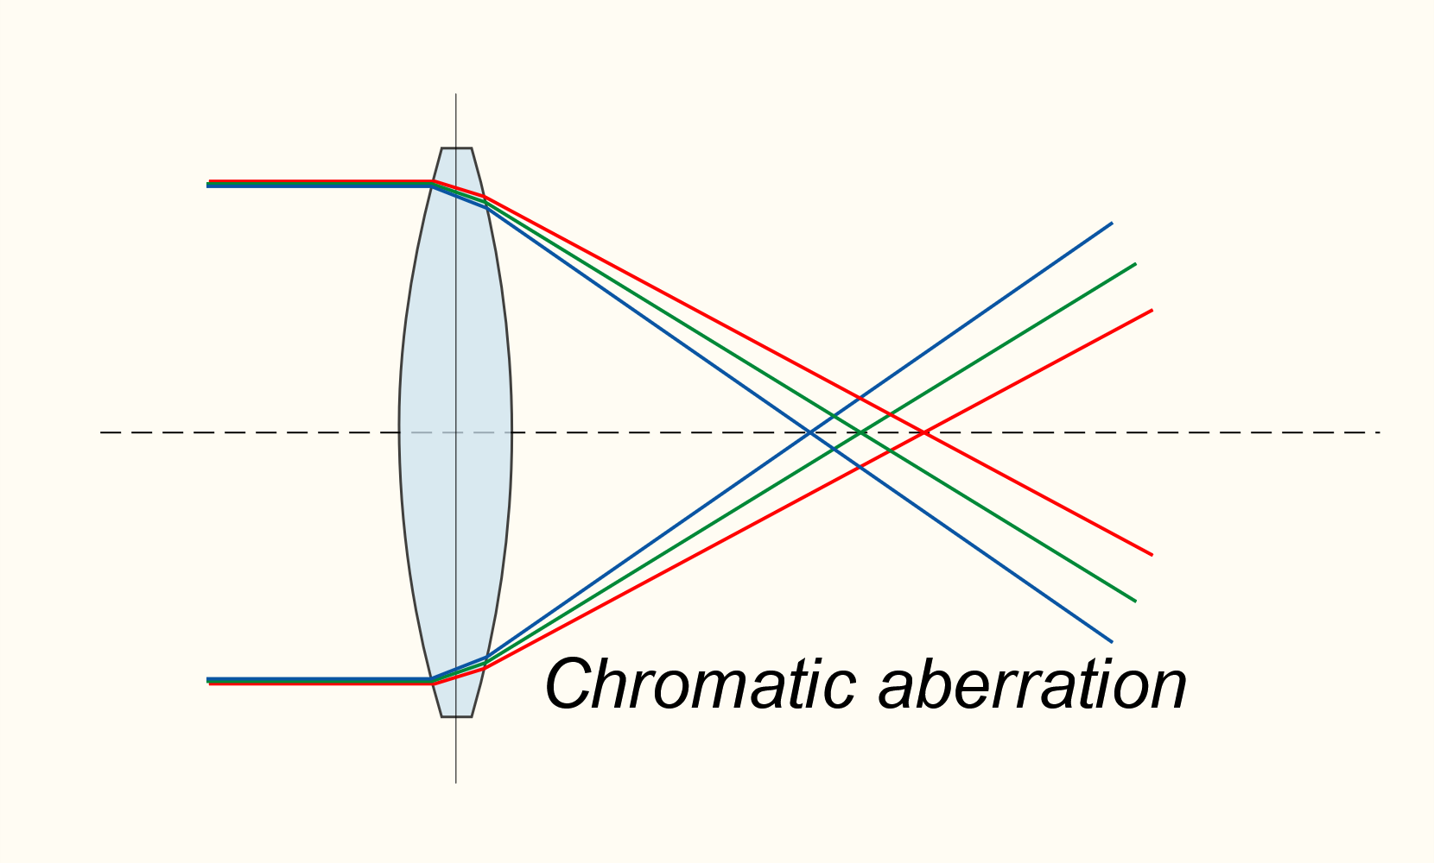
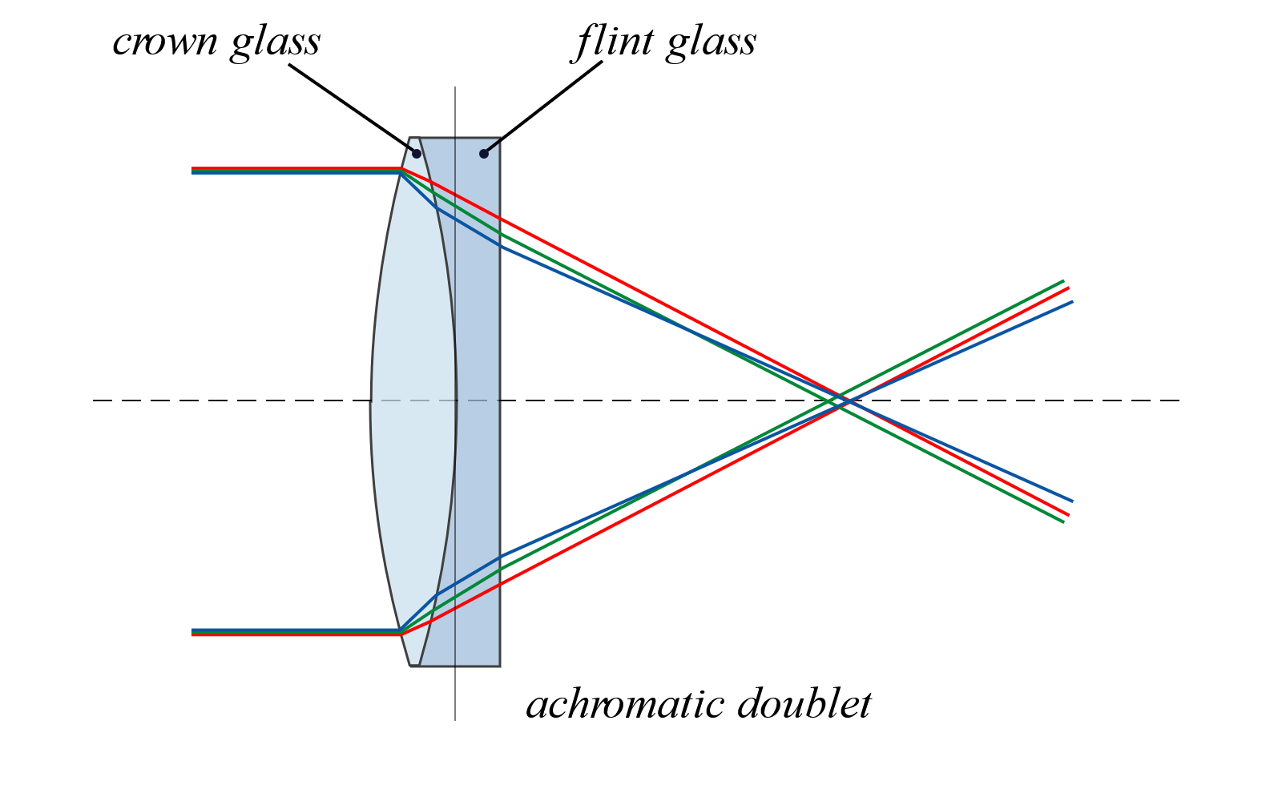
Achromatic Lens
crown glass
flint glass

Slide 18
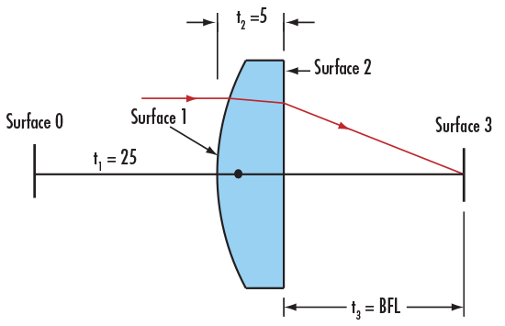
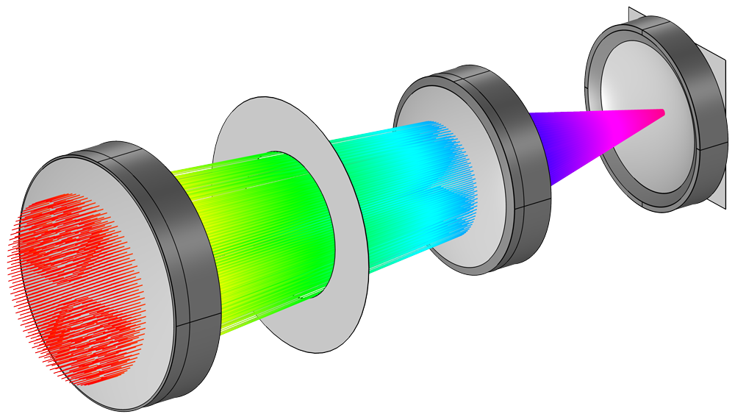
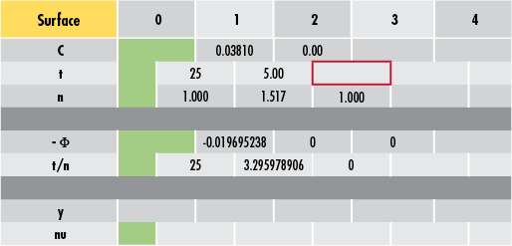
Geometrical Optics and Ray Tracing
In the old days …
2D tracing of a few important rays
Recalculate everything for iterative design change
Modern computer programs
Full 3D tracing of hundreds to millions of rays
Comprehensive material database
Automatic iterative design optimization
Performance and tolerance analysis

Slide 19
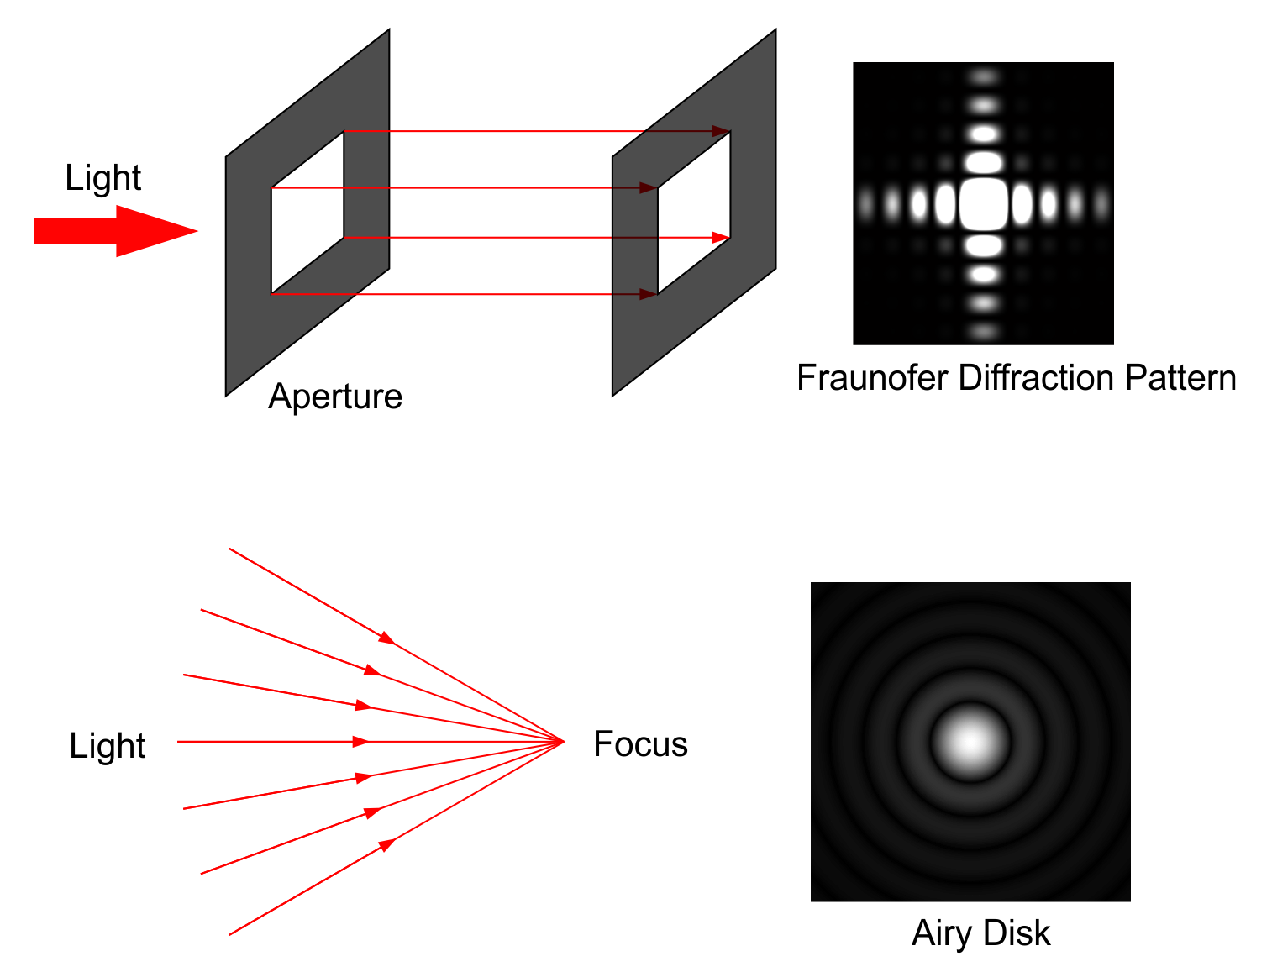
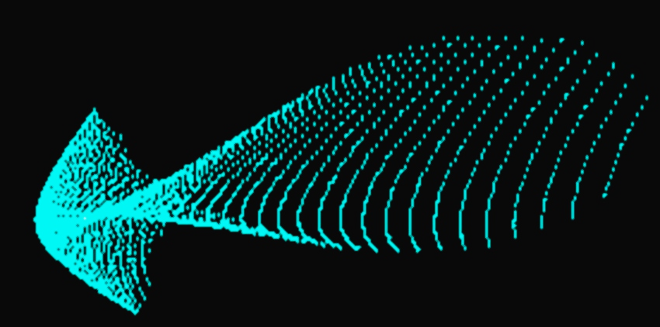
From Ray Tracing to PSF
Where ray optics fails
Ray optics
Fails where diffraction is important
Cannot predict optical behavior at focus (spot diagrams help)
Solution
Approximate PSF from spot diagram
Evaluate PSF from aperture wave front
Spot Diagram

Slide 20
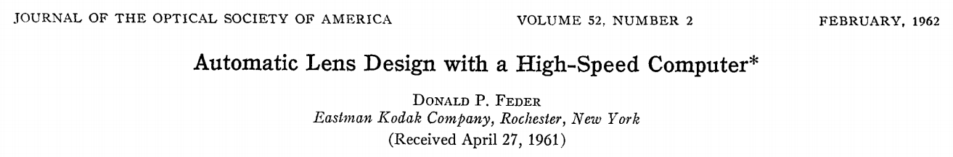
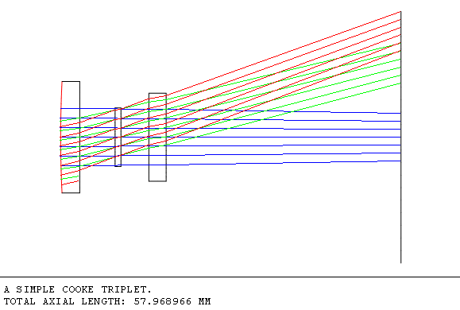
Automatic Design Optimization
Aberration evaluated based on ray-tracing
Merit function minimization with boundary conditions
Material database
Stock design library

Slide 21
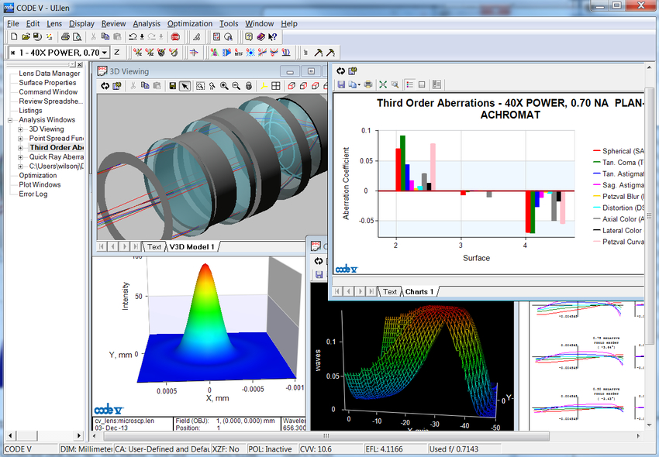
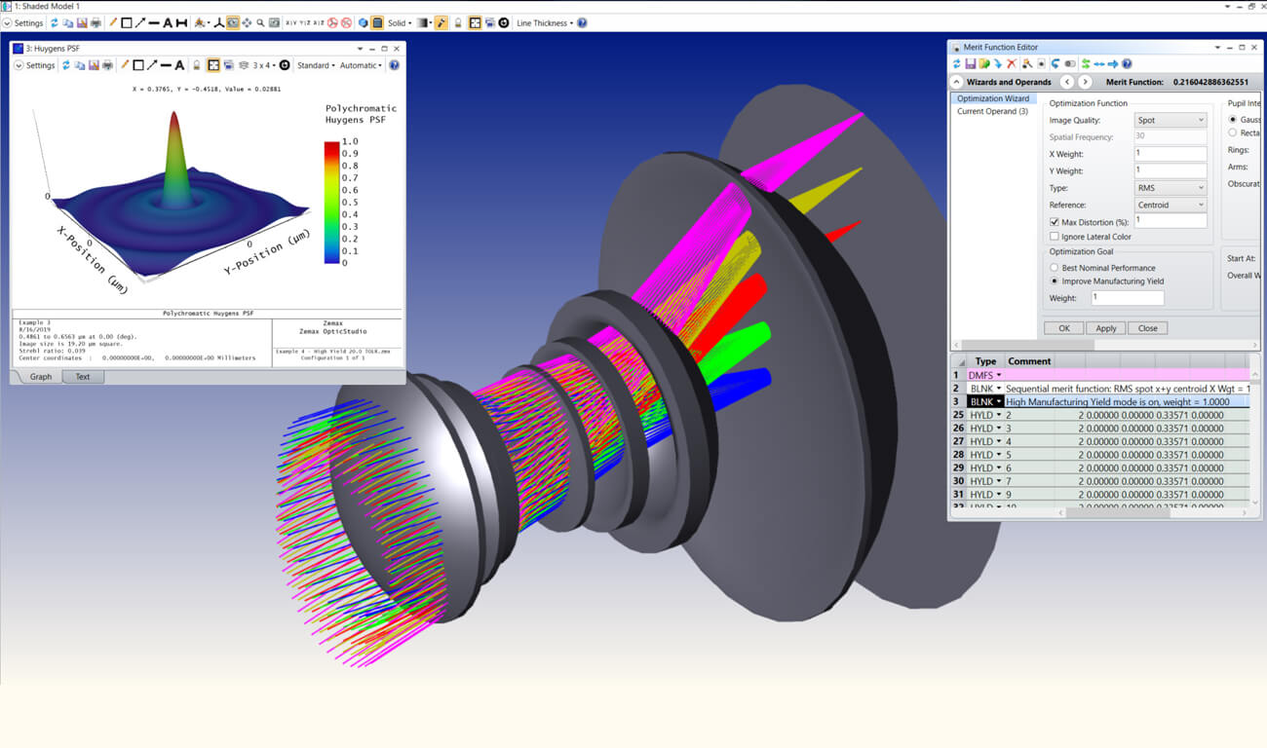
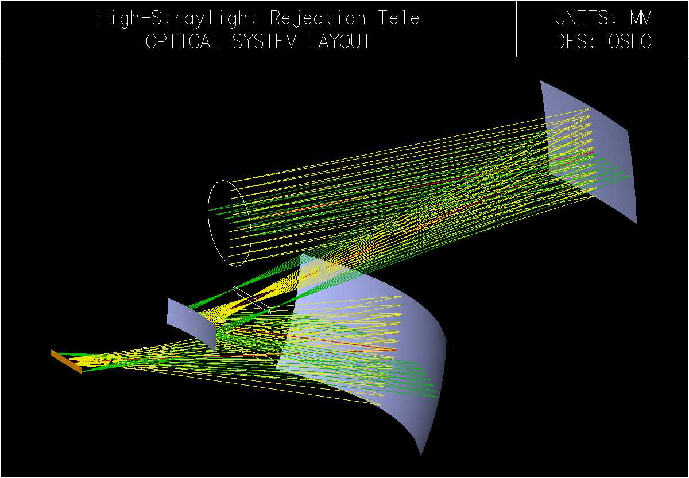
Commercial Optical Design Software
Synopsys Code V
ZEMAX
OSLO
Common Features
2D and 3D modeling
Ray tracing tools
Performance Analysis from optical structures: aberrations, PSF, MTF
Automatic structural optimization to minimize aberrations
Database of material properties

Slide 22
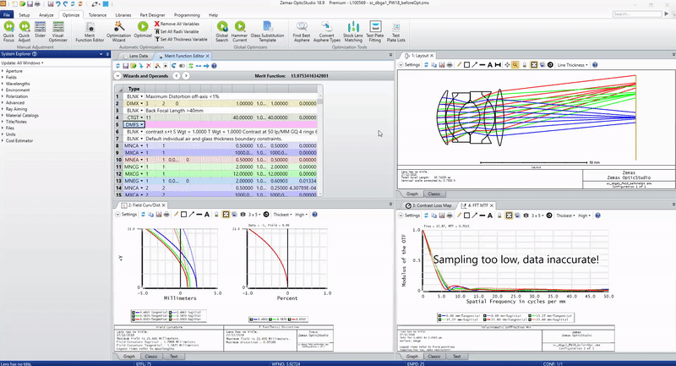
ZEMAX User Interface

Slide 23
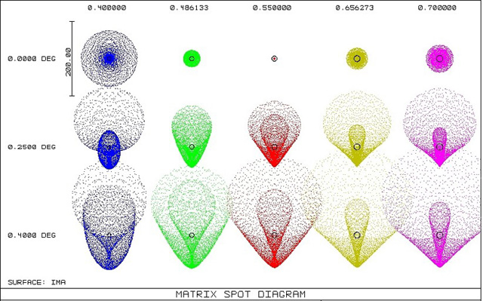
Spot Diagrams

Slide 24
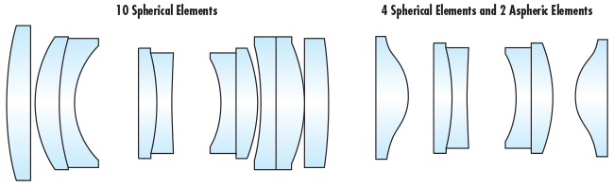
Minimizing Optical Aberrations

Slide 25
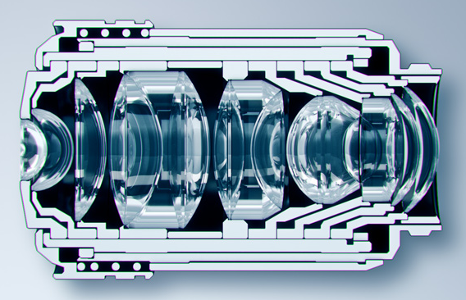
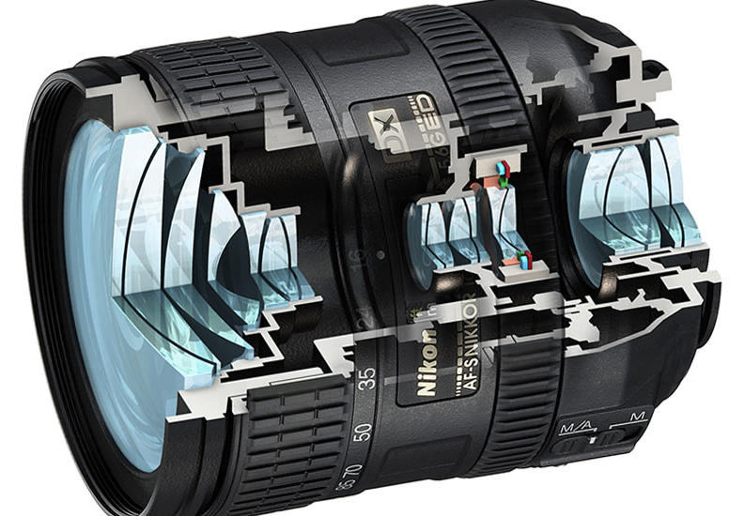
Examples of Imaging Optical Systems
Nikon Photographic Lens
Olympus Oil-immersion Microscope Objective

Slide 26
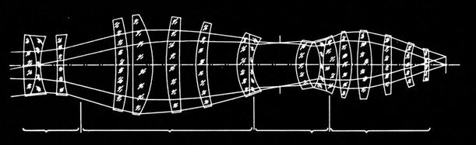
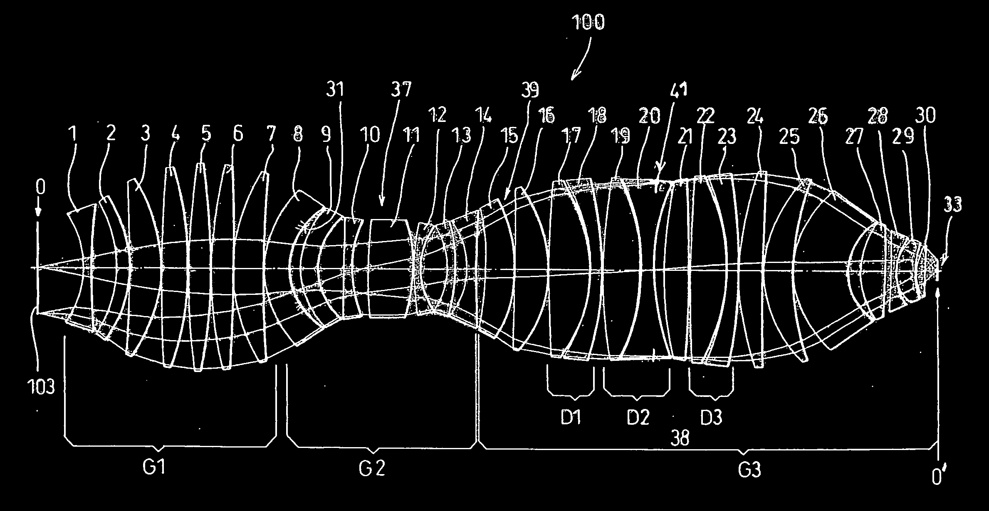
Examples of Imaging Optical Systems
ZEISS 1977 S-planar 10/0.28
1 µm feature size
Used in the first wafer stepper
ZEISS 2004 patent US6791761B2
0.7 NA
Excimer laser source
157 nm wavelength
Diffraction limit: 224 nm

Slide 27
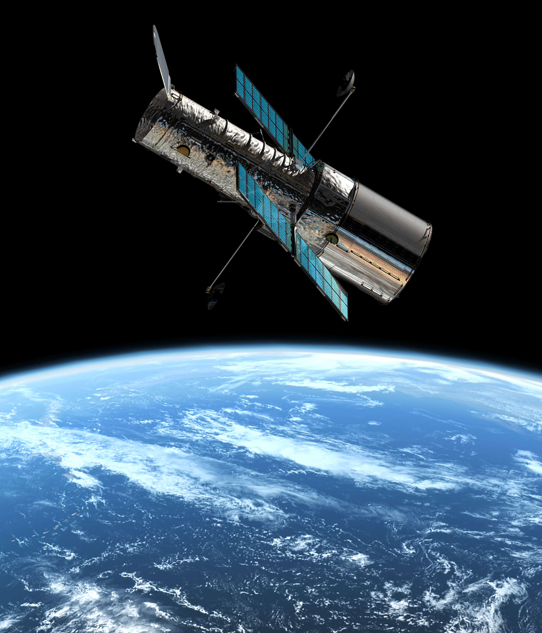
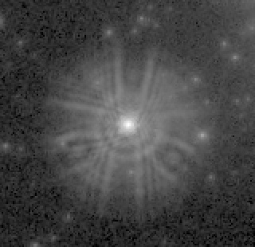
Aberration on the Hubble Telescope
Hubble space telescope
Low-Earth orbit satellite
Launched in 1990
2.4-m f/24 main reflector
UV, visible, NIR images
Numerous breakthroughs in astrophysics
Reflector flaw
Outer perimeter too flat by 2 µm
Severe spherical aberration
Corrected in 1993 by mission STS-61
Servicing cost: $500 million

Slide 28
Aberration on the Hubble Telescope
Spiral galaxy M100
Before STS-61 servicing mission
Spiral galaxy M100
After STS-61 servicing mission

Slide 29
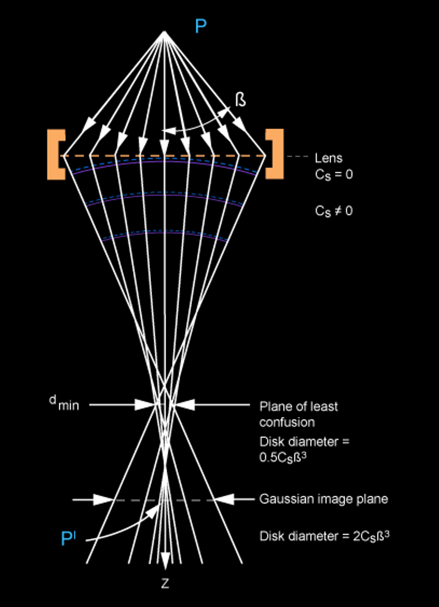
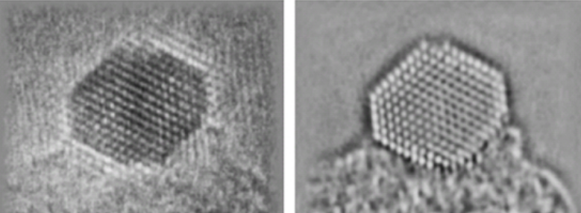
Aberration in Electron Microscopes
2 nm
before correction
after correction
Electron beam focused by magnetic lenses in electron microscopy
Spherical aberration intrinsic to magnetic lenses
Correction methods under intense research for atomic resolution
Historically led to invention of holography

Slide 30
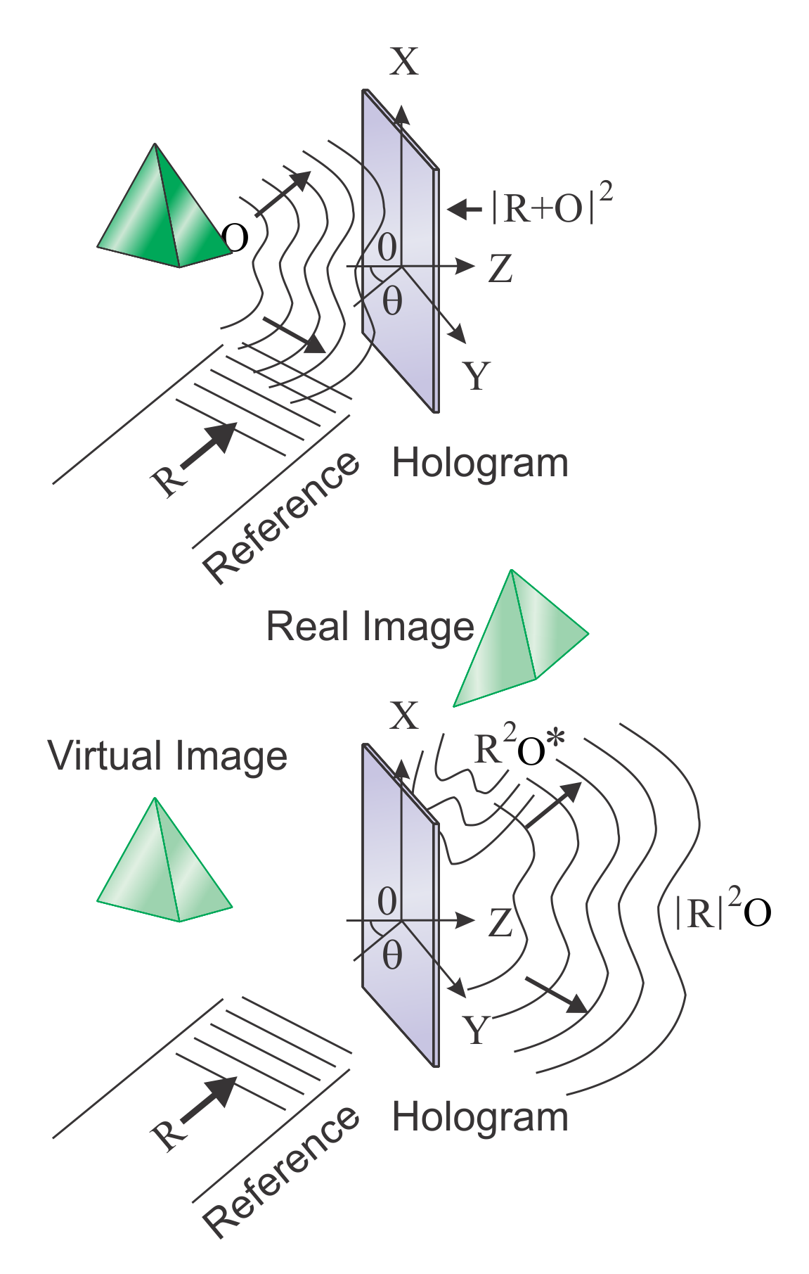
Numerical Aberration Correction
Light wave consists of both amplitude and phase
Photography records only light intensity (amplitude) only
Holography records and reconstructs both amplitude and phase, i.e. the complete wave front
Photography: numerical aberration correction through the aberrated PSF precalculated with ray tracing
Holography: numerical aberration correction through aberrated wave front precalculated with ray tracing

Slide 31
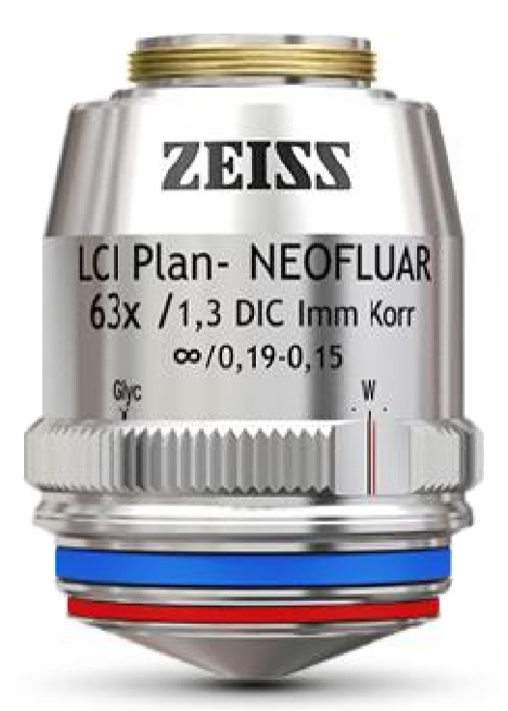
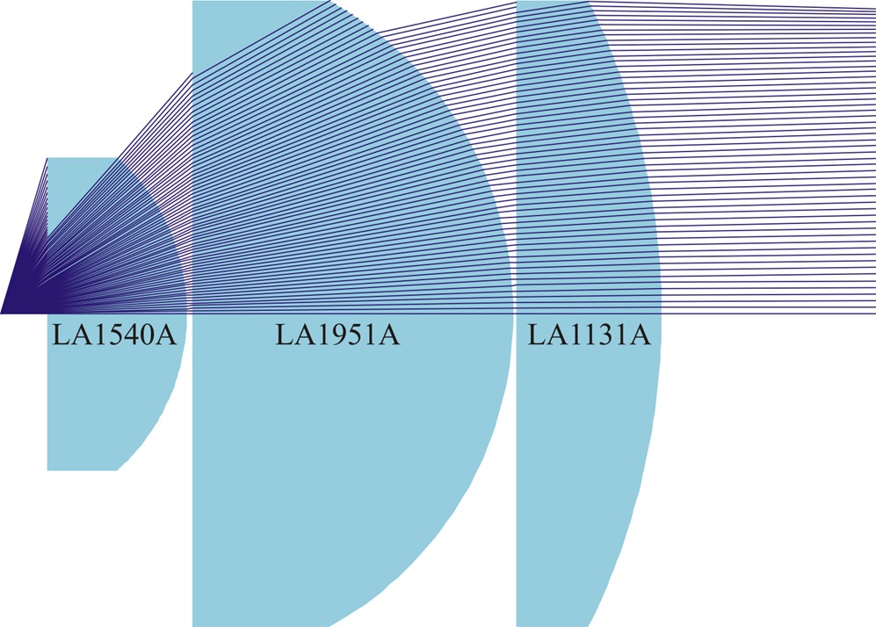
Example: Custom objective design
ZEISS Immersion Long-WD Objective
In-house Design Long-WD Objective Using Stock Optics
NA=1.30
Glycerin or oil immersion
Transmission @ 400 nm ~60%
Working distance 0.49 mm
Cost: CHF 11,138
NA=0.98
Oil or water immersion
Transmission @ 400 nm > 95%
Working distance > 1 mm
Cost: < CHF 500

Slide 32
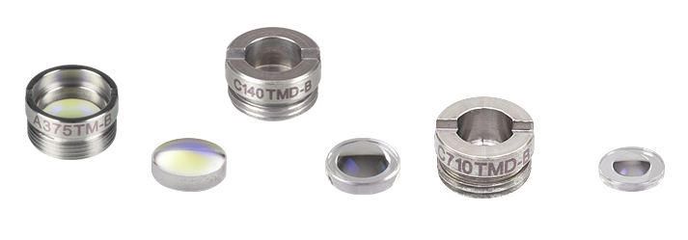
Example: Aspheric Lens Imaging
Thorlabs molded aspheric lens
Low-cost, molded single-element objective
High-refractive index, high-dispersion glass
Up to 12th-order polynomial surface
Diffraction-limited performance under design condition
Significant high-order aberration otherwise
Widely used for fiber coupling or fiber collimation
Definitions of Variables
z | Sag (Surface Profile)
Y | Radial Distance from Optical Axis
R | Radius of Curvature
k | Conic Constant
A_{2n} | 2nth Order Aspheric Coefficient

Slide 33
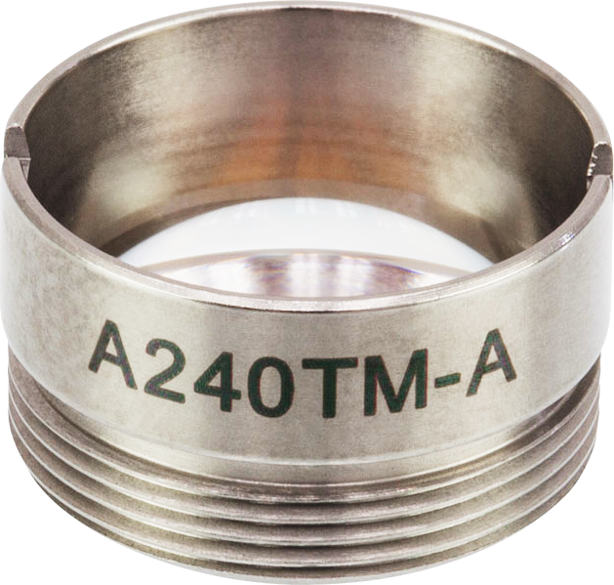
Thorlabs A-240TM as an Imaging Objective
Holographic imaging of 200 nm Au nanoparticles fixed in agarose matrix
Image plane 5 mm deep into the water
5 mW He-Ne laser illumination from side
Illumination sheet ~0.3 mm thick
Severe, high-order aberration due to the presence of the thick water
Ray tracing provides aperture wave front
Aberration-corrected image shows clear particles
No particle image (speckle only) without correction
Aperture: 8 mm
EFL: 8 mm
NA: 0.5
Optimized for 250 µm window thickness

Slide 34

Thorlabs A-240TM as an Imaging Objective
50 µm

Slide 35

THANK YOU!

