Slide 1
Lecture 2
Demetri Psaltis
Optics Laboratory
EPFL - Spring semester 2022

Slide 2
TOPICS
Optical beam propagation; free space (Feb 25)
Plane waves, lens-less imaging (March 4)
Fresnel Diffraction, thin transparencies. (March 11)
Imaging, lenses, eye (March 18)
Ray optics (YE) (March 25)
Microscopy (April 1)
Waveguides, Endoscopy (April 8)
Midterm ?? (April 29)
Coherence, interferometry, OCT ( May 6)
Periodic structures Professor Makris? (May 13)_
Holography (Lyncee) (May 20)
Ptychography, Tomography. (May 27)
Final (written NOT oral) (June 3)

Slide 3
Plan for today
  Review beam propagation method (BPM)
  Plane waves
  Angular spectrum
  Periodic patterns, gratings
  Imaging without a lens: Talbot imaging
  Imaging without a lens: Near field
  Ulas: MATLAB code for grating diffraction
  Homework

Slide 4
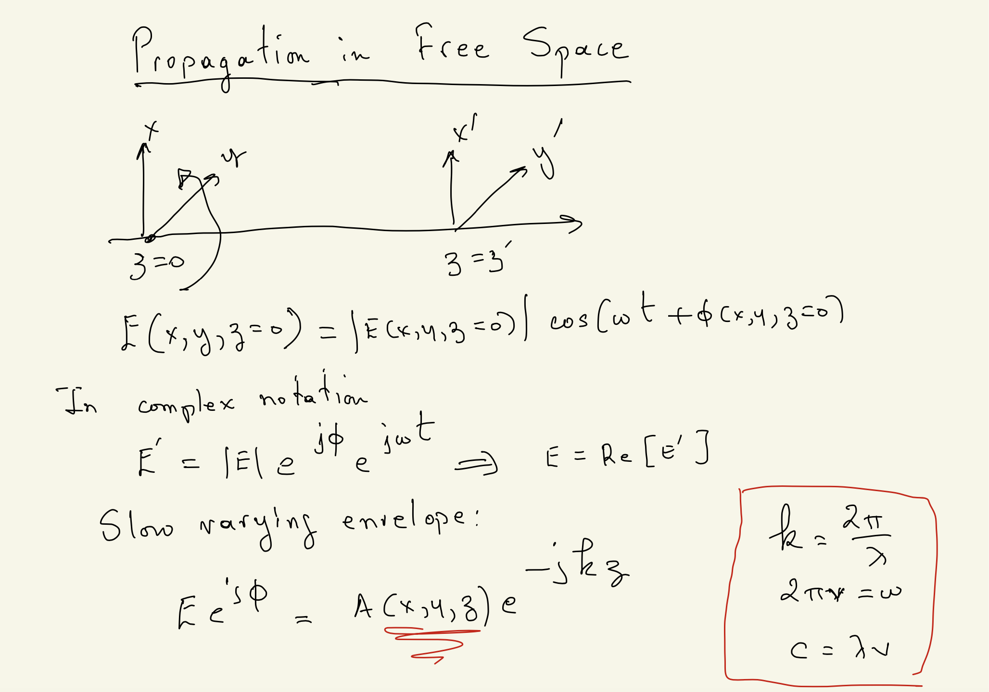

Slide 5
Beam propagation equationn

Slide 6
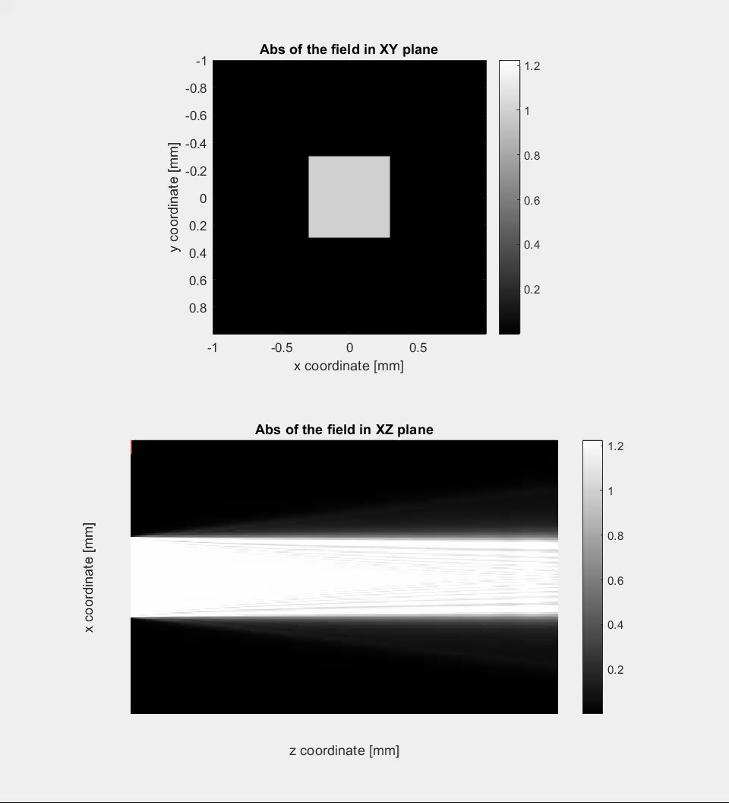
Diffraction Square aperture
1mm
20mm
1mm

Slide 7
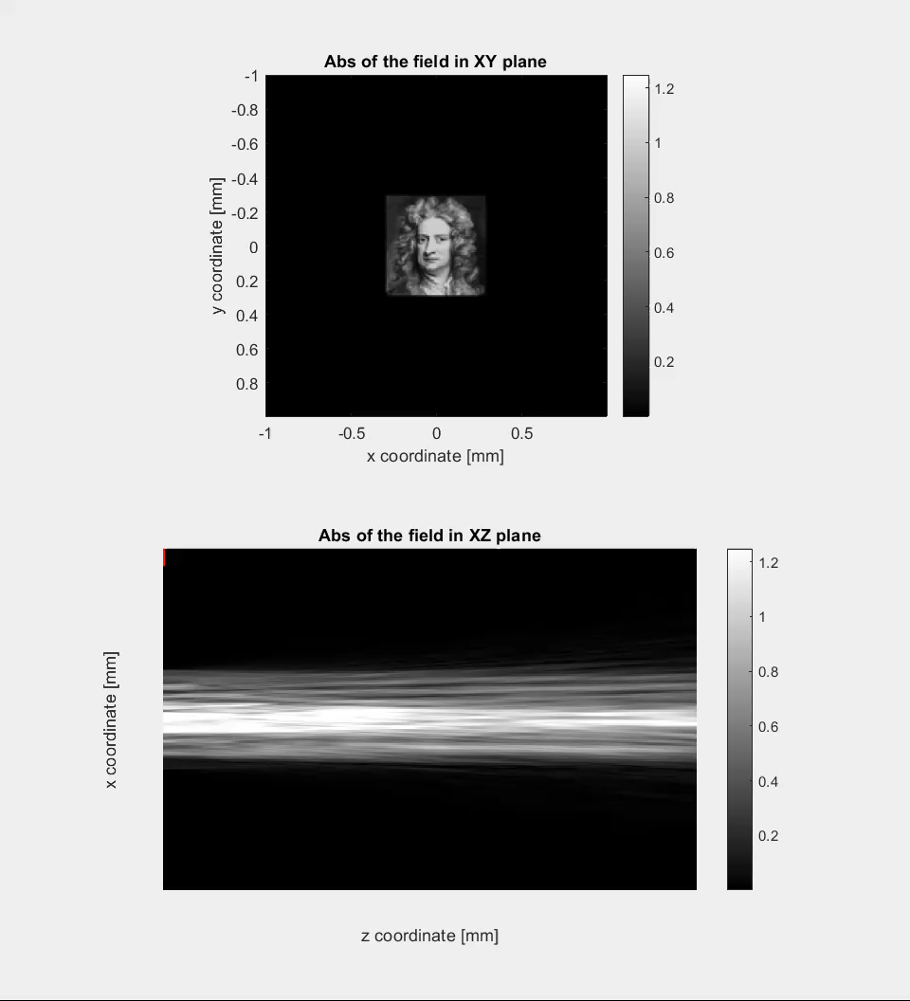
Diffraction Newton
1mm
20mm
1mm

Slide 8
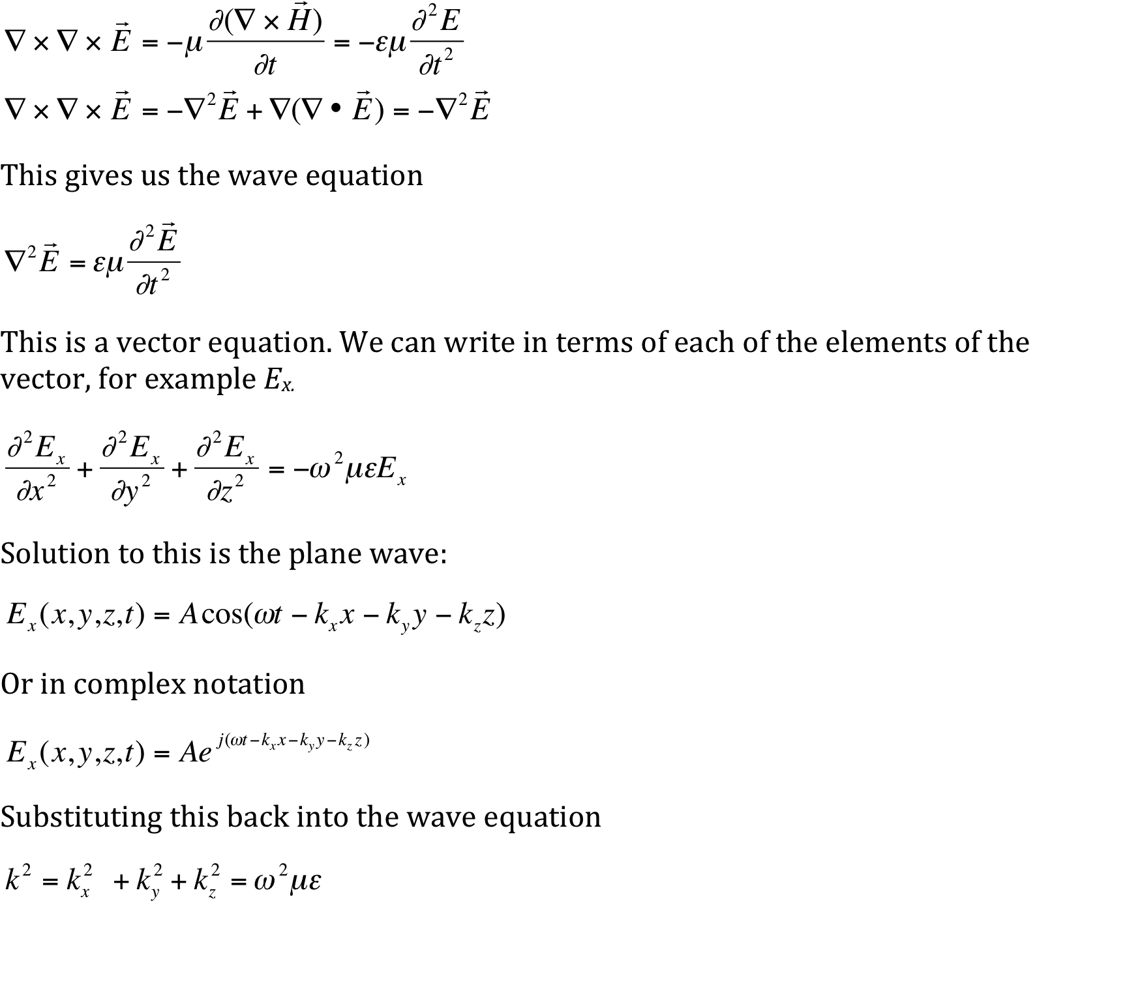
Plane waves

Slide 9
x
Plane Waves
z
λ

Slide 10
x
Plane Waves
x’
λ
z’
z
Eigenmodes and eigenvalues?

Slide 11
Gratings
D. Psaltis, Optical Waves Propagation - EPFL Photonics program doctoral course, Fall semester 2014

Slide 12
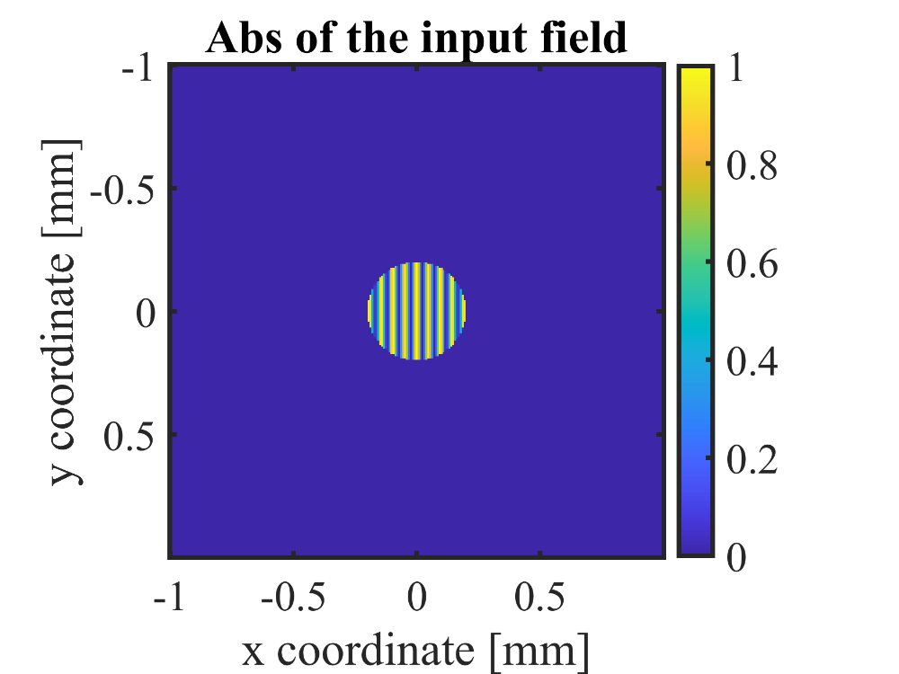
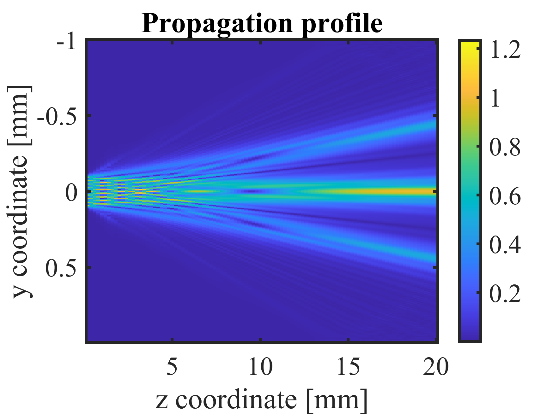
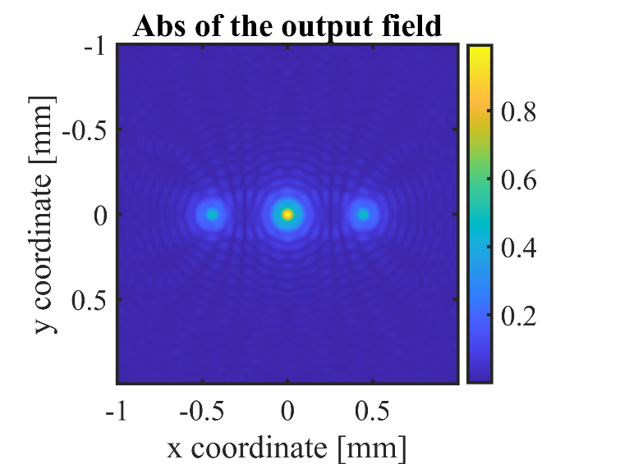

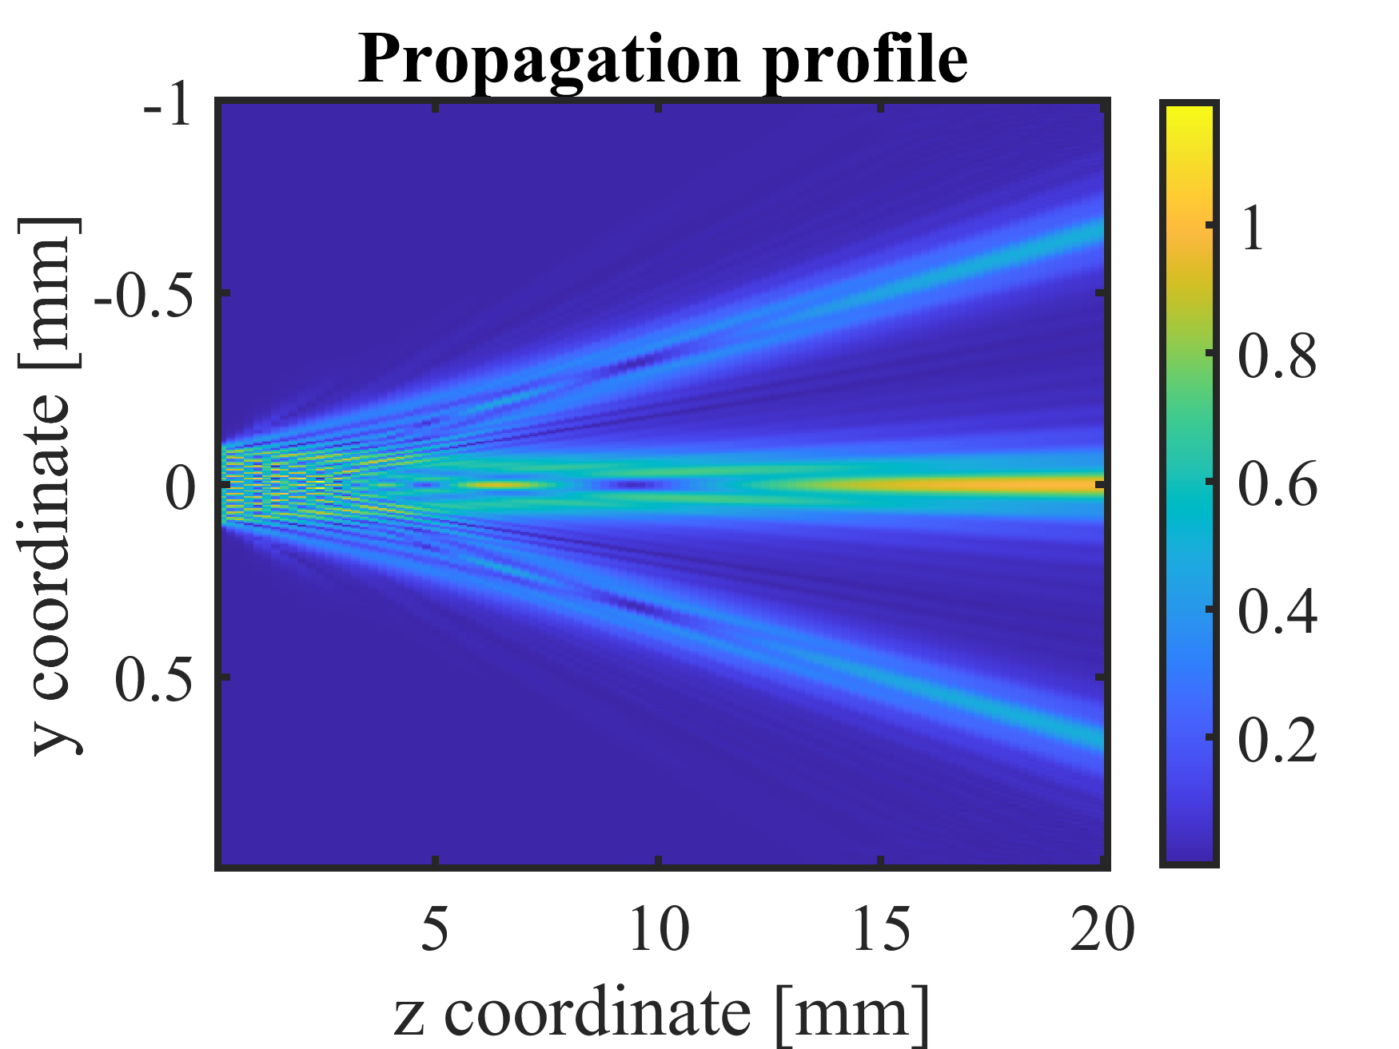
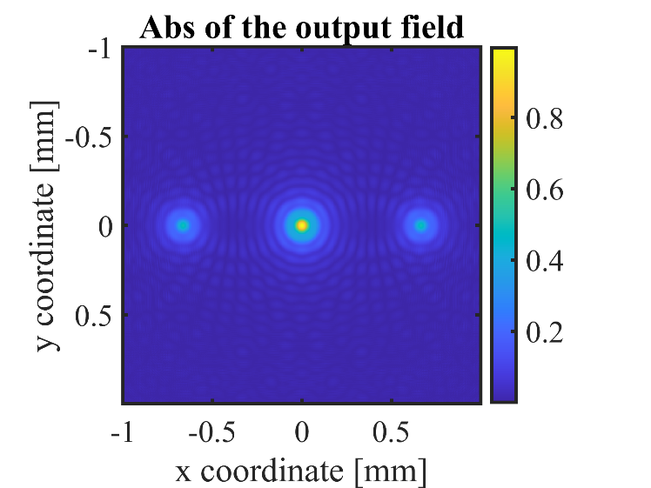
Period: 24 μm
Period: 16 μm

Slide 13
2D Fourier transform

Slide 14
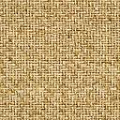
Angular spectrum
x
x’
y
y’
Y’
Z=0

Slide 15
Derivation of BPM
FT
=

Slide 16
Paraxial Approximation

Slide 17
Imaging without lenses
Talbot effect

Slide 18
Periodic structures

Slide 19
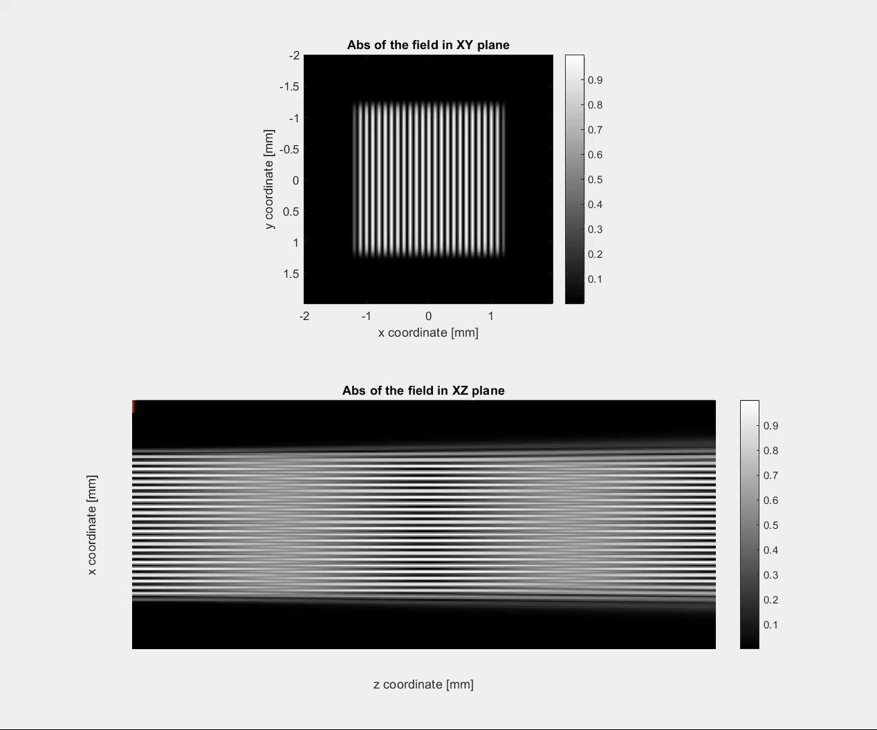
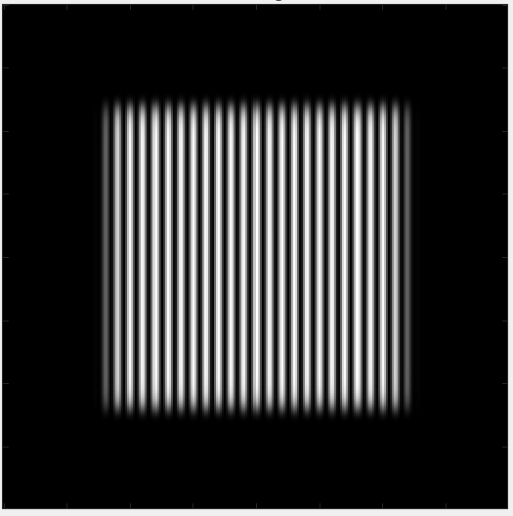
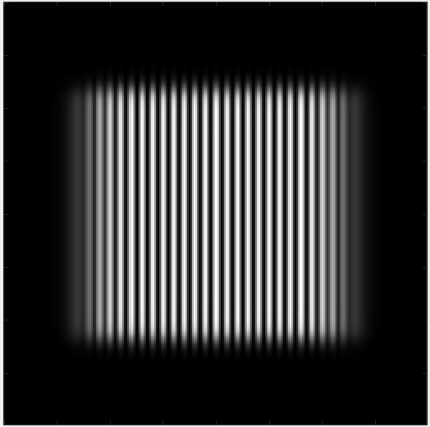
Talbot Effect
Input
Output

Slide 20
Talbot effect explanation

Slide 21
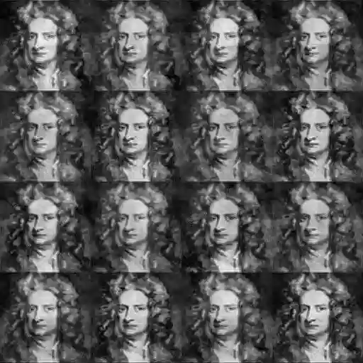

Slide 22
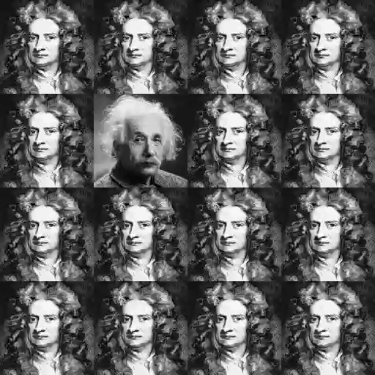

Slide 23
Imaging without lenses
Near field scanning

Slide 24
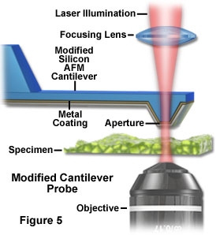
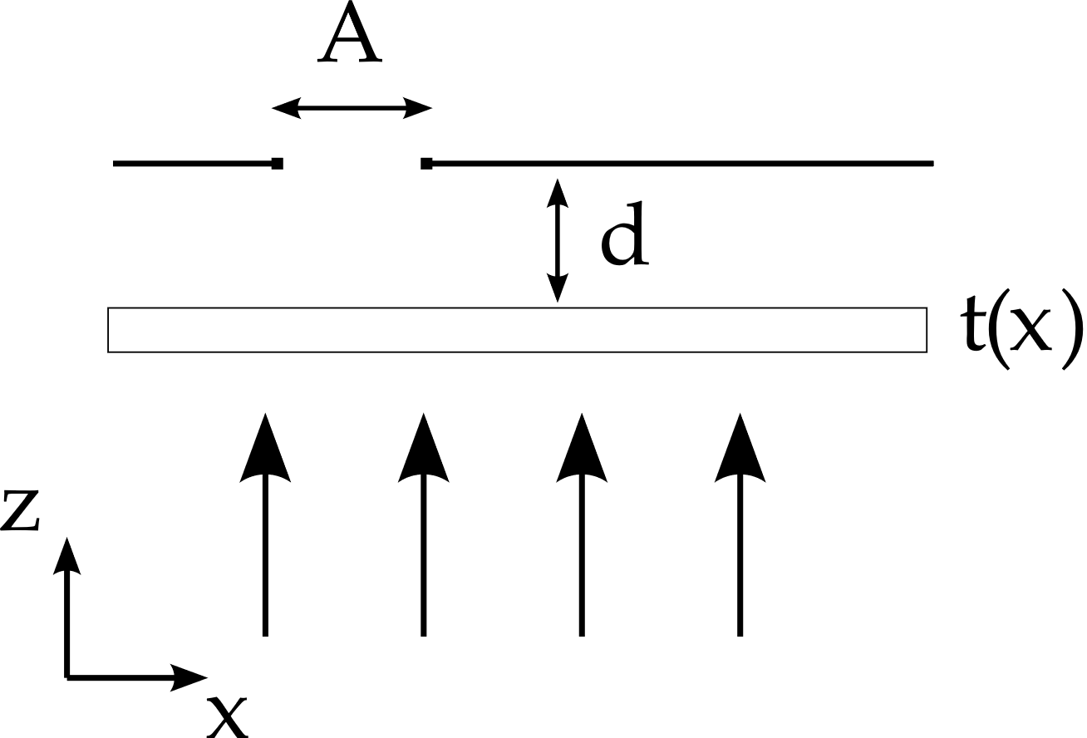
Near-field imaging

Slide 25
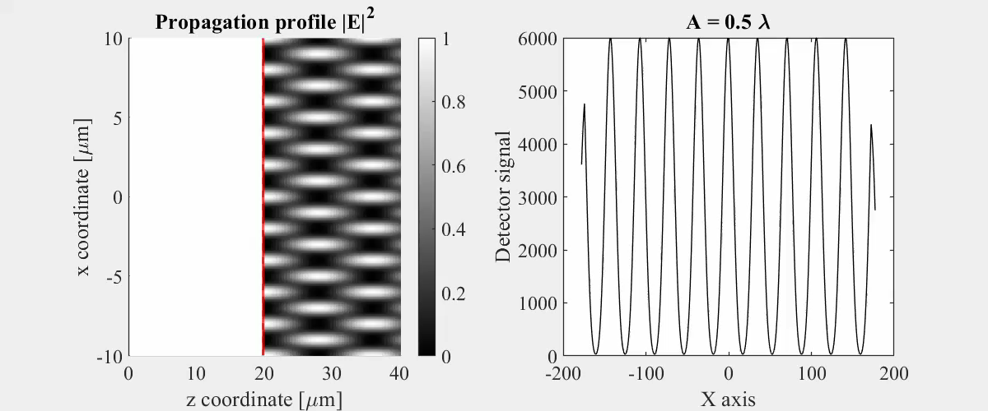
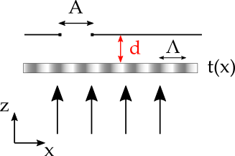

Example 1: Grating
$$t\left(x\right)=\frac{1}{2}+\frac{1}{2}\cos\left(2π\frac{x}{Λ}\right), Λ=4λ$$

Slide 26
Example 1: Grating
$$t\left(x\right)=\frac{1}{2}+\frac{1}{2}\cos\left(2π\frac{x}{Λ}\right), Λ=4λ$$

Slide 27
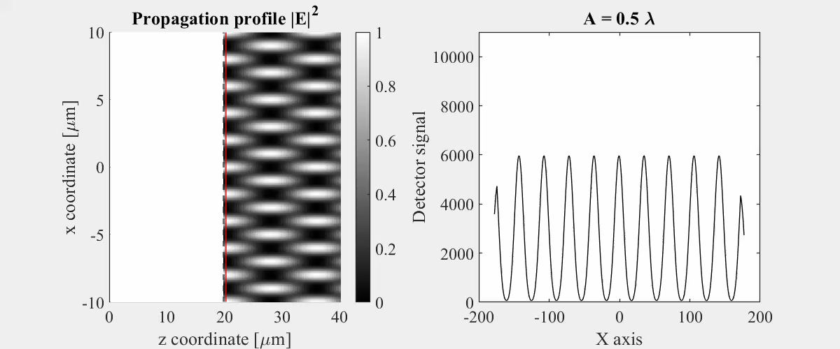
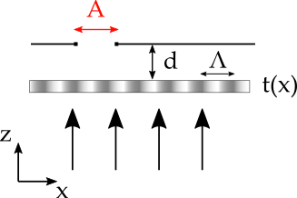
Example 1: Grating
$$t\left(x\right)=\frac{1}{2}+\frac{1}{2}\cos\left(2π\frac{x}{Λ}\right), Λ=4λ$$

Slide 28
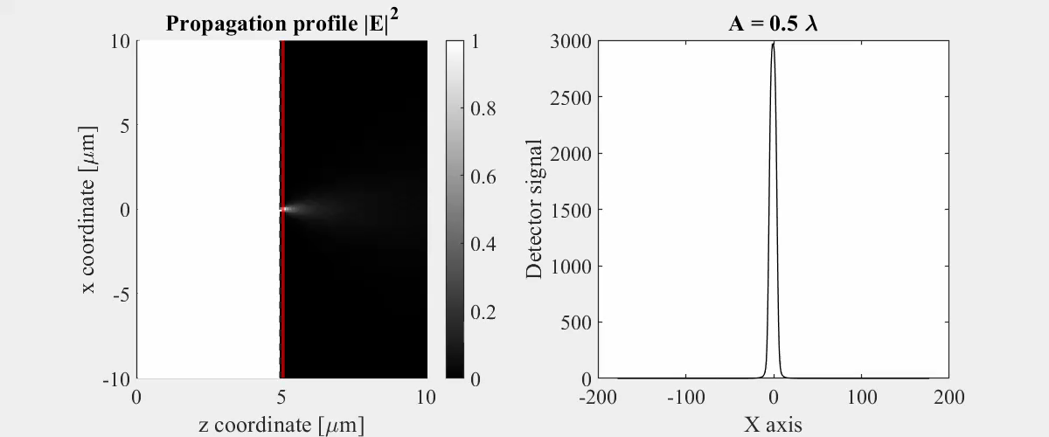
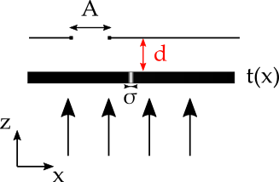

Example 2: Point source
$$σ=λ/2$$

Slide 29
Example 2: Point source
$$σ=λ/2$$

Slide 30

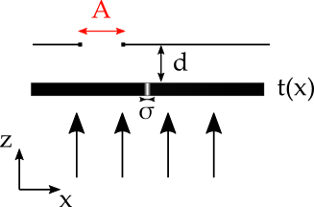
Example 2: Point source
$$σ=λ/2$$

Slide 31

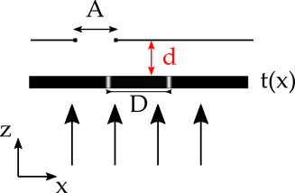

Example 3: Double slit
$$D=2λ$$

Slide 32
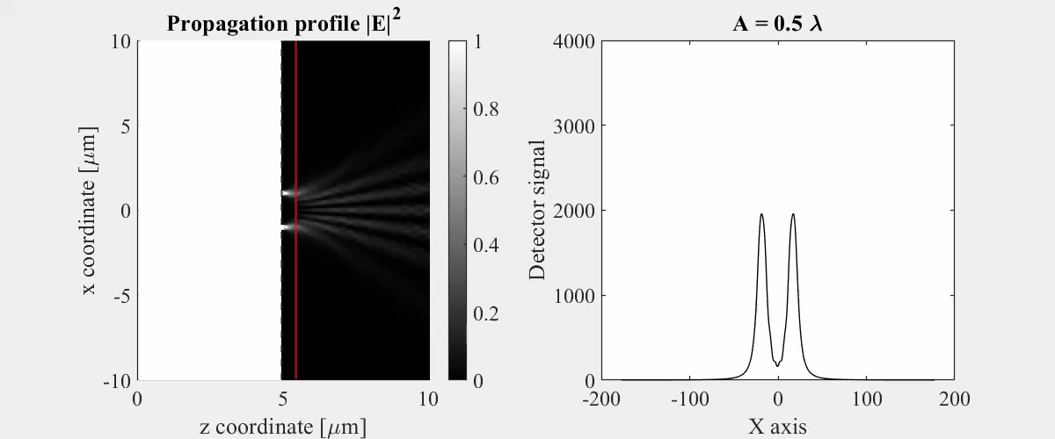
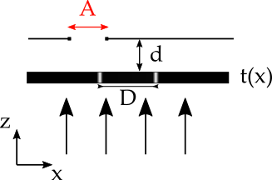
Example 3: Double slit
$$D=2λ$$

Slide 33
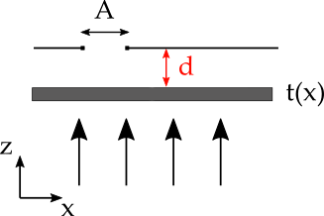
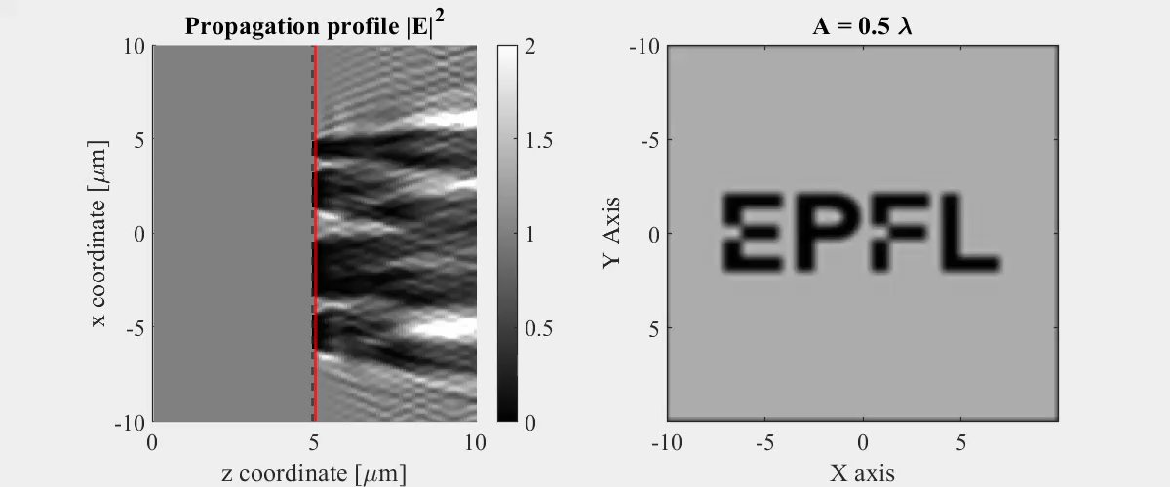
Example 4: Image

Slide 34
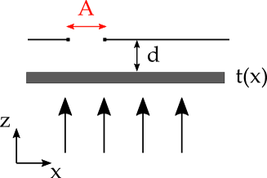
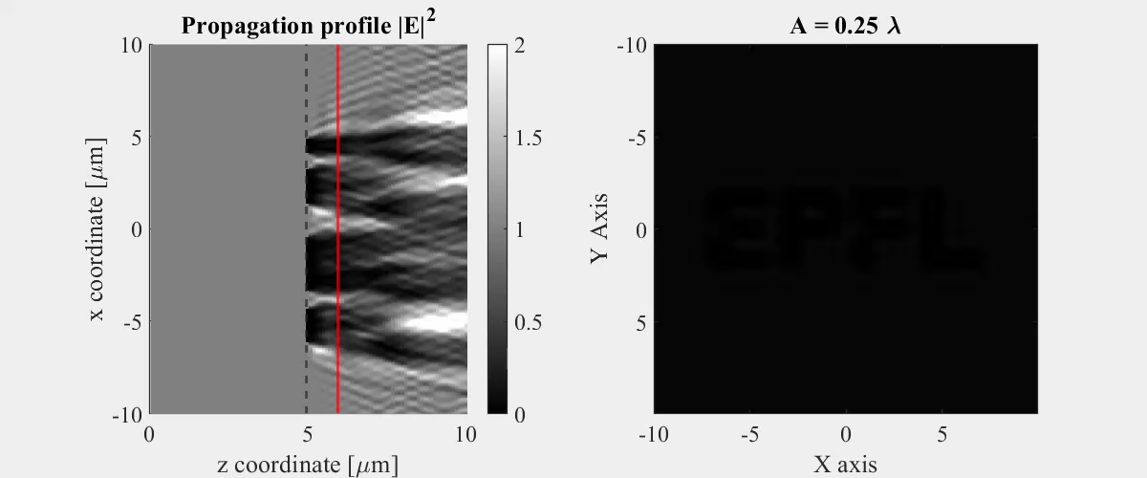
Example 4: Image

Slide 35
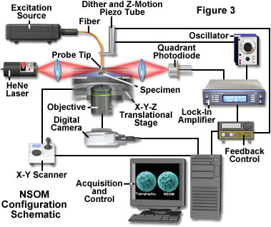

Slide 36
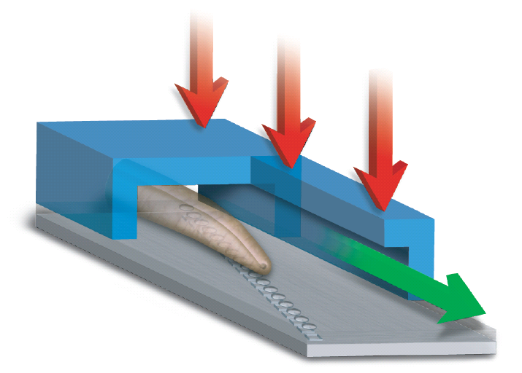

Optofluidic Microscope (OFM)
sample
illumination
flow
direction
y
hole array
metal
layer
x
linear array sensor
OFM
Conventional microscope
Xin Heng, David Erickson, Larry R. Baugh, Zahid Yaqoob, Paul Sternberg, Demetri Psaltis, Changhuei Yang.
'Optofluidic Microscopy: A Method for Implementing High Resolution Optical Microscope On A Chip,'
Lab on a Chip, August (2006)

Slide 37
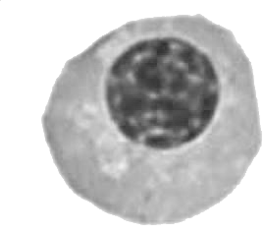
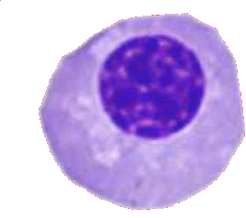
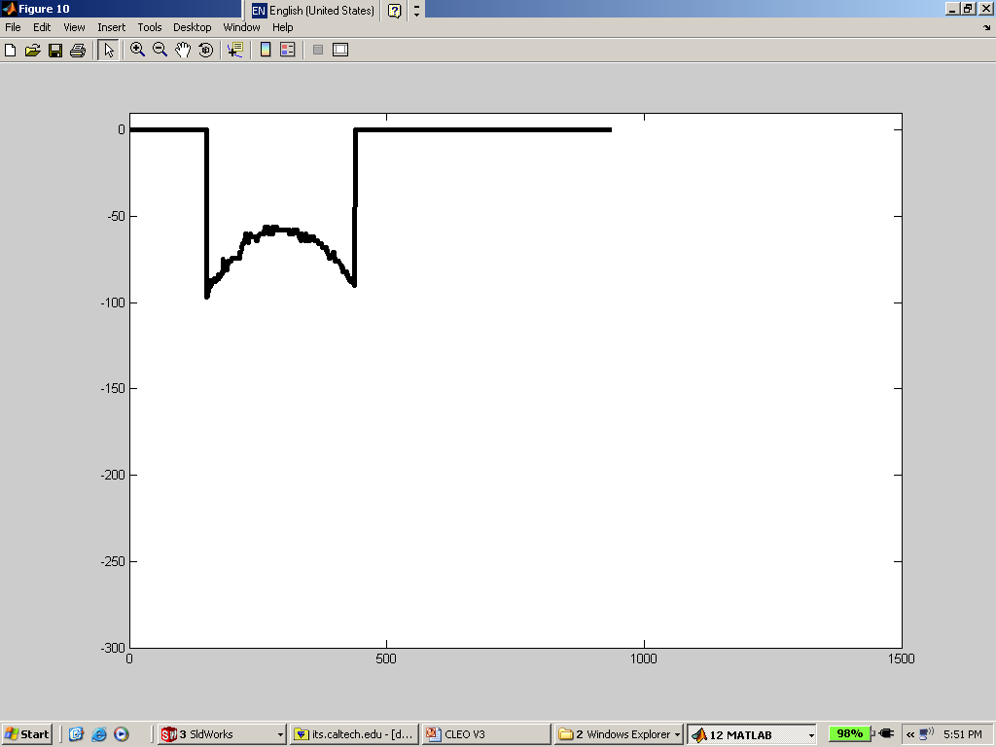
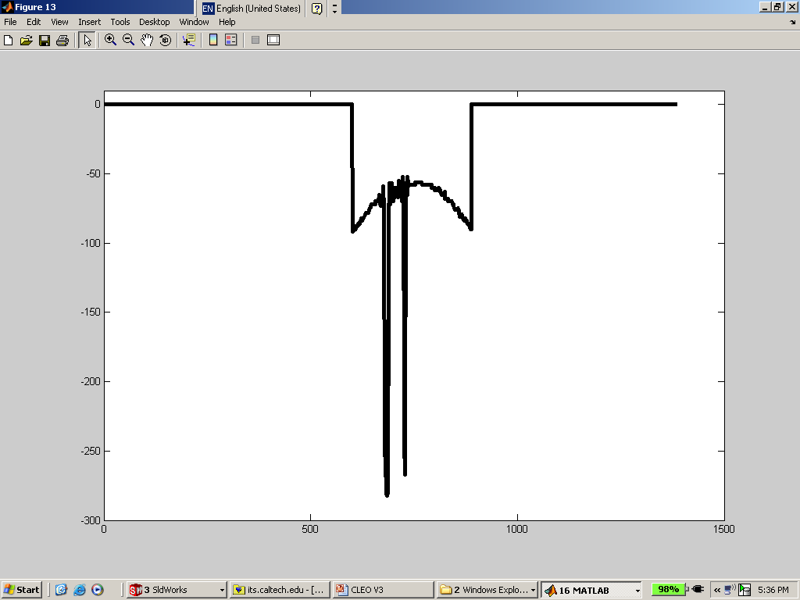
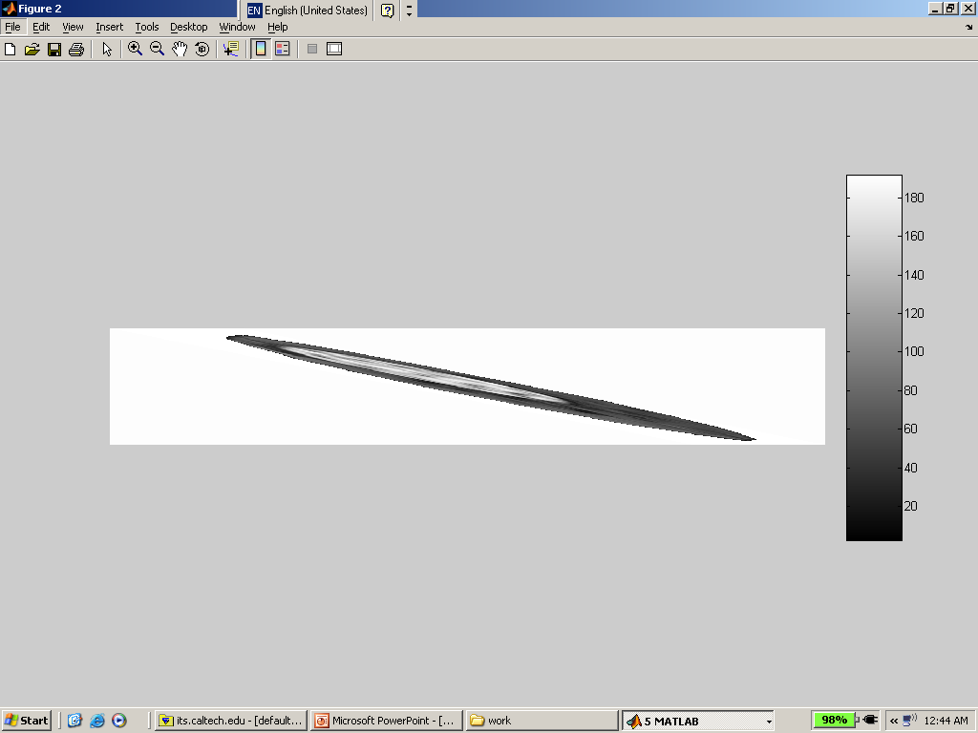
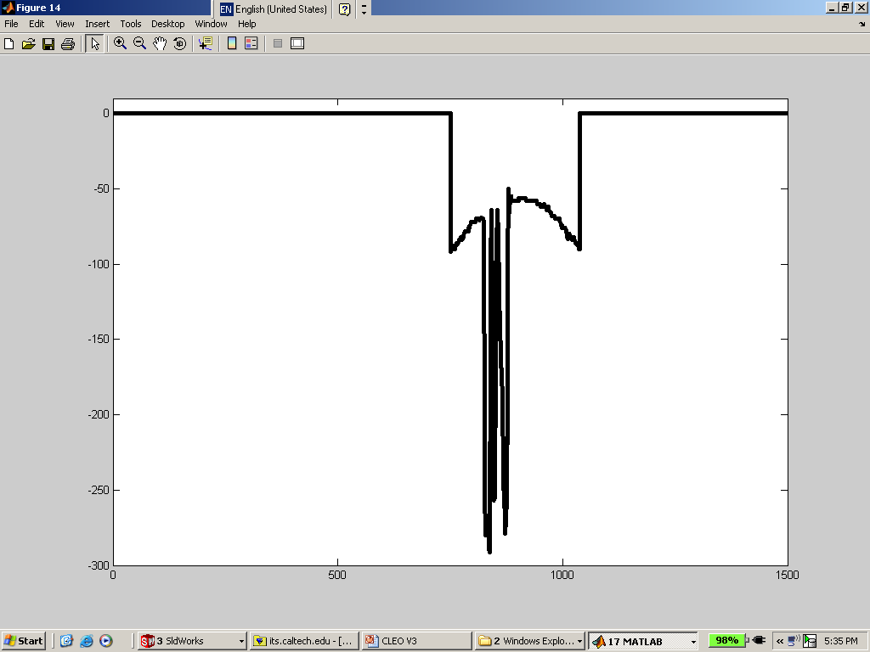
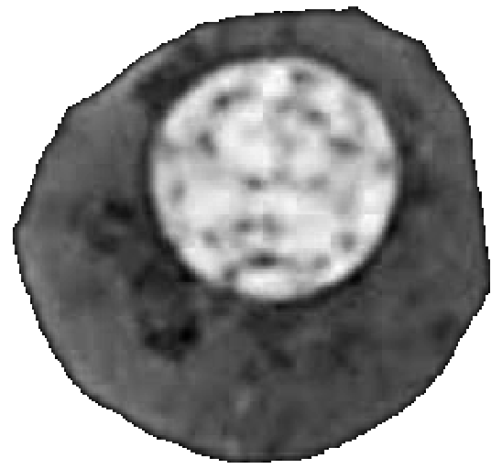
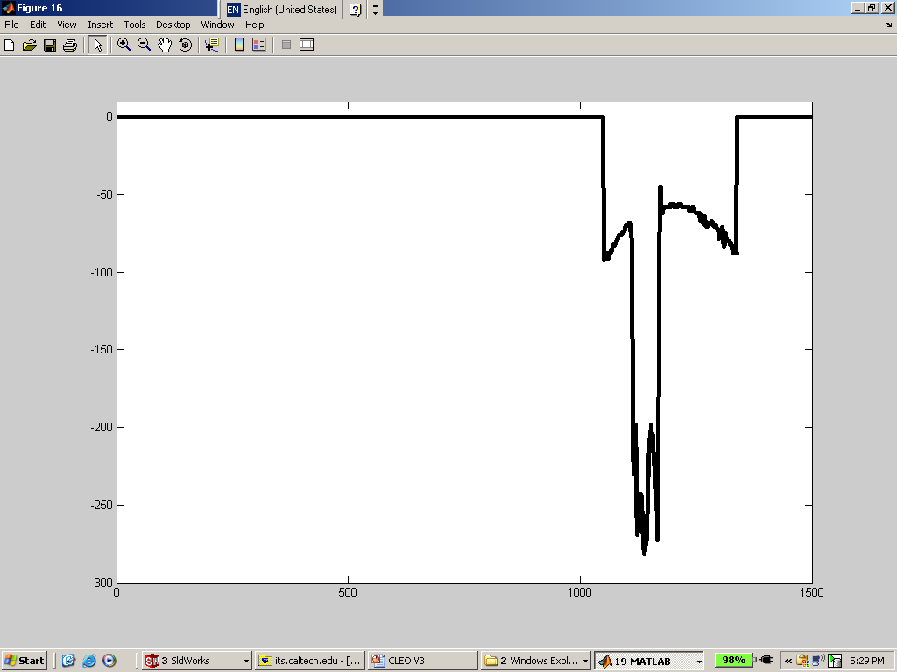
Optofluidic Microscope
(OFM)
y
x
CCD chip
Opaque layer
Hole (A)
Hole (A)
Hole (B)
Hole (C)
Hole (D)
20 µm
Slanted nanohole 1D array
Improve resolution in both x and y direction !!!
Hole (B)
Transmission changes
Hole (C)
Hole (D)
Final !!!
Shift forward linearly
Nucleated blood cell image is from http://www.wadsworth.org/chemheme/heme/glass/slide_011_nrbc.htm
time

Slide 38
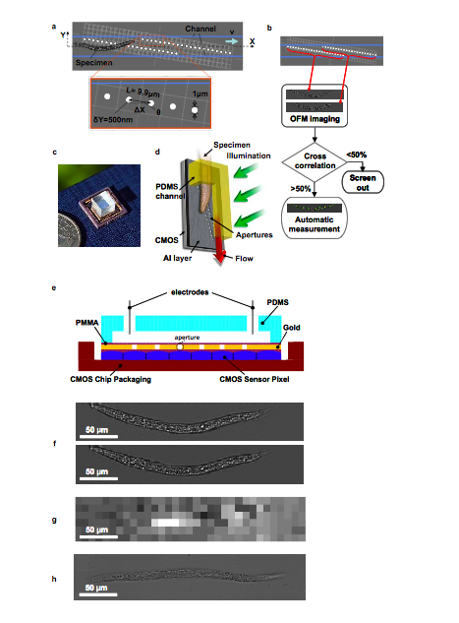
Integrated
OFM
Lensless high-resolution on-chip optofluidic microscopes for Caenorhabditis elegans and cell imaging (pdf) Cui XQ, Lee LM, Heng X, Zhong WW, Sternberg PW, Psaltis D, Yang CH Proceedings of the National Academy of Sciences of the United States of America, Vol. 105, pp. 10670-10675, August 2008

Slide 39
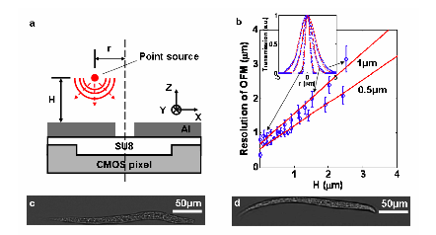
Resolution

