Slide 1
Submodular Dictionary Selection for Sparse Representation
Volkan Cevher
volkan.cevher@epfl.ch
Laboratory for Information and Inference Systems - LIONS & Idiap Research Institute
Joint work with Andreas Krause
krausea@ethz.ch
Learning and Adaptive Systems Group

Slide 2
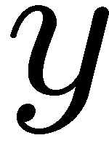
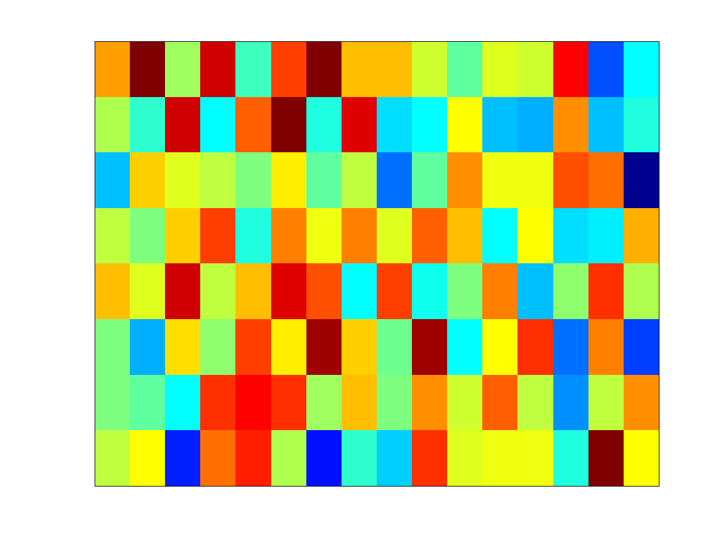
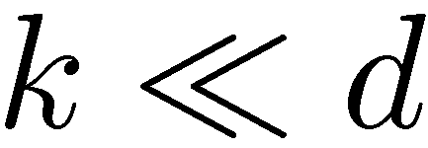
Sparse Representations
Applications du jour:
Compressive sensing,
inpainting, denoising, deblurring, …

Slide 3
Sparse Representations
Which dictionary should we use?

Slide 4
This session / talk: Learning D
Which dictionary should we use?
Suppose we have training data

Slide 5
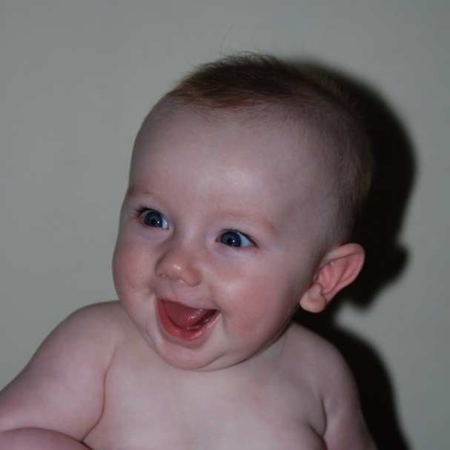
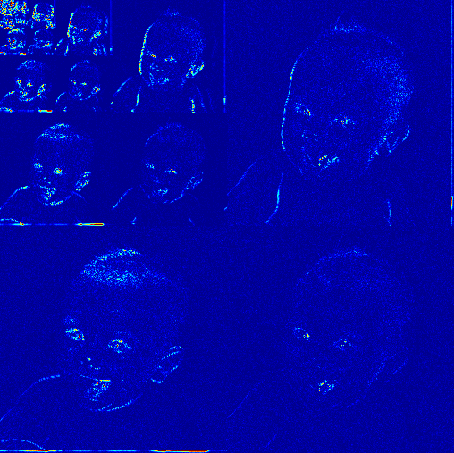
Existing Solutions
Dictionary design
functional space assumptions <> C2, Besov, Sobolev,…
ex. natural images <> smooth regions + edges
induced norms/designed bases & frames
ex. wavelets, curvelets, etc.
Dictionary learning
regularization
clustering <> identify clustering of data
Bayesian <> non-parametric approaches ex. Indian buffet processes

Slide 6
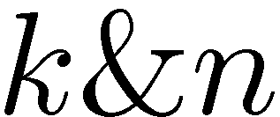
Dictionary Selection Problem—DiSP
Given
candidate columns
sparsity and dictionary size
training data
Choose D to maximize variance reduction:
reconstruction accuracy:
var. reduct. for s-th data:
overall var. reduction:
Want to solve:
Combines dictionary design and learning

Slide 7
Combinatorial Challenges in DiSP
Evaluation of
Finding D*
NP-hard!
Sparse reconstruction problem!

Slide 8
Combinatorial Challenges in DiSP
Evaluation of
Finding D* (NP-hard)
Key observations:
F(D) <> approximately submodular
submodularity <> efficient algorithms with provable guarantees
Sparse reconstruction problem!

Slide 9
(Approximate) Submodularity
Set function F submodular, if
Set function F approximately submodular, if
D
+
v
Large improvement
D’
D’
D
+
v
Small improvement

Slide 10
A Greedy Algorithm for Submodular Opt.
Greedy algorithm:
Start with
For i = 1:k do
Choose
Set
This greedy algorithm empirically performs surprisingly well!

Slide 11
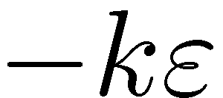
Submodularity and the Greedy Algorithm
Theorem [Nemhauser et al, ‘78]
For the greedy solution A_{G}, it holds that
Krause et al ‘08: For approximately submodular F:
Key question: How can we show that F is approximately submodular?

Slide 12
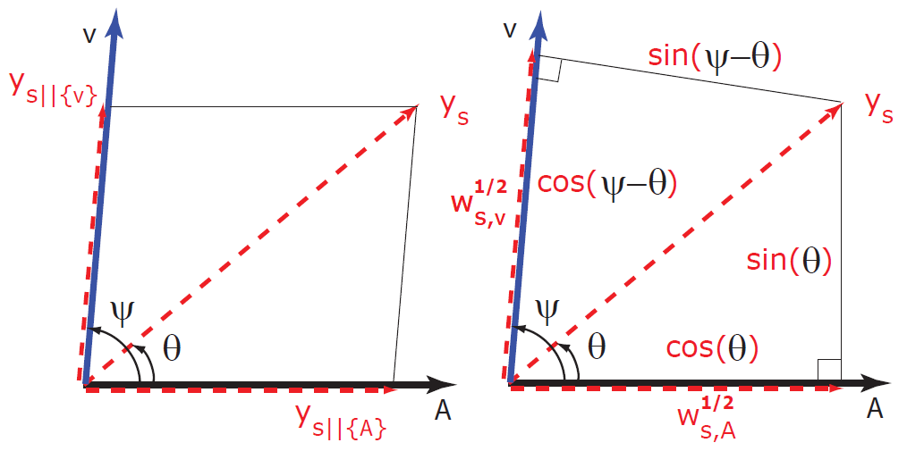
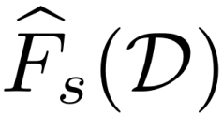
A Sufficient Condition: Incoherence
Incoherence of columns:
Define:
Proposition: is (sub)modular! Furthermore,
Thus is approximately submodular!
(modular approximation)

Slide 13
An Algorithm for DiSP: SDS_{OMP}
Algorithm SDS_{OMP}
Use Orthogonal Matching Pursuit to evaluate F for fixed D
Use greedy algorithm to select columns of D
Theorem:
SDS_{OMP} will produce a dictionary such that
Need n and k to be much less than d
SDS: Sparsifying Dictionary Selection

Slide 14
Improved Guarantees: SDS_{MA}
Algorithm SDS_{MA}
Optimize modular approximation instead of F
Use greedy algorithm to select columns of D
Theorem: SDS_{MA} will produce a dictionary such that
SDS_{MA} <> faster + better guarantees
SDS_{OMP} <> empirically performs better (in particular when μ is small)

Slide 15
Improved Guarantees for both
SDS_{MA} & SDS_{OMP}
incoherence <> restricted singular value
Theorem [Das & Kempe ‘11]: SDS_{MA} will produce a dictionary such that
explains the good performance in practice

Slide 16
Experiment: Finding a Basis in a Haystack
V union of 8 orthonormal, 64-dimensional bases (Discrete Cosine Transform, Haar, Daubechies 4 & 8, Coiflets 1, 3, 5 and Discrete Meyer)
Pick dictionary of size n=64 at random
Generate 100 sparse (k=5) signals at random
Use SDS to pick dictionary of increasing size
Evaluate
fraction of correctly recovered columns
variance reduction

Slide 17
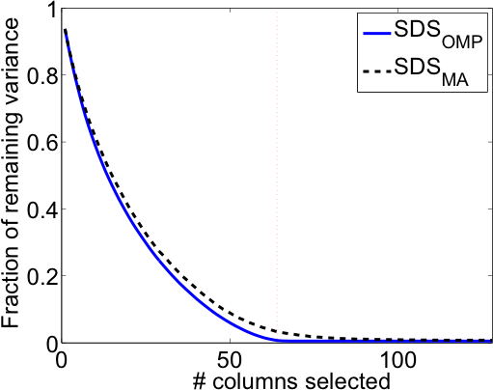
Reconstruction Performance
SDS_{OMP} <> perfect reconstruction accuracy
SDS_{MA} <> comparable the variance reduction

Slide 18
Battle of Bases on Natural Image Patches
Seek a dictionary among existing bases discrete cosine transform (DCT), wavelets (Haar, Daub4), Coiflets, noiselets, and Gabor (frame)
SDS_{OMP} prefers DCT+Gabor
SDS_{MA} chooses Gabor (predominantly)
Optimized dictionary improves compression

Slide 19
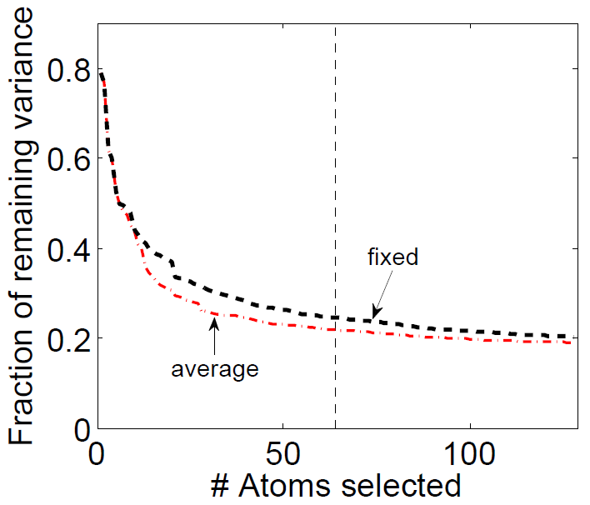
Sparsity on Average
hard sparsity <> group sparsity
cardinality constraint <> matroid constraint

Slide 20
Conclusions
Dictionary Selection <> new problem dictionary learning + dictionary design
Incoherence/ <> approximate / restricted singular value multiplicative submodularity
Two algorithms <> SDS_{MA} and SDS_{OMP} with guarantees
Extensions to structured sparsity in
ICML 2010 / J-STSP 2011
Novel connection between sparsity and submodularity

Slide 21
Experiment: Inpainting
Dictionary selection from dimensionality-reduced measurements
Take Barbara with 50% pixels missing at random
Partition the image into 8x8 patches
Optimize dictionary based on observed pixel values
“Inpaint” the missing pixels via sparse reconstruction
Caveat: This is not a representation problem.

Slide 22
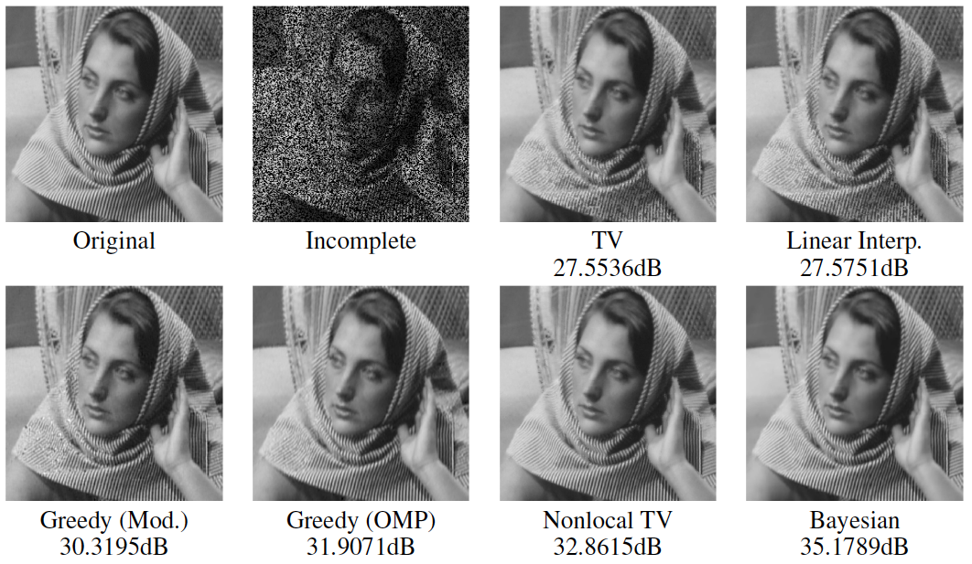
Results: Inpainting
Comparable to state-of-the art nonlocal TV;
but faster!

