Slide 1


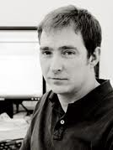

ICASSP 2012 International Conference on Acoustics Speech and Signal Processing Kyoto, Japan, March 29th, 2011
Computational Methods for Structured Sparse Component Analysis of Convolutive Speech Mixtures
Volkan Cevher
Joint work with
Afsaneh Asaei, Mike Davies, Hervé Bourlard,
École Polytechnique Fédérale de Lausanne
The University of Edinburgh
Idiap Research Institute, Martigny, Switzerland

Slide 2
Key idea
We cast the under-determined speech separation problem as a sparse signal recovery where we leverage compressive sensing theory to solve it
Incorporating the structures underlying the spectro-temporal representation in sparse component analysis
Speech Spectrographic Structures
Speech Recovery
Sparse Component Analysis
Model-based Sparse Component Analysis

Slide 3
Compressive Sensing (CS)

Slide 4



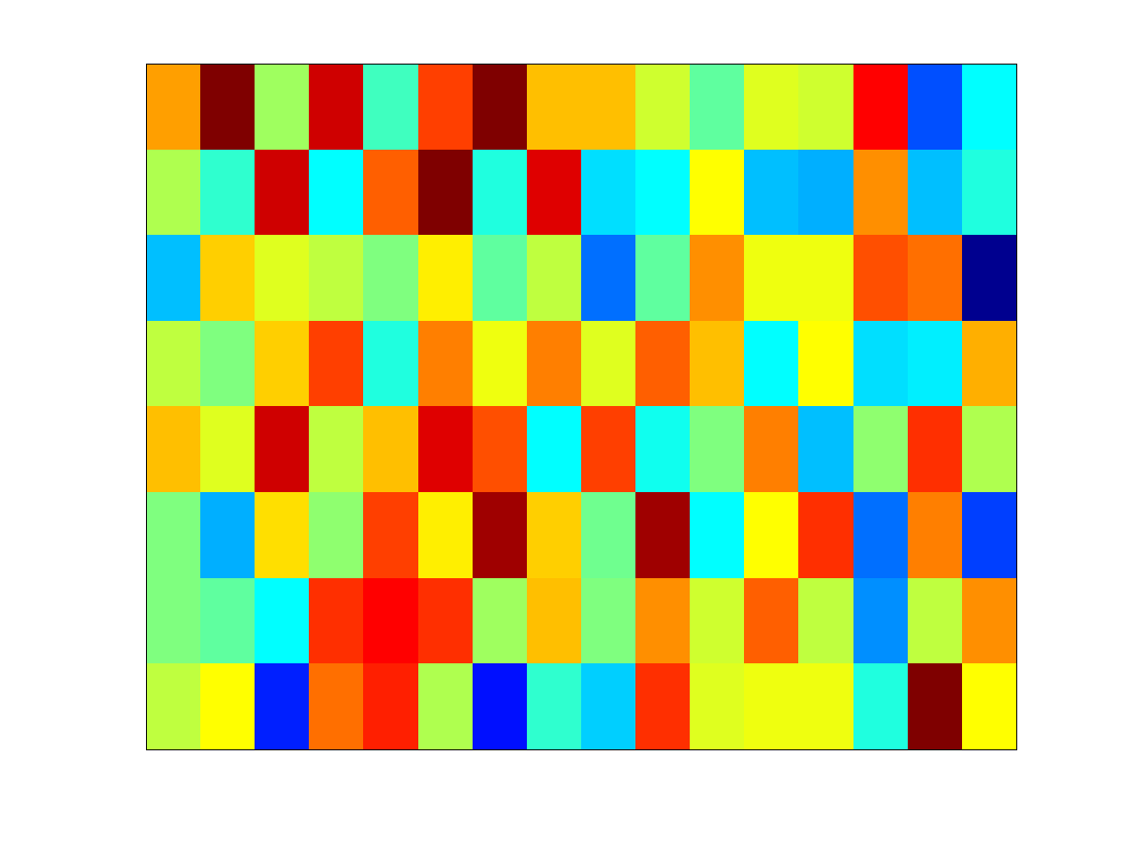

In a nutshell
CS is sensing via dimensionality reduction
Dimensionality reduction naturally happens in many problems. So, we can leverage the CS theory and algorithms.

Slide 5







Sparse signal acquisition and recovery (in theory)
Sparse representation
Only N out of G coordinates are nonzero
N<<G
Compressive measurement
Information/Distance preserving; M < G
Signal recovery
Given the observation and measurement matrix,
finds out the sparsest signal matching those observation
‏
N-planes

Slide 6
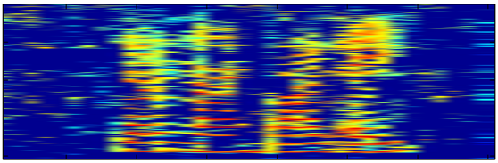
Model-based CS, in practice …
Compressible representation
Sorted coordinates decay according to the power-law
with the rate r < 1
Sparse representation of speech is obtained by Gabor expansion
Model-based signal recovery
Leveraging the structure underlying the sparse coefficients improve the recovery performance and reduces the number of required measurements
‏

Slide 7
Convolutive Speech Separation
via Model-based Sparse Component Analysis

Slide 8
Insights from 2000’s
Sparse component analysis
[Yilmaz , Rickard ; IEEE TSP’04 | Zibulevsky, Bofill; SP’01 | Saab et al. IEEE TSP’07 | Gribonval, ICASSP’02 | O’Grady, Pearlmutter; ICA’04 | Georgiev et al.; IEEE TNN’05]
Source localization by sparse recovery
[Cevher et al. IPSN’09 | Model and Zibulevsky; SP’06 | Malioutov, Cetin, and Willsky; IEEE TSP’05 | Guo et al. MSSP’10 | Chen et al.; Proc. of IEEE’03]
Contribution of this work
Model-based sparse recovery
Model-based characterization of the convolutive acoustic measurements
Importance of the ad-hoc microphone set-up

Slide 9
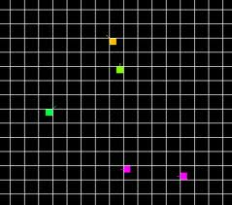
I. Sparse representation
Spatial sparsity
discretize the room into G dense grids
only very few have speech activity
Spatio-spectral representation
Process the signal in spectro-temporal domain
Block-dependency model
Harmonicity model
‏

Slide 10

II. Measurement matrix
Natural compressive measurements are manifested
by the media Green’s function [Carin’09]
Image Model of multi-path effect
source at ; sensor at
Microphone array measurement matrix
‏
Reflection coefficient
Speed of sound

Slide 11
III. Signal recovery
Objective: recover N-sparse signal
Array observation:
Measurement matrix:
Challenge:
Sparsity gives enough prior information to overcome the ill-posed nature of the inverse problem
The recovery algorithm seeks the sparsest solution

Slide 12
Iterative Hard Thresholding (IHT)
Orthogonal Matching Pursuit (OMP)
Convex optimization (L₁L₂)
Structures
Block-dependency
Harmonicity
III. Signal recovery, cont.

Slide 13

Speech separation set-up
Reverberation time: 200ms
Grid resolution: 0.6m×0.6m and room dimension = 3m×3m×3m
Interference 3
1.5m
Interference 2
1m
0.86m
0.2m
1.5m
1.3m
0.64m
0.44m
Target speech
1.4m
1.3m
Interference 1
Interference 4

Slide 14
Quality of the recovered speech
Source to Distortion Ratio (SDR) obtained by different sparse recovery approaches
Baseline SDR = -3dB

Slide 15
Quality of the recovered speech, cont
PESQ: Perceptual Evaluation of Speech Quality
PESQ ranges from 0.5 to 4.5 (clean speech)
Baseline PESQ = 1.44
Topology | B-IHT | H-IHT | B-OMP | H-OMP | B-L₁L₂ | H-L₁L₂
uniform | 2.26 | 2.35 | 2.49 | 1.63 | 2.77 | 2.55
Ad-hoc | 2.33 | 2.36 | 2.69 | 2 | 2.83 | 2.52

Slide 16
Conclusions
Information bearing components of speech are sparse in spectro-temporal domain
Sparse component analysis is a potential approach to deal with the problem of overlapping speech in realistic scenarios
Structured sparsity models provide more efficient signal estimation from very few measurements
Motivates incorporation of speech models in multi-channel sparse component analysis
Ad-hoc microphone arrays offer substantial improvement over the compact microphones

Slide 17
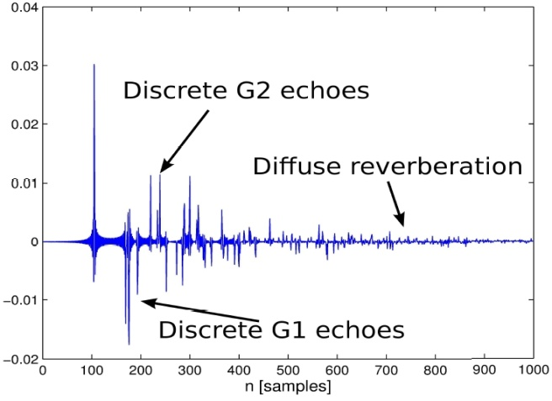
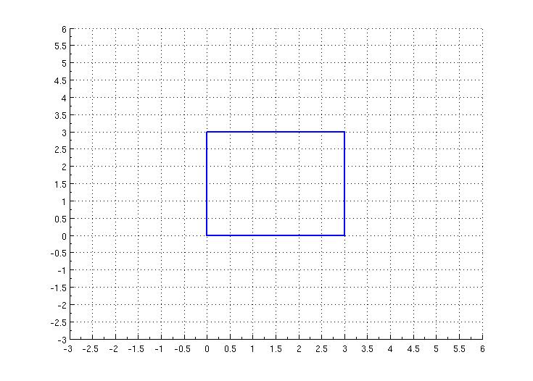
II. Measurement matrix, cont.
First-and-second generation of echoes is a unique signature of the room geometry*
We identify the early support of the RIR based on sparse approximation of a single source and its images in a free-space model
Room geometry is estimated by the best fit of the estimated early support of RIR and the first-and-second generation of the virtual sources using the Image model in least-squares sense
* “Can one hear the shape of a room: The 2-D polygonal case”, I. Dokmanic, Y. M. Lu and M. Vetterli, ICASSP 2011.
‏

