Slide 1
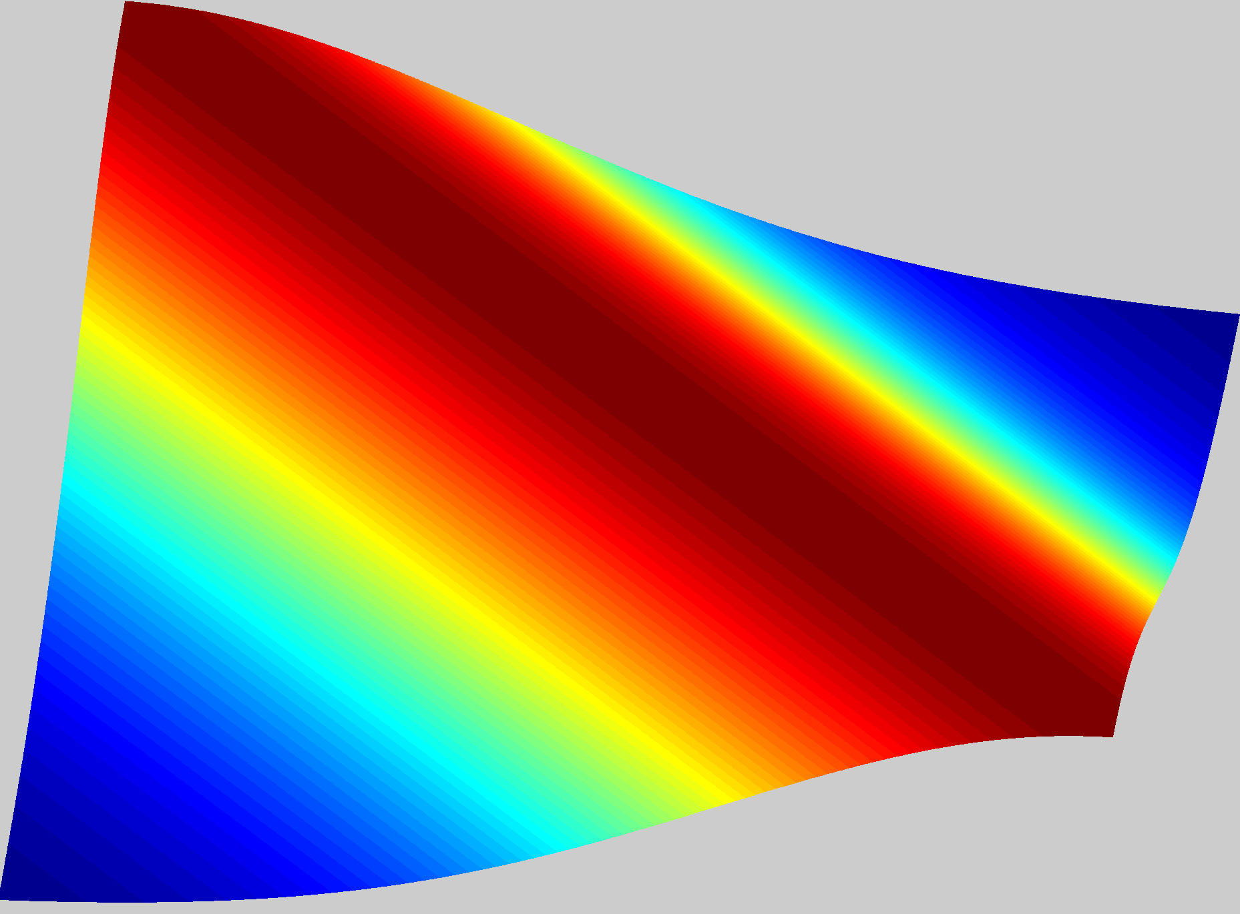
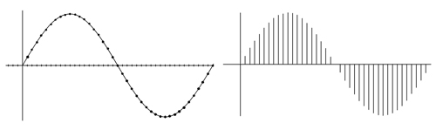
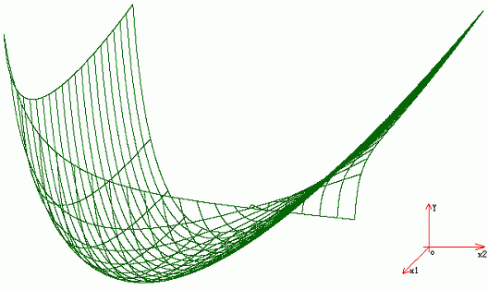
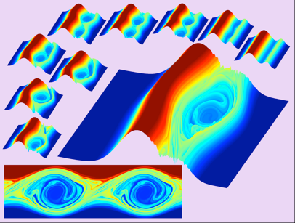







Learning Non-Parametric Basis Independent Models from Point-Queries via Low-rank Methods
Volkan Cevher
Laboratory for Information and Inference Systems (LIONS) École Polytechnique Fédérale de Lausanne (EPFL) Switzerland
http://lions.epfl.ch
joint work with
Hemant Tyagi
Anastasios Kyrillidis
lions@epfl

Slide 2
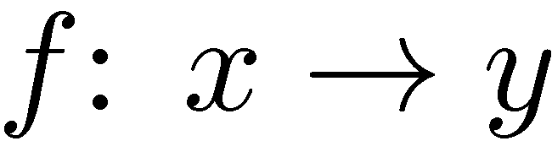
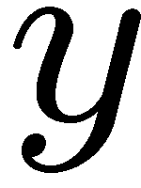
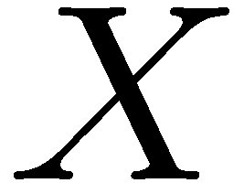

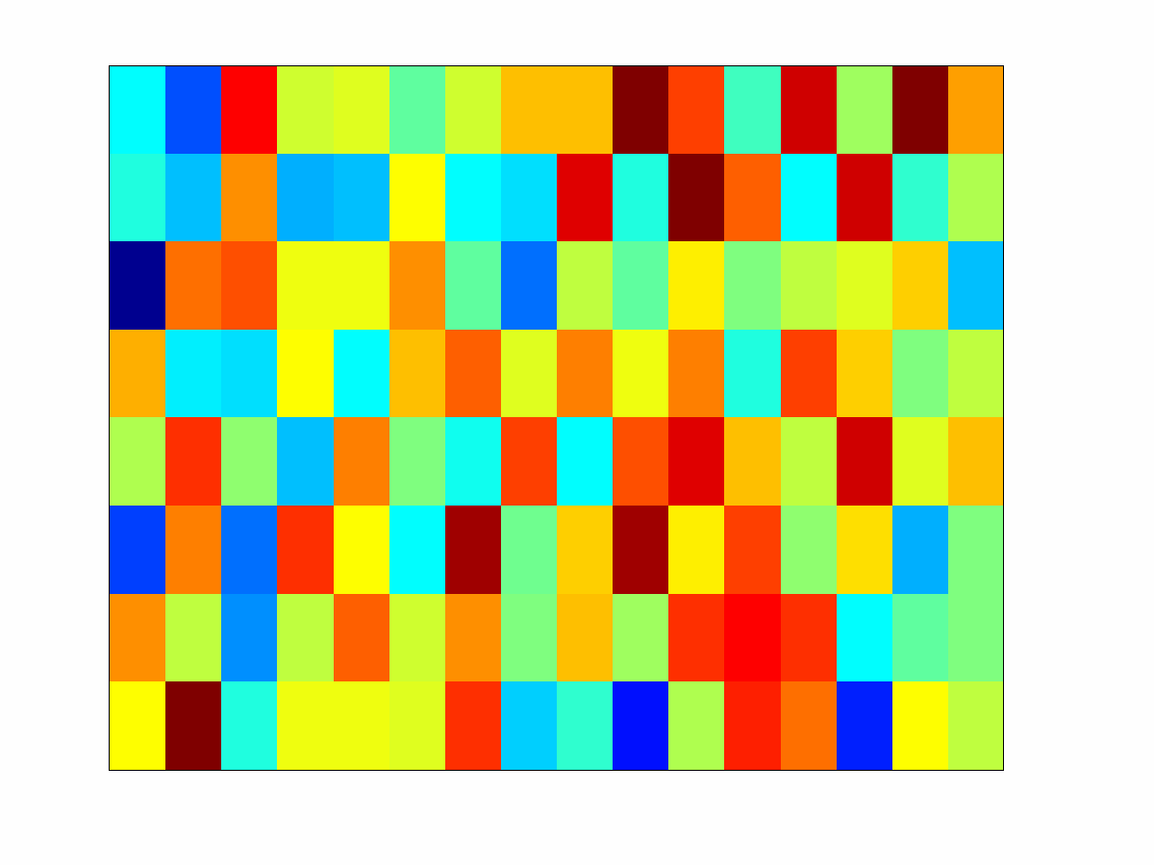

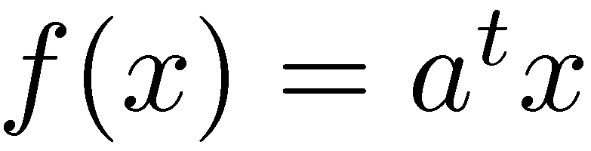
Function learning
A fundamental problem:
given learn a mapping
some call it “regression”
Oft-times f <> parametric form
e.g., linear regression
learning the model
=
learning the parameters

Slide 3
Function learning
A fundamental problem:
given learn a mapping
some call it “regression”
Oft-times f <> parametric form
e.g., linear regression
familiar challenge: learning via dimensionality reduction
learning the model
=
learning the parameters

Slide 4
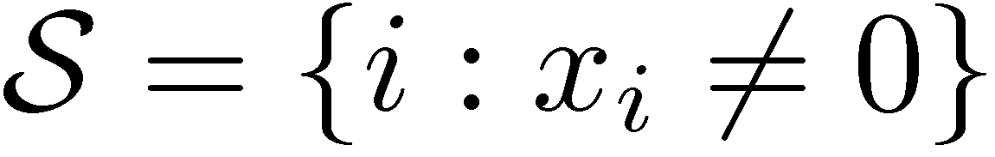

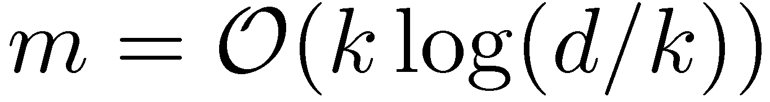
Function learning
A fundamental problem:
given learn a mapping
some call it “regression”
Oft-times f <> parametric form
e.g., linear regression
familiar challenge: learning via dimensionality reduction
learning a
low-dimensional model
=
successful learning the parameters

Slide 5
Function learning
A fundamental problem:
given learn a mapping
some call it “regression”
Oft-times f <> parametric form
e.g., linear regression
low-dim models >> successful learning
sparse, low-rank…
Any parametric form <> at best an approximation
emerging alternative: non-parametric models
learn f from data!

Slide 6
Function learning
A fundamental problem:
given learn a mapping
some call it “regression”
Oft-times f <> parametric form
e.g., linear regression
low-dim models >> successful learning
sparse, low-rank…
Any parametric form <> at best an approximation
emerging alternative: non-parametric models
this talk → learn low-dim f from data!

Slide 7
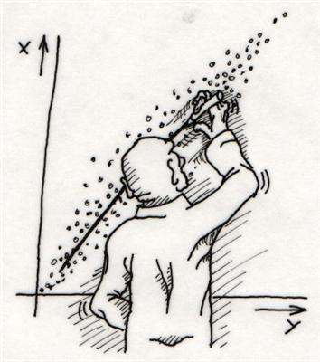
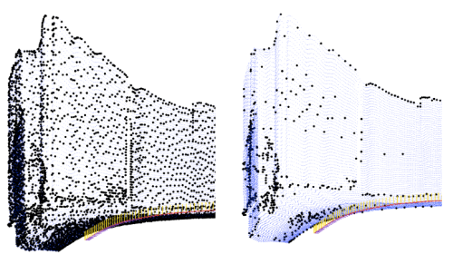
Nonparametric model learning
Two distinct camps:
1. Regression <> use given samples approximation of f
Active learning <> design a sampling scheme approximation of f
maximization/optimization of f
[Friedman and Stuetzle 1981; Li 1991, 1992; Lin and Zhang 2006; Xia 2008; Ravikumar et al., 2009; Raskutti et al., 2010]
(experimental design)
[Cohen et al., 2010; Fornasier, Schnass, Vybiral, 2011; VC and Tyagi 2012; Tyagi and VC 2012]
[Srinivas, Krause, Kakade, Seeger, 2012]

Slide 8
Nonparametric model learning—our contributions
Two distinct camps:
1. Regression <> use given samples approximation of f
Active learning <> design a sampling scheme approximation of f
maximization/optimization of f
[Friedman and Stuetzle 1981; Li 1991, 1992; Lin and Zhang 2006; Xia 2008; Ravikumar et al., 2009; Raskutti et al., 2010]
(experimental design)
[Cohen et al., 2010; Fornasier, Schnass, Vybiral, 2011; VC and Tyagi 2012; Tyagi and VC 2012]
[Srinivas, Krause, Kakade, Seeger, 2012]

Slide 9

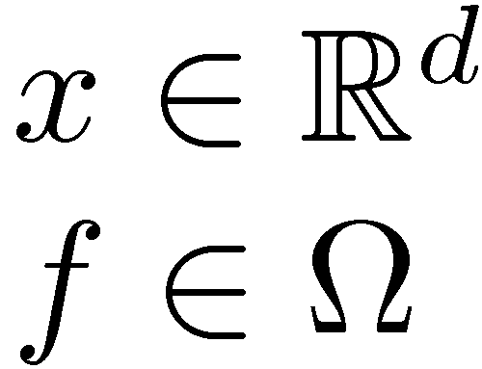
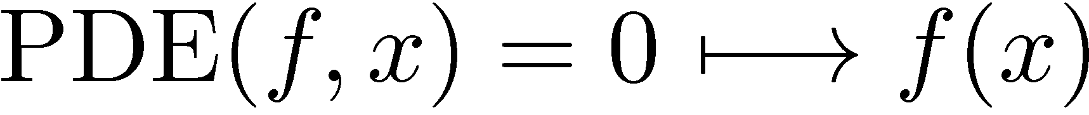
Active function learning
A motivation by Albert Cohen
Numerical solution of parametric PDE’s
query of the solution <> running an expensive simulation
: the (implicit) solution

Slide 10
Active function learning
A motivation by Albert Cohen
Numerical solution of parametric PDE’s
query of the solution <> running an expensive simulation
learn an explicit approximation of f via multiple queries
: the (implicit) solution

Slide 11
Active function learning
A motivation by Albert Cohen
Numerical solution of parametric PDE’s
query of the solution <> running an expensive simulation
ability to choose the samples <> active learning
: the (implicit) solution

Slide 12

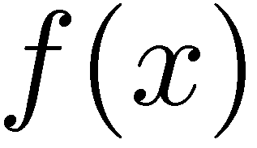


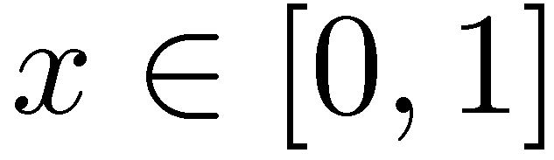
Learning via interpolation

Slide 13
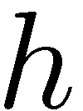
Learning via interpolation

Slide 14
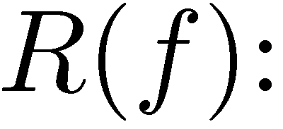
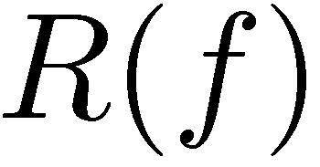
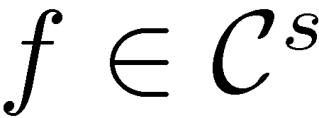
Learning via interpolation
Error characterization for smooth
reconstruction via, e.g., linear interpolation

Slide 15
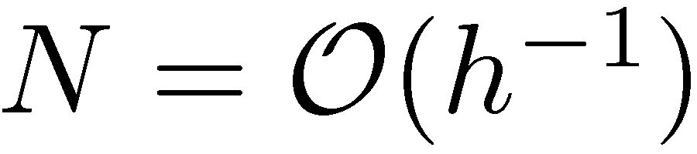
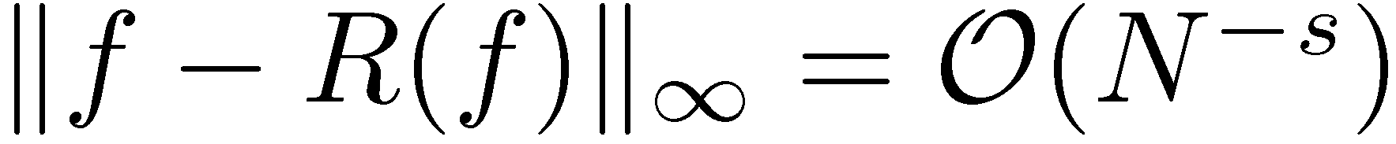
Learning via interpolation
Error characterization for smooth
number of samples <>
reconstruction via, e.g., linear interpolation

Slide 16

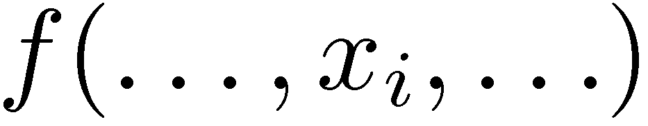
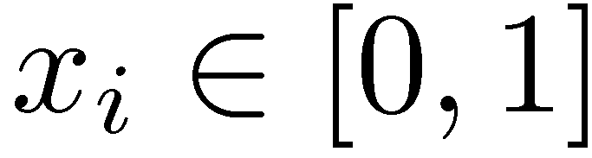
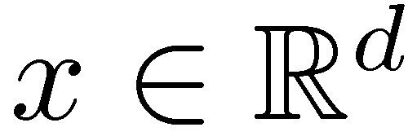
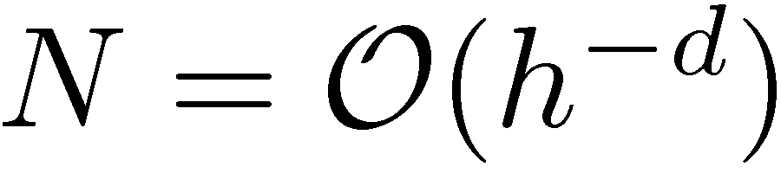
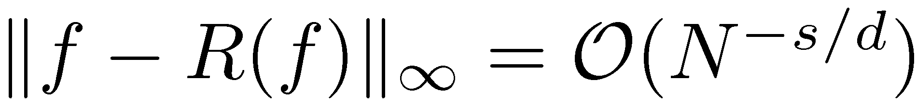
Learning via interpolation
Curse-of-dimensionality
Error characterization for smooth and
number of samples <>
reconstruction via, e.g., linear interpolation

Slide 17
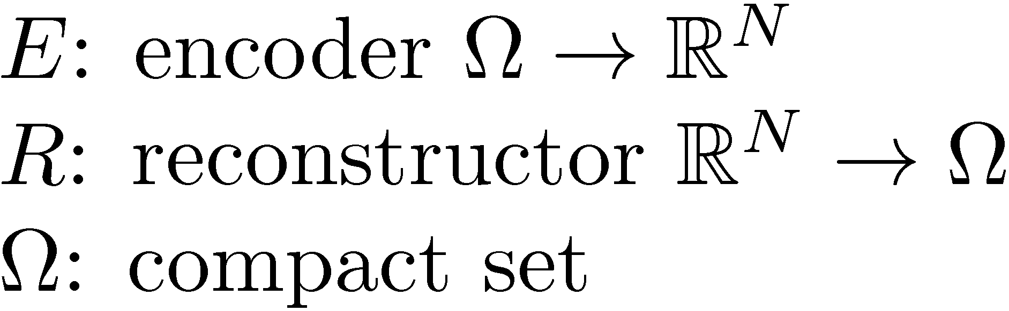
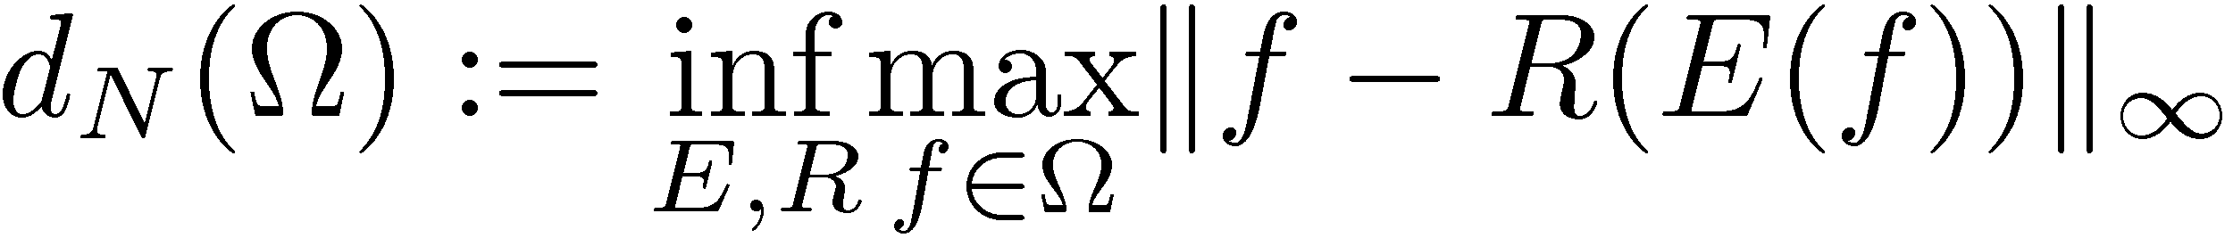
Learning via interpolation
Curse-of-dimensionality
The nonlinear N-width
infimum is taken over all continuous maps (E,R)
[Traub et al., 1988; Devore, Howard, and Micchelli 1989]

Slide 18
Learning via interpolation
Curse-of-dimensionality
The nonlinear N-width
infimum is taken over all continuous maps (E,R)
[Traub et al., 1988; Devore, Howard, and Micchelli 1989]

Slide 19
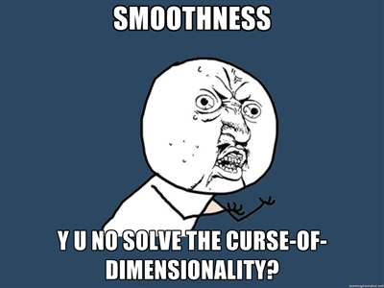
Learning via interpolation
Curse-of-dimensionality
The nonlinear N-width
infimum is taken over all continuous maps (E,R)
Take home message
smoothness-only >> intractability in sample complexity
need additional assumptions on the problem structure!!!
[Traub et al., 1988; Devore, Howard, and Micchelli 1989; Nowak and Wosniakowski 2009]

Slide 20
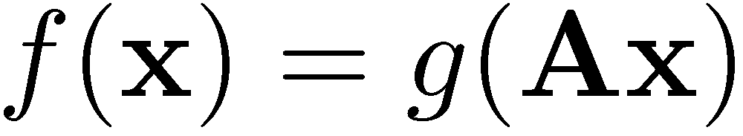
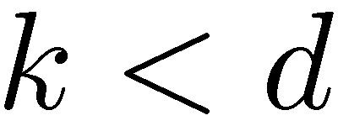
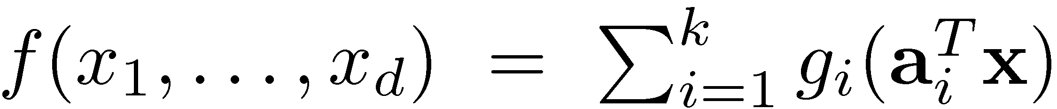
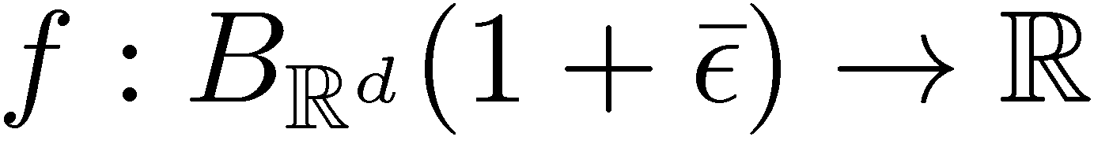
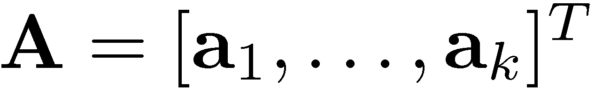
Learning multi-ridge functions
Objective: approximate multi-ridge functions via point queries
other names: multi-index models partially linear single/multi index models generalized additive model sparse additive models…
Model 1:
Model 2:
[Friedman and Stuetzle 1981; Li 1991, 1992; Lin and Zhang 2006; Xia 2008; Ravikumar et al., 2009; Raskutti et al., 2010; Cohen et al., 2010; Fornasier, Schnass, Vybiral, 2011; VC and Tyagi 2012; Tyagi and VC 2012]

Slide 21


Prior Art

Slide 22
Prior work—Regression camp
local smoothing <> first order low-rank model a common approach in nonparametric regression (kernel, nearest neighbor, splines)
[Friedman and Stuetzle 1981; Li 1991, 1992; Fan and Gijbels 1996; Lin and Zhang 2006; Xia 2008]

Slide 23

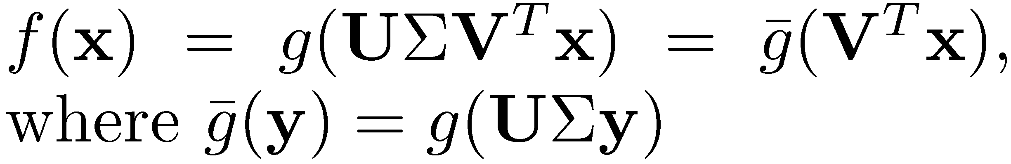
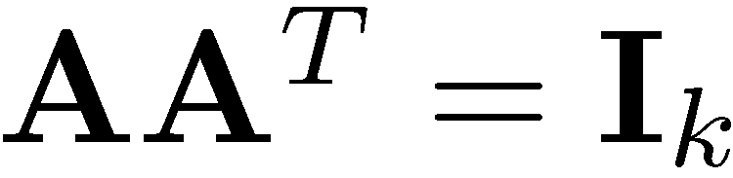
Prior work—Regression camp
local smoothing <> first order low-rank model a common approach in nonparametric regression (kernel, nearest neighbor, splines)
1. assume orthogonality
[Friedman and Stuetzle 1981; Li 1991, 1992; Fan and Gijbels 1996; Lin and Zhang 2006; Xia 2008]

Slide 24
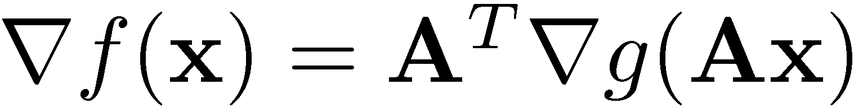
Prior work—Regression camp
local smoothing <> first order low-rank model a common approach in nonparametric regression (kernel, nearest neighbor, splines)
1. assume orthogonality
2. note the differentiability of f
[Friedman and Stuetzle 1981; Li 1991, 1992; Fan and Gijbels 1996; Lin and Zhang 2006; Xia 2008]
Key observation #1: gradients live in at most k-dim. subspaces

Slide 25

Prior work—Regression camp
local smoothing <> first order low-rank model a common approach in nonparametric regression (kernel, nearest neighbor, splines)
1. assume orthogonality
2. note the differentiability of f
3. leverage samples to obtain the hessian via local K/N-N/S…
required: rank-k H^{g}
[Friedman and Stuetzle 1981; Li 1991, 1992; Fan and Gijbels 1996; Lin and Zhang 2006; Xia 2008]
Key observation #1: gradients live in at most k-dim. subspaces
Key observation #2: k- principal components of H^{f} leads to A

Slide 26
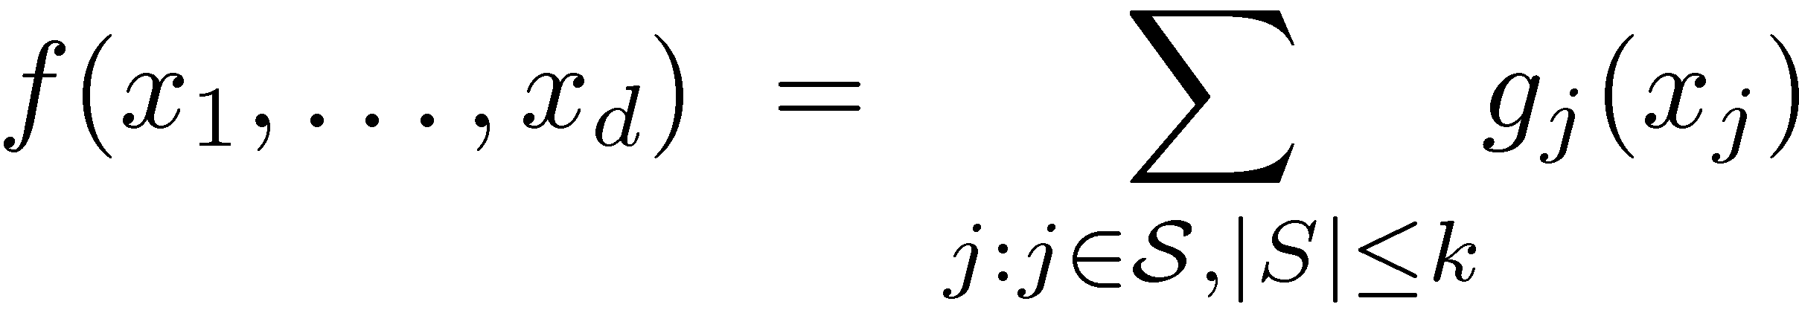
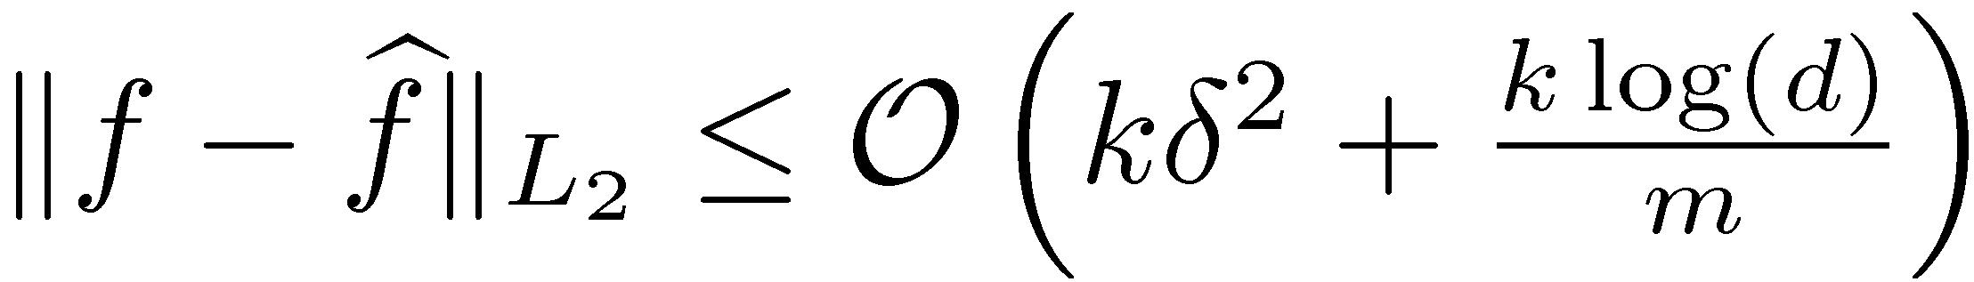
Prior work—Regression camp
local smoothing <> first order low-rank model a common approach in nonparametric regression (kernel, nearest neighbor, splines)
Recent trends <> additive sparse models
g belongs to reproducing kernel Hilbert space
encode smoothness via the kernel
leverage sparse greedy/convex optimization
establish consistency rates:
[Friedman and Stuetzle 1981; Li 1991, 1992; Fan and Gijbels 1996; Lin and Zhang 2006; Xia 2008]
[Stone 1985; Tibshirani and Hastie 1990; Lin Zhang 2006; Ravikumar et al., 2009; Raskutti et al., 2010; Meier et al. 2007; Koltchinski and Yuan, 2008, 2010]

Slide 27
Prior work—Regression camp
local smoothing <> first order low-rank model a common approach in nonparametric regression (kernel, nearest neighbor, splines)
Recent trends <> additive sparse models
g belongs to reproducing kernel Hilbert space
encode smoothness via the kernel
leverage sparse greedy/convex optimization
establish consistency rates:
[Friedman and Stuetzle 1981; Li 1991, 1992; Fan and Gijbels 1996; Lin and Zhang 2006; Xia 2008]
[Stone 1985; Tibshirani and Hastie 1990; Lin Zhang 2006; Ravikumar et al., 2009; Raskutti et al., 2010; Meier et al. 2007; Koltchinski and Yuan, 2008, 2010]
difficulty of estimating the kernel
difficulty of subset selection

Slide 28

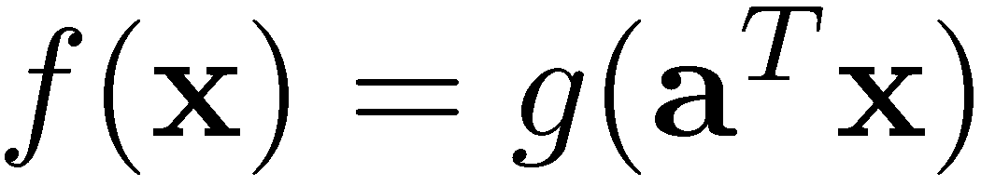
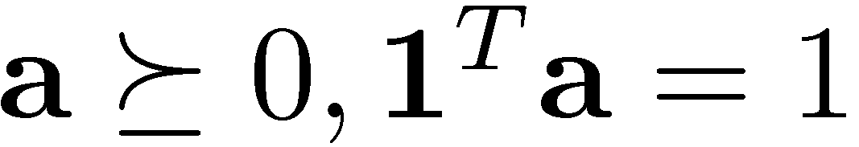
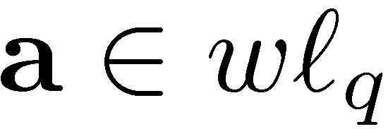
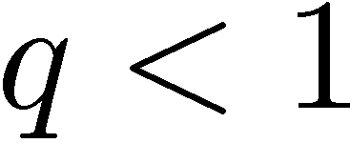
Prior work—Active learning camp
Progress thus far <> the sparse way
highlights:
Cohen, Daubechies, DeVore, Kerkyacharian, and Picard (2010)
(i.e., compressible)

Slide 29
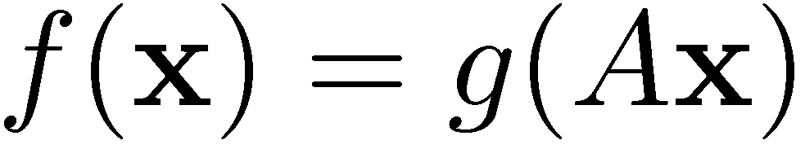
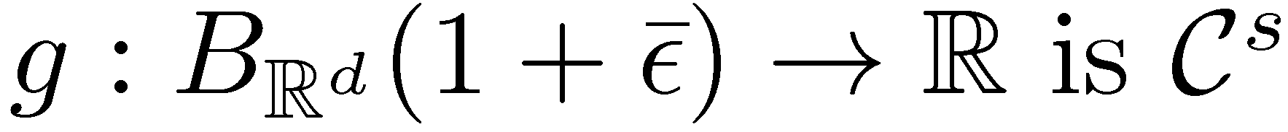
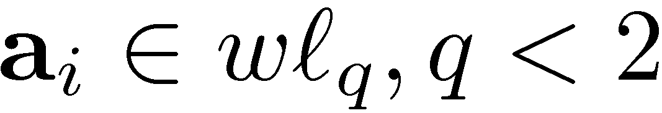
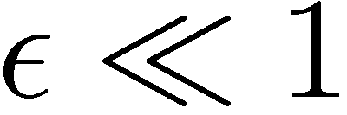
Prior work—Active learning camp
Progress thus far <> the sparse way
highlights:
Cohen, Daubechies, DeVore, Kerkyacharian, and Picard (2010)
Fornassier, Schnass, and Vybiral (2011)
extends on the same local observation model in regression
(i.e., compressible)
Taylor series

Slide 30
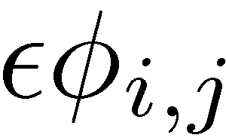






Prior work—Active learning camp (FSV’11)
A sparse observation model
with two ingredients
sampling centers
sampling directions at each center
leads to
curvature
effect
approximately sparse

Slide 31

Prior work—Active learning camp (FSV’11)
A sparse observation model
Key contribution: restricted “Hessian” property
recall G needs to span a k-dim subspace for identifiability of A
with a restricted study of radial functions
Analysis <> leverage compressive sensing results
approximately sparse
μ: uniform
measure

Slide 32
Prior work—Active learning camp (FSV’11)
A sparse observation model
Analysis <> leverage compressive sensing results
Key contribution: restricted Hessian property for radial functions
Two major issues remains to be addressed over FSV’11
validity of orthogonal sparse/compressible directions
need a basis independent model
analysis of H^{f} for anything other than radial functions need a new analysis tool
approximately sparse

Slide 33


Learning multi-ridge functions
Objective: approximate multi-ridge functions via point queries
Results:
(Model 1):
Model 1:
Model 2:
A: compressible
[Fornasier, Schnass, Vybiral, 2011]
*if g has k-restricted Hessian property…

Slide 34

Learning multi-ridge functions
Objective: approximate multi-ridge functions via point queries
Results:
(Model 1):
Model 1:
Model 2:
cost of learning g
A: compressible
*cost of learning A
[Fornasier, Schnass, Vybiral, 2011]
*if f has k-restricted Hessian property…

Slide 35

Learning multi-ridge functions
Objective: approximate multi-ridge functions via point queries
Results:
(Model 1):
Model 1:
Model 2:
cost of learning g
A: compressible
only for radial basis functions
*cost of learning A
[Fornasier, Schnass, Vybiral, 2011]
*if f has k-restricted Hessian property…

Slide 36

Learning Multi-Ridge Functions
…And, this is how you learn non-parametric basis independent models from point-queries via low-rank methods

Slide 37

Learning multi-ridge functions
Objective: approximate multi-ridge functions via point queries
Results:
(Model 1&2):
Model 1:
Model 2:
cost of learning g
A: compressible
Our 1st contribution: a simple verifiable characterization of alpha
for a broad set of functions
*cost of learning A
*with the L-Lipschitz property…

Slide 38
Learning multi-ridge functions: the low-rank way
Objective: approximate multi-ridge functions via point queries
Results:
(Model 1):
Model 1:
Model 2:
cost of learning g
our 2nd contribution: extension to the general A
*cost of learning A
*if f has k-restricted Hessian property…

Slide 39

Learning multi-ridge functions: the low-rank way
Objective: approximate multi-ridge functions via point queries
Results:
(Model 2):
Model 1:
Model 2:
cost of learning g_{i}’s
our 2nd contribution: extension to the general A
*cost of learning A
*with the L-Lipschitz property…

Slide 40

Learning multi-ridge functions: the low-rank way
Objective: approximate multi-ridge functions via point queries
Results:
(Model 2):
Model 1:
Model 2:
just kidding.
cost of learning g_{i}’s
?
?
our 2nd contribution: extension to the general A
*cost of learning A
*with the L-Lipschitz property…

Slide 41
Learning multi-ridge functions: the low-rank way
Objective: approximate multi-ridge functions via point queries
Results:
(Model 1&2):
Model 1:
Model 2:
in general
cost of learning g / g_{i}’s
Given 1st and 2nd contribution: full characterization of Model 1 & 2
with minimal assumptions
*cost of learning A
*with the L-Lipschitz property…

Slide 42
Learning multi-ridge functions
Objective: approximate multi-ridge functions via point queries
Results:
(Model 1&2):
Model 1:
Model 2:
cost of learning g / g_{i}’s
Our 3th contribution: impact of iid noise f+Z
*cost of learning A
*with the L-Lipschitz property…

Slide 43





Non-sparse directions A
A low-rank observation model
along with two ingredients
sampling centers
sampling directions at each center
leads to

Slide 44



Detour #2: low-rank recovery
Stable recovery <> measurements commensurate with degrees of freedom
stable recovery:
measurements:

Slide 45

Detour #2: low-rank recovery
Stable recovery <> measurements commensurate with degrees of freedom
stable recovery:
measurements:
Convex/non-convex decoders <> sampling/noise type
affine rank minimization
matrix completion
robust principal component analysis
Matrix ALPS
http://lions.epfl.ch/MALPS
[Recht et al. (2010); Meka et al. (2009); Candes and Recht (2009); Candes and Tao (2010); Lee and Bresler (2010); Waters et al. (2011); Kyrillidis and Cevher (2012)]

Slide 46

Detour #2: low-rank recovery
Stable recovery <> measurements commensurate with degrees of freedom
stable recovery:
measurements:
Convex/non-convex decoders <> sampling/noise type
affine rank minimization
matrix completion
robust principal component analysis
Matrix ALPS
http://lions.epfl.ch/MALPS
Matrix restricted isometry property (RIP):
[Plan 2011]
[Recht et al. (2010); Meka et al. (2009); Candes and Recht (2009); Candes and Tao (2010); Lee and Bresler (2010); Waters et al. (2011); Kyrillidis and Cevher (2012)]

Slide 47
Active sampling for RIP
: low rank
Recall the two ingredients
sampling centers
sampling directions at each center
Matrix RIP <> uniform sampling on the sphere
[Candes and Plan (2010)]

Slide 48





Here it is… our low-rank approach
achieve/balance three objectives simultaneously
guarantee RIP on Φ with
ensure rank(G)=k with
contain E’s impact with

Slide 49



Here it is… our low-rank approach
guarantee RIP <> by construction
ensure rank(G)=k <> by Lipschitz assumption rank-1 + diagonal / interval matrices
contain E’s impact <> by controlling curvature
collateral damage: additive noise amplification by solution: resample the same points
[VC and Tyagi 2012; Tyagi and VC, 2012]

Slide 50



L-Lipschitz property
New objective: approximate A via point queries of f
New analysis tool: L-Lipschitz 2nd order derivative
recall

Slide 51


Proposition: k-th restricted singular value
New objective: approximate A via point queries of f
New analysis tool: L-Lipschitz 2nd order derivative
(Model 1):
(Model 2):
recall

Slide 52

Theorem: sample complexity

Slide 53

Theorem: sample complexity

Slide 54
Theorem: proof ingredients
Matrix Danzig selector as running example
[Candes and Plan (2010)]

Slide 55

Theorem: proof ingredients
Matrix Danzig selector as running example
Tuning parameters

Slide 56

Theorem: proof ingredients
Matrix Danzig selector as running example
Tuning parameters
Recovery guarantees on X
[Theorem 2.4 from Candes and Plan (2010)]

Slide 57

Theorem: proof ingredients
Matrix Danzig selector as running example
Tuning parameters
Recovery guarantees on X
Translation of guarantees on X to guarantees on A
This is precisely where the restricted Hessian property is used…

Slide 58

Theorem: proof ingredients
Matrix Danzig selector as running example
Tuning parameters
Recovery guarantees on X
Translation of guarantees on X to guarantees on A
Translation of guarantees on A to guarantees on f

Slide 59
Impact of noisy queries
Assume evaluation of f yields

Slide 60
Impact of noisy queries
Assume evaluation of f yields
tuning parameter changes:

Slide 61

Impact of noisy queries
Assume evaluation of f yields
tuning parameter changes:

Slide 62






Learning a logistic function
Declare success if

Slide 63







Learning sum of Gaussian functions
Declare success if

Slide 64








Stability example with the quadratic
Declare success if

Slide 65
Conclusions
lions@epfl
Main focus <> estimation of low-dim subspace for dimensionality reduction
learning/optimizing f for later
model building, cluster analysis, variable selection…
Active setting polynomial time samples/scheme a new link between old low-rank models with new low-rank algorithms
New tools <> L-Lipschitz 2nd order derivative matrix ALPS for low-rank recov. beyond linear models
system calibration, PDE models, matrix compression…

Slide 66

Postdoc positions @ LIONS / EPFL
contact: volkan.cevher@epfl.ch

