Slide 1
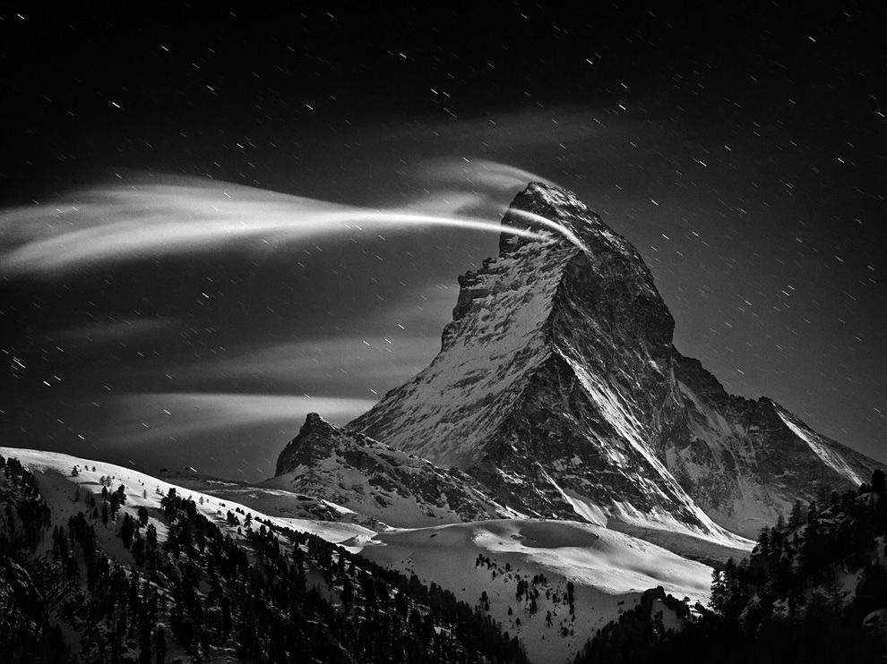




Compressible priors for high-dimensional statistics
Volkan Cevher
volkan.cevher@epfl.ch
LIONS/Laboratory for Information and Inference Systems
lions@epfl

Slide 2
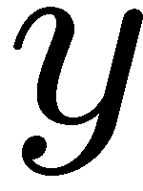


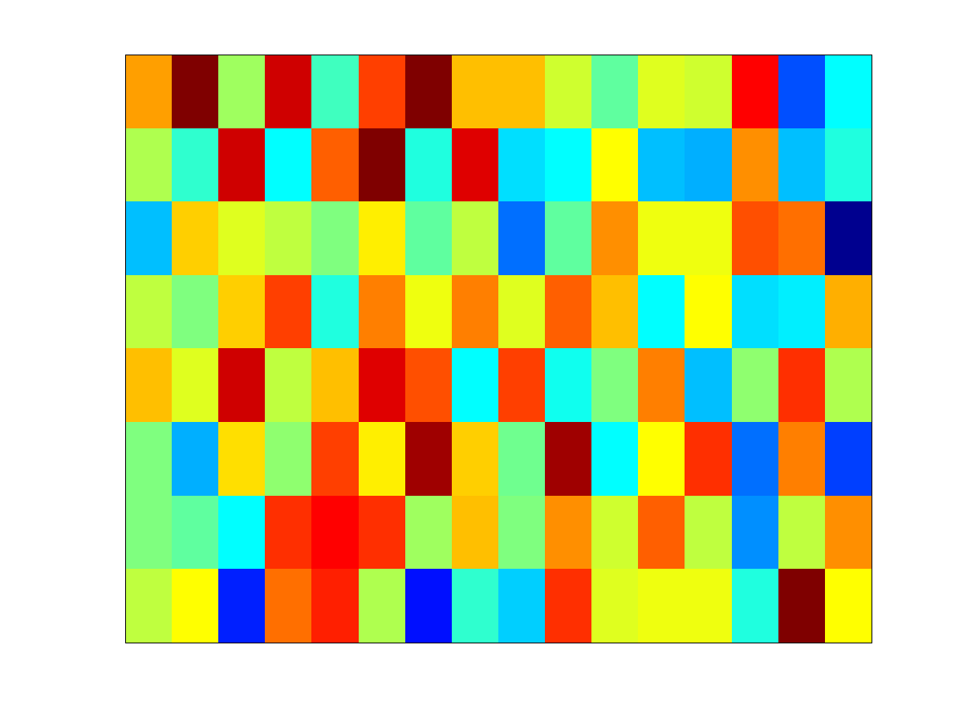




Dimensionality Reduction
Compressive sensing non-adaptive measurements
Sparse Bayesian learning dictionary of features
Information theory coding frame
Theoretical computer science sketching matrix / expander

Slide 3
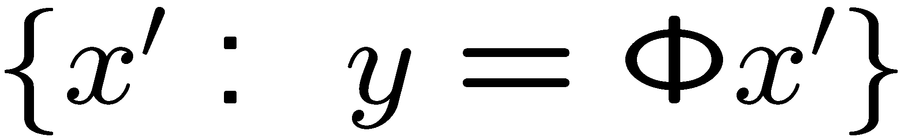
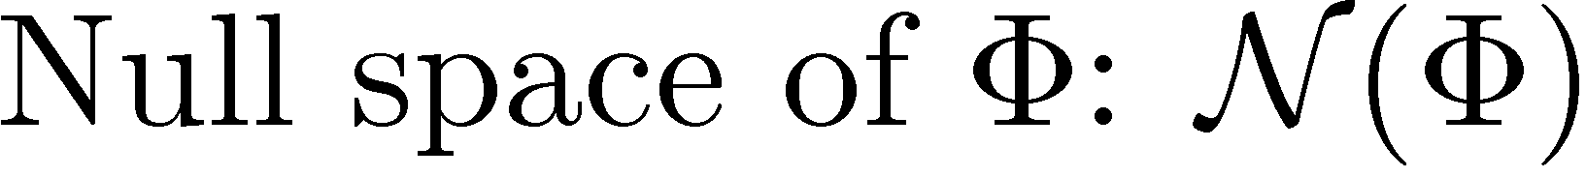

Dimensionality Reduction
Challenge:
`

Slide 4



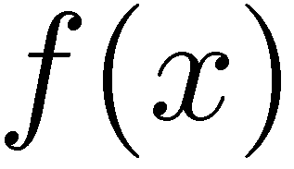
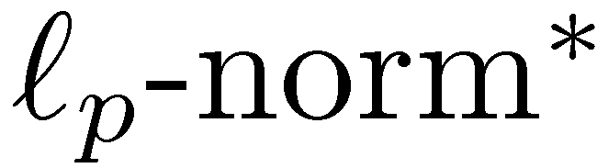
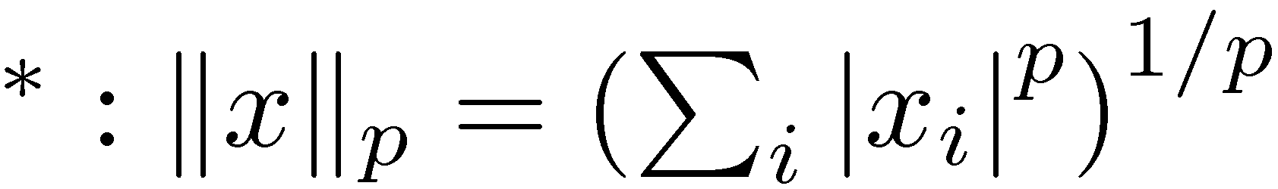
Approaches
Deterministic Probabilistic
Prior sparsity compressibility
Metric likelihood function

Slide 5
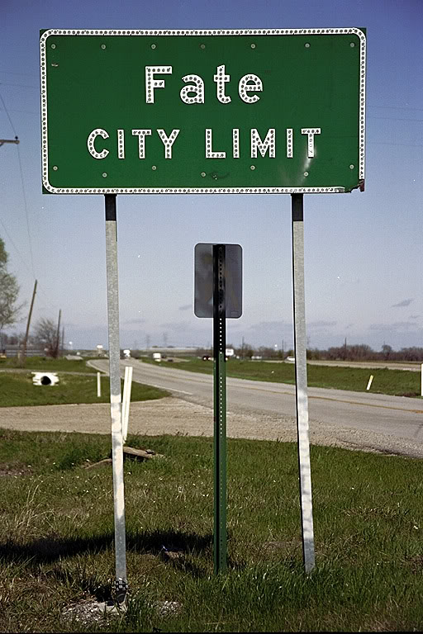
Deterministic View

Slide 6
My Insights on Compressive Sensing
Sparse or compressible
not sufficient alone
Projection
information preserving
(stable embedding / special null space)
Decoding algorithms
tractable

Slide 7
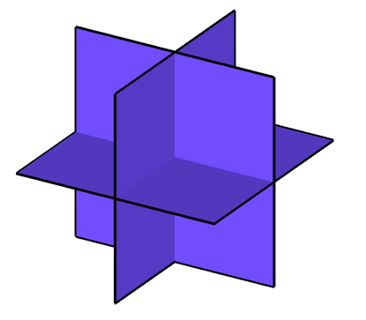
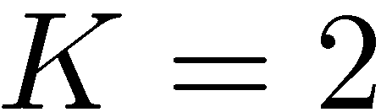
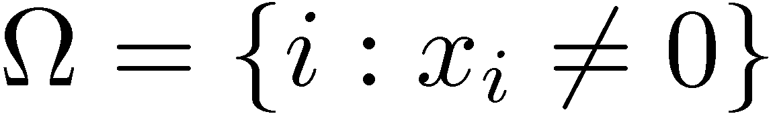
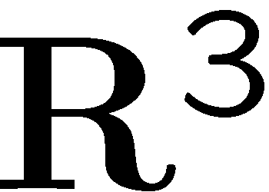
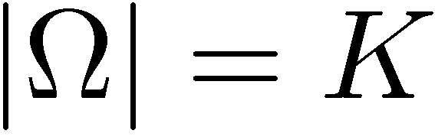
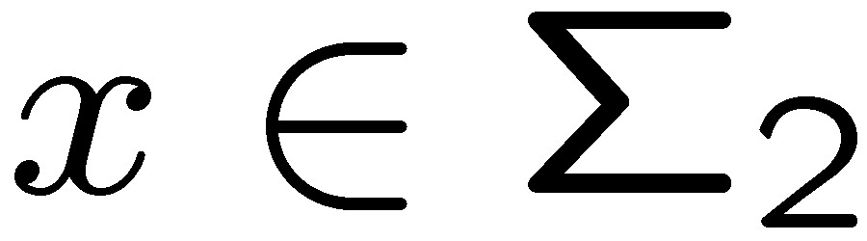
Deterministic Priors
Sparse signal: only K out of N coordinates nonzero
model: union of all K-dimensional subspaces aligned w/ coordinate axes Example: 2-sparse in 3-dimensions
support:

Slide 8
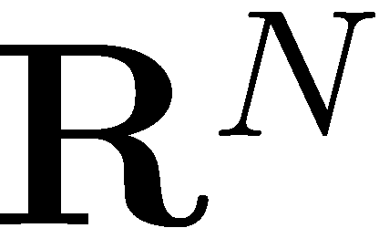
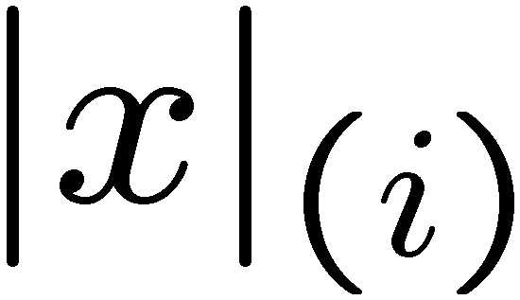
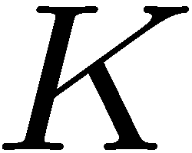
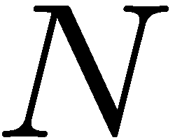
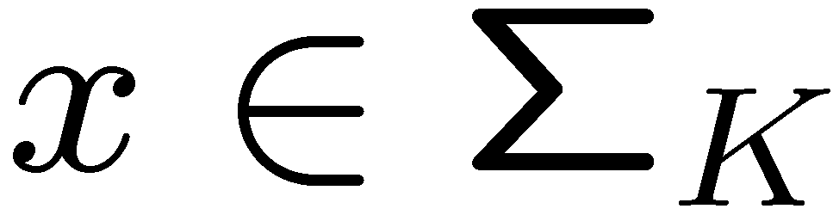
Deterministic Priors
Sparse signal: only K out of N coordinates nonzero
model: union of all K-dimensional subspaces aligned w/ coordinate axes
sorted index

Slide 9
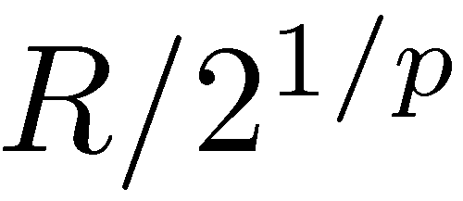
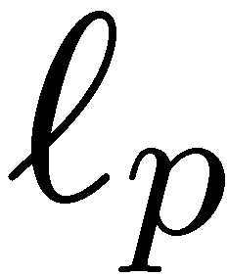
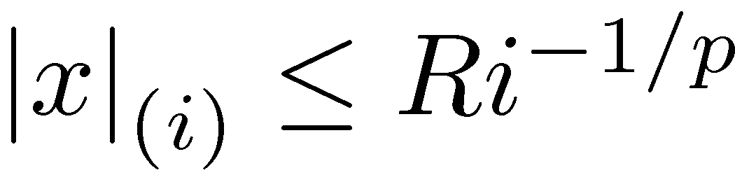
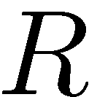
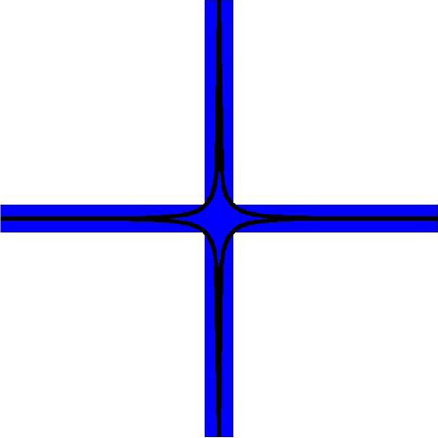
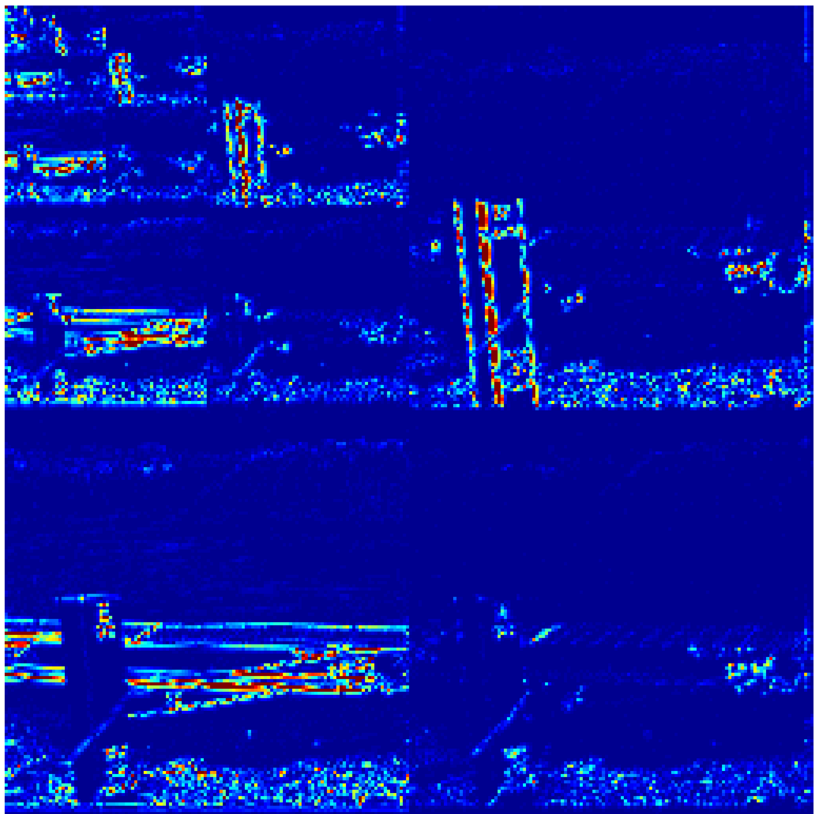
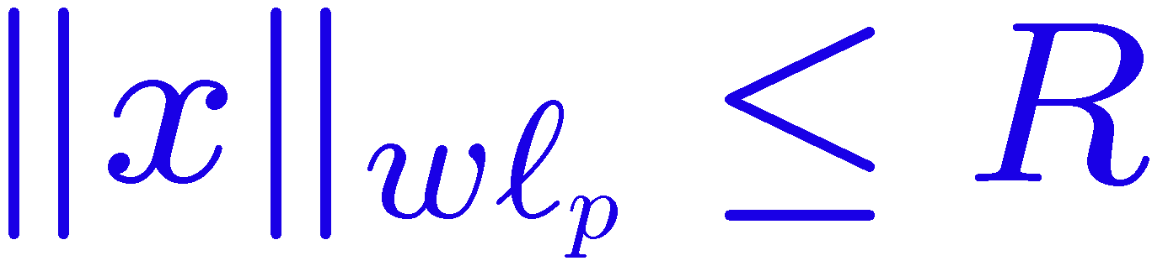
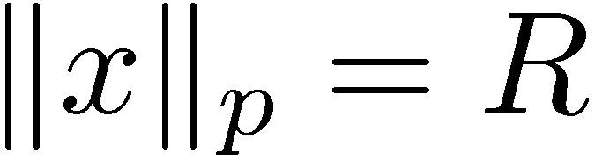
Deterministic Priors
Sparse signal: only K out of N coordinates nonzero
model: union of K-dimensional subspaces
Compressible signal: sorted coordinates decay rapidly to zero
Model: weak ball:
wavelet coefficients:
power-law decay
sorted index

Slide 10
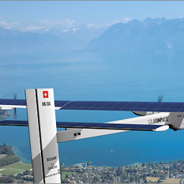

Deterministic Priors
Sparse signal: only K out of N coordinates nonzero
model: union of K-dimensional subspaces
Compressible signal: sorted coordinates decay rapidly to zero well-approximated by a K-sparse signal (simply by thresholding)
sorted index

Slide 11
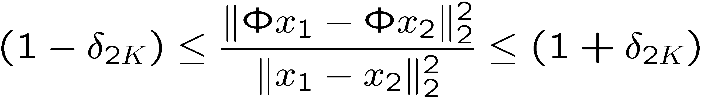
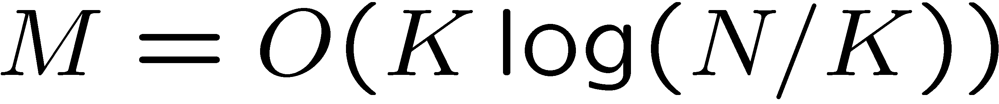
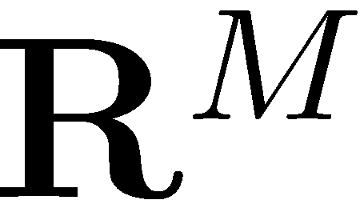



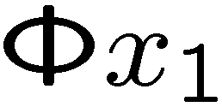
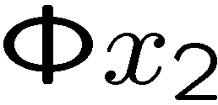
Restricted Isometry Property (RIP)
Preserve the structure of sparse/compressible signals
RIP of order 2K implies: for all K-sparse x₁ and x₂
A random Gaussian matrix has the RIP with high probability if
K-planes

Slide 12


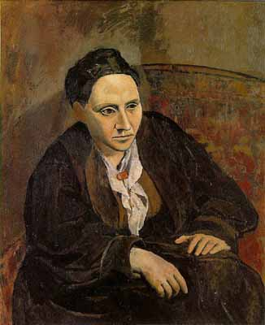
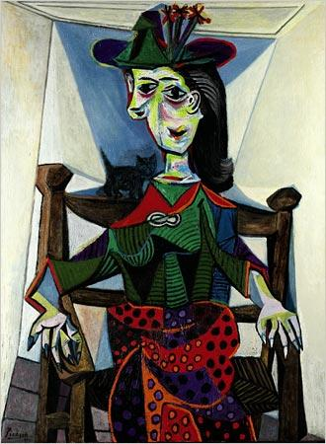
Restricted Isometry Property (RIP)
Preserve the structure of sparse/compressible signals
RIP of order 2K implies: for all K-sparse x₁ and x₂
A random Gaussian matrix has the RIP with high probability if
K-planes
various works by Picasso

Slide 13
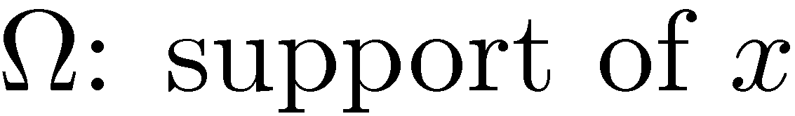
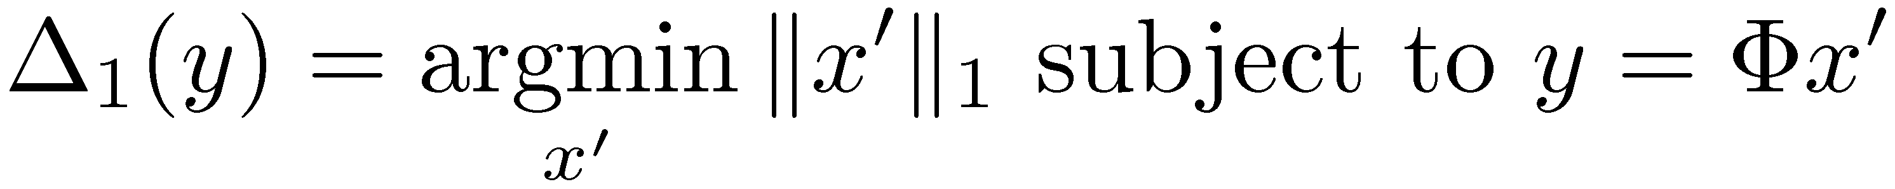
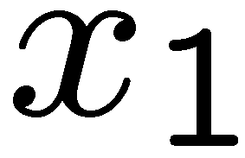
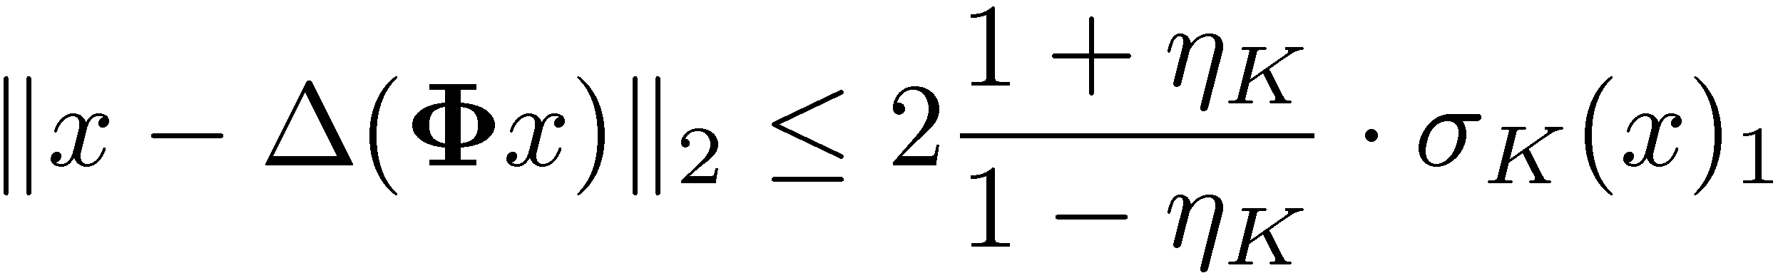

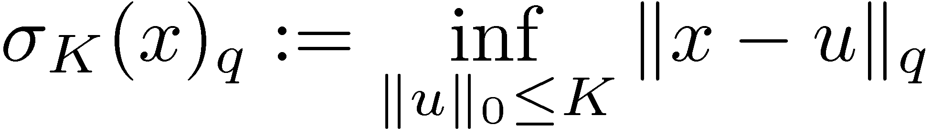
Robust Null Space Property (RNSP)
RNSP in 1-norm (RNSP-1):
RNSP-1 <> instance optimality
Best K-term approximation:
[Cohen, Dahmen, and Devore; Xu and Hassibi; Davies and Gribonval]

Slide 14
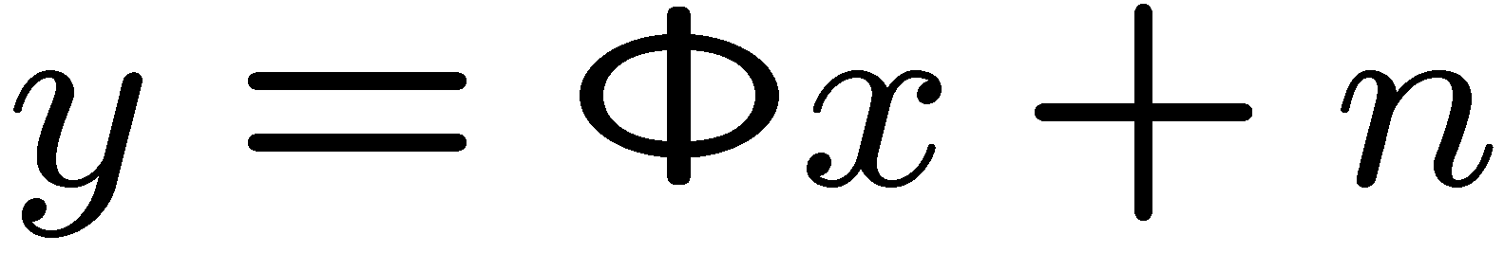

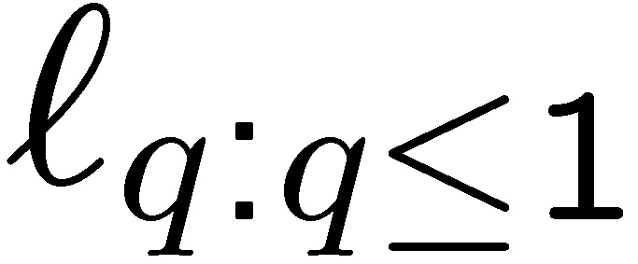
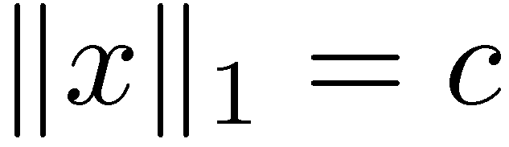
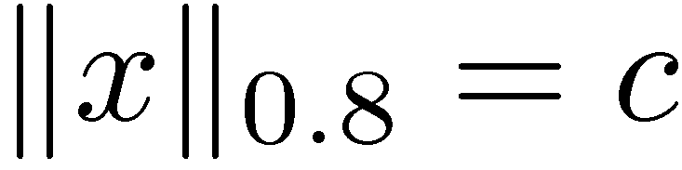
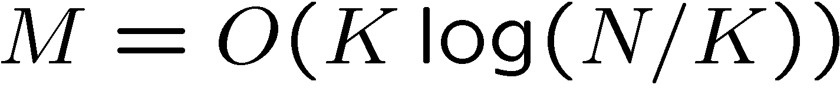
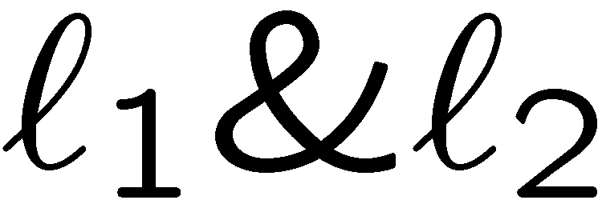
Recovery Algorithms
Goal: given recover
and convex optimization formulations
basis pursuit, Lasso, scalarization …
iterative re-weighted algorithms
Greedy algorithms: CoSaMP, IHT, SP

Slide 15
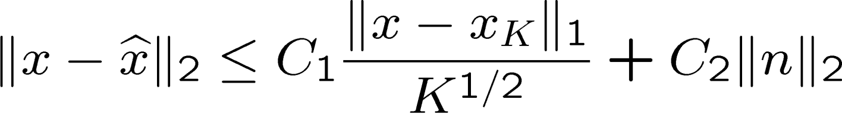
Performance of Recovery (q=1)
Tractability polynomial time
Sparse signals instance optimal
noise-free measurements: exact recovery
noisy measurements: stable recovery
Compressible signals instance optimal
recovery as good as K-sparse approximation (via RIP)
CS recovery error
signal K-term approx error
noise

Slide 16
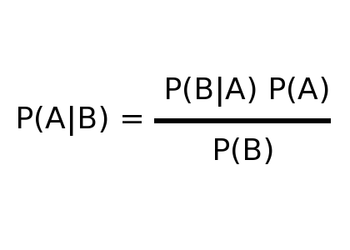
The Probabilistic View

Slide 17
Probabilistic View
Goal: given recover
Prior: iid generalized Gaussian distribution (GGD)
Algorithms: via Bayesian inference arguments
maximize prior
prior thresholding
maximum a posteriori (MAP)
iid: independent and identically distributed

Slide 18


Probabilistic View
Goal: given recover
Prior: iid generalized Gaussian distribution (GGD)
Algorithms: (q=1 <> deterministic view)
maximize prior
prior thresholding
maximum a posteriori (MAP)

Slide 19
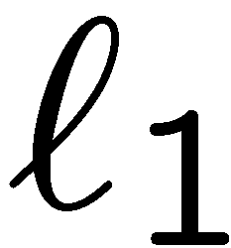
Probabilistic View
Goal: given recover
Prior: iid generalized Gaussian distribution (GGD)
Stable embedding: an experiment
q=1
x from N iid samples from GGD (no noise)
recover using

Slide 20


Probabilistic View
Goal: given recover
Prior: iid generalized Gaussian distribution (GGD)
Stable embedding: a paradox
q=1
x from N iid samples from GGD (no noise)
recover using
need M~0.9 N (Gaussian ) vs.

Slide 21

Approaches
Do nothing / Ignore
be content with where we are…
generalizes well
robust

Slide 22
Compressible Priors*
*You could be a Bayesian if
… your observations are less important than your prior.
[VC; Gribonval, VC, Davies; VC, Gribonval, Davies]

Slide 23




Compressible Priors
Goal: seek distributions whose iid realizations can be well-approximated as sparse
Definition:
relative k-term approximation:
sorted index

Slide 24







Compressible Priors
Goal: seek distributions whose iid realizations can be well-approximated as sparse
Classical:
New:
sorted index

Slide 25
Compressible Priors
Goal: seek distributions whose iid realizations can be well-approximated as sparse
Motivations: deterministic embedding scaffold for the probabilistic view
analytical proxies for sparse signals
learning (e.g., dim. reduced data)
algorithms (e.g., structured sparse)
information theoretic (e.g., coding)
Main concept: order statistics

Slide 26

Key Proposition

Slide 27



Example 1
Consider the Laplacian distribution (with scale parameter 1)
The G-function is straightforward to derive
Laplacian distribution <> NOT 1 or 2-compressible

Slide 28

Example 1
Consider the Laplacian distribution (with scale parameter 1)
Laplacian distribution <> NOT 1 or 2-compressible
Why does minimization work for sparse recovery then?
The sparsity enforcing nature of the cost function
The compressible nature of the unknown vector x

Slide 29



Sparse Modeling vs. Sparsity Promotion
Bayesian interpretation <> inconsistent of sparse recovery
four decoding algorithms:

Slide 30


Example 2

Slide 31




Approximation Heuristic for Compressible Priors via Order Statistics
Probabilistic <> signal model
iid
order statistics of

Slide 32


Approximation Heuristic for Compressible Priors via Order Statistics
Probabilistic <> signal model
Deterministic signal model <>
iid
order statistics of

Slide 33




Approximation Heuristic for Compressible Priors via Order Statistics
Probabilistic <> signal model
Deterministic signal model <>
Quantile approximation
iid
order statistics of
cdf
Magnitude quantile
function (MQF)

Slide 34




Compressible Priors w/ Examples

Slide 35
Compressible Priors w/ Examples

Slide 36

Dimensional (in)Dependence
Dimensional independence <>
<> unbounded moments
example:
CS recovery error
signal K-term approx error
noise

Slide 37




Dimensional (in)Dependence
Dimensional independence <>
truly logarithmic embedding
Dimensional dependence <>
<> bounded moments
example: iid Laplacian
not so much! / same result can be obtained via the G-function

Slide 38

Why should we care?
Natural images
wavelet coefficients
deterministic view vs. probabilistic view
Besov spaces GGD, scale mixtures
wavelet tresholding Shannon source coding

Slide 39




Why should we care?
Natural images
wavelet coefficients
deterministic view vs. probabilistic view
Besov spaces GGD, scale mixtures
wavelet tresholding Shannon source coding
[Choi, Baraniuk; Wainwright, Simoncelli; …]

Slide 40

Berkeley Natural Images Database

Slide 41



Berkeley Natural Images Database

Slide 42


Berkeley Natural Images Database
Learned parameters depend on the dimension

Slide 43
Why should we care?
Natural images (coding / quantization)
wavelet coefficients
deterministic view vs. probabilistic view
Besov spaces GGD, scale mixtures
wavelet tresholding Shannon source coding
(histogram fits, KL divergence) [bad ideas]
Conjecture: Wavelet coefficients of natural images belong to a dimension independent (non-iid) compressible prior

Slide 44
Incompressibility of Natural Images
1-norm instance optimality blows up:

Slide 45
Incompressibility of Natural Images
1-norm instance optimality blows up:
Is compressive sensing USELESS for natural images?

Slide 46


Instance Optimality in Probability to the Rescue

Slide 47
Incompressibility of Natural Images
Is compressive sensing USELESS for natural images?
Not according to Theorem 2!!!
For large N, 1-norm minimization is still near-optimal.

Slide 48
Incompressibility of Natural Images
Is compressive sensing USELESS for natural images?
Not according to Theorem 2!!!
But, are we NOT missing something practical?

Slide 49
Incompressibility of Natural Images
But, are we NOT missing something practical?
Natural images have finite energy since we have finite dynamic range. While the resolution of the images are currently ever-increasing, their dynamic range is not. In this setting, compressive sensing using naïve sparsity will not be useful.

Slide 50




Other Bayesian Interpretations
Multivariate Lomax dist. (non-iid, compressible w/ r=1)
maximize prior
prior thresholding
maximum a posteriori (MAP)
Interactions of Gamma and GGD
iterative re-weighted algorithms
(has GPD(x_{i};q,λ_{i}) marginals)
fixed point continuation

Slide 51


Summary of Results

Slide 52
Conclusions
Compressible priors <> probabilistic models for compressible signals (deterministic view)
q-parameter <> (un)bounded moments
independent of N truly logarithmic embedding with tractable recovery dimension agnostic learning
not independent of N many restrictions (embedding, recovery, learning)
Natural images <> CS is not a good idea w/ naïve sparsity
Why would compressible priors be more useful vs. ?
Ability to determine the goodness or confidence of estimates

Slide 53


Slide 54


Slide 55






Pathology of Dimensional Dependence
parameter learning <> dimension dependent

