Slide 1
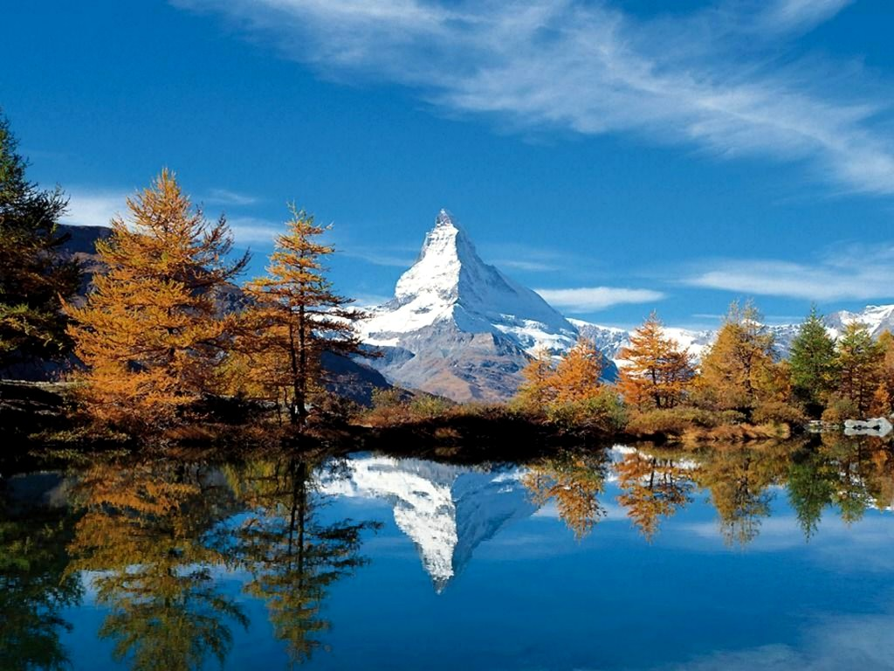






An ALPS’ view of Sparse Recovery
Volkan Cevher
volkan.cevher@epfl.ch
Laboratory for Information and Inference Systems - LIONS
http://lions.epfl.ch

Slide 2



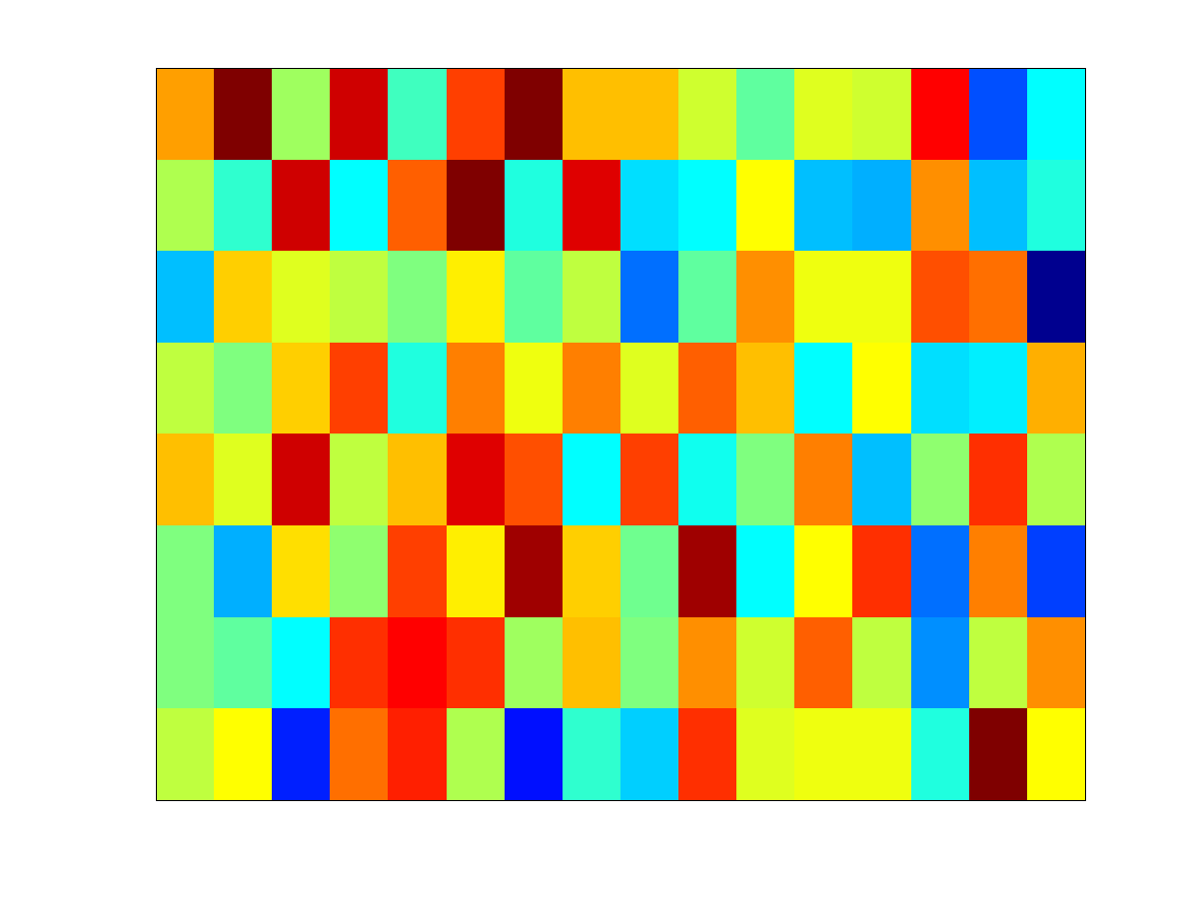




Linear Dimensionality Reduction
Compressive sensing non-adaptive measurements
Sparse Bayesian learning dictionary of features
Theoretical computer science sketching matrix / expander

Slide 3
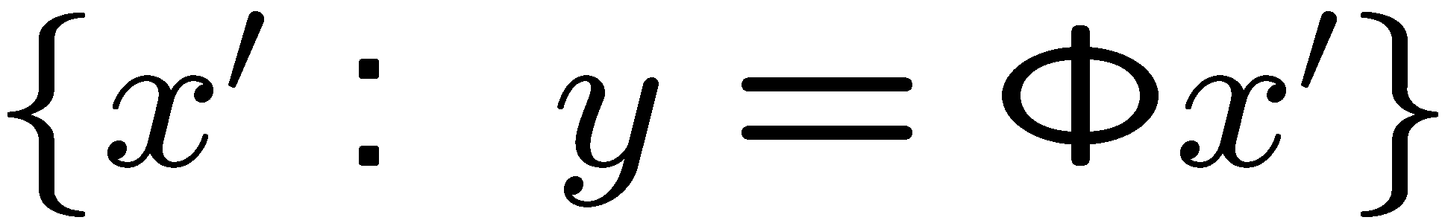
Linear Dimensionality Reduction
Challenge: nullspace of

Slide 4
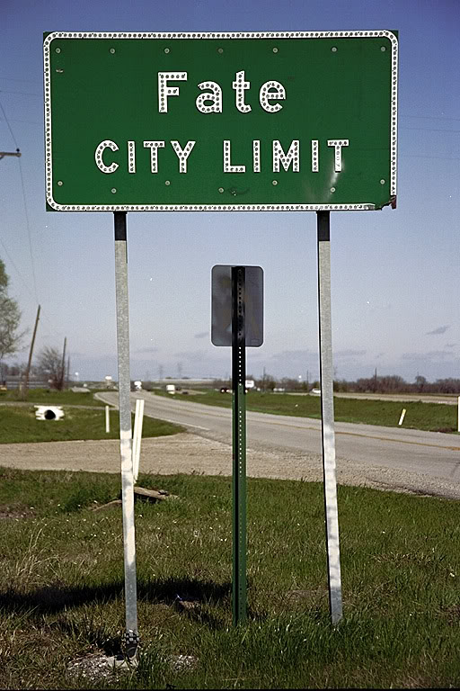
A Deterministic View Compressive Sensing

Slide 5
Compressive Sensing Insights
Sparse / compressible
not sufficient alone
Projection
information preserving / special nullspace
Decoding algorithms
tractable

Slide 6

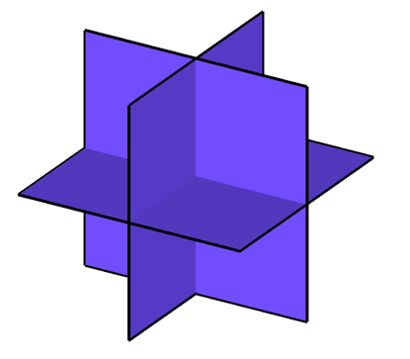
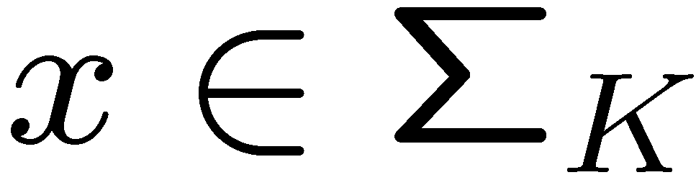
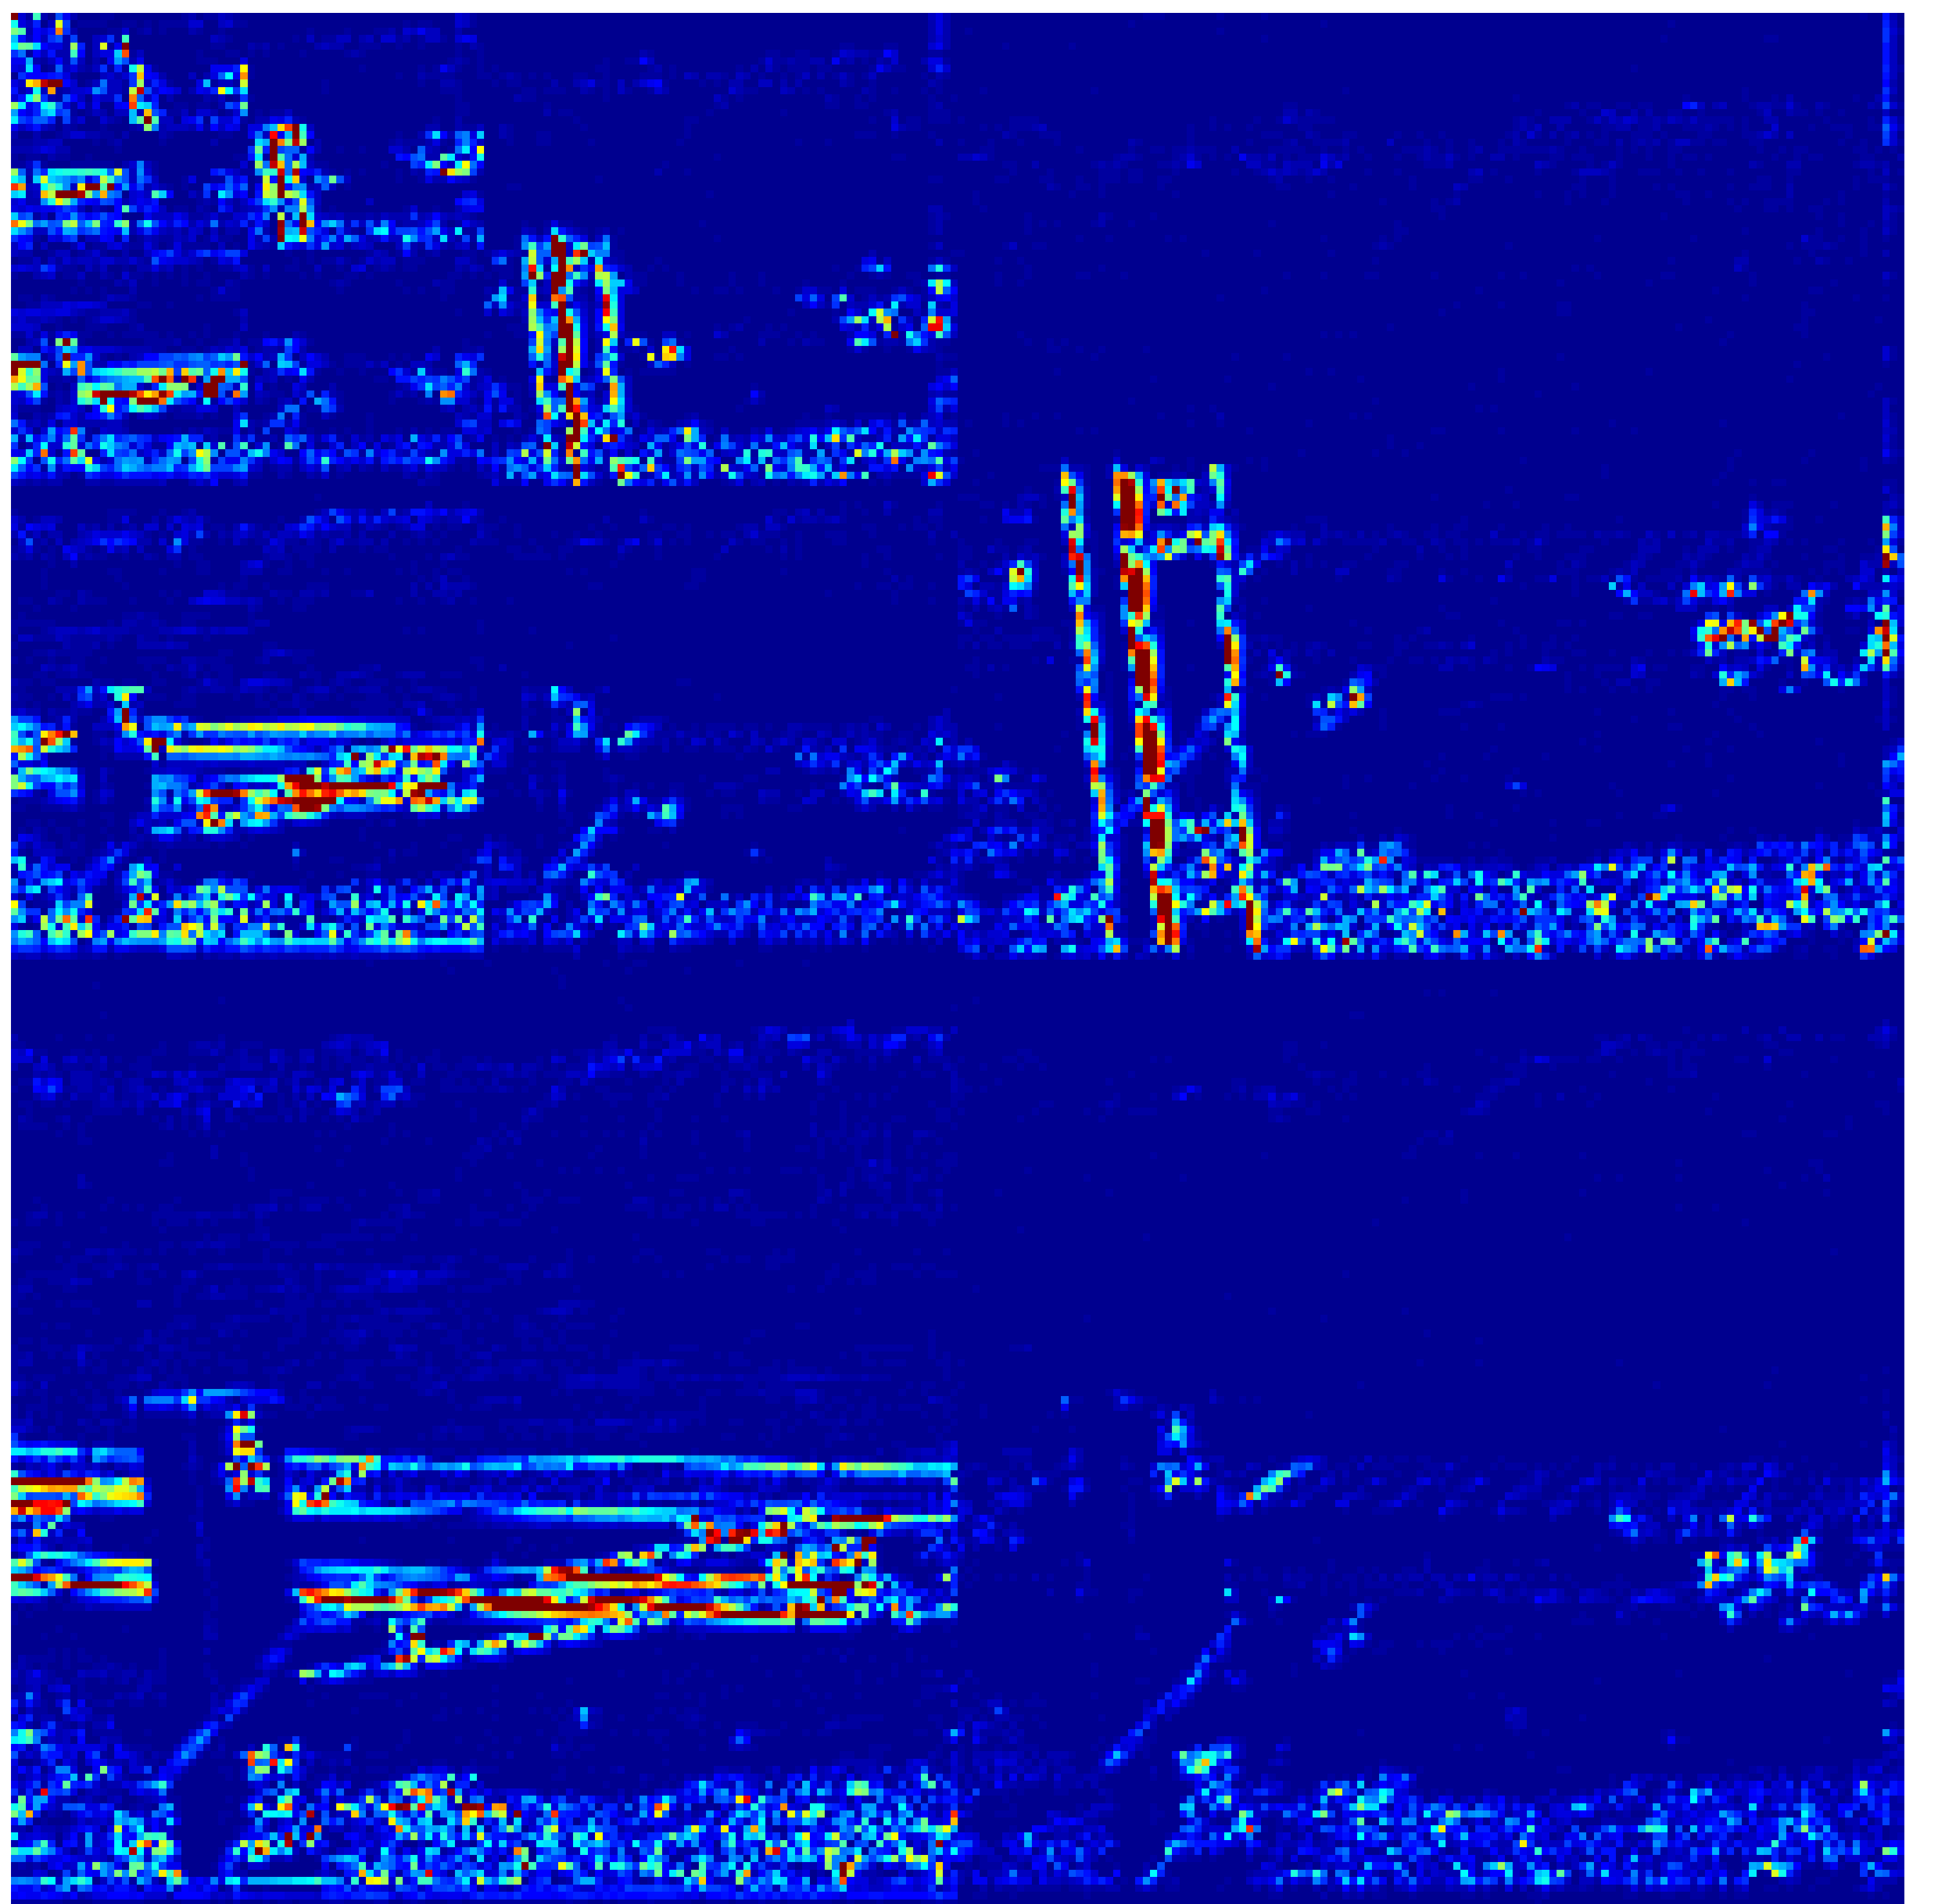
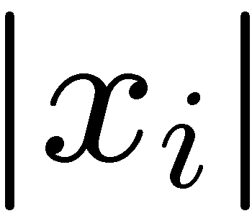
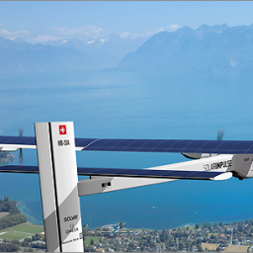


Basic Signal Priors
Sparse signal: only K out of N coordinates nonzero
model: union of K-dimensional subspaces aligned with coordinate axes
Compressible signal: sorted coordinates decay rapidly to zero well-approximated by a K-sparse signal (simply by thresholding)
sorted index

Slide 7
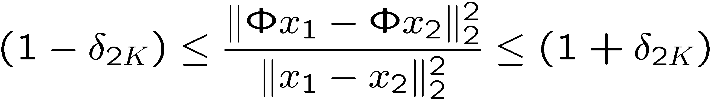
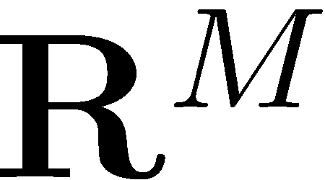



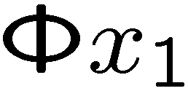
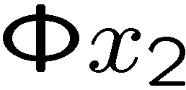
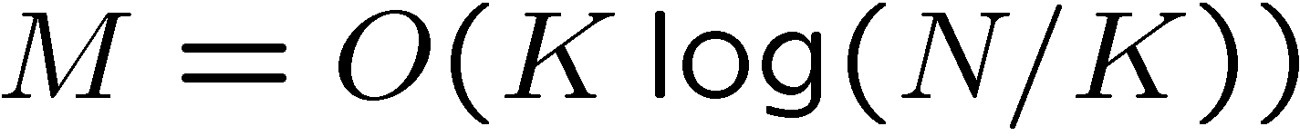
Restricted Isometry Property (RIP)
Model: K-sparse
RIP: stable embedding
Random subGaussian (iid Gaussian, Bernoulli) matrix < > RIP w.h.p.
K-planes

Slide 8
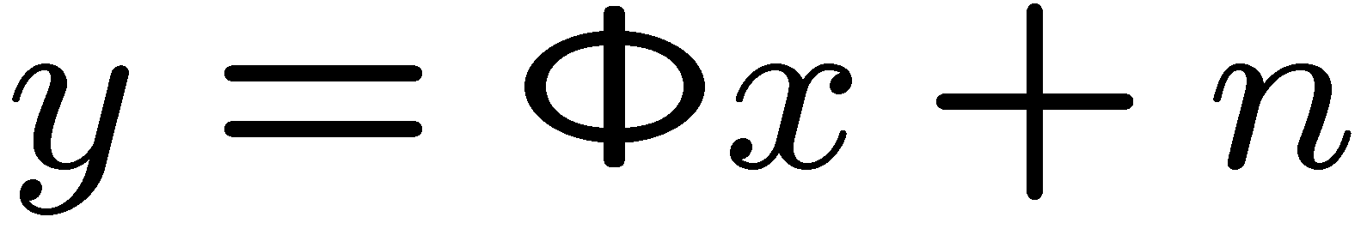

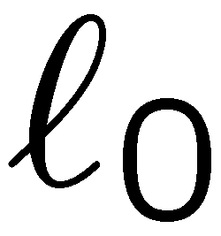



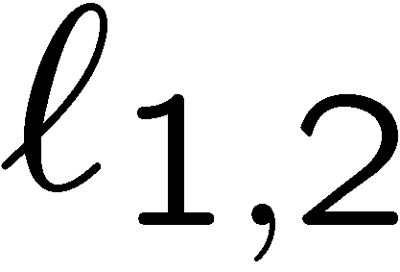
Sparse Recovery Algorithms
Goal: given recover
- minimization:
-minimization formulations
basis pursuit, Lasso, scalarization …
iterative re-weighted algorithms
Greedy algorithms: IHT, CoSaMP, SP, OMP,…
NP-Hard

Slide 9
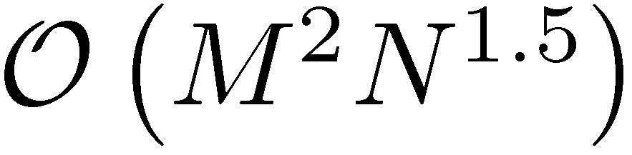
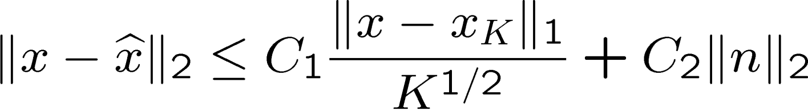

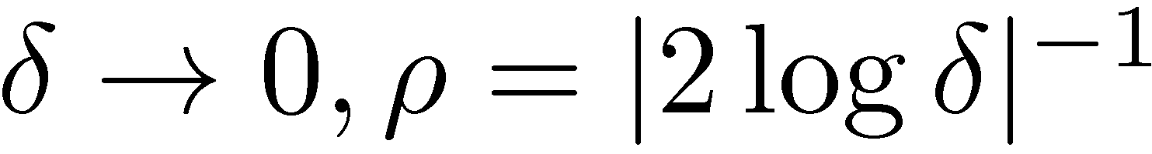
1-Norm Minimization
Properties (sparse signals)
Complexity polynomial time e.g., interior point methods: first order methods <> faster but less accurate
Theoretical guarantees
Number of measurements
(in general, dashed line)
CS recovery error
signal K-term approx error
noise
Threshold =
[Donoho and Tanner]

Slide 10
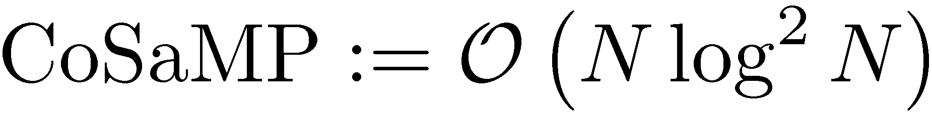
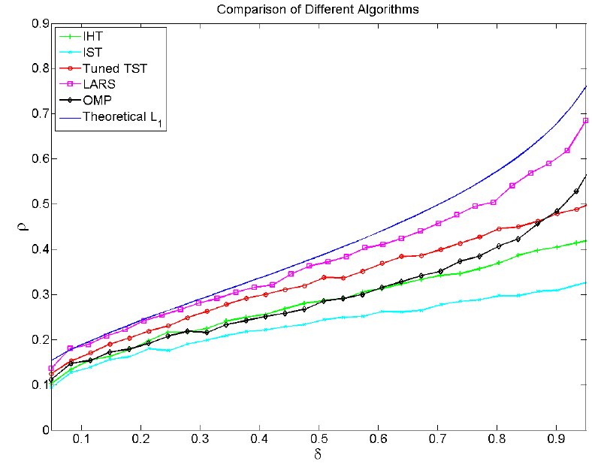
Greedy Approaches
Properties (sparse signals; CoSaMP, IHT, SP,…)
Complexity polynomial time
first-order like: only need forward and adjoint operators fast
Theoretical guarantees
(typically perform worse than linear program)
Number of measurements
(after tuning)
c.f. Figure.
CS recovery error
signal K-term approx error
noise
[Maleki and Donoho]
LP > LARS > TST (SP>CoSaMP)> IHT > IST

Slide 11
The Need for First-order & Greedy Approaches
Complexity <> low complexity
images with millions of pixels
(MRI, interferometry, hyperspectral, etc.)
communication signals hidden in high bandwidths
Performance: (simple sparse)
-minimization <> best performance
First-order, greedy <> performance/complexity trade-off

Slide 12
The Need for First-order & Greedy Approaches
Complexity <> low complexity
Performance: (simple sparse)
-minimization <> best performance
First-order, greedy <> performance tradeoff
Flexibility: (union-of-subspaces)
-minimization <> restricted models block-sparse, all positive,…
Greedy <> union-of-subspace models with tractable approximation algorithms

Slide 13
The Need for First-order & Greedy Approaches
Complexity <> low complexity
Performance: (simple sparse)
-minimization <> best performance
First-order, greedy <> performance tradeoff
Flexibility: (union-of-subspaces)
-minimization <> restricted models block-sparse, all positive,…
Greedy <> union-of-subspace models with tractable approximation algorithms <>
faster, more robust recovery from fewer samples

Slide 14
The Need for First-order & Greedy Approaches
Complexity <> low complexity
Performance: (simple sparse)
-minimization <> best performance
First-order, greedy <> performance tradeoff
Flexibility: (union-of-subspaces)
-minimization <> restricted models
Greedy <> union-of-subspace models (model-based iterative recovery)
Can we have all three in a first-order algorithm?

Slide 15
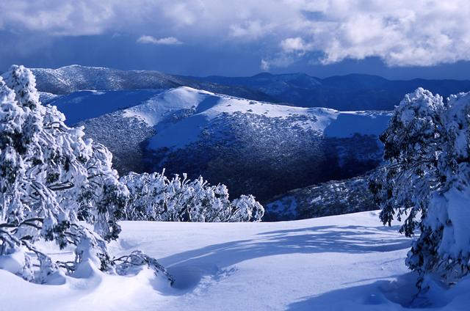
ENTER Algebraic Pursuits—ALPS

Slide 16
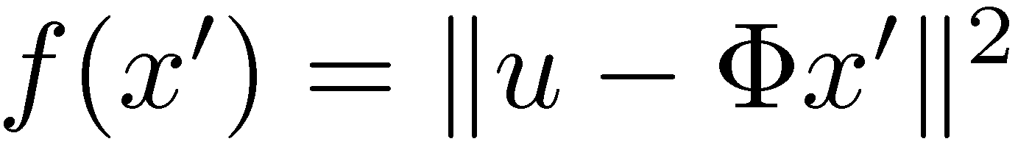
Two Algorithms
Algebraic pursuits (ALPS)
Lipschitz iterative hard tresholding <> LIHT
Fast Lipschitz iterative hard tresholding <> FLIHT
Objective:
canonical sparsity for simplicity
objective function

Slide 17


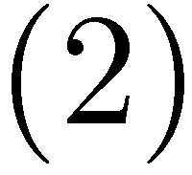
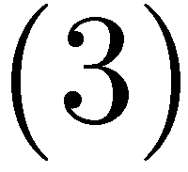
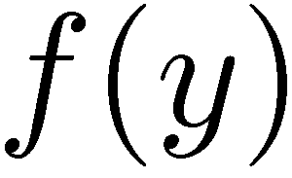
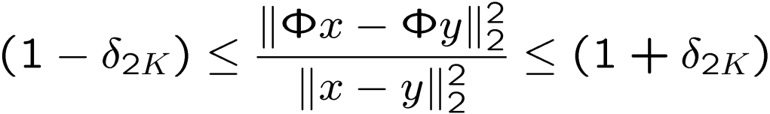

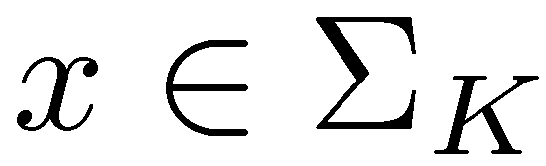
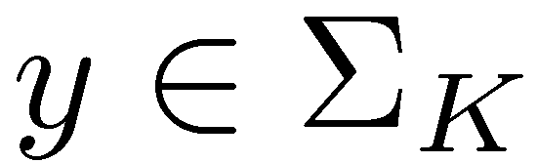
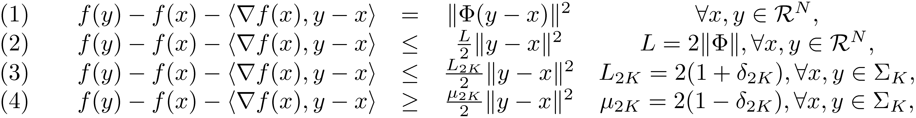
Bregman Distance & RIP
Recall RIP:
Bregman distance

Slide 18
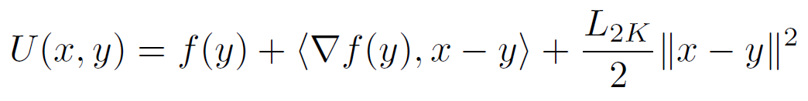
Majorization-Minimization
Model-based combinatorial projection:
e.g., tree-sparse projection

Slide 19
What could be wrong with this naïve approach?
percolations
percolations

Slide 20
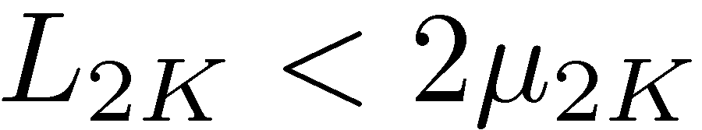
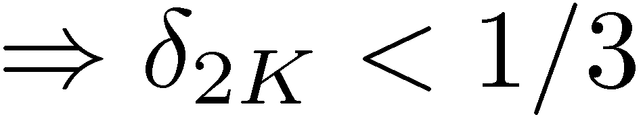
Majorization-Minimization
How can we avoid the void?
Note: LP requires

Slide 21
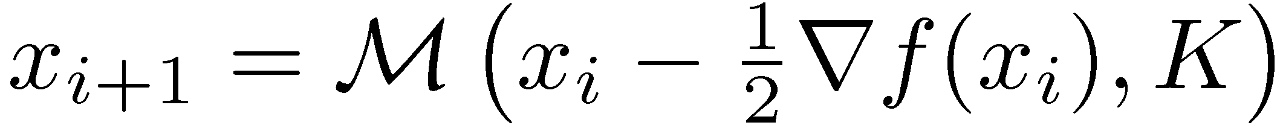
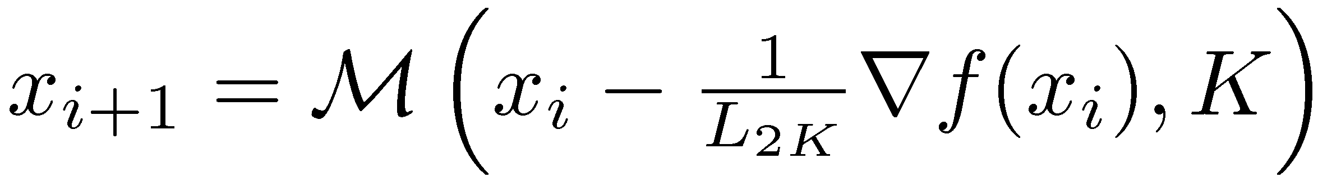
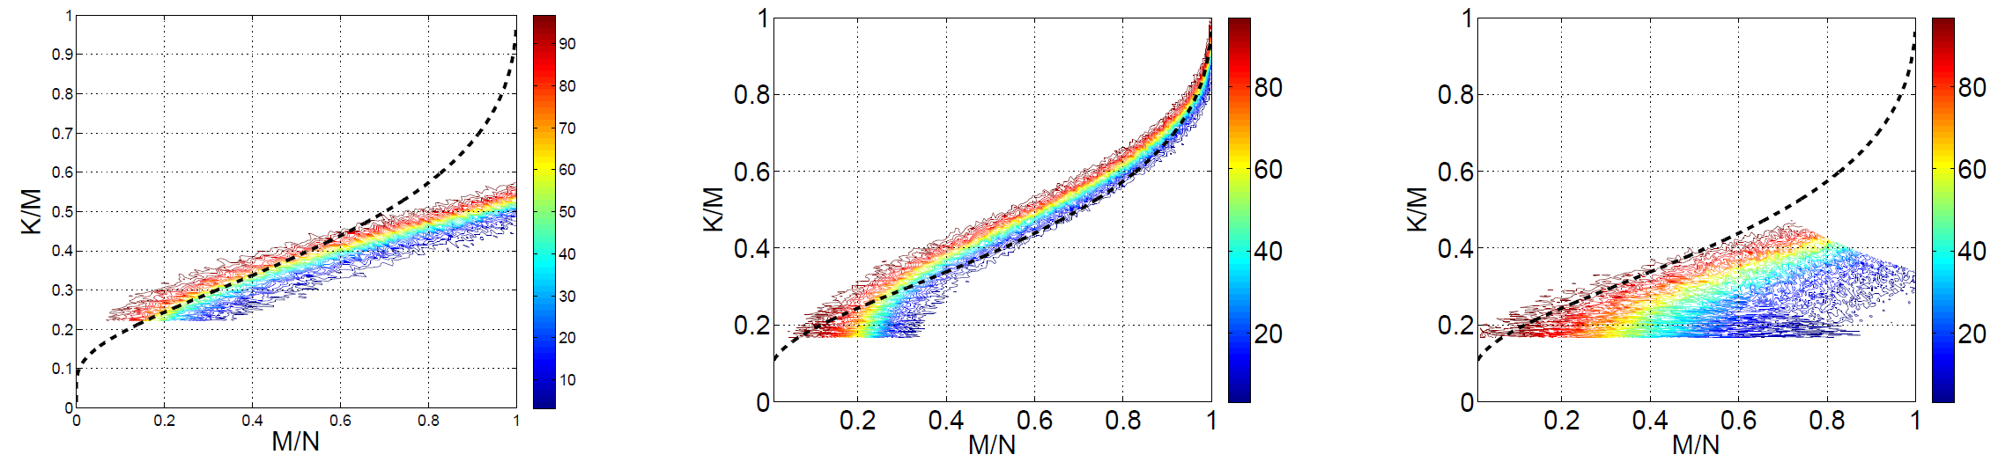
LIHT vs. IHT & ISTA + GraDes
Iterative hard thresholding – Nesterov/B & T variant
IHT:
LIHT:
IHT <> quick initial descent
wasteful iterations afterwards
LIHT <> linear convergence
[Blumensath and Davies]
Ex: K=100, M=300, N=1000, L=10.5.
Gaussian
Fourier
Sparse
LIHT extends GraDes to overcomplete representations

Slide 22

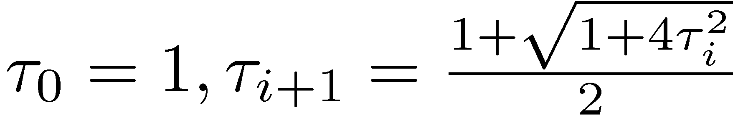
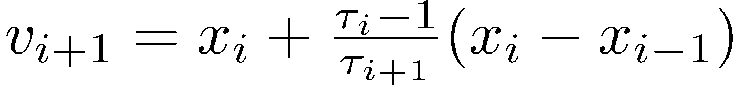
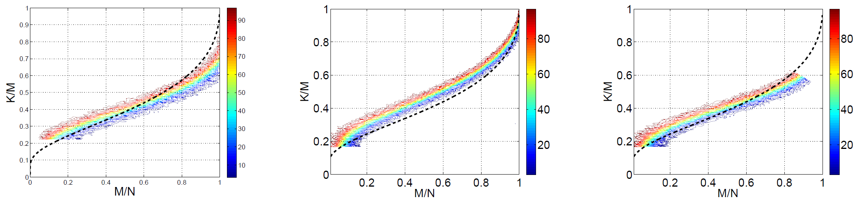
FLIHT
Fast Lipschitz iterative hard thresholding
FLIHT <> linear convergence
more restrictive in isometry constants
[Nesterov ’83]
Gaussian
Fourier
Sparse

Slide 23
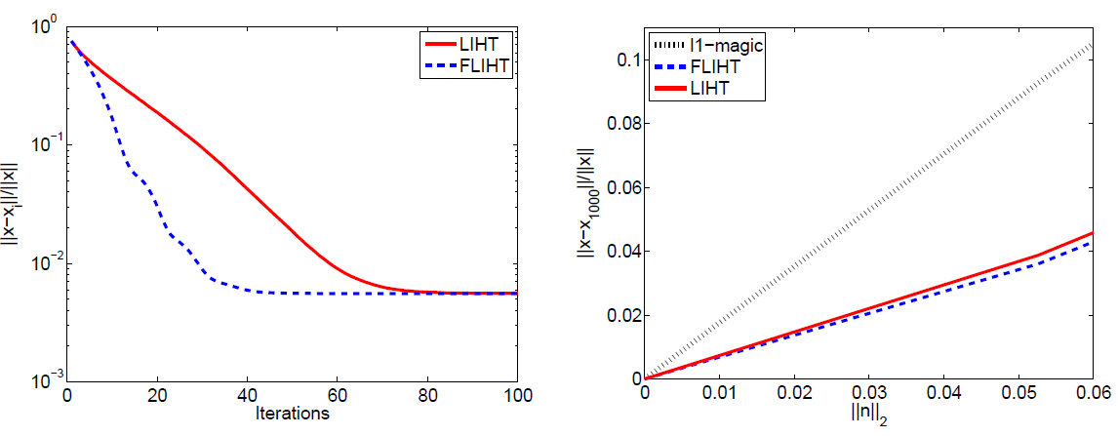
The Intuition behind ALPS
ALPS <> exploit structure of optimization objective
LIHT <> majorization-minimization
FLIHT <> capture a history of previous estimates
Convergence speed example
Robustness
noise level
FLIHT > LIHT

Slide 24
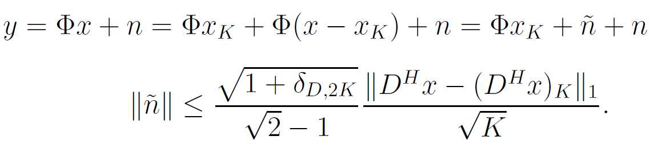
Redundant Dictionaries
CS theory <> orthonormal basis
ALPS <> orthonormal basis + redundant dictionaries
Key ingredient <> D-RIP [Rauhut, Schnass, Vanderghensynt; Candes, Eldar, Needell]
ALPS analysis formulation <> strong guarantees
tight frame

Slide 25
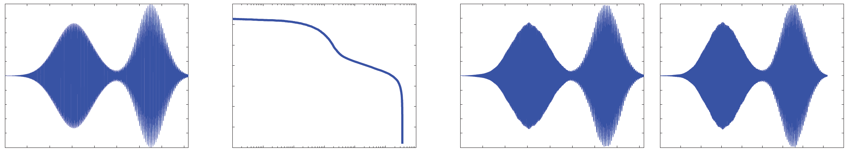
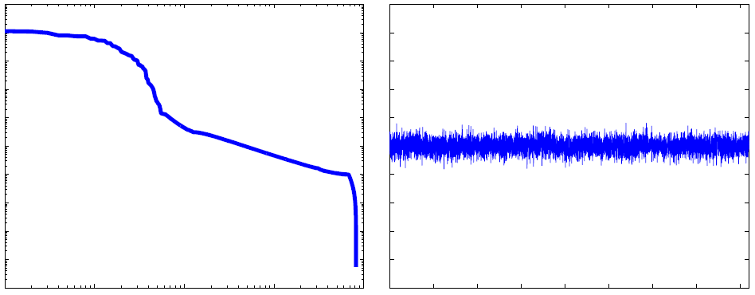
A2D Conversion
Analog-to-digital conversion 43× overcomplete Gabor dictionary
Target
recovery < a few seconds
N=8192; M= 80
FLIHT: 25.4dB
l1-magic recovery with DCT
DCT: 50 sparse

Slide 26
Conclusions
Better, stronger, faster CS <> exploit structure in sparse coefficients objective function
<> first-order methods
ALPS algorithms
automated selection code @ http://lions.epfl.ch/ALPS
RIP analysis <> strong convexity parameter + Lipschitz constant
“Greed is good” in moderation tuning of IHT, etc.
Potential gains <> analysis / cosparse models
Further work game theoretic sparse recovery
(this afternoon)

Slide 27
