Slide 1
IC Research Seminar
A Teaser
Prof. Dr. Volkan Cevher
LIONS/Laboratory for Information and Inference Systems
lions@epfl

Slide 2
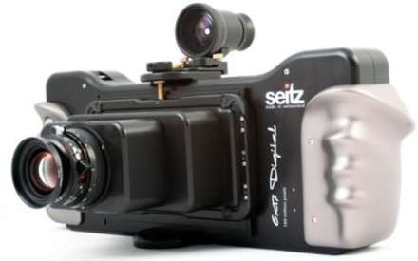
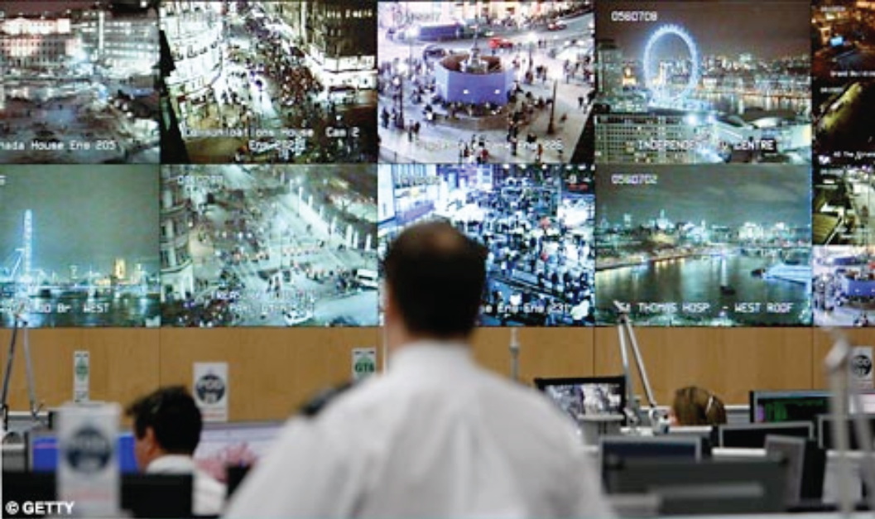
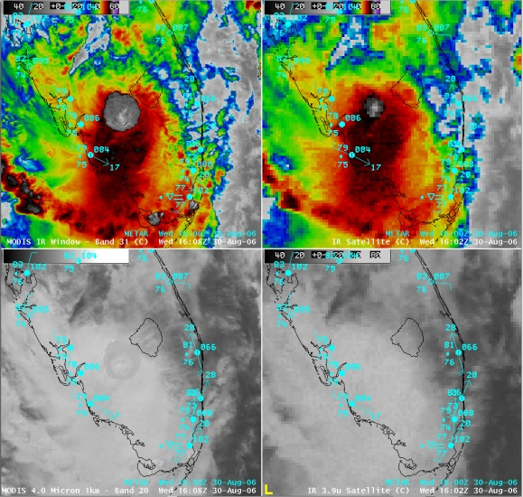
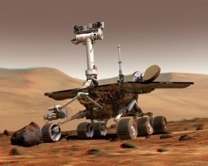
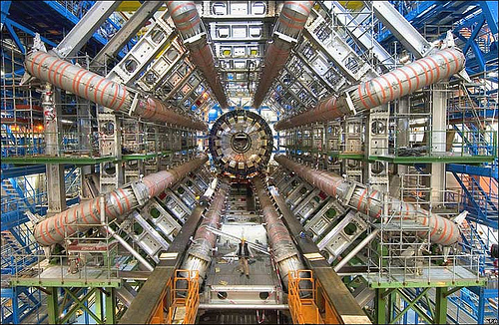
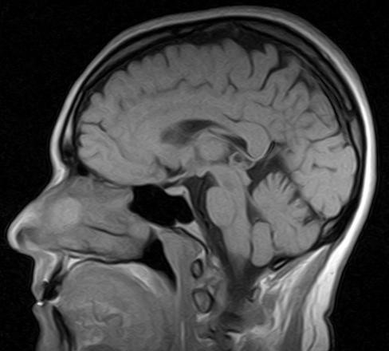
Major trends
higher resolution / denser sampling
x
large numbers of sensors
x
increasing # of modalities / mobility
160MP
Motivation: solve bigger / more important problems
decrease acquisition times / costs
entertainment / new consumer products…

Slide 3
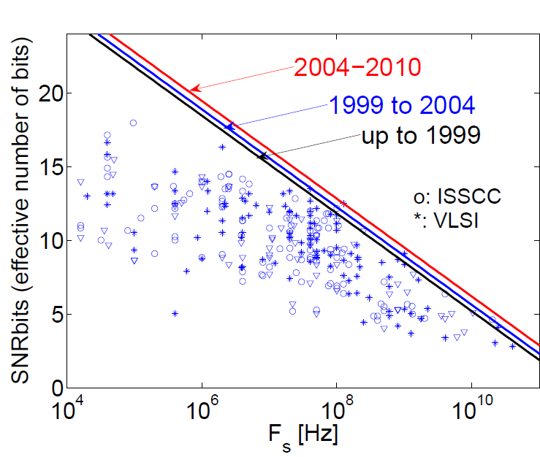
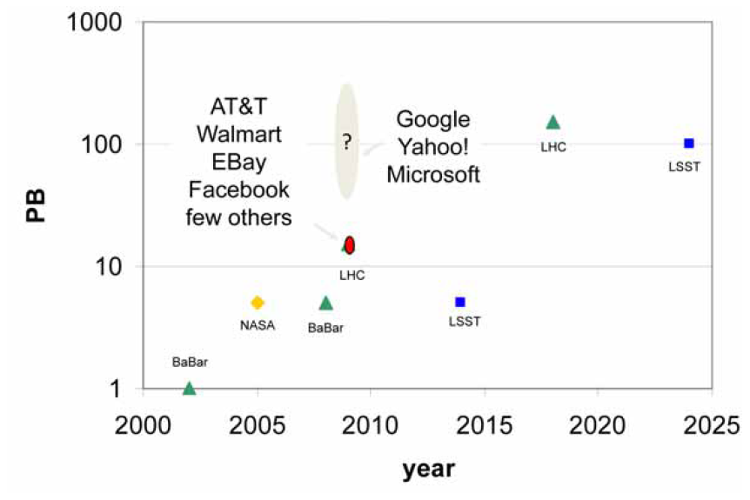
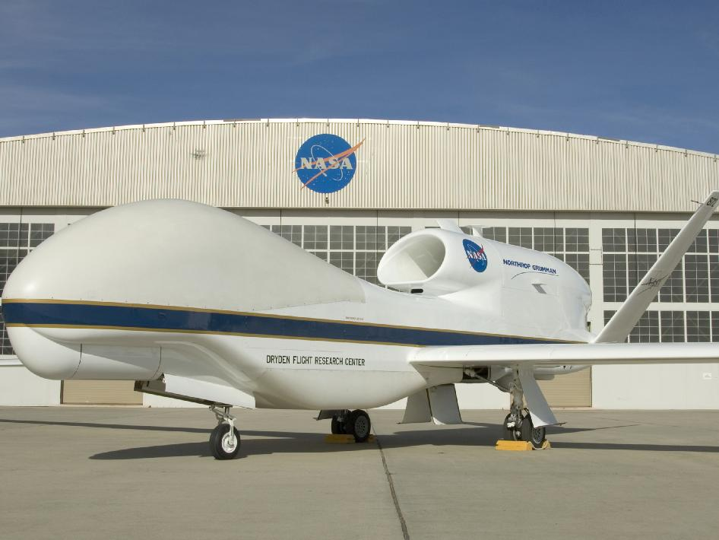
Problems of the current paradigm
Sampling at Nyquist rate
expensive / difficult
Data deluge
communications / storage
Sample then compress
inefficient / impossible / not future proof

Slide 4
Recommended for you: A more familiar example
Recommender systems
observe partial information “ratings” “clicks” “purchases” “compatibilities”

Slide 5
Recommended for you: A more familiar example
Recommender systems
observe partial information “ratings” “clicks” “purchases” “compatibilities”
The Netflix problem
from approx. 100,000,000 ratings predict 3,000,000 ratings
17770 movies x 480189 users
how would you automatically predict?

Slide 6
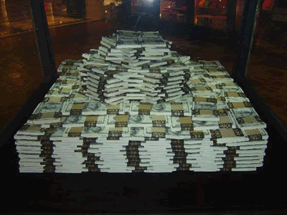
Recommended for you: A more familiar example
Recommender systems
observe partial information “ratings” “clicks” “purchases” “compatibilities”
The Netflix problem
from approx. 100,000,000 ratings predict 3,000,000 ratings
17770 movies x 480189 users
how would you automatically predict?
what is it worth?

Slide 7
Theoretical set-up
Matrix completion for Netflix
users
movies

Slide 8
Theoretical set-up
Matrix completion for Netflix
Mathematical underpinnings: compressive sensing
CS: when we have less samples than the ambient dimension
users
movies
(adversarial) perturbations
observations
linear (sampling) operator

Slide 9
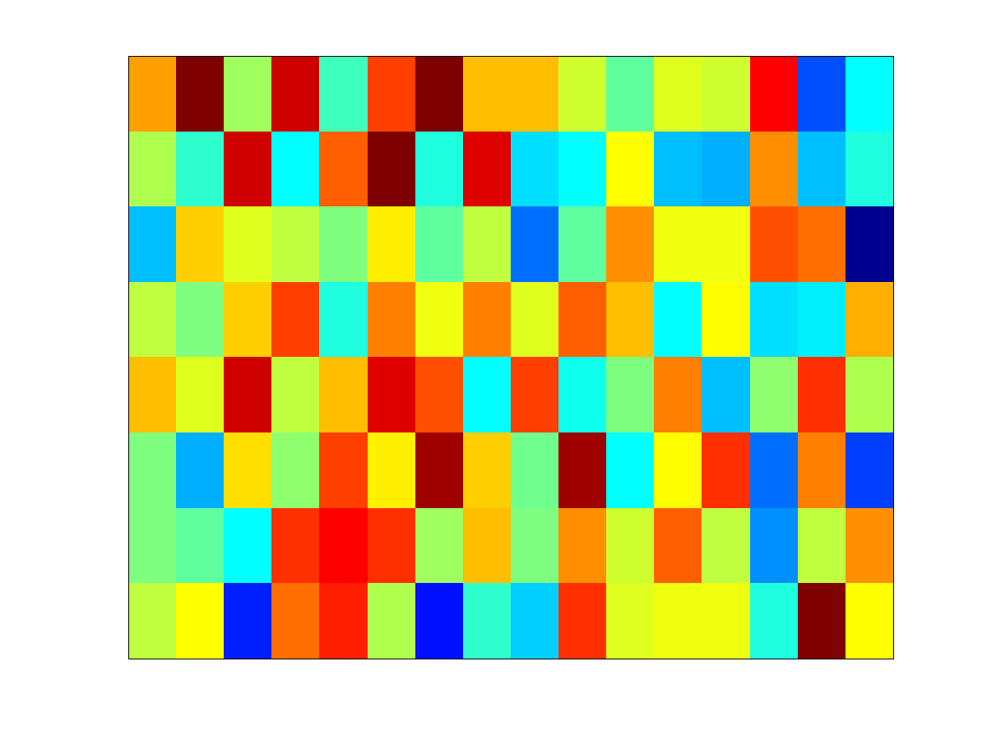
Linear Inverse Problems
myriad applications involve linear dimensionality reduction
from geophysics to medical imaging (MRI)
from quantum tomography to cancer prediction
Many names: compressive sensing, regression, sketching,…

Slide 10
Linear Inverse Problems
Challenge:

Slide 11
Linear Inverse Problems
Deterministic Probabilistic
Prior sparsity prior low-rank
Metric likelihood posterior

Slide 12
Back to the theoretical set-up
Matrix completion for Netflix
What is low-rank?
17770 movies x 480189 users
users
movies

Slide 13
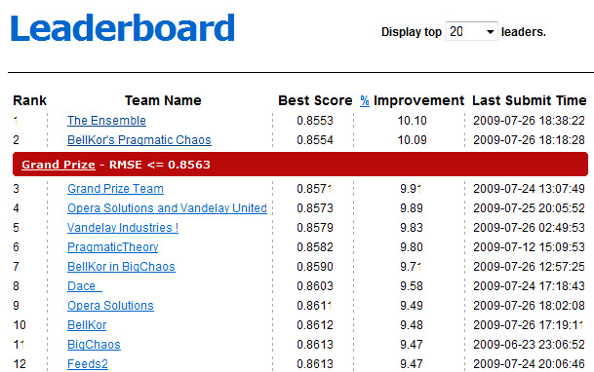
Back to the theoretical set-up
Matrix completion for Netflix
What does the simple low-rank assumption buy?
17770 movies x 480189 users
users
movies
quite a lot of extrapolation power!

Slide 15
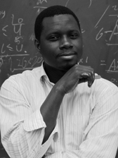
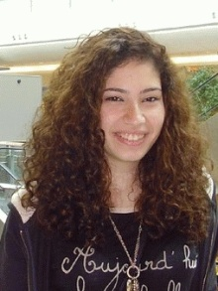
people@lions
three
Current line-up:
Volkan Cevher
Bubacarr Bah
Luca Baldassarre
Quoc Tran Dinh
Tasos Kyrillidis
Marwa El Halabi
Starting January:
Manzil Zaheer
Trainees:
Nima Pourdamghani
Ali Sadeghian
and do this fast with theoretical guarantees

Slide 16
teaching@lions
Theory and methods for linear inverse problems
Wednesday / Friday 10-12 + recitations
Graphical models (last two years)
2010: Graphical models
2011: Probabilistic graphical models (w/ Matthias Seeger)
Circuits and systems (undergrad)

Slide 17
research@lions
Themes:
Theoretical foundations of low-dimensional models
tractability, sample complexity, phase transitions,…
Convex geometry in high-dimensions
polytopes, tangent cones, theta body relaxations,…
Randomness in high-dimensions
concentration-of-measures, expansions, sparsifiers…
Convex and combinatorial optimization
convergence rates, submodular optimization,…
Analysis and design of algorithms
accelerated methods, game theoretic methods,…
see: http://lions.epfl.ch

Slide 18
projects@lions

Slide 19
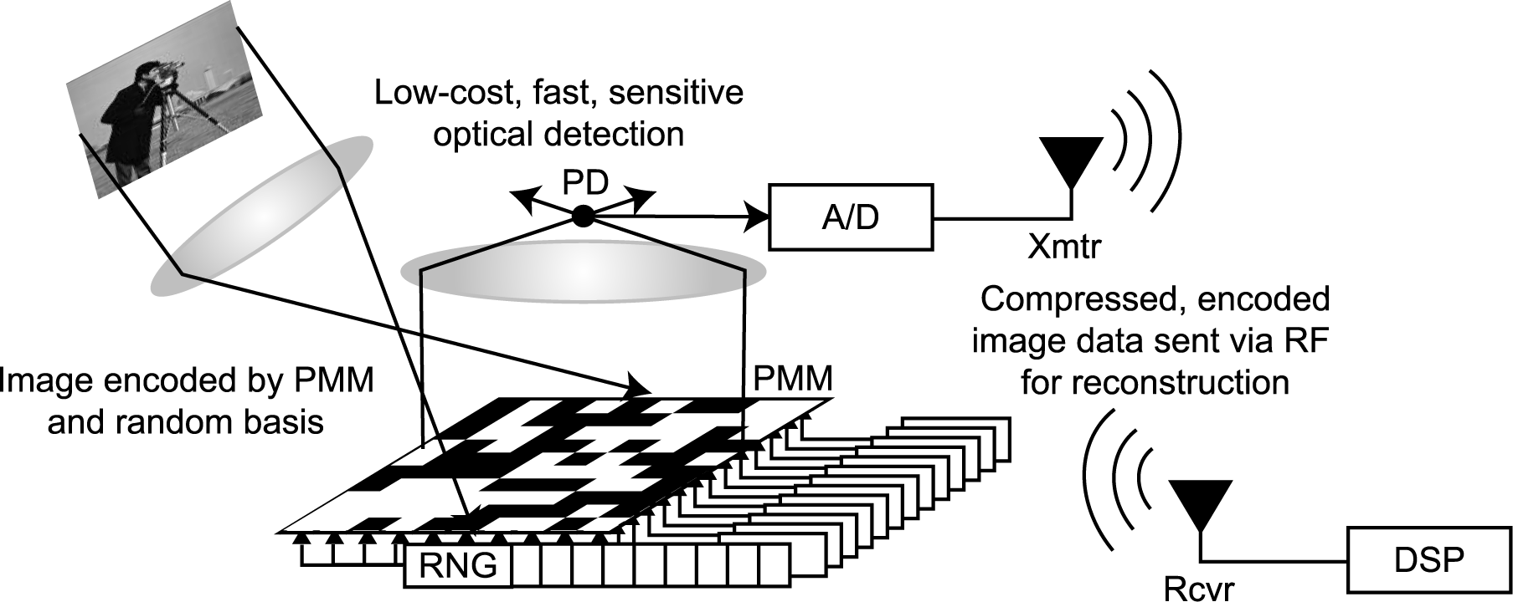
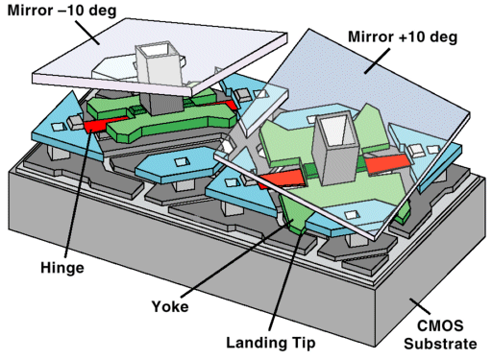
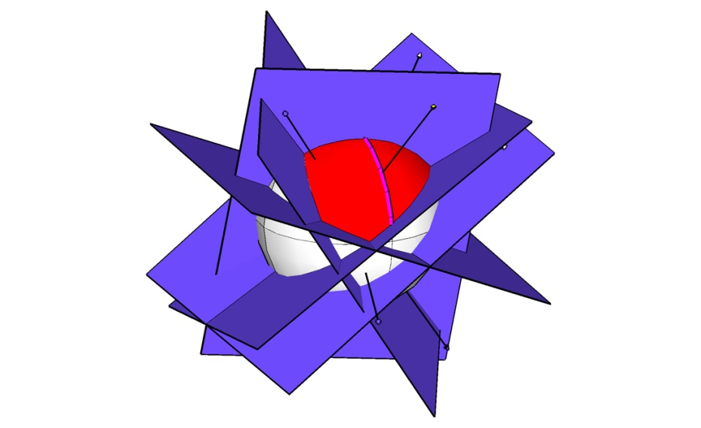
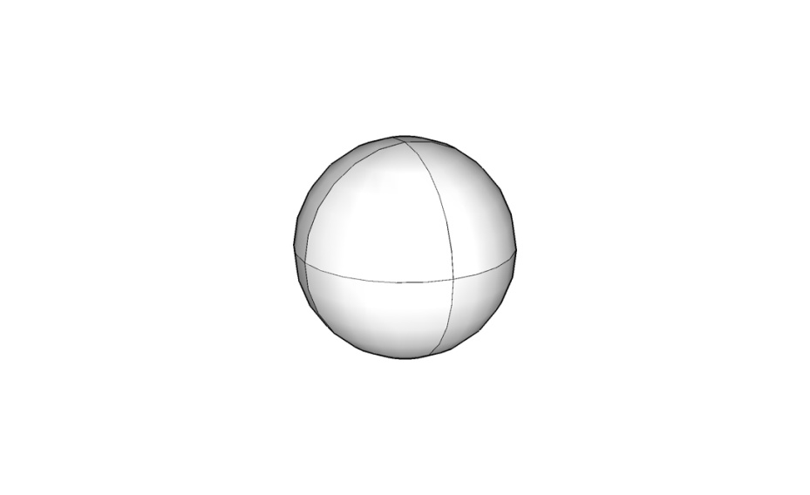
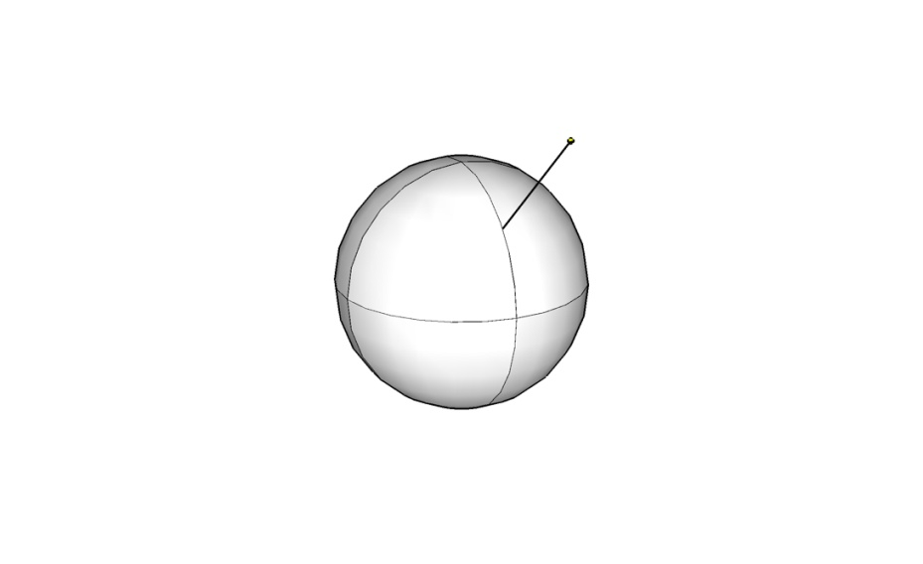
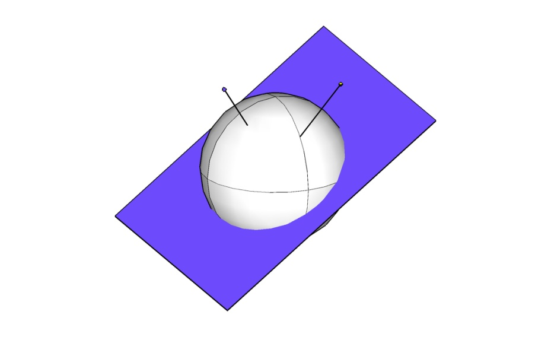
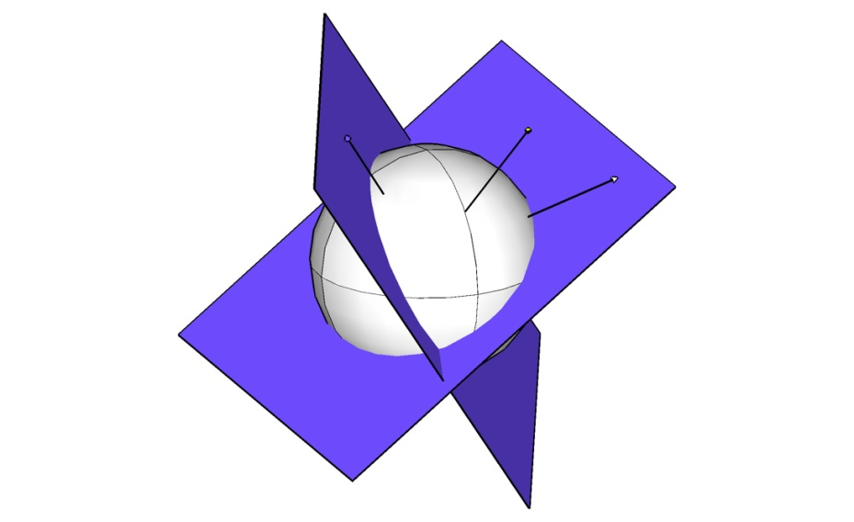
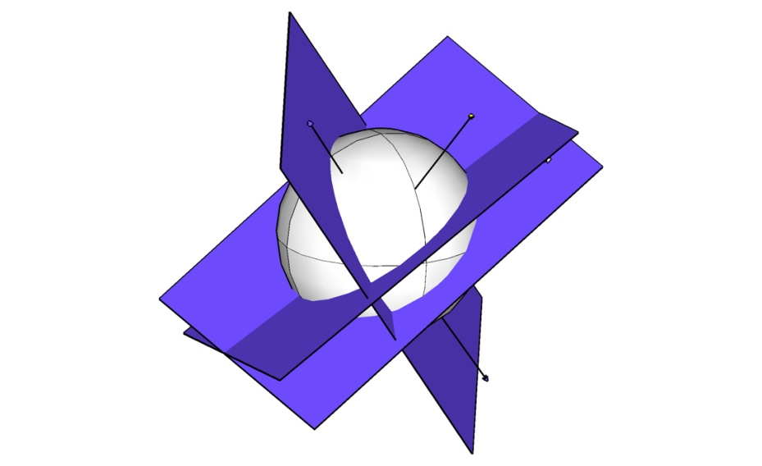
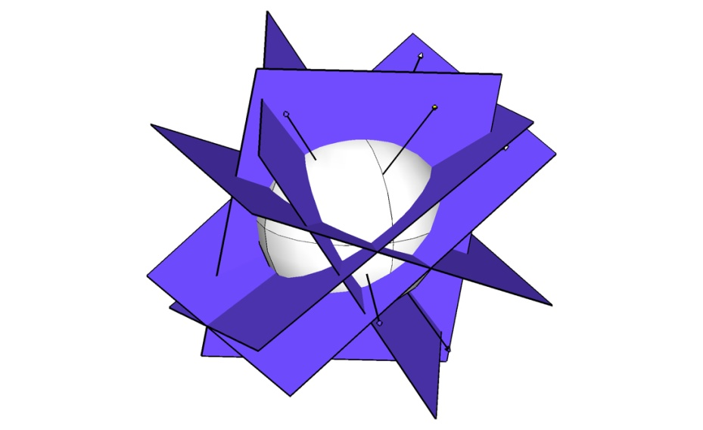
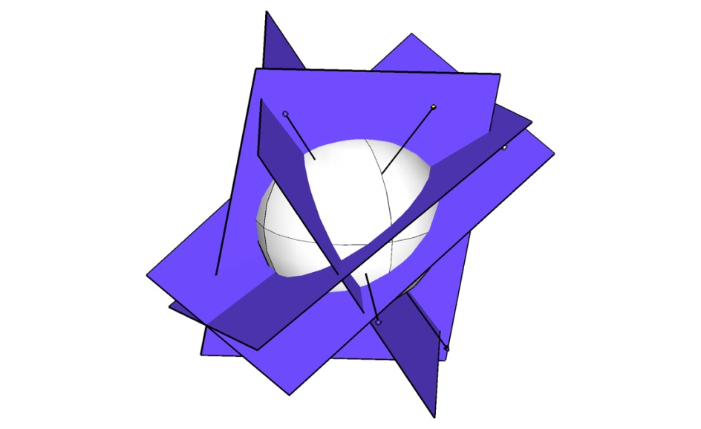
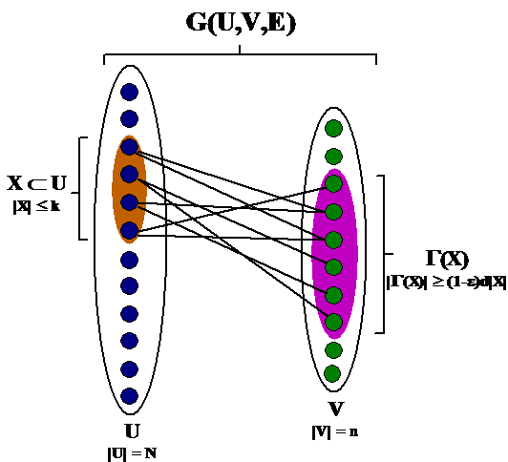
Sampling/sketching design
+Coding theory
+Theoretical computer science
+Learning theory
+Databases
scene
single photon detector
image reconstruction or processing
DMD
DMD
random
pattern on
DMD array
Structured random matrices
1-bit CS
expanders & extractors

Slide 20
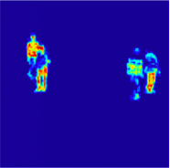
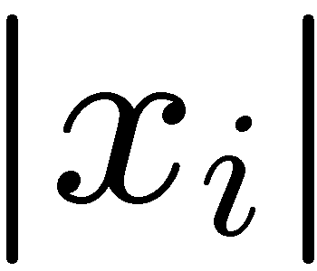
Structured recovery
+Theoretical computer science
+Learning theory
+Optimization
+Databases
Sparsity
sorted index
Sparse vector
only K out of N
coordinates nonzero

Slide 21
Structured recovery
+Theoretical computer science
+Learning theory
+Optimization
+Databases
Sparsity
sorted index
Structured sparse vector
only certain K out of N
coordinates nonzero

Slide 22
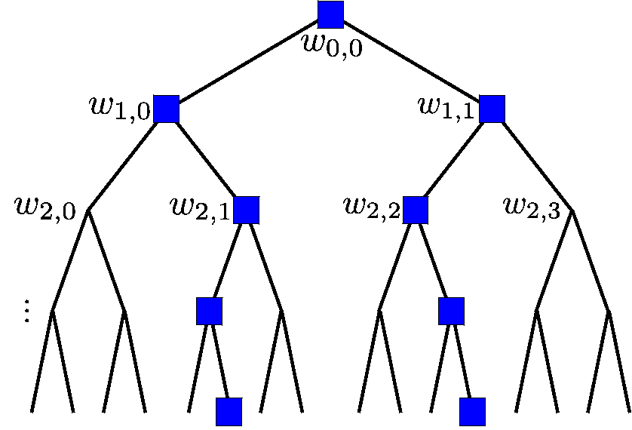
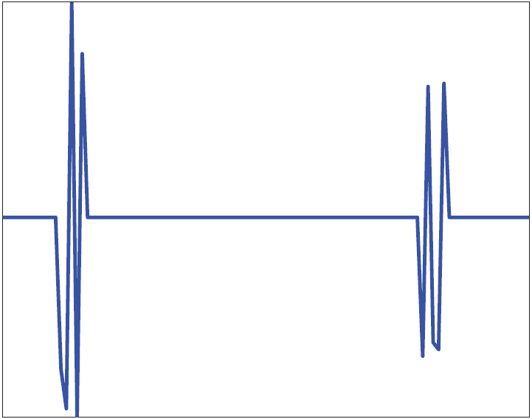
Structured recovery
+Theoretical computer science
+Learning theory
+Optimization
+Databases
Structured sparsity
+ requires smaller sketches + enhanced recovery
+ faster recovery
support of the solution <> modular approximation problem integer linear program
Recovery with low-dimensional models, including low-rank…
matroid structured sparse models
clustered /diversified sparsity models
tightly connected with max-cover,
binpacking, knapsack problems

Slide 23
Quantum tomography
+Theoretical computer science
+Databases
+Information theory
+Optimization
Quantum state estimation
a state of n possibly-entangled qubits takes ~2^{n} bits to specify, even approximately
Recovery with rank and trace constraints
with M=O(N)
Create Pauli measurements (semi-random)
Estimate Tr(Φ_{i}ρ) for each 1≤i≤M
Find any “hypothesis state” σ st Tr(Φ _{i}σ)≈Tr(Φ _{i}ρ) for all 1≤i≤M
Huge dimensional problem!
(desperately) need scalable algorithms
also need theory for perfect density estimation

Slide 24
Learning theory and methods
+Learning theory
+Optimization
+Information theory
+Theoretical computer science
A fundamental problem:
given learn a mapping
Our interest <> non-parametric functions graphs (e.g., social networks)
dictionary learning…
Rigorous foundations <> sample complexity
approximation guarantees
tractability
Key tools <> sparsity/low-rankness submodularity smoothness

Slide 25
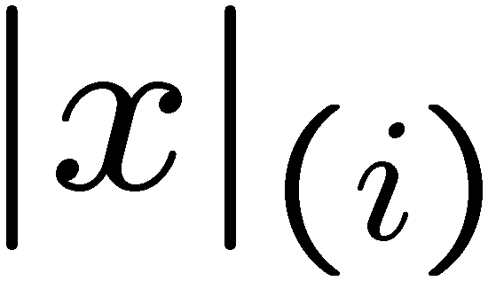
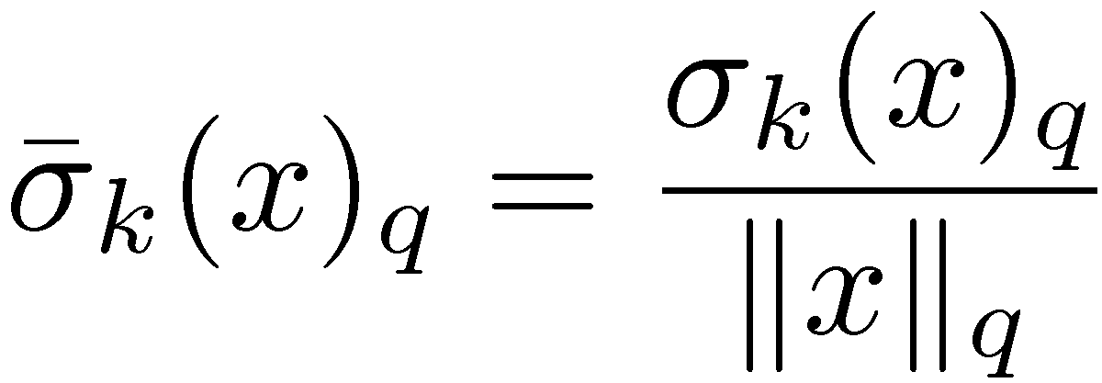
Compressible priors
+Learning theory
+Information theory
Goal: seek distributions whose iid realizations can be well-approximated as sparse
Definition:
relative k-term approximation:
sorted index

Slide 26
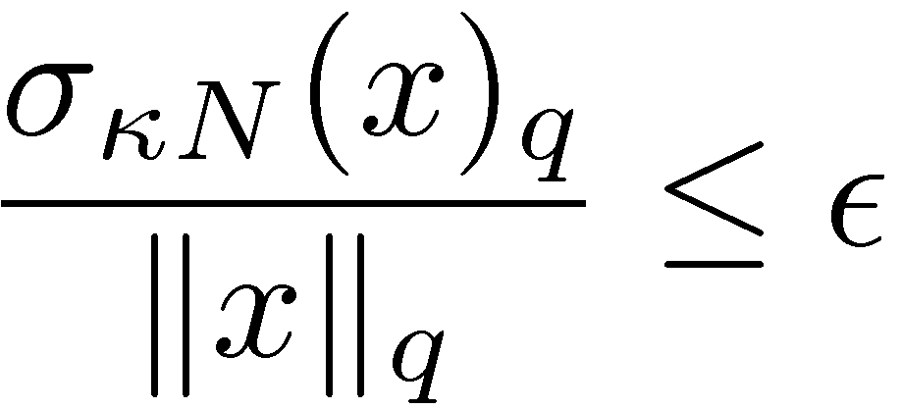
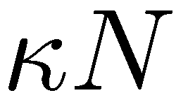
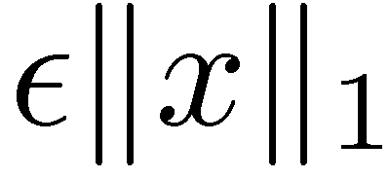
Compressible priors
+Learning theory
+Information theory
Goal: seek distributions whose iid realizations can be well-approximated as sparse
Classical:
New:
sorted index

Slide 27
Compressible priors
+Learning theory
+Information theory
Goal: seek distributions whose iid realizations can be well-approximated as sparse
Motivations: deterministic embedding scaffold for the probabilistic view
analytical proxies for sparse signals
learning (e.g., dim. reduced data)
algorithms (e.g., structured sparse)
information theoretic (e.g., coding)
lots of applications in vision, image understanding / analysis

Slide 28
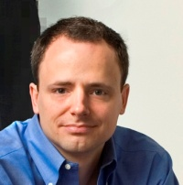
Final remarks: there are a lot more problems…
looking for joint advising…
Reconstruction with low-dimensional methods + databases?
motivation: a principled way of coping with the data deluge
system techniques <> computational + storage + time bottlenecks
EX: 8bits QT single computer | limited by algorithm
32bits QT limited by flops + storage + time
online aggregation >> real-time responsiveness
with probabilistic/deterministic approximation guarantees
dynamic graph streams >> sketching for storage bottlenecks with probabilistic/deterministic approximation guarantees

Slide 29
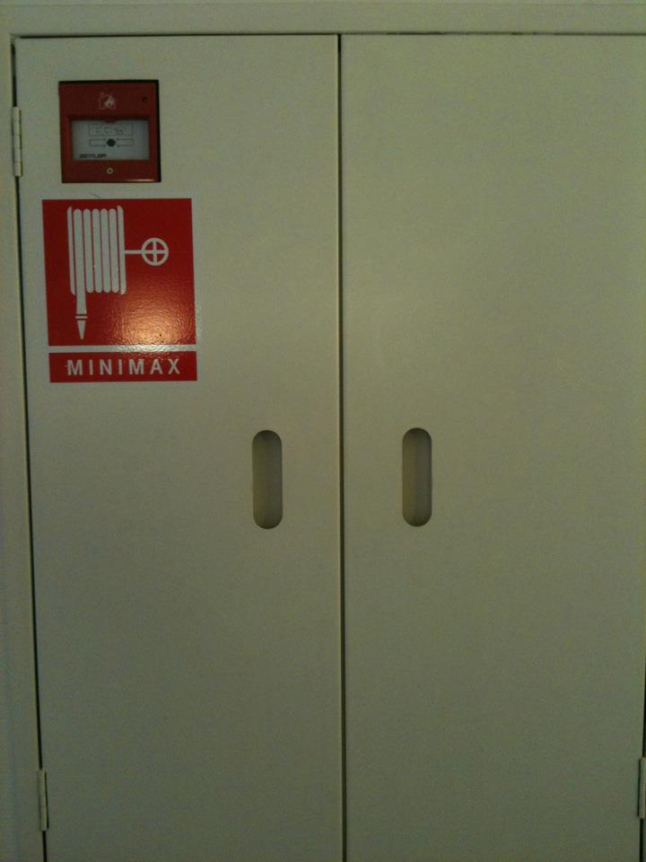
Final remarks: there are a lot more problems…
Lots of interesting theoretical + practical problems @ LIONS
game theoretic sparse/low-rank recovery
approximate message passing
non-negative matrix factorization
portfolio design
density learning
randomized linear algebra
sublinear algorithms
…

Slide 30
volkan.cevher@epfl.ch

Slide 31
A linear inverse problem

Slide 32
Naïve reconstruction

Slide 33
reconstruction with low-dimensional methods

