Slide 1
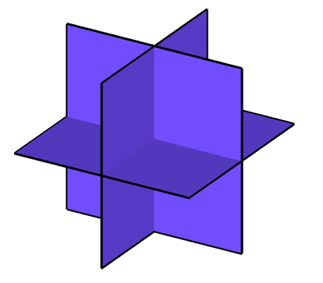





Combinatorial Selection and Least Absolute Shrinkage via The CLASH Operator
Volkan Cevher
Laboratory for Information and Inference Systems – LIONS / EPFL
http://lions.epfl.ch
& Idiap Research Institute joint work with my PhD student Anastasios Kyrillidis @ EPFL

Slide 2



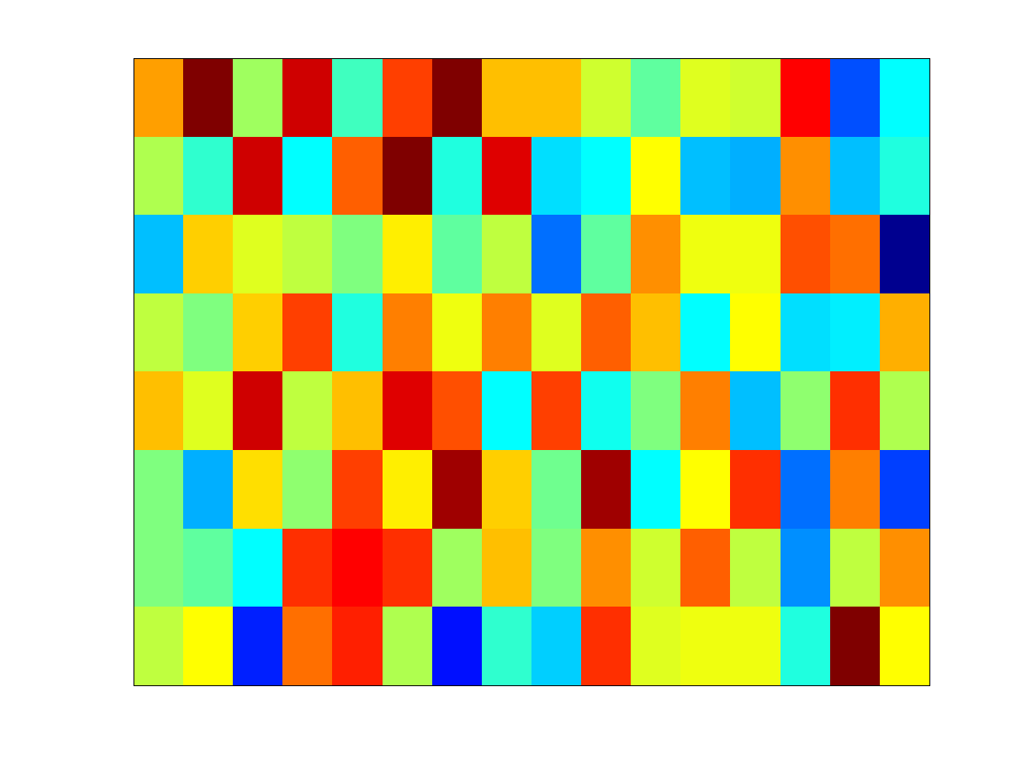




Linear Inverse Problems
Machine learning dictionary of features
Compressive sensing non-adaptive measurements
Information theory coding frame
Theoretical computer science sketching matrix / expander

Slide 3
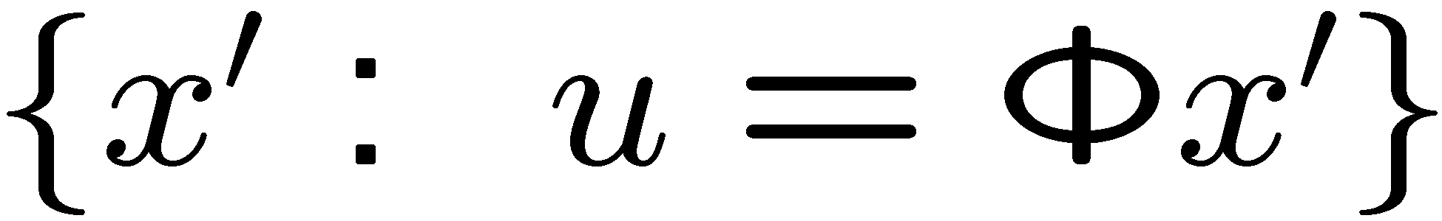

Linear Inverse Problems
Challenge:

Slide 4



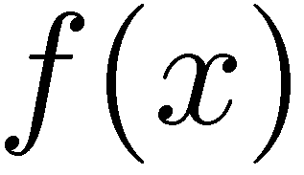
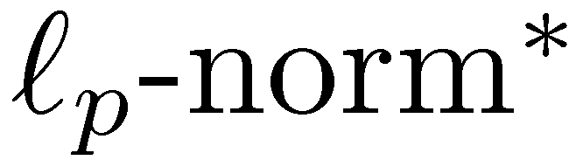
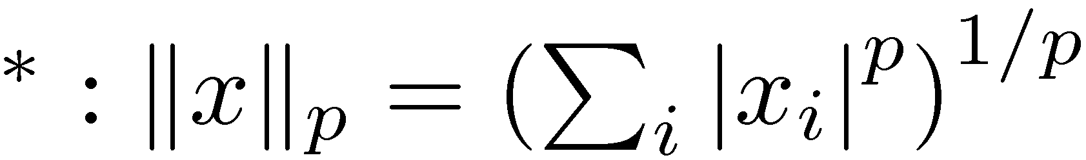
Approaches
Deterministic Probabilistic
Prior sparsity compressibility
Metric likelihood function

Slide 5
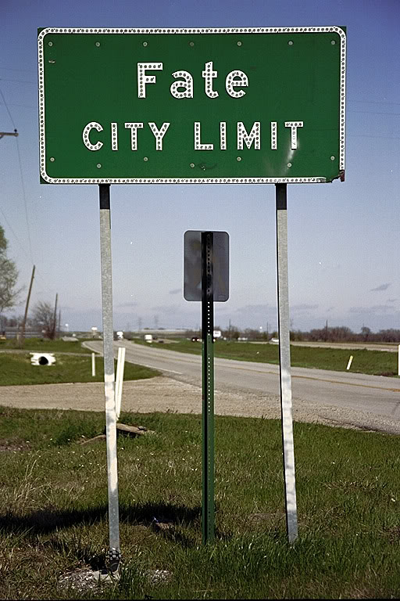
A Deterministic View Model-based CS
(circa Aug 2008)

Slide 6
My Insights on Compressive Sensing
Sparse or compressible
not sufficient alone
Projection
information preserving
(stable embedding / special null space)
Decoding algorithms
tractable

Slide 7
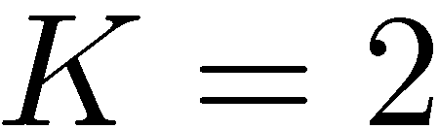
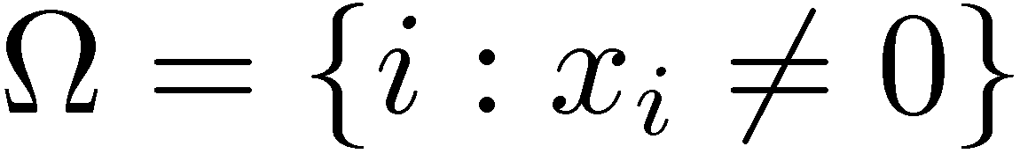
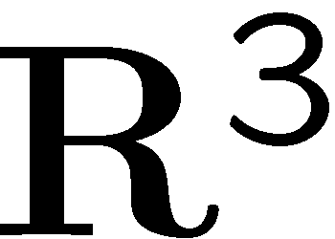

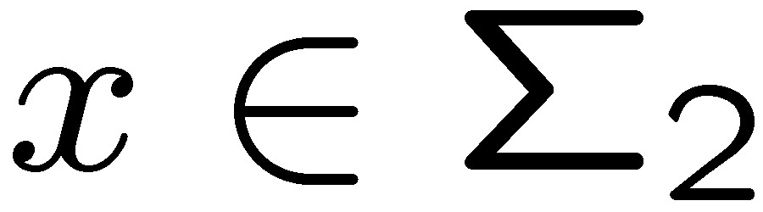
Signal Priors
Sparse signal: only K out of N coordinates nonzero
model: union of all K-dimensional subspaces aligned w/ coordinate axes Example: 2-sparse in 3-dimensions
support:

Slide 8

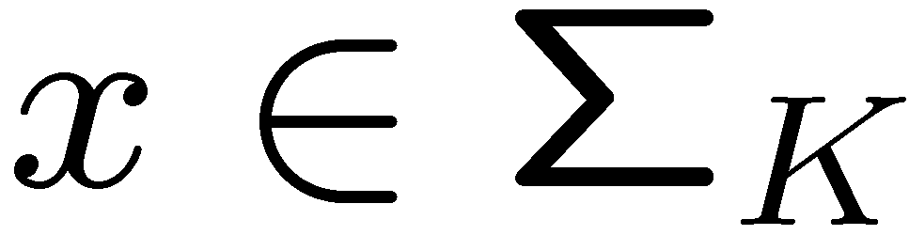
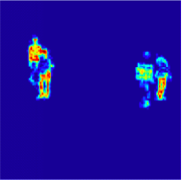
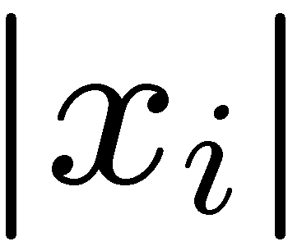


Signal Priors
Sparse signal: only K out of N coordinates nonzero
model: union of all K-dimensional subspaces aligned w/ coordinate axes
Structured sparse signal: reduced set of subspaces
(or model-sparse)
model: a particular union of subspaces ex: clustered or dispersed sparse patterns
sorted index

Slide 9
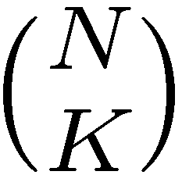

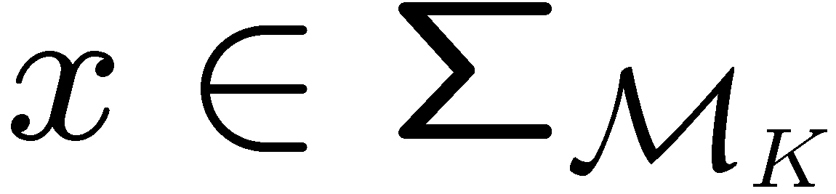
Signal Priors
Sparse signal: only K out of N coordinates nonzero
model: union of all K-dimensional subspaces aligned w/ coordinate axes
Structured sparse signal: reduced set of subspaces
(or model-sparse)
model: a particular union of subspaces ex: clustered or dispersed sparse patterns
sorted index

Slide 10


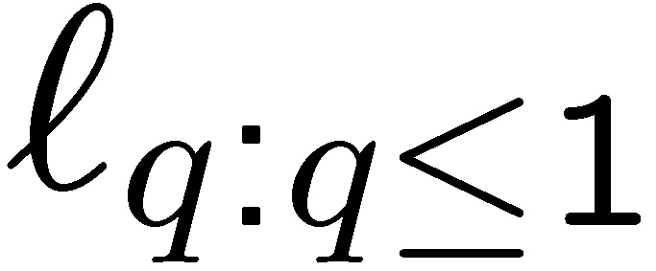
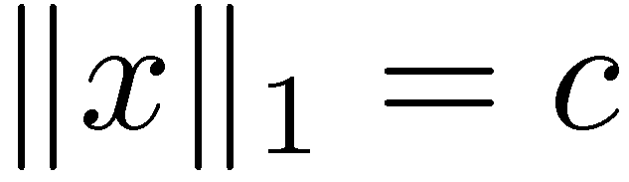
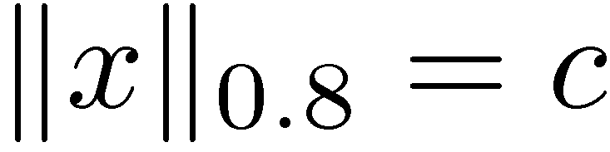
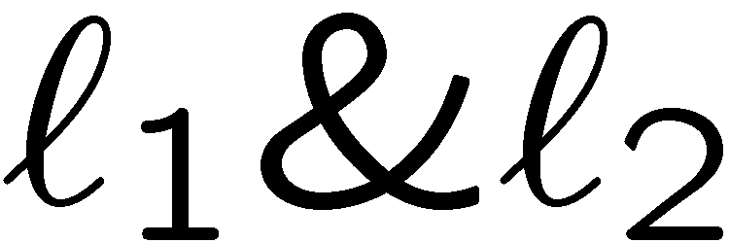
Sparse Recovery Algorithms
Goal: given recover
and convex optimization formulations
basis pursuit, Lasso, BP denoising…
iterative re-weighted algorithms
Hard thresholding algorithms: ALPS, CoSaMP, SP,…
Greedy algorithms: OMP, MP,…
http://lions.epfl.ch/ALPS

Slide 11
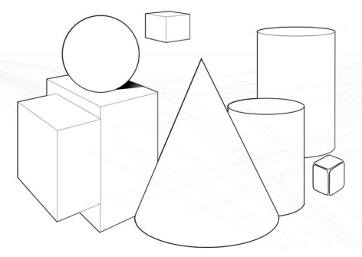
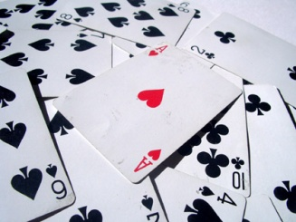


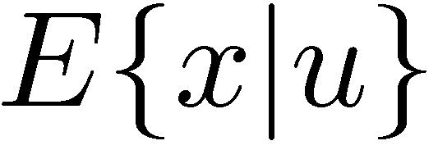
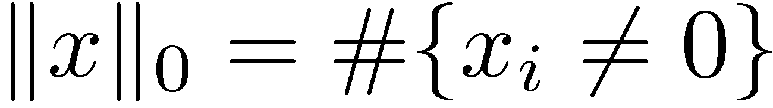
Sparse Recovery Algorithms
 | Geometric | Combinatorial | Probabilistic
Encoding | atomic norm / convex relaxation | non-convex union-of-subspaces | compressible / sparse priors
Example
Algorithm | Basis pursuit, Lasso, basis pursuit denoising… | IHT, CoSaMP, SP, ALPS, OMP… | Variational Bayes, EP, Approximate message passing (AMP)…

Slide 12
Sparse Recovery Algorithms
The Clash Operator
 | Geometric | Combinatorial | Probabilistic
Encoding | atomic norm / convex relaxation | non-convex union-of-subspaces | compressible / sparse priors
Example
Algorithm | Basis pursuit, Lasso, basis pursuit denoising… | IHT, CoSaMP, SP, ALPS, OMP… | Variational Bayes, EP, Approximate message passing (AMP)…

Slide 13
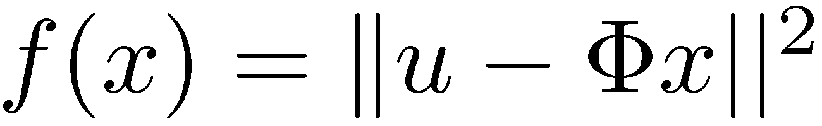
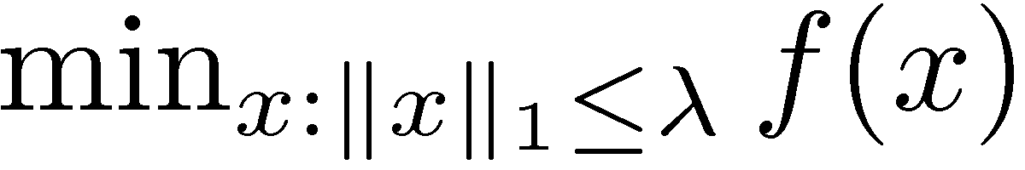
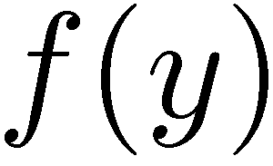
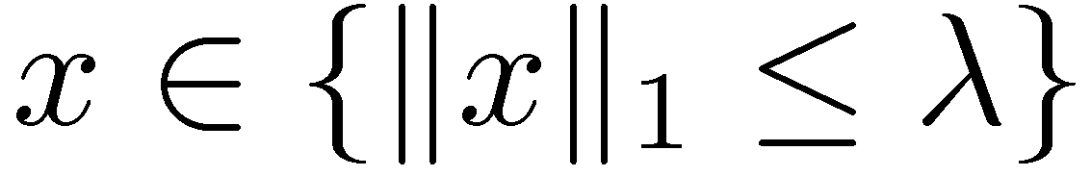
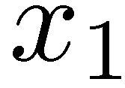
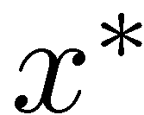
A Tale of Two Algorithms
Soft thresholding

Slide 14


A Tale of Two Algorithms
Soft thresholding
Structure in optimization:
Bregman distance

Slide 15

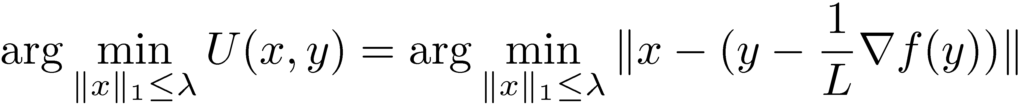
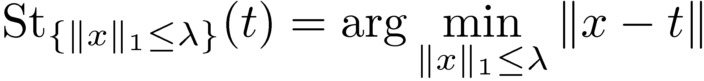
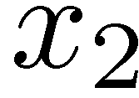
A Tale of Two Algorithms
Soft thresholding
ALGO: cf. J. Duchi et al. ICML 2008
majorization-minimization
Bregman distance

Slide 16
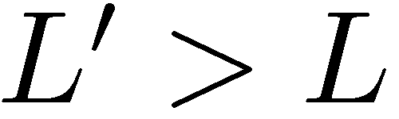
A Tale of Two Algorithms
Soft thresholding
slower
Bregman distance

Slide 17
A Tale of Two Algorithms
Soft thresholding
Is x* what we are looking for?
local “unverifiable” assumptions:
ERC/URC condition
compatibility condition …
(local → global / dual certification / random signal models)

Slide 18
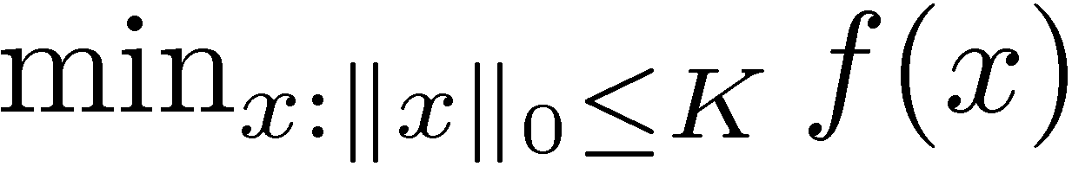
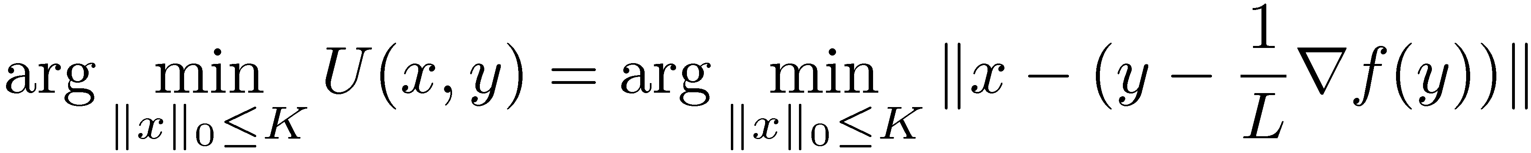
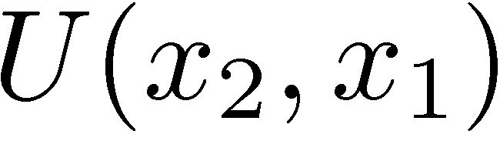
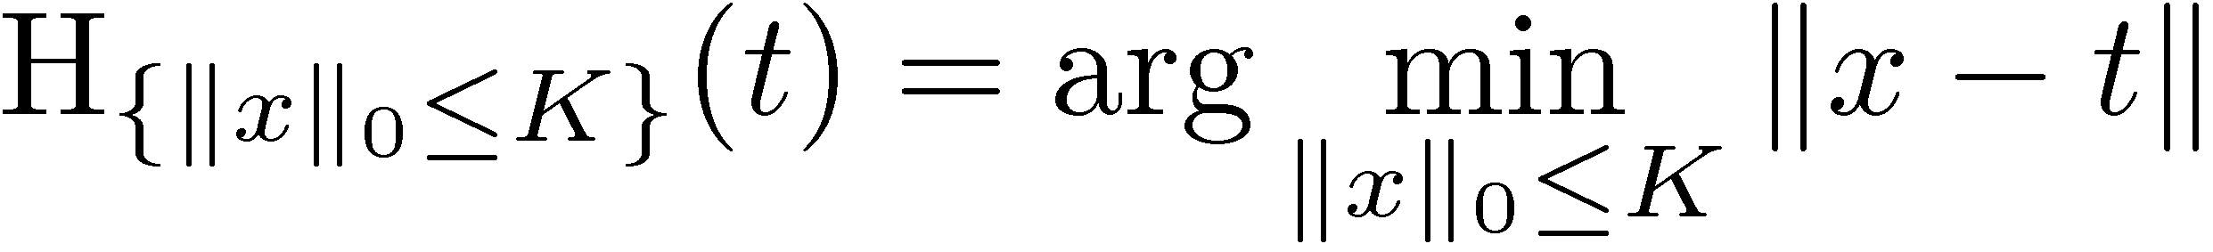
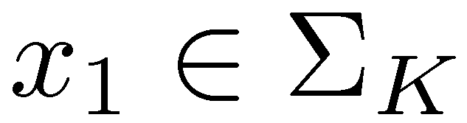
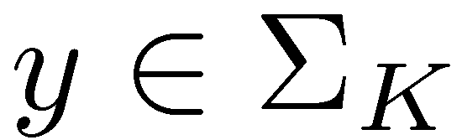
A Tale of Two Algorithms
Hard thresholding
ALGO: sort and pick the largest K

Slide 19
A Tale of Two Algorithms
Hard thresholding
percolations
What could possibly go wrong with this naïve approach?

Slide 20


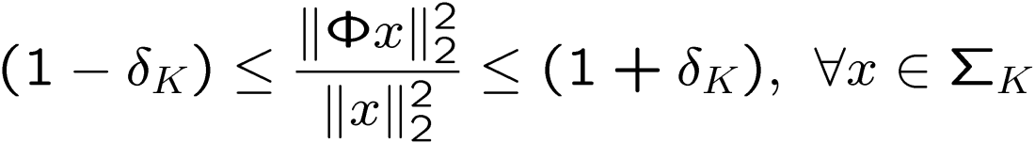
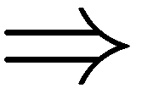
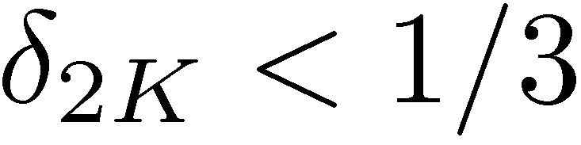
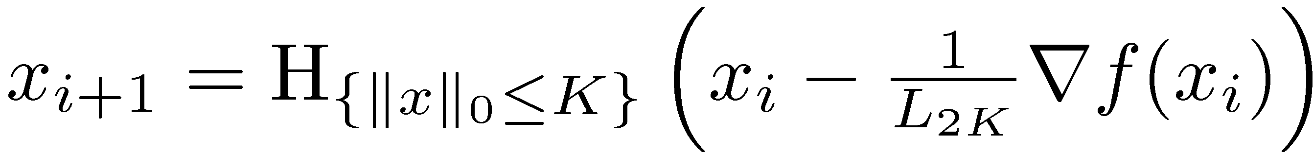
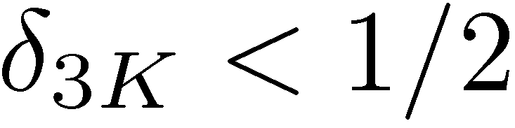
A Tale of Two Algorithms
Hard thresholding
we can tiptoe among percolations!
another variant has
Global “unverifiable” assumption:
GraDes:

Slide 21
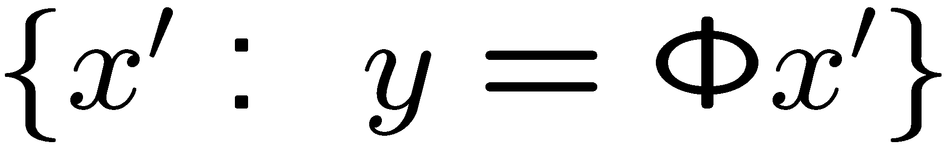






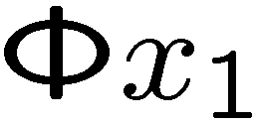
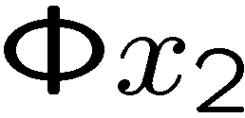
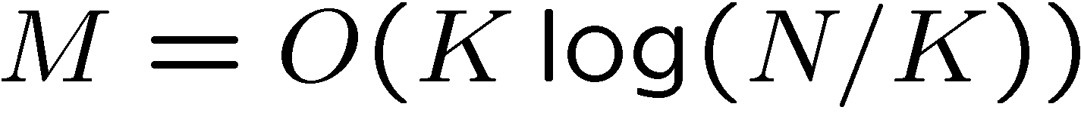
Restricted Isometry Property
Model: K-sparse coefficients
RIP: stable embedding
Remark: implies convergence of convex relaxations also e.g.,
IID sub-Gaussian matrices
K-planes
Notes:
21

Slide 22
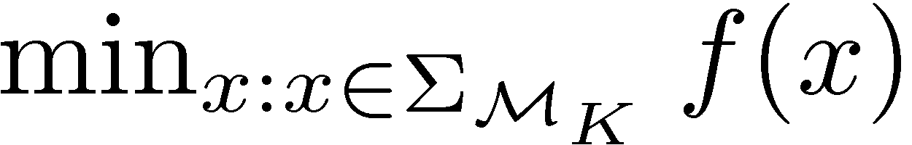





A Model-based CS Algorithm
Model-based hard thresholding
Global “unverifiable” assumption:

Slide 23

Tree-Sparse
Model: K-sparse coefficients + significant coefficients lie on a rooted subtree
Sparse approx: find best set of coefficients
sorting
hard thresholding
Tree-sparse approx: find best rooted subtree of coefficients
condensing sort and select [Baraniuk]
dynamic programming [Donoho]
Notes:
23

Slide 24
Sparse
Model: K-sparse coefficients
RIP: stable embedding
IID sub-Gaussian matrices
K-planes
Notes:
24

Slide 25


Tree-Sparse
Model: K-sparse coefficients + significant coefficients lie on a rooted subtree
Tree-RIP: stable embedding
IID sub-Gaussian matrices
K-planes
Notes:
25

Slide 26





Tree-Sparse Signal Recovery
target signal
CoSaMP, (MSE=1.12)
N=1024 M=80
L1-minimization (MSE=0.751)
Tree-sparse CoSaMP (MSE=0.037)

Slide 27


Tree-Sparse Signal Recovery
Number samples for correct recovery
Piecewise cubic signals + wavelets
Models/algorithms:
compressible (CoSaMP)
tree-compressible (tree-CoSaMP)
Notes:
27

Slide 28

Model CS in Context
Basis pursuit and Lasso
exploit geometry <> interplay of
arbitrary selection <> difficulty of interpretation
cannot leverage further structure
Structured-sparsity inducing norms
“customize” geometry <> “mixing” of norms over groups /
Lovasz extension of submodular set functions
inexact selections
Structured-sparsity via OMP / Model-CS
greedy selection <> cannot leverage geometry
exact selection <> cannot leverage geometry
for selection

Slide 29
Model CS in Context
Basis pursuit and Lasso
exploit geometry <> interplay of
arbitrary selection <> difficulty of interpretation
cannot leverage further structure
Structured-sparsity inducing norms
“customize” geometry <> “mixing” of norms over groups /
Lovasz extension of submodular set functions
inexact selections
Structured-sparsity via OMP / Model-CS
greedy selection <> cannot leverage geometry
exact selection <> cannot leverage geometry
for selection
Or, can it?

Slide 30

Enter CLASH
http://lions.epfl.ch/CLASH

Slide 31

Importance of Geometry
A subtle issue
2 solutions!
Which one is correct?

Slide 32

Importance of Geometry
A subtle issue
2 solutions!
Which one is correct?
EPIC FAIL

Slide 33


CLASH Pseudocode
Algorithm code @ http://lions.epfl.ch/CLASH
Active set expansion
Greedy descend
Combinatorial selection
Least absolute shrinkage
De-bias with convex constraint
&
Minimum 1-norm solution still makes sense!

Slide 34


CLASH Pseudocode
Algorithm code @ http://lions.epfl.ch/CLASH
Active set expansion
Greedy descend
Combinatorial selection
Least absolute shrinkage
De-bias with convex constraint

Slide 35
Geometry of CLASH
Combinatorial selection + least absolute shrinkage
&

Slide 36

Geometry of CLASH
Combinatorial selection + least absolute shrinkage
combinatorial origami
&

Slide 37

Combinatorial Selection
A different view of the model-CS workhorse
(Lemma) support of the solution <> modular approximation problem
where
indexing set

Slide 38

PMAP
An algorithmic generalization of union-of-subspaces
Polynomial time modular epsilon-approximation property:
Sets with PMAP-0
Matroids
uniform matroids <> regular sparsity
partition matroids <> block sparsity (disjoint groups)
cographic matroids <> rooted connected tree group adapted hull model
Totally unimodular systems
mutual exclusivity <> neuronal spike model
interval constraints <> sparsity within groups
Model-CS is applicable for all these cases!

Slide 39











PMAP
An algorithmic generalization of union-of-subspaces
Polynomial time modular epsilon-approximation property:
Sets with PMAP-epsilon
Knapsack multi-knapsack constraints weighted multi-knapsack quadratic knapsack (?)
Define algorithmically!
…
selector
variables

Slide 40
PMAP
An algorithmic generalization of union-of-subspaces
Polynomial time modular epsilon-approximation property:
Sets with PMAP-epsilon
Knapsack
Define algorithmically!
Sets with PMAP-???
pairwise overlapping groups <> mincut with cardinality constraint

Slide 41



CLASH Approximation Guarantees
PMAP / downward compatibility
precise formulae are in the paper
http://lions.epfl.ch/CLASH
Isometry requirement (PMAP-0) <>

Slide 42


Examples
sparse matrix
Model: (K,C)-clustered model
O(KCN) – per iteration
~10-15 iterations
Model: partition model / TU
LP – per iteration
~20-25 iterations

Slide 43

Examples
CCD array readout via noiselets

Slide 44


Conclusions
CLASH <> combinatorial selection + convex geometry
λ→∞ ⇒ model-CS
PMAP-epsilon <> inherent difficulty in combinatorial selection
beyond simple selection towards provable solution quality
+ runtime/space bounds
algorithmic definition of sparsity + many models
matroids, TU, knapsack,…
Postdoc position @ LIONS / EPFL
contact: volkan.cevher@epfl.ch

Slide 45

Postdoc position @ LIONS / EPFL
contact: volkan.cevher@epfl.ch

Slide 46



Signal Priors
Sparse signal: only K out of N coordinates nonzero
model: union of K-dimensional subspaces
Compressible signal: sorted coordinates decay rapidly to zero well-approximated by a K-sparse signal (simply by thresholding)
sorted index

Slide 47

Compressible Signals
Real-world signals are compressible, not sparse
Recall: compressible <> well approximated
by sparse
compressible signals lie close to a union of subspaces
ie: approximation error decays rapidly as
If has RIP, then both sparse and compressible signals are stably recoverable
sorted index

Slide 48
Model-Compressible Signals
Model-compressible <> well approximated by model-sparse
model-compressible signals lie close to a reduced union of subspaces
ie: model-approx error decays rapidly as

Slide 49

Model-Compressible Signals
Model-compressible <> well approximated by model-sparse
model-compressible signals lie close to a reduced union of subspaces
ie: model-approx error decays rapidly as
While model-RIP enables stable model-sparse recovery, model-RIP is not sufficient for stable model-compressible recovery at !

Slide 50





Stable Recovery
Stable model-compressible signal recovery at requires that have both:
RIP + Restricted Amplification Property
RAmP: controls nonisometry of in the approximation’s residual subspaces
optimal K-term model recovery (error controlled by RIP)
optimal 2K-term model recovery (error controlled by RIP)
residual subspace (error not controlled by RIP)
Notes:
50

Slide 51


Tree-RIP, Tree-RAmP
Theorem: An MxN iid subgaussian random matrix has the Tree(K)-RIP if
Theorem: An MxN iid subgaussian random matrix has the Tree(K)-RAmP if
Notes:
51

Slide 52
Other Useful Models
When the model-based framework makes sense:
model with
exact projection algorithm
sensing matrix with
model-RIP
model-RAmP
Ex: block sparsity / signal ensembles [Tropp, Gilbert, Strauss], [Stojnic, Parvaresh, Hassibi], [Eldar, Mishali], [Baron, Duarte et al], [Baraniuk, VC, Duarte, Hegde]
Ex: clustered signals / background subtraction [VC, Duarte, Hegde, Baraniuk], [VC, Indyk, Hegde, Baraniuk]
Ex: neuronal spike trains [Hegde, Duarte, VC – best student paper award]

Slide 53


Combinatorial Selection
A different view of the model-CS workhorse
(Lemma) support of the solution <> modular approximation problem
where
Sets endowed with an ALGO with two properties
ALGO: (pseudo) polynomial time
Denote the projection as
indexing set

Slide 54

Performance of Recovery
With model-based ALPS, CoSaMP, SP with model-RIP
Model-sparse signals
noise-free measurements: exact recovery
noisy measurements: stable recovery
Model-compressible signals (via RaMP)
recovery as good as K-model-sparse approximation
http://lions.epfl.ch/ALPS
CS recovery error
signal K-term model approx error
noise

