Slide 1
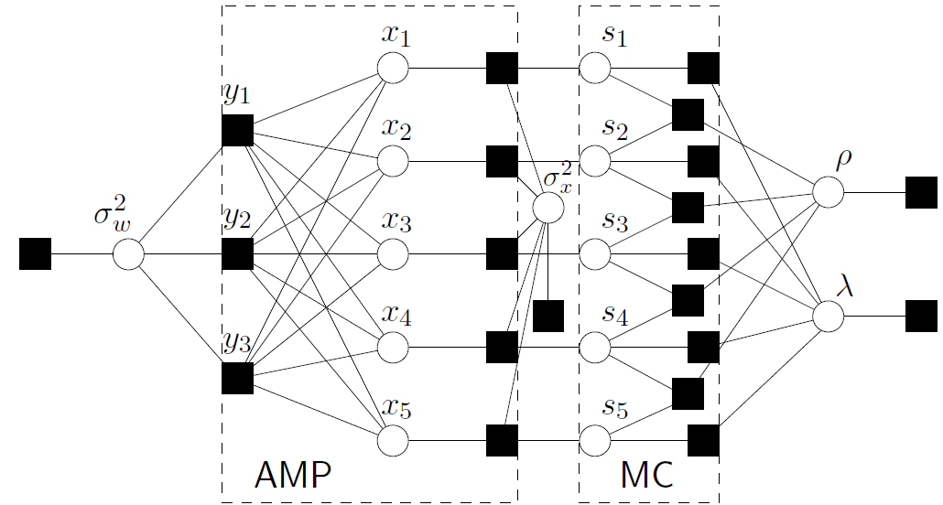







Approximate Message Passing for Bilinear Models
Volkan Cevher
Laboratory for Information and Inference Systems – LIONS / EPFL
http://lions.epfl.ch
& Idiap Research Institute
joint work with
Mitra Fatemi @Idiap
Phil Schniter @OSU
Acknowledgements: Sundeep Rangan and J. T. Parker.

Slide 2



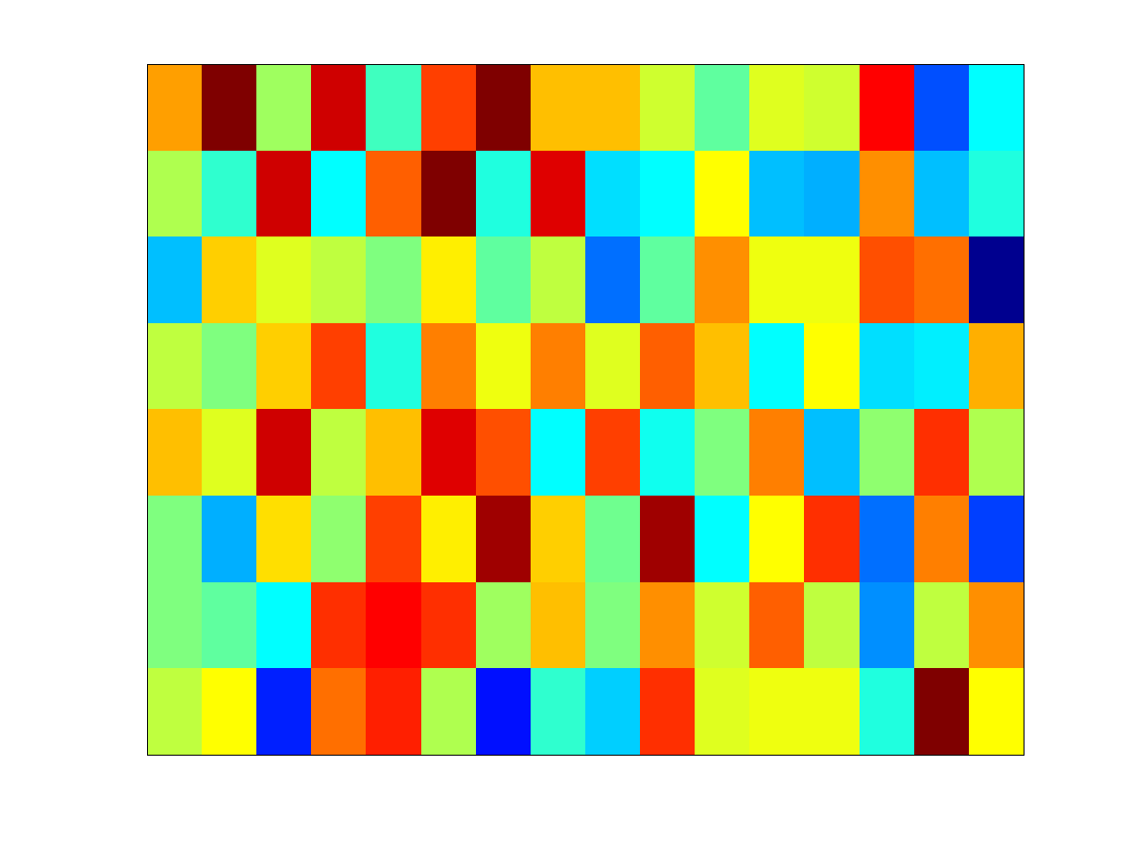




Linear Dimensionality Reduction
Compressive sensing non-adaptive measurements
Sparse Bayesian learning dictionary of features
Information theory coding frame
Theoretical computer science sketching matrix / expander

Slide 3


Linear Dimensionality Reduction
Challenge:

Slide 4




Linear Dimensionality Reduction
Key prior: sparsity in a known basis
  union-of-subspaces
support:

Slide 5




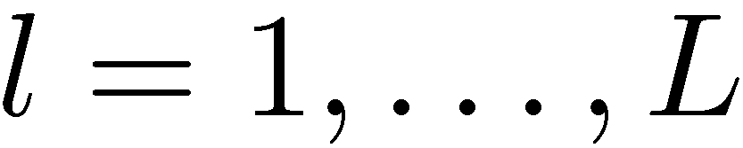

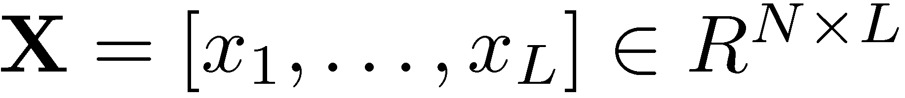

Learning to “Calibrate”
Suppose we are given
Calibrate the sensing
matrix via the basic
bilinear model
  perturbed sensing matrix <>
  sparse signals <>
  model perturbations <>

Slide 6
Learning to “Calibrate”
Suppose we are given
Calibrate the sensing
matrix via the basic
bilinear model
Applications of general bilinear models
  Dictionary learning
  Bayesian experimental design
  Collaborative filtering
  Matrix factorization / completion

Slide 7
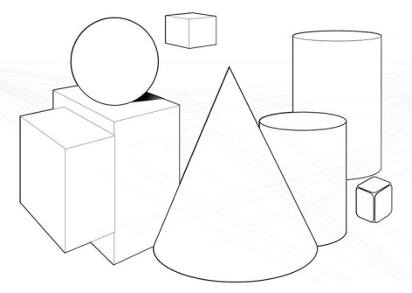

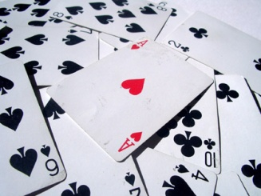

Example Approaches
 | Geometric | Combinatorial | Probabilistic
Idea | atomic norm / TV regularization | non-convex (sparsity) constraints | Distributions on the space of unknowns
Example |  |  | Next few slides
Algorithm based on alternating minimization | Nesterov acceleration, Augmented Lagrangian, Bregman distance, DR splitting,… | Hard thresholding (IHT, CoSaMP, SP, ALPS, OMP) + SVD | Variational Bayes, Gibbs sampling, MCMC, Approximate message passing (AMP)
Literature | Mairal et al. 2008; Zhang & Chan 2009, … | Aharon et al. 2006 (KSVD); Rubinstein et al. 2009, … | Zhou et al. 2009; Donoho et al. 2009, …

Slide 8
Probabilistic View
An Introduction to
Approximate Message Passing
(AMP)

Slide 9


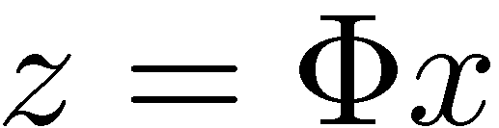

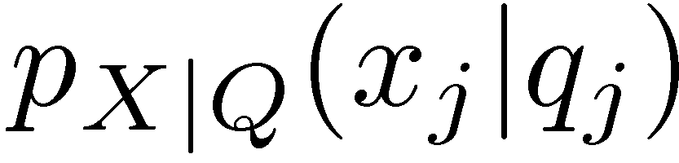
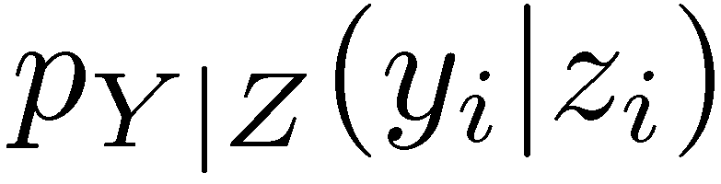

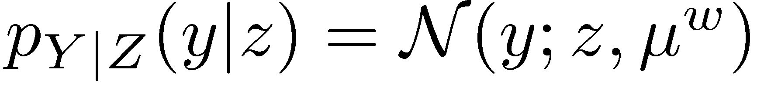
Probabilistic Sparse Recovery: the AMP Way
Goal: given
infer
Model:
Example:
Approach: graphical models / message passing
Key Ideas: CLT / Gaussian approximations
[Boutros and Caire 2002; Montanari and Tse 2006; Guo and Wang 2006; Tanaka and Okada 2006; Donoho, Maleki, and Montanari 2009; Rangan 2010]

Slide 10
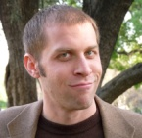
Probabilistic Sparse Recovery: the AMP Way
Goal: given
infer
Model:
Example:
Approach: graphical models / message passing
Key Ideas: CLT / Gaussian approximations
“MAP estimation is so 1996.” – Joel T.
[Boutros and Caire 2002; Montanari and Tse 2006; Guo and Wang 2006; Tanaka and Okada 2006; Donoho, Maleki, and Montanari 2009; Rangan 2010]

Slide 11
Probabilistic Sparse Recovery: the AMP Way
Goal: given
infer
Model:
Example:
Approach: graphical models / message passing
Key Ideas: CLT / Gaussian approximations
[Boutros and Caire 2002; Montanari and Tse 2006; Guo and Wang 2006; Tanaka and Okada 2006; Donoho, Maleki, and Montanari 2009; Rangan 2010]

Slide 12
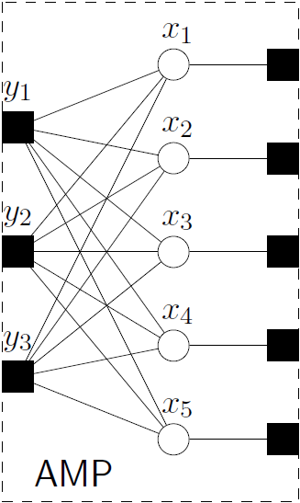
Probabilistic Sparse Recovery: the AMP Way
Goal: given
infer
Model:
Approach: graphical models are modular!
structured sparsity
unknown parameters

Slide 13
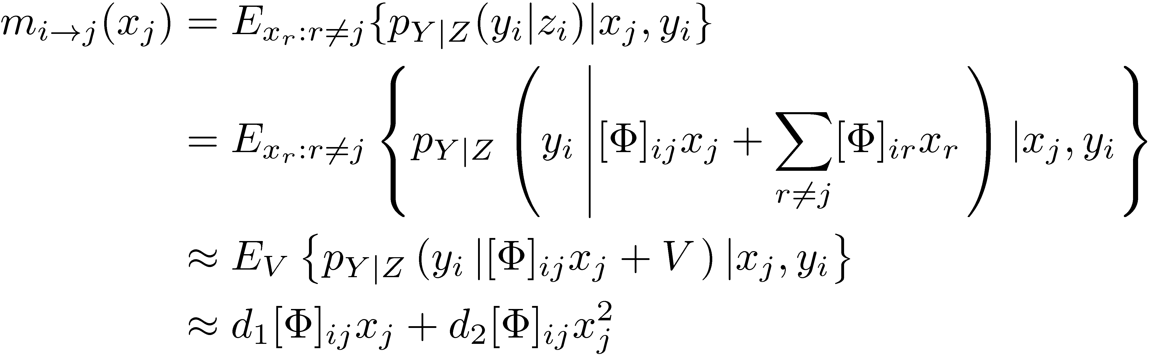
Probabilistic Sparse Recovery: the AMP Way
Goal: given
infer
Model:
Approximate message passing: (sum-product)

Slide 14
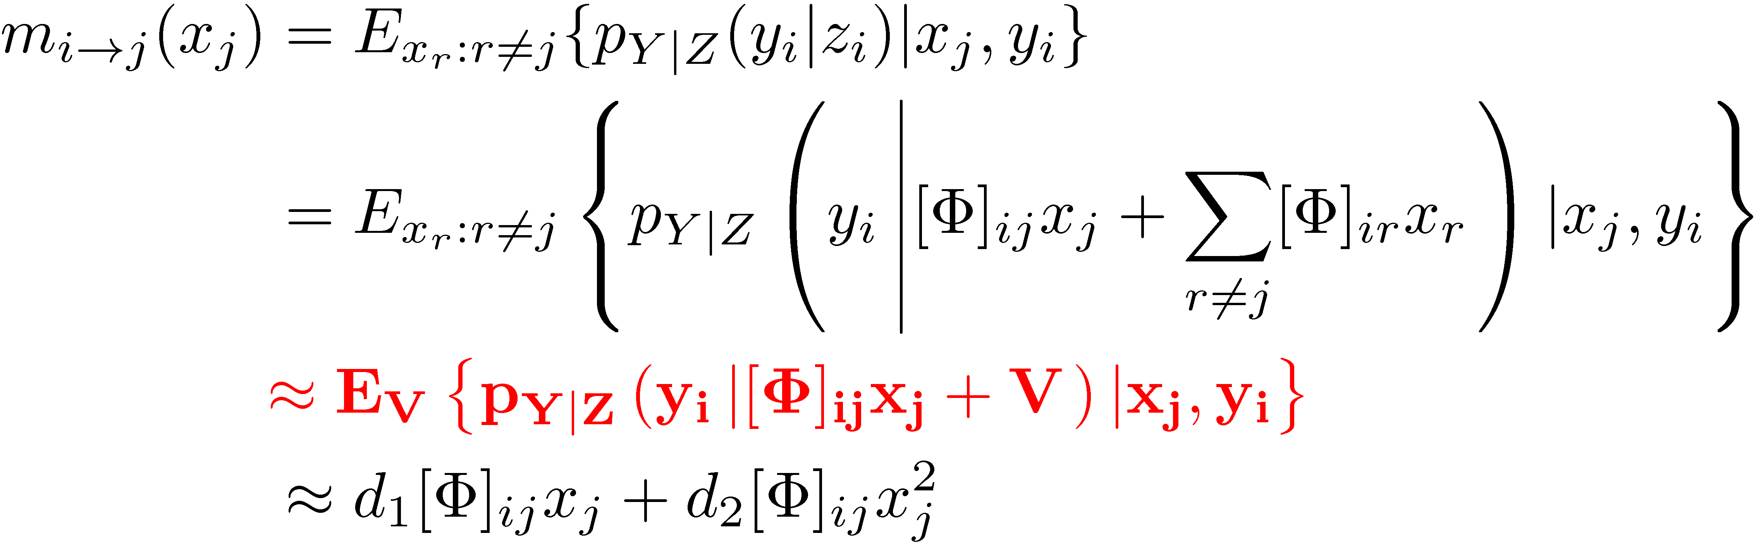

Probabilistic Sparse Recovery: the AMP Way
Goal: given
infer
Model:
Approximate message passing: (sum-product)
Central limit theorem (blessing-of-dimensionality)

Slide 15
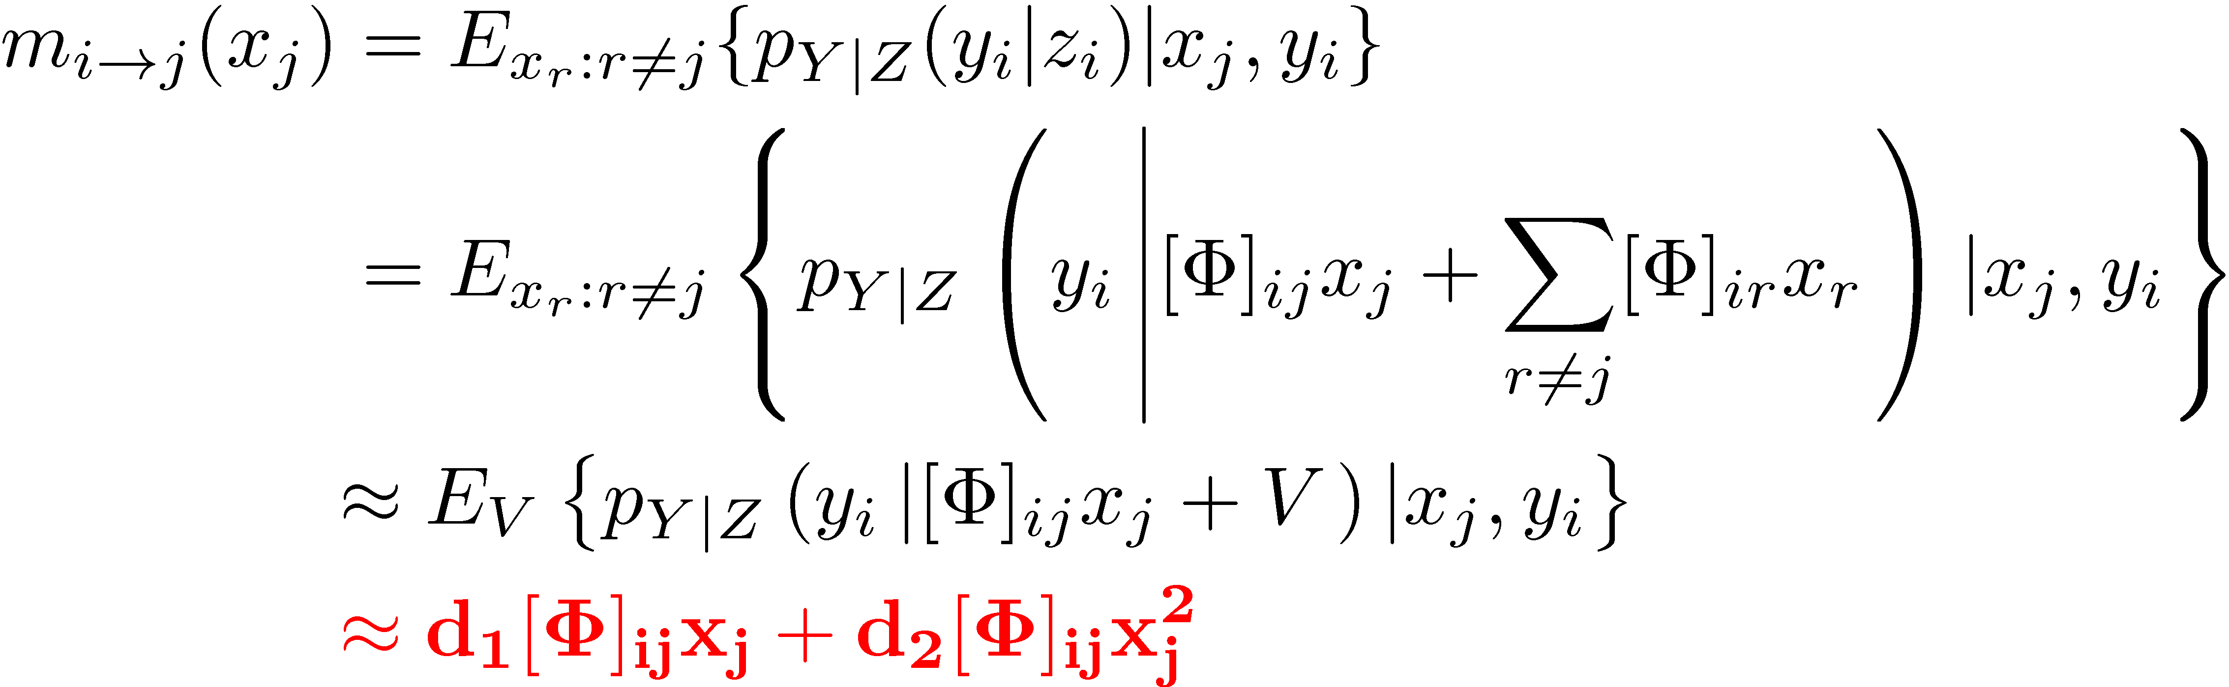
Probabilistic Sparse Recovery: the AMP Way
Goal: given
infer
Model:
Approximate message passing: (sum-product)
Taylor series approximation

Slide 16
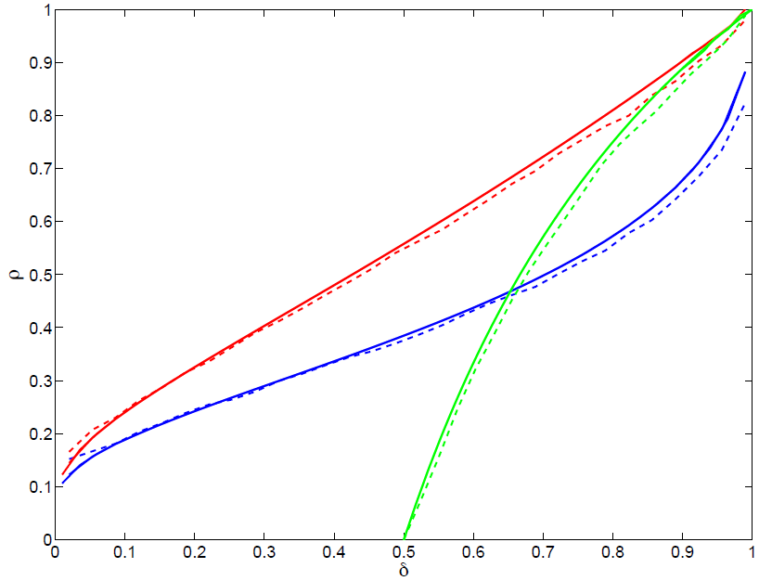
AMP Performance
[Donoho, Maleki, and Montanari 2009; Bayati and Montanari 2011; Montanari 2010; Rangan 2010; Schniter 2010]
Phase transition (Laplace prior)
Convergence (BG prior)
AMP <> state evolution theory
<> fully distributed
Gaussian matrix
Rangan’s GAMP codes are available http://gampmatlab.sourceforge.net

Slide 17
AMP Performance
[Donoho, Maleki, and Montanari 2009; Bayati and Montanari 2011; Montanari 2010; Rangan 2010; Schniter 2010]
Phase transition (Laplace prior)
Convergence (BG prior)
AMP <> state evolution theory
<> fully distributed
Gaussian matrix
http://gampmatlab.sourceforge.net
http://lions.epfl.ch/ALPS/download

Slide 18
AMP Performance
[Donoho, Maleki, and Montanari 2009; Bayati and Montanari 2011; Montanari 2010; Rangan 2010; Schniter 2010]
Phase transition (Laplace prior)
Convergence (BG prior)
AMP <> state evolution theory
<> fully distributed
sparse matrix
(model mismatch)
http://gampmatlab.sourceforge.net
http://lions.epfl.ch/ALPS/download

Slide 19
AMP Performance
[Donoho, Maleki, and Montanari 2009; Bayati and Montanari 2011; Montanari 2010; Rangan 2010; Schniter 2010]
Phase transition (Laplace prior)
Convergence (BG prior)
AMP <> state evolution theory
<> fully distributed
sparse matrix
(model mismatch)
Need to switch to normal BP when the matrix is sparse
http://gampmatlab.sourceforge.net
http://lions.epfl.ch/ALPS/download

Slide 20
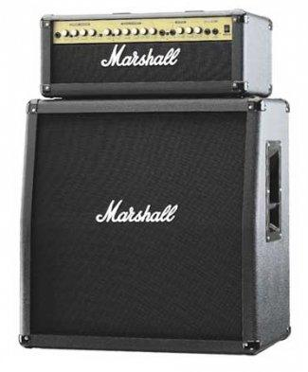
Bilinear AMP

Slide 21



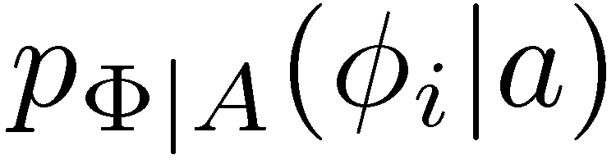
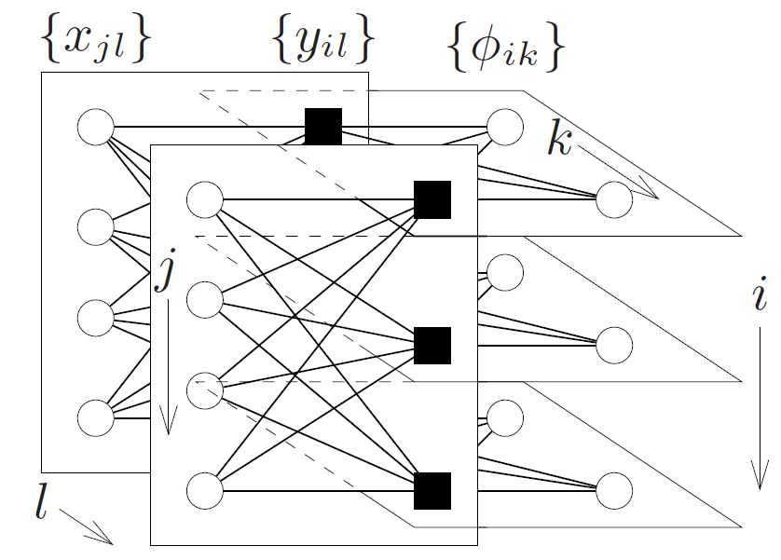
Bilinear AMP
Goal: given
infer
Model:
Algorithm: graphical model

Slide 22
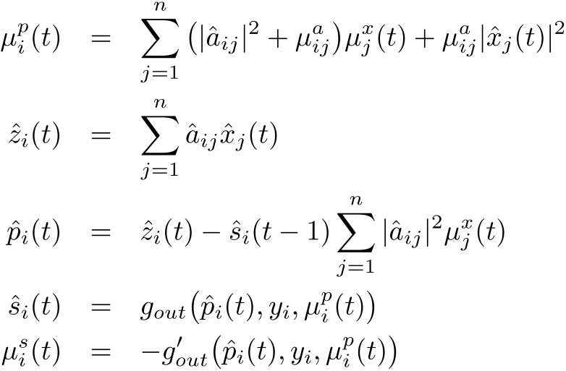
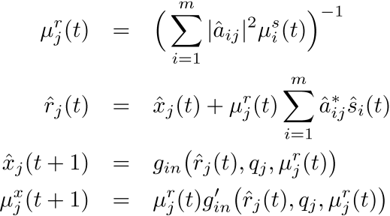
Bilinear AMP
Goal: given
infer
Model:
Algorithm: (G)AMP with matrix uncertainty

Slide 23
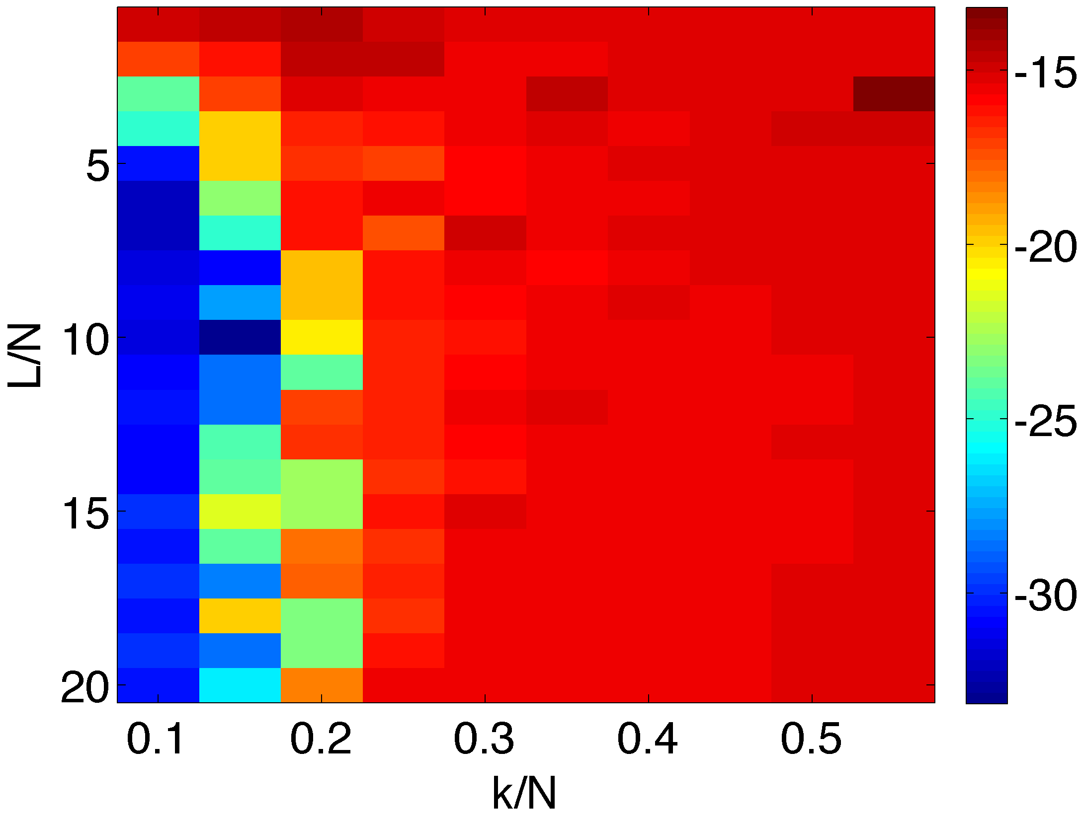
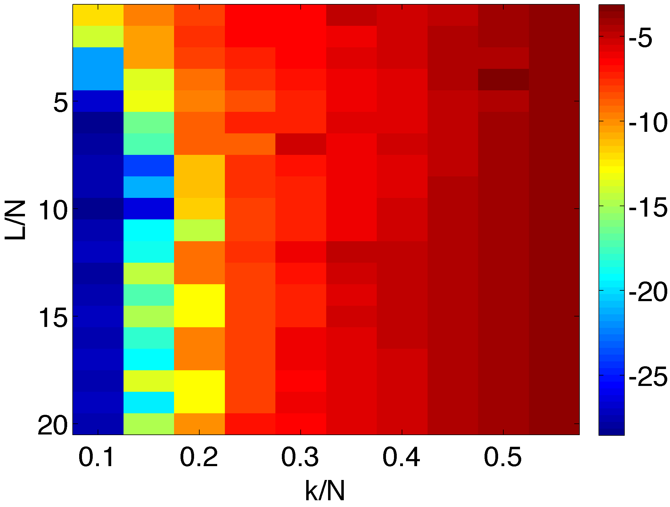
Synthetic Calibration Example
Dictionary error
Signal error
dB
dB

Slide 24
Synthetic Calibration Example
starting noise level -14.7dB
Dictionary error
Signal error
dB
dB
phase transition for sparse recovery
k/N= 0.2632

Slide 25
Conclusions
(G)AMP <> modular / scalable
asymptotic analysis
Extension to bilinear models
  by products: “robust” compressive sensing
  structured sparse dictionary learning
  double-sparsity dictionary learning
More to do comparison with other algorithms
Weakness CLT: dense vs. sparse matrix
Our codes will be available soon http://lions.epfl.ch
Postdoc position @ LIONS / EPFL
contact: volkan.cevher@epfl.ch

