Slide 1


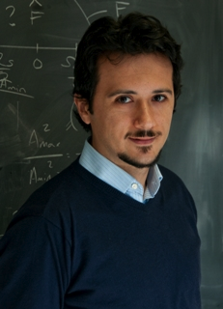

Game Theory Meets
Compressed Sensing
Sina Jafarpour
Princeton University
Based on joint work with:
Robert
Calderbank
Volkan
Cevher
Rob
Schapire

Slide 2
Compressed Sensing
Main tasks:
  Design a sensing matrix
  Design a reconstruction algorithm
Objectives:
  Reconstruct a k-sparse signal from efficiently
    The algorithm should recover without knowing its support
  Successful reconstruction from as few number of measurements as possible!
  Robustness against noise
    Model selection and sparse approximation

Slide 3
Model Selection and Sparse Approximation
Measurement vector:
  : data-domain noise
  : measurement noise
Model Selection Goal:
  Given successfully recover the support of
Sparse Approximation Goal:
  Given find a vector with

Slide 4
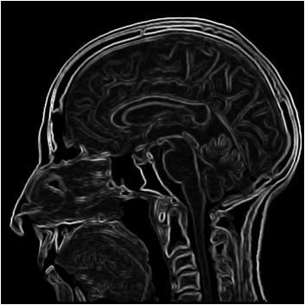
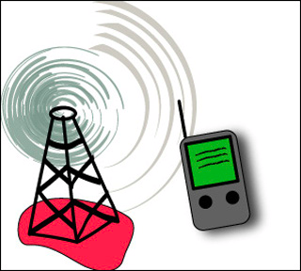
Applications
Data streaming
  Packet routing
  Sparsity in canonical basis
Biomedical imaging
  MRI
  Sparsity in Fourier basis
Digital communication
  Multiuser Detection
  Sparsity in canonical basis
Destination
Source

Slide 5

Restricted Isometry Property
Definition: A matrix satisfies if for every
-sparse vector :
Tractable Compressed Sensing: [CRT’06/Don’06]
  If is , then for the solution of
  satisfies the guarantee
Basis Pursuit optimization

Slide 6
Problems with RIP Matrices
iid Gaussian/Bernoulli matrices:
  No efficient algorithm for verifying RIP
  memory requirement
  Inefficient computation (matrix-vector multiplication)
Partial Fourier/Hadamard ensembles:
  No efficient algorithm for verifying RIP
  Sub-optimal number of measurements:
Algebraic structures:
  Sub-optimal number of measurements:

Slide 7
Deterministic
Compressed Sensing via
Expander Graphs

Slide 8

Expander Graphs
Existence: A random bipartite graph with is expander.
Explicit construction of expander graphs also exist [GUV’08].
Sensing matrix: Normalized adjacency matrix of an expander graph

Slide 9
Expander-Based Compressed Sensing:
Message Passing Algorithms
Decoding in error-free case: Based on expander codes [Sipser and Spielman’96]
Theorem [JXHC’09] : If is a normalized expander then given
a message passing algorithm after iterations recovers .
Decoding when error exists:
[BIR’09] (SSMP): A similar message passing algorithm with running
time and guarantee
Pros:
  Decoding time is almost linear in
  Message-passing methods are easy to implement
Cons:
  Poor practical performance

Slide 10
Basis Pursuit Algorithm
  [BGIKS’08]: Let be the normalized adjacency of a
  expander graph, then the solution of the basis pursuit optimization
  Satisfies the guarantee
Pros:
  Better practical performance
Cons:
  Decoding time is cubic in
  Sub-gradient methods are hard to implement

Slide 11
Game Theory Meets Compressed Sensing
Goal: an efficient approximation algorithm for BP
To solve BP, it is sufficient to be able to efficiently solve
  How? By doing binary search over
Plan: approximately solve efficiently
  By reformulating it as a zero-sum game
  Approximately solving the game-value
Recall BP Optimization:

Slide 12







Game-Theoretic Reformulation of the Problem
1: Consider the following 1-dimensional example
2: Fix (say ) and observe that
Maximum
Interval
Discrete set
(2 elements)

Slide 13


Bregman Divergence
Examples:
  Euclidean distance: with
  Relative-entropy: with

Slide 14
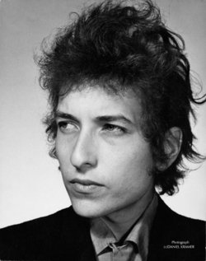







    GAME Algorithm:
Bob: Updates
Alice: Updates
Gradient Projection Alice:
Conservative Alice:
Greedy Alice:
Finds a with
Greedy Bob:
Finds an s.t.
Finds an s.t.
Lemma [JCS’11] is 1-sparse and can be computed in

Slide 15


Game-value Approximation Guarantee
  GAME can be viewed as a repurposing of the Multiplicative Update Algorithm [Freund&Schapire’99]
  After iterations finds a -sparse vector with
  Tradeoff between sparsity and approximation error
    As :
  In expander-based CS we are only interested in the approximation error (Basis Pursuit Theorem)

Slide 16
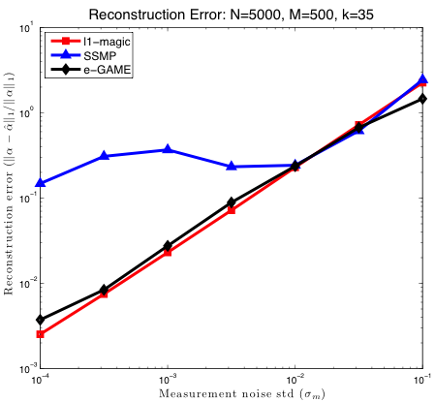
Empirical Performance
BP
MP

Slide 17
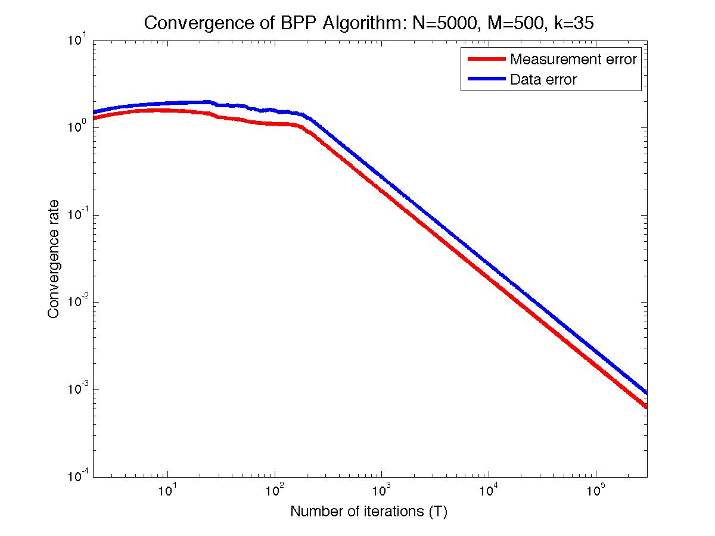
Empirical Convergence Rate
Slope: -1
3
3

Slide 18


Comparison with Nesterov Optimization
Nesterov: A general iterative approximation algorithm for solving non-smooth optimization problems
Nesterov requires iterations (similar to GAME)
  Each iteration requires solving 3 smooth optimization problem
  Much more complicated than one adjoint operation (GAME)
Nesterov’s approximation guarantee:
  GAME’s theoretical guarantee

Slide 19
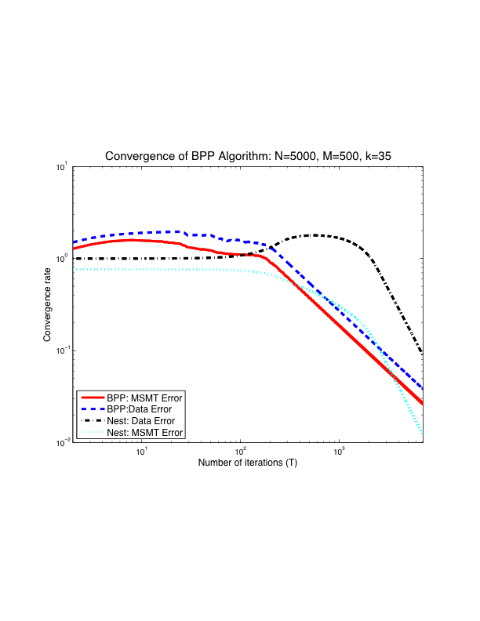
Experimental Comparison
GAME

Slide 20

Random vs. Expander-Based Compressed Sensing
Matrix | Number of Measurements | Encoding Time | Recovery Time | Recovery Guarantee | Explicit Construction
Gaussian |  |  |  |  | No
Fourier |  |  |  |  | No
Expander (MesPas) |  |  |  |  | Yes
Expander (GAME) |  |  |  |  | Yes
Our
Contribution
Best
Good
Fair

Slide 21
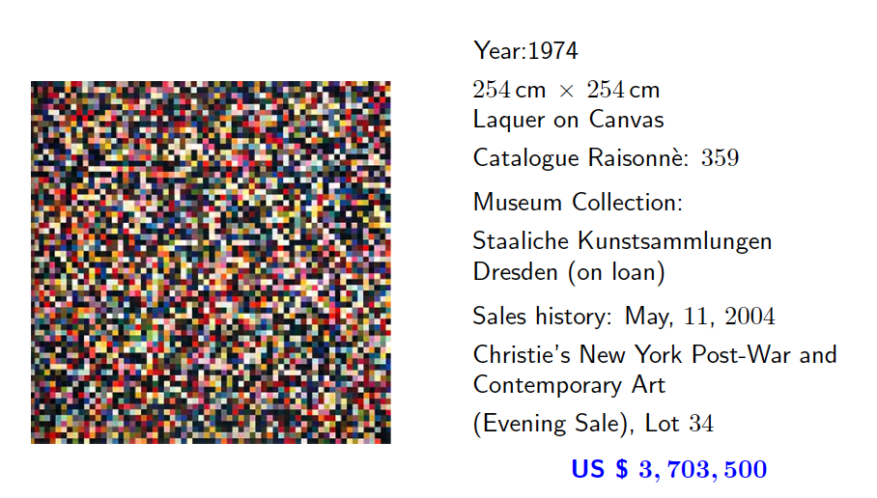
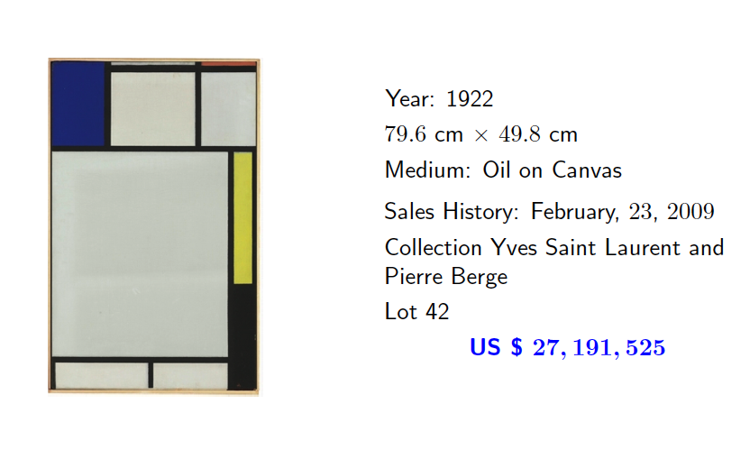
Take-Home Message:
Random vs. Deterministic
Gerhard Richter
Piet Mondrian
The value of a random matrix:
US $ 3,703,500
The value of a deterministic matrix:
US $ 27,191,525

Slide 22

Thank You!

