Slide 1



Structured sparse acoustic modeling for speech separation
Afsaneh Asaei
Joint work with: Mohammad Golbabaee,
Herve Bourlard, Volkan Cevher

Slide 2
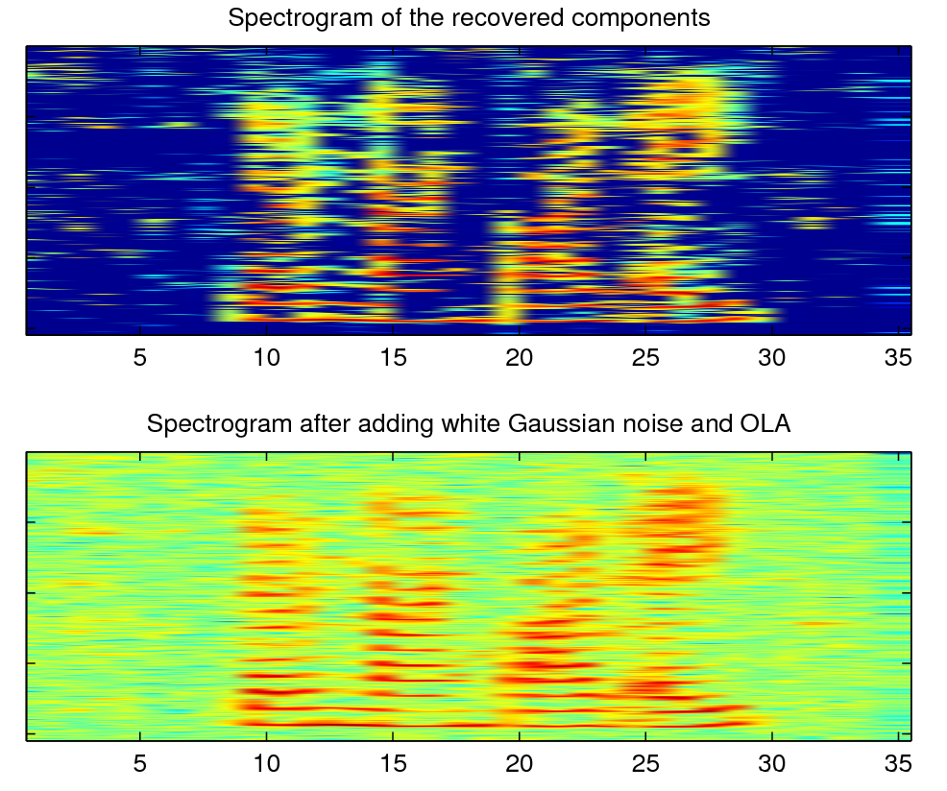
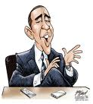

Speech Separation Problem
s₁
φ₁₁
φ₂₁
x₁
s₂
s₃
x₂
s₄
φ₄₂
SPARSITY is essential to deal with the
ill-posed source separation problem
s₅
φ₅₂

Slide 3
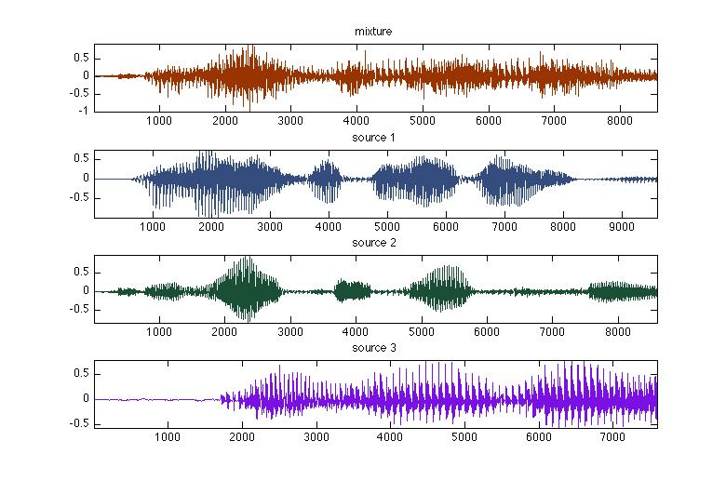

Listening results
http://www.idiap.ch/~aasaei/MONC-Demo.html

Slide 4
Key idea
  Incorporation of acoustic channel model for speech separation
    Cast speech separation problem as spatio-spectral information recovery from compressive acoustic measurements
Structured Sparse Speech Representation
Microphone Array
Speech Separation
Acoustic Reverberation Models
Structured Sparse Acoustic Modeling

Slide 5
Spectrographic Speech
Source 1
Overlapping speech
< M source
Source 2
< M source
M sensor
Source 3
Spectral Sparsity
N sources

Slide 6
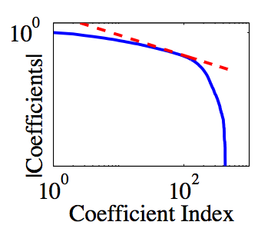
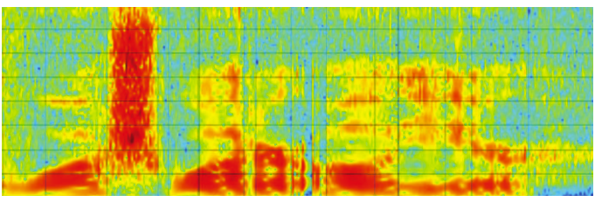
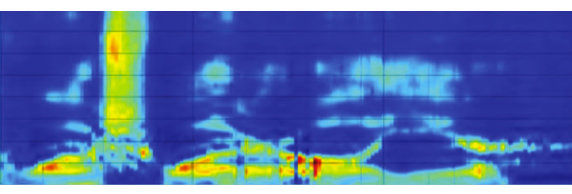
Spectral sparsity
Compressibility of speech information bearing
components
  Enables high accuracy
  speech recognition
original spectrogram
auditory spectrogram
Figs. Ref. “Hearing is Believing”, R. Stern and N. Morgan, IEEE SPS Mag. Nov. 2012

Slide 7
Spectral sparsity
Disjointness of overlapping spectrographic speech
Histogram of the energy of point-wise multiplication
of two histograms of independent sources
Diagonal Gram matrix

Slide 8

Spatial sparsity
Discretization of the planar area of the room
      Location of sound sources is sparse
X₂₁ | X₂₂ | X₂₃ | X₂₄ | X₂₅
X₁₆ | X₁₇ | X₁₈ | X₁₉ | X₂₀
X₁₁ | X₁₂ | X₁₃ | X₁₄ | X₁₅
X₆ | X₇ | X₈ | X₉ | X₁₀
X₁ | X₂ | X₃ | X₄ | X₅
X21 | X22 | X23 | X24 | X25
X16 | X17 | X18 | X19 | X20
X₁₁ | X₁₂ | X₁₃ | X₁₄ | X₁₅
X₆ | X₇ | X₈ | X₉ | X₁₀
X₁ | X₂ | X₃ | X₄ | X₅

Slide 9

objective
    Spatio-spectral sparse representation of overlapping speech sources
    GOAL: Model the acoustic reverberant channel
Number of Microphones
Number of cells on a Grid

Slide 10
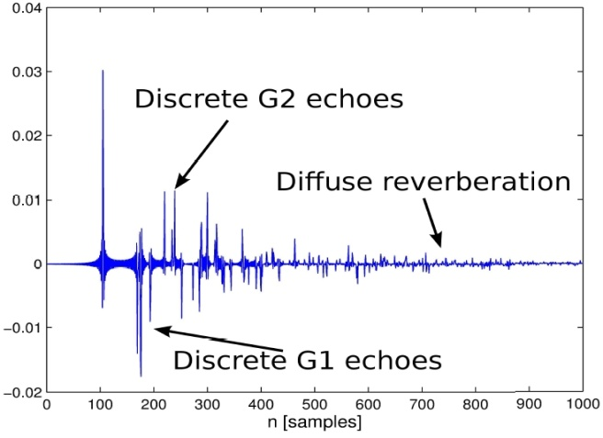
multipath channel
    Image Model and Green’s function of sound propagation
Number of reflections
Source location
Sensor location
Speed of sound
  Microphone array measurement matrix
Reflection coefficient

Slide 11
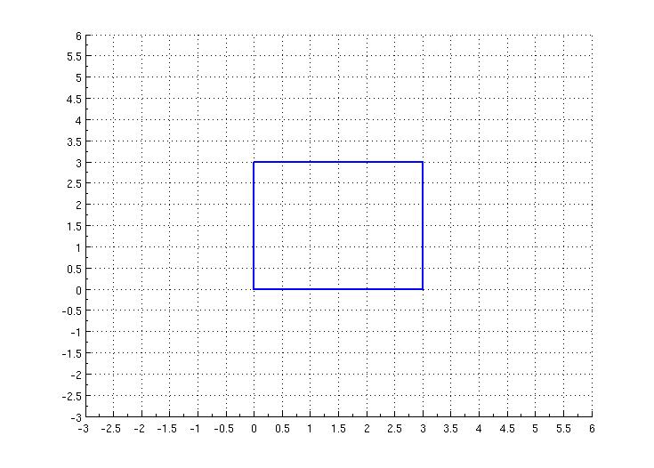
Reverberant acoustic
Structured sparsity underlying multipath propagation
Spatial sparsity
  actual sources
Structured sparsity
  actual-virtual sources
Image Map

Slide 12
factorized formulation
New factorized formulation of multipath acquisition
Free-space Green’s function matrix
Permutation map; Actual sources → actual/virtual sources
Source matrix; spatio-spectral content of frames
at a given frequency
Image map of i^{th} source
X
=
O
S
P

Slide 13
Measurement correlation
Structured sparsity underlying correlation matrix
Goal: estimation of
  Enables source localization and absorption coefficients estimation

Slide 14
group sparse representation
Kronecker product property
Kronecker product
Element-wise conjugate
(number of sources) groups of contain nonzero elements
  Identifying those groups determines source location
  Recovering the corresponding elements of and normalization by source energy determines absorption coefficients

Slide 15
joint localization
& absorption coefficient estimation
Group sparse recovery

Slide 16
Room impulse response

Slide 17
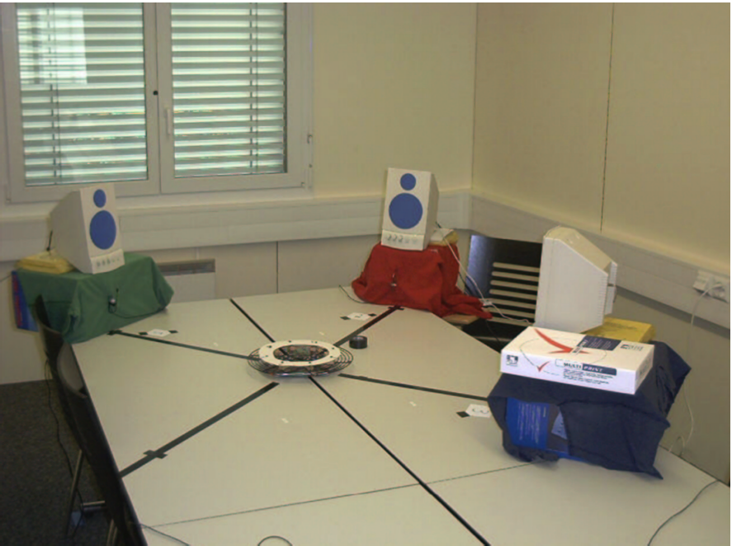
Numerical evaluations
Multichannel overlapping numbers corpus (MONC)
  Numbers corpus are played back
  Recorded by 8-channel circular array in a room 8.2m×3.6m×2.4m
  Reverberation time is 300 ms
  Inverse filtering the acoustic channel following by linear post-filtering to enhance the separated signals

Slide 18
Absorption coefficients

Slide 19
Word recognition rate

Slide 20
Perceptual quality

Slide 21
Concluding remark
  Characterization of the acoustic measurements for reverberant enclosures enables acoustic-aware source separation
    High quality and recognition rate
  Estimation of the reflections and attenuations for an unconstrained environment
    Reconstruction of the sound field using plenacoustic function
  Calibration of the acoustic measurement model
  Non-uniform sampling the acoustic field
    Extension to continuous sources
  Incorporation of signal dependent models and low-rank structures
  Post-processing of the signal recovery residual error

Slide 22
references
  J. B. Allen and D. A. Berkley, “Image method for efficiently simulating small-room acoustics,” Journal of Acoustical Society of America, vol. 60(s1), 1979.
  A. Asaei, M. Golbabaee, H. Bourlard, and V. Cevher, “Structured Sparsity Models for Multiparty Speech Recovery from Convolutive Recordings,” TASL submission, 2012.
  “Can one hear the shape of a room: The 2-D polygonal case”, I. Dokmanic, Y. M. Lu and M. Vetterli, ICASSP 2011.
  A. Asaei, H. Bourlard, and V. Cevher, “Model-based compressive sensing for multi-party distant speech recognition,” in Intl. Conference on Acoustic Speech and Signal Processing (ICASSP), 2011.
  “The Multichannel Overlapping Numbers Corpus,” Idiap resources available online:, http://www.cslu.ogi.edu/corpora/monc.pdf
Thank you!

