Slide 1





A Multipath Sparse Beamforming Method
Afsaneh Asaei
Joint work with: baran gözcü, Volkan Cevher,
Mohammad J. Taghizadeh, Bhiksha Raj, Herve Bourlard

Slide 2
Acquisition model
S
Sensor array acquisition forward model
Objective
Estimate or detect signal or bearing
Applications
Sonar
Biomedicine
Wireless communications
Speech processing
Radio astronomy
θ_{s}
x_{M}
x.
x.
x.
x₂
x₁
Δ

Slide 3
Prior art
A. C. Gurbuz, J. H. McClellan and Volkan Cevher, “A compressive beamforming method”, ICASSP 2008.
Y. Zhang, B.P. Ng and Q. Wan, “Sidelobe suppression for adaptive beamforming with sparse constraint on beam pattern”, Electronic Letters 2008.
Sergiy Vorobyov
Yonina’s book

Slide 4
Linear prediction
S
Source estimation
Interferences
θ_{s}
x_{M}
x.
x.
x.
x₂
x₁
Δ
W*_{M}
W*.
W*.
W*.
W*₂
W*₁
a(θ_{s})†
Σ

Slide 5
Spatial filtering
S
Weights optimization
Rank deficiency – noise free case
Regularization
Delay-and-sum beamformer: data independent
Inefficient for interference cancellation
θ_{s}
x_{M}
x.
x.
x.
x₂
x₁
Δ
W?
W*_{M}
W*.
W*.
W*.
W*₂
W*₁
Σ

Slide 6
Sparse beamformer
MVDR beamformer
Empirical risk minimization
Regularization
Analysis sparsity
Synthesis sparsity
Wavenumber Dictionary

Slide 7
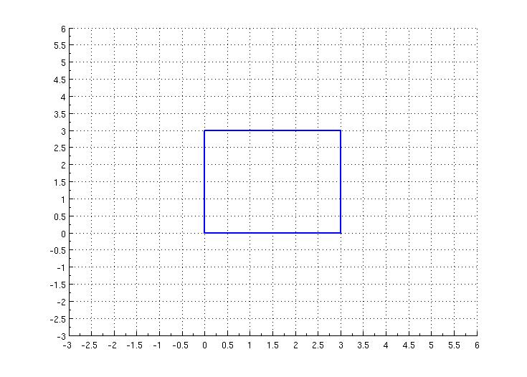
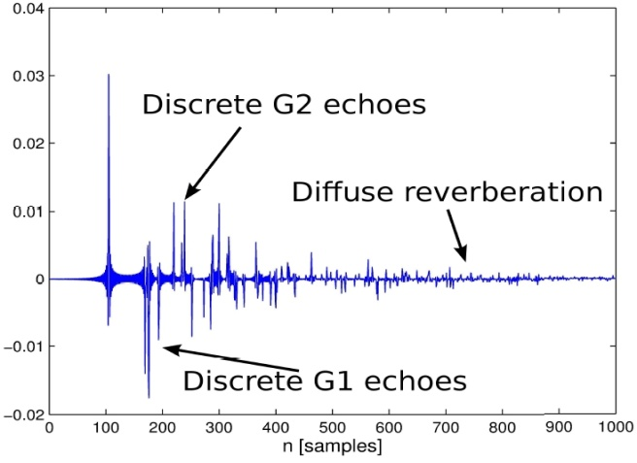
Multipath MVDR
Image Model of multi-path effect
source at ; sensor at
Sensor array acoustic measurement matrix
Reflection coefficient
Speed of sound

Slide 8
Sparse multipath Mvdr
Forward model of array acquisition
Regularization on channel dictionary: channel-aware beamforming
Interference cancellation

Slide 9
Robustness principle
Regularization (diagonal loading)
Eigenspace projection
Worst case optimization
Little-info sector-based

Slide 10
Numerical evaluations
Beampattern and signal estimation
Deep nulls
Sidelobe levels
Sensitivity to steering angle mismatch
Limited number of snapshots
Wavefront distortion (local scattering)
Test scenarios
Far-field
Uniform linear array
Narrowband signal (freq. of1024 sampled at 16kHz)
5% random sample out of 1000 samples
Reverberant
Circular array – RT₆₀ ≅ 300ms
1000 speech frames
SNR = 20 dB

Slide 11
far-field estimation

Slide 12
Reverberant estimation

Slide 13
Beampattern in the presence of 3 interferences using 100 snapshots

Slide 14
Beampattern in the presence of 3 interferences using only10 snapshots

Slide 15
Three sources at 13, 31, 81º – Input SNR = SIR 20 dB

Slide 16
Three sources at 13, 31, 81º
using 6 snapshots
using 16 snapshots

Slide 17
Desired signal steering vector mismatch due to coherent local scattering

Slide 18
conclusion
Multipath beamforming for acoustic-informed spatial filtering
Improves reverberant acquisition
Enables acoustic calibration framework
Sparse beamforming enables robust spatial filtering
Rapid convergence rate in adaptive arrays
Interference cancellation
Effect of correlation among signal and interference
Improved performance in mismatch condition
Further extensions
Atomic norm minimization for infinite/continuous dictionary
Regularization parameter

Slide 19
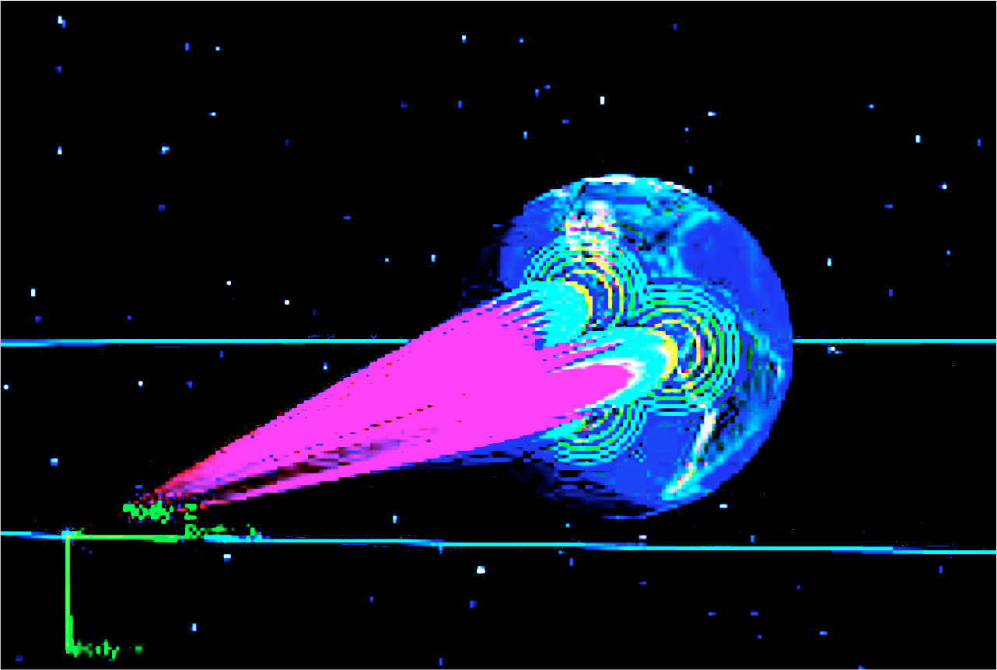
thank you!
Questions?

