Slide 1
SKMF Roundtable Web Social Tagging
Vittorio Mischi, EPFL
Business School Lausanne
2010.12.02

Slide 2
A virtual Presenter
Stuck in London in winter storm
GVA in trouble, LGW closed
Opportunity in disguise - Thanks to Skype
200 Kgs CO₂ not in the atmosphere

Slide 3
What this presentation is about
“We become what we behold. We shape our tools and then our tools shape us.”
Marshall McLuhan

Slide 4
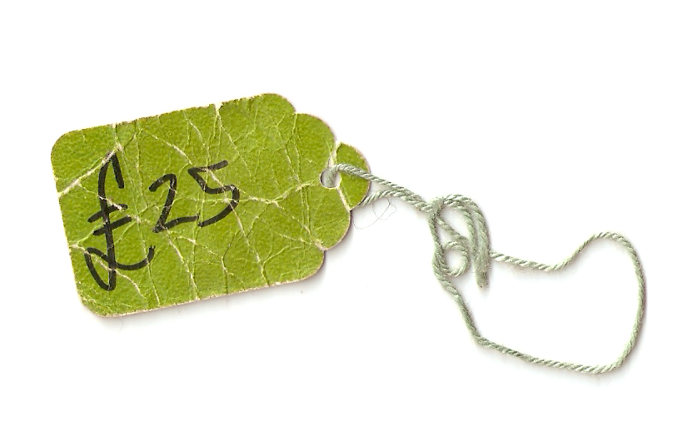
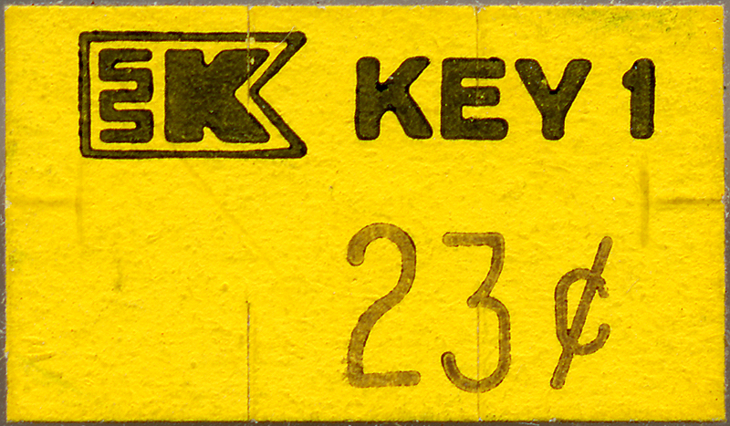
What is a Tag?
Meta-(data)
Attached to another object
Adds a new dimension to the object
Personal, not absolute

Slide 5
What is Web Social Tagging?
Systems that organize “Web Tags”
A Web 2.0 App – “Sharing Bookmarks”
User-Generated Content
Submitted freely
Purpose: for their own benefit
With no specific limitations, grammars, rules, or even MEANING
Just “strings”

Slide 6
We owe this man (1494)

Slide 7
Tagging = 3-Entry Bookkeeping
Visualize 3 Immense Web Ledgers
User
Item
Tag
Free input -> Statistical Analysis -> Emergence

Slide 8
All you need is LATCH
Acronym for structuring ALL information
Location
Alpha-numeric
Time
Category
Hierarchy
If you knew in advance the one correct structure…

Slide 9
WST introduces Latch-ES
Emergent (like a “top 10”)
Social (Affecting People Affected by People)

Slide 10
Why Social?
There is always a person behind a tag
There is always a 3-way link
Many tags, many links among people & things
Acting in the “tag world” effects a change that is “Social”
Leveraging the Social aspect to solve human problems

Slide 11
Knowledge Management & WST
 | Know | Don’t Know
Know | No Problem | Traditional Search WST
Don’t Know | WST | WST
Think of what your organization does not know (that it knows or doesn't know it does not know)

Slide 12
Adding the Social Layer in KM
Finding not just the Knowledge
BUT
Who may already have it
Expertise recognized and valued

Slide 13
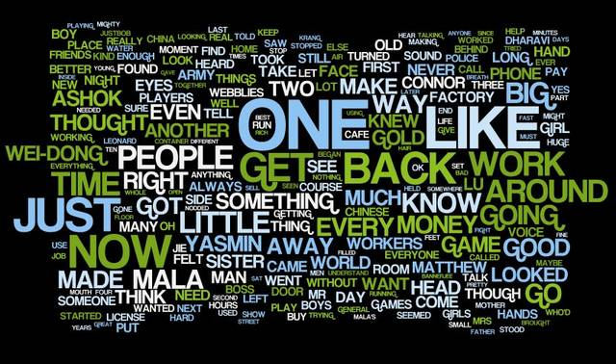
How does WST look?
Tag Cloud
App to make it: Wordle

Slide 14
Classic Examples of WST
Del.icio.us
WST as a ”Mental Model” -> Aardvark
One Corporate case: IBM – Dogear

Slide 15
Academic Examples
Connotea (http://www.connotea.org/)
Librarything (http://www.librarything.com/)

Slide 16
WST “enlarged” to Annotations
Integration with Semantics
Annotations
Google Add-On
iOS 4
Acrobat PDF
Awesome Highlighter

Slide 17
Before we start our Exercise…

Slide 18
A new Strategy: Pivoting
A keyword search is mono-dimensional
A Google search is mono-dimensional
A Tag search can Pivot on its 3 axes
User
Item
Tag

Slide 19
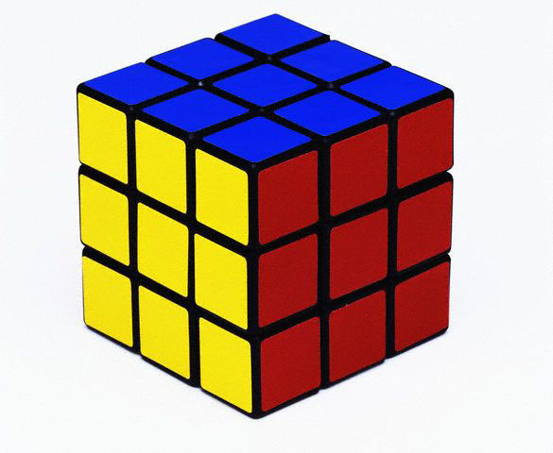
Rubik in Billions of colours
From Here
To There

Slide 20
3 Exercises – In sequence
Exercise 1 - Group work
(Some of) You have submitted a “question”
Some questions did not have “keywords” (i.e. Tags on which to search…)
Group work on brainstorming Tags to search Find up to 10 TAGS
(single word, multiple word, etc.)

Slide 21
Step 2
Take out your IP connected devices (if you do not have one, team up with someone who has)
Enrol in Aardvark (www.vark.com)
Enter the re-phrased question (including your “Best bet” tags)
See who has answered
First answer should take less than 30 min…

Slide 22
Exercise No.3
Depending on the nature of your question…
Choose a WST Site (del.icio.us, Connotea, Librarything)
Start searching for a tagger that might have an answer for you How?
Find a Tag (or combination) that best categorizes your question
Find Items tagged by it
Find correlated Tags
Find associated Users
Find Tagger(s) who may be expert in the field sought
Find a channel to contact Tagger

Slide 23
Discussion
Where does my organization not know what it knows
And how would a tagging system help

Slide 24
Feedback, Please
New survey up where the previous one was http://questionnaire.epfl.ch/index.php?form=Questionnaire_SKMF
Please do return your comments
Very helpful for my research

Slide 25
Thank You
Vittorio Mischi
EPFL CDM
ODY 4 15
Station 5
1015 Lausanne
Switzerland
+41 21 510 5043
Skype: Dr.Nightfly
vittorio.mischi@epfl.ch

