Slide 1
Universal Remote Control
For Biorob’s robots
Matthieu Tardivon

Slide 2
Contents
Reminder
Functioning of the remote control
Software development
Mechanical integration
Live demo

Slide 3
Reminder
Objectives
  Being able to control every robot in the lab
  Being able to flash a robot with the remote control (SD card)
  Make it more ergonomic
At mid-term
  PCB prototype just received

Slide 4
Functionning of the remote control
LCD screen
Displaying menu
Communication
Radio & Zigbee
Up
SD Card
Back
Ok
STM32F103
Microcontroller
Down
Joysticks to control the robot

Slide 5
Software development
Use of a RealTime OS : ChibiOS/RT
  Ease the development
  Produce well written code
  Possibility of doing several things at the same time
Threads
  LCD screen display (one per line)
  Buttons
  State machine
  Joysticks (when robot started)

Slide 6
State machine
Zigbee
Main menu
Connect to a robot
Radio
Select a robot
Select a channel
Scan
Battery
Robot menu
Play Mario song
Start/Stop robot
Explore SD Card
Error
Flash robot

Slide 7
Hardware issues
Radio problem on the PCB prototype
Missing 25mOhm resistor to check battery state
ACI workshop closing during one month

Slide 8
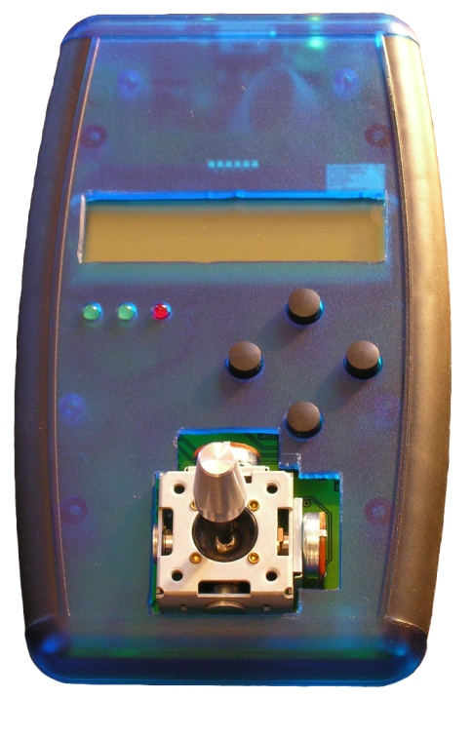
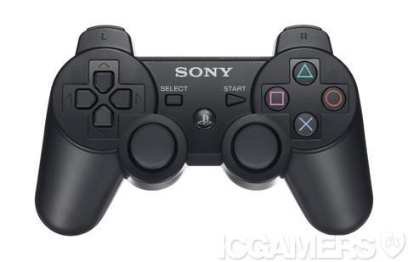
Mechanical integration
Sony : same controller for almost 20 years
Source: http://media.moddb.com
Source: G. Cuendet’s presentation

Slide 9
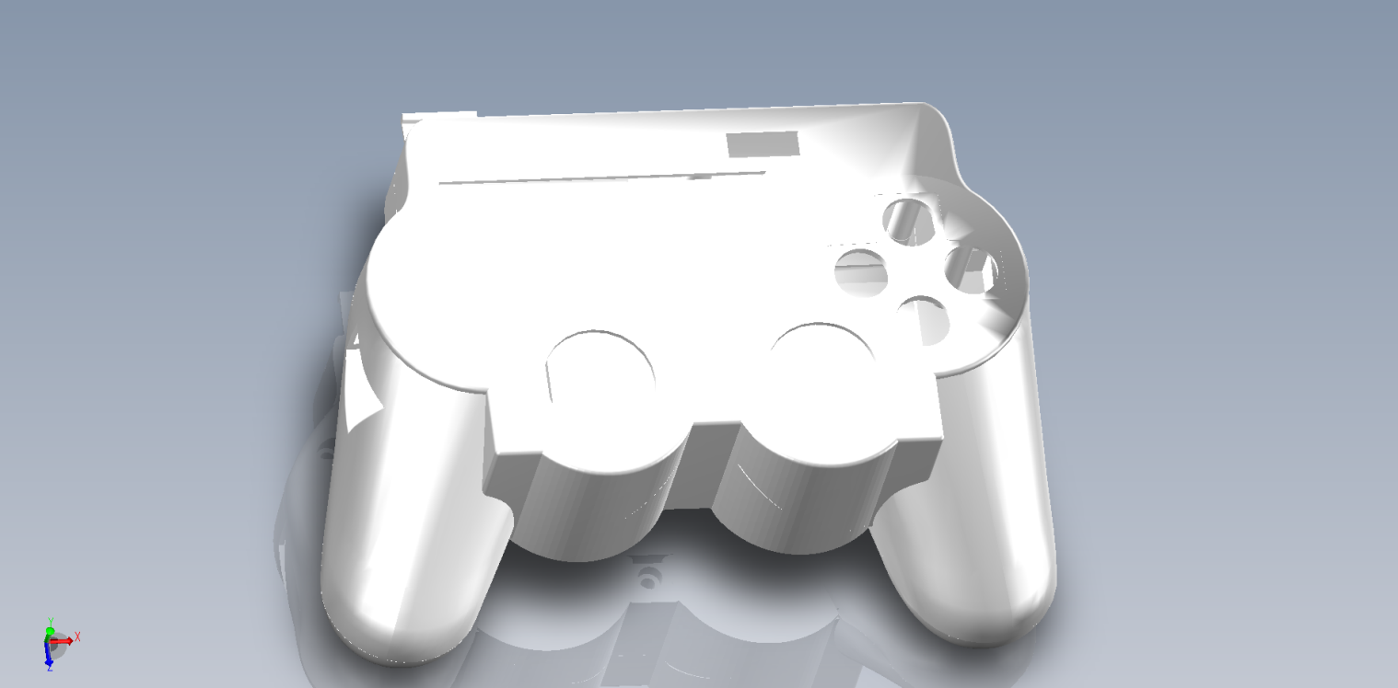
Mechanical integration
Ergonomics
  SolidWorks design and 3D printing

Slide 10
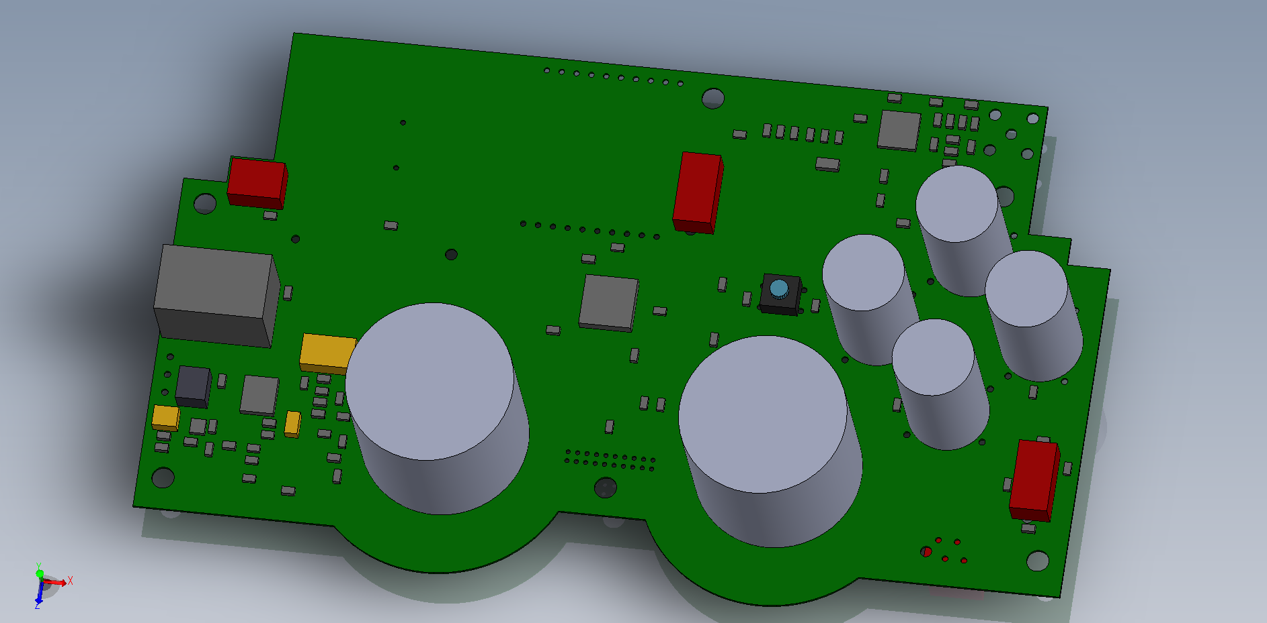
Mechanical integration
New PCB in production

Slide 11
Live demo
Let’s flash the salamandra and play with it a little !

Slide 12
Thank you for your attention!
Do you have any question?

