Slide 1

Active connection mechanism (ACM) for space exploration on Mars with modular robots
W. PONSOT, January 2016

Slide 2
Outline
Introduction
Constraints
Study of existing ACM
Concept
3D model
Passive connector
Conclusion
Future works

Slide 3
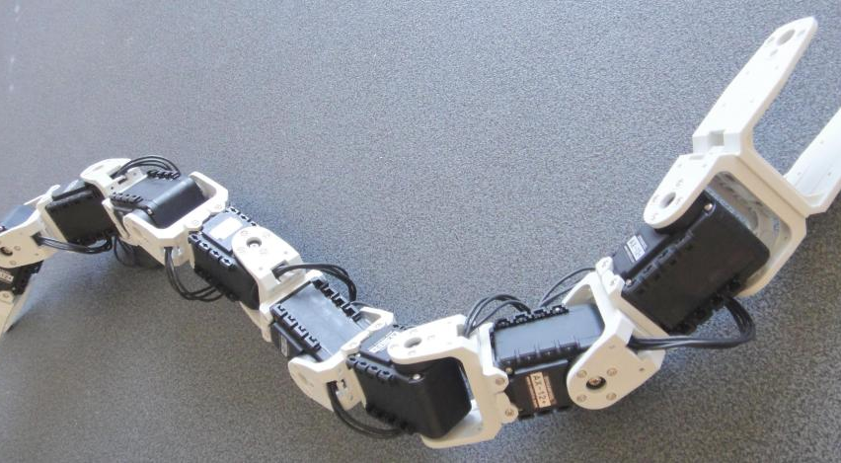
Introduction
Lola-OP metamodule with 8 modules [1]

Slide 4
Constraints
Alignment
Payload
Environment
Connection time
Energy
Electronics
Lola-OP strategies

Slide 5
Alignment
ACM
m
m
m
m
ACM
Positioning servomotor error (± 0,3°)
Bending effect
-> with a 50% margin

Slide 6
Payload
-> Margin of 20% to be sure that the ACM
resist to dynamic motion

Slide 7
Environment
Dust
  average diameter = 1um
  magnetic material
Temperature

Slide 8
Other constraints
Connection time :
  under 30 s
Energy :
  be able to work on embedded battery
Electronics :
  power and data transfer
Lola-OP strategies :
  hermaphrodite, 4-way symmetrical and unilateral disconnection allowed

Slide 9
Study of existing ACM
Roombot V3 [2]
Singo [3]
I-Cubes [4]
Physical lock
Vacuum
Magnetism
Melting material
Shady [5]
Smores [6]
Solder cube [7]

Slide 10
Study of existing ACM

Slide 11
Concept
Wet-mate connector [8] : electrical connector used in petrol fields

Slide 12
Concept
1

Slide 13
Concept - connection steps
2
3
4

Slide 14
Concept - final design

Slide 15
3D model - animation
Video : Cylinder movement

Slide 16
Video : Pin mechanism

Slide 17
3D model

Slide 18
3D model
m = 485 g with most of the parts in 3D printing ABS (filling rate of 30%)

Slide 19
Passive connector
m = 330g

Slide 20
Conclusion
ACM with physical latch and magnetism alignment
Hermaphrodite
Size and mass are too high !

Slide 21
Future works
Verify the assumption made on friction forces between seals and the cylinder
Real prototype
  Connection between two electromagnets
  The lip seal cleans well the dust around the cylinder

Slide 22
Referance
[1]Biorobotics Laboratory EPFL. [Online]. http://biorob.epfl.ch/lola-op
[2]A. Spröwitz, R. Moeckel, M. Vespignani, S. Bonardi, and A.J. Ijspeert, "Roombots: A hardware perspective on 3D self-reconfiguration and locomotion with a homogeneous modular robot ," 2014.
[3]Wei-Min Shen, Robert Kovac, and Michael Rubenstein, "SINGO: A Single- End-Operative and Genderless Connector for Self-Reconfiguration, Self- Assembly and Self-Healing ," 2009.
[4]Cem Ünsal, Han Kiliççöte, and Pradeep Khosla, "I(CES)-Cubes: A Modular Self-Recon'gurable Bipartite Robotic System ," 1999.
[5]Marsette Vona, Carrick Detweiler, and Daniela Rus, "Shady: Robust Truss Climbing With Mechanical Compliances ," 2006.
[6]Jay Davey, Ngai Kwok, and Mark Yim, "Emulating Self-reconfigurable Robots - Design of the SMORES System ," 2012.
[7]Jonas Neubert, Arne Rost, and Hod Lipson, "Self-Soldering Connectors for Modular Robots ," 2014.
[8] G E Brown, "Operational Considerations for Underwater-Mateable Connectors ," 2003.

Slide 23
Questions ?

Slide 24
Pin mechanism – crank slide

Slide 25
Yaw misalgnment correction - chamfer

Slide 26
Optimization

