Slide 1
Vice Presidency for
Research

Slide 2
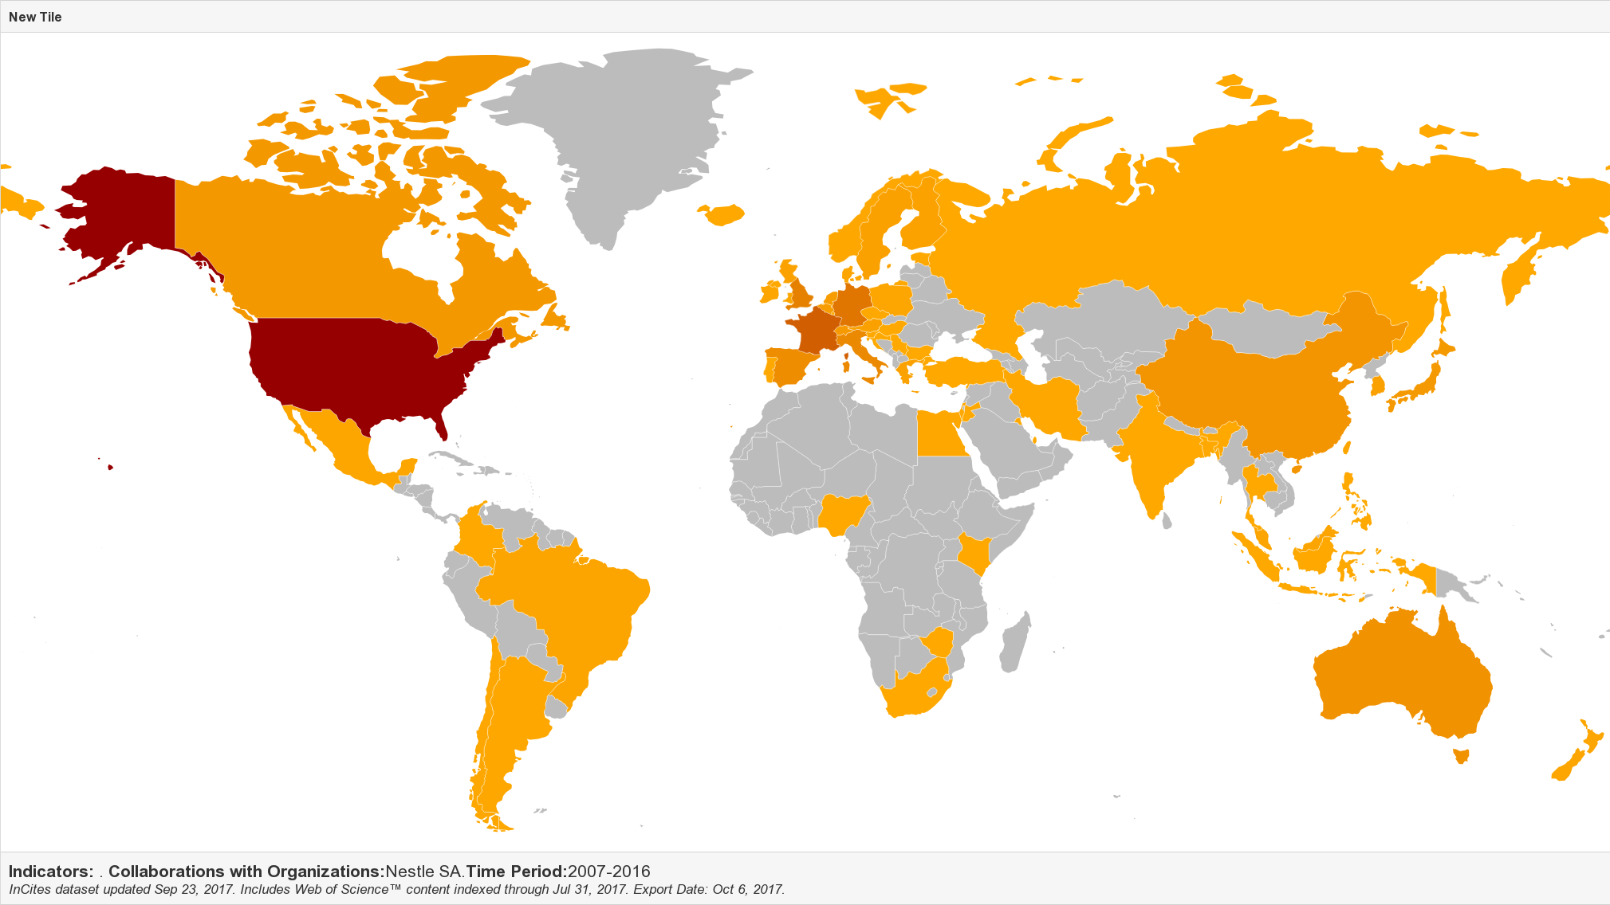
Publication co-authors
Location of instititutions co-authoring publications with EPFL 2007-2016
Source: Web of Science
EPFL co-authored with 1’609 institutions in 2016

Slide 3
Publication co-authors
Institution | Nation | Organization Type | Web of Science documents
Centre National de la Recherche Scientifique (CNRS) | France | Research Institute | 868
University of Lausanne | Switzerland | Academic | 601
University of Geneva | Switzerland | Academic | 572
Max Planck Society | Germany | Research Institute | 560
University of California System | USA | Academic System | 426
Russian Academy of Sciences | Russia | National Academy | 402
Pierre & Marie Curie University - Paris 6 | France | Academic | 383
United States Department of Energy (DOE) | USA | Government | 336
University of Oxford | UK | Academic | 335
Swiss Federal Institute of Technology Zurich | Switzerland | Academic | 329
Universite Paris Saclay (ComUE) | France | Academic | 328
University of Cambridge | UK | Academic | 325
Top instititutions co-authoring publications with EPFL 2014-2016
Source: Web of Science

Slide 4
Average citations per publication
Source: Essential Science Indicators

Slide 5
International University Rankings

Slide 6
Top recipients of H2020 funding framework
H2020 calls signed up to September 1, 2016

Slide 7
FP7 & H2020 success rates
ERC grant success rates by call

Slide 8
EPFL H2020 collaboration partners

Slide 9
EPFL ERC Grants
Source: EPFL Research Affairs

Slide 10
Top ERC Grant Recipients FP7&H2020
ERC grants 2007-2016
Source: ERC annual report

Slide 11
ERC Grants
ERC grant success rates by call
Source: ERC annual report

Slide 12
Project partners
Grant partners
Most frequent project partners
Source: GrantsDB

Slide 13
Ranking - EPFL is well-placed
* Overall institutional ranking, all scientific fields combined
3
6
10
12
18
29
38
76
800 universities *
Europe
Europe
Europe
Europe
1000 universities *
1000 universities *
900 universities *
World
World
World
World
Shanghai
QS
THE
Leiden

Slide 14
ERC Grants
From FP7, H2020 and SNF Temporary Backup Scheme
Total number of grants: 153

